Slide 1
David Easley and Jon Kleinberg: Networks, Crowds, and Markets
(and some other stuff)
Amos Fiat
Tel Aviv University
Tel Aviv University
Class in Networks, Crowds, and Markets
1st Semester 2014-2015

Slide 2
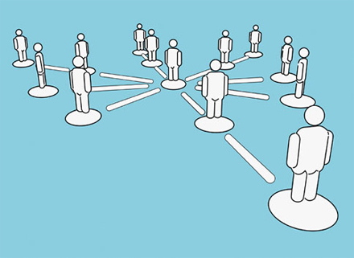
RU T-214-SINE Summer 2011
Ýmir Vigfússon
Emory University www.ymsir.com/networks/
Credit for (some) Slides from:
CS224W: Social and Information Network Analysis
Jure Leskovec,
Stanford University
http://cs224w.stanford.edu

Slide 3
Some Examples of Social Network Questions and Issues

Slide 4
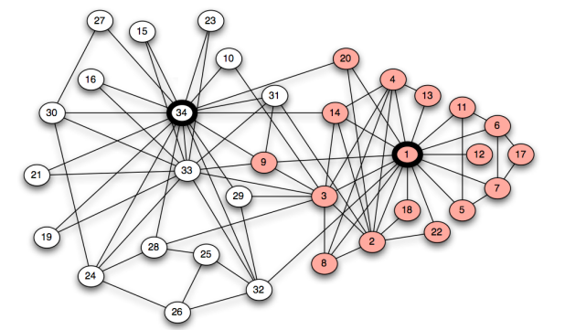
Zachary: An information flow model for conflict and fusion in small group, 1977.
Karate Club splits up between owner and instructor
Can we predict split?
Subclusters of graph?

Slide 5
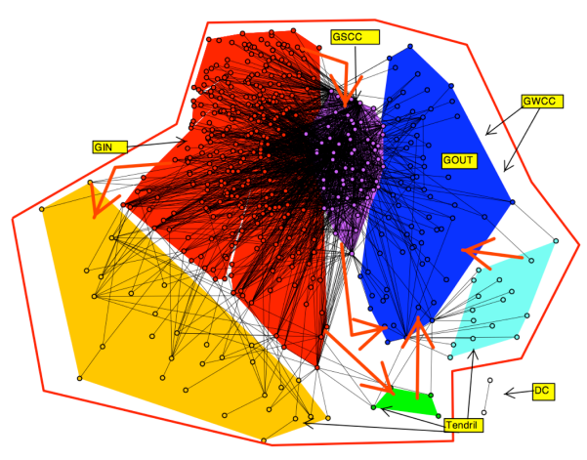
Loans amongst financial institutions
Which Institution is
more powerful?

Slide 6
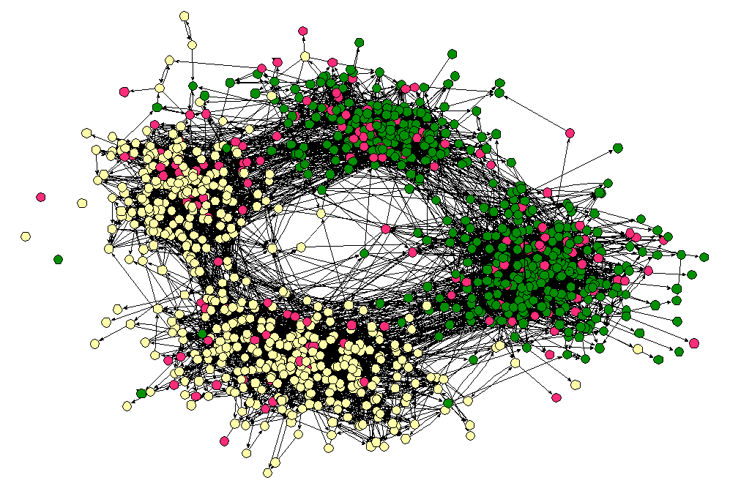
James Moody: Race, School Integration and Friendship Segregation in America, 2001
Color = race
Arc = friendship
Height = age
Measure effects
and explain?

Slide 7
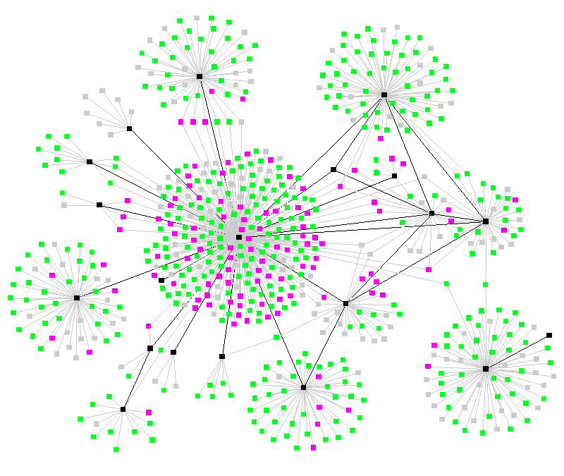
Spread of an Epidemic
Cascading Effect
Viral Marketing?

Slide 8
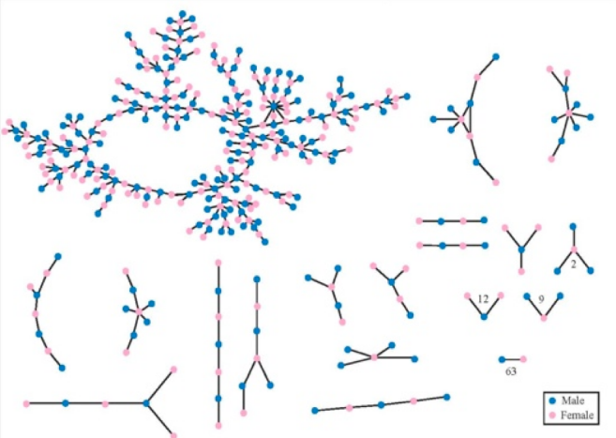
Berman, Moody, Stovel: Chains of Affection: The structure of adolescent romantic and sexual networks, 2004
For non-bipartite random
Graphs G(n,p) with np>1,
there is a giant component
Erdős and Rényi 1960

Slide 9
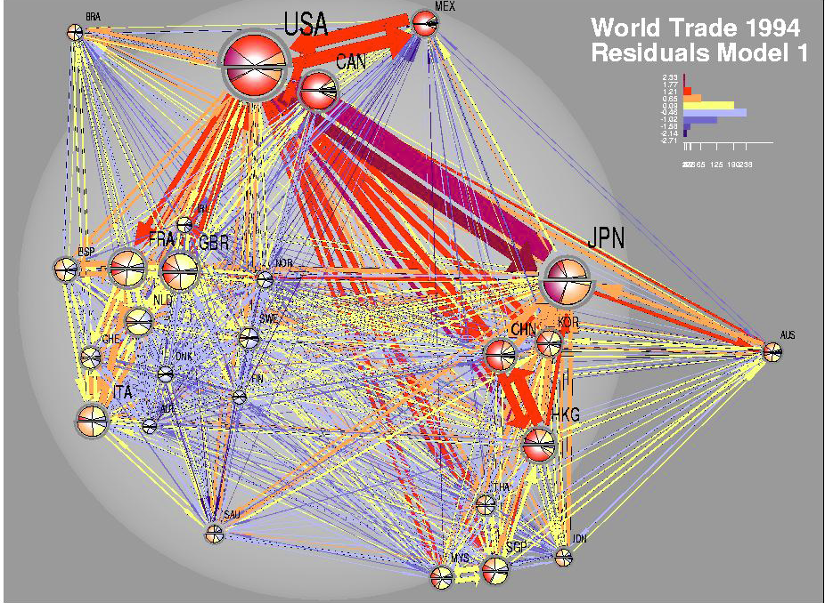
World Trade
Who were the
Economic powers?

Slide 10
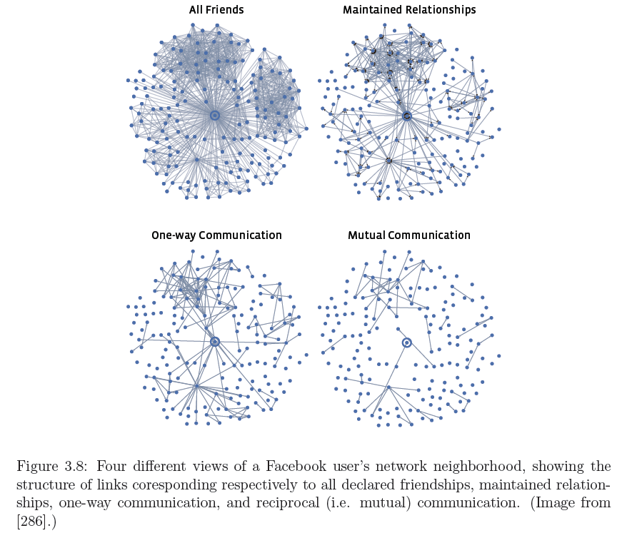
Marlow,Byron, Lento, Rosen: Maintained Relationships on Facebook, 2009
Not all links
are equal

Slide 11
Forming Friendships
How do Friendships form?

Slide 12
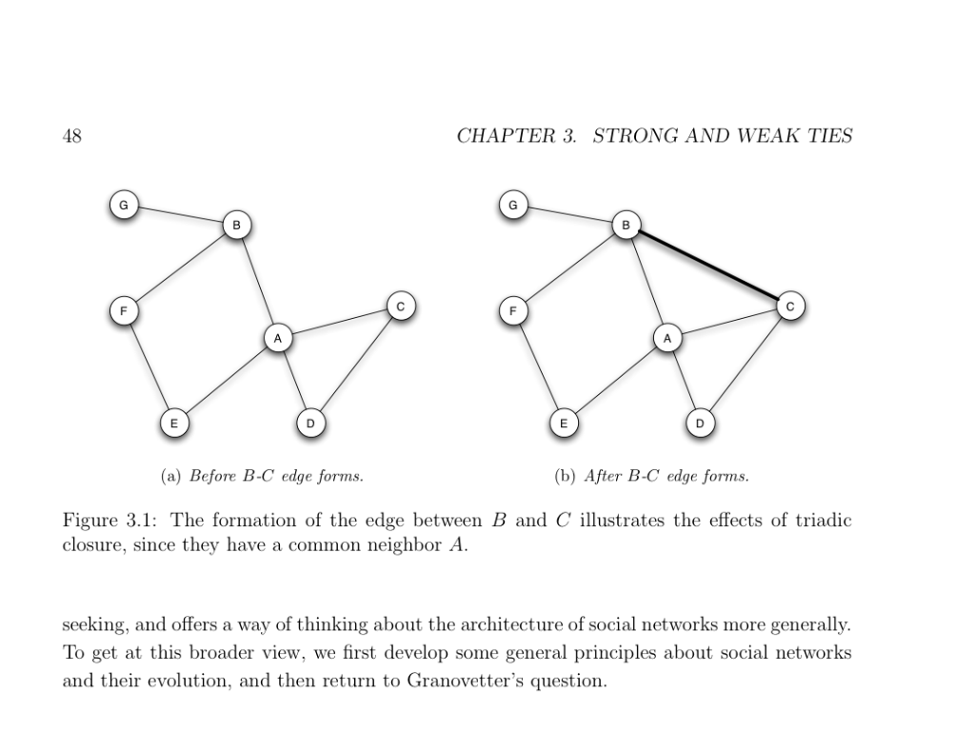
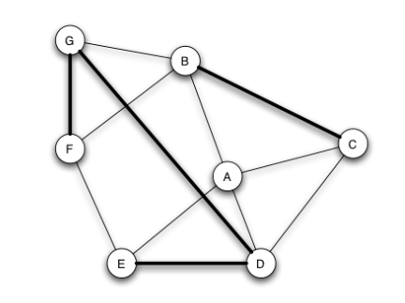
Triadic
Closure
“Friends of
friends become
friends”
Not quite triadic closure

Slide 13
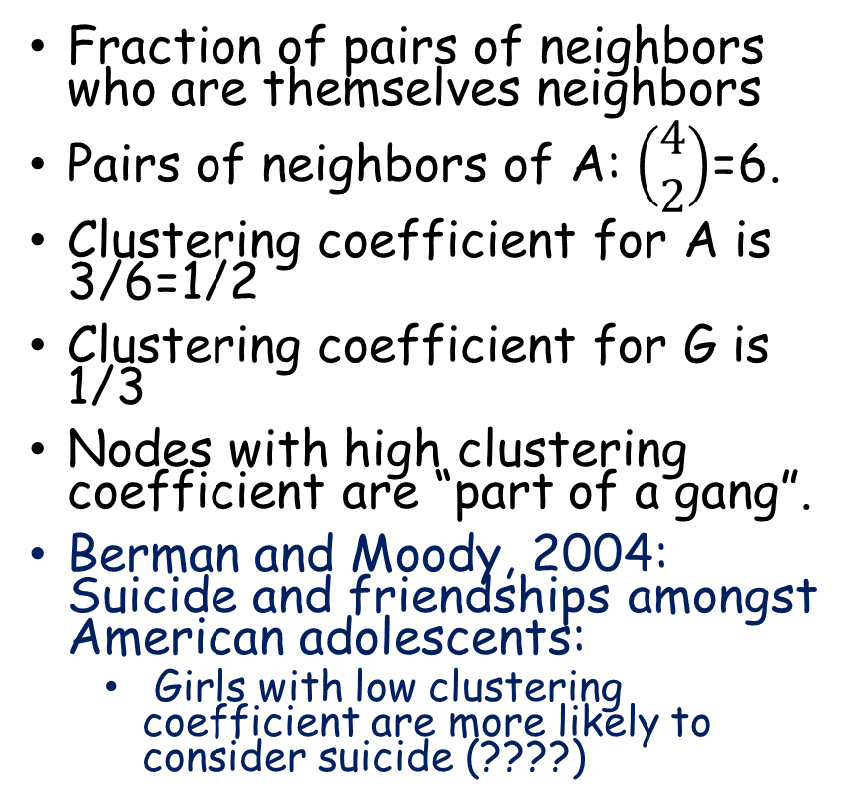
Clustering Coefficient of a node
Fraction of pairs of neighbors who are themselves neighbors
Pairs of neighbors of A: $\left(\begin{matrix}4 \\ 2\end{matrix}\right)$=6.
Clustering coefficient for A is 3/6=1/2
Clustering coefficient for G is 1/3
Nodes with high clustering coefficient are “part of a gang”.
Berman and Moody, 2004: Suicide and friendships amongst American adolescents:
  Girls with low clustering coefficient are more likely to consider suicide (????)

Slide 14
Embeddedness and Neighborhood overlap (of an edge)
If A cheats C, B and D may
know about it.
If G cheats D, they have no
common friends.
The embeddedness of an edge is the number of common neighbors shared by the endpoints
The embeddedness of G-D is zero, the embeddedness of C-A is two.
The neighborhood overlap of an edge A-B is the embeddedness of A-B divided by the union of their neighborhoods excluding A and B.
The neighborhood overlap of A-B is 1/5

Slide 15
Embeddedness
If A cheats C, B and D may
learn about it.
If G cheats D, they have no
common friends.
The embeddedness of an edge is the number of common neighbors shared by the endpoints
The embeddedness of G-D is zero, the embeddedness of C-A is two.
Edges with high embeddedness are safe (?)
Edges with low emeddedness are risky (?)

Slide 16
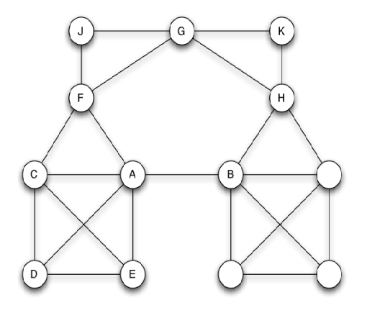
Bridges and Local Bridges
Edge A-B is a local bridge: Removal of the edge would increase the distance between A and B to more than two.
  They have no friends in common.
  An edge is a local bridge iff it is not part of any triangle in the graph.
  If the embeddedness of an edge is zero (the neighborhood overlap is also zero) then the edge is a local bridge.
If removal of edge places endpoints in different connected components then the edge is a bridge – distance infinity

Slide 17
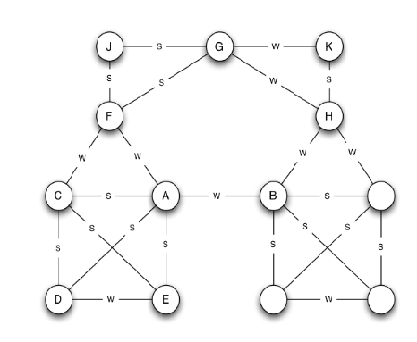
Not all links are equal: The Strong Triadic Property
Granovetter: a node v violates the strong triadic property if it has strong ties to two vertices u, w, and there is no edge (weak or strong) between u and w
A node v satisfies the strong triadic property otherwise
Violation
s

Slide 18
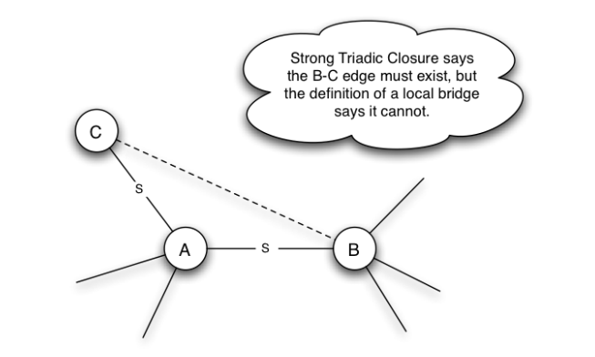
Prove that:
If
  The strong triadic assumption holds, and
  Every node has at least two strong ties:
  Then, every local bridge must be a weak tie.

Slide 19
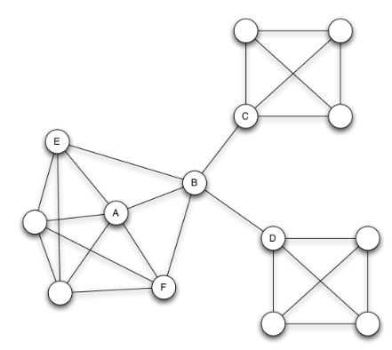
A or B: which is “better off”?
A has high clustering coefficient, A has many edges with high embeddedness – edges that are “trustworthy”
(?) A has a “support community”
B – Links separate communities
  The B-C link is not trustworthy but it does allow information flow
  B can be more innovative, multidisciplinary, imports tea from China
  B can control access: F learns about a job opportunity from a “friend of a friend” (from B)
The local bridges that connect B to the outside world (in this case actual bridges)
are typically weak ties. “The streangth of weak ties”.

Slide 20
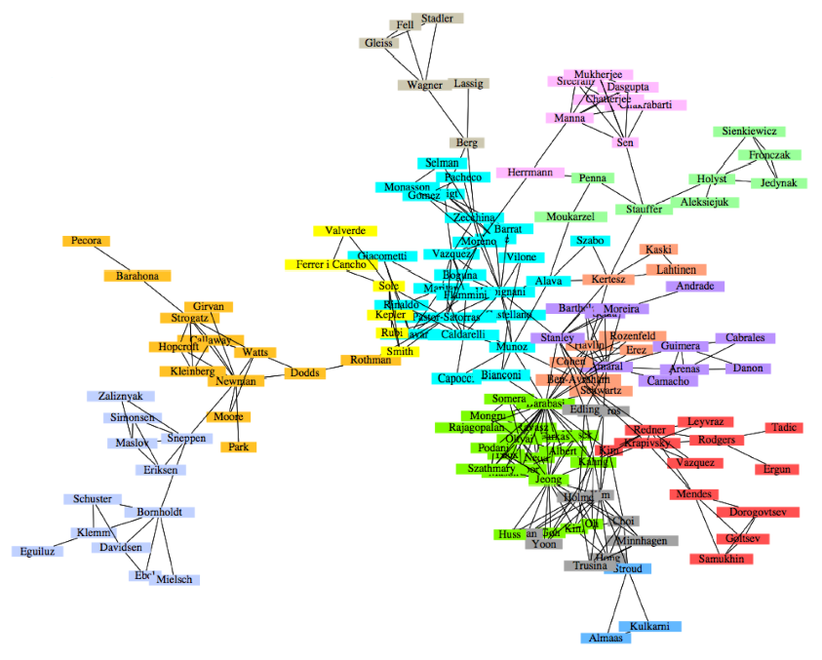
Co-authorship
in Network papers
Different
communities
How is this partitioning
done?

Slide 21
Zachary: An information flow model for conflict and fusion in small groups, 1977.
Karate Club splits up between owner (34) and instructor (1)
Can we predict split?
Subclusters of graph?
Remark the “theory” we’ll
present predicts that 9
should stay with 34,
But – in “real life” 9 was a
month away from a 4 year
black belt project and needed
1 to finish it.

Slide 22
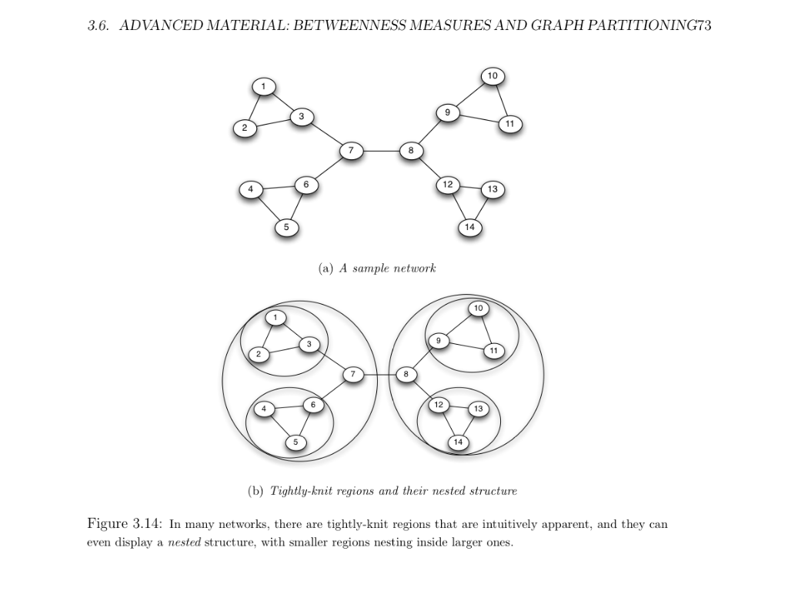
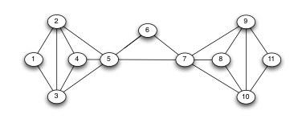
Easy to guess clusters
Less Obvious:

Slide 23
Generalization of local bridges
Betweeness:
  For Every pair of nodes A,B in the graph that are connected by a path, imagine one unit of flow between A and B
  The flow between A and B divides itself evenly amongst all possible shortest paths from A to B
  If there are k such paths, each path gets 1/k flow
  The Betweeness of an edge is the total amount of flow it gets
12
12
1
1
12
33
12
7*7=49
33
3*11=33
33

Slide 24
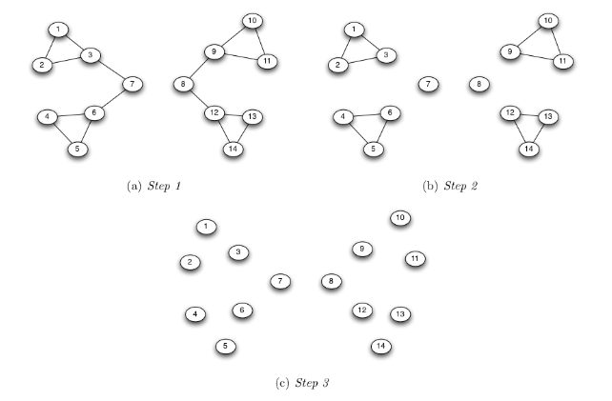
The Girvan-Newman Clustering method
Find the edge of the highest betweenness – or multiple edges if there is a tie
Remove these edges
Recalculate (graph could be disjoint components)
Repeat

Slide 25
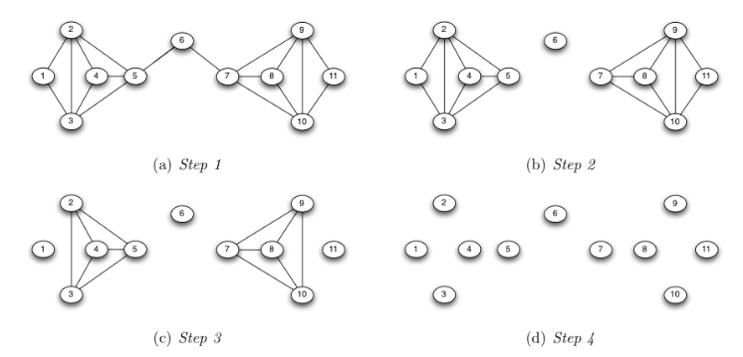
Girvan-Newman again

Slide 26
Computing Betweenness Values
Do for every node A:
  Perform BFS from A
  Determine number of shortest paths from A to every other node
  Based on these numbers, determine the amount of flow from A to all other nodes that use each edge

Slide 27
Computing Betweenness values
Compute number of
shortest paths from
the top to the bottom
of the layered graph.

Slide 28
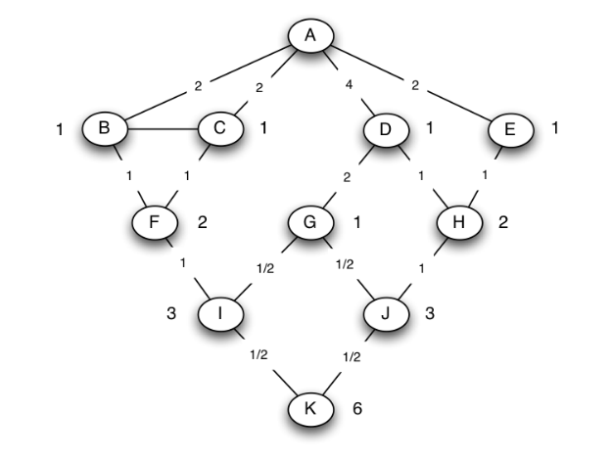
Computing Betweenness values
Compute flow in layered graph
from bottom to top.
The total flow for F from A
Is 2, 1 from A to F, 2/3 from
A to I, and 1/3 from A to K.
This splits at a 1:1 ratio
The total flow for I from A
Is 3/2, 1 from A to I, and ½ from
A to K. This splits at a 2:1 ratio
(number of SP’s at F and G)
A-K flow (1 unit)
½ via I and ½ from
J (because 3 SP end at I
And 3 at J)

Slide 29
HW assignment #1
What is the complexity of the Girvan-Newman algorithm on a graph G=(V,E) with n nodes and m edges?
How would you define the betweeness of a vertex?

Slide 30
HW Assignment 1: Brandes Algorithm, 2001
BFS |V|+|E|
|V| times
|V|^2 +|V||E|
Weghted Graphs?

Slide 31
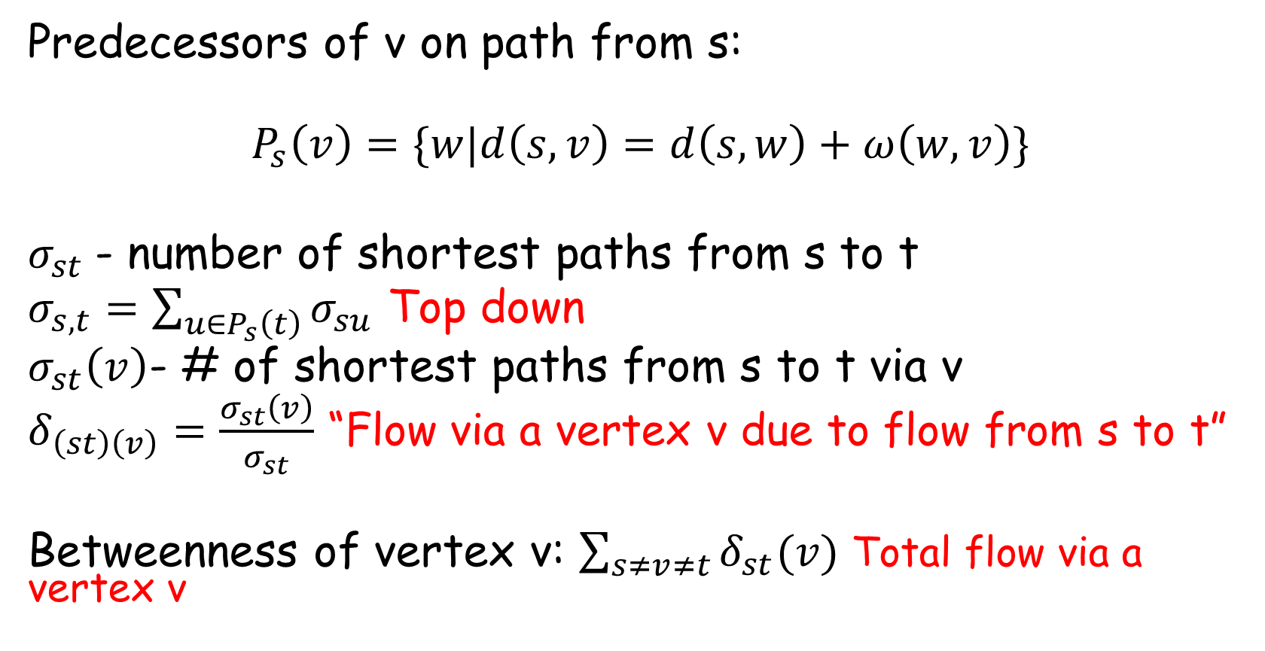
Brandes Algorithm for Weighted Vertex Betweenness
Predecessors of v on path from s:
$$P_{s}\left(v\right)=\{w|d\left(s,v\right)=d\left(s,w\right)+ω\left(w,v\right)\}$$
$σ_{st}$- number of shortest paths from s to t
$σ_{s,t}=\sum_{u∈P_{s}\left(t\right)}{σ_{su}}$ Top down
$σ_{st}\left(v\right)$- # of shortest paths from s to t via v
$δ_{\left(st\right)\left(v\right)}=\frac{σ_{st}\left(v\right)}{σ_{st}}$ “Flow via a vertex v due to flow from s to t”
Betweenness of vertex v: $\sum_{s≠v≠t}{δ_{st}(v)}$ Total flow via a vertex v

Slide 32

$δ_{s∗}(v)=\sum_{t∈V}{δ_{\left(st\right)}(v)}$
$δ_{s∗}\left(v\right)=\sum_{w:v∈P_{s}\left(w\right)}{\frac{σ_{sv}}{σ_{sw}}}\left(1+σ_{s∗}\left(w\right)\right)$ Bottom up
Approximating Betweenness Centrality
  David A. Bader, Shiva Kintali, Kamesh Madduri, and Milena Mihail
  Sampling, time $εt$if betweenness is n/t and with error $ε$

Slide 33
James Moody: Race, School Integration and Friendship Segregation in America, 2001

Slide 34
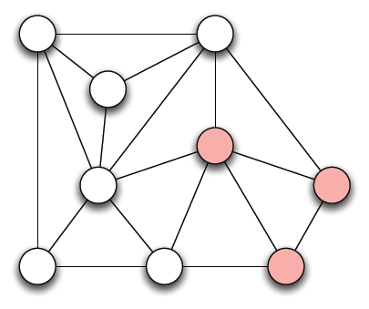
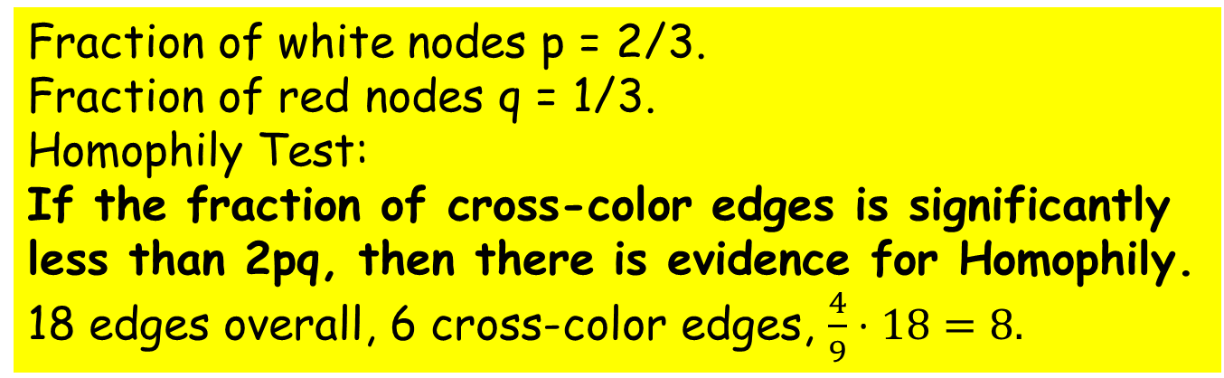
Measuring Homophily
Fraction of white nodes p = 2/3.
Fraction of red nodes q = 1/3.
Homophily Test:
If the fraction of cross-color edges is significantly
less than 2pq, then there is evidence for Homophily.
18 edges overall, 6 cross-color edges, $\frac{4}{9}⋅18=8.$
“Similarity Begets Friendship” – Plato
“People love those who are like themselves” - Aristole

Slide 35
Invited talk by Claire Mathieu at ICALP 2014
Homophily and the Emergence of a Glass Ceiling Effect in Social Networks
Theoretical (and experimental) study. Glass ceiling effect caused by:
  Rich get richer
  Homophily Women prefer to work with Women, Men with Men
  New nodes biased towards majority
Without Homophily no Glass ceiling effect.
https://www.youtube.com/watch?v=XyewnrPciqw
Chen Aviv, Zvi Lotker, Barbara Keller, David Peleg, Yvonne-Ann Pignolet, Claire Mathieu

Slide 36
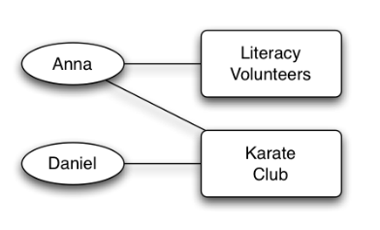
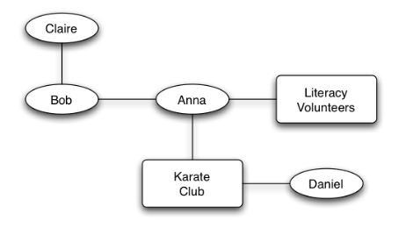
Generating Homophily: Race, Gender, Interests (Affiliation Networks)
Affiliation Networks
Social-affiliation networks

Slide 37
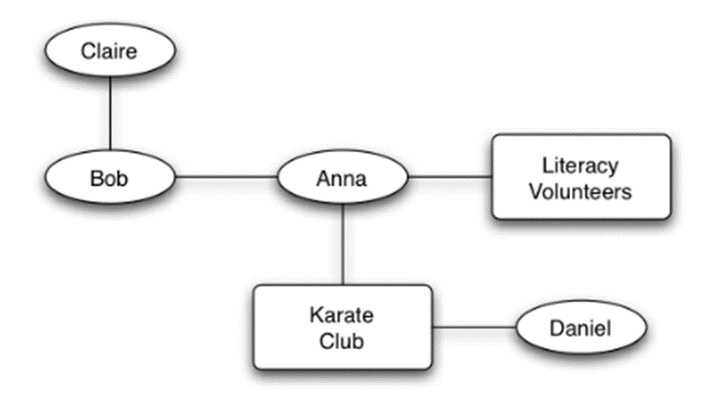
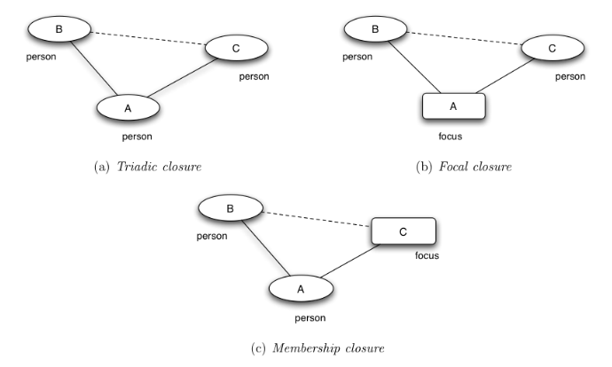
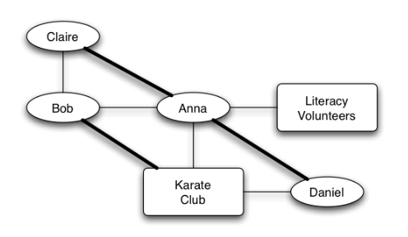
Triadic Closure, Focal Closure, Membership Closure
TC
FC
MC
TC
FC
MC

Slide 38
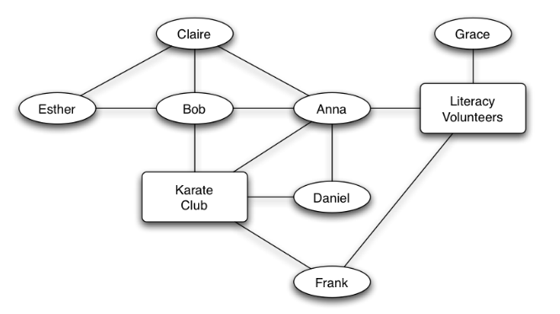
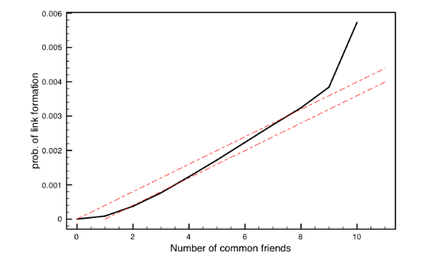
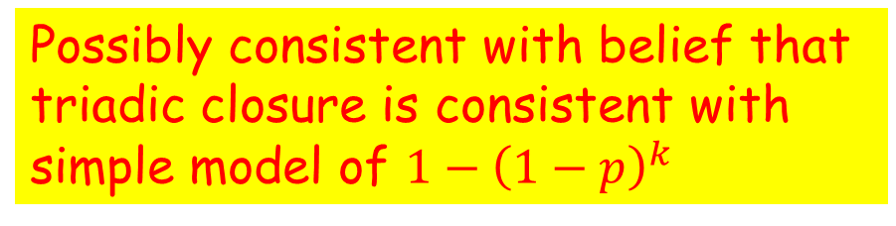

What if many common friends? Focii?
Email Triadic
Closure
Red line: $1−{\left(1−p\right)}^{k}$
Wikipeida editing
Membership
Closure
Possibly consistent with belief that
triadic closure is consistent with
simple model of $1−{\left(1−p\right)}^{k}$

Slide 39
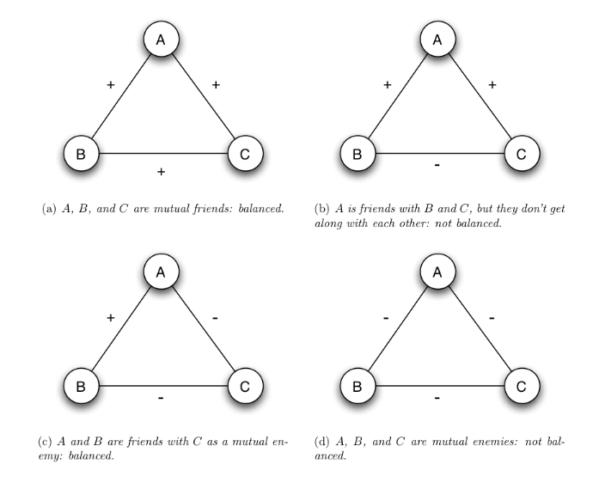
Positive and Negative Relationships: Structural Balance
Not
Balanced
Balanced
+
+
+
+
+
-
Not
Balanced
Balanced
+
-
-
-
-
-

Slide 40
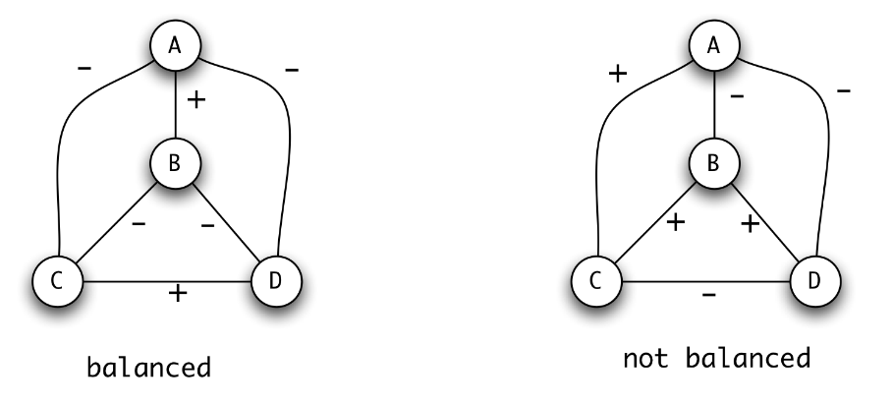
Structural Balance: Complete Graphs

Slide 41
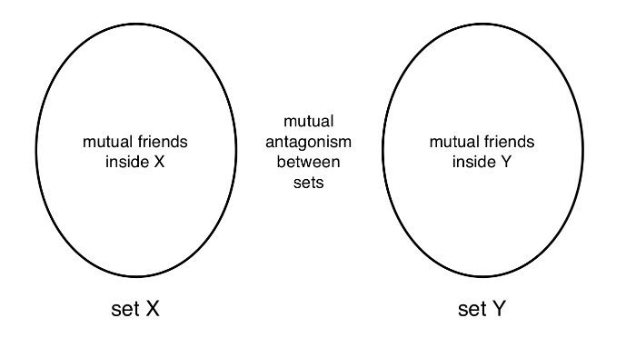

Balance theorem
If a complete graph is balanced then either all pairs of nodes are friends or else the nodes can be divided into two groups, X and Y, such that
The people in X all like one another, likewise in Y,
Everyone in X is the enemy of everyone in Y

Slide 42
Proof of the Balance Theorem, arbitrary A
Cannot
be +
?
Cannot
be -
+
-
Cannot
be -
?
?
+
-

Slide 43
Leading up to WWI
Remark: Italy Switched
Sides – Treaty of London 1915
Note: Not complete graph
Secret Reinsurance Treaty
Germany refuses to renew

Slide 44
Weak Structured Balanced Networks
There is no set of three nodes such that the edges amongst them consist of two positive edges and one negative edge
We allow a triangle that is all negative, unlike structured balanced networks
Characterization theorem:
If a labeled complete graph is weakly balanced then it’s nodes can be divided into groups that that every two nodes in the same group are friends and every two nodes in different groups are enemies

Slide 45
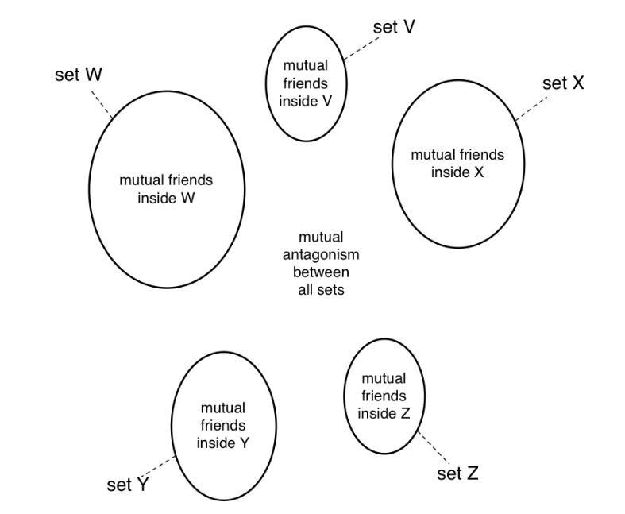
Allowing negative triangles:
Weakly
Balanced
Networks

Slide 46
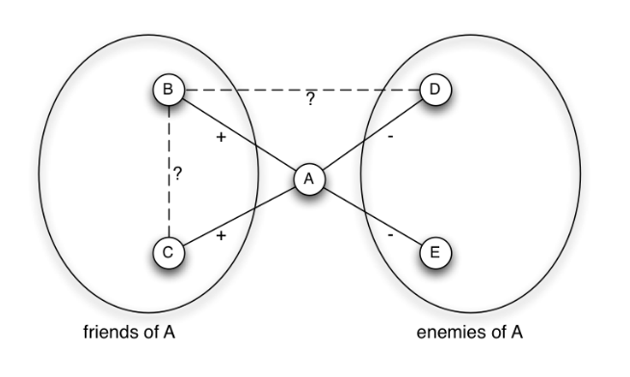
Essentially same proof as before
Cannot
be +
?
Cannot
be -
+
-
?
+
-

Slide 47
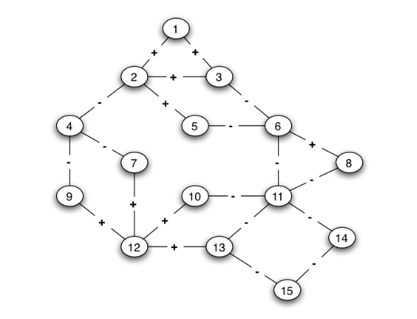
Structural Balance in Arbitrary Networks

Slide 48
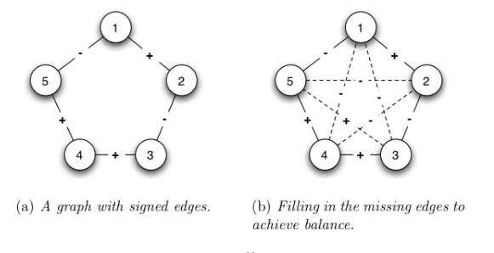
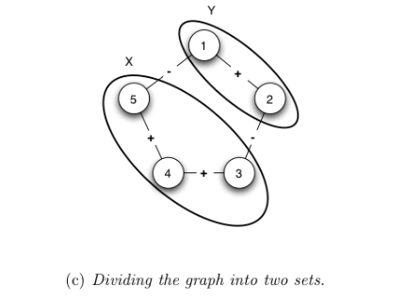
Structural Balance in Arbitrary Networks (Disallowing negative cycles)
Two equivalent defintions:
  Is it possible to fill in the remaining edges so that we have structural balance?
  Is it possible to divide the nodes into two sets, so that all positive edges are within a set, and all negative edges between the sets?

Slide 49
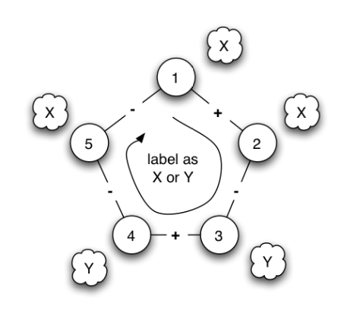
Characterization
Theorem: A signed graph is balanced if and only if it contains no cycle with an odd number of negative edges
Negative cycle:
No consistent labels
Also negative cycle

Slide 50
Create Positive Supernodes
Negative edges only between supernodes

Slide 51
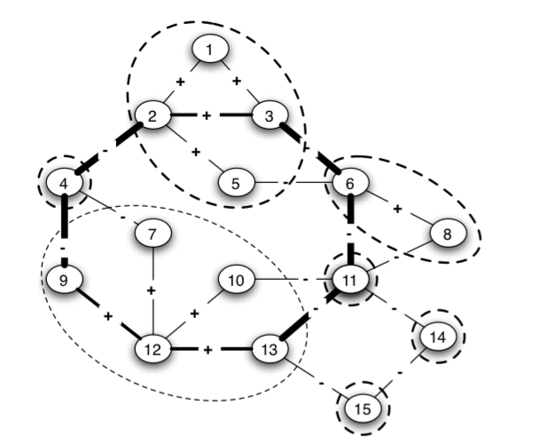
Negative cycle in supernode graph gives negative cycle in original graph
Same number
of negative
edges

Slide 52
Negative cycle in supernode graph gives negative cycle in original graph
Same number
of negative
edges

Slide 53
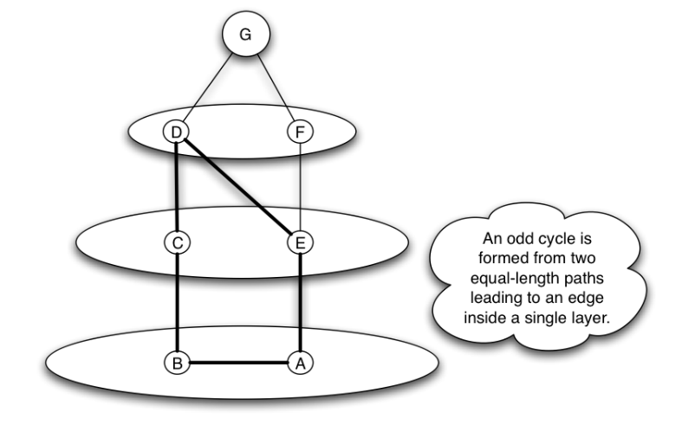
No negative odd cycle = The graph is bipartite
The BFS has a cross edge iff the graph is not bipartite
If the graph is bipartite then we can add even layers to X, odd to Y, and all negative edges go between X and Y
If the graph is not bipartite, there is a negative odd cycle (2*d+1)

Slide 54
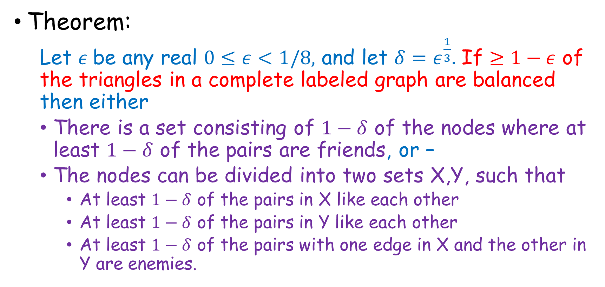
Approximately Balanced Networks
Theorem:
  Let $ε$be any real $0≤ε<1/8,$ and let $δ=ε^{\frac{1}{3}}.$ If $≥1−ε$ of the triangles in a complete labeled graph are balanced then either
  There is a set consisting of $1−δ$ of the nodes where at least $1−δ$ of the pairs are friends, or –
  The nodes can be divided into two sets X,Y, such that
    At least $1−δ$ of the pairs in X like each other
    At least $1−δ$ of the pairs in Y like each other
    At least $1−δ$ of the pairs with one edge in X and the other in Y are enemies.

Slide 55
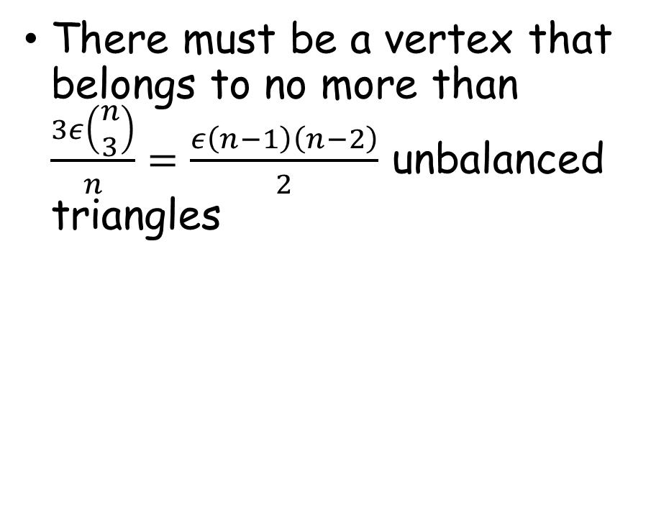
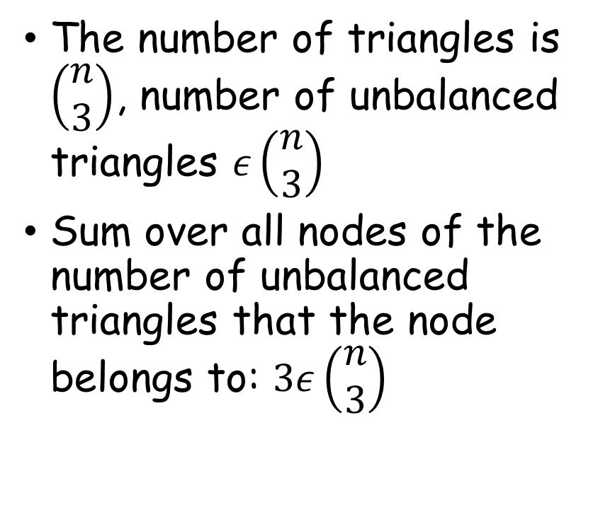
Proof
The number of triangles is $\left(\begin{matrix}n \\ 3\end{matrix}\right)$, number of unbalanced triangles $ε\left(\begin{matrix}n \\ 3\end{matrix}\right)$
Sum over all nodes of the number of unbalanced triangles that the node belongs to: $3ε\left(\begin{matrix}n \\ 3\end{matrix}\right)$
There must be a vertex that belongs to no more than $\frac{3ε\left(\begin{matrix}n \\ 3\end{matrix}\right)}{n}=\frac{ε\left(n−1\right)\left(n−2\right)}{2}$ unbalanced triangles

Slide 56
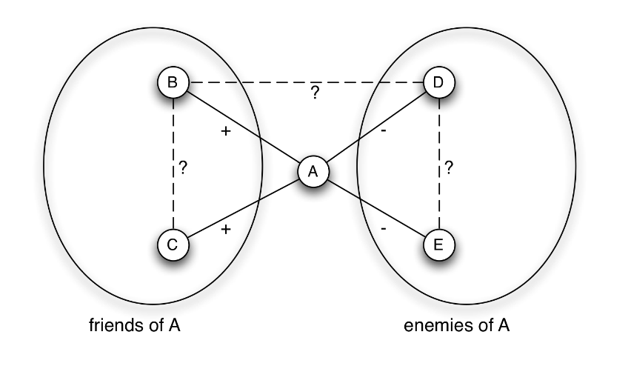
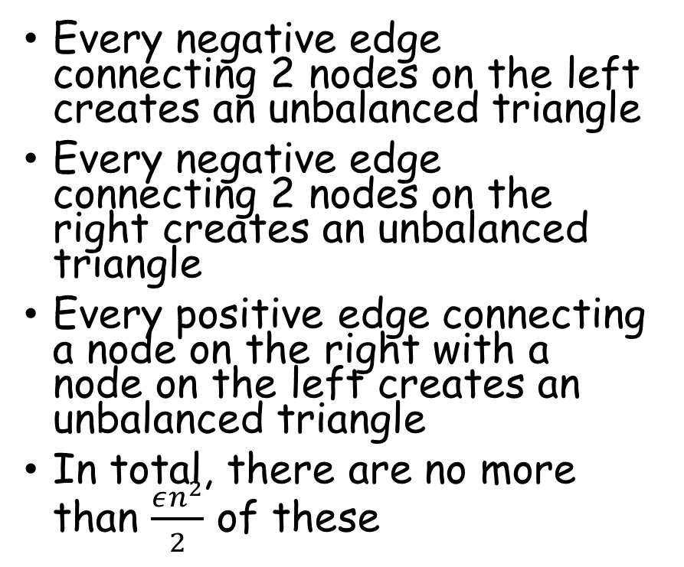
Proof (cont.)
Every negative edge connecting 2 nodes on the left creates an unbalanced triangle
Every negative edge connecting 2 nodes on the right creates an unbalanced triangle
Every positive edge connecting a node on the right with a node on the left creates an unbalanced triangle
In total, there are no more than $\frac{εn^{2}}{2}$ of these

Slide 57
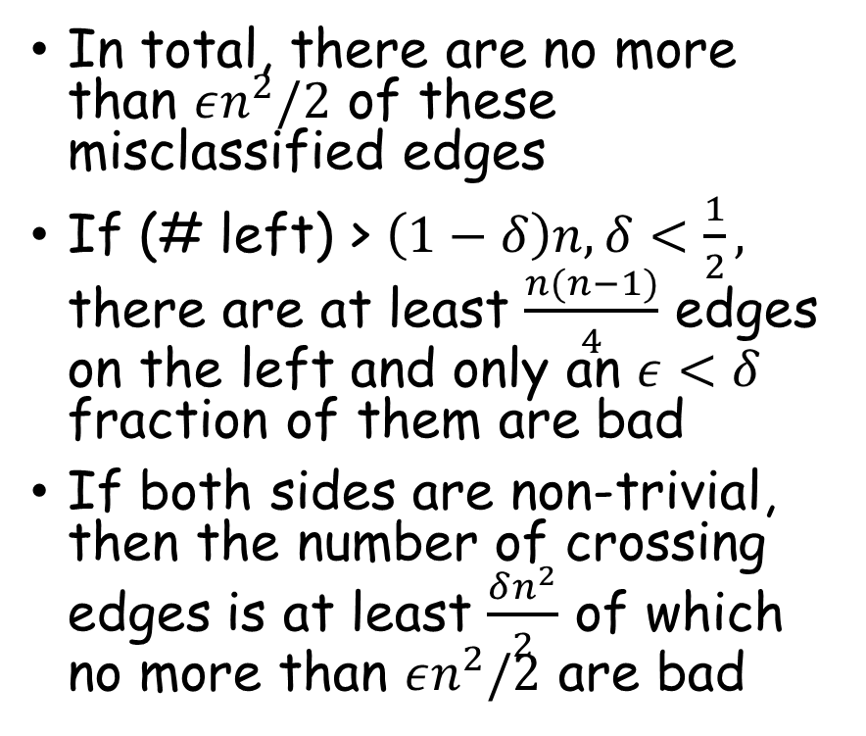

Proof Cont. Both sides non trivial
In total, there are no more than $εn^{2}/2$ of these misclassified edges
If (# left) > $\left(1−δ\right)n, δ<\frac{1}{2},$ there are at least $\frac{n(n−1)}{4}$ edges on the left and only an $ε<δ$ fraction of them are bad
If both sides are non-trivial, then the number of crossing edges is at least $\frac{δn^{2}}{2}$ of which no more than $εn^{2}/2$ are bad
The ratio $\frac{ε}{δ}=δ^{2}<δ$

Slide 58


Proof Cont. Both sides non trivial
Number of mislabeled edges on left and right?
Total number of edges on left (right) at least $\frac{δ^{2}n^{2}}{2}$
No more than $\frac{εn^{2}}{2}$are mislabeled
The ratio $\frac{ε}{δ^{2}}=δ$

Slide 59
Signed Networks in Social Media, Jure Leskovec, Daniel Huttenlocher, Jon Kleinberg

Slide 60

Matching Markets
Different people have different values for the various options
The social welfare maximizing allocation is to find the allocation that maximizes the sum of values
This is a maximal weighted matching problem
Also solvable via min cost max flow (Polytime)
Problem: Set prices to maximize social welfare

Slide 61

Matching Markets: Perfect Matchings
Edges: acceptable rooms
A perfect matching:
  Everyone gets an acceptable room

Slide 62
A perfect matching need not exist
Hall’s theorem:
  There is a perfect matching iff there is no constricted set

Slide 63

Prices give “Preferred Seller” links
“Clearing the Market”
there is a perfect matching
in the preferred seller graph

Slide 64

Optimality of Market Clearing Prices
Claim: For any set of Market Clearing prices, a perfect matching in the resulting preferred-seller graph has the maximum total valuation of any assignment of sellers to buyers
In a perfect matching every buyer gets a house that maximizes value – payment
Taking this sum over all buyers we get
  $∑{(v}_{ij(i)}−p_{ij(i)})≥∑(v_{ij^{′}(i)}−p_{ij^{′}(i)})$
  for any permutation j’
This means that the sum of valuations $v_{ij\left(i\right)}$is at least that of the sum of valuations of any other permutation
Walrasian
Equilibrium

Slide 65
Repeatedly increase price of items in contention by a constricted set
Construct preferred seller graph
If perfect matching – done
Find constricted set of buyers S and items N(S)
Each seller in N(S) increases prices
Normalize so minimal price is zero
Repeat

Slide 66
This must come to an end
Potential of a buyer is the maximal payoff she can get from any seller
Potential of a seller is the current price she is charging
Potential energy of the system is the sum of all potentials
All sellers start with potential 0, all buyers start with potential equal to their maximal valuation
The lowest price is always zero, so the buyer potential is always at least zero, seller potential is also positive
Subtracting a constant from all prices does not change system potential
When the sellers in N(S) increase their price, their potential goes up, their buyers goes down, but there are more buyers
Potential goes down by at least 1.

Slide 67
Finding Augmenting paths
Starting with unmatched buyer,
Do BFS, alternating unmatched edges with
currently matched edges.
If you wind up with an unmatched seller (D)
this is an augmenting path and increases size of
Matching

Slide 68

If no augmenting paths
Buyer
The buyers in this tree are a constricted set S.
There is one more buyer than there are sellers
Use the associated sellers N(S) and increase their prices.
Sellers

Slide 69
Walrasian Equlibria exist in more general settings
Generally, when things are substitutes
There are many generalizations (going to Rome after Erice to talk to Stefano Leonardi and Michal Feldman about extensions).

Slide 70

VCG for Matching Markets
(In the context of ad slots)
VCG prices are the minimal
Walrasian prices, and are dominant
strategy incentive compatible for
the buyers

Slide 71

Markets with Intermediaries
Suppliers S
Buyers B
Intermediaries T
Geographic restrictions on who can approach what intermediary

Slide 72

Markets with Intermediaries
Sellers have inherent value (assume zero throughout)
Buyers have inherent value
Sellers will always sell to trader who offers higher price
Buyers will always buy from trader who offers lower price
Seeking Nash Equlibria amongst traders

Slide 73
Nash Equlibria
Too much to discuss in detail here
Every agent (trader in our context) sets prices to maximize her own profit subject to the prices set by the others
We consider only pure Nash Equlibria (not randomized strategies)
Dominant Strategy: It is always in the interest of the agent to do something irrespective of what the other’s do. Dominant strategy equilibria is a special case of Nash Equilibria
It is not necessarily in the best interest of the buyer and sellers to reveal their true values

Slide 74


Example of Pricing: Not Nash equilibria

Slide 75


Monopoly and Perfect Competition

Slide 76


Example of Equilibria
Implicit Perfect Competition
No trader makes any profit

Slide 77

Is there an Equilibria where a trader makes a profit?
In the bottom equilibria it must be that x=y=0, nothing else is in equilibria
This is despite the fact that both traders have a monopoly on their sellers

Slide 78
Social Welfare, Trader profits, and Equilibria
Blume, Easley, Kleinberg and Tardos: Trading Networks with Price setting agents, 2007:
  In every trading network there is an equilibria (pure)
  Every equilibria achieves a flow of goods that gives the social optimum
  Trader T makes a profit in some equilibria iff T has an edge e to a seller or buyer such that deleting e would change the value of the social optimum, THIS IS NOT THE SAME AS SAYING DELETING T WOULD CHANGE SOCIAL OPTIMUM

Slide 79

Bargaining in Networks
Every edge represents a possible “arrangement” making a profit of one.
Every agent can take part in at most one “arrangement”
How should they split the profits?
Seems like B should be better off than others, ??

Slide 80



How should power be divided?

Slide 81

Bargaining with outside options
A “thinks” that she already has x in her pocket, B “thinks” that she already has y in her pocket
They are willing to split 1-x-y, say ½ and ½ (I will explain why this seems to make sense)
A get x + (1-x-y)/2, but this only makes sense if (1-x-y)>0. B likewise.

Slide 82


Stable and Unstable outcomes
Unstable: No node can propose and offer that makes both parties better off
In (a), B can propose $ε$to C, take for herself $1−ε$, and both B and C are better off.
In (c) B can propose to C to take slightly more than ¼, and will take slightly less than ¾ for herself
Instability is an edge not in the matching with values x,y, such that x+y<1

Slide 83

Balanced and Unbalanced outcomes
In 1st example B and C are talking too little of the surplus (1-1/2)
In 3rd example B and C are takeing too much
Balanced Outcome: for each edge in the matching, the split of the money represents the Nash Bargaining outcome for the two nodes given the best outside option for these nodes
Every Balanced outcome must be stable

Slide 84

The Stem Graph

Slide 85
MedicalTests
HIV Test error = 1% of the time
Test says you are HIV positive.
Are you sick?
“The probability that one of these women has breast cancer is 0.8 percent. If a woman has breast cancer, the probability is 90 percent that she will have a positive mammogram. If a woman does not have breast cancer, the probability is 7 percent that she will still have a positive mammogram. Imagine a woman who has a positive mammogram. What is the probability that she actually has breast cancer?”
When Gigerenzer asked 25 German doctors the question, their estimates whipsawed from 1 percent to 90 percent. Eight of them thought the chances were 10 percent or less, 9 more said 90 percent, and the remaining 8 guessed somewhere between 50 and 80 percent.
As for the American doctors, 95 out of 100 estimated the woman’s probability of having breast cancer to be somewhere around 75 percent.
The right answer is 9 percent.

Slide 86

Bayes Rule
$\operatorname{Pr}\left[A | B\right]=\frac{\operatorname{Pr}\left[A∩B\right]}{\operatorname{Pr}\left[B\right]}$
$\operatorname{Pr}\left[B | A\right]=\frac{\operatorname{Pr}\left[A∩B\right]}{\operatorname{Pr}\left[A\right]}$
$\operatorname{Pr}\left[A | B\right]⋅\operatorname{Pr}\left[B\right]=\operatorname{Pr}\left[A∩B\right]=\operatorname{Pr}\left[B | A\right]⋅\operatorname{Pr}\left[A\right]$
$\operatorname{Pr}\left[A | B\right]=\frac{\operatorname{Pr}\left[A\right]⋅\operatorname{Pr}\left[B | A\right]}{Pr⁡[B]}$

Slide 87


Bayes Rule
$$\operatorname{Pr}\left[A | B\right]=\frac{\operatorname{Pr}\left[A\right]⋅\operatorname{Pr}\left[B | A\right]}{Pr⁡[B]}$$
80% taxicabs Black
20% taxicabs Yellow
Eyewitness error = 20% of the time
Eyewitness says cab is yellows
What is the probability that the cab is Yellow?
$\operatorname{Pr}\left[true=Y|report=Y\right]=Pr\left[true=Y\right]⋅\frac{\operatorname{Pr}\left[report=Y | true=Y\right]}{Pr⁡[report=Y]}$
$\operatorname{Pr}\left[true=Y|report=Y\right]=0.2⋅\frac{0.8}{\operatorname{Pr}\left[true=Y\right]⋅\operatorname{Pr}\left[report=Y | true=Y\right]+\operatorname{Pr}\left[true=B\right]⋅\operatorname{Pr}\left[report=Y | true=B\right]}$
$0.2⋅\frac{0.8}{0.2⋅0.8+0.8⋅0.2}=1/2$

Slide 88


Bayes Rule
$$\operatorname{Pr}\left[A | B\right]=\frac{\operatorname{Pr}\left[A\right]⋅\operatorname{Pr}\left[B | A\right]}{Pr⁡[B]}$$
Original Question:
HIV Test error = 1% of the time
Test says you are HIV positive.
Are you sick or not?
Critical Missing Data:
Prior distribution:
  99.9% Healthy
  0.1% HIV
What is the probability that you are sick?
$\operatorname{Pr}\left[Sick|report=P\right]=Pr\left[Sick\right]⋅\frac{\operatorname{Pr}\left[report=P | Sick\right]}{Pr⁡[report=P]}$
$\operatorname{Pr}\left[Sick|report=P\right]=0.00001⋅\frac{0.99}{\operatorname{Pr}\left[Sick\right]⋅\operatorname{Pr}\left[report=P | Sick\right]+\operatorname{Pr}\left[¬Sick\right]⋅\operatorname{Pr}\left[report=P | ¬Sick\right]}$
$=0.00001⋅\frac{0.99}{0.00001⋅0.99+0.99999⋅0.01}≈\frac{0.00001}{0.01}=0.001.$

Slide 89
Idea: Wisdom of the crowd
Lots of little bits of information make can be combined into a lot of significant information
Is this true?

Slide 90
Herding Experiment
With probability 0.5, urn has two red and one blue ball
With probability 0.5, urn has two blue and one red ball
Experiment:
Everyone, in sequence, takes a random ball from urn, looks at it, and returns it
After looking at result: says if the she thinks
  2 red / 1 blue, or
  2 blue / 1 red

Slide 91

Using Bayes Law
If Pr[majority-blue|what she has seen and heard]> ½
  Say majority blue,
  OW say majority red
Pr[majority blue] = Pr[majority red] = 1/2
First to draw
$\operatorname{Pr}\left[majority−blue | blue\right]=\operatorname{Pr}\left[majority−blue\right]⋅\frac{\operatorname{Pr}\left[blue | majority−blue\right]}{\operatorname{Pr}\left[blue\right]}=\frac{\frac{1}{3}}{\frac{1}{2}}=\frac{2}{3}>\frac{1}{2}$
$\operatorname{Pr}\left[majority−blue | blue,blue,red\right]=\operatorname{Pr}\left[majority−blue\right]⋅\frac{\operatorname{Pr}\left[blue,blue,red | majority−blue\right]}{\operatorname{Pr}\left[blue,blue,red\right]}=?$

Slide 92
Another Experiment
With probability 0.5, urn has two red and one blue ball
With probability 0.5, urn has two blue and one red ball
Experiment:
Everyone, in sequence, takes a random ball from urn, looks at it, and returns it
Everyone sees what color ball she took out
After looking at result: says if the she thinks
  2 red / 1 blue, or
  2 blue / 1 red

Slide 93

Cascade model
State of the world: option is good/bad, $\operatorname{Pr}\left[G\right]=p,\operatorname{Pr}\left[B\right]=1−p$
Payoffs:$v_{g}>0, v_{b}<0, i$f option accepted, ow zero
$v_{g}p+\left(1−p\right)v_{b}=0.$
Private signals $\operatorname{Pr}\left[H | G\right]=q>\frac{1}{2},\operatorname{Pr}\left[L | G\right]=1−q<\frac{1}{2},\operatorname{Pr}\left[L | B\right]=q,\operatorname{Pr}\left[H | B\right]=1−q$

Slide 94
Network Goods
Technology goods
Using a product depends on how many others use it
(Or, how many of your friends use it)

Slide 95
Regular Goods: Demand drops with price
Different consumers have different value for good.
Consumers mapped to real [0,1] line segment, where r(x) is the value of the good to consumer x, r(x) descending. r(1)=0.

Slide 96



Network goods
If z fraction of the consumers use the product, the value to consumer x is r(x)f(z) where r(x) is descending, r(1)=0, and f(z) is ascending, f(0)=0, f(1)=1.
r(z)f(z)
Example: $r\left(x\right)=1−x,$
$$f\left(x\right)=x,$$
$$r\left(z\right)f\left(z\right)=z−z^{2}.$$
If $p^{∗}>\frac{1}{4}$ no self-fulfilling prophecy
For $p^{∗}≤\frac{1}{4}$ there are two equilibria

Slide 97
Network goods
For z<z’, (actual fraction using vs projected fraction using) the consumer z and those between z and z’ will want to leave.
If z’ < z < z’’, consumers slightly above z will want to join in
r(z)f(z)
z’ is a tipping point, it is critical for the success of the
new technology to get saturation above z’

Slide 98
Network goods
If the production cost would drop this has two important advantages:
The tipping point moves to the left (less saturation required)
The 2nd equilibria z’’ moves to the right
r(z)f(z)
z’ is a tipping point, it is critical for the success of the
new technology to get saturation above z’

Slide 99



Shared Expectations
If everyone expects a z fraction to purchase then consumer x with $r\left(x\right)f\left(z\right)≥p^{∗}$ will want to purchase
Everyone between 0 and $\hat{z}$ will want to purchase where $r\left(\hat{z}\right)=\frac{p^{∗}}{f\left(z\right)};$
Define $g\left(z\right)=r^{−1}\left(\frac{p^{∗}}{f\left(z\right)}\right)$ if $\frac{p^{∗}}{f\left(z\right)}≤r\left(0\right),$
g(z)=0 otherwise

Slide 100


Shared Expectations
Example: $r\left(x\right)=1−x,$
$$f\left(x\right)=x,$$
$$r^{−1}\left(x\right)=1−x, r\left(0\right)=1,$$
$$r\left(z\right)f\left(z\right)=z−z^{2}.$$
$g\left(z\right)=1−\frac{p^{∗}}{z},$when $z≥p^{∗}$
$g\left(z\right)=0$Otherwise
Define $g\left(z\right)=r^{−1}\left(\frac{p^{∗}}{f\left(z\right)}\right)$ if $\frac{p^{∗}}{f\left(z\right)}≤r\left(0\right),$
g(z)=0 otherwise

Slide 101

What will actually happen?
If the shared expectation is too small, no one will use it.
The point z’ is a tipping point, it is the critical point, beyond with the product will go viral
z’’ is the stable equilibria.

Slide 102

Dynamics
When people react to the current user base size

Slide 103

Dynamics

Slide 104

If its’ not a pure network good (has some inherent value)

Slide 105

If its’ not a pure network good (has some inherent value)

Slide 106

If its’ not a pure network good (has some inherent value) and price is reduced
Avoid getting
stuck in
low saturation
equilibria by
reducing cost

Slide 107


Positive and Negative network effects
The El Farol Bar problem:
  Good to drink with more people, except
  Over 60 people it becomes too crowded.
Mixed strategy symmetric equilibria (agents must toss a coin to decide if to go or not to the El Farol Bar)
Santa fe

Slide 108
Diffusion and Viral Cascades

Slide 109


Diffusion Through a Network
Coordination game: value is non-zero only if both do the same (battle of the sexes is another example)
v plays many simultaneous coordination games with all of it’s neighbors
If
  $pda≥\left(1−p\right)db,$or
  $p≥\frac{b}{a+b}$
  then A is the better choice
If a q=b/(b+a) fraction of your neighbors use A then you should too

Slide 110

Cascading Behaviour
a=3, b=2, q=2/5
If a q=b/(b+a) fraction of your neighbors use A then you should too

Slide 111

The cascade can STOP

Slide 112

Density and Clusters
A cluster of density p is a set of nodes such that
each node in the set has at least a fraction p
of it’s network neighbors in the set
Above: 3 4-node clusters, each of density 2/3.

Slide 113

Clusters are (the only) obstacles to Cascades
The two clusters have density 2/3
Remember q=2/5
Theorem:
  If the remaining network has a cluster of density greater than 1-q, there is no complete cascade
  Whenever there is no complete cascade, the remaining network must contain a cluster of density greater than 1-q

Slide 114


Proof
Those that don’t switch must have a fraction > 1-q amongst
those that don’t switch
v has a 1-q fraction of it’s neighbors amongst those that
did not switch, ergo, less than a q fraction amongst those
that did switch

Slide 115

Weak Ties
Will be useful for information flow
Will not be a conduit for high threshold innovation

Slide 116


Extensions to Cascade Model
Hetrogeneous Thresholds
A is a better choice for v if a $q_{v}=\frac{b_{v}}{a_{v}+b_{v}}$ fraction of it’s neighbors use A

Slide 117


Cascades with
Different thresholds
A blocking cluster in the network is a set of nodes for which each node v has more than a $1−q_{v}$ fraction of it’s neighbors in the set

Slide 118

Knowledge, Thresholds and Collective Action
Should you vote for a party that may not reach the minimal threshold?
Should you start a revolution if you fear that you don’t have enough revolutionaries?
Collective action
It may be that a large majority of you want to vote for
But you don’t know it: pluralistic ignorance

Slide 119

Pluralistic Ignorance
You know your own threshold and those of your neighbors
Chwe: Apple commercial in 1984 superbowl was not to
inform people about Macintosh computers but to create
“common knowledge” that “everyone” knew about Macs
Patal: Shiites in Iraq have common knowledge via hierarchical
networks of clerical deputies

Slide 120



The Cascade Capacity
An infinite graph (finite degrees)
A set of early adapters S
Every node other than S chooses new technology A if more than q of her neighbors use A
Cascade capacity of a network: the largest value of q for which some finite set of early adaptors can cause a complete cascade (every node will eventually use A)
$$q≤\frac{1}{2}$$
$$q>\frac{1}{2}$$

Slide 121

How large can a network cascade capacity be?
Theorem: There is no network where the network capacity exceeds 1/2.
Potential function: number of agents using B that have neighbors using A

Slide 122
Node w switches, it has a edges to nodes with A, and b edges to nodes with B, but q>1/2 so there are more edges to A than to B, a>b
After the switch, w becomes A, so there are now fewer vertices using B that have neighbors using A

Slide 123

Using two technologies: the “bilingual option”
An extra cost of c if one becomes “bilingual”

Slide 124

What if
a=2, b=3,
c=1

Slide 125



Slide 126


Neighbors A and B
Neighbors AB and B

Slide 127


Slide 128


Slide 129
Markets and Information
The market for lemons: quality uncertainty and the market mechanism, George A. Akerlof, cited by 20000+
“Nobel” prize

Slide 130


Bernoulli Family
Daniel Bernoulli
Born: 8 Feb 1700 in Groningen, Netherlands
Died: 17 March 1782 in Basel, Switzerland
Notes:
Jacob was both a great teacher who attracted students from all over Europe and an acclaimed genius in mathematics, engineering and astronomy.
(First) Jacob is the discoverer of the Law of Large Numbers in his book “The art of conjecture”.
When Jacob died in 1705 after a long illness, leaving the Art of Conjecture all but complete, Nicolaus I asked to edit the work for publication even though he was only 18 at the time. He took eight years to finish the task.
Johann, the father of Daniel, is described by James Newman, (an anthologist of science,) as “violent, abusive. And then necessary, dishonest.” When Daniel won a prize from the French Academy of Sciences from his work on planetary orbits, his father, who coveted the prize for himself, threw him out of the house.

Slide 131





Bernoulli Utility of Money
$u\left(x\right)=\ln\left(x\right)$
$Wealth w$
Expected utility after bet:
$a\ln\left(rwO_{a}\right)+\left(1−a\right)ln⁡(\left(1−r\right)wO_{B})$
$$=a\ln\left(r\right)+\left(1−a\right)\ln\left(1−r\right)+$$
$$a\ln\left(wO_{B}\right)+\left(1−a\right)\ln{(wO_{b})}$$
  $\frac{a}{r}−\frac{1−a}{1−r}=0⇒r=a$
  The bettor “bets her beliefs”
A, $Odds$ $O_{A}$
Prob a
B$, Odds O_{B}$
Prob 1-a

Slide 132

Aggregate Beliefs “wisdom of the crowd”
n bettors 1,2, …, n
Bettor i thinks that A will win with probability $a_{i}$
Bettor i has initial wealth $w_{i}$
$w=w_{1}+w_{2}+⋯+w_{n}$
Utility of money $u(x)=ln⁡(x)$
We know that bidders bet their beliefs

Slide 133


Aggregate Beliefs “wisdom of the crowd”
n bettors 1,2, …, n
Bettor i thinks that A will win with probability $a_{i}$
Bettor i has initial wealth $w_{i}$
$w=w_{1}+w_{2}+⋯+w_{n}$
Utility of money $u(x)=ln⁡(x)$
We know that bidders bet their beliefs
Money bet on horse A:
$a_{1}w_{1}+a_{2}w_{2}+⋯+a_{n}w_{n}$
Money bet on horse B:
$${(1−a}_{1})w_{1}+{(1−a}_{2})w_{2}+⋯+{(1−a}_{n})w_{n}$$
“Honest race track” Loses nothing Profits nothing
  If A wins payoff = $a_{1}w_{1}O_{A}+⋯+a_{n}w_{n}O_{A}$
  If B wins payoff =
${(1−a}_{1})w_{1}O_{B}+⋯+{(1−a}_{n})w_{n}O_{B}$

Slide 134


Aggregate Beliefs “wisdom of the crowd”
Money bet on A + Money bet on B = sum of wealth (w)
To solve for “fair odds” it must be that $a_{1}w_{1}O_{A}+⋯+a_{n}w_{n}O_{A}=w=\sum_{i}{w_{i}}$
Or, divide by $O_{A}⋅w:$
$$\frac{a_{1}w_{1}}{w}+⋯+\frac{a_{n}w_{n}}{w}=\frac{1}{{ O}_{A}}$$
Let $f_{i}=\frac{w_{i}}{w}$- fraction of wealth held by i
$a_{1}f_{1}+⋯+a_{n}f_{n}=\frac{1}{{ O}_{A}}$
$${(1−a}_{1})f_{1}+⋯+{(1−a}_{n})f_{n}=\frac{1}{{ O}_{B}}$$
Money bet on horse A:
$a_{1}w_{1}+a_{2}w_{2}+⋯+a_{n}w_{n}$
Money bet on horse B:
${(1−a}_{1})w_{1}+{(1−a}_{2})w_{2}+⋯+{(1−a}_{n})w_{n}$
“Honest race track” Loses nothing Profits nothing
  If A wins payoff = $a_{1}w_{1}O_{A}+⋯+a_{n}w_{n}O_{A}$
  If B wins payoff =
${(1−a}_{1})w_{1}O_{B}+⋯+{(1−a}_{n})w_{n}O_{B}$

Slide 135


Aggregate Beliefs “wisdom of the crowd”
$\frac{1}{O_{A}}$ - to get a $1 payoff if A wins, bet $\frac{1}{O_{A}}$ on A
$\frac{1}{O_{B}}$ - to get a $1 payoff if B wins, bet $\frac{1}{O_{B}}$ on B
$ρ_{A}=\frac{1}{O_{A}}$ , $ρ_{B}=\frac{1}{O_{B}}$ - state prices: price of a dollar if a certain event happens
To get one dollar in any case: bet $ρ_{A}$on A, $ρ_{B}$on B
$ρ_{A}+ρ_{B}=$
$a_{1}f_{1}+⋯+a_{n}f_{n}$+ ${(1−a}_{1})f_{1}+⋯+{(1−a}_{n})f_{n}$=
$f_{1}+f_{2}+⋯+f_{n}=1$
Assuming bettors bet all their wealth is not a restriction, they can always bet part of their wealth $ρ_{A}$on A, $ρ_{B}$on B and get it back
Money bet on A + Money bet on B = sum of wealth (w)
To solve for “fair odds” it must be that
$a_{1}w_{1}O_{A}+⋯+a_{n}w_{n}O_{A}=w=\sum_{i}{w_{i}}$
Or, divide by $O_{A}⋅w:$
$\frac{a_{1}w_{1}}{w}+⋯+\frac{a_{n}w_{n}}{w}=\frac{1}{{ O}_{A}}$
Let $f_{i}=\frac{w_{i}}{w}$- fraction of wealth held by i
$a_{1}f_{1}+⋯+a_{n}f_{n}=\frac{1}{{ O}_{A}}$
${(1−a}_{1})f_{1}+⋯+{(1−a}_{n})f_{n}=\frac{1}{{ O}_{B}}$

Slide 136


Aggregate Beliefs “wisdom of the crowd”
If all bettors agree that $a_{i}=a,$ then
$a_{1}f_{1}+⋯+a_{n}f_{n}=\frac{1}{{ O}_{A}}$ = a
State prices are weighted averages of the bettors beliefs, the weight is the fraction of wealth that a bidder has (of the total wealth)
State prices are the “market beliefs”
$\frac{a_{1}w_{1}}{w}+⋯+\frac{a_{n}w_{n}}{w}=\frac{1}{{ O}_{A}}$
$f_{i}=\frac{w_{i}}{w}$
$a_{1}f_{1}+⋯+a_{n}f_{n}=\frac{1}{{ O}_{A}}$
${(1−a}_{1})f_{1}+⋯+{(1−a}_{n})f_{n}=\frac{1}{{ O}_{B}}$

Slide 137

Aggregate Beliefs “wisdom of the crowd”
If all bettors agree that $a_{i}=a,$ then
$a_{1}f_{1}+⋯+a_{n}f_{n}=\frac{1}{{ O}_{A}}$ = a
State prices are weighted averages of the bettors beliefs, the weight is the fraction of wealth that a bidder has (of the total wealth)
State prices are the “market beliefs”
“Wisdom of the crowd”: If the opinions in the crowd (about a) are drawn from a distribution with mean equal to the true probability of A winning, and, if all wealth fractions are equal, then the “market belief” will converge to the true probability (for large crowds)
$\frac{a_{1}w_{1}}{w}+⋯+\frac{a_{n}w_{n}}{w}=\frac{1}{{ O}_{A}}$
$f_{i}=\frac{w_{i}}{w}$
$a_{1}f_{1}+⋯+a_{n}f_{n}=\frac{1}{{ O}_{A}}$
${(1−a}_{1})f_{1}+⋯+{(1−a}_{n})f_{n}=\frac{1}{{ O}_{B}}$

Slide 138
Aggregate Beliefs “wisdom of the crowd”
If all bettors agree that $a_{i}=a,$ then
$a_{1}f_{1}+⋯+a_{n}f_{n}=\frac{1}{{ O}_{A}}$ = a
State prices are weighted averages of the bettors beliefs, the weight is the fraction of wealth that a bidder has (of the total wealth)
State prices are the “market beliefs”
“Wisdom of the crowd”: If the opinions in the crowd (about a) are drawn from a distribution with mean equal to the true probability of A winning, and, if all wealth fractions are equal, then the “market belief” will converge to the true probability (for large crowds)
$\frac{a_{1}w_{1}}{w}+⋯+\frac{a_{n}w_{n}}{w}=\frac{1}{{ O}_{A}}$
$f_{i}=\frac{w_{i}}{w}$
$a_{1}f_{1}+⋯+a_{n}f_{n}=\frac{1}{{ O}_{A}}$
${(1−a}_{1})f_{1}+⋯+{(1−a}_{n})f_{n}=\frac{1}{{ O}_{B}}$
Problems with “Wisdom of the Crowd”:
Assumes independent opinions
(vs. cascades)
All opinions are equally weighted, if some
bettors are more wealthy than others
this depends on “Are the rich more stupid”?
Idea: clever people become richer over time
(to come later)

Slide 139
Prediction Markets and Stock Markets
Stock markets:
  Value of stock depends on state of the world
  Many states of the world
  If we knew the price of a dollar in each of these states (state prices) and the value of the stock in the state:
Prediction markets:
  Participants trade “securities” that pay one dollar if an event happens
  Prices should be exactly those of horse betting (assumes exogenous beliefs – you believe something irrespective of what others do)

Slide 140
Prediction Markets and Stock Markets
Stock markets:
  Value of stock depends on state of the world
  Many states of the world
  If we knew the price of a dollar in each of these states (state prices) and the value of the stock in the state:
  Investors would be willing to pay for one share: (value of stock in state)*(state price)
  Price of stock today is sum over all states
Prediction markets:
  Participants trade “securities” that pay one dollar if an event happens
  Prices should be exactly those of horse betting (assumes exogenous beliefs – you believe something irrespective of what others do)

Slide 141
Prediction Markets and Stock Markets
Stock markets:
  Value of stock depends on state of the world
  Many states of the world
  If we knew the price of a dollar in each of these states (state prices) and the value of the stock in the state:
  Investors would be willing to pay for one share: (value of stock in state)*(state price)
  Price of stock today is sum over all states
Prediction markets:
  Participants trade “securities” that pay one dollar if an event happens
  Prices should be exactly those of horse betting (assumes exogenous beliefs – you believe something irrespective of what others do)
Problems: determine state prices from stock prices
Determine stock prices from state prices

Slide 142
Simple case, 2 firms, 2 states, equivalent to prediction markets
Companies 1,2
States of the world {a,b}
Company 1 does well in state a:
  Stock worth 1 in state a
  Stock worth 0 in state b
Company 2 does well in state b:
  Stock worth 0 in state a
  Stock worth 1 in state b
Prices are the same as in prediction markets, and are equal to the market probabilities for the events (the weighted probabilities of the investors)

Slide 143

Less simple case, 2 firms, 2 states,
Companies 1,2
States of the world {a,b}
Company 1 does well in state a:
  Stock worth 2 in state a
  Stock worth 1 in state b
Company 2 does well in state b:
  Stock worth 1 in state a
  Stock worth 2 in state b
If we know the state prices $ρ_{a}, ρ_{b},$ we can compute the price of the stocks,
$v_{1},v_{2}$ - variables - prices (today) for stocks 1, 2
$v_{1}=2 ρ_{a}+ρ_{b};v_{2}=ρ_{a}+2ρ_{b}$

Slide 144

Less simple case, 2 firms, 2 states,
Companies 1,2
States of the world {a,b}
Company 1 does well in state a:
  Stock worth 2 in state a
  Stock worth 1 in state b
Company 2 does well in state b:
  Stock worth 1 in state a
  Stock worth 2 in state b
If we know the current value of the stocks, we can compute the state prices:
$v_{1},v_{2}$ - constants - prices (today) for stocks 1, 2, solve for $ρ_{a},ρ_{b}:$
$v_{1}=2 ρ_{a}+ρ_{b};v_{2}=ρ_{a}+2ρ_{b}$
$ρ_{1}=\frac{2v_{1}−v_{2}}{3};ρ_{2}=\frac{2v_{2}−v_{1}}{3}$

Slide 145

A “rich” set of stocks:
When we write the stock prices as a
function of the state prices, we can
solve uniquely for the state prices
Stock prices determine state prices
Investors can trade stocks to move
money across states
Imagine there is a prediction market
for every state, determine state prices,
use them to determine stock prices
Stock markets, prediction markets, horse
Races are all the “same”
If we know the current value of the stocks, we can compute the state prices:
$v_{1},v_{2}$ - constants - prices (today) for stocks 1, 2, solve for $ρ_{a},ρ_{b}:$
$v_{1}=2 ρ_{a}+ρ_{b};v_{2}=ρ_{a}+2ρ_{b}$
$ρ_{1}=\frac{2v_{1}−v_{2}}{3};ρ_{2}=\frac{2v_{2}−v_{1}}{3}$

Slide 146
Why do prices change?
Individual beliefs change
Individual wealth changes
Thus far: Exogenious beliefs.
Why do individual beliefs change?
  Learning via Bayes rule? (later)
  Via cascades? Small events can lead to market crashes.

Slide 147
Endogenous events: whether something becomes true depends on the aggregate behavior of individuals
Not exactly
Asymmetric Information:
  Sellers of used cars know if their car is good or bad
  Buyers of used cars don’t
  Buyers of insurance know if they are healthy or not
  Sellers of insurance don’t really
  People seeking work know if they are good or not
  Employers don’t
Market failure is possible
If everyone thinks that used cars are good, prices will be high, and good used cars will be put on the market
A self fulfilling prophecy?
Like network goods?

Slide 148




The market for lemons

Slide 149
The market for lemons: simple cases
George Akerlof, 2001 “Nobel prize”
Good cars and bad cars
Sellers: Good car = 10, bad car = 4 (minimal reserve prices)
Buyers: Good car = 12, bad car = 6
A g fraction of the used cars are good cars, everyone knows g
Sellers always know if their car is good or bad
There are more buyers than sellers (to push up the price)
If everyone knew if a car was good or bad, good cars would be sold for 12, bad cars for 6

Slide 150

The market for lemons: simple cases
Good cars and bad cars
Sellers: Good car = 10, bad car = 4 (minimal reserve prices)
Buyers: Good car = 12, bad car = 6
A g fraction of the used cars are good cars, everyone knows g
Sellers always know if their car is good or bad
There are more buyers than sellers (to push up the price)
Buyers cannot tell good cars apart from bad cars
Forget risk (forget log utility – for now)
The fraction of good cars in the set of cars for sale is h
The value a buyer puts on a used car is $12h+6\left(1−h\right)=6+6h$
To know how much to pay, the buyers need to know h

Slide 151

The market for lemons: simple cases
Good cars and bad cars
Sellers: Good car = 10, bad car = 4 (minimal reserve prices)
Buyers: Good car = 12, bad car = 6
A g fraction of the used cars are good cars, everyone knows g
Sellers always know if their car is good or bad
There are more buyers than sellers (to push up the price)
Buyers cannot tell good cars apart from bad cars
The fraction of good cars in the set of cars for sale is h
The value a buyer puts on a used car is $12h+6\left(1−h\right)=6+6h$
What is a shared expectation h that is self-fulfilling: if all buyers assume that the fraction of good cars is h then there will be an h fraction of good cars on the Market.

Slide 152


Characterizing the self-fulfilling equilibria
What if $g<\frac{2}{3}?$
The buyers will be willing to pay 6+6g < 10
Owners of good cars will not be willing to sell at 10
The fraction of good cars goes down to zero (in this simple setting)
For any g, there is a self fulfilling expectations equilibrium with h=0, only bad cars are sold
What about g=h?
Buyers would be willing to pay 6+6g for a used car
A seller with a good car would offer it for sale at price 6+6g provided that $6+6g≥10, or g≥\frac{2}{3}.$
If a seller with a good car offers it for sale, so will a seller with a bad car
If $g≥\frac{2}{3}$ there are two self fulfilling equilibria, for $g<\frac{2}{3}$ only bad cars can be sold

Slide 153
Complete market failure
Used cars: Good, Bad, Lemons, 1/3 of each type
Value for sellers:
  Good: 10
  Bad: 4
  Lemons: 0
Value for buyers:
  Good: 12
  Bad: 6
  Lemons: 0
More buyers than used cars
If complete information – good cars would be sold at 12, bad at 6, Lemons would not be sold
What self fulfilling expectations equilibria exist?

Slide 154

Three options
All cars are for sale
  Expected value of car to buyer $\frac{12+6+0}{3}=6$
Only bad cars and lemons are for sale
  Expected value of car to buyer $\frac{6+0}{3}=2$
Only lemons are for sale – complete market failure
If buyers offer 6 (or less) no seller with a good car will sell
If buyers offer 2 (or less) no seller with a bad car will sell
Only other option: lemons sold at zero
“It is possible to have the bad driving out the not-so-bad driving out the medium
driving out the not-so-good driving out the good” - Akerlof

Slide 155
Key features of example
Items for sale have varying qualities
For any level of quality, the buyers value the item at least as much as the sellers, so with complete information, the market would transfer items from sellers to buyers
There is asymmetric information about the quality of the items
Because of the asymmetric information, items must be sold at the same price, and sellers will put their items up for sale only if they value them below the uniform price

Slide 156




Bayesian Learning in Markets
N hypothesis (different investors) $\left(a_{1},b_{1}=1−a_{1}\right), \left(a_{2},b_{2}\right), …, \left(a_{N}, b_{N}\right)$
$f_{i}−$ prior probability of hypothesis I
T races run between A and B
Sequence S of results (A,A,B,A,B, …)
Initial probability of A winning:
$$a_{1}f_{1}+⋯+a_{N}f_{N}$$
$$\operatorname{Pr}\left[A | B\right]=\frac{\operatorname{Pr}\left[A\right]⋅\operatorname{Pr}\left[B | A\right]}{Pr⁡[B]}$$

Slide 157


