Slide 1
Introduction to Toda Brackets and secondary operations
By: Jonatan Kogan

Slide 2
Abstract
The Toda bracket is an operation originally invented to compute homotopy groups of spheres, but turned out to be a simple but important example of a "secondary operation". The talk is intended to introduce the concept of "secondary operations" and the philosophy behind them through this example.

Slide 3
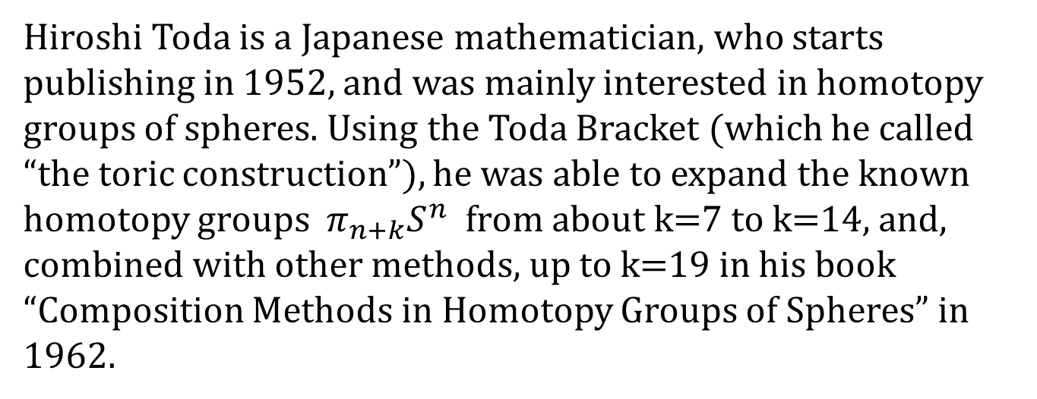
Background
Hiroshi Toda is a Japanese mathematician, who starts publishing in 1952, and was mainly interested in homotopy groups of spheres. Using the Toda Bracket (which he called “the toric construction”), he was able to expand the known homotopy groups $π_{n+k}S^{n}$ from about k=7 to k=14, and, combined with other methods, up to k=19 in his book “Composition Methods in Homotopy Groups of Spheres” in 1962.

Slide 4
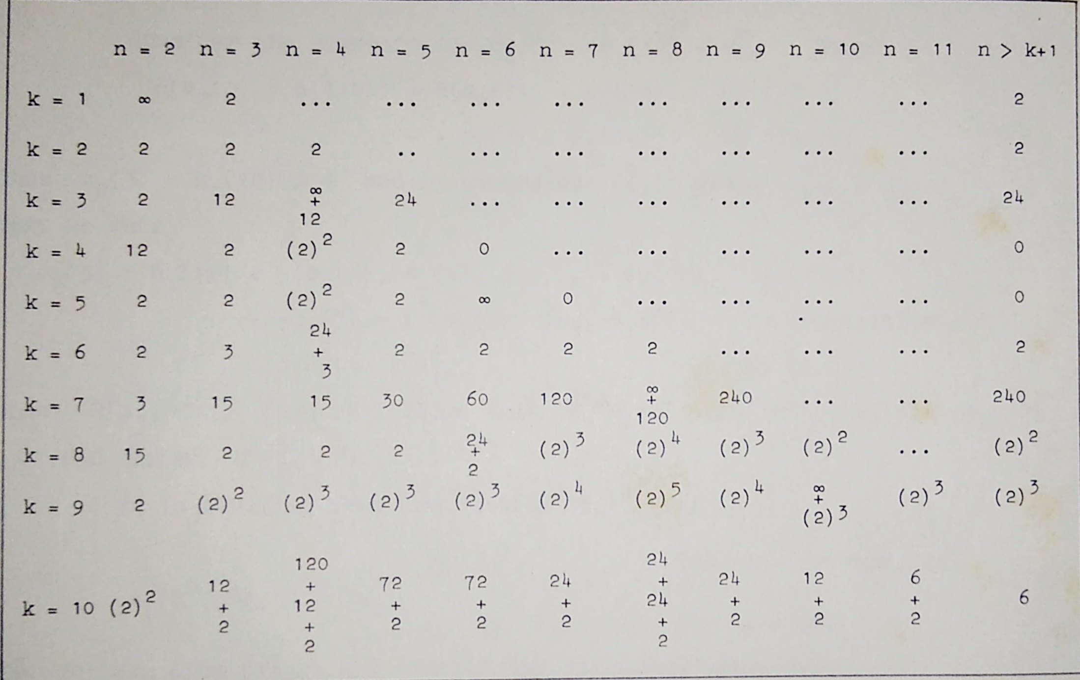
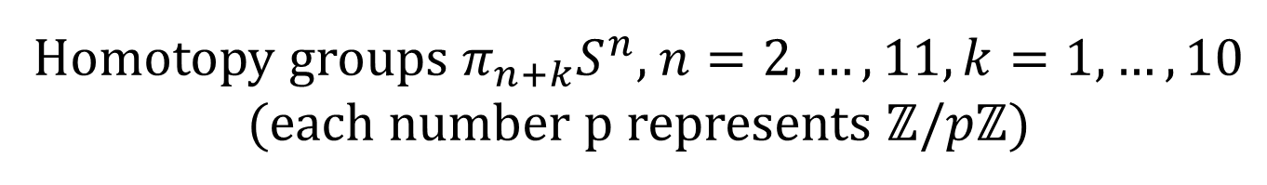
Homotopy groups $π_{n+k}S^{n}$, $n=2,…,11, k=1,…,10$ (each number p represents $ℤ/pℤ$)

Slide 5
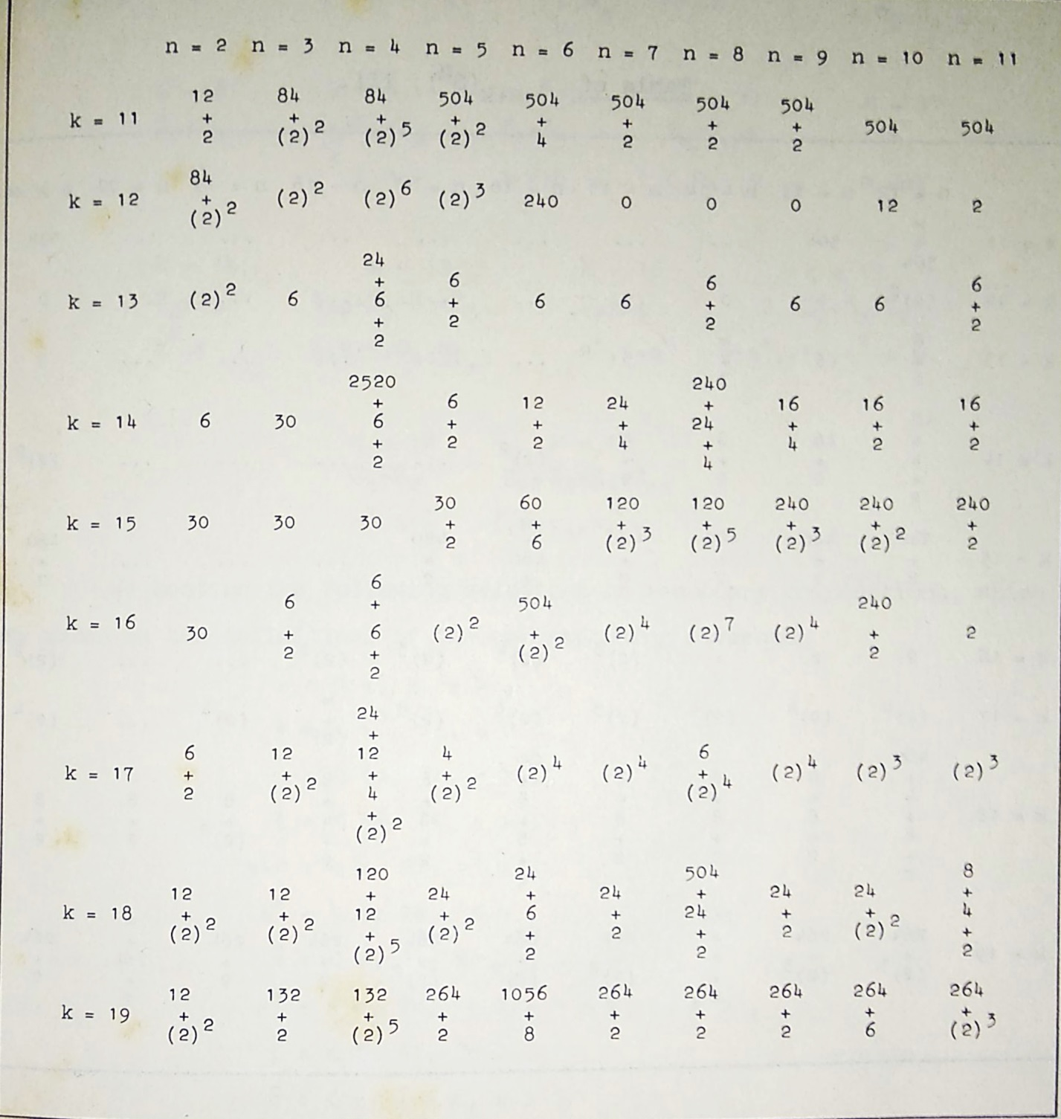
Homotopy groups $π_{n+k}S^{n}$, $n=2,…,11, k=11,…,19$

Slide 6
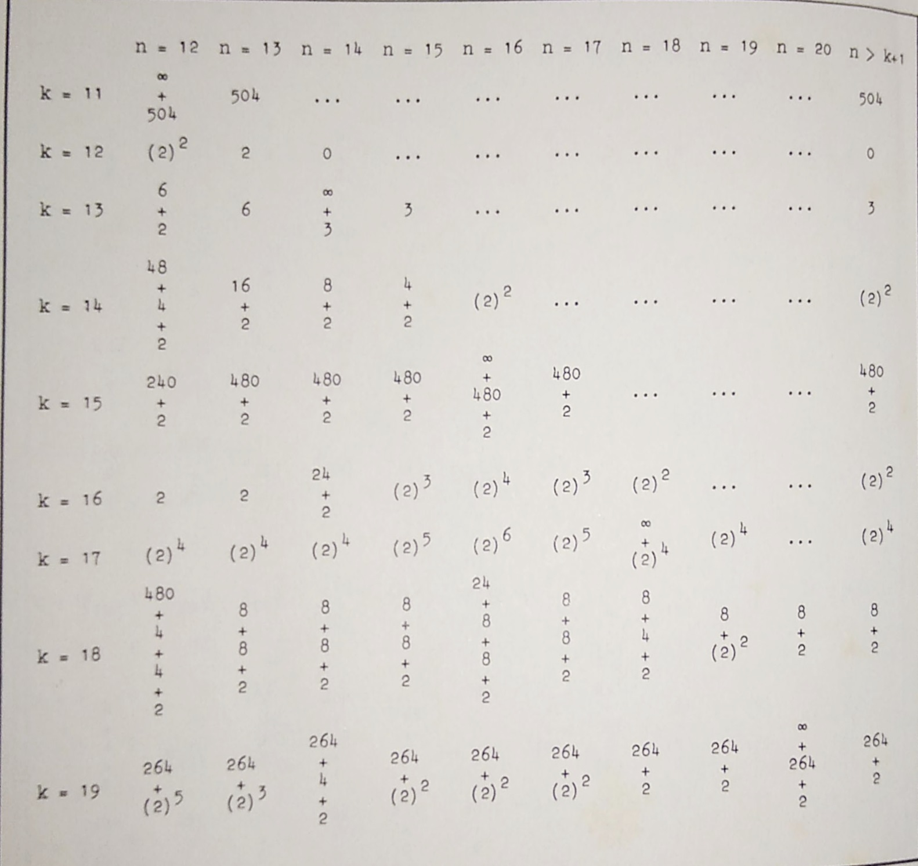
Homotopy groups $π_{n+k}S^{n}$, $n=12,…,20, k=11,…,19$

Slide 7

Definition of a Toda Bracket
Definition: a sequence of 4 spaces $X\underset{→}{f}Y\underset{→}{g}Z\underset{→}{h}W$is called a Toda Sequence if $g∘f,h∘g \overset{h}{\sim }∗$. Choose such null-homotopies F,G respectively- then we can construct a map $ΣX→W$ as shown in the diagram:
We denote this map $<f,g,h,F,G>$, and the subset of $[ΣX,W]$ acquired in this way by $<f,g,h>$. This is in fact a double coset of $f^{∗}[ΣY,W]$ and $h_{∗}[ΣX,Z]$.

Slide 8
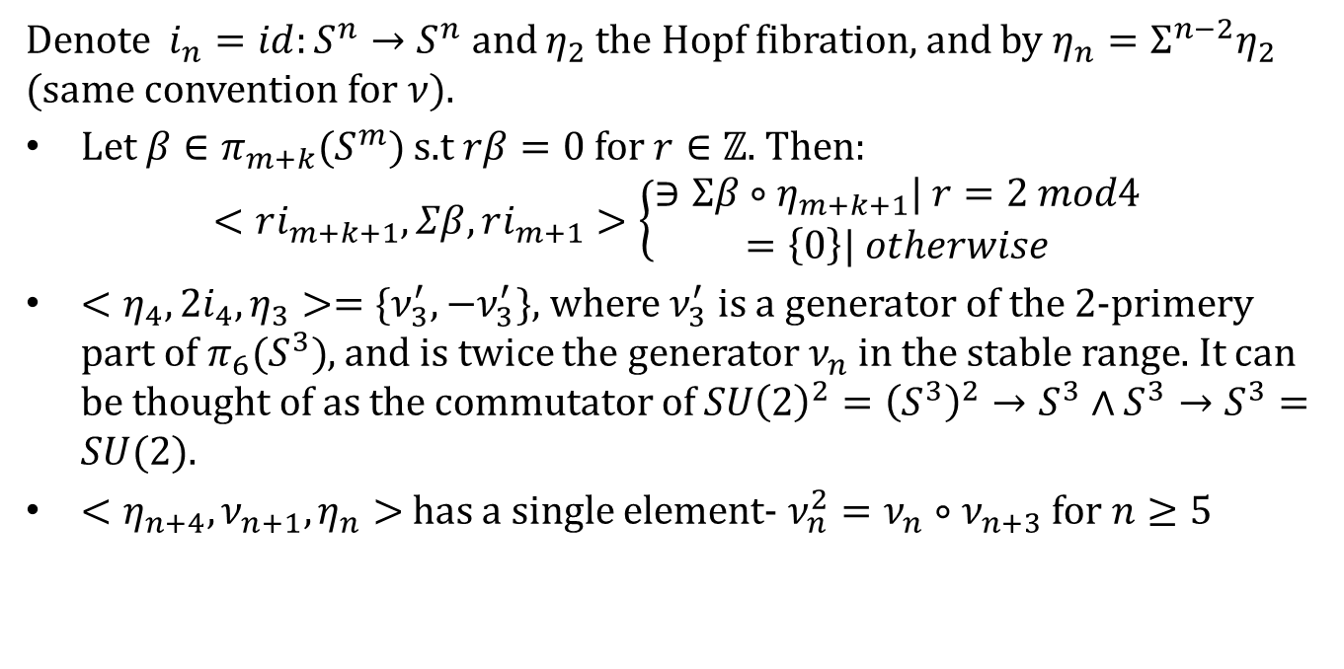
Examples from Toda’s book
Denote $i_{n}=id:S^{n}→S^{n}$ and $η_{2}$ the Hopf fibration, and by $η_{n}=Σ^{n−2}η_{2}$ (same convention for $ν$).
Let $β∈π_{m+k}(S^{m})$ s.t $rβ=0$ for $r∈ℤ$. Then:
$$<ri_{m+k+1},Σβ,ri_{m+1}>\left\{\begin{aligned}∋Σβ∘η_{m+k+1}| r=2 mod4 \\ =\left\{0\right\}| otherwise\end{aligned}\right.$$
$<η_{4},2i_{4},η_{3}>=\{ν_{3}^{′},−ν_{3}^{′}\}$, where $ν_{3}^{′}$ is a generator of the 2-primery part of $π_{6}(S^{3})$, and is twice the generator $ν_{n}$ in the stable range. It can be thought of as the commutator of $SU{\left(2\right)}^{2}={\left(S^{3}\right)}^{2}→S^{3}∧S^{3}→S^{3}=SU(2)$.
$<η_{n+4},ν_{n+1},η_{n}>$ has a single element- $ν_{n}^{2}=ν_{n}∘ν_{n+3}$ for $n≥5$

Slide 9
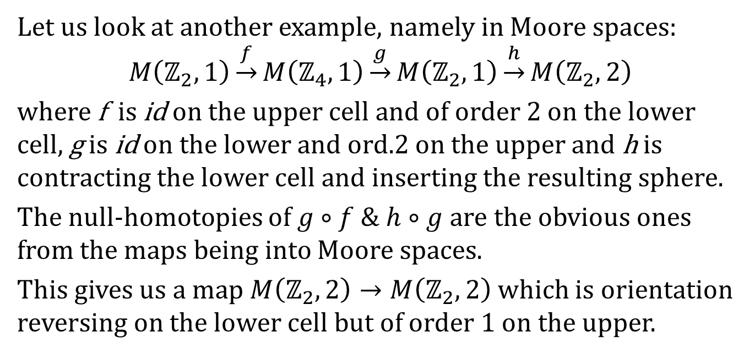
Example with Moore spaces
Let us look at another example, namely in Moore spaces: $$M\left(ℤ_{2},1\right)\underset{→}{f}M\left(ℤ_{4},1\right)\underset{→}{g}M\left(ℤ_{2},1\right)\underset{→}{h}M\left(ℤ_{2},2\right)$$
where f is id on the upper cell and of order 2 on the lower cell, g is id on the lower and ord.2 on the upper and h is contracting the lower cell and inserting the resulting sphere.
The null-homotopies of $g∘f \& h∘g$ are the obvious ones from the maps being into Moore spaces.
This gives us a map $M\left(ℤ_{2},2\right)→M\left(ℤ_{2},2\right)$ which is orientation reversing on the lower cell but of order 1 on the upper.

Slide 10
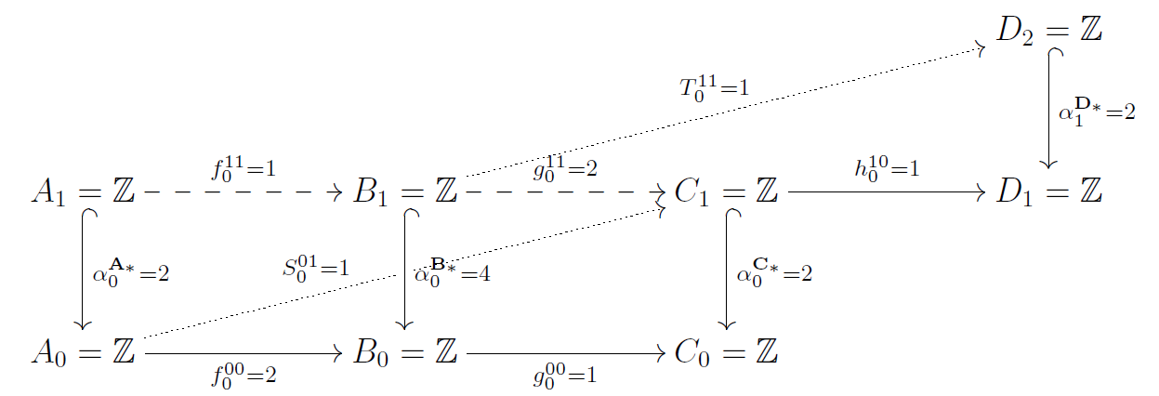
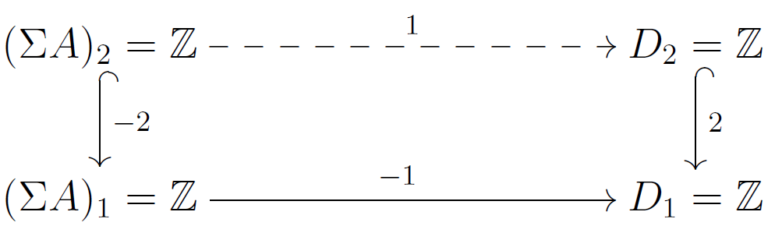

Same Example in Chain Complexes
Lets look at the corresponding operations in cellular chain sequences:
In fact, this gives us a Toda Bracket in the category Chain by the formula $<f,g,h,F,G>={(Σf)}^{∗}G+h_{∗}F$, which, in diagram, looks like:

Slide 11
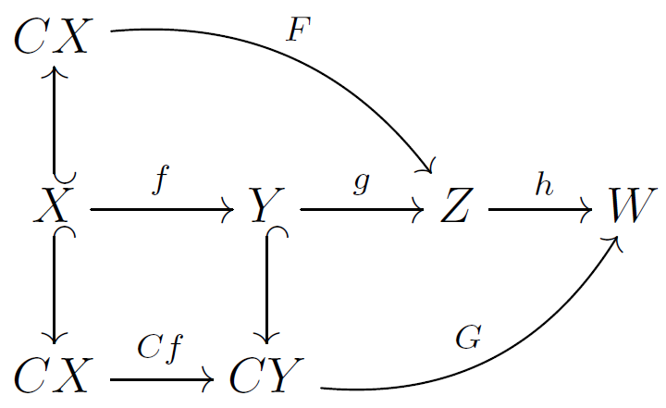
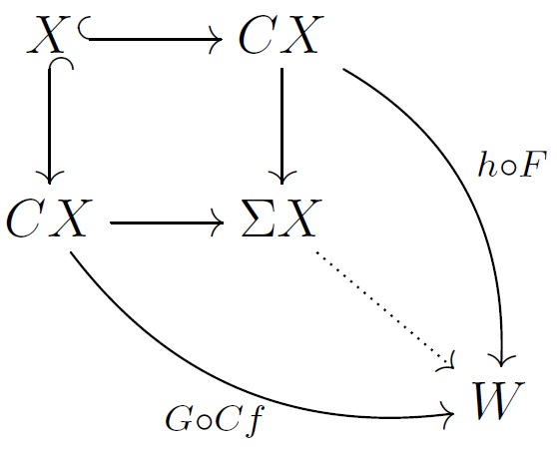
General definition of a Toda bracket
It turns put that we can define it in any category with the suitable constructions, s.a Model-Cat. or cat. with homoopy:
For any sequence as above, we have the following diagram:
which gives us the following diagram:

Slide 12
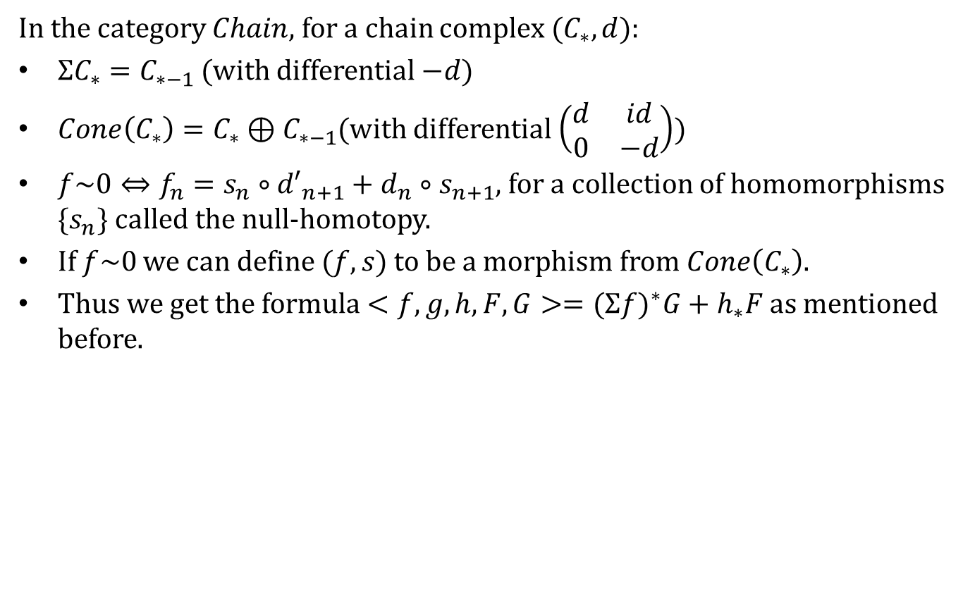
How it manifests in chain complexes
In the category $Chain$, for a chain complex $(C_{∗},d)$:
$ΣC_{∗}=C_{∗−1}$ (with differential $−d$)
$Cone\left(C_{∗}\right)=C_{∗}⊕C_{∗−1}$(with differential $\left(\begin{matrix}d & id \\ 0 & −d\end{matrix}\right)$)
$f\sim 0⇔f_{n}=s_{n}∘{d′}_{n+1}+d_{n}∘s_{n+1}$, for a collection of homomorphisms $\{s_{n}\}$ called the null-homotopy.
If $f\sim 0$ we can define $(f,s)$ to be a morphism from $Cone\left(C_{∗}\right)$.
Thus we get the formula $<f,g,h,F,G>={(Σf)}^{∗}G+h_{∗}F$ as mentioned before.

Slide 13
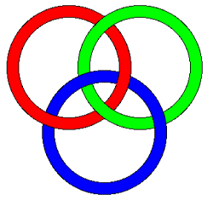
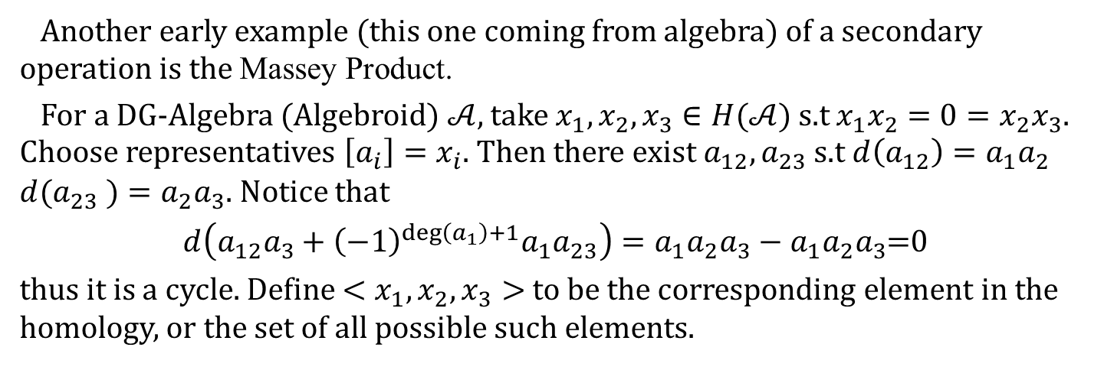
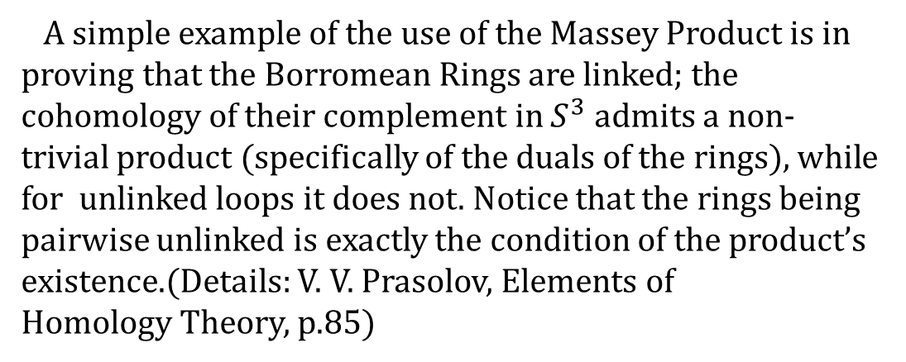
Massey Product
Another early example (this one coming from algebra) of a secondary operation is the Massey Product.
For a DG-Algebra (Algebroid) $𝒜$, take $x_{1},x_{2},x_{3}∈H(𝒜)$ s.t $x_{1}x_{2}=0=x_{2}x_{3}$. Choose representatives $\left[a_{i}\right]=x_{i}$. Then there exist $a_{12},a_{23}$ s.t $d\left(a_{12}\right)=a_{1}a_{2}$ $d(a_{23} )=a_{2}a_{3}$. Notice that
$d\left(a_{12}a_{3}+{\left(−1\right)}^{\deg\left(a_{1}\right)+1}a_{1}a_{23}\right)=a_{1}a_{2}a_{3}−a_{1}a_{2}a_{3}$=0
thus it is a cycle. Define $<x_{1},x_{2},x_{3}>$ to be the corresponding element in the homology, or the set of all possible such elements.
A simple example of the use of the Massey Product is in proving that the Borromean Rings are linked; the cohomology of their complement in $S^{3}$ admits a non-trivial product (specifically of the duals of the rings), while for unlinked loops it does not. Notice that the rings being pairwise unlinked is exactly the condition of the product’s existence.(Details: V. V. Prasolov, Elements of
Homology Theory, p.85)

Slide 14
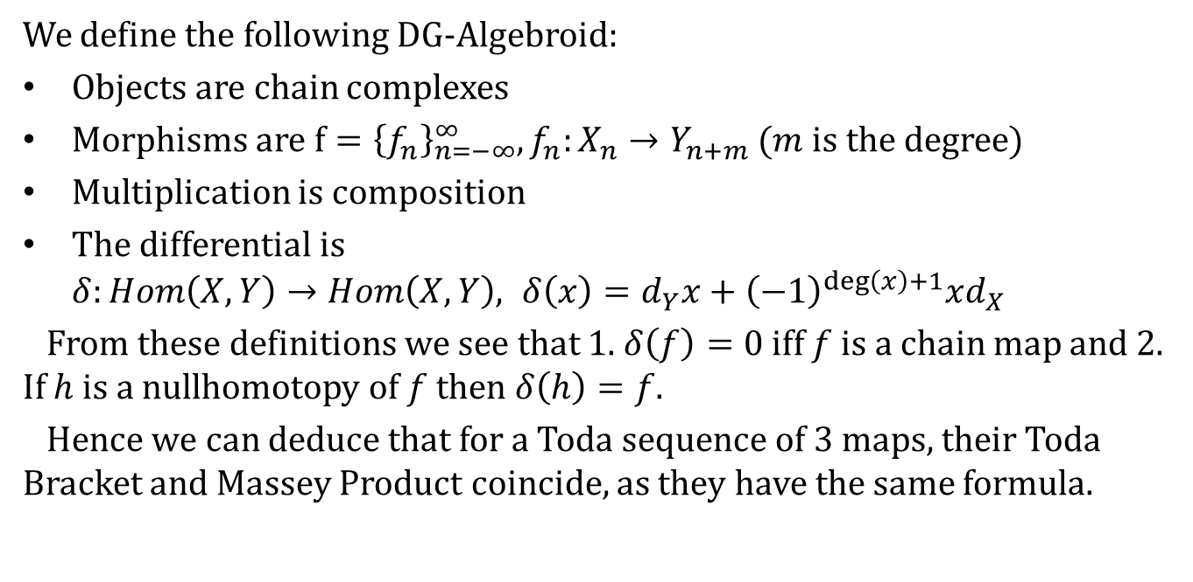
Connection to Toda Bracket
We define the following DG-Algebroid:
Objects are chain complexes
Morphisms are $f={\left\{f_{n}\right\}}_{n=−∞}^{∞}, f_{n}:X_{n}→Y_{n+m}$ ($m$ is the degree)
Multiplication is composition
The differential is $δ:Hom\left(X,Y\right)→Hom\left(X,Y\right), δ\left(x\right)=d_{Y}x+{\left(−1\right)}^{\deg\left(x\right)+1}xd_{X}$
From these definitions we see that 1. $δ\left(f\right)=0$ iff $f$ is a chain map and 2. If $h$ is a nullhomotopy of $f$ then $δ\left(h\right)=f$.
Hence we can deduce that for a Toda sequence of 3 maps, their Toda Bracket and Massey Product coincide, as they have the same formula.

Slide 15
A Philosophy of Secondary Operations
In Cohomology theory, a Secondary Operation is a natural transformation from the kernel of some primary cohomology operation to the cokernel of another primary operation (the later being, for example, Steenrod Squares).
There is no general definition of a “Secondary Operation” at the moment, but from the examples above we can see the following trend: they study the homotopy structure of a category, or what is lost in going to the Homotopy Category (same objects, maps- up to homotopy).

Slide 16

Example Continued
Recall our previous example:
In homology (which is the homotopy category of $Chain$), this just looks like:
$$\begin{matrix} 0 →0→ 0 → ℤ_{2} \\ ℤ_{2}\underset{→}{2}ℤ_{4}\underset{→}{1}ℤ_{2}→0\end{matrix}$$
which is obviously trivial.
But we remember that the Toda Bracket was non-0, so we know that some higher structure was lost.

Slide 17
Thank you!

