Slide 1
Complements of discriminants of real function singularities
Seminar in Real and Complex Geometry,
Tel-Aviv University, March 16, 2023

Slide 2
Notion of Discriminant
f: (C^{n}, R^{n},0) → (C,R,0) a real holomorphic function with singularity at 0: df(a)=0;
F: (C^{n} x C^{q}, R^{n} x R^{q}, 0) → (C, R, 0) its smooth deformation, i.e. a family of functions f_{λ} depending on parameter λ ∊ C^{q} of , f₀ ≡ f. f_{λ} is a real function (i.e. takes real values on R^{n} ) for real values of parameter λ .
Discriminant Σ(F) of family F is the set of values λ ∊ R^{q} such that f_{λ} has a critical point in R^{n} with critical value 0. Complex discriminant Σ_{C}(F) of F is the set of values λ ∊ C^{q} such that f_{λ} has a critical point in C^{n} with critical value 0.
Obviously, Σ(F) ⊂ Σ_{C}(F)∩ R^{q} ; (maybe a strict inclusion).
Or: for any λ ∊ C^{q} , consider the zero set of corresponding function, V_{λ} = f_{λ}⁻¹(0), then complex discriminant Σ_{C}(F) is the set of parameters for which it is a regular submanifold.

Slide 3
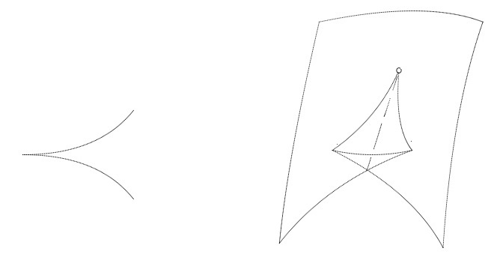
Examples
f=x³, F(x; λ₁, λ₂) = x³+ λ₁x + λ₂, discriminant = semicubic parabola (λ₂/2)²+(λ₁/3)³=0
f=x⁴, F(x; λ₁, λ_{2,} λ₃) = x⁴+ λ₁ x² + λ₂ x + λ₃, discriminant = swallowtail

Slide 4
The discriminant separates the parameter space into several domains in any of which which the real zero level sets f_{λ}⁻¹(0) ⋂ R^{n} have a fixed topology. In the case of functions in 1 variable, the “topology” is just the number of points: for x³ it is equal to 1 in the “bigger” domain and to 3 in the “smaller”, for x⁴ 0, 2 or 4 .
Discriminants occur naturally in theory of PDE (where they are called wavefronts), in integral geometry, and projective duality: the surfaces dual to smooth ones can be described as discriminants of certain families of functions and have corresponding typical singularities. (Examples for 2 and 3 dimensions).
Many important special functions of PDE and integral geometry are regular outside the wavefronts, and their behavior in different components of the complement depends very much on these components. ⇒ problem of enumeration of these components.

Slide 5
It is an analog of rigid classification of algebraic varieties
For any function singularity f, there is a class of “most representative” deformations, to which all other deformations can be reduced: versal deformations (actually any transversal slice of the orbit of the function under diffeomorphisms of argument space): it represents the local geometry of discriminant in entire function space. This deformation can be chosen in the form
F(x, Λ) = f(x) + λ₁ φ₁ + … + λ_{m} φ_{m} : λ_{i} are numerical parameters, φ_{m} monomials.
Main problem: to study components of the complement of discriminant of arbitrary (and then any) versal deformation. This is an analog of classification up to rigid equivalence in RAG (Real Algebraic Geometry), where instead of versal deformation the space of polynomials of a given degree is considered. Cf. [Kharlamov 1981] where theory of discriminants was applied to a standard problem of RAG.

Slide 6
Differences from the standard problem of RAG:
1) boundary conditions. The problem is local: parameters λ are small, functions f_{λ} are considered in a neighbourhood of the origin in R^{n}, and their behavior at the boundary is fixed and determined by f=f_{0.} .
2) functions and not varieties are considered. f and -f can define rigid isotopic varieties but are different.
3) different set of parameters. The most close analogy with RAG is when f is a homogeneous polynomial, and f_{λ} has only monomials of lower or the same degree as f₀. But in versal deformations of complicated singularities also upper monomials are necessary. Fortunately, for simple and parabolic only lower monomials are present.

Slide 7




Classification of singularities (after Arnold)
Consider first the least degenerate singularities (which occur in generic families depending on low number of parameters, or whose discriminants occur as wavefronts of generic PDEs in spaces of low dimensions.
Simple singularities and their normal forms: A_{k} x^{k+1}
D_{2k}⁺ x²y + y^{2k-1} D_{2k}– x²y – y^{2k-1} D_{2k+1} x²y + y^{2k}
E₆ x³ + y⁴ E₇ x³ + xy³ E₈ x³ + y⁵

Slide 8
Parabolic singularities
P₈¹ and P₈²: non-degenerate cubic forms in 3 variables, with 1 or 2 components in RP²
X₉⁰ , X₉¹, X₉² : homogeneous non-degenerate polynomials in two variables, vanishing on 0, 2 or 4 real lines
J₁₀¹ and J₁₀³ : quasihomogeneous polynomials of degree 6 with weights (2,1), (x³ + α x²y² + xy⁴ ) vanishing on 1 or three pairwise tangent smooth curves.
For singularities A_{k} the enumeration problem is trivial: the number of roots of f_{λ} is a complete invariant of the component, so there are [(k+3)/2] different components. For singularities with Milnor number up to 6 (i.e. D₄, D₅, D₆, E₆) numbers of components follow from explicit lists of strata of discriminants by V.Sedykh (2012).

Slide 9
Results of E. Looijenga (1978) for simple singularities
Theorem: any component of the complement of discriminant of any versal deformation of a simple singularity is contractible.
Consider the “stabilization” f_{st} of f and F by adding squares of additional variables, for example for D₅ singularity it will be x²y + y⁴ + z² . Deformation of f defines also a deformation of its stabilization, and their discriminants (both real and complex) coincide. Fundamental group of the set C^{l} \ Σ_{C} (F) of non-discriminant parameters acts by monodromy on the homology group H₂(V(λ)) of the Milnor fibers ( zero level sets) V(λ) = f_{λ st}⁻¹(0).

Slide 10
By Milnor’s theorem, this homology group is the lattice Z^{m} , where m is Milnor number of f (= lower index in notation of singularity).
Monodromy action preserves the intersection form in 2-homology of 4-dimensional manifold V(λ) (which is negative definite for simple singularities), so monodromy group M(F) is a subgroup of the group O(F) of transformations of Z^{m} preserving this form. Denote by N(F) the normalizer of this subgroup in O(F). All these objects are related to any non-discriminant λ, but the quotient groups N(F)/M(F) related with different λ, can be canonically identified with each other.

Slide 11
Also, for each real non-discriminant value of parameter λ , the group N(F) contains an important element σ induced by the complex conjugation. Its class in N(F)/M(F) is the same for all λ .
Theorem (Looijenga 1978): for any simple singularity, there is a natural one-to-one correspondence between components of R^{l} \ Σ(F) and M(F)-conjugacy classes of involutions of the lattice H₂(V(λ)) contained in this coset σM(F) ⊂ N(F) .
Remark: In classical RAG, similar methods at approximately the same time were used by V. Nikulin.

Slide 12
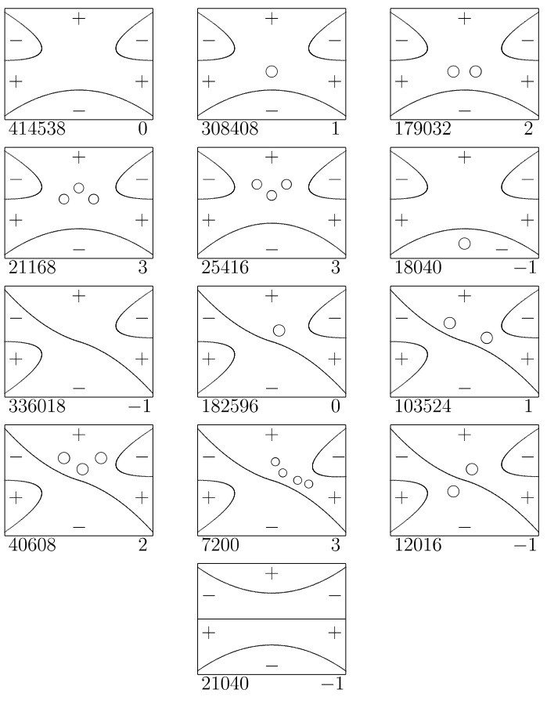
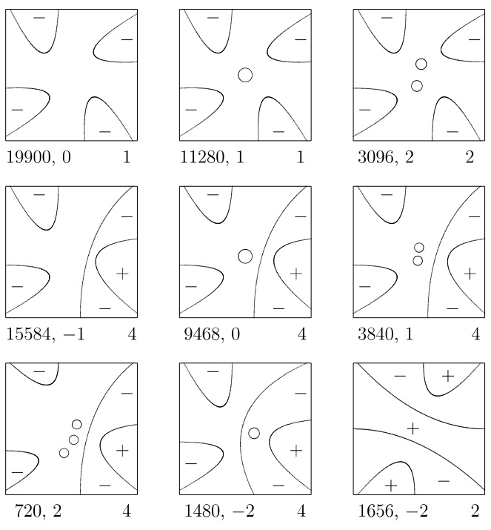
Explicit answers for simple, parabolic and X₁₀ (V, 2021-23) . Samples (for X₉² and J₁₀³):

Slide 13
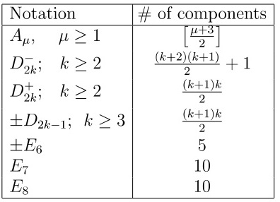
Answers for simple singularities
Topological type of f_{λ} = isotopy class of the set f_{λ}⁻¹ ((-∞,0]) ⊂ R² up to isotopies preserving the “asymptotic sectors”. Obviously an invariant of a component of complement of discriminant.
Theorem 1. For simple singularities,
topological type is a complete invariant
The numbers of components: see Table

Slide 14
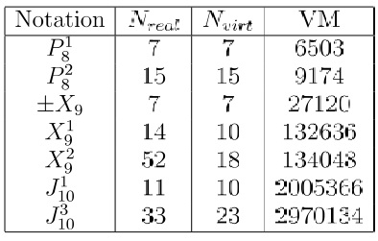
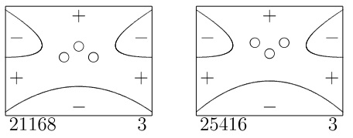
Answers (partly conjectural) for parabolic
Analog of first statement of Theorem 1 is not correct: see for example two pictures for J₁₀³ . Cases of X₉ and P₈ are very close to standard problems of affine real algebraic geometry.

Slide 15
Methods
Of guessing (and partially proving) the answers. A combinatorial program enumerating all possible morsifications of a real function singularity (see my 2017 talk in Eilat, on E.Shustin conference). Deals with virtual morsifications, i.e. topological characteristics of a Morse function formulated in terms of Picard–Lefschetz theory (intersection matrix of basis of vanishing cycles in homology of zero level set, + Morse indices of real critical points, + the number of negative critical values), applies to them all standard moves modeling the standard topological surgeries of morsifications. The data of a virtual morsification are sufficient to predict the result of such a surgery.

Slide 16
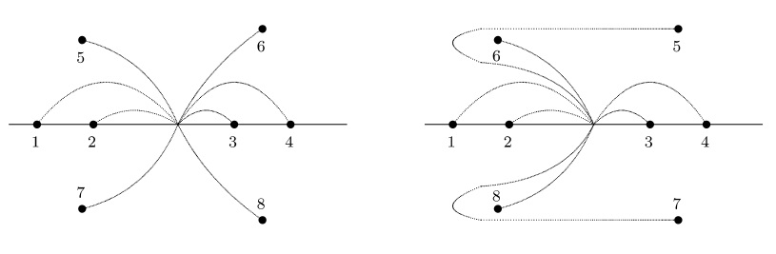

Slide 17
Virtual components: the sets of such virtual morsifications which can be obtained from one another by moves modeling surgeries not crossing the discriminant. Enumerate the virtual components and reconstruct the real ones from their topological characteristics.
A strong combinatorial invariant of components of the complement of discriminant is provided by this program: the number of virtual morsifications in the corresponding virtual component.

Slide 18
2. Of proving the completeness of the list of components: Calculation of homology groups of the discriminant: by Alexander duality the number of components of the complement of Σ ⊂ R^{l} is equal to rank Ĥ _{l-1}(Σ) + 1. (cf. Kharlamov 1981)
3. A major tool of both proofs and guesses is the Looijenga map from the parameter space to Sym^{m}(C) , associating the set of critical values of f_{λ} with any point λ ⊂ C^{n} . It is a proper map for miniversal deformations of simple singularities, so that any chain of formal moves can indeed be implemented by a path in the parameter space.

Slide 19
Difficulties with extension to non-simple singularities
Loijenga map is not proper any more, so lists of morsifications obtained by the program can be greater than the realistic one.
Conversely, by the same reason the program can in principle unite into a single virtual component the virtual morsifications related with the real morsifications which in fact are not in the same real component.
The number of virtual morsifications can be infinite (and this actually happens already for singularity X₁₀¹ which is one of two next singularities beyond simple and parabolic ones). This inconvenience can be improved by considering only virtual morsifications with restricted matrix entries.
The complexity of calculation grows exponentially: for a usual PC the bound of computability is between singularities with Milnor numbers 10 and 11.

Slide 20
References
V.M.Kharlamov, Rigid isotopy classification of real planar curves of degree 5, Funct. Anal. Appl. 15:1 (1981), 73-74.
E.Looijenga, The discriminant of a real simple singularity, Compositio Math. 37:1 (1978), 51-62
V.D.Sedych, On the topology of wave fronts in spaces of low dimensions. Izvestiya Math., 76:2, 2012, 375-419.
V.V., Complements of discriminants of simple real function singularities, arxiv 2109.12287..
V.V., Complements of discriminants of real parabolic function singularities, arxiv 2208.10929
V.V,, Complements of discriminants of real singularities of type X₁₀, arxiv 2301.16994

