Slide 1
Debugging 2.0 Direct Approach to Debugging and System Understanding
Dekel Cohen
Tel-Aviv University
dekelcohen@gmail.com
Notes:
Setup:
QuickTime .mov code (for WhyLine demo & Insight)
Flash player (Internet Explorer with Flash installed)
=====================================================================
Intro:
Imagine you are a new developer in a large company WebBrowser team, assigned a task to fix or add new functionality to an existing system.
Let’s take as an example an enhancement to the Back/Forward History in a WebBrowser.

Slide 2
There must be a better way …
Notes:
Using common tools (Eclipse/VS.NET), you will probably grep and set some breakpoints, hoping to hit the right area.
After some time, when you finally find it, you struggle with understanding who calls who and how and how the code is related to what the user is doing.

Slide 3
And there is!
Notes:
In a different time and place, where debugging 2.0 is already in daily use:
You launch the browser, click the Back button and immediately jumps to the feature relevant code. You can inspect the code that actually executed, see who calls who and examine the data
Questions:
) Looking at a method you think should have executed: Why wasn’t this code executed?
) Where did this value come from?
) In case of a regression (bug): What source code have changed during the past few days that is relevant to the Browser history module?
A Primary goal of this work is to try to get the developer easy answers to some of the “natural high level questions” asked during debugging and system understanding. Today, developers have to go to great lengths to dig the information using existing tools, such as debuggers or the developer’s best friend - printf
Research prototypes that attempt to answers such questions usually incur huge runtime overhead rendering them unusable in a daily usage, we will describe techniques that minimizes runtime overhead.
We will also try to build the basic tools that don’t rely on existence of automated test-suite and can help when accurate and up-to-date code level documentation is not available. More advanced statistical tools, do sometimes depend on large number of executions.
No tool is an Island – Many of the existing tools we will see are stand alone tools. Since different tools have strengths and weaknesses , it is not enough to even build Eclipse plugin for each. We will see for example how tracing interacts with search, debugger and code browsing.
And Finally, easy of use is of importance, because developers will generally try less demanding methods first. Since dev doesn’t usually know in advance if using a certain method will succeed, there is less motivation to invest heavily in harder to use and long preparations.

Slide 4
Outline
Motivation
Mapping Application ⬄ Code
Existing Tools and Techniques
Related Work
Proposed Solutions
Summary
Notes:
In this talk, we will examine the difficulties of working with existing tools, as well as their advantages, continue with related research work and move to advanced tools and proposed solutions.

Slide 5
Motivation
Fault Localization and Fixing
Detailed design: Enhance existing system with new functionality
How to: Follow example from another system
Technical investigation: Effort estimation / Risk assessment
How stuff works?
Notes:
TODO: Reference: analysis of the difficulties of practical code comprehension (Lakhotia, 1993).
The common prerequisite to all the activities above is some level of system understanding
Example: Solution architect (who doesn’t work on the product development team) investigate customer request.
Example: Effort estimation for Porting project (Eclipse to VS.NET using IKVM)
~ 1 million lines of code to investigate, understand some of the subsystems in order to prepare porting plan.
More:
Integrator , Chief Eng, Chief Arch and Escalation Eng (2nd level support) roles – touches many parts of the system – briefly
Academic research – need to implement Eclipse Plugin for research – doesn’t know the relevant parts in Eclipse.
Prototypes leverage existing systems, such as GCC or Linux kernel, modifying them in specific places.

Slide 6
The Goal
Create mental simplified model of relevant flow and functionality
And locate the related source code
Notes:
If you achieve that – don’t need all the tools we are going to talk about
Experts in a relatively small systems / specialists in specific modules
Maintaining Mental Models: A Study of Developer Work Habits - http://research.microsoft.com/pubs/74240/p492-latoza.pdf
“Developers go to great lengths to create and maintain a mental model of the code, and knowledge is shared between developers through face-to-face communication and the code itself.”
“Exploring code is made difficult by tool limitations and difficulties traversing relationships”

Slide 7
Not my code
Software systems are complex and mostly unknown to the developers.
3rd party / Open source libraries
Other teams code
Hosts vs. Plugins
Legacy systems
New Hires
Business conditions: Offshore, M&A
Software Systems are simply too complex ☺
Notes:
Dependencies (libraries - 3rd party / Open source) – Bugs and Unexplained behaviors of the code in the layers below yours (not my code) are much harder to understand.
In 2002, the National Institute of Standards and
Technology estimated that testing and debugging
account for 30-90% of software development costs,
further finding that the average error takes 17.4 hours
to find and fix [19].
Many projects are Extensions (Plugins) to: Eclipse/VS.NET , Application servers (servlets/web apps), SharePoint, Office (Lotus Notes/Outlook)
Legacy systems - developers (or their minds) are long gone.
New Hires - get up to speed with new technologies

Slide 8
Local Understanding
Luckily, we don’t have to understand all of it
Only the relevant module or function.
But How?
Notes:
TODO: See related work http://dub.washington.edu/djangosite/media/papers/tmp8BioCV.pdf
Problem: Littman et al. (1986) it was shown that the as needed
strategy (local) does not afford the programmer sufficient knowledge about the causal
interactions of the program’s functional components, and therefore often leads to unsuccessful
modifications.
TODO: However, cannot understand the entire large program, so von Mayrhauser and Vans suggest
that building tools to make opportunistic understanding less error-prone should be an
important goal for research (von Mayrhauser and Vans, 1993).
Sillito extended this finding [1], showing that developers seek “focus points,” or places in code related to the developer’s goal. A similar study framed program understanding as “fact finding” [2], driven by efforts to discover properties of a program.
[1]Sillito J., Murphy G.C., & De Volder K. 2006. Questions programmers ask during software evolution tasks
[2] LaToza T.D., Garlan D., Herblseb J.D. & Myers B.A. 2007. Program comprehension as fact finding

Slide 9
Understanding Today
Use the product
User Documentation
Monitor inputs and outputs
UI Spy
Search & Browse Source Code
Decompile (if no code and if possible)
Technical Documentation
Google : Formal and Informal (Blogs, Forums)
Place Break Points and Single Step
Logging
Ask someone who knows
Take a look at some pros and cons
Notes:
TODO: Motivation: Dynamic techniques – also suitable for dynamic languages
Technical and Product leaders often don’t even read the code - they create a mental simplified model of the flow and functionalities
* We may claim that in part it is good, but the flip side is that they cannot quickly get at the code.
Logging: Generic (Intellitrace) vs Custom
Custom: Higher level, but never available at the place you need it.
Most useful in server applications, in production, support and when code is not available.

Slide 10
Search & Browse
Grep for a keyword
Easy to use with immediate feedback
Great potential – Think Google
Ranking, Did you mean xxx?
Relies on familiar naming conventions
Cache <–> Pool, Cache Items <?–?> Swimmers
Static: Results may be completely irrelevant to the behavior at interest
Notes:
Grep and similar textual searches are very commonly used by programmers (Sim et al., 1998).
How developers search for information in code and docs : http://leannagingras.com/GingrasL-AnnotatedBibliography.pdf
Pros:
Easy to use with immediate feedback – mucho importanto
No need to setup live system to explore
important when there are several versions and only the latest is readily available on dev machine
Systems are not easy to build and setup for source level debugging.
Ex: Took several hours to setup Social connector on RTC 2.0.0.2 (old version) and debug it
Cons:
Static – results may be completely irrelevant to the behavior at interest
Searching and Browsing in an unknown large code base – easy to get lost and spend a lot of time.
Runtime data is not included – only code and configuration files, as well as some input data (database search)
Requires knowledge of jargon – systems uses different names and keywords to express the same concepts
Ex: Cache – Pool, Cache Items – Swimmers …
Today’s Search tools are overly simplistic – no ranking, link analysis, did you mean? … unlike Web Search engines
Submit the same query to several search tools : Desktop, enterprise, Web, database, registry …

Slide 11
Debugger
Single Step
Watch variables
Breakpoints
Conditional and Read/Write data breakpoints
Trace points
Finally, some tools ☺
Notes:
Conditional and Read/Write data breakpoints – interesting, because they allow to bypass the control flow and concentrate of the data flow.
Pros:
Controls the flow and allows detailed examination (stop, cont, set another bp)
Examine most data (except complex data structs – need Visualizers and Print/Dump/Logs)
Experiment - Limited ability to change (Fix and Continue)
Cons:
Needs prior source level knowledge (Where to place bp)?
Sometimes an educated guess following a search
Incomplete, highly narrow window
Stepping into and over code is tedious
Cannot navigate and browse naturally – only where the execution takes you.
Setting several bp in a large code base – hard to know the relationships and what happens in between the stops.
Interferes with MT timing and UI redraw operations (if debugger window on the same screen as the debugee)

Slide 12
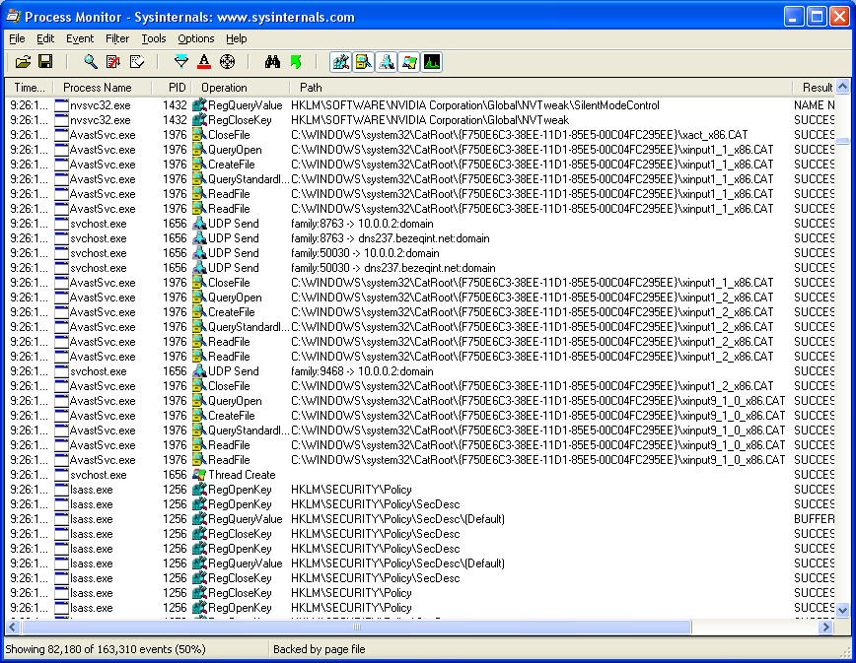
Process Monitor
Finally, some tools ☺
Notes:
File system, registry, windows events tracing, processes.
Low to Medium overhead
Limited stacktrace and source code mapping (only native stacks – no Java)
Pros:
System info (network, file system, registry)
Easy to configure and start a trace (but not to analyze and understand)
Source code not needed (customer site, reverse eng, other team code)
Works for many runtimes (not language or runtime specific)
Cons:
Very partial view (closed set of events)
Low level (partly because not runtime specific)
User has to map Application functions to system level events – expert level.
Lots of info – sometimes hard to interpret
Dtrace supports extensibility via the d language – allows to customize the tracing (but wait. Do you know how to program in d?)
Even if you study it, will you remember it in six month where you don’t use it on a daily basis
See example of how complex it is: http://developers.sun.com/solaris/articles/dtrace_example.pdf
Solaris and Partial Linux port.

Slide 13
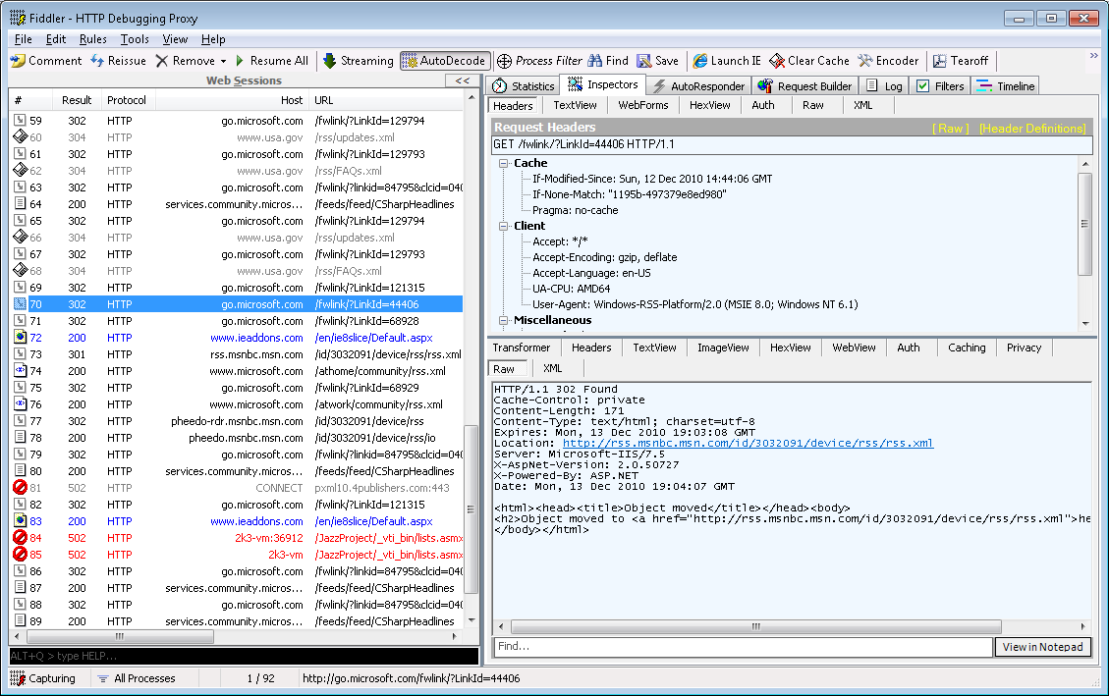
Fiddler
Finally, some tools ☺
Notes:
Http sniffer – Pros and Cons similar to Process Montior, execpt Fiddler output is simpler (restricted HTTP domain) and easier to understand.
Pros:
Fast
Generic (not language or runtime specific)
Easy to use (collect and analyze)
Source code not needed (customer site, reverse eng, other team code)
Cons:
Very partial view, low level (partly because not runtime specific), lots of info – sometimes hard to interpret, specific execution, doesn’t map http requests to source code.

Slide 14
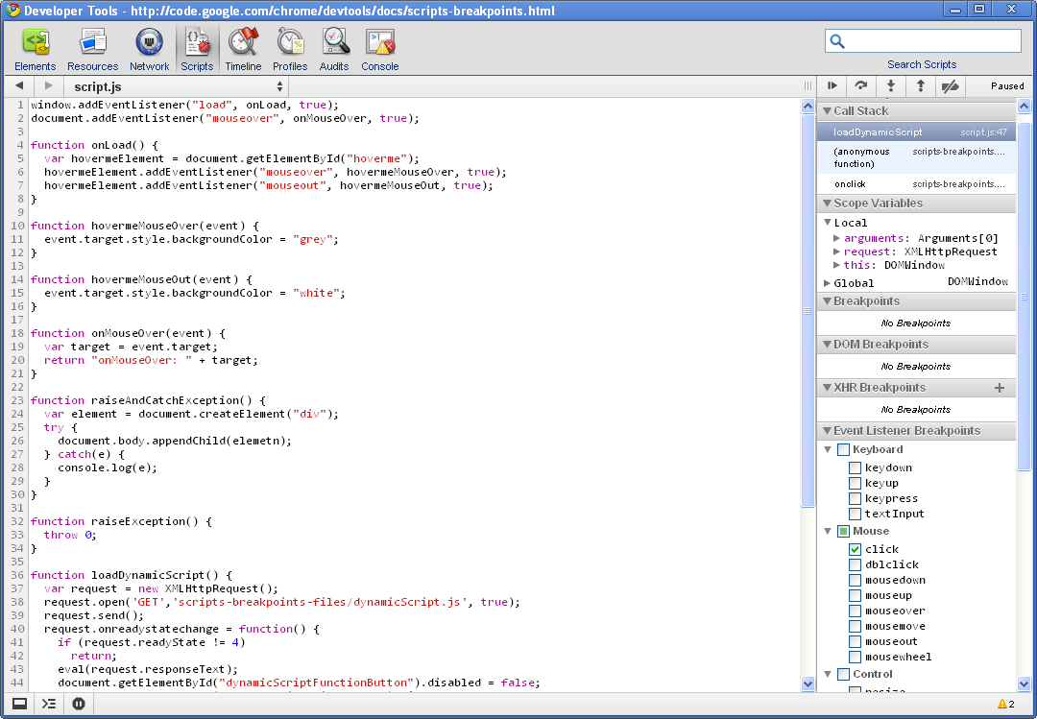
Google Chrome Developer Tools
Spy and Debugger
Notes:
Video: Google_Chrome_Developer_Tools_Breakpoints.swf
Chrome Developer Tools (Firebug for Firefox) is a JavaScript debugger and Spy for Web Browser applications
Spy is a tool that supports selection of visible objects to inspect their internal state, and listen to their events. There are Spy tools for all major UI frameworks, and some applications specific spy.
Pros:
Intuitive – point and click to inspect an element
Breakpoints on events – click on a button → stop in event handler source code
Breakpoint on Next JavaScript Statement
Breakpoint on Exceptions \ Uncaught Exceptions – supported also by Traditional debuggers
Breakpoints on DOM Mutation Events – Browser DOM is mutated via JavaScript
Cons:
Spy (Desktop and Web) is targeted at UI applications (vs server, compilers and tools, algorithms …)

Slide 15
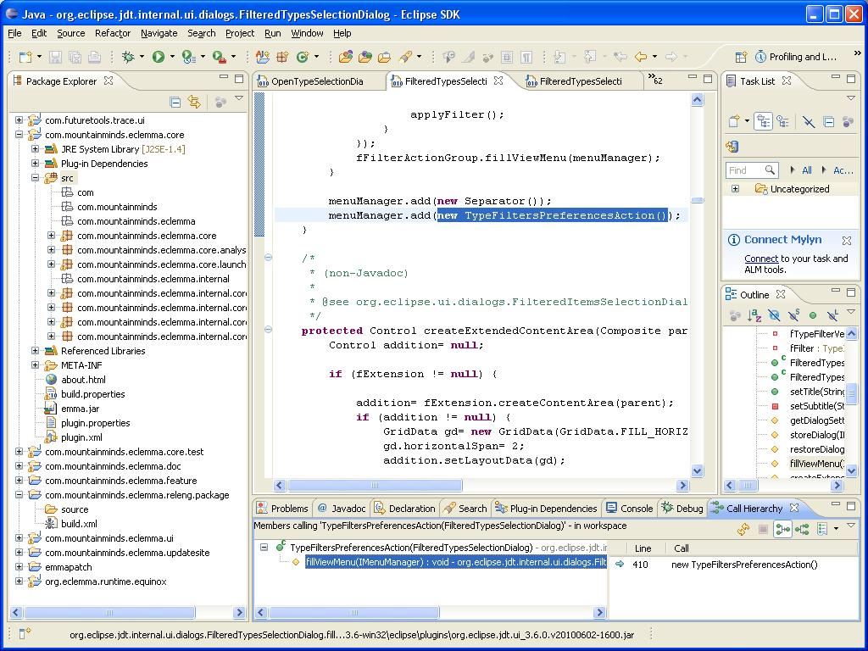
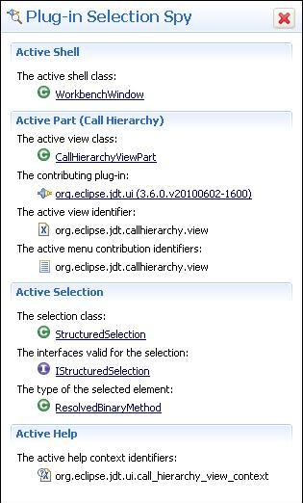
Eclipse Plug-in Spy
Finally, some tools ☺
Notes:
Hover over an Eclipse view or menu item and get to its entry point source code in one click – very useful and impressive!
Pros:
Spy is the most direct and natural mapping between product features and code.
No prior knowledge required
Not even terminology to phrase a query (unlike Search)
Cons:
Specific: Not even generic UI element – only for Eclipse Views and Commands (Menus & Toolbars buttons).
There are other Spy tools more generic (but not as friendly and source code mapping)
Requires significant custom programming to add new elements
For UI framework with designers, such as WinForms and WPF or MSAccess – the design view is similar to runtime view – thus the developer can easily move from UI to code.
Office (C++ Win32), Java-SWT, Web -

Slide 16
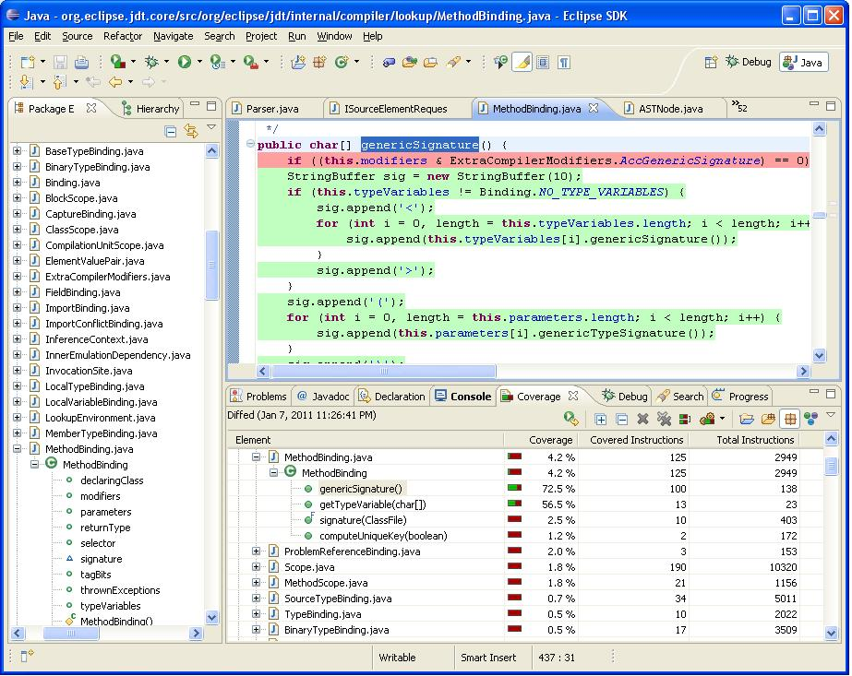
Software reconnaissance
Finally, some tools ☺
Notes:
Software Reconnaissance: Mapping Program Features to Code NORMAN WILDE AND MICHAEL C. SCULLY (1995)
Coined the name: Map Program features using set operations on coverage analysis data results of multiple executions.
Diff for isolating program feature
Intersection to highlight common code (ex: base libraries). It helps also in preventing regressions (in the other features) when fixing code.
Related search terms: “feature assignment”, “program comprehension dynamic analysis”
Emphasized Test Cases (as opposed to interactive manual testing/development cycle)
Funny: Name origin: Experienced maintainers do not seem to be too uncomfortable with the concept of regarding the program as an enemy whose secrets need to be extracted at some cost in casualties!
Provides a starting point for developers to focus their exploration on relevant code. In the simple case, it may be enough to pinpoint the exact location of interest.
Tripoli - Differential Code Coverage - Kaitlin Duck Sherwood and Gail C. Murphy, University of British Columbia
Eclipse plug-in, Instruments Code Blocks – boolean flag (executed) per codeblock.
Example:
Where is the code inside Eclispe JDT compiler that processes a generic method parameters : private <T> T printTest(T a)
Results:
Software Reconnaissance articles I’ve seen concentrate on measuring the relevance of the identified code (as rated by domain experts)
Locating Program Features using Execution Slices Eric Wong, Swapna ,…
Tripoli tries to conduct a user study, compared 6 experienced programmers (without the tool) with 6 students (with the tool)
Attentiveness problems (students) – 1 or 2 didn’t even use the tool (as instructed)
Good: Resize handler: only one of the professional programmers ever saw endResizingFrame() and it is not clear if he noticed it. By contrast, all of the subjects in Experiment #2 were able to find endResizingFrame()
Good: Arrows: Without the tool, it was hard for the professional programmers to understand that setAttributes method executed when menu clicked.
Bad: Non-GUI output task (Change the output for number of fields to be two bytes instead of four) – some participants didn’t started the task, some didn’t finish (in the 2 groups). Hard to say if the tool improved productivity.
Programmer Difficulties: This and other studies show that developers often fail to statically trace / effectively use the debugger to identify executed code and the order of calls, as well as relationships (who calls who, Class hrr and objects involved).
Pros:
Supports all types of programs
Low runtime overhead
Set Difference: identify code unique to execution
Browsing: Coloring branches that really executed (or specific to a feature – diff) really focuses developer code browsing
Cons:
Problem: Diff/Intersection : Cannot isolate code always executed (ex: initialization/startup code, post dominator stage of a pipeline filter)
Workaround: Refer to String bp and Spy (+ Search)
Note: Can Identify All Shared components (Utility/Base/Core), but not part of them (e.g Symbol table init)
Coverage is per class – not per object instance. If Coverage is not the same in different object instances, it will show a union of all covered.

Slide 17
Better Software reconnaissance
Call graph
Loops
Noise and Ranking
Multiple threads
Logical stacks
Call Hierarchy and Search
Regressions Isolation
Notes:
Dynamic Feature Tracing: Finding Features in Unfamiliar Code by Andrew David Eisenberg B. A., Rice University, 1998
Developer maps tests from comprehensive test suite to features and then asks to locate the code.
Has Dynamic Call Stacks, Dynamic Call Hierarchy, Ranking heuristics (different from the above ranking) + some integration with JQuery (code exploration and query plugin for Eclipse)
Con: Assumes comprehensive test suite + dev has to map tests to features.
Overhead: Not very large (2x), but is prohibitive in some scenarios (slow system, collection of data in production ...)
Feature location using probabilistic ranking of methods based on execution scenarios and information retrieval (2007) Denys Poshyvanyk , Yann-gaël Guéhéneuc, Andrian Marcus
Combine Static Search (LSI) with coverage recon (code belong to a feature if it appears more frequently in exhibiting than non-exhibiting scenarios). Results from Mozilla (C++) and Eclipse (Java) code base where (at least in Mozilla) it improves on both methods considerably.
Next, we will describe techniques for obtaining a lot more information without incurring significant overhead. We also discuss how to effectively present the information to the user and combine it with existing tools.
Coverage information is a bag of executed functions and code block:
Who calls who (Also Multiple threads) ? Where to start?
Solution: Dynamic Call Hierarchy gives a good approximation of callers-callees.
Problem: Reflection is not supported and cannot map multi interface callsites to multiple concerete interface implementation methods.
Solution: For the cases above, save, on the callsite, the callee address (perf: JVM change needed in interface dispatch and reflection code)
Pre-allocate counting potential static/polymorphic callees (don’t record more than a few)
Stack walk to obtain caller (usually 1 frame – fast). Note: JVM change needed to efficiently implement it
J9 JVM modified for instrumentation collection http://www.research.ibm.com/qvm/papers/oopsla08.pdf
Cons: Doesn’t pass through un-instrumented code, but stack walk from caller also shouldn’t cross un-instrumented code. Call via interface pointer (poly) or reflection requires recording several callees, but this rare and if 2 threads race, they usually call the same callee.
How many times a block was called?
Relevant also in case code is always already covered and only then the scenario of interest starts (and we don’t want reset coverage in the middle)
Solution: Loops: Count instead of coverage boolean – represent as a secondary diff.
Multiple Loops – sum the total amount of executions of loop callers.
MT: Counter may lose (drop) some increments, because we don’t want to lock or use expensive atomic operations (Interlocked), or – we take cov per thread, in that case no MT conflicts
Diff can still result in a lot of noise
Recording starts at application launch and ends when app exists – no facility filter by time-range or event-range
Solution: Record time or event-range
Note: Starting the feature-scenario recording at some arbitrary point in the middle only decreases the diff (code that only executes at this scenario). There is no problem with the non-feature scenario to be recorded in enclosing (wider) time/event range. The other way is not true.
Markers: Instead of running twice, start with the thin run (non-feature), place a marker and continue with the feature specific code – now diff before and after the marker.
Current Ranking by % coverage within class sometimes results in very small utility methods high
Solution: Improved Ranking: Rank higher diffs that are more likely to be directly related to the feature:
Rank higher diffs that are higher in stack trace (more likely to be high level code than utility code or noise)
CovRank: If a feature is split across several classes that each has low % of methods executed for the feature – they still call each other. Rank higher diffs that calls into a graph of many diffs.
Rank higher methods and classes with larger diffs (abs and/or %). Many irrelevant diffs are very small.
UI - Tooltips and UI that is dynamic and changing may generate a diff.
No Immediate direct feedback – Need 2 complete executions of the monitored program
Not suitable for long running programs
Solution: Record time or event-range (above)
Multiple threads – irrelevant work (Background threads and scheduled Tasks: Eclipse source code indexer) generates a diff.
Solution:
User Filter out background threads
Causality – associate async Tasks to its originating thread by keeping the originating stack trace in the task object.
UI: Display the Task as an expansion of the original thread.
Has applications to Debugger (logical stacks) and Logging in general
Note: If feature-scenario indirectly triggers a task (say it listens to changes caused by scenario), it is a special case of Task spawn, that is not covered by Logical stack (unless programmed to)
Substract many recorded non-exhibiting feature coverages – they probably have the background task as well.
Implementation: Each thread has cov tables (similar to emma, but per thread).
TLS: Native __declspec( thread ) was order of magnitude faster than Java and .NET HashTable based TLS
Array in TLS: Each class has a null ptr (lazy init) that contains all its code-blocks. Array is init in Thread.run
Problem: Same thread is reused for Tasks/Jobs.
Solution: Causality: Associate task coverage with the originating thread (that called Job.schedule).
Tasks write cov data to their originating thread tables with a special mark (cov also by task).
Problem: Lazy init is problematic, since the same cov-datastruct is accessed by originating thread and all child tasks
Solution: Use Atomic initalization.
Problem: Developer Studies show, that the Static Call Hierarchy / Call Graphs are overwhelming because of their branching factor “Answering Common Questions about Code” Thomas D. LaToza CMU 2008 http://www.cs.cmu.edu/~tlatoza/icse08ds-final.pdf.
Solution: Filter / Highlight Eclipse Call Hierarchy, which currently don’t even eliminate infeasible paths statically.
If caller-site was executed – green
If caller-site was not executed, but its function was executed (caller-site control dependence branch to else instead of if) – yellow.
Search only inside and around executed code (ex: include comments around)
Combine Ranking from search and Ranking from CovRank (needed even if search only inside and around executed code)
Regressions Isolation: Cannot difference between different version of the same application
Generalize the tools to allow comparison of different application versions
More about debugging and regression analysis later
No UI mapping to code – unlike FireCrystal, doesn’t map source code to UI or to other program outputs.
We saw Spy and will see more solutions later on.
Example: We know that the e-mail processing code used some e-mail client api (we don’t know which one)
Feature isolation (flow-diff)
Q: Where did MyCode first accessed a some third party api methods ( com.ibm.*. )
Search for every call-site in executed code which is from com.<my company> to com.<other company> or org.<not eclipse>, excluding JDK and base libraries.

Slide 18
More data
Coverage data
Better Software Recon
Full Tracing
Notes:
We will now see techniques and tools that collect much more data – such as method parameters and variables values.

Slide 19
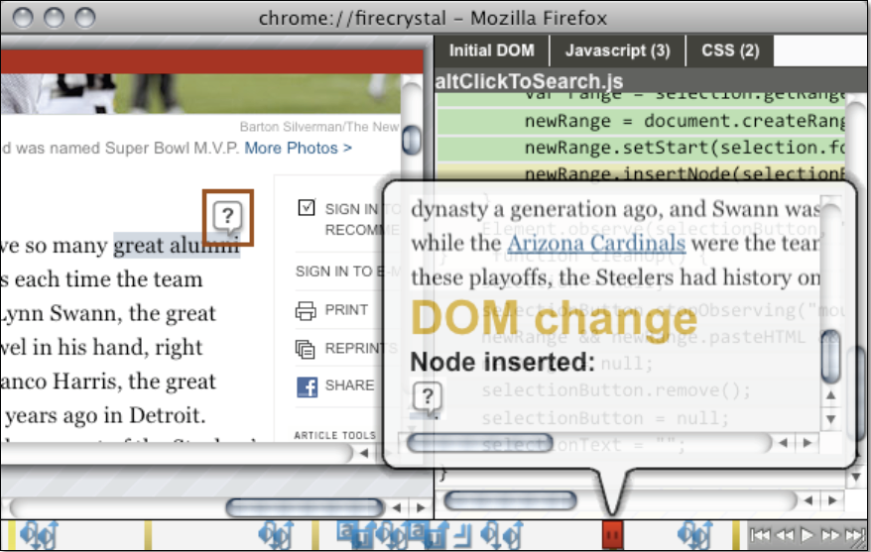
FireCrystal
Finally, some tools ☺
Notes:
Research prototype from CMU by Stephen Oney and Brad Myers.
First tool we have seen that records interactive application behavior and map it to the source code.
Cons: UI only (applies to WebUI), Unacceptably slow (records every JavaScript instruction)
Figure 1 - FireCrystal replaying an interaction with an article on the New York Times website
(http://www.nytimes.com/). In this interaction, the question mark box (outlined in red) appears after the user has
highlighted a phrase (“great alumni” in this case). The timeline on the bottom of the screen shows user input events
(in blue, from left: mouse down and up events, keyboard keys down and up, and window resizing, etc.) and DOM
changes (as yellow bars). As the user drags the timeline handle (in red) to different times, a callout box gives more
details on the event, the interaction is shown on a clone of the web page (left panel), and relevant code (Javascript,
HTML, or CSS) is highlighted (right panel)

Slide 20
WhyLine
WhyLine demo - whyline-java-demo-web.mov
Answers High level questions about code
Time line visualization
Why not executed
Notes:
Andrew J. Ko and Brad A. Myers (2009) Finding Causes of Program Output with the Java Whyline.
Results : User study: Why Color is not correct task - took half the time with WhyLine for novice programmers (control group are experts)
Why didn’t execute?: Method wasn’t called, Codeblock wasn’t called (dominating if statement branched the other way),
Pro:
Start from UI (Spy like easy of use) – point and click
Backward Dynamic slicing like techniques for debugging.
Questions seems to help focus developer and highlight possible directions
Why not executed
Cons:
Huge runtime overhead ~ 10 times slower and many GB of trace files in a modern app.
UI only & framework specific (specific Java UI framework emulator)
No flow-diff
Ex: Tripolli resize study task: It will not help directly in discovering that in order to update window rect in statusbar → resize message handler is the place, because you can’t flow-diff between a session with and without resize.
Note: Even if there is “why is the size width by height” question, the resize event is not the cause of the resize. Status bar update is not yet implemented, so will not be able to query on it.
No integration with other tools (search)
Why question format is not generic:
No extensibility
Why not executed algorithm schema
if the method of the instruction being analyzed was not executed within the time
chosen by the user, there are few potential reasons why:
• It has no known callers (although such a call may exist, but its
class may not have been dynamically loaded).
• A caller of the instruction’s method’s did execute, but on a
different instance.
• None of the method’s callers executed; the algorithm then
recursively explains why each potential caller was not reached.
If the instruction’s method was executed, there are many possible
reasons why the instruction was not reached:
• The method executed, but the instruction of interest had not yet.
• A caught exception jumped over the instruction of interest, or
the method exited because of an uncaught exception.
• None of the instruction’s control dependencies executed (such
as an if or switch); the algorithm recursively explains why
none of these control dependencies executed.
• One of the instruction’s control dependencies did execute, but
jumped to the wrong target, skipping over the instruction.

Slide 21
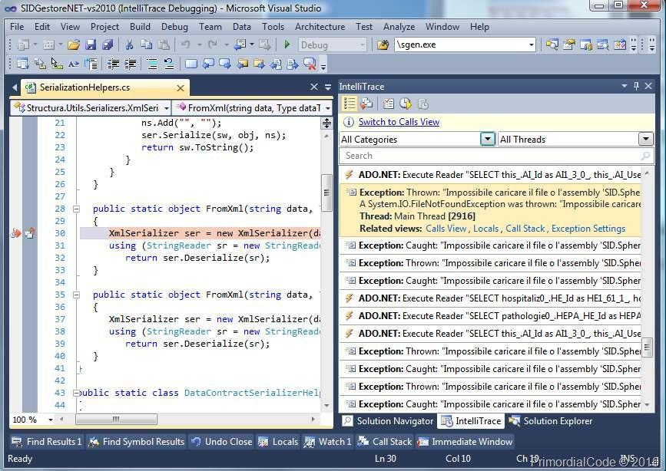
Intellitrace
Notes:
Microsoft Visual Studio 2010 – Trace high level events and method calls with arguments information
Tries to trace less but maintain reasonable runtime overhead (but not code blocks or assignments).
Pro: Some UI and good integration with debugger
Con: Cannot start and stop tracing once the process has started
Hard to selectively trace certain parts of the app
Con: Hard to map trace to application UI / outputs
Con: But no real search integration (except in events) – cannot search source code or argument values of traced methods
Con: Tracing only (without flowdiff or Spy and search integration) generates Gigantic amounts of info that are not comprehensible.
Con: trace ONLY method entry + params (CodeBlocks: large functions such as get_token has cases for different flows)
Cannot drill down if need to to block/variable level
Con: Logs every parameter (arrays, long strings/buffers) without static analysis. Doesn’t work if – need to selectively add interim assignments to large datastructs between logging points
Con: In general full tracing has huge overhead ~ 10 times slower and many GB of trace files in a modern app
Note: Intellitrace demonstrated reasonable overhead for small UI apps, but not for larger apps (SharpDevelop IDE)– for method entry/exit only
Pro: May be useful to MT hard to repro cases, to step backward (there are other tools like ODB and Spyder for that – very slow)

Slide 22
Recap
Research enhance commercial tools:
Mapping UI to Program Code
Query Data Flow
Explore Execution Flow
Higher level / less detailed then debugger
Finally, some tools ☺
Notes:
Cons: Huge overhead ~ 10 times slower and many GB of trace files in a modern app, UI specific, no flowdiff, no extensibility, no integration with other tools (search)
Summary for existing methods: most developers don't even use the basic tools (such as Process Monitor)
Not integrated with the main toolset (editor/debugger/compiler)
Perceived as a bag of utilities
Not standard in any way
Require expert knowledge to efficiently utilize

Slide 23
What’s still missing?
Low overhead, detailed tracing
Filter by / Highlight Trace information
Search, Editor, Call Graph
Combine Debugging, Tracing, Custom Logging and Spy
Code browsing assistance
Overlay execution and repositories data onto the code
Investigate Regressions - Diff between versions of the same application
Notes:
Search & Call Graph:
Filter out code not executed in the Fat run (the execution of the feature of interest)
Highlight code – only in fat run, both, only in thin run
Editor – show all code with highlights (as Tripoli should have been) .
Assumptions:
Re-execution is possible (repro)
Doc: Code is not very well commented (otherwise grep should do the job)
Doc: Missing detailed Requirement/Spec to Code Tractability & Doc is partial at best
Getting developers to the relevant area and narrow the search/browse scope, but not to point at exact root cause increases productivity significantly
While good automatic unit tests are helpful, the tools and techniques presented don’t depend on them (especially for UI applications). This is not an assumption:
The developer is not necessarily an expert for the relevant (small) module or doesn’t have convenient direct access to one.

Slide 24
Spy Example
Trace elements
I/O Break/Trace point and Stack traces
UI events (creation / visibility / resize / focus)
Console output
Sniffer packet
Extensible Spy Information
No UI and No extended debug info? →
Notes:
Chrome Developer Tools is really pushes debugging capabilities forward. Still, if we add some advanced tracing & extensibility we can handle more types of bugs
Example:Browser navigation bar select-all-text (Debugger Integration) : On set focus to a textbox, select all text within the navigation bar (url)
Problem: Didn’t work: text.selectAll() succeeded, but the text was not selected.
Tool support: Point in spy to the textbox, right click to trace all instance methods, field writes and events
Appear in Spy tool along with messages from other application (another process could have sent a message to clear the selection).
Principle: Combine My Code trace in the bigger picture of system trace (that already exists today in Spy++ or Process Monitor)
Solution: Now it is clear that mouseUp event called text.clearSelection() and removed the selection.
Development style: When want to implement an event/message handler that appeared in the trace – right click | create handler.
Extensible Spy Information
Higher level abstraction – Today spy tools handle predefined set of objects, events (ex: html elements)
With extensibility, we can attach state information, code-location (stack traces, method name) to a visible logical element (ex: report subtotal) to allow Spy user to observe the state and events on object selection.
Accessibility technologies :support screen readers by attaching semantic information (such as roles) to UI elements.

Slide 25
String Theory
Break/Trace on UI visible or packet strings
Heap & Stack scan
Scan object graph from a specified instance
Other data types - integer / double
Debugger integration
Starting point for dynamic slicing
Short cutting
Search for unique string/value technique
What if no anchor value?
Notes:
Many times the code we seek is not directly related to UI or I/O (Backend / Business logic computation)
We know of a value used or calculated by the computation and we want to locate the relevant code
Heap scan
Scan object graph from a specified instance
Debugger integration
Break on assignment of specified value (not a memory location or expressions – as in existing debuggers)
Trace/Break between 2 breakpoints
Example: Product search - Distributed WebApp
Search for “laptop”
Results appear grouped by e-commerce site (Facet): Amazon Marketplace (405,967),
Click on: Amazon Marketplace (405,967)
Expected: 405,967 results for laptop in Amazon
Actual: 404,794 results in Amazon
Search in Browser DevTool Sniffer traces “405 ..” to understand which server it came from.
In the server JVM - Breakpoint on int assignment=405,967 if called from a service request thread (ProductSeachFederationService.search entry point in our case)
Overhead: Adds only 15% to runtime (micro benchmark in java) to test (but not log) for a value after each int assignment.
Note: Short Cutting example: We could start from Spy (click on the WebUI showing “405 …”) but we would have to backward slice into the javascript -> sniffer -> server code. Probably possible with Spy and distributed dynamic slicing – but very complicated to implement.
Problem: String may already exist in some in memory cache and only referenced and reused
Solution: G.C like Heap scan for already constructed strings / ints and break on read (debug registers)
Problem: Constant strings in class files
Solution: byte-code code static search or in class loader
Problem: String may be constructed by concatenation
Solution: Can search also sub-strings
Problem: Construction of string may be in the “view” part, far away from where the actual business logic executed (Ex: Reporting system)
Workaround: String search is less effective in this case. Need to continue from string to origin with Thin + Fine (user directed interactive) Slice.
Difference from Slicing
Q: Why not use slicing as it is? What is the added contribution of the above methods?
A: With generic slicer, you typically cannot start from the output/UI/value (Unless specialized Spy like mapping for those outputs - WhyLine)
A: Shortcuts dynamic data flow dependencies: Can bp on String in a server JVM as opposed to slice from Web Browser (javascript) via Rest services (and reflection) to java …
Distributed slicing is not easy to implement.
Implementation challenges: comparison overhead, many string ctors (cannot simply place a conditional bp)
Thin Slice: y = x.f does not directly use x, but it does directly use o.f , where x points to o. So statements like x=u are excluded from thin slice
Thin Slice:=Flow dependent (also known as data dependent), obtained by ignoring uses of base pointers in dereferences (ignore x in example above).
A statement s is flow dependent on statement t if the following
three conditions hold [10]:
1. s can read from some storage location l.
2. t can write to l.
3. There exists a control-flow path from t to s on which l is not re-defined.
Depends on pre-computed points-to analysis → compute a call graph
Q: Why do we need String bp, if we have thin slicing?
A:
Thin slice, as implemented in walla, doesn’t easily cross data structures : Ex: hash.put(keyA,val) … val2=hash.get(keyB) are not related, but walla thinks they are.
String bp can shortcut across complex flows even across processes and machines (hard to slice/flowback even with dynamic slice)

Slide 26
Reducing Trace overhead
Hardware trace support
Drill down: Incremental refinement
Start with Differential Coverage and partial trace
Continue/Mix with detailed tracing
Developer can easily exclude components
What to do with all that data ?
Notes:
TODO: Better software tracing research – find articles, results or better: instrumentation with AspectJ and measurements.
Monitoring Deployed Software Using Software Tomography
ALITER http://www.sdsc.edu/pmac/publications/pubs/gao05aliter.pdf
Compile Time Planning http://www.cs.virginia.edu/~dww4s/pubs/Kumar_compile_time_planning.pdf
Hardware trace support
Can hardware trace completely solve the problem?
We have trace support in Embedded CPUs, that allows capturing execution history and data with no overhead.
Intel Pentium has a support to trace the target location of a branch
Still, ~ Hundreds of MBs of data / second.
Better software tracing (research)
TODO: QVM – J9 JVM modified for instrumentation collection http://www.research.ibm.com/qvm/papers/oopsla08.pdf
Pro: Much Faster: instrumentation (few machine instructions), Stack scans, Heap scans, TLS access
Pro: Runtime patching of instrumentation code with JIT integration + reuse of JVM code.
Con: Not portable
TODO: See if relevant: BODDEN, E., HENDREN, L. J., AND L HOTAK, O. A staged static program analysis to improve the performance of runtime monitoring
Sampling – collecting small percentage of data and flow from many executions (ex: GMail, MS Office)
Bug Isolation via Remote Program Sampling (Ben Liblit) http://theory.stanford.edu/~aiken/publications/papers/pldi03b.pdf
Framework for fast sampling of Instruments checks
2 versions of the function, fastpath without instrument and slowpath with instrument
At the beginning of the func a coin is tossed (or more efficient) and if we want every instrument in 1/100 and there are 4 in the func,
it will take fastpath if > 4/100 at the beginning of the func, thus saving rand() at every instrumentation site.
Incremental refinement:
Start by high level coverage diff and/or I/O events trace (File System, Network http sniff, UI, Database)
Configure the detailed trace to the areas of interest
Filters: Include / Exclude using : Limit Stack trace depth, Exclude a trace by clicking it.
If identified certain class or package – trace (methods + fields writes) – as described in SpyNG slide
Data trace for slow operations: The most important is the input/output data – which is luckily very slow, so low overhead again!
Ex: When thr hit a slow I/O operation – it is time to scan the stack and log every parameter and local variable.
The output and stack itself is logged similar to Intellitrace event (http, file …), but we can add valuable data from the stack.
Stack scans by a different thread are common in Concurrent G.C as in the work of Gabriel, Erez Petrank (Technion) & Bjarne www.cs.technion.ac.il/~erez/Papers/sctack-scan-vee09.pdf
Q: How? The thread is sleeping.
A: Whenever the thread is about to enter a slow operation, it can mark a special thread to scan its stack. We can Instrument the (internal) sleep function for example, or instrument call sites to profiled slow operations.
Profile to add more tracing where we already hit slow operations? on the fly (or for next time build a trace plan)
Note: In addition to operations a-priori known to be slow (like sleep)

Slide 27
Tracing
Map trace ⬄ application UI / outputs
Debugger Integration
Now that you located the code →
Notes:
Tracing tools, such as Intellitrace Method entry/exit level trace are overwhelming. They usually don’t supply the developer the right tools to explore, search, filter and analyze the data.
Solution:
Start by high level coverage diff and/or I/O events trace (File System, Network http sniff, UI, Database)
Filter trace Spy can also operate as a natural UI for detailed tracing – click on element to show its associated traces (hard to do with current tracing facilities)
Example: Report: Click on a report section or subtotal, to get a subset of trace associated high level events.
Diff I/O events not only code, but also I/O events (found license file in one trace, but not in the other one …)
Configure the detailed trace to the areas of interest
Map trace ⬄ application UI / outputs
Record a video annotated by UI events and present it in a timeline interface (similar to WhyLine, but without the overhead)
Code that manipulates a UI element[s] → a bounding rectangle annotates the video to show its associated UI element.
Browse and Search the annotated code (more in the next slide)
Code editor - overlay parameter values from a trace (or union of traces)
Examples:
Navigation History Back / Forward (Detailed tracing): After Spy or diff-coverage was used to locate the Browser Back / Forward code:
Customized tracing can be used with data structures. It is often easier to place a trace on a class (methods + fields writes) than to break at different places and examine the data struct (repeatedly expanding objects at the variables window) over and over while the app executes.
Easy to initiate Tracing
Mark in the Variables view the members to print out (Visual selection of Detail Formatter)
Filter out based on stack traces or other criteria (Ex: flood of field writes when obj.clone called – filter out clone with a click)

Slide 28
Why Not Executed Example
Sending usage logs example
Highly focused code browsing

Slide 29
1 – WNE: Configuration
Problem: no log is sent
Let’s examine if we have correct configuration
Trace code accessing registry entries
Discover: Incorrect config – validation failed. Fix it

Slide 30
2 – WNE: Where is the feature?
Problem: log is still not sent
Where is the code for sending the logs?
Coverage Diff - with & without logging configured
switch from diff to coverage
public void deliverLogs()
{
if (logDeliveryProvider == null )
return;
try {
…. Lots of code here
Bla bla bla bla – doesn’t matter because not executed.

Slide 31
3 – WNE: Simple Dynamic slicing
Why is logDeliveryProvider == null?
Simple case - Find Write Accesses (Statically)
3 locations in result list, but only one executed
Navigate into getLogDeliveryProvider();
String fileName = JFileUtil.getFileName(fileNamePattern);
_zipFileName = getZipFileName(fileNamePattern);
_fileFilter = new PatternFileNameFilter(getFilePattern(fileName));
_directory = new File(JFileUtil.getDirectoryName(fileNamePattern));
_logDeliveryProvider = ExtensionsHelper.getLogDeliveryProvider();
_logDeliveryConfiguration =ExtensionsHelper.getLogDeliveryConfig();
Notes:
If the data flow was more complicated, we could use sophisticated slicing techniques, combined with the execution information we already collected.

Slide 32
4 – WNE: Missing Plugin
Still, Why is logDeliveryProvider == null?
Reason: Extension contribution missing
public static LogDeliveryProvider getLogDeliveryProvider()
{
IExtensionRegistry registry = Platform.getExtensionRegistry();
IExtensionPoint point = registry.getExtensionPoint("com.acme.sidebar.LogDeliveryProvider");
if (point != null) {
IExtension[] extensions = point.getExtensions();
if (extensions.length > 0) {
for (int i = 0; i < extensions.length; i++) {
try {
m_logDeliveryProvider = extensions[i].getConfigurationElements()[0].createExecutableExtension("class");

Slide 33
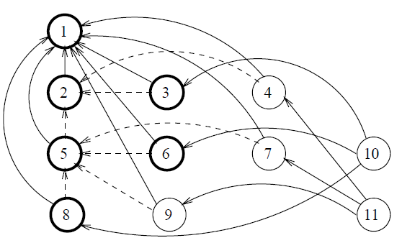
Simple Dynamic slicing
Program Dependence Graph
Nodes for non-compound statements and for control predicates. Edges for data and control dependence.
Notes:
If the data flow was more complicated, we could use sophisticated slicing techniques, combined with the execution information we already collected.
Static slicing sometimes results in a too large slice for debugging purposes, because the current execution history is not used.
Data dependence: statement/expression at vertex v1 uses a var from v2 and there is an execution path from v2 to v1 along var is never redefined.
Debugging with Dynamic Slicing and Backtracking - H Agrawal, RA Demillo 1993
Spyder tool based on modified GCC and GDB – Debug backward, Dynamic and Static slicing
http://reference.kfupm.edu.sa/content/d/e/debugging_with_dynamic_slicing_and_backt_289990.pdf
TODO: Dynamic slicing doesn’t solve the bug – only helps locating it. It sometimes result in a too large slice

Slide 34
Dynamic slicing for Debugging
Execution History: <1,2,3,5¹ …. , 5²>
Full trace of control flow
Dynamic slice of a program P, input N with respect to a variable V for a given execution history H
The set of statements in H whose execution had some effect on V at the end of the partial execution
Executable slice is not required for debugging
Notes:
TODO: Cost effective dynamic program slicing http://citeseerx.ist.psu.edu/viewdoc/download?doi=10.1.1.2.6378&rep=rep1&type=pdf

Slide 35
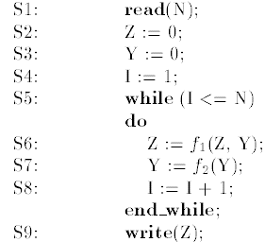
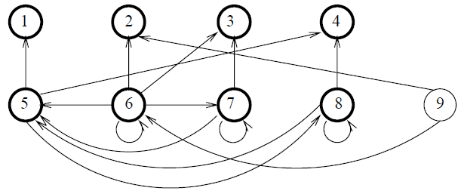
Static slicing + Coverage
Produces smaller slices than pure static slicing
Larger slices than advanced, high overhead dynamic slicers
Dice := Diff of slices
Notes:
* TODO: Call stack sensitive slicing (Liblit): http://doi.ieeecomputersociety.org/10.1109/TSE.2009.66
Existing IDE (Eclipse) tools don’t support tracking a data value propagation across many method invocations, variable assignments and transformation. Find References and Find callers / Call Hierarchy tools are hard to use in complex navigations and data flows.
Con: Tracing a parameter from callee to call-site is not automated and developer has to match the index of param
Con: Simple assignments are not tracked
Con: Slow to recursively find read/write variable references
First solution: proposed by Hiralal Agrawl Dynamic Program Slicing - static slicing filtered by executed code.
Problem: Multiple-Reaching-Definitions: N=1, Slice on S9: write(Z) → S3: Y=0 and S7: Y=f2(Y) – but S7 shouldn’t be in the slice
Note: S6 data depend on S2 (Z), S6 (Z), S3 (Y) and S7 (Y) and control depend on S5 (while)
Idea: Uses thin interactive slicing to reduce slice size and resolve the Multiple-Reaching-Definitions ambiguity.
Employ static thin slicing filtered by executed code (if not execution – static slicing only)
If there is only one option to flow-back → do it automatically
If there are several options, or static analysis is not accurate enough → Allow developer to click for the next step.
x=obj.mtd(p1,p2) – can click to slice into the mtd (starting from return statement[s]) or continue with one of the parameters p1, p2 or obj.
func1(p) → func2(p) → … - the same parameter passed in a chain of funcs (often between overloads or wrappers) : option to skip the chain.
x=hashtable.get(key) – option to slice into HashTable.get(…) or find references to hashtable.put(…)
Back / Forward in the navigation history to have user return to decision junctions and select other directions.
Used for debugging and program understanding – not for refactoring and transformations.
Note: Doesn’t solve the above case, but represent huge practical improvements to existing industry tools
Dicing – narrows down the flow-diff to executed code affecting a variable at position.
if an incorrect value is determined at a faulty run (not necessarily easy to point at first), slicing can determine its origin, and dicing further to limit it to the slice affecting the incorrect value (good vs. bad inputs)
Common problems and considerations
Aliasing: Q: Why not “simple static analysis” – find var read/write references backward?
A: Will work in many cases, but aliasing not supported.
Loops: Kill coverage like info (counters) – full trace does work.
Unstructured flow Gotos
Multiple Threads
Dynamic data-structs – hard to statically analyze

Slide 36
Augmented code browsing
Map Source Code → Application Features
Correlate source code with inputs and outputs
Overlay concrete parameter and variable values
Video
Persist Recordings for later Search
Covering Test cases
Notes:
The next phase after the programmer locates the relevant component (Search, flowdiff, String search) is to browse around the code, trying to understand it to the more detailed level.
Solution: Augment the source code with relevant information, mapping it to the application inputs and outputs.
We saw a similar facility with FireCrystal and WhyLine (but without persistence of different scenarios and indexing and without the repositories overlay)
1) Record and Index (on server) several traces of different product scenarios. Record inputs and outputs (Video + high level events)
2) Code editor - overlay parameter values from a trace (or union of traces)
If you have multiple traces, you can show all possible values or summary statistics (approximate the distribution of values)
Min/Max or DAIKON invariants – that relates variables values (x < y, length(arr argument) == size argument)
DAIKON uses a library of patterns which it tries to match to the trace
Problem: How many param values to record? Every string
Solution: Record stacktrace + locals + params on first execution of basic block.
Problem: mtd(String url). What if Url.Decode is called – same execution seq in user code for both encoded and non-encoded url?
Solution: But inside Url.Decode, first time basic block for decoding % char was called – record.
Problem: Still: mtd(int x) if (x > 0) {do A} else {do B} – say developer wants to modify and add if (x>1000) … - she only has 2 samples- one negative and one positive (if and else executed first time) – so doesn’t know much values distribution.
Solution: Add sampling (in addition to executed first time). User can specify to record all inputs in a session – during Q/A cycle bug repro by support – since these represent more important (surprising) values.
3) Show input, outputs and high level events that occurred in trace before and after the method code Ex: File system, network, configuration read/write … - as in Intellitrace.
For UI interactive applications – show video from the trace (or several frames from unified traces)
Problem: Cov data is not on a Time Line – how to correlate it with Video and high-level events?
Solution: Since High level events and UI updates sampling rate can be limited to every millisecond (lose some data if more than that), we can take record new coverage every millisecond, and spill that to disk async with background thread. This should be still low-overhead, because we went down from 100 million trace records per-second to a thousand per-second.
Further optimize if no major UI updates or I/O events – may be even cov per second or so in some applications.
See ‘Reduce Trace overhead’ for further techniques
4) Traces can be collected during Q/A cycles, Sampling (Liblit) (automatic or manual) as well as product demos.
Motivating Example: Price comparison batch job crawls e-commerce sites to extracts products and prices, insert them to a database → display them in a front-end web site.
Cache, Persistent effects on Find origin: products page → String search → you get to the database, but the real origin is html scraping of a commercial site (executes every night as a batch job)
Software reconnaissance helps to get to the database read (product.get)
Static techniques can find to product.insert and its callers (simplest - find references to product.insert)
But product.insert was called from a different process on a different machine, in a different timing → this where Reverse spy helps with concrete values and process info.
We learned not only the code and data flows, but the actual IT configuration used (machine, process, timing – at night)
Pros:
Maps source code → application (the reverse direction)
Covers scenarios and flows unknown to developer (recorded before) → prevent regressions and contributes to understanding.
“Developers find concrete values essential for interpreting program state” – method parameter name doesn’t usually reveals its possible values.
Ex: method(string filePath) – dev introduced a regression inside the method, because didn’t realize that path can be absolute or relative.
Relative path is used in different execution scenario.
Problem: Code changes invalidates the recording
Solution:
Small changes → Use static analysis to propagate changes to new variables and try to patch
Track insertion, update and deletion of lines using standard diff between revisions.
Larger changes → system should mark traces as invalid in relevant places → plan automatic re-recording
During the dev execution of the change (before commit)
During Q/A or internal beta usage.

Slide 37
Anomalies, Regressions and Bugs
Cov-diff of good vs. bad inputs
Compare also basic-blocks counts
Regression: Source code diff – included in execution
Limitations of Diff
Delta Debugging
Statistical Debugging - Liblit
Notes:
TODO: Fault Localization With Nearest Neighbor Queries
Cov-diff of good vs. bad inputs
Heuristic: coverage is different in good vs bad runs
Counter example: If output is suppose to be always 1 and the code just rounds to nearest integer: inputs 0.5-1.4999 are good, and other not, but there is no difference in flow.
Why count basic-blocks
nExecuted Counting instead of boolean bExecuted helps in some cases
Ex: Liblit bc memory overrun bug was identified by noting that certain loop index is large at failing cases:
Assuming there is no interesting diff in cov, you can next diff counts instead of bExecuted to find out which code is executed more/less in the buggy scenario.
Regression isolation is an important topic – both in research and practice.
Regressions isolation - simple
When a developer discovers a regression, one of the first questions may be:
What has recently changed, that is relevant to the bug at hand?
SCM changes in cov-diff Log from the source control of changes that are included in the recorded coverage may quickly reveal the cause.
Once there is a diff – allow the developer to merge diff of one version to the other (as in textual diff/merge tools)
Q: Why not delta-debugging, which automates this?
A: Maybe there is no env (automated test) and there are only several suspected diffs – so easy to proceed manually
Repositories information is an important tool for understanding
Who changed the code (so we can ask them)
When (is it recent? Was the code covered by Q/A after the change?)
Why (checkin comment and associated Work Item and e-mails / documents).
If this first step isn’t enough, the developer can find a previous version where the bug doesn’t exist.
Diff executed code in the two versions (there will be a diff following changes)
Detailed Trace method inputs/outputs (filtered to buggy flow area) and compare that also
Limitations of Diff
What if there are 2 runs: good run with minimal input and bad, with huge program that crashes gcc compiler?
The diff will be large, since the large input triggers cov all over.
We could minimize the diff in input, but then we almost already isolated the bug, since usually small diff in input allows developers track down the bug without further assistance (although cov-diff does help to get to the buggy code)
Delta-Debugging
Zeller - http://www.st.cs.uni-saarland.de/zeller/ http://www.cs.umd.edu/~pugh/BugWorkshop05/papers/22-dallmeier.pdf
Pro: Overcome complex diff by relying on the test case pass/fail result & Mutating one input / program state to become closer to the other.
Con: Doesn’t work well for non-deterministic bugs
Con: Require automated pass/fail test case, input splitter (simple parser) in case of dd-input
Statistical Debugging
The Cooperative Bug Isolation Project http://www.cs.wisc.edu/cbi/
Bug Isolation via Remote Program Sampling (Ben Liblit) http://theory.stanford.edu/~aiken/publications/papers/pldi03b.pdf
For each scalar assignment compare it to each of the other local vars: maintain per scalar assignment a triplet <num of locals less, num of locals eq, num of locals greater>
Run the program large number of times with different inputs (can be collected from the field) and samples the collection (1/100 - see above)
Knows if each run failed or succeeded - binary response (training set label)
Logistic regression with L1 B-coeff regularization to find the largest coeff --> features (locations) in code that most explain the failure/success
Normalized features (counters) to 0-1 with std dev 1 to allow comparison of B coeffs
Automated test-suite
Up until now, we didn’t assume comprehensive automated test-suite.
However, large complex software often requires them anyway, and it can be leveraged by automated debugging tools.
If an extensive automatic test suite exists, Continuous integration tools can be used to catch regressions shortly after check-in
Code that is executed only/more in failing runs is more likely to contain the defect than code that is always executed (or only in passing runs)
AMPLE: Some failures, though, occur only through a sequence of method calls
Compare windows of size k of method trace on the same object. http://www.cs.umd.edu/~pugh/BugWorkshop05/papers/22-dallmeier.pdf

Slide 38
Summary
Build tools that answer common developer questions:
Where is this functionality implemented in code?
Spy, Data values search, High level Tracing
How does the functionality works?
Detailed Tracing, Augmented Code Browsing
La fin
Notes:
IDE Integration (Debugger, Editor, Search, Class Hrr): No tool can be very effective by itself.
Other system understanding methods: System Grokker …

Slide 39
Using the product
Non Coders can grasp the product behaviors pretty well
Q/A: Try Different scenarios to isolate a bug
Technical and Product leaders often don’t read the code
Notes:
Pros: Fast, Higher level, Easy
Cons: Specific Execution, Coarse

Slide 40
Monitor inputs and outputs
strace / truss / DTrace
Process Monitor, Process Explorer (Windows)
Network sniffers
Finally, some tools ☺
Notes:
System (vs. Application) tracing tools : Let’s see some examples

Slide 41
Mapping Application ⬄ Code
In general it is a hard problem
Integrated Tool support is missing
There are easier cases :
High level small systems (ex: MSAccess app)
11/2010
Notes:
What if we could combine using the product, as a power users, with querying, searching and browsing the executed code within the debug session?
Move from product UI, inputs, outputs to code back and forth in an interactive manner?

Slide 42
Spring Insight
Performance measurement tool
Demonstrates end to end tracing
Browser to Application server
Uses AspectJ to instrument events (ex: JDBC)
Demo video attached.
Notes:
While Spring Insight is performance oriented, it demonstrates how end to end tracing and mapping of application (browser Web UI) to server code using drill down UI
While we don’t emphasize performance profiling, it is only natural that dynamic analysis tools collect also timing measurements.
Cons:
Doesn’t support ad-hoc tracing (this instance, all member fields writes …).
No integration with Search and Debugger – What happens when the trace gets bigger and MT?
No flow-diff or other advanced

Slide 43
Overlay repositories information
Work Items - Bugs & Tasks
Work Item → Change set → Code
SCM - Commit comments
People
Technical docs, E-mails, Forums …
Tags – human or ML generated
Search integration
What people say about the code
Notes:
Motivation: In addition to Reverse-Spy recorded traces of control flow, data and application UI, there is a lot of relevant information in repositories. It is useful to understand history (for regressions and original’s developer intent), asses risk and complexity and learn about related features (in related Work Items)
Note: We assume imperfect code comments.
It would help If the packages were annotated with short descriptions of their functionality.
Later, when developer focuses on specific set of methods, well commented code makes it easier to understand.
Developers spend much time browsing or editing source code, but are generally reluctant to searching and reading valuable external information such as bugs and technical documentation.
They do sometimes read code comments near the location of interest – Why comments yes and bugs no?
A: It may be that tool support is missing, so developer has to switch to several other systems (Bug Database, SCM …) and search for information, trying to correlate it with the source lines of interest – time consuming may result in no interesting information.
Solution: We assume that tool support that display relevant repositories info in context can contribute to developer understanding of the system behavior, as well as its design rationale and history.
Ex: Jazz work item on the Eclipse editor side
SCM: Some SCM systems support Blame / Annotate (SVN/Clearcase) – but it takes time to fetch the info and the SVN comments are not visible on the side as code comments are (only on hover).
CVSSearch: Search in code and CVS comments as if they were inline as code comments.
“While open source code may not always be well-commented, large open source applications almost always have very good CVS comments”.
While search is important, CVSSearch didn’t implement UI for accessing source line related CVS comments from the code editor (as Jazz Work Items did)
ftp://ftp.cse.unsw.edu.au/pub/doc/papers/UNSW/0106.pdf
SCM markers also informs of area of frequently changed code – guiding the developers toward more “interesting” areas.
People: Display people related to code changes (directly from SCM, or via associated Work Items and documents).
Tags – TagSEA Eclipse plugin http://tagsea.sourceforge.net together with Machine Learning methods to label the code.
Note that when package explorer or call hrr views are displayed, we want to optionally show tags for packages and classes (not only methods).
Navigational Data - Statistics of frequently visited code, recently visited code (from your team), Favorite code and code recommendations (code co-visited) were also reported to focus code browsing and increase productivity. Easing Program Comprehension by Sharing Navigation Data (MSR)

Slide 44
Deep Intellisense
Work Items - Bugs & Tasks
SCM, People, Technical docs, E-mails & Forums
Plain-text allusions
IDE Integration
XXX
Notes:
R. Holmes and A. Begel. Deep intellisense: a tool for rehydrating evaporated information. In MSR ’08
http://research.microsoft.com/en-us/um/people/abegel/di/ http://research.microsoft.com/en-us/um/people/abegel/papers/deep-intellisense.pdf
IDE Integrated : Show information pertaining for the current code element under cursor.
Plain-text allusions: Example: the crawler would scan an email message that contains the text, "Last night I fixed bug 4567 by incrementing the
counter at the end of the Account.Add method," and produce links between the graph node for bug 4567 and for any graph node labelled by the class Account and method Add.
Codebook extends Deep intellisense work to social software development.
Con: Doesn’t include blame like view to show the per-line information on the side. Developer has to click each element to see detailed view (in the screenshot above).
Con: Doesn’t include Tagging (human or machine learning generated)

