Slide 1
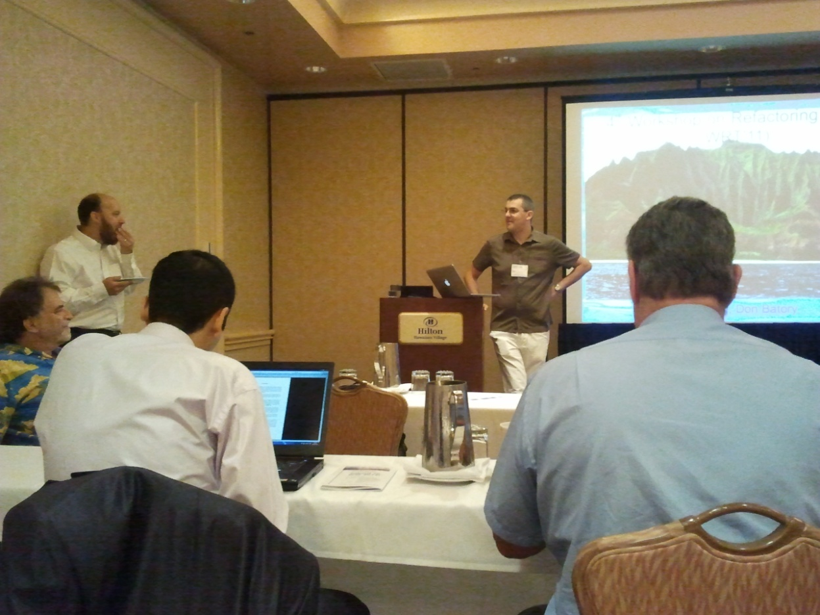
Workshop on Refactoring Tools (WRT)
Keynote: The Birth of Refactoring – A Personal Perspective Bill Griswold

Slide 2
WRT
Domain specific refactoring (security, GPU)
…but is it Refactoring?
Automatic search-based refactoring

Slide 3
WRT
Discussion groups:
What is Refactoring?
no real answer
Refactoring beyond Java
Let’s get it right for Java first

Slide 4
Workshop on Software Clones (IWSC)
Largest of ICSE workshops
We know how to find them, but what do we do afterwards?

Slide 5
IWSC
Where next? (panel)
refactoring
type 3 & 4 (semantic, structure)
clone management
User’s intent
beyond code (e.g. binary)
bugs in clones
plagiarism and IP
domain patterns

Slide 6
End-User Refactoring
Refactoring Pipe-like Web Mashups for End-User Programmers Kathryn T. Stolee and Sebastian Elbaum University of Nebraska–Lincoln
“… how to bring the benefits of software engineering to end users programming mashups.”

Slide 7
Clone Management
Frequency and Risks of Changes to Clones Nils Göde and Rainer Koschke Universität Bremen
“… the most important characteristic of a clone is its change behavior and not its structure.”

Slide 8
Code Search
Portfolio: Finding relevant Functions and Their Usage Collin McMillan, Mark Grechanik, Denys Poshyvanyk, Qing Xie, and Chen Fu College of William and Mary, USA; Accenture Technology Lab, USA
“understanding the chains of function invocations is a key question that programmers ask.”
http://www.searchportfolio.net/
Call graph, PageRank, SAN
User Study

Slide 9
More Refactoring
Refactoring Java Programs for Flexible Locking Max Schäfer, Manu Sridharan, Julian Dolby, Frank Tip
Replace the inefficient synchronized locking with Reentrant lock and read-write lock
Transformation for Class Immutability Fredrick Kjolstad, Danny Dig, Gabriel Acevedo, Marc Snir
Making a class immutable

Slide 10
Even More …
Why Software Quality Improvement Fails (and How to Succeed Nevertheless)
Programs Tests, and Oracles: The Foundation of Testing Revisited
Code-Imp: A Tool for Automated Search-Based Refactoring

Slide 11
Submissions by Topic
Programming languages | 27 | Testing & analysis | 127
Patterns & frameworks | 27 | Empirical SE | 112
Distributed/parallel sys. | 26 | Tools & environments | 84
CM & depolyment | 21 | Architecture & design | 75
HCI | 20 | Rev. eng. & maint. | 60
Agile dev. | 17 | Depend., safety, reliab. | 53
Eng. secure soft. | 14 | Components & reuse | 49
CSCW | 14 | Requirements eng. | 41
Mobile, ubiquitous, pervasive | 13 | Processes & workflow | 40
Internet & IS dev. | 11 | Theory & FM | 33
Embedded & RT | 11 | Economics & metrics | 30
Aspect-oriented | 8 | AI & KBSE | 30
End-user SE | 5 | Comprehension & vis. | 29
Soft. policy & ethics | 2

