Slide 1
Introduction To Erlang
Advanced Software Tools Research Seminar
Fall 07
Arik Nemtsov

Slide 2
Agenda
Design Goals & History
Basic Syntax
Main strengths
Concurrency Oriented Programming
Distributed Programming
Soft Real-time Environment
Continuous Operation
Misc
Criticism
Real World Development using Erlang
Bit Syntax
Usage Examples

Slide 3
Erlang Design Goals
Support of concurrency
Soft real-time environment
Continuous operation – no downtime
Support of distributed computing
Easy integration with binary modules

Slide 4
History
1982 – 1985 - Experiments with programming of telecom using > 20 different languages. Conclusion: The language must be a very high level symbolic language in order to achieve productivity gains ! (Leaves us with: Lisp , Prolog , Parlog ...)
1985 – 86 - Experiments with Lisp, Prolog, Parlog etc. Conclusion: The language must contain primitives for concurrency and error recovery, and the execution model must not have back-tracking (Rules out Lisp and Prolog.)
1988 - Prototype construction of PABX functionality by external users. Erlang escapes from the lab!
1989 - ACS/Dunder Phase 2. Reconstruction of 1/10 of the complete MD-110 system. Results: 10 times greater gains in efficiency at construction compared with construction in PLEX!

Slide 5
History (2)
1991 - Fast implementation of Erlang is released to users. Erlang is represented at Telecom'91. More functionality such as ASN1 - Compiler , graphical interface etc.
1992 - A lot of new users. Erlang is ported to VxWorks, PC, Macintosh etc. Three applications using Erlang are presented at ISS'92. The two first product projects using Erlang are started.
1993 - Distribution is added to Erlang, which makes it possible to run a homgeneous Erlang system on a heterogeneous hardware.
1996 – 1997 – construction of BEAM – Erlang to C compiler. Replaces old compiler.

Slide 6
Unique development process
Specific problem at hand: large soft real-time control systems
Millions of lines of code
Robust – 3min/year downtime
Prototype language used for massively concurrent projects
Language features removed/added by developer demand

Slide 7
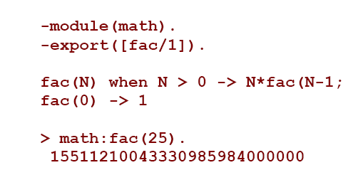
Basic Syntax
Notes:
Program is made up of modules. Each module exports a list of functions.
Each function has a declarative syntax.

Slide 8
Basic Syntax (2)
Notes:
Searching for a node in a binary tree.
{} denotes a structure. Also note the use of two special atoms – “ok” and “not_found”.
Here the pattern matching syntax of Erlang is more apparent.
Notice how all functions constructed are recursive in nature.
It’s important to understand this. The rest are more complicated.

Slide 9
Basic Properties
Declarative syntax
Single assignment property
Data Types:
Primitive:
Numbers – 1, 2#101011, 16#1FFA3, $B, 0.23
Atoms – mememe, start_with_lower_case, ‘quoted’
Complex:
Lists – [123, xyz, ’aaa’]
Tuples – {123, xyz, ‘aaa’}
String implemented as a list of integers “abc” <-> [97,98,99]
Variables start with an Uppercase letter
Notes:
Single assignment – a variable can only be given a value once in the scope of a match statement

Slide 10
More Examples
Notes:
Pattern matching
List comprehensions
A function returning a function

Slide 11
Concurrent Programming: Current State of Affairs
C#, Java – shared state concurrency
Any thread can modify any state at any time
All synchronization is explicit, manual
No compile-time verification of correctness properties:
Deadlock-free
Race-free
Software generally scales poorly to thread count (= multi-processors)

Slide 12
Concurrent Programming: The Hardware world
At present:
Xbox 360 – 3 cores
Intel Core 2 – up to 4 cores
Sun T2000 – 8 cores, 32 hardware threads
In a couple of years:
20+ cores
80+ hardware threads
Multi-core support is a must at this point
Notes:
Taken from tim sweeney’s presentation

Slide 13
Concurrency Oriented Programming (The Erlang Philosophy)
Lightweight Processes
provide a convenient partitioning into concurrent sub-components
Efficiency in scaling to a multi-processor environment
Functional programming style avoids mutable state
Message passing avoids shared state
Fault isolation
no sharing of data that can be corrupted (affecting many processes)

Slide 14
Properties of a COPL
Support of processes
a sort of self contained VMs
Processes are strongly isolated
Each process has a unique identifier
The name of a process cannot be forged
Message passing is the only way processes interact
The is no shared state
If one knows the name of a process it can send a message to the process
Message passing is unreliable
Messages are delivered asynchronously
Messages are atomic – they are either delivered, or not
A process can detect failure in another process
We should also be able to find the reason for failure
Notes:
Invented by Joe Armstrong (in his PHD thesis)

Slide 15
Concurrent Programming in Erlang
Support of lightweight processes
All executed code resides inside processes
No use of OS processes/threads
Built-in scheduler
Processes share no resources
Process naming scheme
register(Name, Pid)
Non local Error handling
Error-kernel: not all processes must be correct
Leads to fault-tolerance
Uses Actor Model
Notes:
Processes - The estimated minimal overhead for each is 300 bytes, so many of them can be created without degrading performance (a benchmark with 20 million processes was tried)
Message passing – Process communication is done via a share-nothing asynchronous message-passing system: every process has a “mailbox”, a queue of messages sent by other processes, that are not yet consumed. A process uses the receive primitive to retrieve messages that match desired patterns. A message-handling routine tests messages in turn against each pattern, until one of them matches. When the message is consumed (removed from the mailbox) the process resumes execution. A message may comprise any Erlang structure, including primitives (integers, floats, characters, atoms), tuples, lists, and functions.
Actor model - The Actor model adopts the philosophy that everything is an actor. This is similar to the everything is an object philosophy used by some object-oriented programming languages, but differs in that object-oriented software is typically executed sequentially, while the Actor model is inherently concurrent.
An actor is a computational entity that, in response to a message it receives, can concurrently:
send a finite number of messages to other actors;
create a finite number of new actors;
designate the behavior to be used for the next message it receives.
There is no assumed sequence to the above actions and they could be carried out in parallel.
Communications among actors occur asynchronously: that is, the sending actor does not wait until the message is received before proceeding with computation.
Recipients of messages are identified by address, sometimes called "mailing address". Thus an actor can only communicate with actors whose addresses it has. It can obtain those from a message it receives, or if the address is for an actor it just created.
The Actor model is characterized by inherent concurrency of computation within and among actors, dynamic creation of actors, inclusion of actor addresses in messages, and interaction only through direct asynchronous message passing with no restriction on message arrival order.

Slide 16
Concurrent Programming in Erlang (2)
Message Passing
One must know the name/Pid of process to send it a message
Why not shared memory?
Critical Regions
Programs crash in a critical region (lacking transaction semantics)
Programs spend too much time in a critical region
Locking more than you need
No support of distribution – multi CPU/multi physical computers
Can introduce deadlocks
Creates process inter-dependency -> error prone -> unreliable
Notes:
Locking more than you need - Unfortunately we often lock far more memory than we need to,
a program will typical lock all the shared memory, just to manipulate one tiny fragment of it.

Slide 17
Examples
Notes:
Messages are matched as patterns

Slide 18
Examples (2)
Notes:
The self call to loop is of course optimized (so it does not overflow the stack)

Slide 19
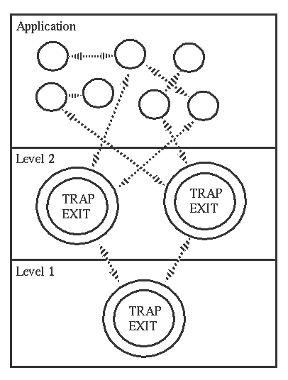
Process Exit Signal Trapping
Erlang allows linking of processes
Exit signals propagate through linked processes
Policy choice:
Trap exit signal – no process termination
No trapping – termination
Allows design of layered applications:
No error handling code at lower levels
Encourages application modularity
Notes:
An exit signal propagates through linked processes - This is similar to a normal OS process exit, which forces all its threads to exit.
Example usage: ftp server receiving connections
Demonstrates the principle of non-local error handling

Slide 20
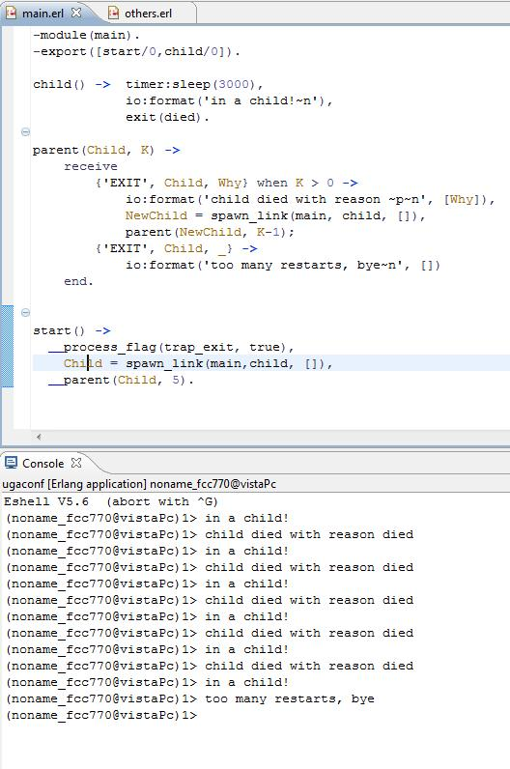
Examples (3)
Parent traps child exit
Re-spawns the child if K > 0
Notes:
Notice what the picture is written in

Slide 21
Distributed Programming
Transparent extension across many nodes
Process spawning
Message passing (IPC) – not so easy
Code marshalling issues handled by environment
Essentially enables code “hot-swapping” – run time replacement of executable modules
Leads to a fault tolerant programming paradigm
Additional security considerations
Notes:
Message passing difficulties – process naming issues on other nodes, serialization of message data
Fault tolerant programming paradigm – people expect the network connection to fail (or the remote computer).
So they put limited trust in other processes. This unlike processes on the same system which are assumed to “behave”.
Security – possible message spoofing. Handled by assigning each node a magic cookie. The cookie must be passed in each message,
otherwise the message is sent to a special process for unauthorized messages.

Slide 22
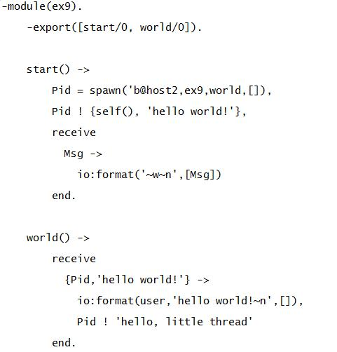
Example

Slide 23
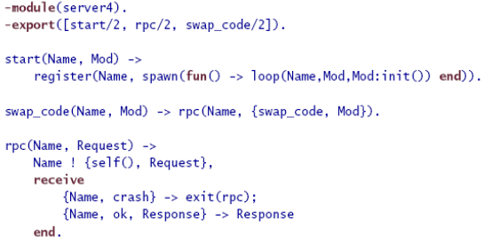
Example - Code Hot-Swapping
Notes:
Taken from Joe Armstrong’s ECOOP07 presentation
this RPC server supports code hot-swapping and change of running state to a new one.
All this is done in response to a request by the client (which calls rpc() or swap_code() with the name of the server as argument).
The function “loop” is on the next page.

Slide 24
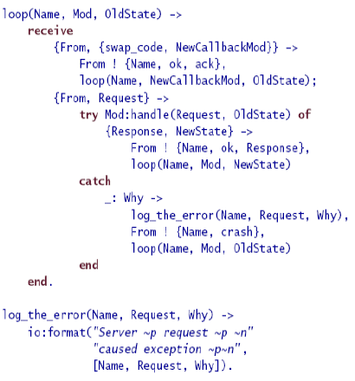
Code Hot-Swapping (2)

Slide 25
Soft Real-time Environment
Little need of OS services (Makes porting easier)
Real-time garbage collector
Lightweight processes
Efficient message passing
Internal cooperative process scheduler
Notes:
Erlang process = micro-thread. A “context-switch” takes only a few machine instructions.
Garbage collector – per process garbage collection. Response time in the order of milliseconds

Slide 26
Continuous Operation
Dynamic module upgrade mechanism
Old and Current code can run in parallel
Advanced error detection primitives
Process exit signal trapping
Exception handling mechanism
Notes:
Old code runs as long as the full name of the function (Mod:func()) has not been invoked

Slide 27
Erlang-OS (ERTS)
Process Management
Scheduler, I/O, …
Memory Management
Garbage Collector
Process Isolation & Security
Process Registration, Naming issues
Networking
Distributed Computing
Device Drivers
Ports
Notes:
ERTS – Erlang runtime system
Security – forging names of processes in the OS. Name distribution problem – knowing a process’ name (Pid) will allow sending of messages.
Of course, a process can filter messages by sender.
Networking (wikipedia) - computers running dissimilar operating systems can participate in a common network for sharing resources such as computing, files, printers, and scanners using either wired or wireless connections.
Ports provide the basic mechanism for communication with the external world, from Erlang's point of view. They provide a byte-oriented interface to an external program. When a port has been created, Erlang can communicate with it by sending and receiving lists of bytes, including binaries.
It is also possible to write a driver in C according to certain principles and dynamically link it to the Erlang runtime system. The linked-in driver looks like a port from the Erlang programmer's point of view and is called a port driver.

Slide 28
Criticism
Primitive security model
How to restrict access to a node?
Limit the abilities of a process
Message Passing only IPC
Copying of buffers back and forth
How to program “Photoshop”?
Game-state simulation
1000’s of objects updated 30 times per second. Each update touches up to 5-10 other objects. (Tim Sweeny)
How to program “Quake”?
Notes:
Process limitations – for instance accessing a hardware device on a machine
Buffer copying – it’s a little simplistic (the implementation can be more efficient in local interactions), but it still affects the way we program

Slide 29
Real World Erlang Development
OTP core library
OTP “drives” the application and you supply the “business logic” via callbacks
Many useful generalization of behavior (e.g. gen_server)
Battle-tested in Ericsson (scalability, reliability)
Good software development tools
Fast Native compiler
Helper tools – debugger, procman, table viewer, …
Again tested by ericsson
Ecplise IDE Plugin! (December 2007)

Slide 30
Misc
Bit Syntax
Real World projects:
Ejabberd – jabber server
Yaws – web server
ErlyWeb – web application framework (a la “Rails”)
Erricsson AXD301 – 1.7 MLOC
Erlang for .NET
Notes:
Bit syntax – Erlang’s syntax has an inherent similarity to that of a lexical parser. Very efficient for simple decoding tasks.

Slide 31
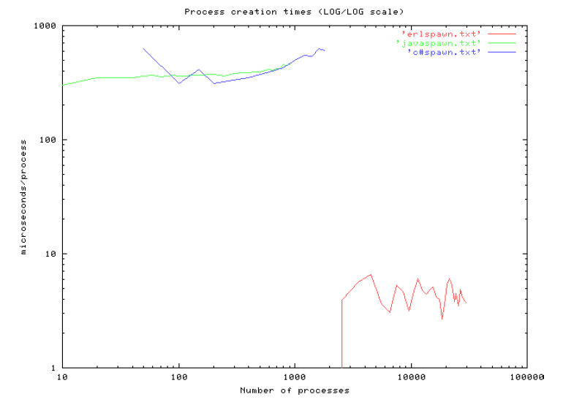
Process Start Times

Slide 32
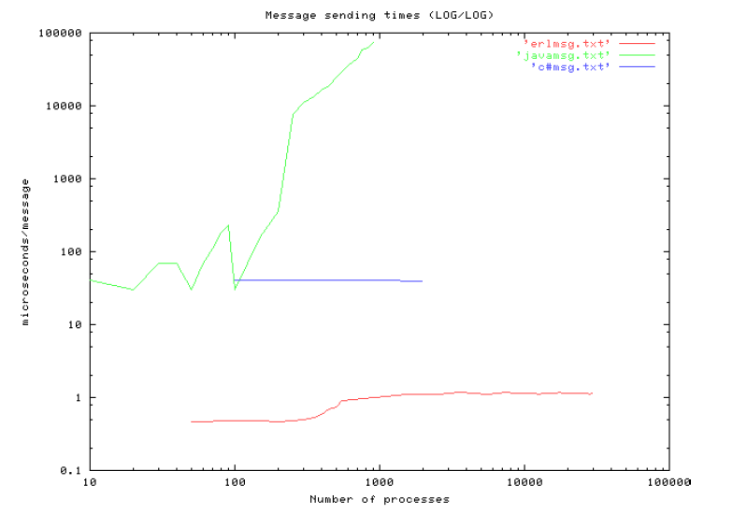
Message Passing Times
Notes:
All messages were sent in a loop

Slide 33
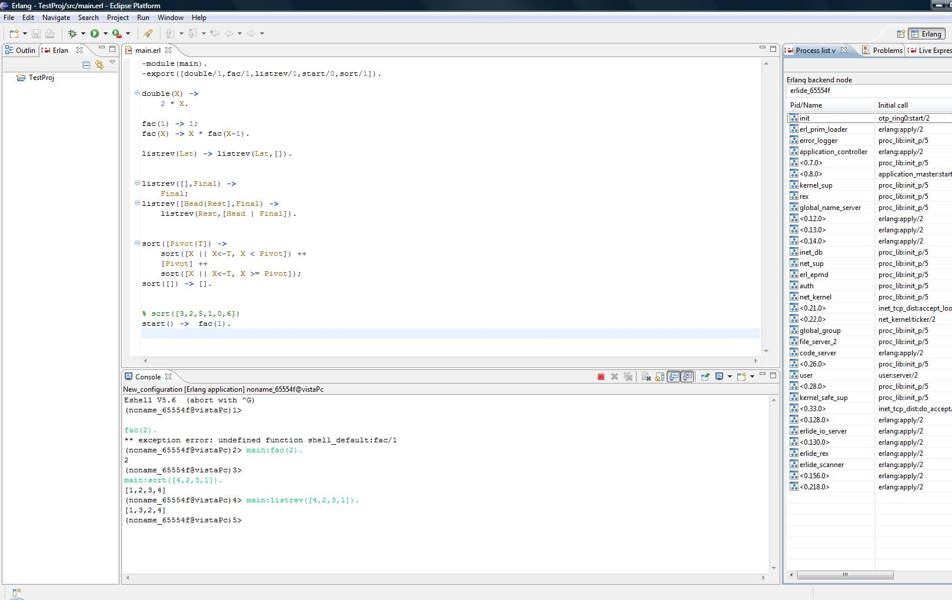
Eclipse Plug-in

Slide 34
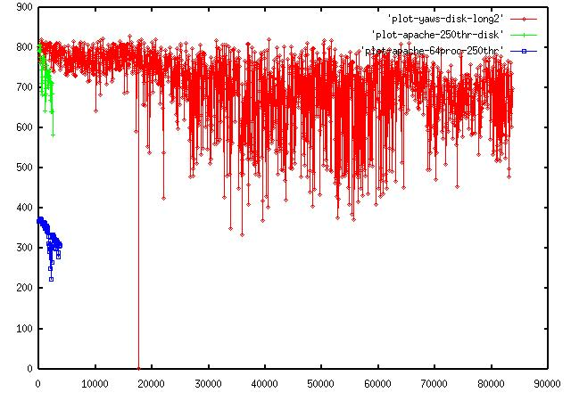
Apache vs. Yaws
Throughput (kb/sec) vs. load (requests)
Apache dies at ~4000 requests
Yaws endures very high loads

