Slide 1
Parvaresh-Vardy Codes
Derandomization Seminar, 2016
Guy Biron

Slide 2
Reminders

Slide 3
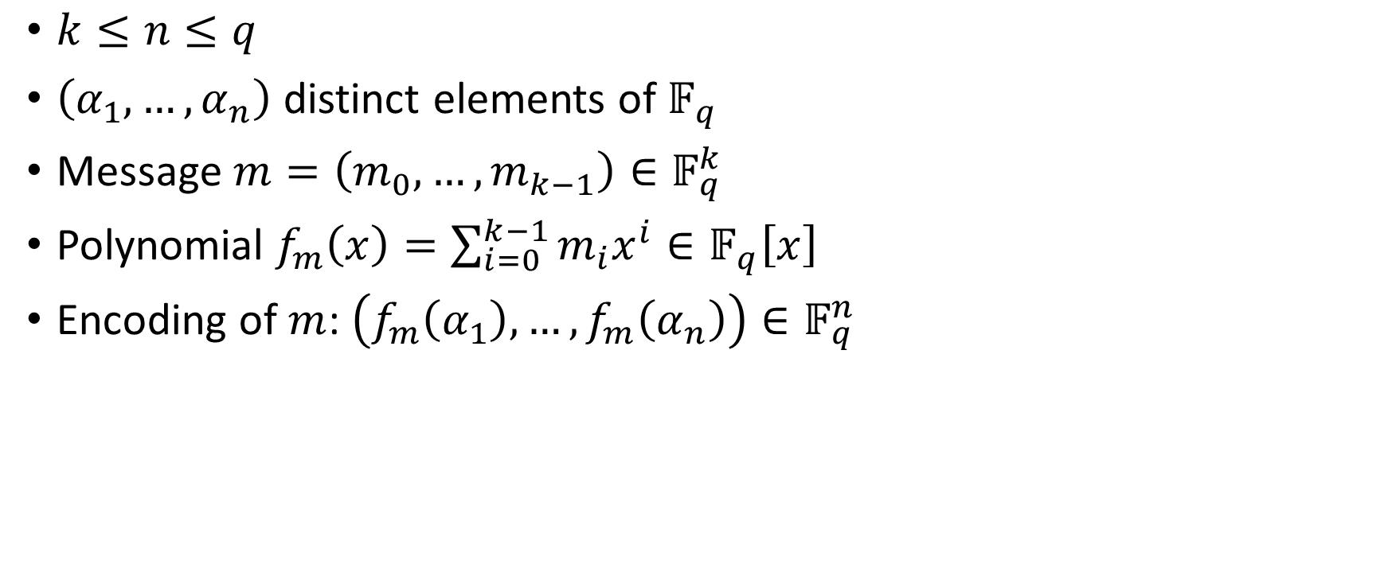
Reed-Solomon Codes
$k≤n≤q$
$\left(α_{1},…,α_{n}\right)$ distinct elements of $𝔽_{q}$
Message $m=\left(m_{0},…,m_{k−1}\right)∈𝔽_{q}^{k}$
Polynomial $f_{m}\left(x\right)=\sum_{i=0}^{k−1}{m_{i}x^{i}}∈𝔽_{q}\left[x\right]$
Encoding of $m$: $\left(f_{m}\left(α_{1}\right),…,f_{m}\left(α_{n}\right)\right)∈𝔽_{q}^{n}$

Slide 4
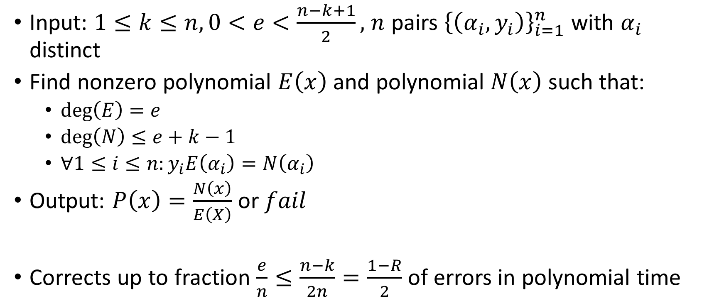
Unique Decoding RS – Welch-Berlekamp
Input: $1≤k≤n,0<e<\frac{n−k+1}{2},$ $n$ pairs ${\left\{\left(α_{i},y_{i}\right)\right\}}_{i=1}^{n}$ with $α_{i}$ distinct
Find nonzero polynomial $E\left(x\right)$ and polynomial $N\left(x\right)$ such that:
  $\deg\left(E\right)=e$
  $\deg\left(N\right)≤e+k−1$
  $∀1≤i≤n:y_{i}E\left(α_{i}\right)=N\left(α_{i}\right)$
Output: $P\left(x\right)=\frac{N\left(x\right)}{E\left(X\right)}$ or $fail$
Corrects up to fraction $\frac{e}{n}≤\frac{n−k}{2n}=\frac{1−R}{2}$ of errors in polynomial time

Slide 5

List Decoding RS – Definition
Input: received word $\left(y_{1},…,y_{n}\right),y_{i}∈𝔽_{q}$, error parameter $e=n−t$
Output: all polynomials $P\left(X\right)∈𝔽_{q}\left[X\right]$ of degree at most $k−1$ such that $P\left(α_{i}\right)=y_{i}$ for at least $t$ values of $i$
Should work in polynomial time

Slide 6
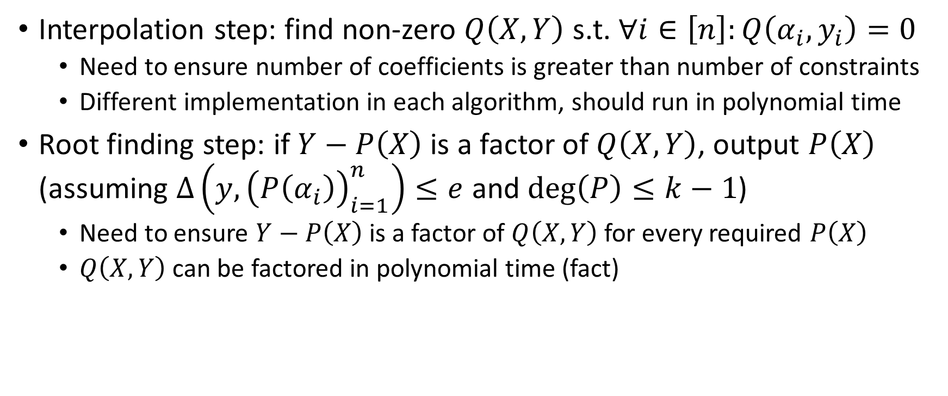
List Decoding RS – General Structure
Interpolation step: find non-zero $Q\left(X,Y\right)$ s.t. $∀i∈\left[n\right]:Q\left(α_{i},y_{i}\right)=0$
  Need to ensure number of coefficients is greater than number of constraints
  Different implementation in each algorithm, should run in polynomial time
Root finding step: if $Y−P\left(X\right)$ is a factor of $Q\left(X,Y\right)$, output $P\left(X\right)$ (assuming $∆\left(y,{\left(P\left(α_{i}\right)\right)}_{i=1}^{n}\right)≤e$ and $\deg\left(P\right)≤k−1$)
  Need to ensure $Y−P\left(X\right)$ is a factor of $Q\left(X,Y\right)$ for every required $P\left(X\right)$
  $Q\left(X,Y\right)$ can be factored in polynomial time (fact)

Slide 7
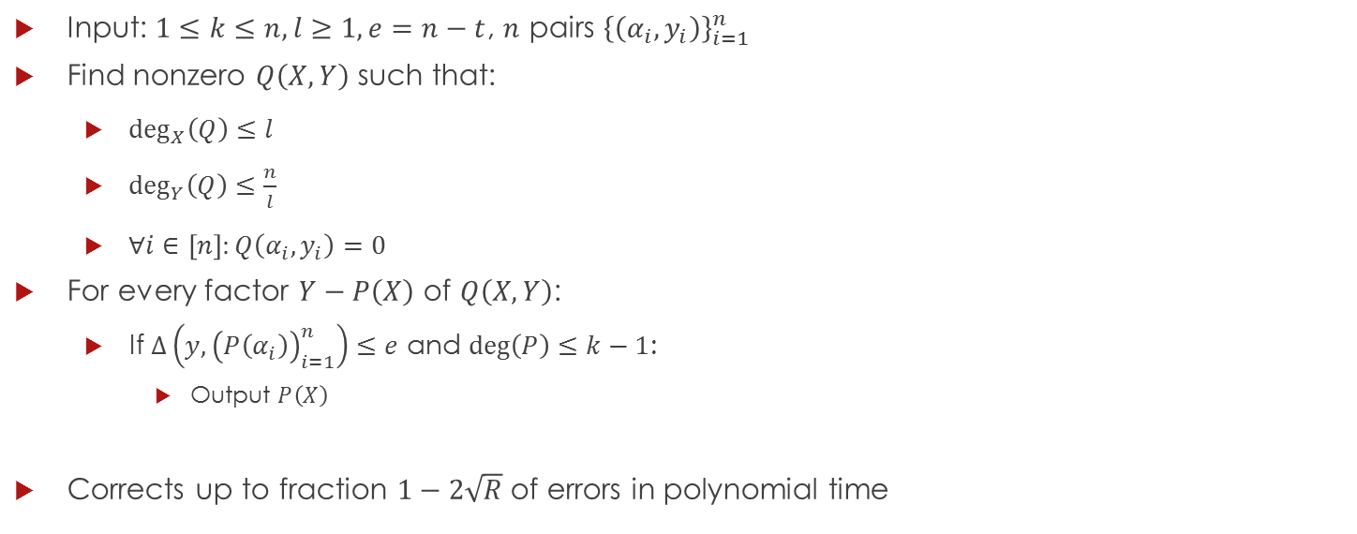
List Decoding RS – Alg. 1
Input: $1≤k≤n,l≥1,e=n−t$, $n$ pairs ${\left\{\left(α_{i},y_{i}\right)\right\}}_{i=1}^{n}$
Find nonzero $Q\left(X,Y\right)$ such that:
  $\deg_{X}\left(Q\right)≤l$
  $\deg_{Y}\left(Q\right)≤\frac{n}{l}$
  $∀i∈\left[n\right]:Q\left(α_{i},y_{i}\right)=0$
For every factor $Y−P\left(X\right)$ of $Q\left(X,Y\right)$:
  If $∆\left(y,{\left(P\left(α_{i}\right)\right)}_{i=1}^{n}\right)≤e$ and $\deg\left(P\right)≤k−1$:
    Output $P\left(X\right)$
Corrects up to fraction $1−2\sqrt{R}$ of errors in polynomial time

Slide 8
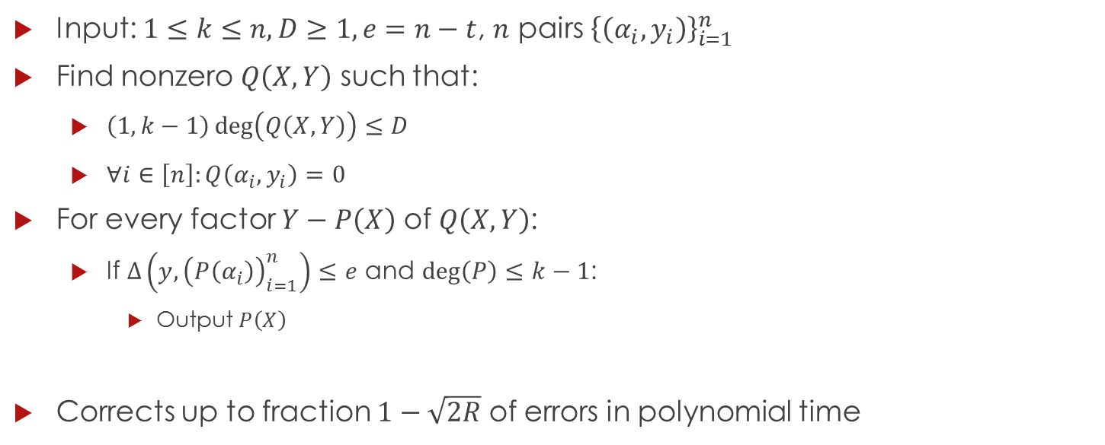
List Decoding RS – Alg. 2 (Sudan)
Input: $1≤k≤n,D≥1,e=n−t$, $n$ pairs ${\left\{\left(α_{i},y_{i}\right)\right\}}_{i=1}^{n}$
Find nonzero $Q\left(X,Y\right)$ such that:
  $\left(1,k−1\right)\deg\left(Q\left(X,Y\right)\right)≤D$
  $∀i∈\left[n\right]:Q\left(α_{i},y_{i}\right)=0$
For every factor $Y−P\left(X\right)$ of $Q\left(X,Y\right)$:
  If $∆\left(y,{\left(P\left(α_{i}\right)\right)}_{i=1}^{n}\right)≤e$ and $\deg\left(P\right)≤k−1$:
    Output $P\left(X\right)$
Corrects up to fraction $1−\sqrt{2R}$ of errors in polynomial time

Slide 9
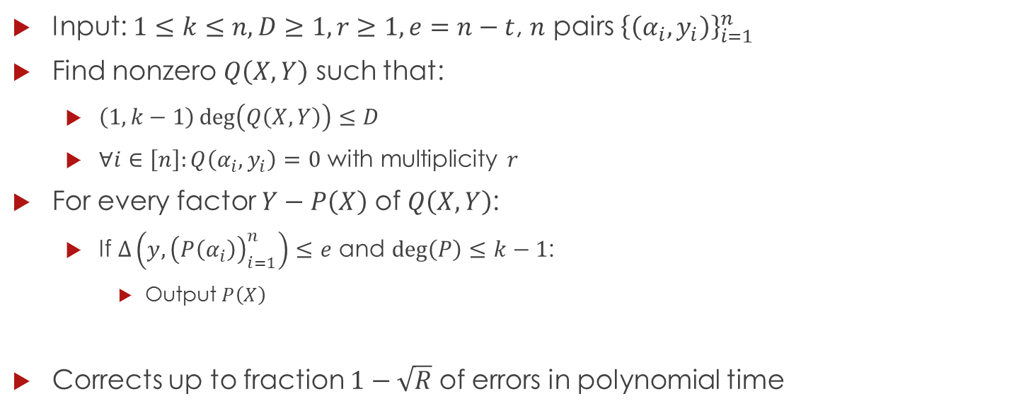
List Decoding RS – Alg. 3 (Guruswami-Sudan)
Input: $1≤k≤n,D≥1,r≥1,e=n−t$, $n$ pairs ${\left\{\left(α_{i},y_{i}\right)\right\}}_{i=1}^{n}$
Find nonzero $Q\left(X,Y\right)$ such that:
  $\left(1,k−1\right)\deg\left(Q\left(X,Y\right)\right)≤D$
  $∀i∈\left[n\right]:Q\left(α_{i},y_{i}\right)=0$ with multiplicity $r$
For every factor $Y−P\left(X\right)$ of $Q\left(X,Y\right)$:
  If $∆\left(y,{\left(P\left(α_{i}\right)\right)}_{i=1}^{n}\right)≤e$ and $\deg\left(P\right)≤k−1$:
    Output $P\left(X\right)$
Corrects up to fraction $1−\sqrt{R}$ of errors in polynomial time

Slide 10
Parvaresh-Vardy

Slide 11
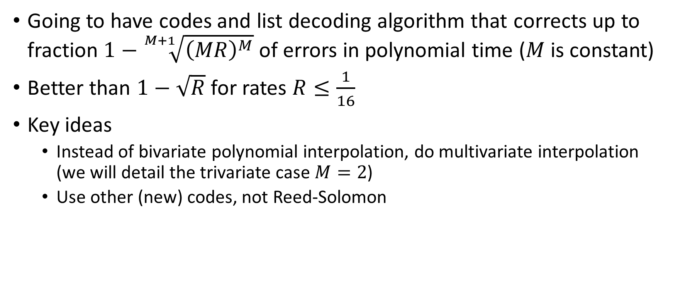
Spoiler
Going to have codes and list decoding algorithm that corrects up to fraction $1−\sqrt[M+1]{{\left(MR\right)}^{M}}$ of errors in polynomial time ($M$ is constant)
Better than $1−\sqrt{R}$ for rates $R≤\frac{1}{16}$
Key ideas
  Instead of bivariate polynomial interpolation, do multivariate interpolation (we will detail the trivariate case $M=2$)
  Use other (new) codes, not Reed-Solomon

Slide 12
Definitions and Relevant Lemmas

Slide 13
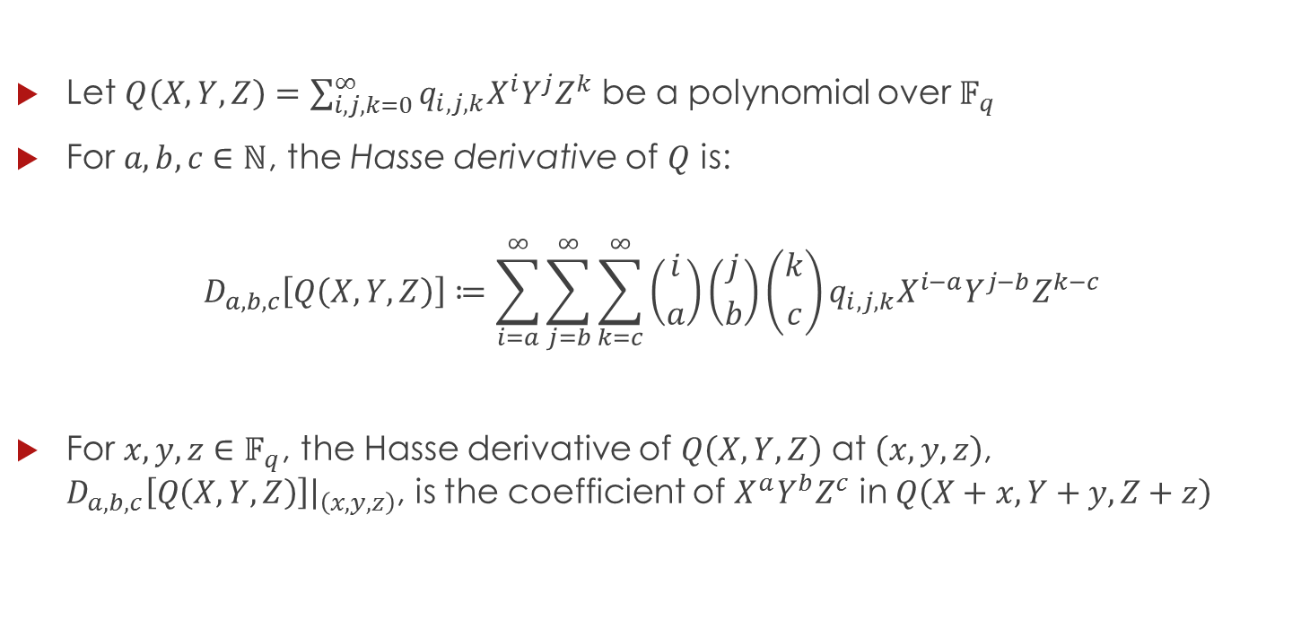
Hasse Derivative
Let $Q\left(X,Y,Z\right)=\sum_{i,j,k=0}^{∞}{q_{i,j,k}X^{i}Y^{j}Z^{k}}$ be a polynomial over $𝔽_{q}$
For $a,b,c∈ℕ$, the Hasse derivative of $Q$ is:
$$D_{a,b,c}\left[Q\left(X,Y,Z\right)\right]≔\sum_{i=a}^{∞}{\sum_{j=b}^{∞}{\sum_{k=c}^{∞}{\left({i \atop a}\right)\left({j \atop b}\right)\left({k \atop c}\right)q_{i,j,k}X^{i−a}Y^{j−b}Z^{k−c}}}}$$
For $x,y,z∈𝔽_{q}$, the Hasse derivative of $Q\left(X,Y,Z\right)$ at $\left(x,y,z\right)$, $D_{a,b,c}\left[Q\left(X,Y,Z\right)\right]{\left.​\right|}_{\left(x,y,z\right)}$, is the coefficient of $X^{a}Y^{b}Z^{c}$ in $Q\left(X+x,Y+y,Z+z\right)$

Slide 14
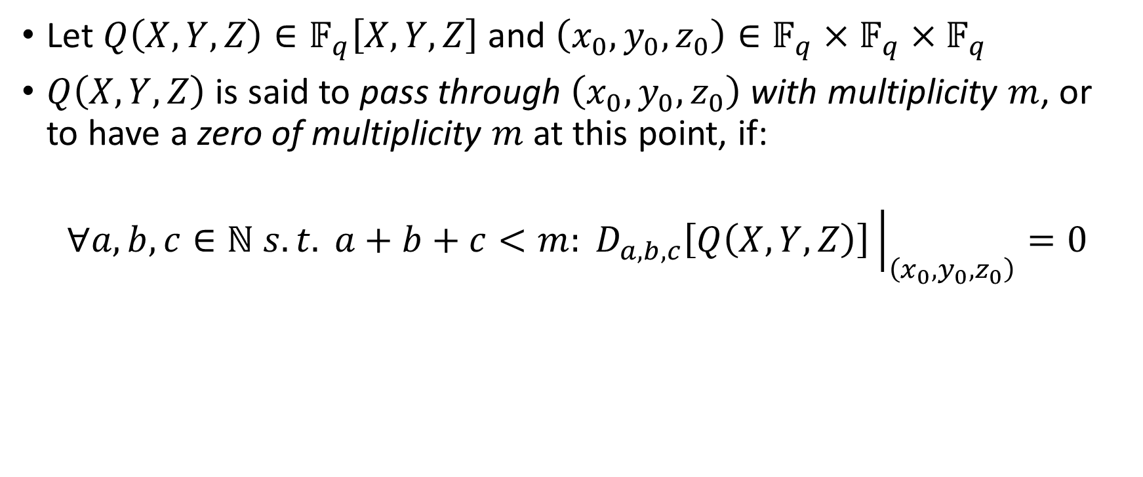
Multiplicity
Let $Q\left(X,Y,Z\right)∈𝔽_{q}\left[X,Y,Z\right]$ and $\left(x_{0},y_{0},z_{0}\right)∈𝔽_{q}×𝔽_{q}×𝔽_{q}$
$Q\left(X,Y,Z\right)$ is said to pass through $\left(x_{0},y_{0},z_{0}\right)$ with multiplicity $m$, or to have a zero of multiplicity $m$ at this point, if:
$$∀a,b,c∈ℕ s.t. a+b+c<m: D_{a,b,c}\left[Q\left(X,Y,Z\right)\right]{\left.​\right|}_{\left(x_{0},y_{0},z_{0}\right)}=0$$

Slide 15
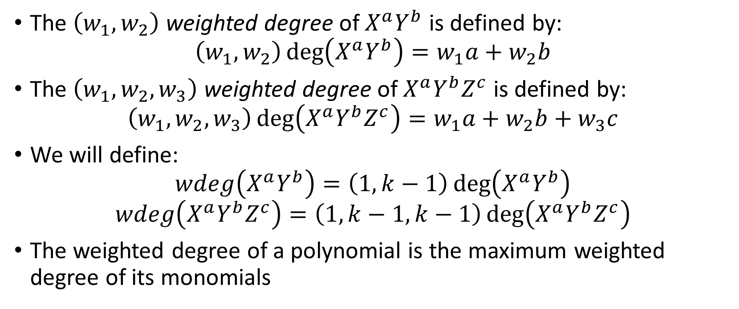
Weighted Degree
The $\left(w_{1},w_{2}\right)$ weighted degree of $X^{a}Y^{b}$ is defined by:
$$\left(w_{1},w_{2}\right)\deg\left(X^{a}Y^{b}\right)=w_{1}a+w_{2}b$$
The $\left(w_{1},w_{2},w_{3}\right)$ weighted degree of $X^{a}Y^{b}Z^{c}$ is defined by:
$$\left(w_{1},w_{2},w_{3}\right)\deg\left(X^{a}Y^{b}Z^{c}\right)=w_{1}a+w_{2}b+w_{3}c$$
We will define:
$$wdeg\left(X^{a}Y^{b}\right)=\left(1,k−1\right)\deg\left(X^{a}Y^{b}\right)$$
$$wdeg\left(X^{a}Y^{b}Z^{c}\right)=\left(1,k−1,k−1\right)\deg\left(X^{a}Y^{b}Z^{c}\right)$$
The weighted degree of a polynomial is the maximum weighted degree of its monomials

Slide 16
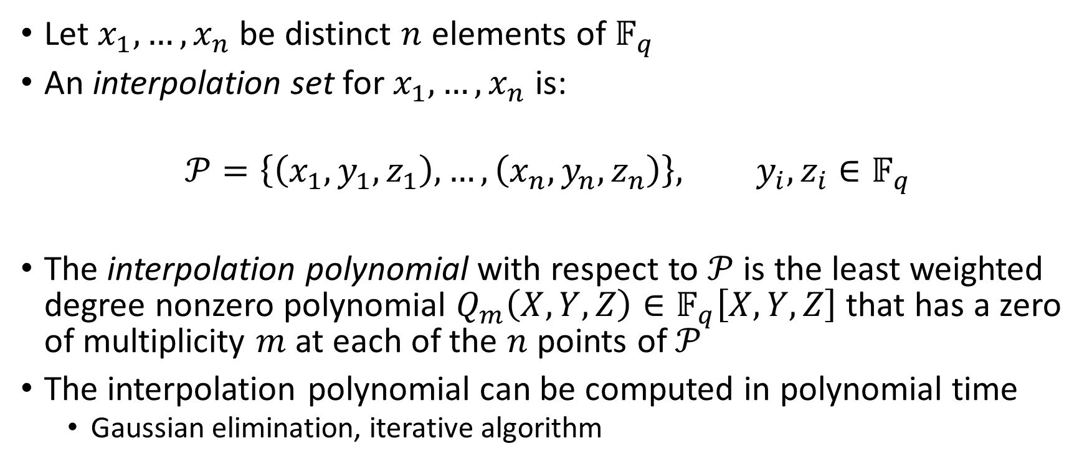
Interpolation
Let $x_{1},…,x_{n}$ be distinct $n$ elements of $𝔽_{q}$
An interpolation set for $x_{1},…,x_{n}$ is:
$$𝒫=\left\{\left(x_{1},y_{1},z_{1}\right),…,\left(x_{n},y_{n},z_{n}\right)\right\}, y_{i},z_{i}∈𝔽_{q}$$
The interpolation polynomial with respect to $𝒫$ is the least weighted degree nonzero polynomial $Q_{m}\left(X,Y,Z\right)∈𝔽_{q}\left[X,Y,Z\right]$ that has a zero of multiplicity $m$ at each of the $n$ points of $𝒫$
The interpolation polynomial can be computed in polynomial time
  Gaussian elimination, iterative algorithm

Slide 17
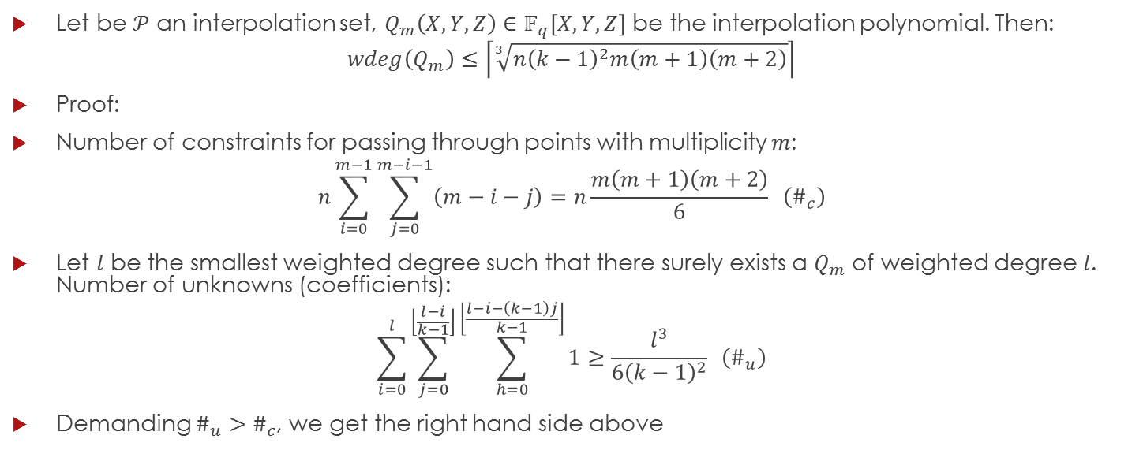
Lemma 3
Let be $𝒫$ an interpolation set, $Q_{m}\left(X,Y,Z\right)∈𝔽_{q}\left[X,Y,Z\right]$ be the interpolation polynomial. Then:
$$wdeg\left(Q_{m}\right)≤\left\lceil \sqrt[3]{n{\left(k−1\right)}^{2}m\left(m+1\right)\left(m+2\right)}\right\rceil$$
Proof:
Number of constraints for passing through points with multiplicity $m$:
$$n\sum_{i=0}^{m−1}{\sum_{j=0}^{m−i−1}{\left(m−i−j\right)}}=n\frac{m\left(m+1\right)\left(m+2\right)}{6} \left(\#_{c}\right)$$
Let $l$ be the smallest weighted degree such that there surely exists a $Q_{m}$ of weighted degree $l$. Number of unknowns (coefficients):
$$\sum_{i=0}^{l}{\sum_{j=0}^{\left\lfloor \frac{l−i}{k−1}\right\rfloor }{\sum_{h=0}^{\left\lfloor \frac{l−i−\left(k−1\right)j}{k−1}\right\rfloor }{1}}}≥\frac{l^{3}}{6{\left(k−1\right)}^{2}} \left(\#_{u}\right)$$
Demanding $\#_{u}>\#_{c}$, we get the right hand side above
Notes:
1. Number of ways to sum up to m – 1. 2. number of ways to sum up to l with weights (1, k – 1, k – 1)

Slide 18
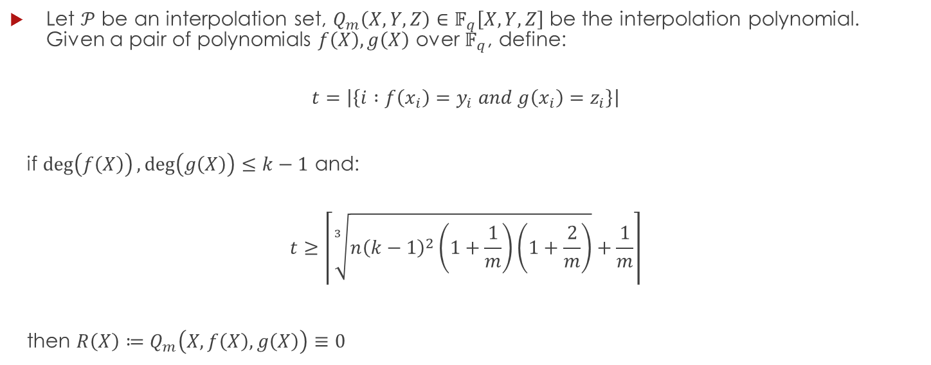
Lemma 4
Let $𝒫$ be an interpolation set, $Q_{m}\left(X,Y,Z\right)∈𝔽_{q}\left[X,Y,Z\right]$ be the interpolation polynomial. Given a pair of polynomials $f\left(X\right),g\left(X\right)$ over $𝔽_{q}$, define:
$$t=\left|\left\{i :f\left(x_{i}\right)=y_{i} and g\left(x_{i}\right)=z_{i}\right\}\right|$$
if $\deg\left(f\left(X\right)\right),\deg\left(g\left(X\right)\right)≤k−1$ and:
$$t≥\left\lceil \sqrt[3]{n{\left(k−1\right)}^{2}\left(1+\frac{1}{m}\right)\left(1+\frac{2}{m}\right)}+\frac{1}{m}\right\rceil$$
then $R\left(X\right)≔Q_{m}\left(X,f\left(X\right),g\left(X\right)\right)≡0$

Slide 19
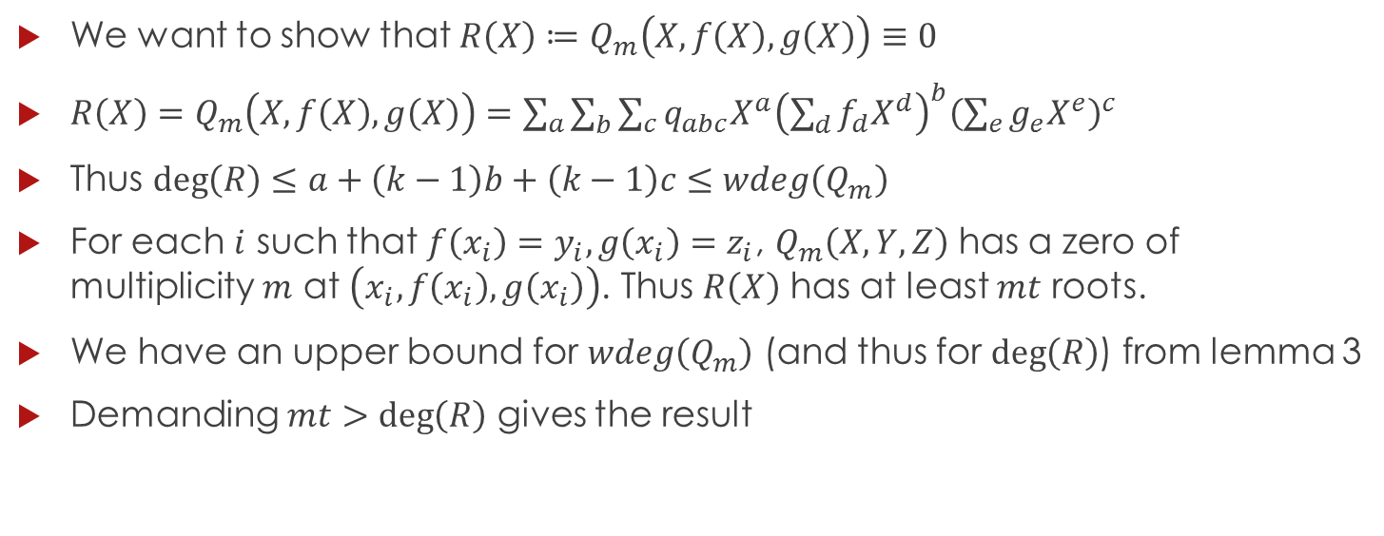
Proof of Lemma 4
We want to show that $R\left(X\right)≔Q_{m}\left(X,f\left(X\right),g\left(X\right)\right)≡0$
$R\left(X\right)=Q_{m}\left(X,f\left(X\right),g\left(X\right)\right)=\sum_{a}{\sum_{b}{\sum_{c}{q_{abc}X^{a}{\left(\sum_{d}{f_{d}X^{d}}\right)}^{b}{\left(\sum_{e}{g_{e}X^{e}}\right)}^{c}}}}$
Thus $\deg\left(R\right)≤a+\left(k−1\right)b+\left(k−1\right)c≤wdeg\left(Q_{m}\right)$
For each $i$ such that $f\left(x_{i}\right)=y_{i},g\left(x_{i}\right)=z_{i}$, $Q_{m}\left(X,Y,Z\right)$ has a zero of multiplicity $m$ at $\left(x_{i},f\left(x_{i}\right),g\left(x_{i}\right)\right)$. Thus $R\left(X\right)$ has at least $mt$ roots.
We have an upper bound for $wdeg\left(Q_{m}\right)$ (and thus for $\deg\left(R\right)$) from lemma 3
Demanding $mt>\deg\left(R\right)$ gives the result

Slide 20
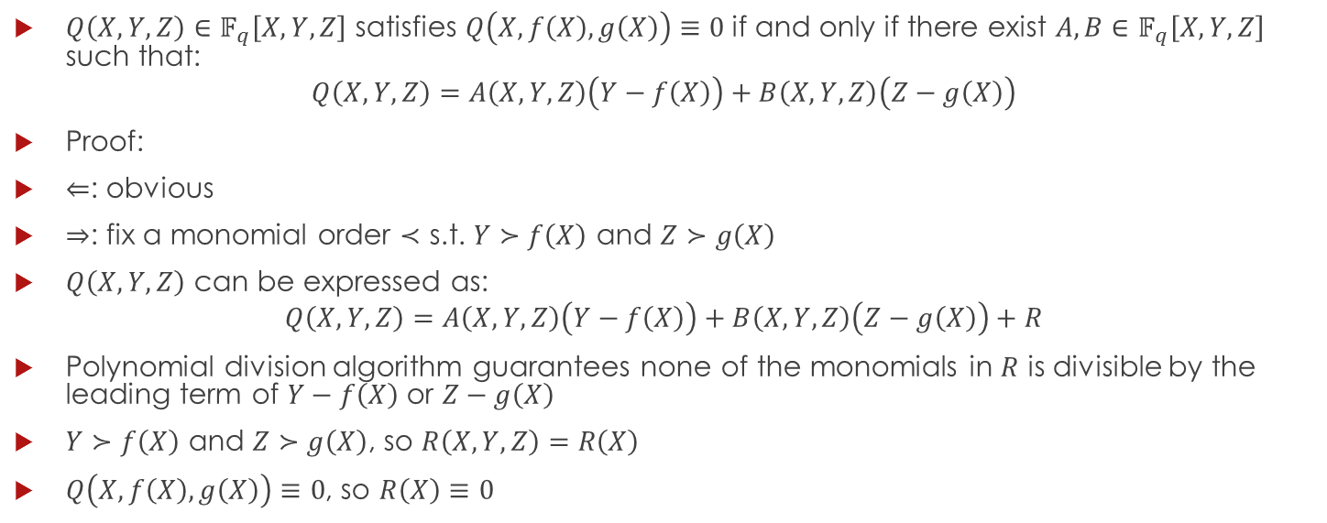
Lemma 5
$Q\left(X,Y,Z\right)∈𝔽_{q}\left[X,Y,Z\right]$ satisfies $Q\left(X,f\left(X\right),g\left(X\right)\right)≡0$ if and only if there exist $A,B∈𝔽_{q}\left[X,Y,Z\right]$ such that:
$$Q\left(X,Y,Z\right)=A\left(X,Y,Z\right)\left(Y−f\left(X\right)\right)+B\left(X,Y,Z\right)\left(Z−g\left(X\right)\right)$$
Proof:
$⇐$: obvious
$⇒$: fix a monomial order $≺$ s.t. $Y≻f\left(X\right)$ and $Z≻g\left(X\right)$
$Q\left(X,Y,Z\right)$ can be expressed as:
$$Q\left(X,Y,Z\right)=A\left(X,Y,Z\right)\left(Y−f\left(X\right)\right)+B\left(X,Y,Z\right)\left(Z−g\left(X\right)\right)+R$$
Polynomial division algorithm guarantees none of the monomials in $R$ is divisible by the leading term of $Y−f\left(X\right)$ or $Z−g\left(X\right)$
$Y≻f\left(X\right)$ and $Z≻g\left(X\right)$, so $R\left(X,Y,Z\right)=R\left(X\right)$
$Q\left(X,f\left(X\right),g\left(X\right)\right)≡0$, so $R\left(X\right)≡0$

Slide 21
Encoding and Decoding Algorithms

Slide 22
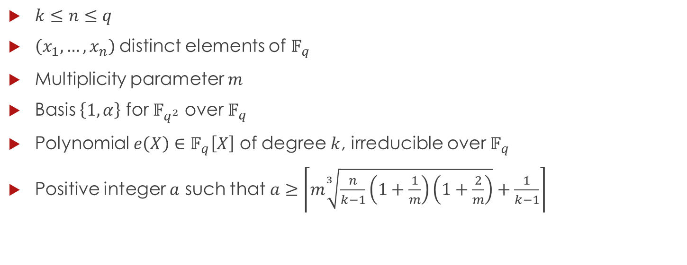
Code Parameters
$k≤n≤q$
$\left(x_{1},…,x_{n}\right)$distinct elements of $𝔽_{q}$
Multiplicity parameter $m$
Basis $\left\{1,α\right\}$ for $𝔽_{q^{2}}$ over $𝔽_{q}$
Polynomial $e\left(X\right)∈𝔽_{q}\left[X\right]$ of degree $k$, irreducible over $𝔽_{q}$
Positive integer $a$ such that $a≥\left\lceil m\sqrt[3]{\frac{n}{k−1}\left(1+\frac{1}{m}\right)\left(1+\frac{2}{m}\right)}+\frac{1}{k−1}\right\rceil$

Slide 23
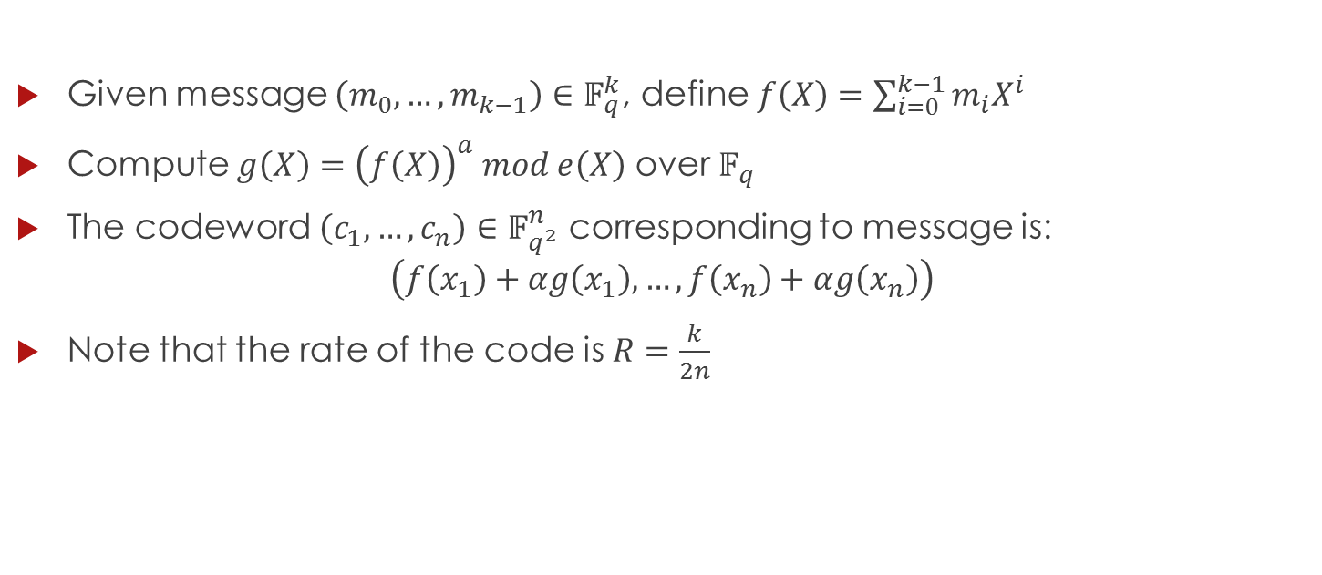
Encoding Algorithm
Given message $\left(m_{0},…,m_{k−1}\right)∈𝔽_{q}^{k}$, define $f\left(X\right)=\sum_{i=0}^{k−1}{m_{i}X^{i}}$
Compute $g\left(X\right)={\left(f\left(X\right)\right)}^{a} mod e\left(X\right)$ over $𝔽_{q}$
The codeword $\left(c_{1},…,c_{n}\right)∈𝔽_{q^{2}}^{n}$ corresponding to message is:
$$\left(f\left(x_{1}\right)+αg\left(x_{1}\right),…,f\left(x_{n}\right)+αg\left(x_{n}\right)\right)$$
Note that the rate of the code is $R=\frac{k}{2n}$

Slide 24
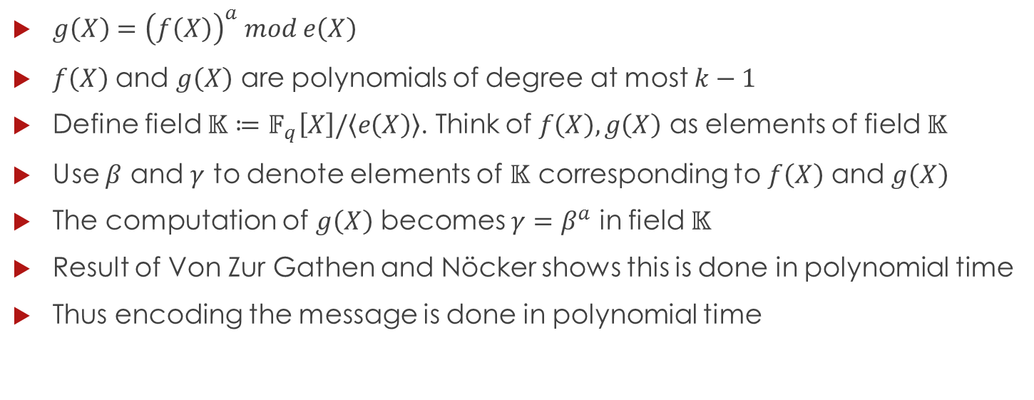
Encoding Time
$g\left(X\right)={\left(f\left(X\right)\right)}^{a} mod e\left(X\right)$
$f\left(X\right)$ and $g\left(X\right)$ are polynomials of degree at most $k−1$
Define field $𝕂≔𝔽_{q}\left[X\right]/\left\langle e\left(X\right)\right\rangle$. Think of $f\left(X\right),g\left(X\right)$ as elements of field $𝕂$
Use $β$ and $γ$ to denote elements of $𝕂$ corresponding to $f\left(X\right)$ and $g\left(X\right)$
The computation of $g\left(X\right)$ becomes $γ=β^{a}$ in field $𝕂$
Result of Von Zur Gathen and Nöcker shows this is done in polynomial time
Thus encoding the message is done in polynomial time

Slide 25
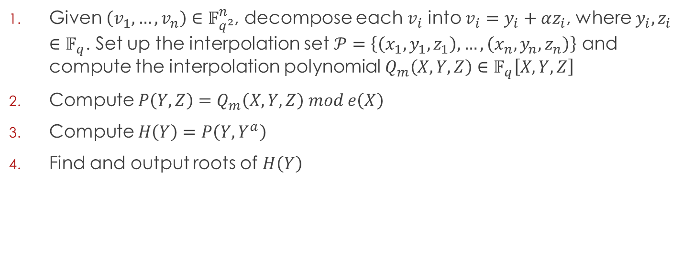
Decoding Algorithm
Given $\left(v_{1},…,v_{n}\right)∈𝔽_{q^{2}}^{n}$, decompose each $v_{i}$ into $v_{i}=y_{i}+αz_{i}$, where $y_{i},z_{i}∈𝔽_{q}$. Set up the interpolation set $𝒫=\left\{\left(x_{1},y_{1},z_{1}\right),…,\left(x_{n},y_{n},z_{n}\right)\right\}$ and compute the interpolation polynomial $Q_{m}\left(X,Y,Z\right)∈𝔽_{q}\left[X,Y,Z\right]$
Compute $P\left(Y,Z\right)=Q_{m}\left(X,Y,Z\right) mod e\left(X\right)$
Compute $H\left(Y\right)=P\left(Y,Y^{a}\right)$
Find and output roots of $H\left(Y\right)$
Notes:
Plan: 1. Understand each step and how to perform it in polynomial time. 2. Correctness (why does this algorithm produce all wanted polynomials).

Slide 26
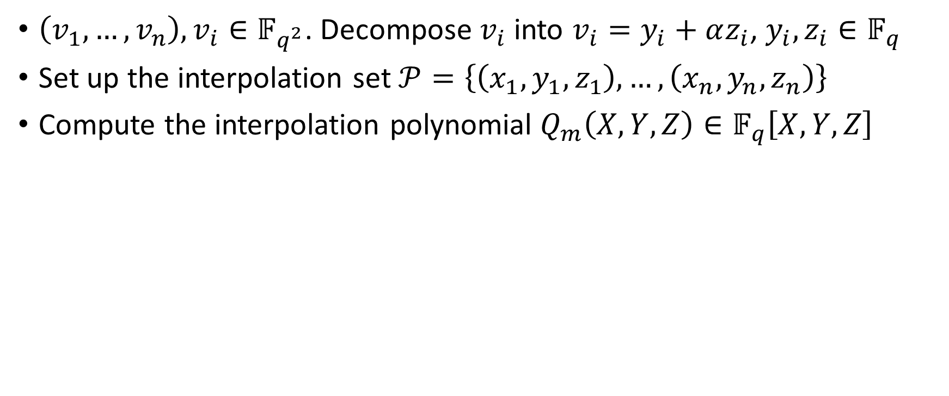
Decoding – Step 1
$\left(v_{1},…,v_{n}\right),v_{i}∈𝔽_{q^{2}}$. Decompose $v_{i}$ into $v_{i}=y_{i}+αz_{i}$, $y_{i},z_{i}∈𝔽_{q}$
Set up the interpolation set $𝒫=\left\{\left(x_{1},y_{1},z_{1}\right),…,\left(x_{n},y_{n},z_{n}\right)\right\}$
Compute the interpolation polynomial $Q_{m}\left(X,Y,Z\right)∈𝔽_{q}\left[X,Y,Z\right]$

Slide 27
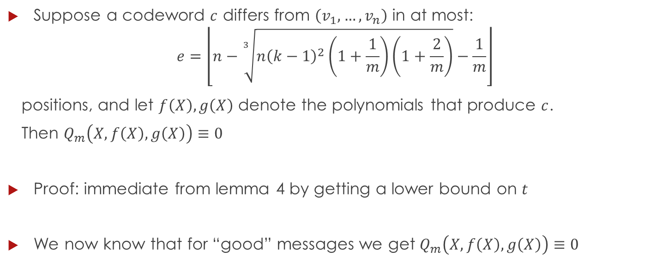
Lemma 6
Suppose a codeword $c$ differs from $\left(v_{1},…,v_{n}\right)$ in at most:
$$e=\left\lfloor n−\sqrt[3]{n{\left(k−1\right)}^{2}\left(1+\frac{1}{m}\right)\left(1+\frac{2}{m}\right)}−\frac{1}{m}\right\rfloor$$
positions, and let $f\left(X\right),g\left(X\right)$ denote the polynomials that produce $c$.
Then $Q_{m}\left(X,f\left(X\right),g\left(X\right)\right)≡0$
Proof: immediate from lemma 4 by getting a lower bound on $t$
We now know that for “good” messages we get $Q_{m}\left(X,f\left(X\right),g\left(X\right)\right)≡0$

Slide 28
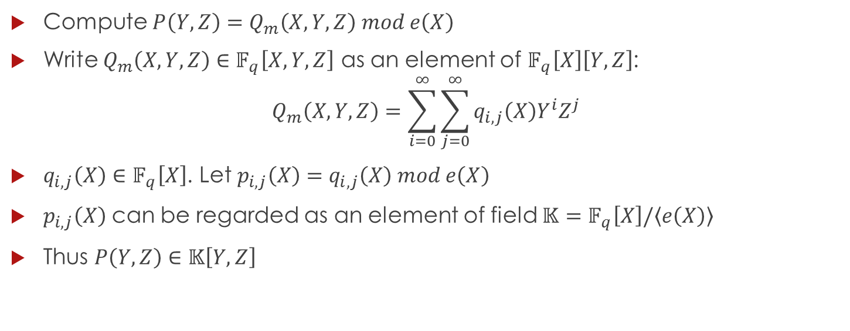
Decoding – Step 2
Compute $P\left(Y,Z\right)=Q_{m}\left(X,Y,Z\right) mod e\left(X\right)$
Write $Q_{m}\left(X,Y,Z\right)∈𝔽_{q}\left[X,Y,Z\right]$ as an element of $𝔽_{q}\left[X\right]\left[Y,Z\right]$:
$$Q_{m}\left(X,Y,Z\right)=\sum_{i=0}^{∞}{\sum_{j=0}^{∞}{q_{i,j}\left(X\right)Y^{i}Z^{j}}}$$
$q_{i,j}\left(X\right)∈𝔽_{q}\left[X\right]$. Let $p_{i,j}\left(X\right)=q_{i,j}\left(X\right) mod e\left(X\right)$
$p_{i,j}\left(X\right)$ can be regarded as an element of field $𝕂=𝔽_{q}\left[X\right]/\left\langle e\left(X\right)\right\rangle$
Thus $P\left(Y,Z\right)∈𝕂\left[Y,Z\right]$

Slide 29
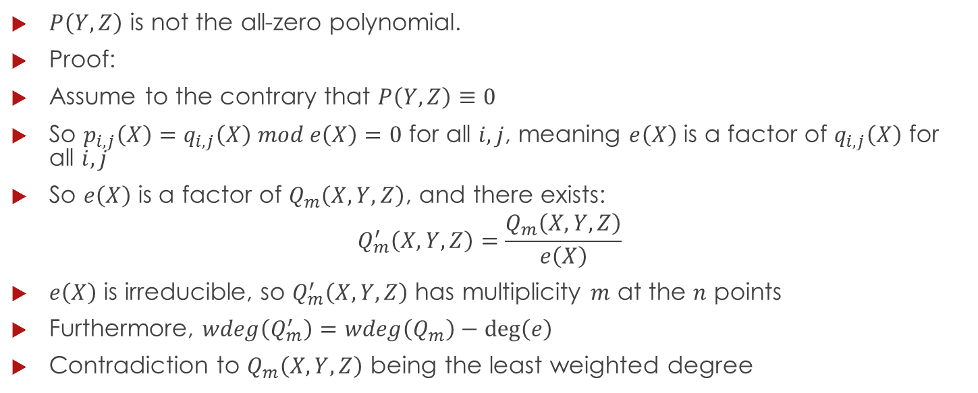
Lemma 7
$P\left(Y,Z\right)$ is not the all-zero polynomial.
Proof:
Assume to the contrary that $P\left(Y,Z\right)≡0$
So $p_{i,j}\left(X\right)=q_{i,j}\left(X\right) mod e\left(X\right)=0$ for all $i,j$, meaning $e\left(X\right)$ is a factor of $q_{i,j}\left(X\right)$ for all $i,j$
So $e\left(X\right)$ is a factor of $Q_{m}\left(X,Y,Z\right)$, and there exists:
$$Q_{m}^{′}\left(X,Y,Z\right)=\frac{Q_{m}\left(X,Y,Z\right)}{e\left(X\right)}$$
$e\left(X\right)$ is irreducible, so $Q_{m}^{′}\left(X,Y,Z\right)$ has multiplicity $m$ at the $n$ points
Furthermore, $wdeg\left(Q_{m}^{′}\right)=wdeg\left(Q_{m}\right)−\deg\left(e\right)$
Contradiction to $Q_{m}\left(X,Y,Z\right)$ being the least weighted degree

Slide 30
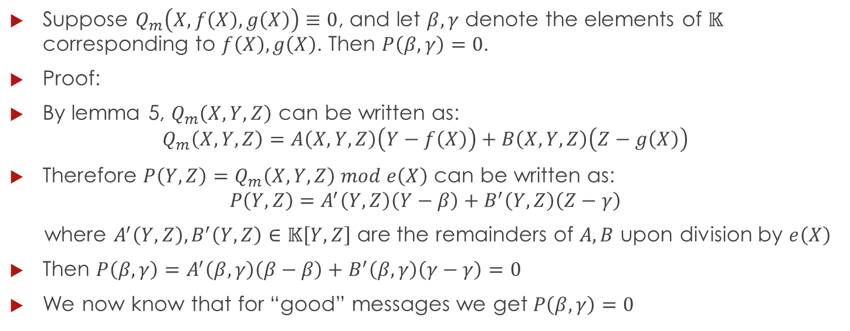
Lemma 8
Suppose $Q_{m}\left(X,f\left(X\right),g\left(X\right)\right)≡0$, and let $β,γ$ denote the elements of $𝕂$ corresponding to $f\left(X\right),g\left(X\right)$. Then $P\left(β,γ\right)=0$.
Proof:
By lemma 5, $Q_{m}\left(X,Y,Z\right)$ can be written as:
$$Q_{m}\left(X,Y,Z\right)=A\left(X,Y,Z\right)\left(Y−f\left(X\right)\right)+B\left(X,Y,Z\right)\left(Z−g\left(X\right)\right)$$
Therefore $P\left(Y,Z\right)=Q_{m}\left(X,Y,Z\right) mod e\left(X\right)$ can be written as:
$$P\left(Y,Z\right)=A^{′}\left(Y,Z\right)\left(Y−β\right)+B^{′}\left(Y,Z\right)\left(Z−γ\right)$$
where $A^{′}\left(Y,Z\right),B^{′}\left(Y,Z\right)∈𝕂\left[Y,Z\right]$ are the remainders of $A,B$ upon division by $e\left(X\right)$
Then $P\left(β,γ\right)=A^{′}\left(β,γ\right)\left(β−β\right)+B^{′}\left(β,γ\right)\left(γ−γ\right)=0$
We now know that for “good” messages we get $P\left(β,γ\right)=0$

Slide 31
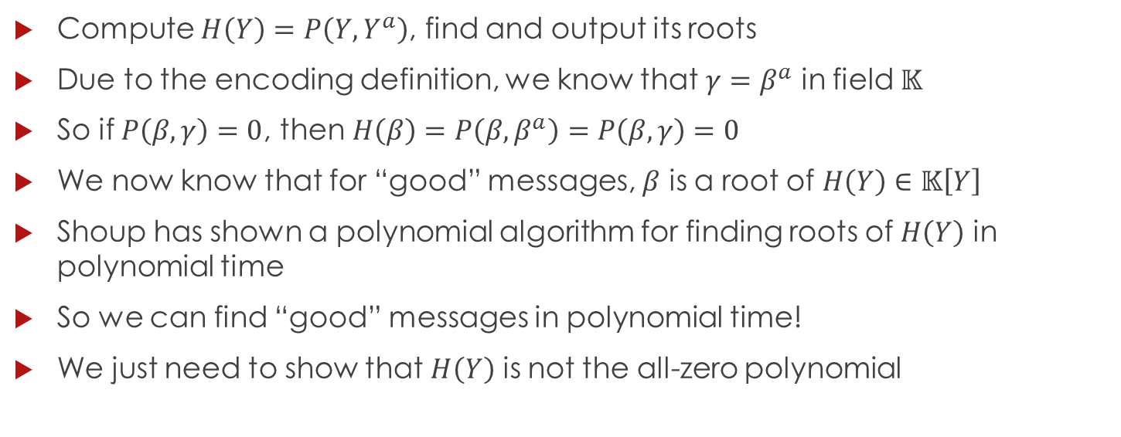
Decoding – Steps 3,4
Compute $H\left(Y\right)=P\left(Y,Y^{a}\right)$, find and output its roots
Due to the encoding definition, we know that $γ=β^{a}$ in field $𝕂$
So if $P\left(β,γ\right)=0$, then $H\left(β\right)=P\left(β,β^{a}\right)=P\left(β,γ\right)=0$
We now know that for “good” messages, $β$ is a root of $H\left(Y\right)∈𝕂\left[Y\right]$
Shoup has shown a polynomial algorithm for finding roots of $H\left(Y\right)$ in polynomial time
So we can find “good” messages in polynomial time!
We just need to show that $H\left(Y\right)$ is not the all-zero polynomial

Slide 32
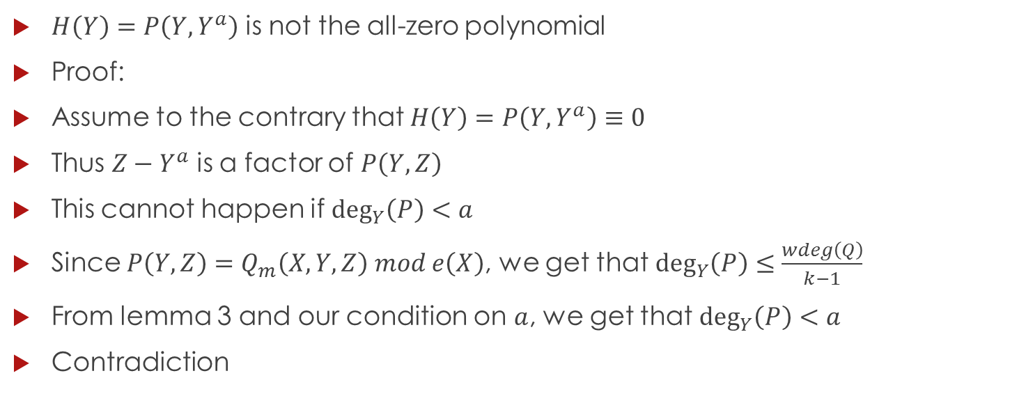
Lemma 9
$H\left(Y\right)=P\left(Y,Y^{a}\right)$ is not the all-zero polynomial
Proof:
Assume to the contrary that $H\left(Y\right)=P\left(Y,Y^{a}\right)≡0$
Thus $Z−Y^{a}$ is a factor of $P\left(Y,Z\right)$
This cannot happen if $\deg_{Y}\left(P\right)<a$
Since $P\left(Y,Z\right)=Q_{m}\left(X,Y,Z\right) mod e\left(X\right)$, we get that $\deg_{Y}\left(P\right)≤\frac{wdeg\left(Q\right)}{k−1}$
From lemma 3 and our condition on $a$, we get that $\deg_{Y}\left(P\right)<a$
Contradiction

Slide 33
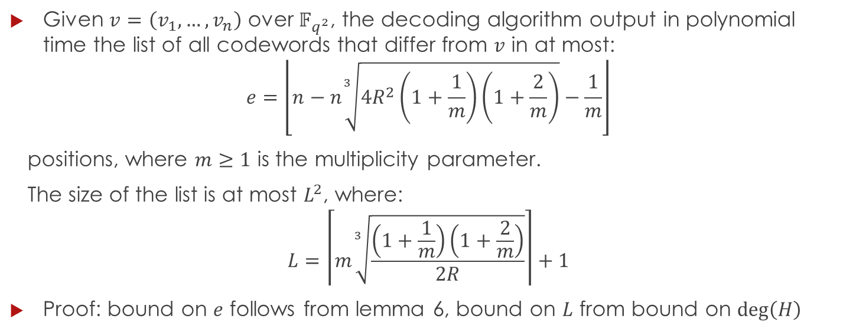
Theorem 10
Given $v=\left(v_{1},…,v_{n}\right)$ over $𝔽_{q^{2}}$, the decoding algorithm output in polynomial time the list of all codewords that differ from $v$ in at most:
$$e=\left\lfloor n−n\sqrt[3]{4R^{2}\left(1+\frac{1}{m}\right)\left(1+\frac{2}{m}\right)}−\frac{1}{m}\right\rfloor$$
positions, where $m≥1$ is the multiplicity parameter.
The size of the list is at most $L^{2}$, where:
$$L=\left\lceil m\sqrt[3]{\frac{\left(1+\frac{1}{m}\right)\left(1+\frac{2}{m}\right)}{2R}}\right\rceil +1$$
Proof: bound on $e$ follows from lemma 6, bound on $L$ from bound on $\deg\left(H\right)$

Slide 34
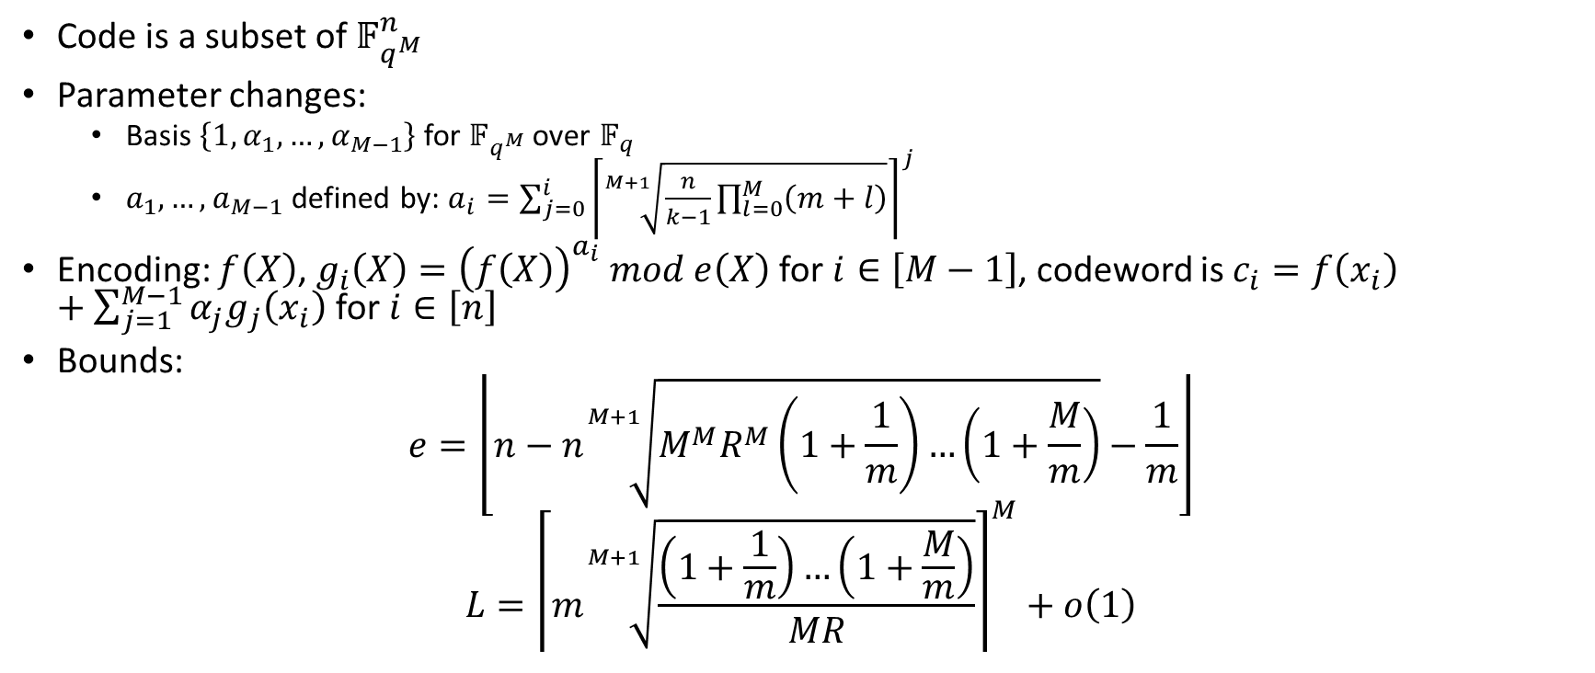
Parvaresh-Vardy General Case
Code is a subset of $𝔽_{q^{M}}^{n}$
Parameter changes:
  Basis $\left\{1,α_{1},…,α_{M−1}\right\}$ for $𝔽_{q^{M}}$ over $𝔽_{q}$
  $a_{1},…,a_{M−1}$ defined by: $a_{i}=\sum_{j=0}^{i}{{\left\lceil \sqrt[M+1]{\frac{n}{k−1}\prod_{l=0}^{M}{\left(m+l\right)}}\right\rceil }^{j}}$
Encoding: $f\left(X\right)$, $g_{i}\left(X\right)={\left(f\left(X\right)\right)}^{a_{i}} mod e\left(X\right)$ for $i∈\left[M−1\right]$, codeword is $c_{i}=f\left(x_{i}\right)+\sum_{j=1}^{M−1}{α_{j}g_{j}\left(x_{i}\right)}$ for $i∈\left[n\right]$
Bounds:
$$e=\left\lfloor n−n\sqrt[M+1]{M^{M}R^{M}\left(1+\frac{1}{m}\right)…\left(1+\frac{M}{m}\right)}−\frac{1}{m}\right\rfloor$$
$$L={\left\lceil m\sqrt[M+1]{\frac{\left(1+\frac{1}{m}\right)…\left(1+\frac{M}{m}\right)}{MR}}\right\rceil }^{M}+o\left(1\right)$$

Slide 35
That’s All Folks!

