Slide 1
RS – Reed Solomon
Error correcting code

Slide 2
Error-correcting codes are clever ways of representing data so that one can recover the original information even if parts of it are corrupted.
We will do it using redundancy so that the original information can be recovered even when parts of the (redundant) data have been corrupted.

Slide 3
There is a sender who wants to send k message symbols over a noisy channel.
The sender first encodes the k message symbols into n symbols (called a codeword) and then sends it over the channel.
The receiver gets a word consisting of n symbols.
The receiver then tries to decode and recover the original k message symbols.
Thus, encoding is the process of adding redundancy and decoding is the process of removing errors and recovering the original message.

Slide 4
The most interesting question is the tradeoff between the amount of redundancy used and the number of errors that can be corrected by a code.
Intuitively, maximizing error correction and minimizing redundancy are contradictory goals:
A code with higher redundancy should be able to recover from more errors.

Slide 5
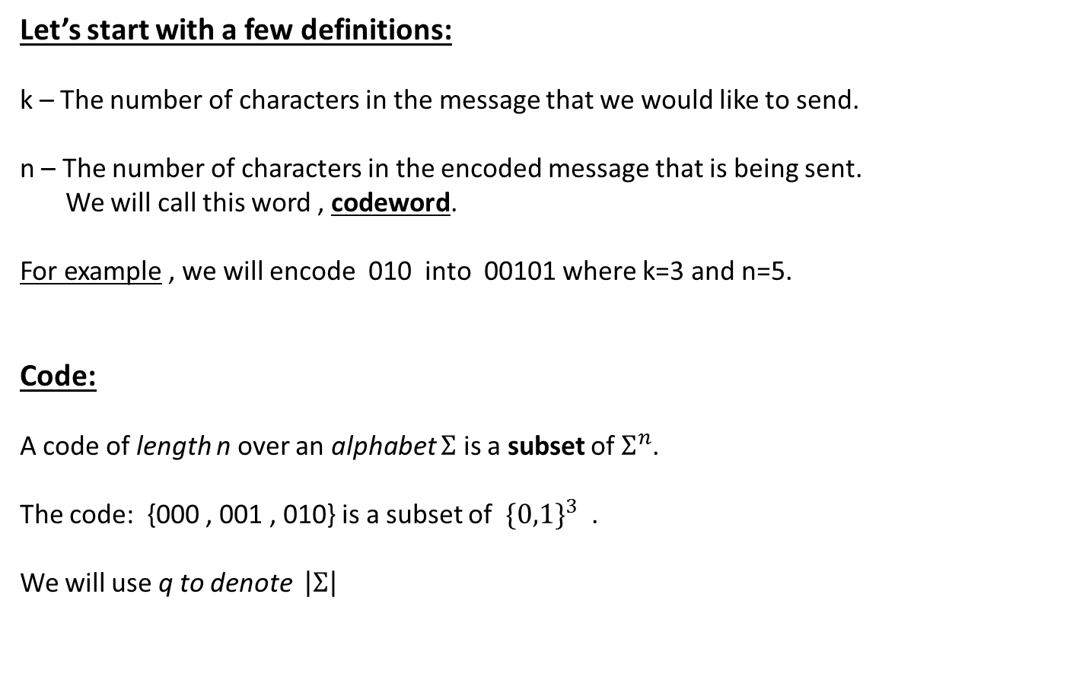
Let’s start with a few definitions:
k – The number of characters in the message that we would like to send.
n – The number of characters in the encoded message that is being sent.
We will call this word , codeword.
For example , we will encode 010 into 00101 where k=3 and n=5.
Code:
A code of length n over an alphabet $Σ$ is a subset of $Σ^{n}$.
The code: {000 , 001 , 010} is a subset of ${\{0,1\}}^{3}$ .
We will use q to denote $\left|Σ\right|$

Slide 6
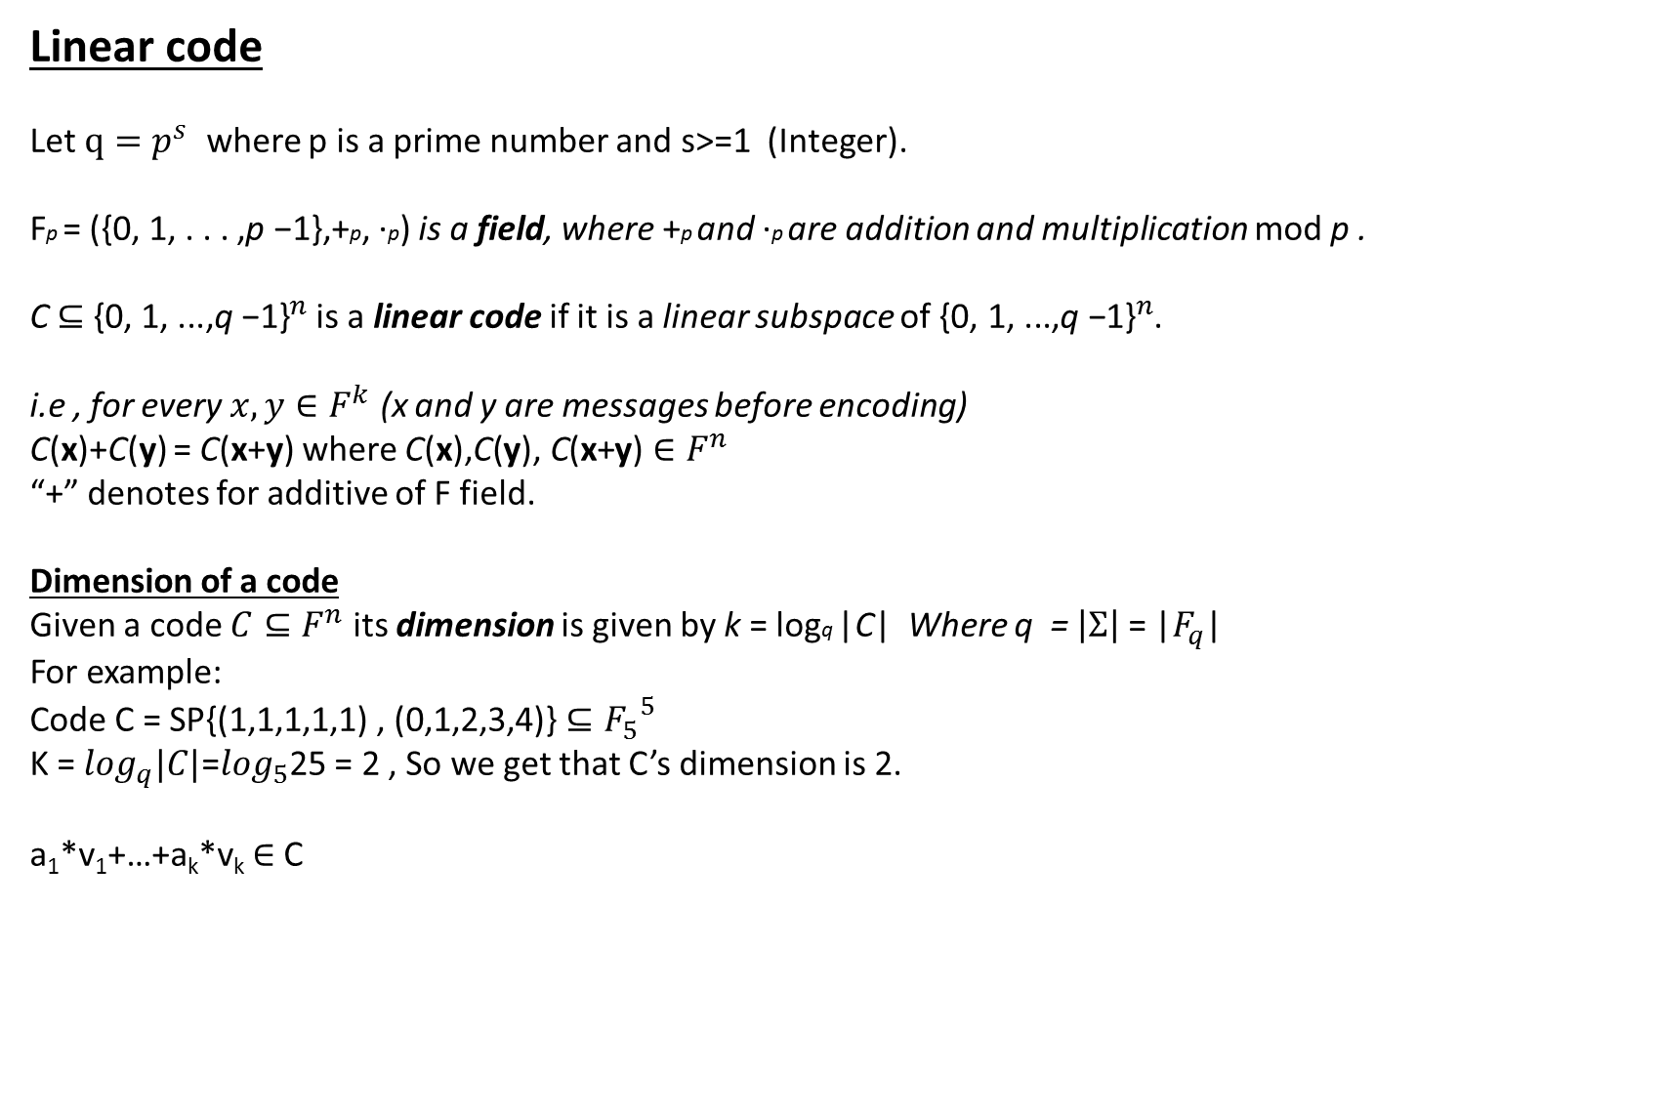
Linear code
Let $q=p^{s}$ where p is a prime number and s>=1 (Integer).
Fp = ({0, 1, . . . ,p −1},+p, ·p) is a field, where +p and ·p are addition and multiplication mod p .
C $⊆$ ${\text{\{}\text{0}\text{, }\text{1}\text{, ...,}\text{q} \text{−}\text{1}\text{\}}}^{n}$ is a linear code if it is a linear subspace of ${\text{\{}\text{0}\text{, }\text{1}\text{, ...,}\text{q} \text{−}\text{1}\text{\}}}^{n}$.
i.e , for every $x,y∈F^{k}$ (x and y are messages before encoding)
C(x)+C(y) = C(x+y) where $\text{C}\text{(}\text{x}\text{),}\text{C}\text{(}\text{y}\text{),} \text{C}\text{(}\text{x}\text{+}\text{y}\text{)}∈F^{n}$
“+” denotes for additive of F field.
Dimension of a code
Given a code $C⊆F^{n}$ its dimension is given by k = logq |C| Where q =$\left|Σ\right|$ = |$F_{q}$|
For example:
Code C = SP{(1,1,1,1,1) , (0,1,2,3,4)} $⊆{F_{5}}^{5}$
K =$\log_{q}|C|$=$\log_{5}$25 = 2 , So we get that C’s dimension is 2.
a₁*v₁+…+a_{k}*v_{k} $∈$ C

Slide 7
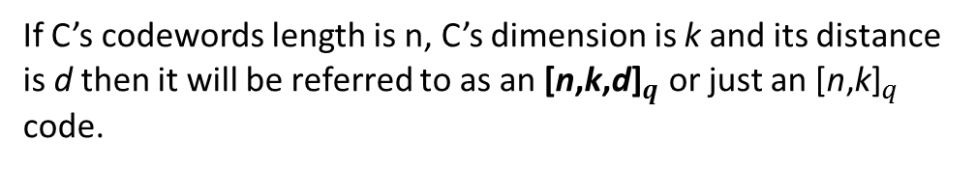
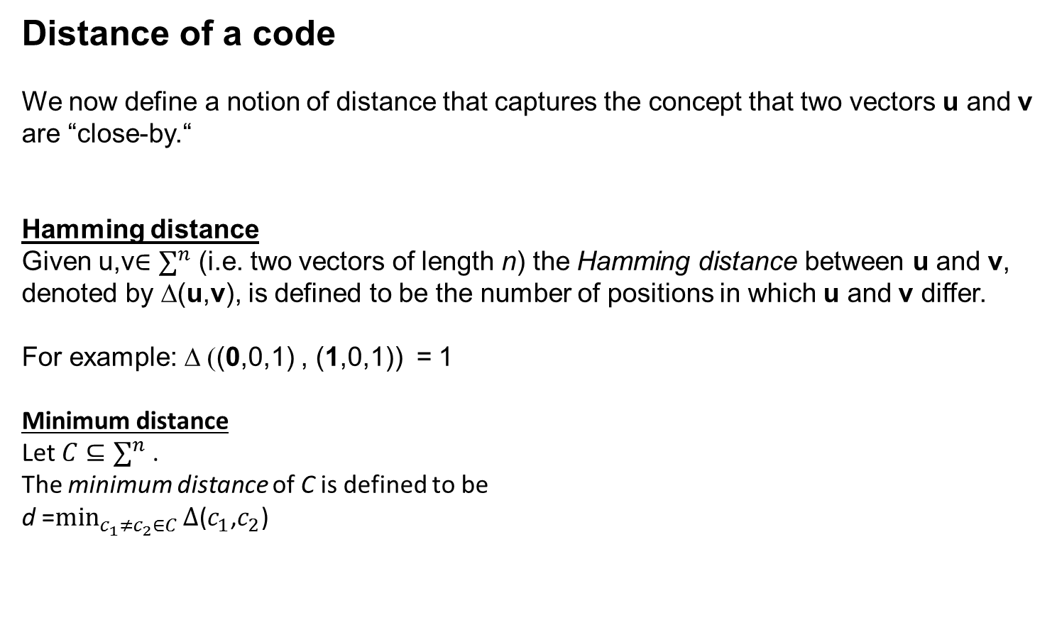
Distance of a code
We now define a notion of distance that captures the concept that two vectors u and v are “close-by.“
Hamming distance
Given u,v$∈∑^{n}$ (i.e. two vectors of length n) the Hamming distance between u and v, denoted by ∆(u,v), is defined to be the number of positions in which u and v differ.
For example: ∆ ((0,0,1) , (1,0,1)) = 1
Minimum distance
Let $C⊆∑^{n}$ .
The minimum distance of C is defined to be
d =$\min_{c_{1}≠c_{2}∈C}{∆\text{(}c_{1}\text{,}c_{2}\text{)}}$
If C’s codewords length is n, C’s dimension is k and its distance is d then it will be referred to as an ${\text{[}\text{n}\text{,}\text{k}\text{,}\text{d}\text{]}}_{q}$ or just an ${\text{[}\text{n}\text{,}\text{k}\text{]}}_{q}$ code.

Slide 8

Questions:
Message length (dimension)?
Codeword length?
Distance of the code?
(Note: every two codewords have at most one
identical position)
4. What is the size of Ʃ?
Code C = SP{(1,1,1,1,1) , (0,1,2,3,4)} $⊆{F_{5}}^{5}$

Slide 9

Generator matrix
A generator matrix is a matrix whose rows form a basis for a linear code.
The codewords are all of the linear combinations of the rows of this matrix.

Slide 10
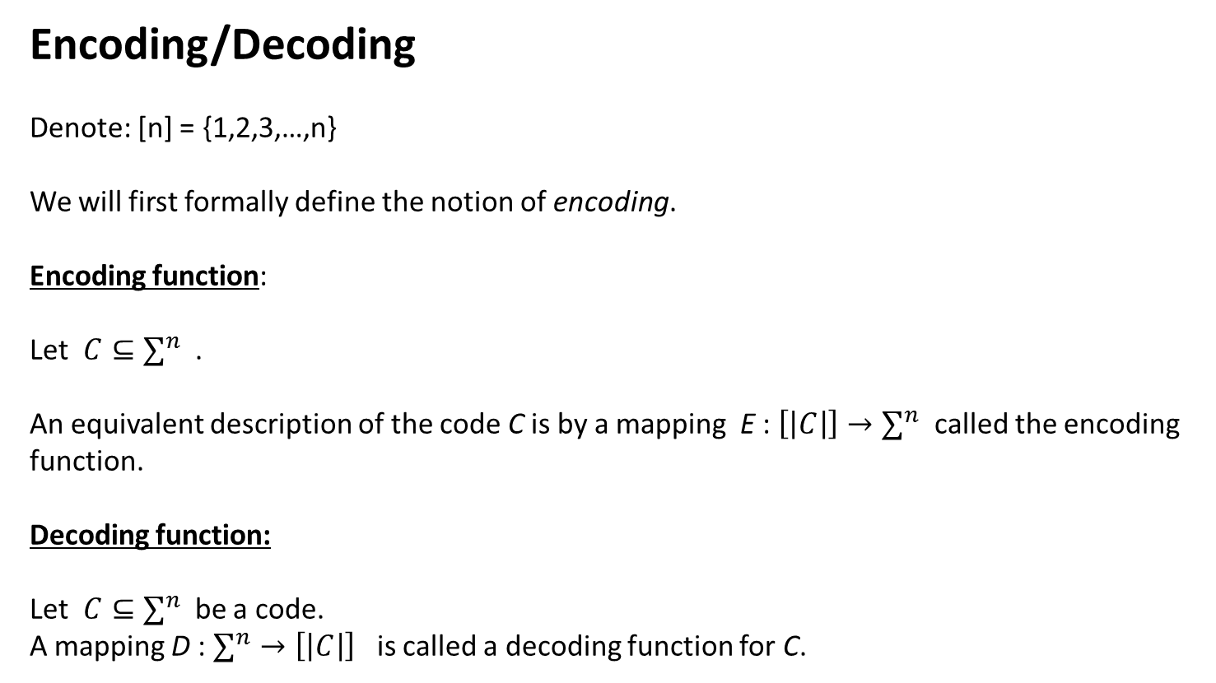
Encoding/Decoding
Denote: [n] = {1,2,3,…,n}
We will first formally define the notion of encoding.
Encoding function:
Let $C⊆∑^{n}$ .
An equivalent description of the code C is by a mapping E : $\left[\left|C\right|\right]→∑^{n}$ called the encoding function.
Decoding function:
Let $C⊆∑^{n}$ be a code.
A mapping D : $∑^{n}→\left[\left|C\right|\right]$ is called a decoding function for C.

Slide 11
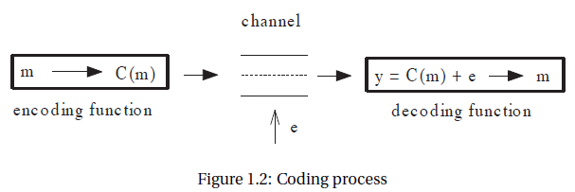
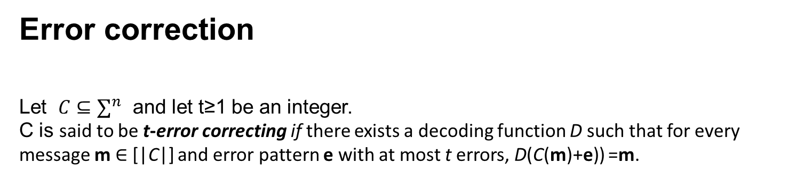
Error correction
Let $C⊆∑^{n}$ and let t≥1 be an integer.
C is said to be t-error correcting if there exists a decoding function D such that for every message m$∈$ [|C|] and error pattern e with at most t errors, D(C(m)+e)) =m.

Slide 12
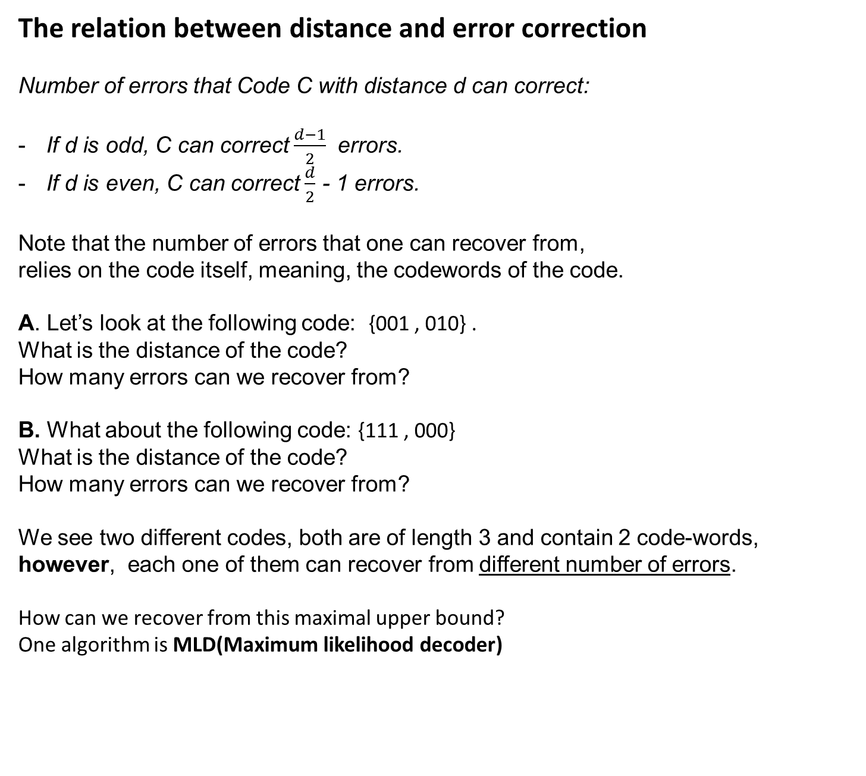
The relation between distance and error correction
Number of errors that Code C with distance d can correct:
If d is odd, C can correct $\frac{d−1}{2}$ errors.
If d is even, C can correct $\frac{d}{2}$ - 1 errors.
Note that the number of errors that one can recover from,
relies on the code itself, meaning, the codewords of the code.
A. Let’s look at the following code: {001 , 010} .
What is the distance of the code?
How many errors can we recover from?
B. What about the following code: {111 , 000}
What is the distance of the code?
How many errors can we recover from?
We see two different codes, both are of length 3 and contain 2 code-words, however, each one of them can recover from different number of errors.
How can we recover from this maximal upper bound?
One algorithm is MLD(Maximum likelihood decoder)

Slide 13
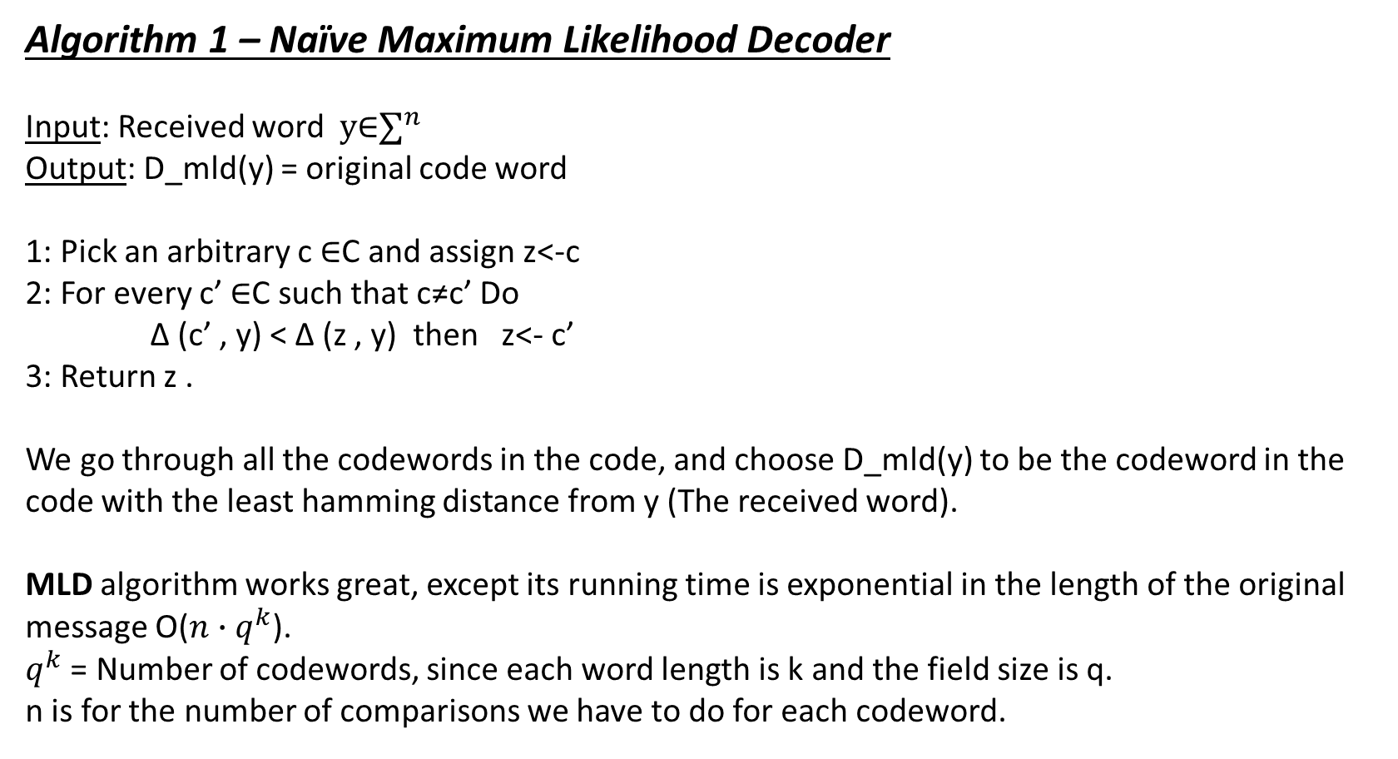
Algorithm 1 – Naïve Maximum Likelihood Decoder
Input: Received word $y\text{∈}∑^{n}$
Output: D_mld(y) = original code word
1: Pick an arbitrary c $\text{∈}$C and assign z<-c
2: For every c’ $\text{∈}$C such that c≠c’ Do
∆ (c’ , y) < ∆ (z , y) then z<- c’
3: Return z .
We go through all the codewords in the code, and choose D_mld(y) to be the codeword in the code with the least hamming distance from y (The received word).
MLD algorithm works great, except its running time is exponential in the length of the original message O(${n∙q}^{k}$).
$q^{k}$ = Number of codewords, since each word length is k and the field size is q.
n is for the number of comparisons we have to do for each codeword.

Slide 14
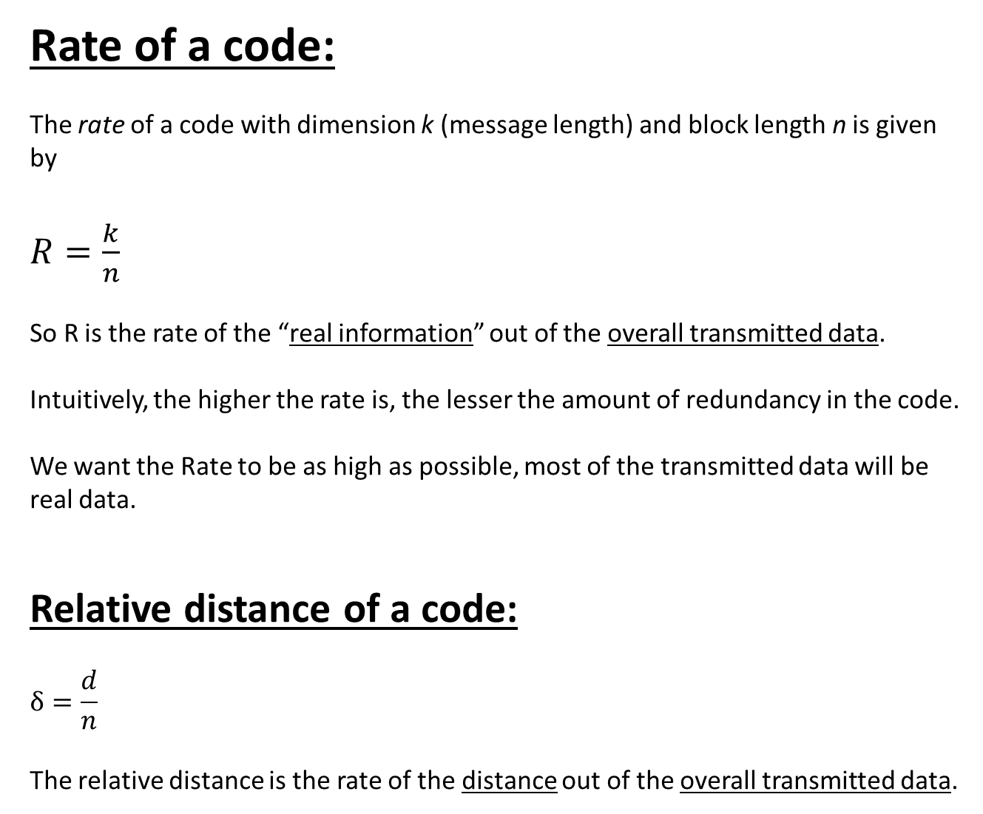
Rate of a code:
The rate of a code with dimension k (message length) and block length n is given by
$R=\frac{k}{n}$
So R is the rate of the “real information” out of the overall transmitted data.
Intuitively, the higher the rate is, the lesser the amount of redundancy in the code.
We want the Rate to be as high as possible, most of the transmitted data will be real data.
Relative distance of a code:
$$δ=\frac{d}{n}$$
The relative distance is the rate of the distance out of the overall transmitted data.

Slide 15
Questions:
Rate?
Relative distance?

Slide 16

The Singleton bound states that for any [n,k,d]_{q} code, k ≤ n−d +1.
In other words, the upper bound distance of a code with k-message length and n-codeword length is n-k+1.
[d ≤ n-k+1]
We can look at this bound as following:
k≤n-d+1
k+d≤n+1
$\frac{k}{n}$+$\frac{d}{n}$≤1+$\frac{1}{n}$
R(x)+δ(x)≤1+$\frac{1}{n}$
Let’s say that the encoded message length n , is fixed.
We can see that increasing the rate will result in decreased the relative distance and vice versa.

Slide 17
The Greatest Code of Them All: Reed-Solomon Codes
Reed Solomon code is based upon interpolation using polynomials over finite fields.
Interpolation is a method of constructing a polynomial that goes through a given set of points.

Slide 18
Reed-Solomon Codes
We will start with an example of Reed-Solomon codes:
Our Σ = F3 = {0, 1,2} where +p and ·p are addition and multiplication mod p .
As we stated before , F3 is a field.
Let us transmit the following message: (2,1).
1. Set the polynomial coefficients to be the message elements 2,1 : f(x) = 2+1∙x
2. Evaluate the polynomial values at predefined points (all field elements) x=0 , x=1 , x=2:
(x=0,y=2) , (x=1,y=0) , (x=2,y=1) .
3. Transmit the evaluation result , meaning codeword : (2,0,1)

Slide 19
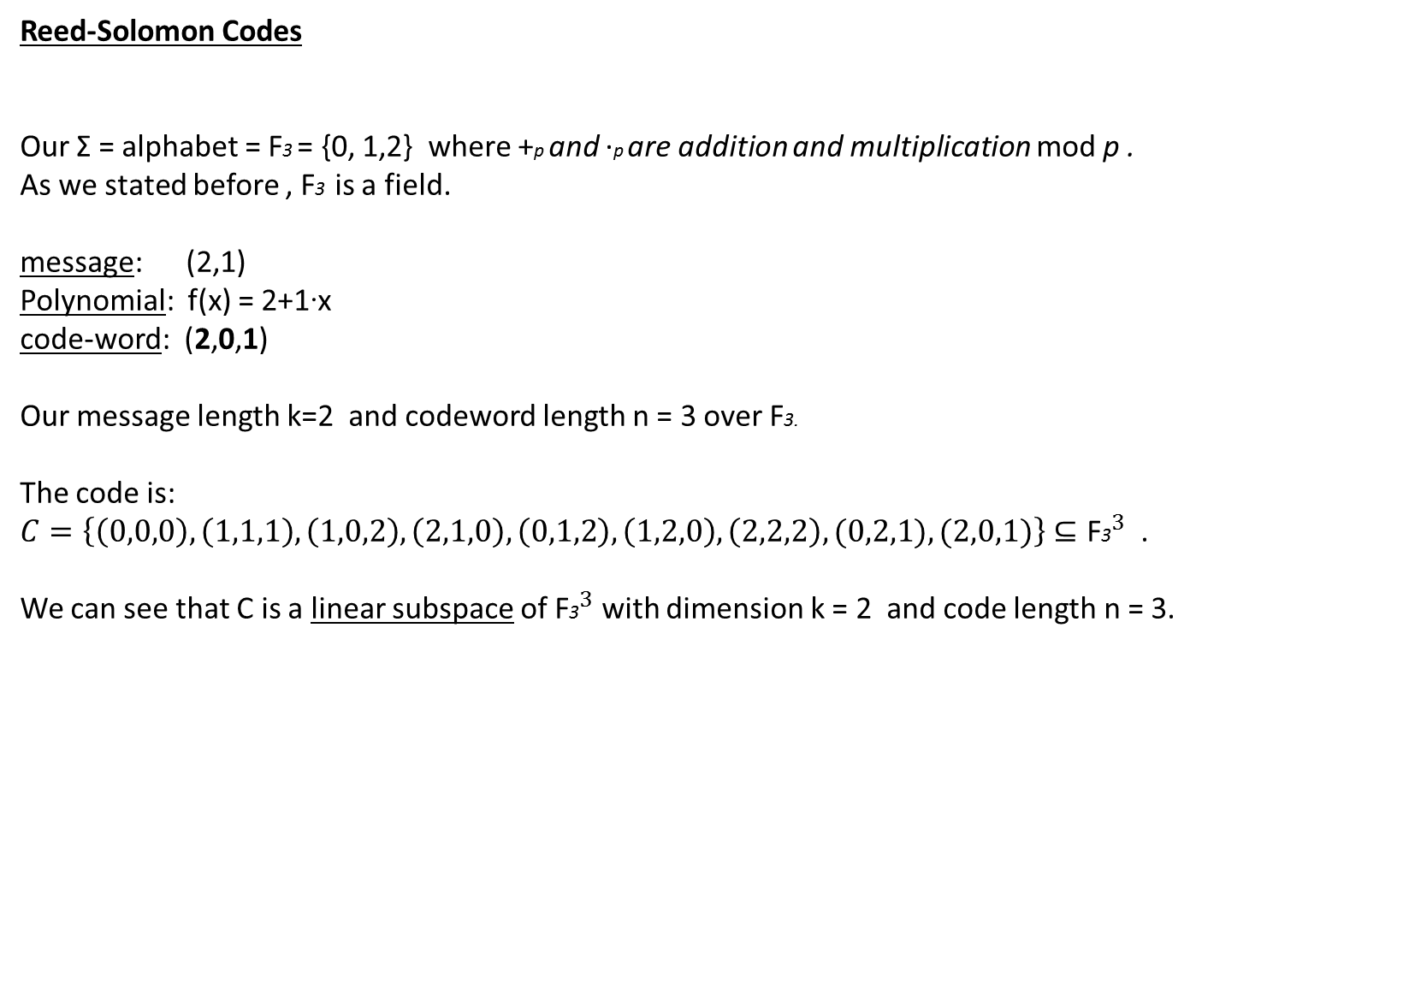
Reed-Solomon Codes
Our Σ = alphabet = F3 = {0, 1,2} where +p and ·p are addition and multiplication mod p .
As we stated before , F3 is a field.
message: (2,1)
Polynomial: f(x) = 2+1∙x
code-word: (2,0,1)
Our message length k=2 and codeword length n = 3 over F3.
The code is:
$C=\left\{\left(0,0,0\right),\left(1,1,1\right),\left(1,0,2\right),\left(2,1,0\right),\left(0,1,2\right),\left(1,2,0\right),\left(2,2,2\right),(0,2,1),(2,0,1)\right\}⊆{\text{F}\text{3}}^{3}$ .
We can see that C is a linear subspace of ${\text{F}\text{3}}^{3}$ with dimension k = 2 and code length n = 3.

Slide 20
Question:
What is the relationship between
the encoding algorithm and the
following table?

Slide 21
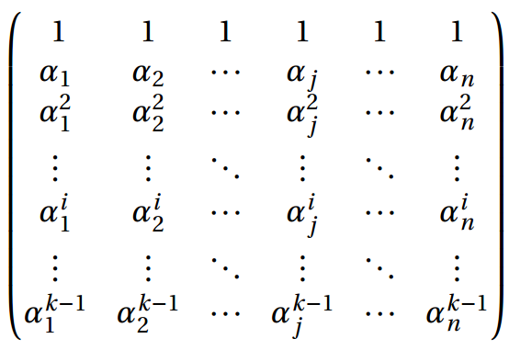
Generator matrix:
The generator matrix of reed-Solomon is Vandermonde matrix.
The Vandermonde matrix evaluates a polynomial at a set of points.
General Vandermonde matrix

Slide 22
Generator matrix:
The generator matrix of reed-Solomon is Vandermonde matrix.
The Vandermonde matrix evaluates a polynomial at a set of points.

Slide 23
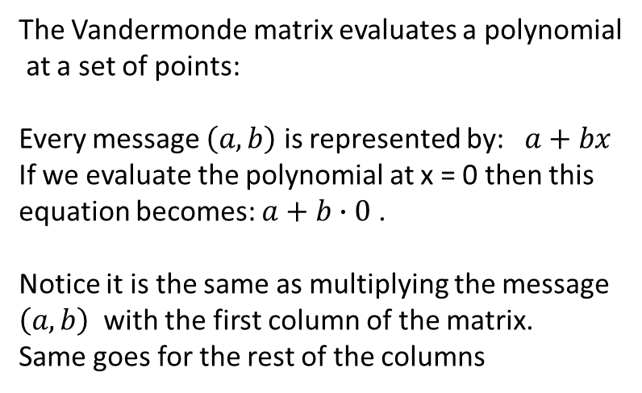
Generator matrix:
The generator matrix of reed-Solomon is Vandermonde matrix.
The Vandermonde matrix evaluates a polynomial at a set of points.
The Vandermonde matrix evaluates a polynomial
at a set of points:
Every message $\left(a,b\right)$ is represented by: $a+bx$
If we evaluate the polynomial at x = 0 then this
equation becomes: $a+b∙0$ .
Notice it is the same as multiplying the message
$\left(a,b\right)$ with the first column of the matrix.
Same goes for the rest of the columns

Slide 24
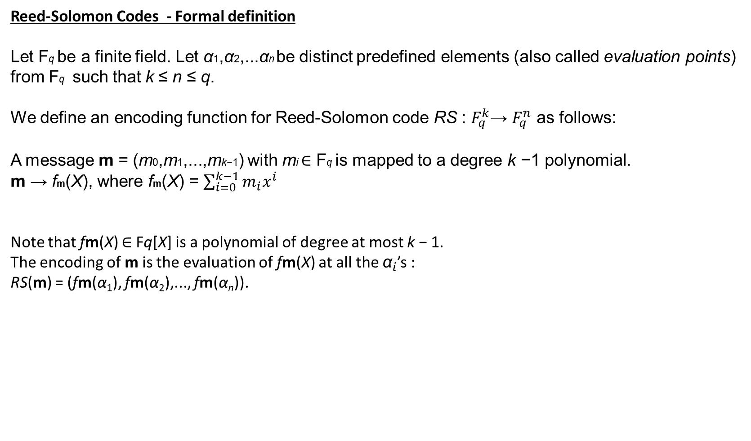
Reed-Solomon Codes - Formal definition
Let Fq be a finite field. Let α1,α2,...αn be distinct predefined elements (also called evaluation points) from Fq such that k ≤ n ≤ q.
We define an encoding function for Reed-Solomon code RS : $F_{q}^{k}$→ $F_{q}^{n}$ as follows:
A message m = (m0,m1,...,mk−1) with mi ∈ Fq is mapped to a degree k −1 polynomial.
m → fm(X), where fm(X) = $\sum_{i=0}^{k−1}{m_{i}x^{i}}$
Note that fm(X) ∈ Fq[X] is a polynomial of degree at most k − 1.
The encoding of m is the evaluation of fm(X) at all the ${\text{α}}_{i}$’s :
RS(m) = (fm(α₁), fm(α₂),..., fm(α_{n})).

Slide 25
Reed-Solomon Codes
Reed-Solomon codes meet the Singleton bound, i.e. satisfy d = n−k+1.
Reminder: The Singleton bound states that for any [n,k,d]_{q} code, d ≤ n−k+1.
[ n is the code-word length, k is the message length and d is the code distance. ]
This means that Reed-Solomon codes meet the upper bound efficiency between the redundancy and the
error recovering capability, i.e. we send the maximal amount of real data when k and n are given.

Slide 26
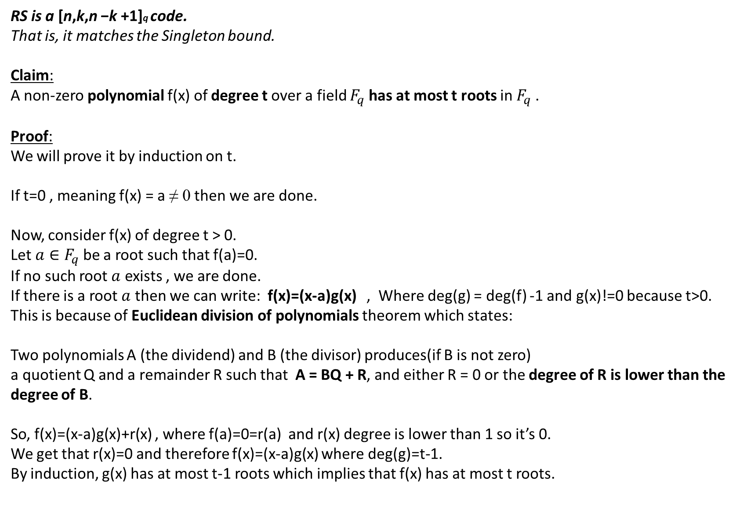
RS is a [n,k,n −k +1]q code.
That is, it matches the Singleton bound.
Claim:
A non-zero polynomial f(x) of degree t over a field $F_{q}$ has at most t roots in $F_{q}$ .
Proof:
We will prove it by induction on t.
If t=0 , meaning f(x) = a ≠ 0 then we are done.
Now, consider f(x) of degree t > 0.
Let ${a∈F}_{q}$ be a root such that f(a)=0.
If no such root $a$ exists , we are done.
If there is a root $a$ then we can write: f(x)=(x-a)g(x) , Where deg(g) = deg(f) -1 and g(x)!=0 because t>0.
This is because of Euclidean division of polynomials theorem which states:
Two polynomials A (the dividend) and B (the divisor) produces(if B is not zero)
a quotient Q and a remainder R such that A = BQ + R, and either R = 0 or the degree of R is lower than the degree of B.
So, f(x)=(x-a)g(x)+r(x) , where f(a)=0=r(a) and r(x) degree is lower than 1 so it’s 0.
We get that r(x)=0 and therefore f(x)=(x-a)g(x) where deg(g)=t-1.
By induction, g(x) has at most t-1 roots which implies that f(x) has at most t roots.

Slide 27
RS is a [n,k,n −k +1]q code.
That is, it matches the Singleton bound.
Claim:
If p(x) and q(x) are polynomials of degree at most k-1 and identical for k values then p(x)=q(x).
Proof:
We will assume that p(x)≠q(x).
Then f(x)=p(x)-q(x)≠0 is a polynomial of degree at most k-1.
However, we know that they are identical for k values,
so f(x) has at least k roots, but f(x)’s degree is at most k-1.
Every polynomial (except for zero polynomial) of degree n has at most n root.
Therefore f(x) = 0 which means p(x)=q(x), and we got contradiction.

Slide 28
RS is a [n,k,n −k +1]q code.
That is, it matches the Singleton bound.
Claim:
If p(x) and q(x) are polynomials of degree at most k-1 and identical for k values then p(x)=q(x).
Conclusion:
Each message is being translated into a polynomial of degree at most k-1.
That is because the message length is k , and each message character represents a coefficient of the polynomial.
Every two different messages represent different polynomials.
This polynomial is evaluated at n different evaluation points (different field elements).
Each one of the evaluations represents a value of the polynomial at a specific point, and the entire sequence of evaluations represents a codeword.
If every two polynomials are identical for at most k-1 values, and we evaluate them at n different points then they are different on at least n-(k-1)=n-k+1=d of the evaluations.
Therefore, every two encoded messages are different in at least n-k+1 elements.

Slide 29
Decoding of Reed-Solomon Codes
At first, we had a k length message which we translated to a polynomial of k-1 degree at most.
Each character was a polynomial coefficient.
Then we evaluated it at n different points.
These values represent the encoded message that we send.
The receiver side receives this values with random noise.
Now, the receiver needs to construct the original polynomial which represents the original message using these evaluations.
Note that every k points define a unique polynomial with degree of at most k-1.
Why? Let’s assume that two different polynomial with degree of at most k-1 are identical on these k points. Then, as proved earlier, they must be the same polynomial.

Slide 30
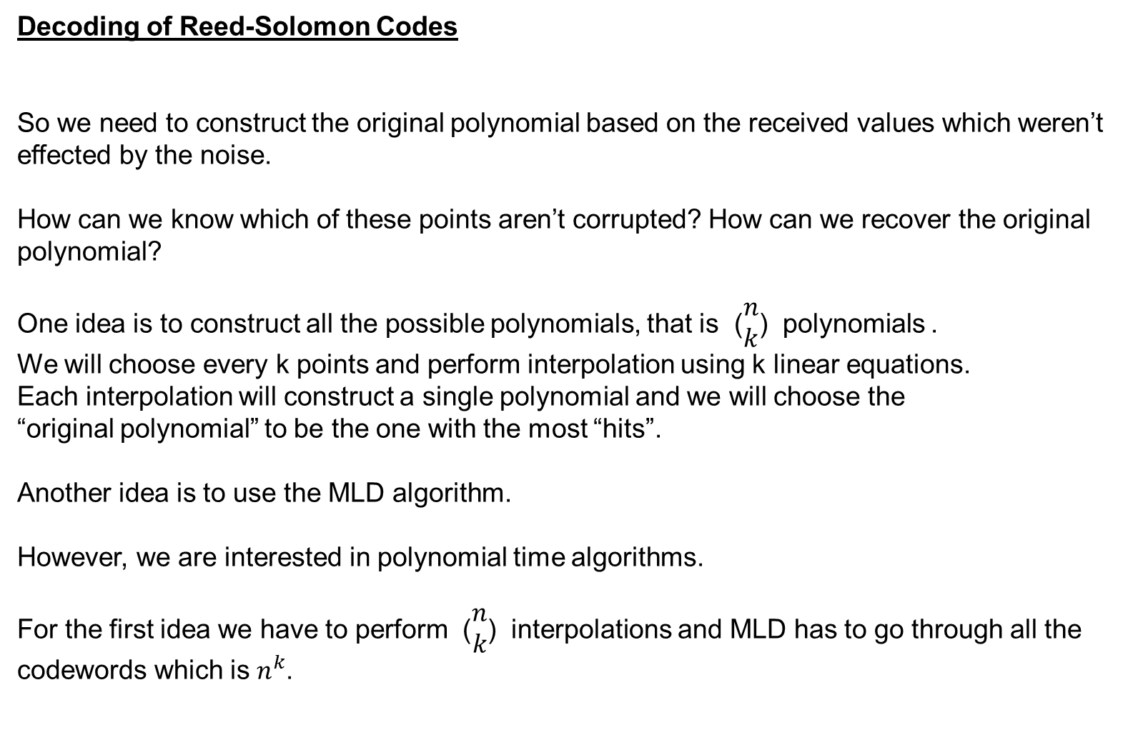
Decoding of Reed-Solomon Codes
So we need to construct the original polynomial based on the received values which weren’t effected by the noise.
How can we know which of these points aren’t corrupted? How can we recover the original polynomial?
One idea is to construct all the possible polynomials, that is ($\begin{matrix}n \\ k\end{matrix}$) polynomials .
We will choose every k points and perform interpolation using k linear equations.
Each interpolation will construct a single polynomial and we will choose the
“original polynomial” to be the one with the most “hits”.
Another idea is to use the MLD algorithm.
However, we are interested in polynomial time algorithms.
For the first idea we have to perform ($\begin{matrix}n \\ k\end{matrix}$) interpolations and MLD has to go through all the codewords which is $n^{k}$.

Slide 31
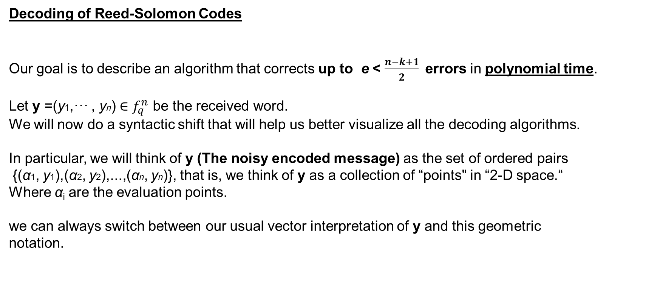
Decoding of Reed-Solomon Codes
Our goal is to describe an algorithm that corrects up to e < $\frac{n−k+1}{2}$errors in polynomial time.
Let y =(y1,··· , yn) ∈ $f_{q}^{n}$ be the received word.
We will now do a syntactic shift that will help us better visualize all the decoding algorithms.
In particular, we will think of y (The noisy encoded message) as the set of ordered pairs
{(α1, y1),(α2, y2),...,(αn, yn)}, that is, we think of y as a collection of “points" in “2-D space.“
Where α_{i} are the evaluation points.
we can always switch between our usual vector interpretation of y and this geometric
notation.

Slide 32
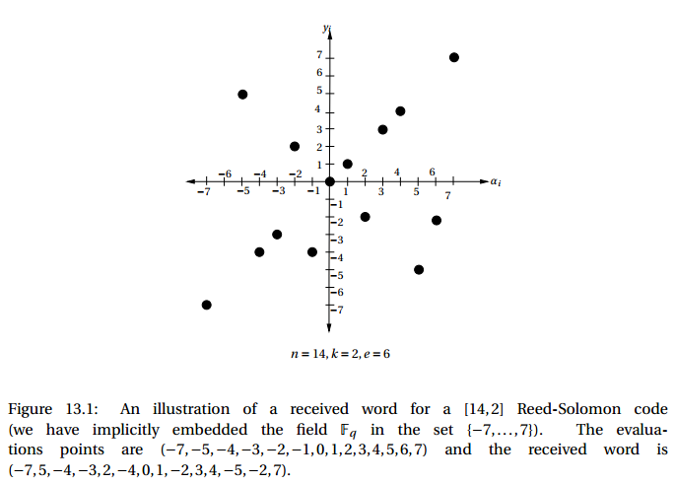

Slide 33
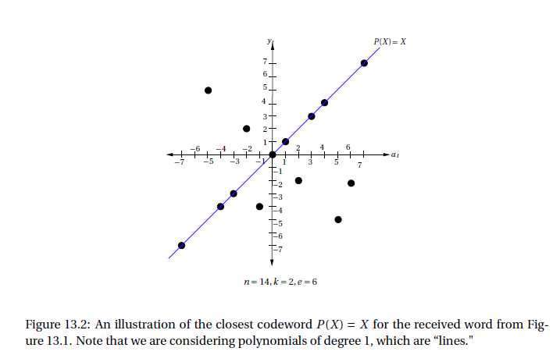

Slide 34
We now start to describe Welch-Berlekamp algorithm which solves the problem of finding p(x) in Polynomial time.
Intuitively, in order to construct the original polynomial, we “need” the ability
to distinguish between the correct values and the noisy values so that
the polynomial we construct will be based on the correct values only.

Slide 35
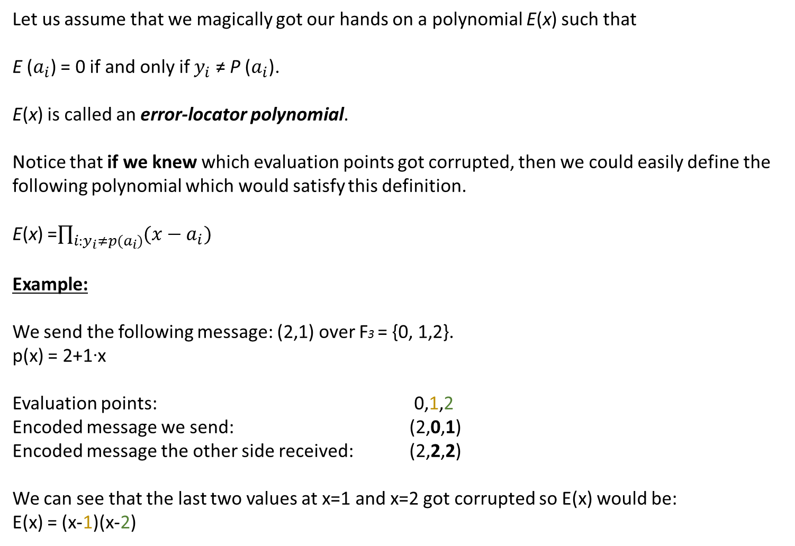
Let us assume that we magically got our hands on a polynomial E(x) such that
E ($a_{i}$) = 0 if and only if $y_{i}$ ≠ P ($a_{i}$).
E(x) is called an error-locator polynomial.
Notice that if we knew which evaluation points got corrupted, then we could easily define the following polynomial which would satisfy this definition.
E(x) =$\prod_{i:y_{i}≠p(a_{i})}{(x−a_{i})}$
Example:
We send the following message: (2,1) over F3 = {0, 1,2}.
p(x) = 2+1∙x
Evaluation points: 0,1,2
Encoded message we send: (2,0,1)
Encoded message the other side received: (2,2,2)
We can see that the last two values at x=1 and x=2 got corrupted so E(x) would be:
E(x) = (x-1)(x-2)

Slide 36
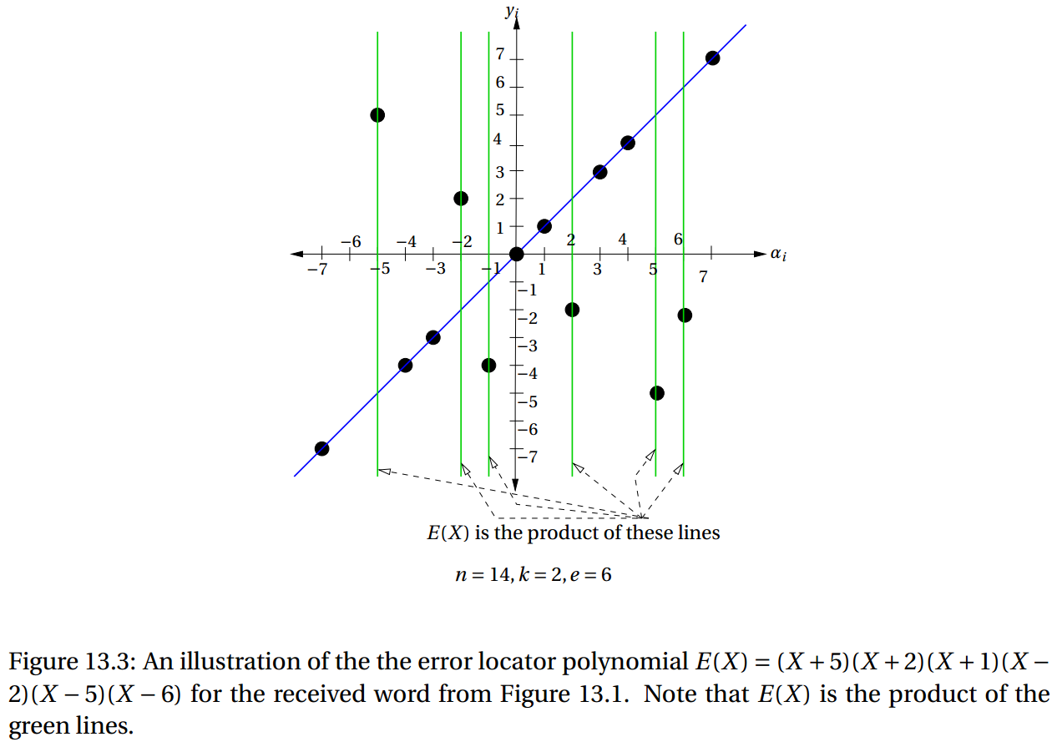

Slide 37
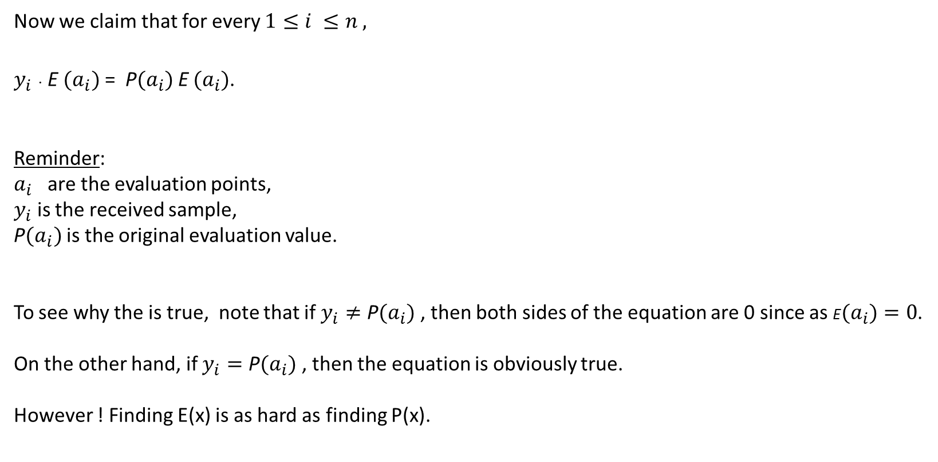
Now we claim that for every $1≤i ≤n ,$
$y_{i}$ $∙$ E ${(a}_{i})$ = ${\text{P}(a}_{i})$E ${(a}_{i})$.
Reminder:
$a_{i}$ are the evaluation points,
$y_{i}$ is the received sample,
P${(a}_{i})$ is the original evaluation value.
To see why the is true, note that if $y_{i}≠{\text{P}(a}_{i})$ , then both sides of the equation are 0 since as ${\text{E}(a}_{i})=0$.
On the other hand, if $y_{i}={\text{P}(a}_{i})$ , then the equation is obviously true.
However ! Finding E(x) is as hard as finding P(x).

Slide 38
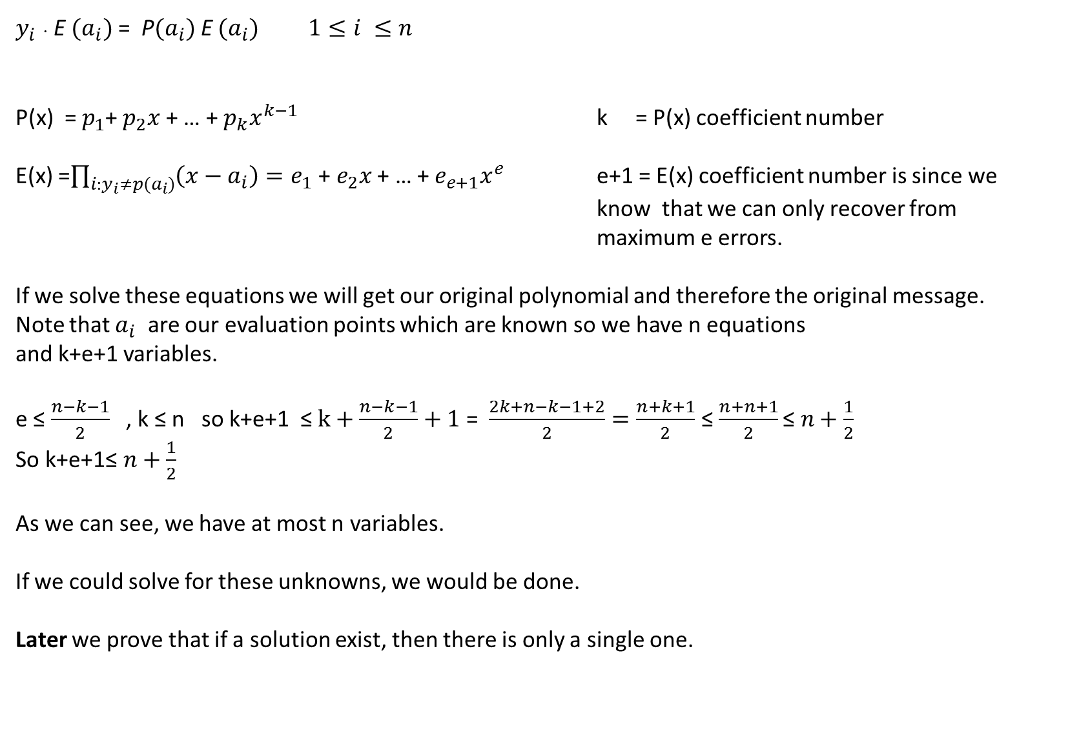
$y_{i}$ $∙$ E ${(a}_{i})$ = ${\text{P}(a}_{i})$E ${(a}_{i})$ $1≤i ≤n$
P(x) = $p_{1}$+ $p_{2}x$ + … + $p_{k}x^{k−1}$ k = P(x) coefficient number
E(x) =$\prod_{i:y_{i}≠p(a_{i})}{\left(x−a_{i}\right)=e_{1}\text{ + }e_{2}x\text{ + }\text{… }\text{+ }e_{e+1}x^{e}}$ e+1 = E(x) coefficient number is since we know that we can only recover from maximum e errors.
If we solve these equations we will get our original polynomial and therefore the original message.
Note that $a_{i}$ are our evaluation points which are known so we have n equations
and k+e+1 variables.
e ≤ $\frac{n−k−1}{2}$ , k ≤ n so k+e+1 ≤ $k+\frac{n−k−1}{2}+1$ = $\frac{2k+n−k−1+2}{2}=\frac{n+k+1}{2}$ ≤ $\frac{n+n+1}{2}\text{≤ }n+\frac{1}{2}$
So k+e+1$\text{≤ }n+\frac{1}{2}$
As we can see, we have at most n variables.
If we could solve for these unknowns, we would be done.
Later we prove that if a solution exist, then there is only a single one.

Slide 39
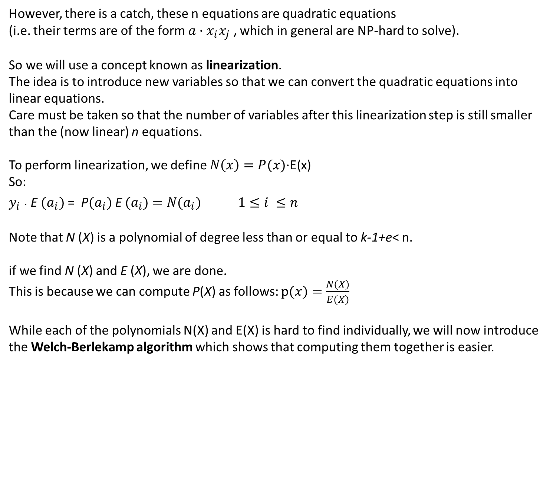
However, there is a catch, these n equations are quadratic equations
(i.e. their terms are of the form $a∙x_{i}x_{j}$ , which in general are NP-hard to solve).
So we will use a concept known as linearization.
The idea is to introduce new variables so that we can convert the quadratic equations into linear equations.
Care must be taken so that the number of variables after this linearization step is still smaller than the (now linear) n equations.
To perform linearization, we define $N\left(x\right)=P(x)\text{·}\text{E}\text{(}\text{x}\text{)}$
So:
$y_{i}$ $∙$ E ${(a}_{i})$ = ${\text{P}(a}_{i})$E ${(a}_{i})=N{(a}_{i}) 1≤i ≤n$
Note that N (X) is a polynomial of degree less than or equal to k-1+e< n.
if we find N (X) and E (X), we are done.
This is because we can compute P(X) as follows: $p(x)=\frac{N(X)}{E(X)}$
While each of the polynomials N(X) and E(X) is hard to find individually, we will now introduce the Welch-Berlekamp algorithm which shows that computing them together is easier.

Slide 40
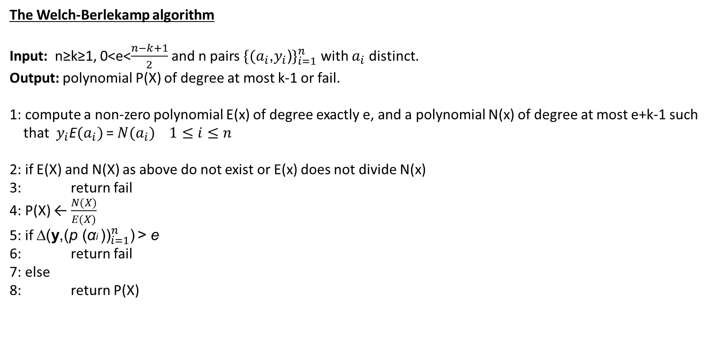
The Welch-Berlekamp algorithm
Input: n≥k≥1, 0<e<$\frac{n−k+1}{2}$ and n pairs ${\text{\{(}a_{i}\text{,}y_{i}\text{)}\}}_{i=1}^{n}$ with $a_{i}$ distinct.
Output: polynomial P(X) of degree at most k-1 or fail.
1: compute a non-zero polynomial E(x) of degree exactly e, and a polynomial N(x) of degree at most e+k-1 such
that $y_{i}$E${(a}_{i})$ = $N{(a}_{i})$ $1≤i≤n$
2: if E(X) and N(X) as above do not exist or E(x) does not divide N(x)
3: return fail
4: P(X) ← $\frac{N(X)}{E(X)}$
5: if ∆(${\text{y}\text{,(}\text{p} \text{(}\text{α}\text{i} \text{))}}_{i=1}^{n}$) > e
6: return fail
7: else
8: return P(X)

Slide 41
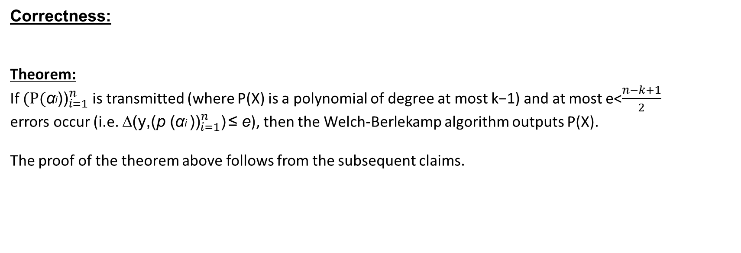
Correctness:
Theorem:
If ${\text{(}\text{P}\text{(}\text{α}\text{i}\text{)}\text{)}}_{i=1}^{n}$ is transmitted (where P(X) is a polynomial of degree at most k−1) and at most e<$\frac{n−k+1}{2}$
errors occur (i.e. ∆(${\text{y}\text{,(}\text{p} \text{(}\text{α}\text{i} \text{))}}_{i=1}^{n}$) ≤ e), then the Welch-Berlekamp algorithm outputs P(X).
The proof of the theorem above follows from the subsequent claims.

Slide 42
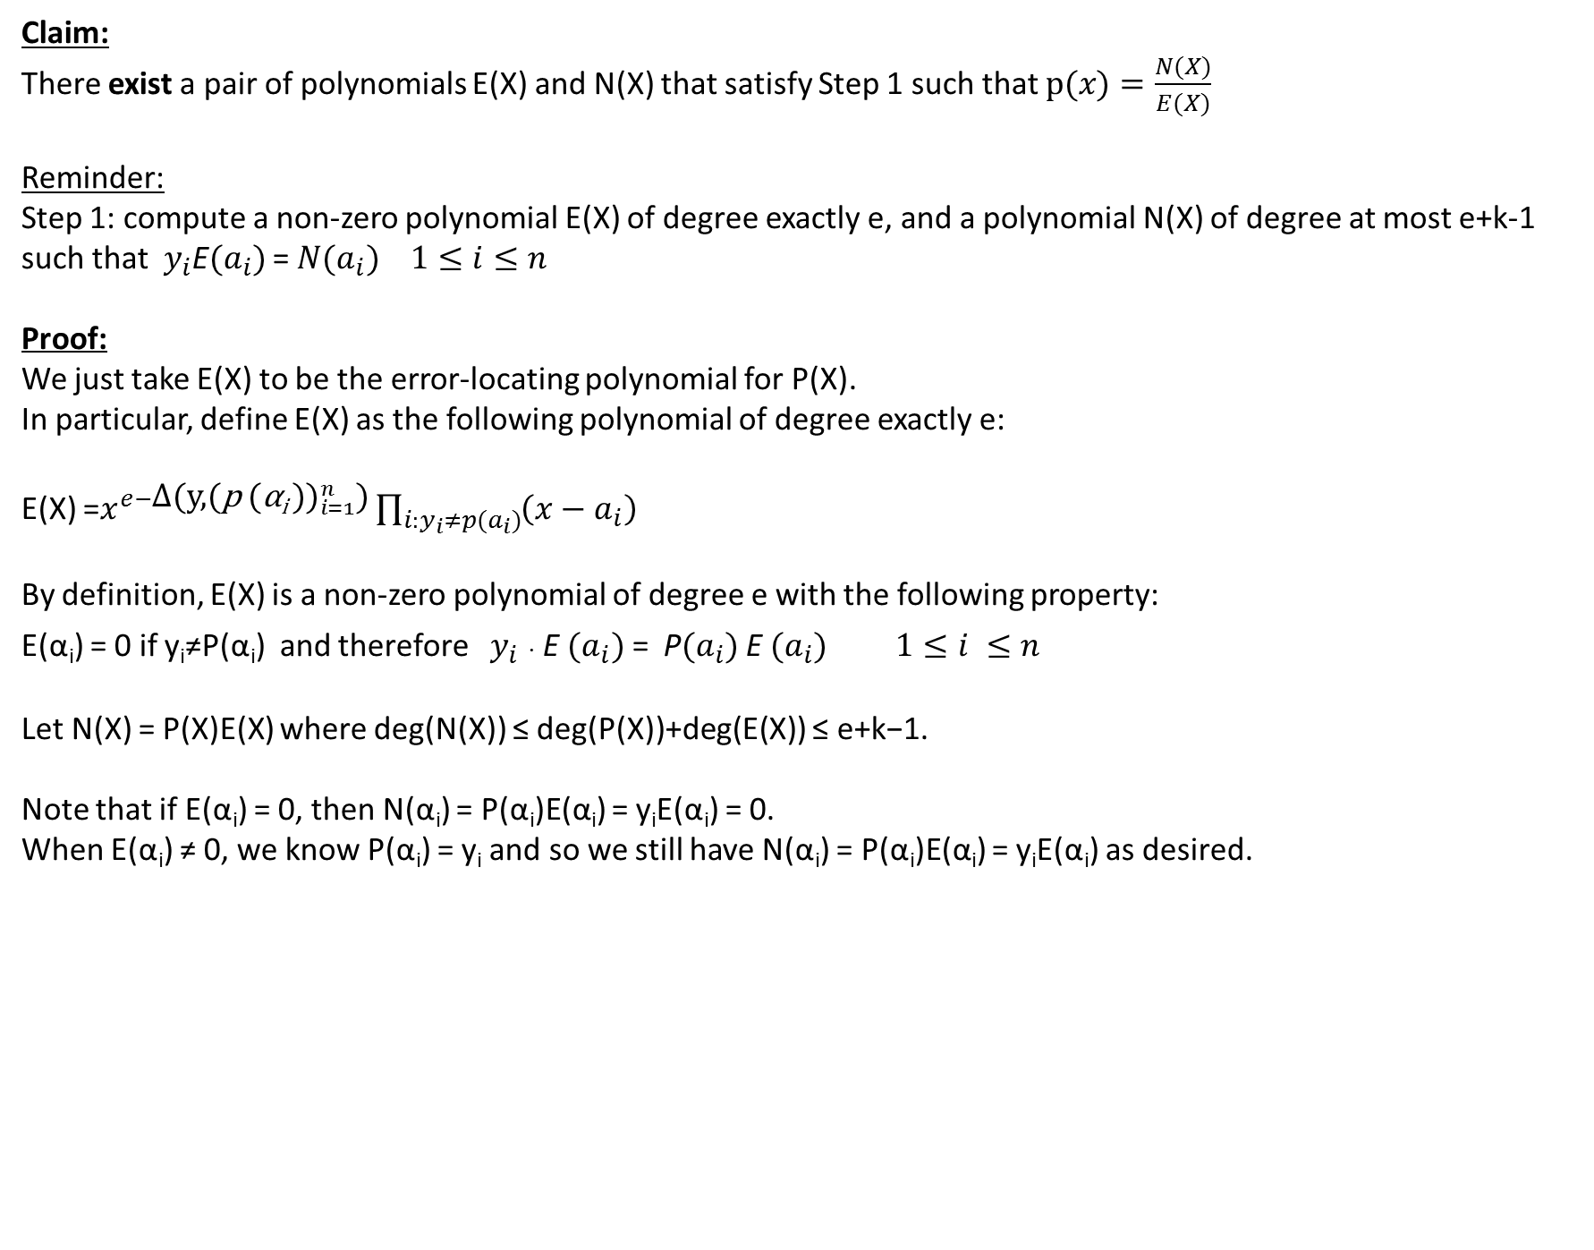
Claim:
There exist a pair of polynomials E(X) and N(X) that satisfy Step 1 such that $p(x)=\frac{N(X)}{E(X)}$
Reminder:
Step 1: compute a non-zero polynomial E(X) of degree exactly e, and a polynomial N(X) of degree at most e+k-1 such that $y_{i}$E${(a}_{i})$ = $N{(a}_{i})$ $1≤i≤n$
Proof:
We just take E(X) to be the error-locating polynomial for P(X).
In particular, define E(X) as the following polynomial of degree exactly e:
E(X) =$x^{e−\text{∆}\text{(}{\text{y}\text{,(}\text{p} \text{(}\text{α}\text{i} \text{))}}_{i=1}^{n}\text{)}}\prod_{i:y_{i}≠p(a_{i})}{\left(x−a_{i}\right)}$
By definition, E(X) is a non-zero polynomial of degree e with the following property:
E(α_{i}) = 0 if y_{i}≠P(α_{i}) and therefore $y_{i}$ $∙$ E ${(a}_{i})$ = ${\text{P}(a}_{i})$E ${(a}_{i})$ $1≤i ≤n$
Let N(X) = P(X)E(X) where deg(N(X)) ≤ deg(P(X))+deg(E(X)) ≤ e+k−1.
Note that if E(α_{i}) = 0, then N(α_{i}) = P(α_{i})E(α_{i}) = y_{i}E(α_{i}) = 0.
When E(α_{i}) ≠ 0, we know P(α_{i}) = y_{i} and so we still have N(α_{i}) = P(α_{i})E(α_{i}) = y_{i}E(α_{i}) as desired.

Slide 43
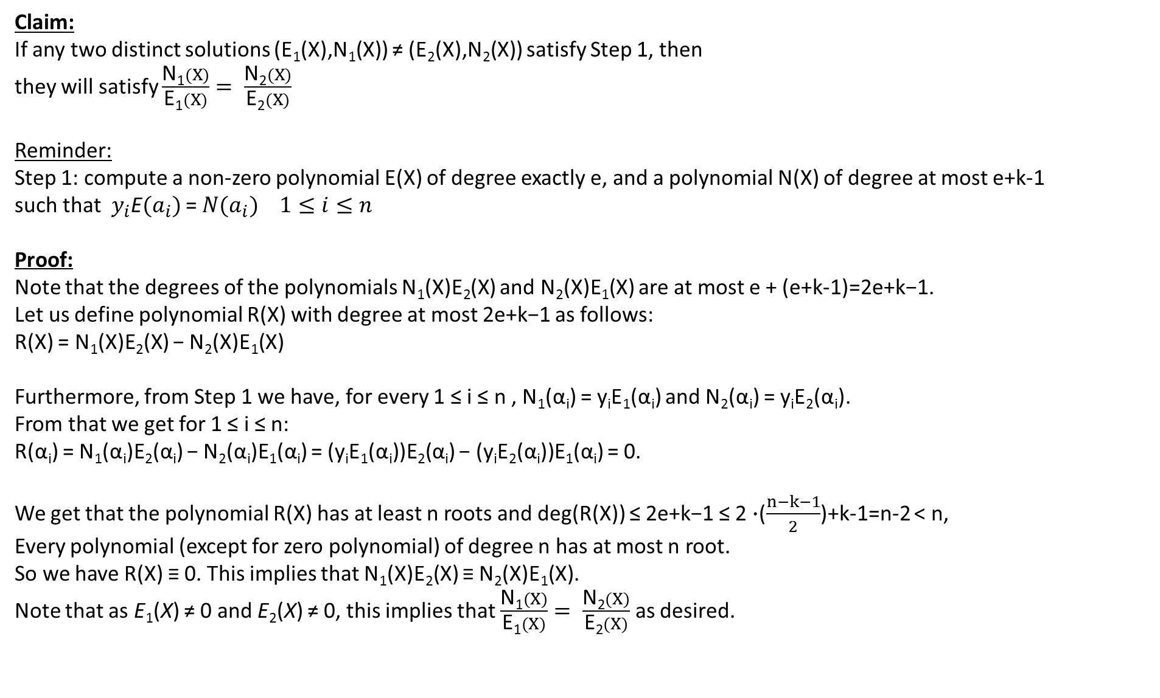
Claim:
If any two distinct solutions (E₁(X),N₁(X)) ≠ (E₂(X),N₂(X)) satisfy Step 1, then
they will satisfy $\frac{\text{N}\text{1}(X)}{\text{E}\text{1}(X)}= \frac{\text{N}\text{2}(X)}{\text{E}\text{2}(X)}$
Reminder:
Step 1: compute a non-zero polynomial E(X) of degree exactly e, and a polynomial N(X) of degree at most e+k-1
such that $y_{i}$E${(a}_{i})$ = $N{(a}_{i})$ $1≤i≤n$
Proof:
Note that the degrees of the polynomials N₁(X)E₂(X) and N₂(X)E₁(X) are at most e + (e+k-1)=2e+k−1.
Let us define polynomial R(X) with degree at most 2e+k−1 as follows:
R(X) = N₁(X)E₂(X) − N₂(X)E₁(X)
Furthermore, from Step 1 we have, for every 1 ≤ i ≤ n , N₁(α_{i}) = y_{i}E₁(α_{i}) and N₂(α_{i}) = y_{i}E₂(α_{i}).
From that we get for 1 ≤ i ≤ n:
R(α_{i}) = N₁(α_{i})E₂(α_{i}) − N₂(α_{i})E₁(α_{i}) = (y_{i}E₁(α_{i}))E₂(α_{i}) − (y_{i}E₂(α_{i}))E₁(α_{i}) = 0.
We get that the polynomial R(X) has at least n roots and deg(R(X)) ≤ 2e+k−1 ≤ 2 $∙$($\frac{n−k−1}{2}$)+k-1=n-2 < n,
Every polynomial (except for zero polynomial) of degree n has at most n root.
So we have R(X) ≡ 0. This implies that N₁(X)E₂(X) ≡ N₂(X)E₁(X).
Note that as E₁(X) ≠ 0 and E₂(X) ≠ 0, this implies that $\frac{\text{N}\text{1}(X)}{\text{E}\text{1}(X)}= \frac{\text{N}\text{2}(X)}{\text{E}\text{2}(X)}$ as desired.

Slide 44
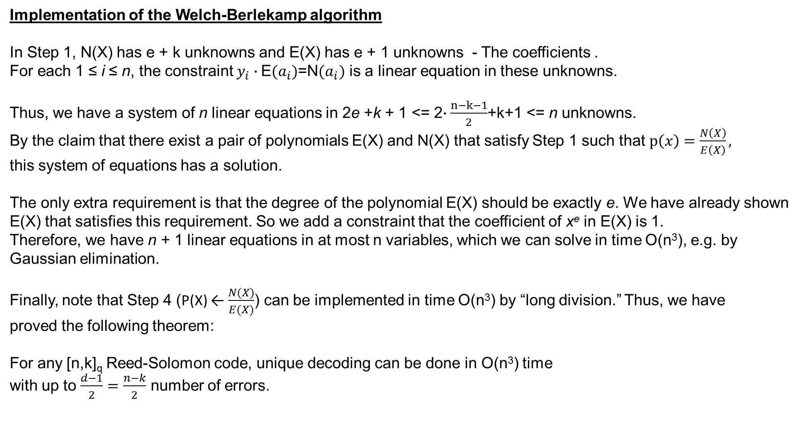
Implementation of the Welch-Berlekamp algorithm
In Step 1, N(X) has e + k unknowns and E(X) has e + 1 unknowns - The coefficients .
For each 1 ≤ i ≤ n, the constraint $y_{i}∙$E${(a}_{i})$=N${(a}_{i})$ is a linear equation in these unknowns.
Thus, we have a system of n linear equations in 2e +k + 1 <= 2$∙\frac{n−k−1}{2}$+k+1 <= n unknowns.
By the claim that there exist a pair of polynomials E(X) and N(X) that satisfy Step 1 such that $p\left(x\right)=\frac{N\left(X\right)}{E\left(X\right)},$
this system of equations has a solution.
The only extra requirement is that the degree of the polynomial E(X) should be exactly e. We have already shown E(X) that satisfies this requirement. So we add a constraint that the coefficient of x^{e} in E(X) is 1.
Therefore, we have n + 1 linear equations in at most n variables, which we can solve in time O(n³), e.g. by
Gaussian elimination.
Finally, note that Step 4 (P(X) ← $\frac{N(X)}{E(X)}$) can be implemented in time O(n³) by “long division.” Thus, we have
proved the following theorem:
For any [n,k]_{q} Reed-Solomon code, unique decoding can be done in O(n³) time
with up to $\frac{d−1}{2}=\frac{n−k}{2}$ number of errors.

