Slide 1
RS – Reed Solomon
List Decoding

Slide 2
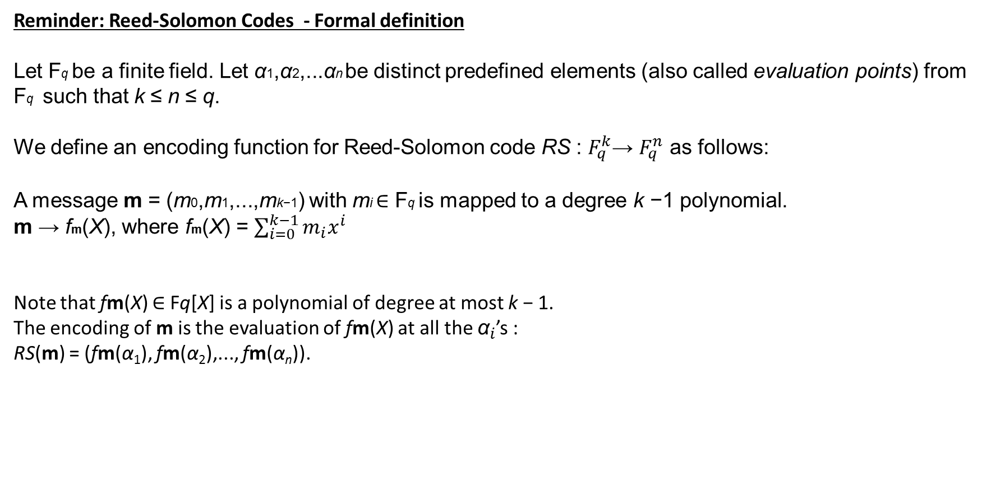
Reminder: Reed-Solomon Codes - Formal definition
Let Fq be a finite field. Let α1,α2,...αn be distinct predefined elements (also called evaluation points) from Fq such that k ≤ n ≤ q.
We define an encoding function for Reed-Solomon code RS : $F_{q}^{k}$→ $F_{q}^{n}$ as follows:
A message m = (m0,m1,...,mk−1) with mi ∈ Fq is mapped to a degree k −1 polynomial.
m → fm(X), where fm(X) = $\sum_{i=0}^{k−1}{m_{i}x^{i}}$
Note that fm(X) ∈ Fq[X] is a polynomial of degree at most k − 1.
The encoding of m is the evaluation of fm(X) at all the ${\text{α}}_{i}$’s :
RS(m) = (fm(α₁), fm(α₂),..., fm(α_{n})).

Slide 3
Reed-Solomon Codes
Our Σ = F3 = {0, 1,2} where +p and ·p are addition and multiplication mod p .
As we stated before , F3 is a field.
Let us transmit the following message: (2,1).
1. Set the polynomial coefficients to be the message elements 2,1 : f(x) = 2+1∙x
2. Evaluate the polynomial values at predefined points (all field elements) x=0 , x=1 , x=2:
(x=0,y=2) , (x=1,y=0) , (x=2,y=1) .
3. Transmit the evaluation result , meaning codeword : (2,0,1)

Slide 4
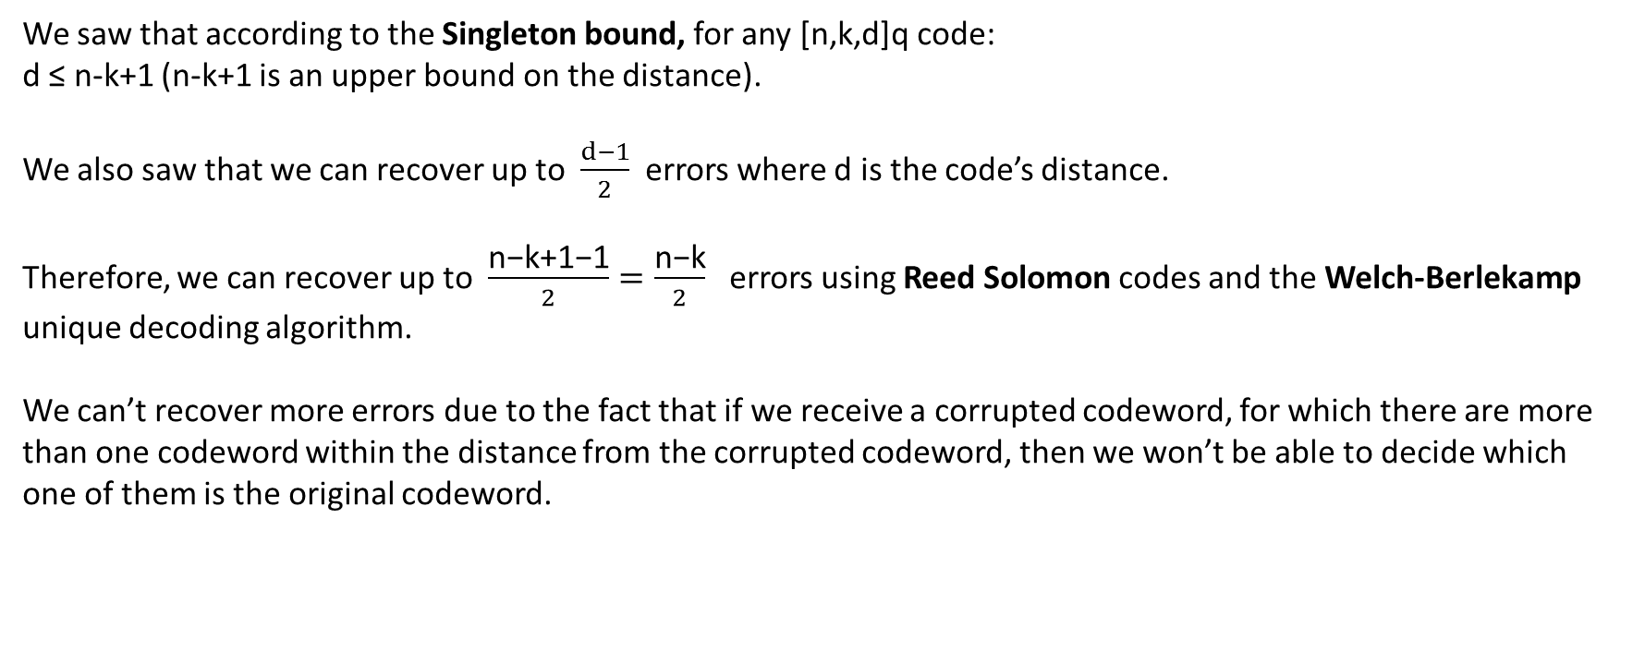
We saw that according to the Singleton bound, for any [n,k,d]q code:
d ≤ n-k+1 (n-k+1 is an upper bound on the distance).
We also saw that we can recover up to $\frac{d−1}{2}$ errors where d is the code’s distance.
Therefore, we can recover up to $\frac{\text{n}\text{−}\text{k}\text{+}\text{1}\text{−}\text{1}}{2}=\frac{\text{n}\text{−}\text{k}}{2}$ errors using Reed Solomon codes and the Welch-Berlekamp unique decoding algorithm.
We can’t recover more errors due to the fact that if we receive a corrupted codeword, for which there are more than one codeword within the distance from the corrupted codeword, then we won’t be able to decide which one of them is the original codeword.

Slide 5
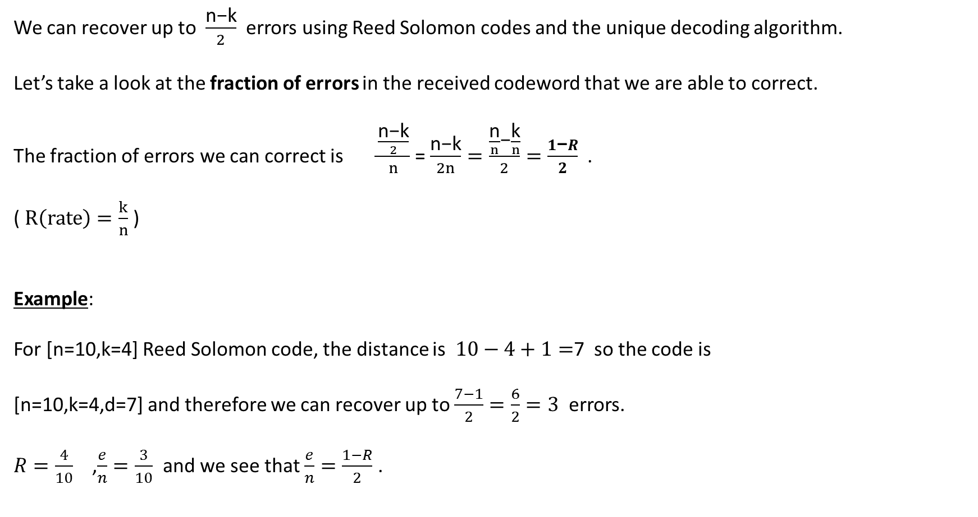
We can recover up to $\frac{\text{n}\text{−}\text{k}}{2}$ errors using Reed Solomon codes and the unique decoding algorithm.
Let’s take a look at the fraction of errors in the received codeword that we are able to correct.
The fraction of errors we can correct is $\frac{\frac{\text{n}\text{−}\text{k}}{2}}{n}$ = $\frac{\text{n}\text{−}\text{k}}{2n}=\frac{\frac{\text{n}}{n}\text{−}\frac{\text{k}}{n}}{2}=\frac{1\text{−}R}{2}$ .
( $R\left(rate\right)=\frac{k}{n}$ )
Example:
For [n=10,k=4] Reed Solomon code, the distance is $10−4+1=$7 so the code is
[n=10,k=4,d=7] and therefore we can recover up to $\frac{7−1}{2}=\frac{6}{2}=3$ errors.
$R=\frac{4}{10}$ ,$\frac{e}{n}=\frac{3}{10}$ and we see that $\frac{e}{n}=\frac{1−R}{2}$ .

Slide 6
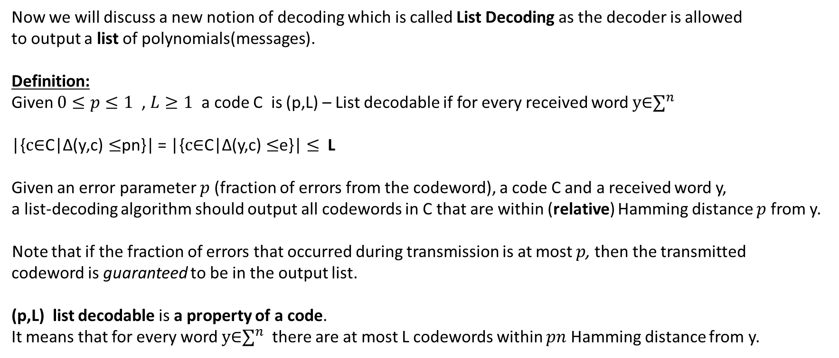
Now we will discuss a new notion of decoding which is called List Decoding as the decoder is allowed
to output a list of polynomials(messages).
Definition:
Given $0≤p≤1$ , $L≥1$ a code C is (p,L) – List decodable if for every received word $y\text{∈}∑^{n}$
|{$c\text{∈}\text{C}\text{|}\text{∆}\text{(}\text{y}\text{,}\text{c}\text{)}≤$pn}| = |{$c\text{∈}\text{C}\text{|}\text{∆}\text{(}\text{y}\text{,}\text{c}\text{)}≤$e}|$≤$L
Given an error parameter $p$ (fraction of errors from the codeword), a code C and a received word y,
a list-decoding algorithm should output all codewords in C that are within (relative) Hamming distance $p$ from y.
Note that if the fraction of errors that occurred during transmission is at most $p$, then the transmitted
codeword is guaranteed to be in the output list.
(p,L) list decodable is a property of a code.
It means that for every word $y\text{∈}∑^{n}$ there are at most L codewords within $pn$ Hamming distance from y.

Slide 7
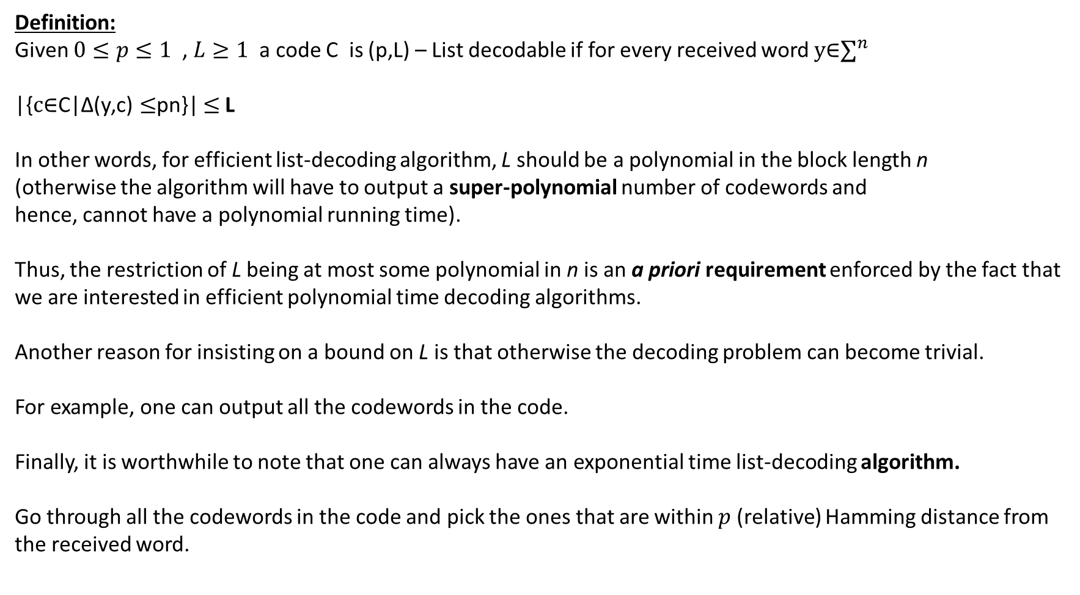
Definition:
Given $0≤p≤1$ , $L≥1$ a code C is (p,L) – List decodable if for every received word $y\text{∈}∑^{n}$
|{$c\text{∈}\text{C}\text{|}\text{∆}\text{(}\text{y}\text{,}\text{c}\text{)}≤$pn}| $≤$L
In other words, for efficient list-decoding algorithm, L should be a polynomial in the block length n
(otherwise the algorithm will have to output a super-polynomial number of codewords and
hence, cannot have a polynomial running time).
Thus, the restriction of L being at most some polynomial in n is an a priori requirement enforced by the fact that we are interested in efficient polynomial time decoding algorithms.
Another reason for insisting on a bound on L is that otherwise the decoding problem can become trivial.
For example, one can output all the codewords in the code.
Finally, it is worthwhile to note that one can always have an exponential time list-decoding algorithm.
Go through all the codewords in the code and pick the ones that are within $p$(relative) Hamming distance from the received word.

Slide 8
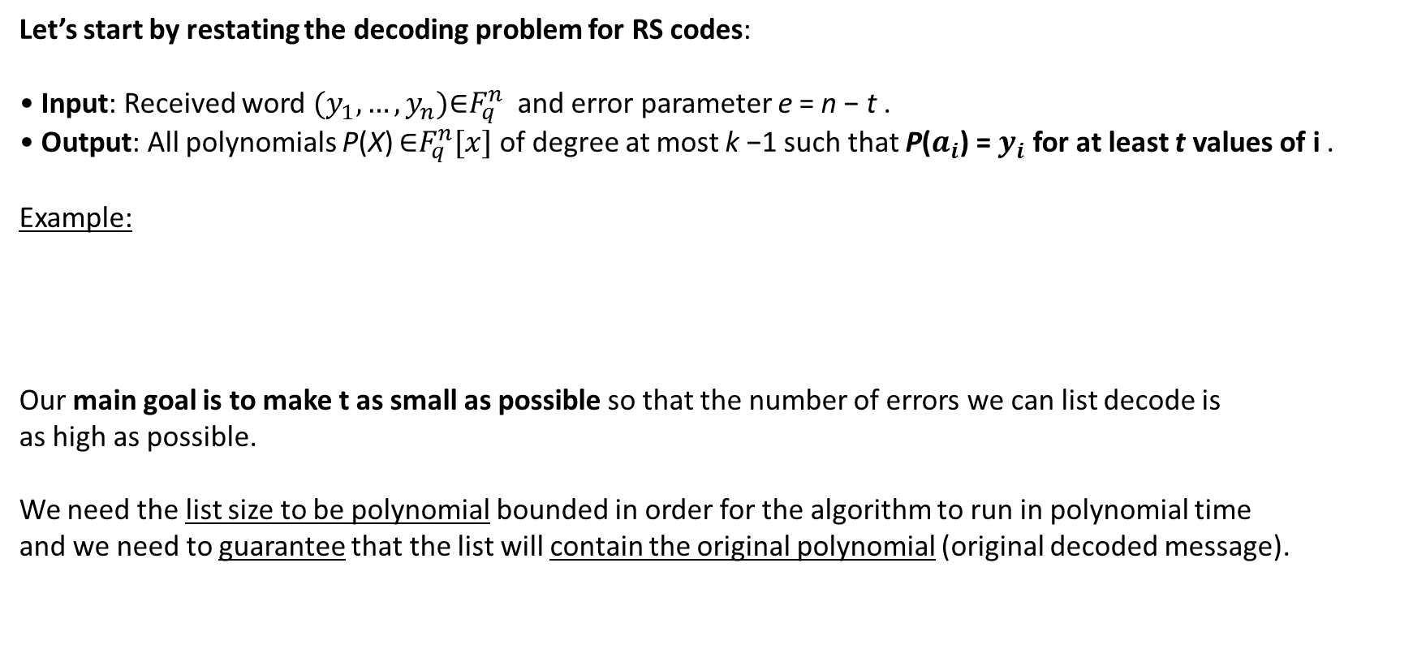
Let’s start by restating the decoding problem for RS codes:
• Input: Received word $(y_{1},…,y_{n})\text{∈}F_{q}^{n}$ and error parameter e = n − t .
• Output: All polynomials P(X) $\text{∈}F_{q}^{n}[x]$ of degree at most k −1 such that P($a_{i}$) = $y_{i}$ for at least t values of i .
Example:
Our main goal is to make t as small as possible so that the number of errors we can list decode is
as high as possible.
We need the list size to be polynomial bounded in order for the algorithm to run in polynomial time
and we need to guarantee that the list will contain the original polynomial (original decoded message).

Slide 9
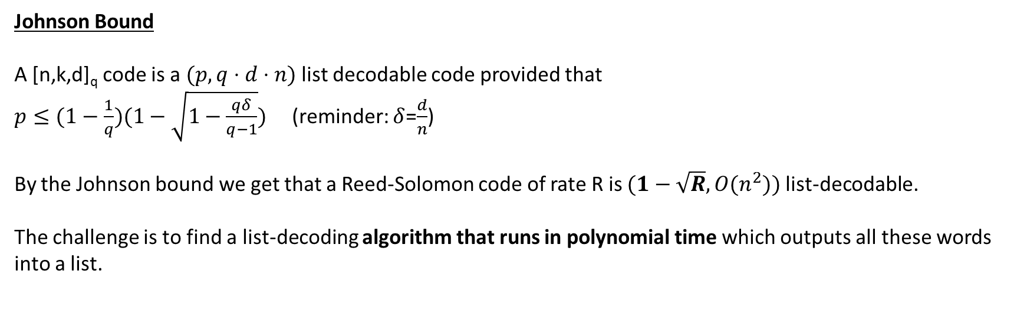
Johnson Bound
A [n,k,d]_{q} code is a $(p,q⋅d⋅n)$ list decodable code provided that
$p≤(1−\frac{1}{q})(1−\sqrt{1−\frac{qδ}{q−1}})$ (reminder: $δ$=$\frac{d}{n}$)
By the Johnson bound we get that a Reed-Solomon code of rate R is $(1−\sqrt{R},O(n^{2}))$ list-decodable.
The challenge is to find a list-decoding algorithm that runs in polynomial time which outputs all these words into a list.

Slide 10

Reminder: Welch-Berlekamp algorithm
Input: n≥k≥1, 0<e<$\frac{n−k+1}{2}$ and n pairs ${\text{\{(}a_{i}\text{,}y_{i}\text{)}\}}_{i=1}^{n}$ with $a_{i}$ distinct.
Output: polynomial P(X) of degree at most k-1 or fail.
1: compute a non-zero polynomial E(x) of degree exactly e, and a polynomial N(x) of degree at most e+k-1 such
that $y_{i}$E${(a}_{i})$ = $N{(a}_{i})$ $1≤i≤n$
2: if E(X) and N(X) as above do not exist or E(x) does not divide N(x)
3: return fail
4: P(X) ← $\frac{N(X)}{E(X)}$
5: if ∆(${\text{y}\text{,(}\text{p} \text{(}\text{α}\text{i} \text{))}}_{i=1}^{n}$) > e
6: return fail
7: else
8: return P(X)

Slide 11
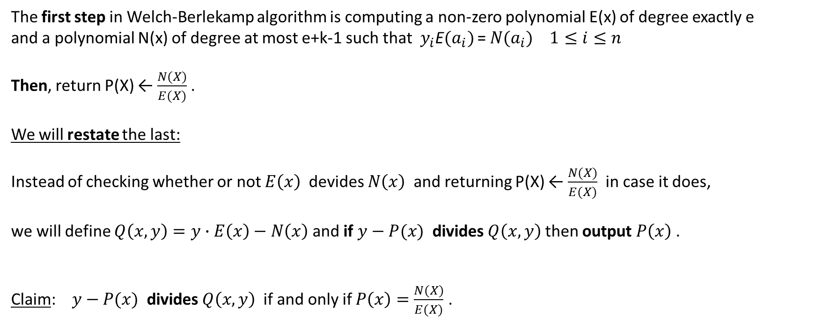
The first step in Welch-Berlekamp algorithm is computing a non-zero polynomial E(x) of degree exactly e
and a polynomial N(x) of degree at most e+k-1 such that $y_{i}$E${(a}_{i})$ = $N{(a}_{i})$ $1≤i≤n$
Then, return P(X) ← $\frac{N(X)}{E(X)}$ .
We will restate the last:
Instead of checking whether or not $E\left(x\right)$ devides $N\left(x\right)$ and returning P(X) ← $\frac{N(X)}{E(X)}$ in case it does,
we will define $Q\left(x,y\right)=y∙E\left(x\right)−N\left(x\right)$ and if $y−P(x)$ divides $Q\left(x,y\right)$ then output $P\left(x\right)$ .
Claim: $y−P(x)$ divides $Q\left(x,y\right)$ if and only if $P\left(x\right)=\frac{N(X)}{E(X)}$ .

Slide 12
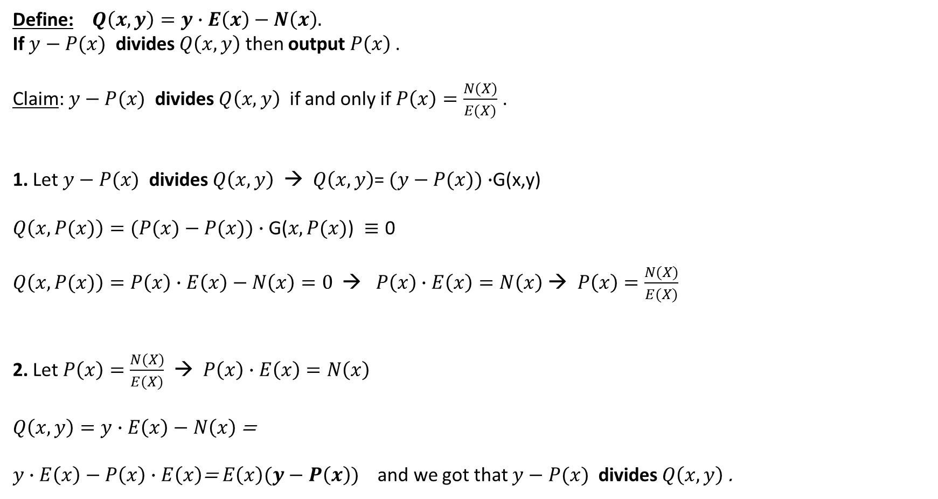
Define: $Q\left(x,y\right)=y∙E\left(x\right)−N\left(x\right).$
If $y−P(x)$ divides $Q\left(x,y\right)$ then output $P\left(x\right)$ .
Claim: $y−P(x)$ divides $Q\left(x,y\right)$ if and only if $P\left(x\right)=\frac{N(X)}{E(X)}$ .
1. Let $y−P(x)$ divides $Q\left(x,y\right)$ → $Q\left(x,y\right)$= $(y−P(x))∙$G(x,y)
$$Q\left(x,P(x)\right)=(P(x)−P(x))∙\text{G}\text{(}x,P(x)\text{) }≡\text{0}$$
$Q\left(x,P(x)\right)=P\left(x\right)∙E\left(x\right)−N\left(x\right)=0 \text{→}$ $P\left(x\right)∙E\left(x\right)=N\left(x\right)$ $\text{→}$ $P\left(x\right)=\frac{N(X)}{E(X)}$
2. Let $P\left(x\right)=\frac{N(X)}{E(X)}$ → $P\left(x\right)∙E\left(x\right)=N\left(x\right)$
$Q\left(x,y\right)=y∙E\left(x\right)−N\left(x\right)$ =
$y∙E\left(x\right)−P\left(x\right)∙E\left(x\right)$=$E\left(x\right)(y−P\left(x\right))$ and we got that $y−P(x)$ divides $Q\left(x,y\right)$ .

Slide 13
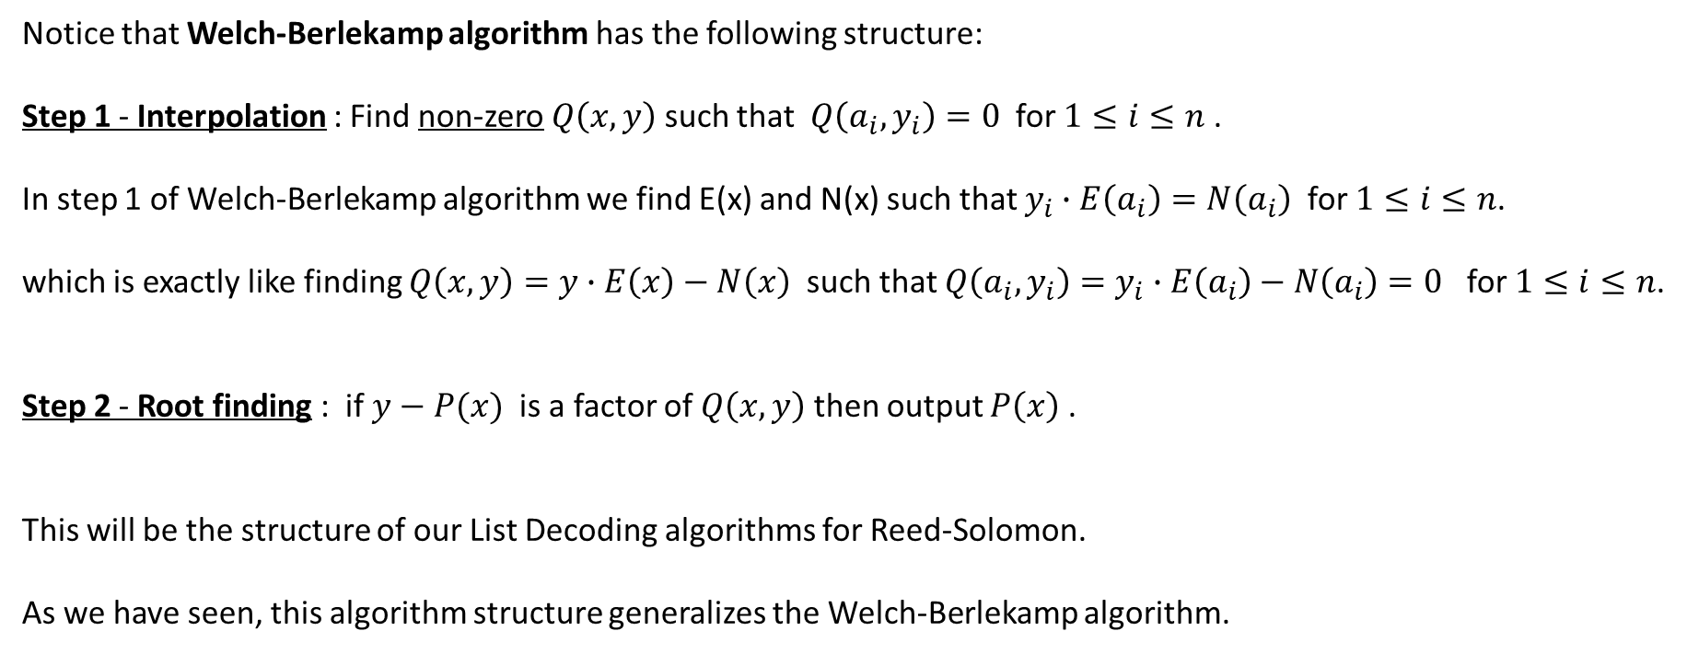
Notice that Welch-Berlekamp algorithm has the following structure:
Step 1 - Interpolation : Find non-zero $Q\left(x,y\right)$ such that $Q\left(a_{i},y_{i}\right)=0$ for $1≤i≤n$ .
In step 1 of Welch-Berlekamp algorithm we find E(x) and N(x) such that $y_{i}∙E\left(a_{i}\right)=N\left(a_{i}\right)$ for $1≤i≤n$.
which is exactly like finding $Q\left(x,y\right)=y∙E\left(x\right)−N\left(x\right)$ such that $Q\left(a_{i},y_{i}\right)=y_{i}∙E\left(a_{i}\right)−N\left(a_{i}\right)=0$ for $1≤i≤n$.
Step 2 - Root finding : if $y−P(x)$ is a factor of $Q\left(x,y\right)$ then output $P\left(x\right)$ .
This will be the structure of our List Decoding algorithms for Reed-Solomon.
As we have seen, this algorithm structure generalizes the Welch-Berlekamp algorithm.

Slide 14
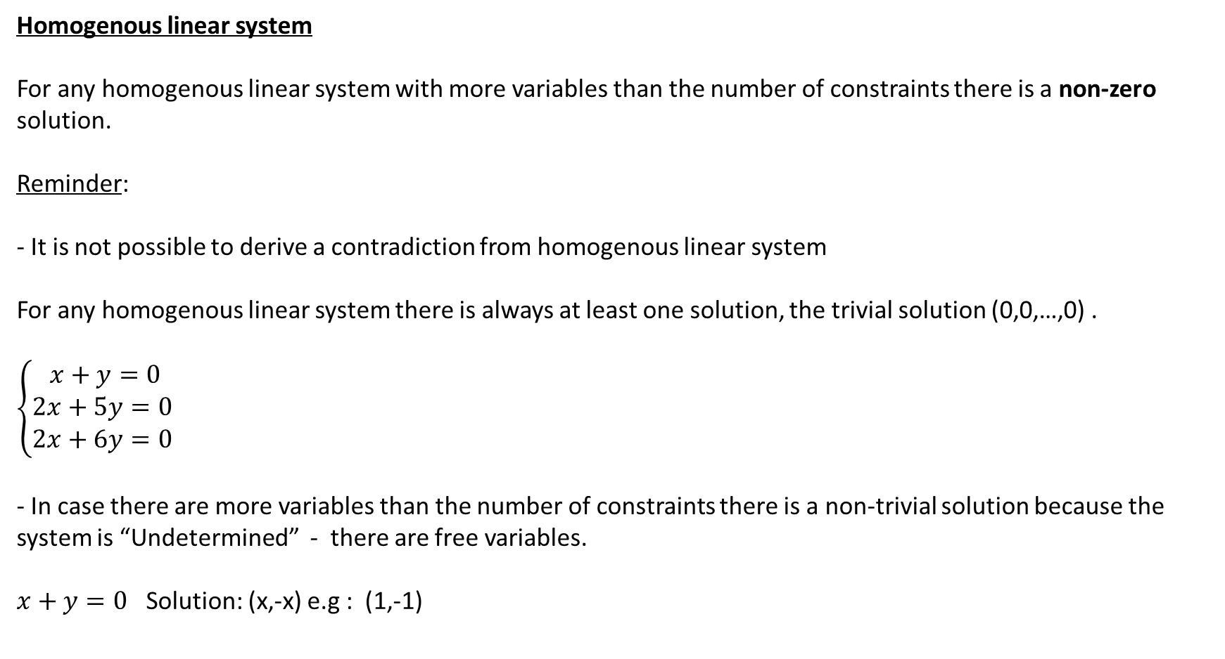
Homogenous linear system
For any homogenous linear system with more variables than the number of constraints there is a non-zero solution.
Reminder:
- It is not possible to derive a contradiction from homogenous linear system
For any homogenous linear system there is always at least one solution, the trivial solution (0,0,…,0) .
$$\left\{\begin{matrix}x+y=0 \\ 2x+5y=0 \\ 2x+6y=0 \end{matrix}\right.$$
- In case there are more variables than the number of constraints there is a non-trivial solution because the system is “Undetermined” - there are free variables.
$x+y=0$ Solution: (x,-x) e.g : (1,-1)

Slide 15
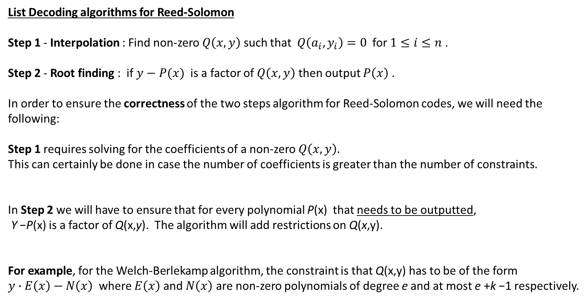
List Decoding algorithms for Reed-Solomon
Step 1 - Interpolation : Find non-zero $Q\left(x,y\right)$ such that $Q\left(a_{i},y_{i}\right)=0$ for $1≤i≤n$ .
Step 2 - Root finding : if $y−P(x)$ is a factor of $Q\left(x,y\right)$ then output $P\left(x\right)$ .
In order to ensure the correctness of the two steps algorithm for Reed-Solomon codes, we will need the following:
Step 1 requires solving for the coefficients of a non-zero $Q\left(x,y\right).$
This can certainly be done in case the number of coefficients is greater than the number of constraints.
In Step 2 we will have to ensure that for every polynomial P(x) that needs to be outputted,
Y −P(x) is a factor of Q(x,y). The algorithm will add restrictions on Q(x,y).
For example, for the Welch-Berlekamp algorithm, the constraint is that Q(x,y) has to be of the form
$y∙E\left(x\right)−N\left(x\right)$ where $E\left(x\right)$ and $N\left(x\right)$ are non-zero polynomials of degree e and at most e +k −1 respectively.

Slide 16
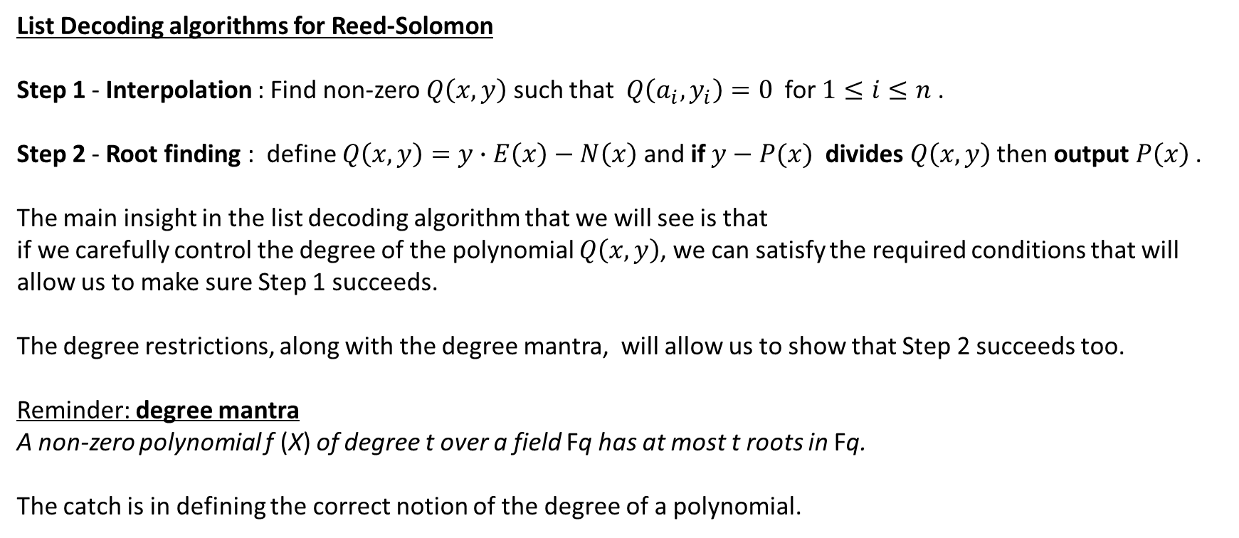
List Decoding algorithms for Reed-Solomon
Step 1 - Interpolation : Find non-zero $Q\left(x,y\right)$ such that $Q\left(a_{i},y_{i}\right)=0$ for $1≤i≤n$ .
Step 2 - Root finding : define $Q\left(x,y\right)=y∙E\left(x\right)−N\left(x\right)$ and if $y−P(x)$ divides $Q\left(x,y\right)$ then output $P\left(x\right)$ .
The main insight in the list decoding algorithm that we will see is that
if we carefully control the degree of the polynomial $Q\left(x,y\right)$, we can satisfy the required conditions that will allow us to make sure Step 1 succeeds.
The degree restrictions, along with the degree mantra, will allow us to show that Step 2 succeeds too.
Reminder: degree mantra
A non-zero polynomial f (X) of degree t over a field Fq has at most t roots in Fq.
The catch is in defining the correct notion of the degree of a polynomial.

Slide 17
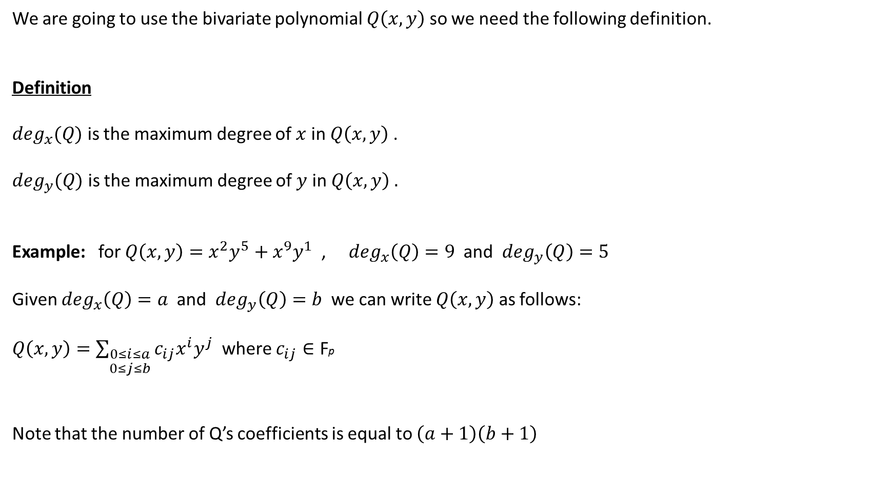
We are going to use the bivariate polynomial $Q\left(x,y\right)$ so we need the following definition.
Definition
$\deg_{x}(Q)$ is the maximum degree of $x$in $Q\left(x,y\right)$ .
$\deg_{y}(Q)$ is the maximum degree of $y$ in $Q\left(x,y\right) .$
Example: for $Q\left(x,y\right)=x^{2}y^{5}+x^{9}y^{1}$ , $\deg_{x}\left(Q\right)=9$ and $\deg_{y}\left(Q\right)=5$
Given $\deg_{x}\left(Q\right)=a$ and $\deg_{y}\left(Q\right)=b$ we can write $Q\left(x,y\right)$ as follows:
$Q\left(x,y\right)=\sum_{\begin{aligned}0≤i≤a \\ 0≤j≤b\end{aligned}}{c_{ij}x^{i}y^{j}}$ where $c_{ij}∈\text{F}\text{p}$
Note that the number of Q’s coefficients is equal to $\left(a+1\right)\left(b+1\right)$

Slide 18
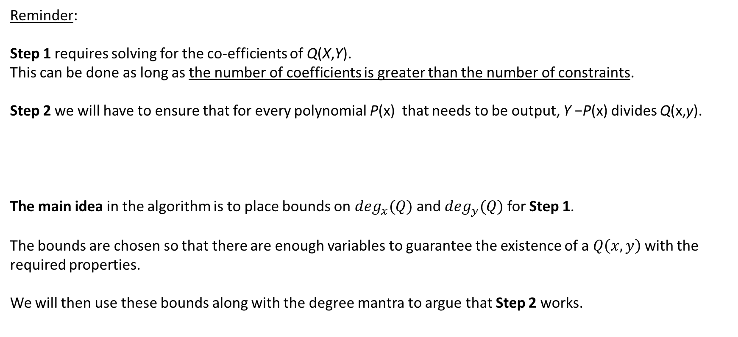
Reminder:
Step 1 requires solving for the co-efficients of Q(X,Y).
This can be done as long as the number of coefficients is greater than the number of constraints.
Step 2 we will have to ensure that for every polynomial P(x) that needs to be output, Y −P(x) divides Q(x,y).
The main idea in the algorithm is to place bounds on $\deg_{x}(Q)$ and $\deg_{y}(Q)$ for Step 1.
The bounds are chosen so that there are enough variables to guarantee the existence of a $Q\left(x,y\right)$ with the required properties.
We will then use these bounds along with the degree mantra to argue that Step 2 works.

Slide 19
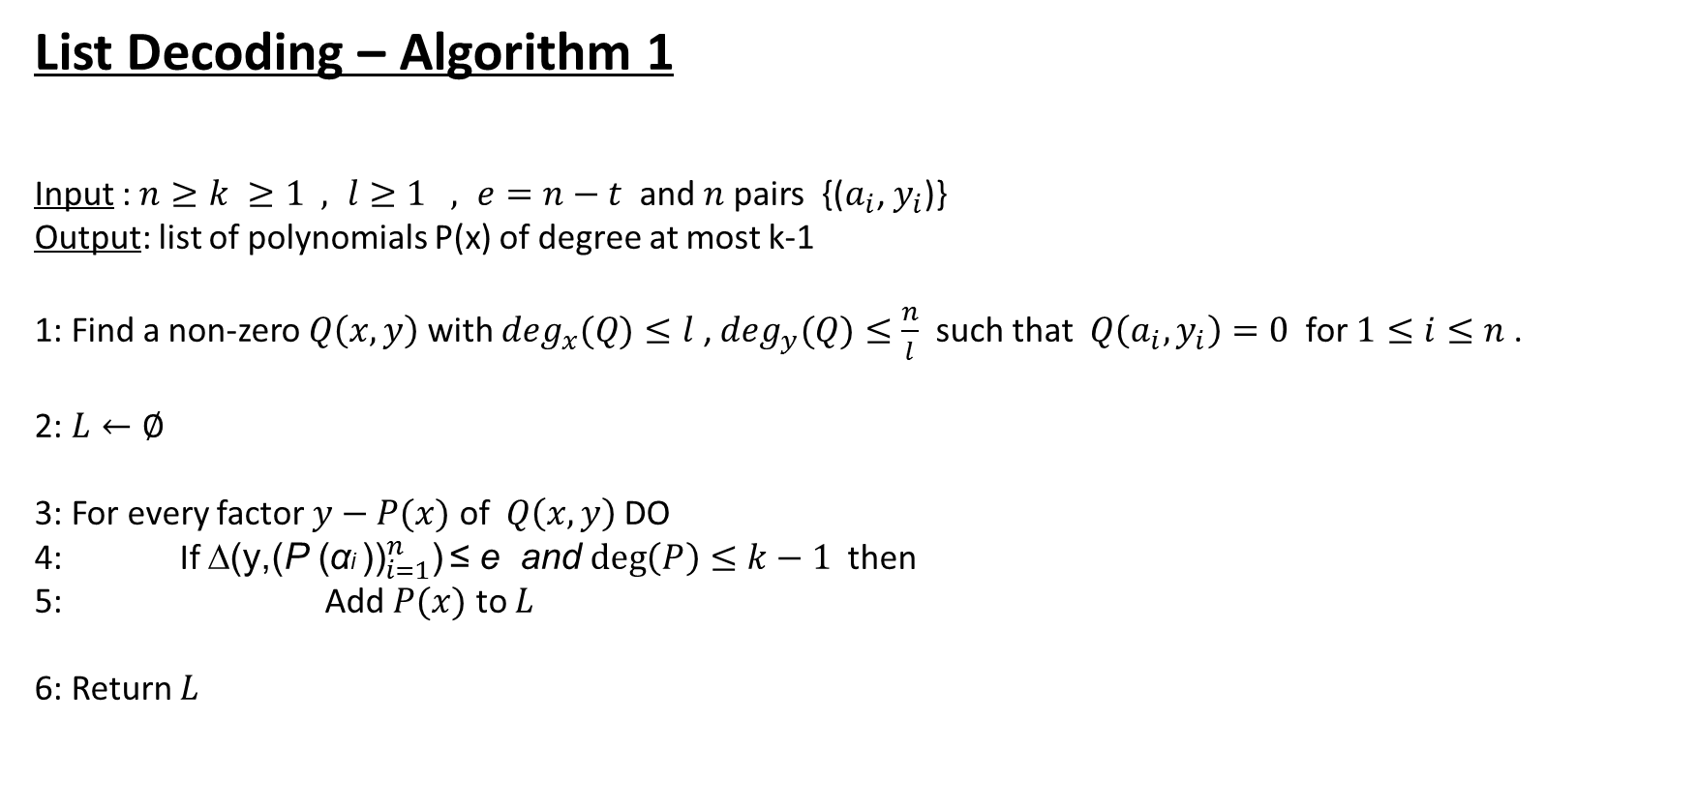
List Decoding – Algorithm 1
Input :$n≥k ≥1 , l≥1 , e=n−t$ and $n$pairs {($a_{i}$, $y_{i}$)}
Output: list of polynomials P(x) of degree at most k-1
1: Find a non-zero $Q\left(x,y\right)$ with $\deg_{x}(Q)≤l$ , $\deg_{y}(Q)≤\frac{n}{l}$ such that $Q\left(a_{i},y_{i}\right)=0$ for $1≤i≤n$ .
2: $L←∅$
3: For every factor $y−P(x)$ of $Q\left(x,y\right)$ DO
4: If ∆(${\text{y}\text{,(}\text{P} \text{(}\text{α}\text{i} \text{))}}_{i=1}^{n}$) ≤ e and $\deg\left(P\right)≤k−1$ then
5: Add $P(x)$ to $L$
6: Return $L$

Slide 20
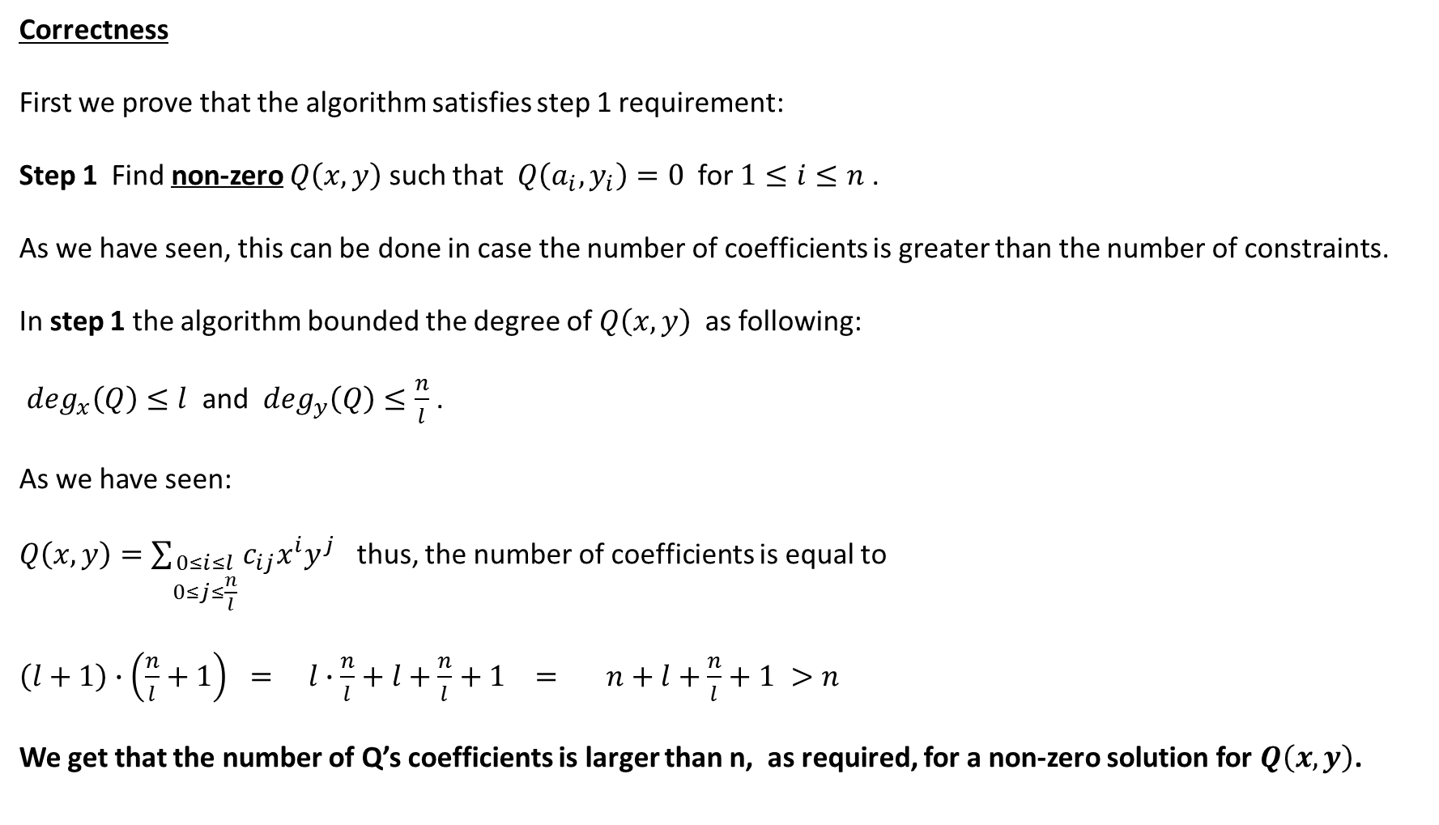
Correctness
First we prove that the algorithm satisfies step 1 requirement:
Step 1 Find non-zero $Q\left(x,y\right)$ such that $Q\left(a_{i},y_{i}\right)=0$ for $1≤i≤n$.
As we have seen, this can be done in case the number of coefficients is greater than the number of constraints.
In step 1 the algorithm bounded the degree of $Q\left(x,y\right)$ as following:
$\deg_{x}\left(Q\right)≤l$ and $\deg_{y}\left(Q\right)≤\frac{n}{l}$ .
As we have seen:
$Q\left(x,y\right)=\sum_{\begin{aligned}0≤i≤l \\ 0≤j≤\frac{n}{l}\end{aligned}}{c_{ij}x^{i}y^{j}}$ thus, the number of coefficients is equal to
$\left(l+1\right)∙\left(\frac{n}{l}+1\right) = l∙\frac{n}{l}+l+\frac{n}{l}+1 = n+l+\frac{n}{l}+1 >n$
We get that the number of Q’s coefficients is larger than n, as required, for a non-zero solution for $Q\left(x,y\right)$.

Slide 21
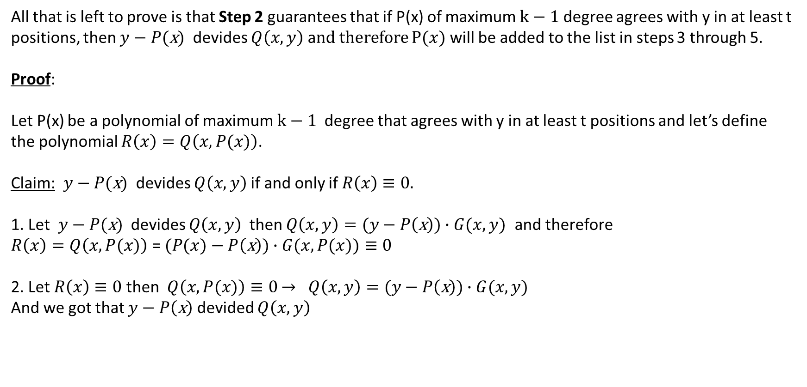
All that is left to prove is that Step 2 guarantees that if P(x) of maximum $k−1$ degree agrees with y in at least t positions, then $y−P(\text{x})$ devides $Q\left(x,y\right)$ a$nd therefore$ $P(x)$ will be added to the list in steps 3 through 5.
Proof:
Let P(x) be a polynomial of maximum $k−1$ degree that agrees with y in at least t positions and let’s define
the polynomial $R\left(x\right)=Q\left(x,P(x)\right)$.
Claim: $y−P(\text{x})$ devides $Q\left(x,y\right)$ if and only if $R\left(x\right)≡0.$
1. Let $y−P(\text{x})$ devides $Q\left(x,y\right)$ then $Q\left(x,y\right)=(y−P\left(\text{x}\right))∙G(x,y)$ and therefore
$R\left(x\right)=Q\left(x,P(x)\right)$ = $(P(x)−P\left(\text{x}\right))∙G(x,P(x))≡0$
2. Let $R\left(x\right)≡0$ then $Q\left(x,P(x)\right)≡0$ $→$ $Q\left(x,y\right)=(y−P\left(\text{x}\right))∙G(x, y)$
And we got that $y−P\left(\text{x}\right)$ devided $Q\left(x,y\right)$

Slide 22
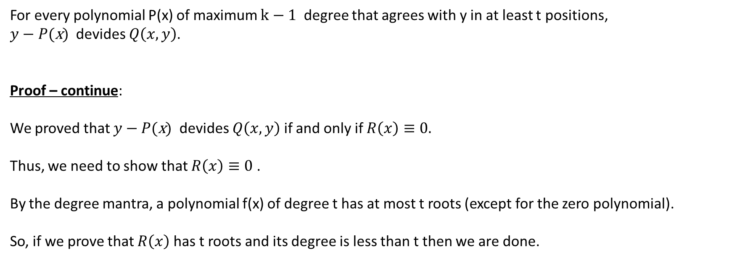
For every polynomial P(x) of maximum $k−1$ degree that agrees with y in at least t positions,
$y−P(\text{x})$ devides $Q\left(x,y\right)$.
Proof – continue:
We proved that $y−P(\text{x})$ devides $Q\left(x,y\right)$ if and only if $R\left(x\right)≡0.$
Thus, we need to show that $R\left(x\right)≡0$ .
By the degree mantra, a polynomial f(x) of degree t has at most t roots (except for the zero polynomial).
So, if we prove that $R\left(x\right)$ has t roots and its degree is less than t then we are done.

Slide 23
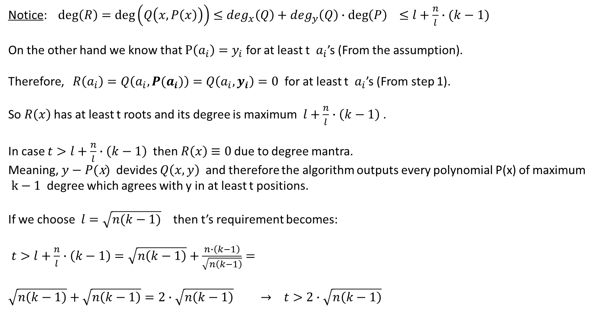
Notice: $deg\left(R\right)=\deg\left(Q\left(x,P\left(x\right)\right)\right)≤\deg_{x}\left(Q\right)+\deg_{y}\left(Q\right)∙\deg\left(P\right) ≤l+\frac{n}{l}∙(k−1)$
On the other hand we know that $P\left(a_{i}\right)=y_{i}$ for at least t $a_{i}$’s (From the assumption).
Therefore, $R\left(a_{i}\right)=Q\left(a_{i},P(a_{i})\right)=Q\left(a_{i},y_{i}\right)=0$ for at least t $a_{i}$’s (From step 1).
So $R\left(x\right)$ has at least t roots and its degree is maximum $l+\frac{n}{l}∙\left(k−1\right)$ .
In case $t>l+\frac{n}{l}∙\left(k−1\right)$ then $R\left(x\right)$ $≡0$ due to degree mantra.
Meaning, $y−P(\text{x})$ devides $Q\left(x,y\right)$ and therefore the algorithm outputs every polynomial P(x) of maximum
$k−1$ degree which agrees with y in at least t positions.
If we choose $l=\sqrt{n(k−1)}$ then t’s requirement becomes:
$t>l+\frac{n}{l}∙\left(k−1\right)=\sqrt{n\left(k−1\right)}+\frac{n∙\left(k−1\right)}{\sqrt{n\left(k−1\right)}}=$
$$\sqrt{n\left(k−1\right)}+\sqrt{n\left(k−1\right)}=2∙\sqrt{n\left(k−1\right)} → t>2∙\sqrt{n\left(k−1\right)}$$

Slide 24
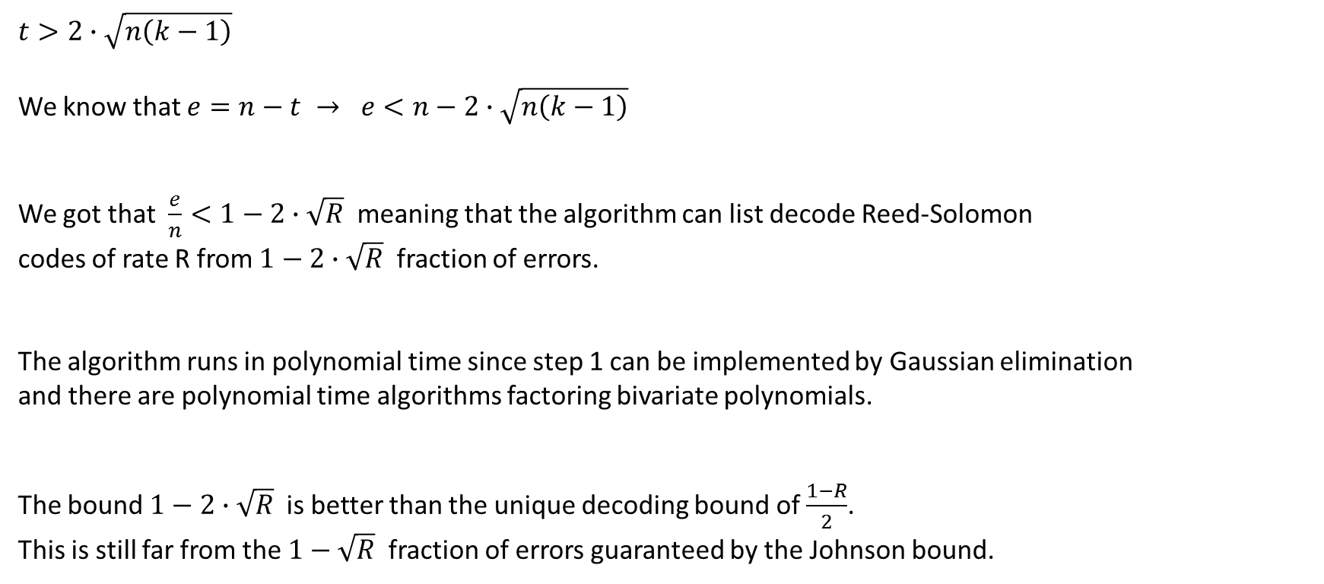
$$t>2∙\sqrt{n\left(k−1\right)}$$
We know that $e=n−t → e<n−2∙\sqrt{n\left(k−1\right)}$
We got that $\frac{e}{n}<1−2∙\sqrt{R}$ meaning that the algorithm can list decode Reed-Solomon
codes of rate R from $1−2∙\sqrt{R}$ fraction of errors.
The algorithm runs in polynomial time since step 1 can be implemented by Gaussian elimination
and there are polynomial time algorithms factoring bivariate polynomials.
The bound $1−2∙\sqrt{R}$ is better than the unique decoding bound of $\frac{1−R}{2}$.
This is still far from the $1−\sqrt{R}$ fraction of errors guaranteed by the Johnson bound.

Slide 25
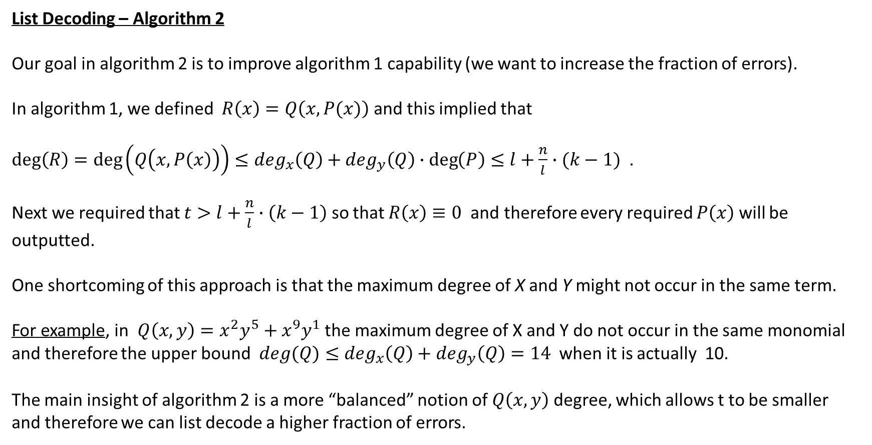
List Decoding – Algorithm 2
Our goal in algorithm 2 is to improve algorithm 1 capability (we want to increase the fraction of errors).
In algorithm 1, we defined $R\left(x\right)=Q\left(x,P(x)\right)$ and this implied that
$deg\left(R\right)=\deg\left(Q\left(x,P\left(x\right)\right)\right)≤\deg_{x}\left(Q\right)+\deg_{y}\left(Q\right)∙\deg\left(P\right)≤l+\frac{n}{l}∙(k−1)$ .
Next we required that $t>l+\frac{n}{l}∙\left(k−1\right)$ so that $R\left(x\right)≡0$ and therefore every required $P\left(x\right)$ will be outputted.
One shortcoming of this approach is that the maximum degree of X and Y might not occur in the same term.
For example, in $Q\left(x,y\right)=x^{2}y^{5}+x^{9}y^{1}$ the maximum degree of X and Y do not occur in the same monomial and therefore the upper bound $deg(Q)≤\deg_{x}\left(Q\right)+\deg_{y}\left(Q\right)=14$ when it is actually 10.
The main insight of algorithm 2 is a more “balanced” notion of $Q\left(x,y\right)$ degree, which allows t to be smaller
and therefore we can list decode a higher fraction of errors.

Slide 26
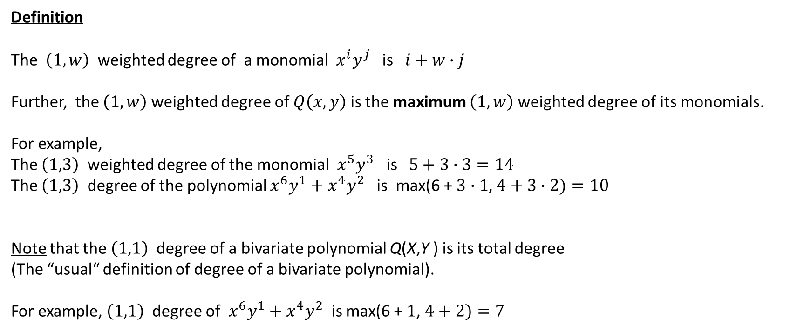
Definition
The $\left(1,w\right)$ weighted degree of a monomial $x^{i}y^{j}$ is $i+w∙j$
Further, the $\left(1,w\right)$ weighted degree of $Q\left(x,y\right)$ is the maximum $\left(1,w\right)$ weighted degree of its monomials.
For example,
The $\left(1,3\right)$ weighted degree of the monomial $x^{5}y^{3}$ is $5+3∙3=14$
The $\left(1,3\right)$ degree of the polynomial $x^{6}y^{1}+x^{4}y^{2}$ is max(6 +$3∙1$, $4+3∙2)=10$
Note that the $\left(1,1\right)$ degree of a bivariate polynomial Q(X,Y ) is its total degree
(The “usual“ definition of degree of a bivariate polynomial).
For example, $\left(1,1\right)$ degree of $x^{6}y^{1}+x^{4}y^{2}$ is max(6 +$1$, $4+2)=7$

Slide 27

Lemma:
Let P(X) be a polynomial such that $deg\left(P\right)≤w$.
Let $Q\left(x,y\right)$ be a polynomial of $\left(1,w\right)$ degree D.
Then we have $\deg\left(Q\left(x,P\left(x\right)\right)\right)≤D$
For example:
$P\left(x\right)$ = $x^{3}$ , $deg\left(P\right)≤3$
$Q\left(x,y\right)$ = $x^{6}y^{1}+x^{4}y^{2}$ so $Q\left(x,y\right)$ is a polynomial of $\left(1,w=3\right)$ degree $4+3∙2=10$.
$Q\left(x,P\left(x\right)\right)=x^{6}x^{3}+x^{4}x^{6}=x^{9}+x^{10}$ → $\deg\left(Q\left(x,P\left(x\right)\right)\right)=10$
Note that a polynomial $Q\left(x,y\right)$ of $\left(1,w\right)$ degree at most D can be represented as follows:
$$Q\left(x,y\right)=\sum_{\begin{aligned}i+wj≤D \\ i,j≥0\end{aligned}}{c_{ij}x^{i}y^{j}}$$

Slide 28
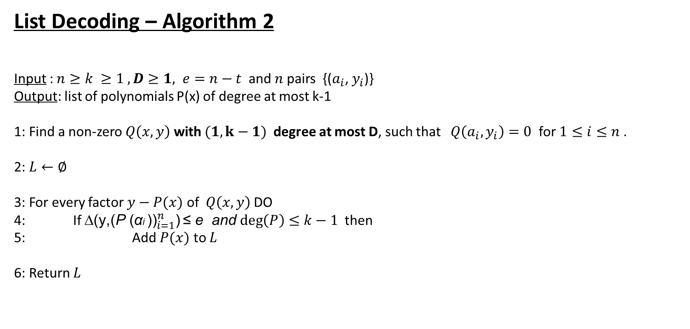
List Decoding – Algorithm 2
Input :$n≥k ≥1 , D≥1, e=n−t$ and $n$pairs {($a_{i}$, $y_{i}$)}
Output: list of polynomials P(x) of degree at most k-1
1: Find a non-zero $Q\left(x,y\right)$ with $(1,k−1)$ degree at most D, such that $Q\left(a_{i},y_{i}\right)=0$ for $1≤i≤n$ .
2: $L←∅$
3: For every factor $y−P(x)$ of $Q\left(x,y\right)$ DO
4: If ∆(${\text{y}\text{,(}\text{P} \text{(}\text{α}\text{i} \text{))}}_{i=1}^{n}$) ≤ e and $\deg\left(P\right)≤k−1$ then
5: Add $P(x)$ to $L$
6: Return $L$

Slide 29
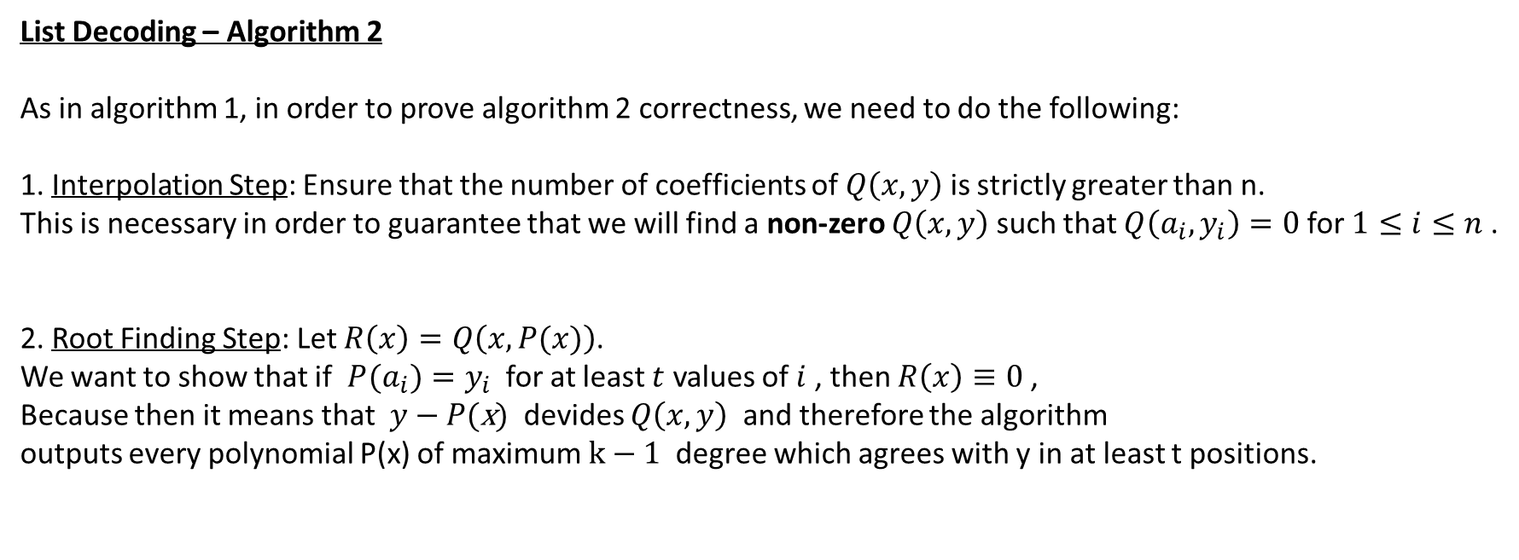
List Decoding – Algorithm 2
As in algorithm 1, in order to prove algorithm 2 correctness, we need to do the following:
1. Interpolation Step: Ensure that the number of coefficients of $Q\left(x,y\right)$ is strictly greater than n.
This is necessary in order to guarantee that we will find a non-zero $Q\left(x,y\right)$ such that $Q\left(a_{i},y_{i}\right)=0$ for $1≤i≤n$.
2. Root Finding Step: Let $R\left(x\right)=Q\left(x,P(x)\right)$.
We want to show that if $P(a_{i})=y_{i}$ for at least $t$ values of $i$ , then $R\left(x\right)≡0$ ,
Because then it means that $y−P(\text{x})$ devides $Q\left(x,y\right)$ and therefore the algorithm
outputs every polynomial P(x) of maximum $k−1$ degree which agrees with y in at least t positions.

Slide 30
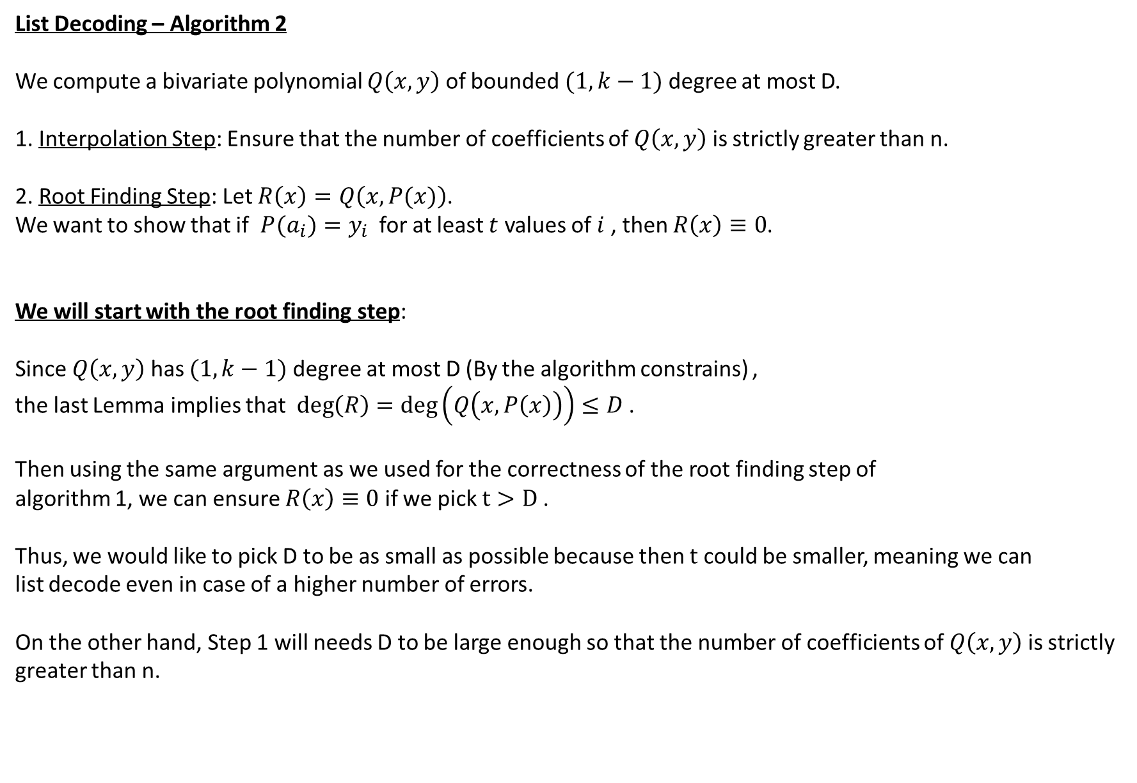
List Decoding – Algorithm 2
We compute a bivariate polynomial $Q\left(x,y\right)$ of bounded $(1,k−1)$ degree at most D.
1. Interpolation Step: Ensure that the number of coefficients of $Q\left(x,y\right)$ is strictly greater than n.
2. Root Finding Step: Let $R\left(x\right)=Q\left(x,P(x)\right)$.
We want to show that if $P(a_{i})=y_{i}$ for at least $t$ values of $i$ , then $R\left(x\right)≡0$.
We will start with the root finding step:
Since $Q\left(x,y\right)$ has $(1,k−1)$ degree at most D (By the algorithm constrains) ,
the last Lemma implies that $deg\left(R\right)=\deg\left(Q\left(x,P\left(x\right)\right)\right)≤D$ .
Then using the same argument as we used for the correctness of the root finding step of
algorithm 1, we can ensure $R\left(x\right)≡0$ if we pick $t>D$ .
Thus, we would like to pick D to be as small as possible because then $t$ could be smaller, meaning we can
list decode even in case of a higher number of errors.
On the other hand, Step 1 will needs D to be large enough so that the number of coefficients of $Q\left(x,y\right)$ is strictly greater than n.

Slide 31
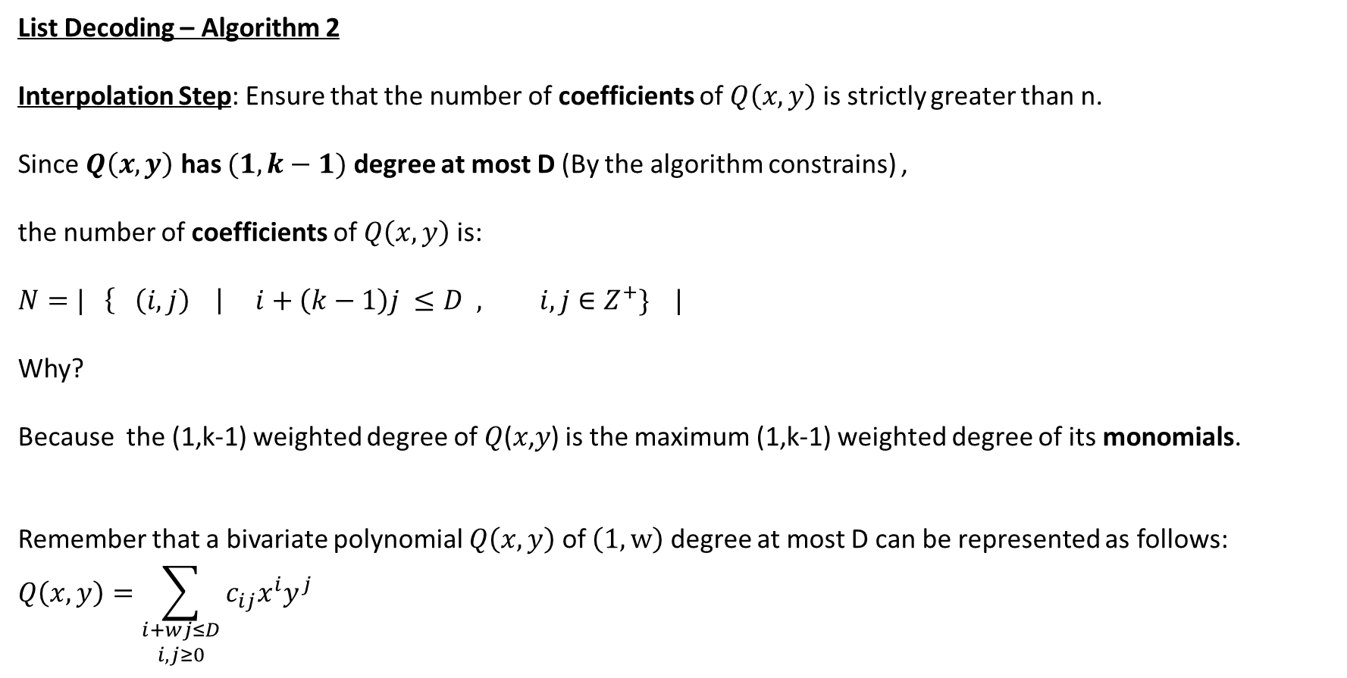
List Decoding – Algorithm 2
Interpolation Step: Ensure that the number of coefficients of $Q\left(x,y\right)$ is strictly greater than n.
Since $Q\left(x,y\right)$ has $(1,k−1)$ degree at most D (By the algorithm constrains) ,
the number of coefficients of $Q\left(x,y\right)$ is:
$$N=| \left\{ \left(i,j\right) \right| i+\left(k−1\right)j ≤D , i,j∈Z^{+}\} |$$
Why?
Because the (1,k-1) weighted degree of 𝑄(𝑥,𝑦) is the maximum (1,k-1) weighted degree of its monomials.
Remember that a bivariate polynomial $Q\left(x,y\right)$ of $\left(1,w\right)$ degree at most D can be represented as follows:
$$Q\left(x,y\right)=\sum_{\begin{aligned}i+wj≤D \\ i,j≥0\end{aligned}}{c_{ij}x^{i}y^{j}}$$

Slide 32
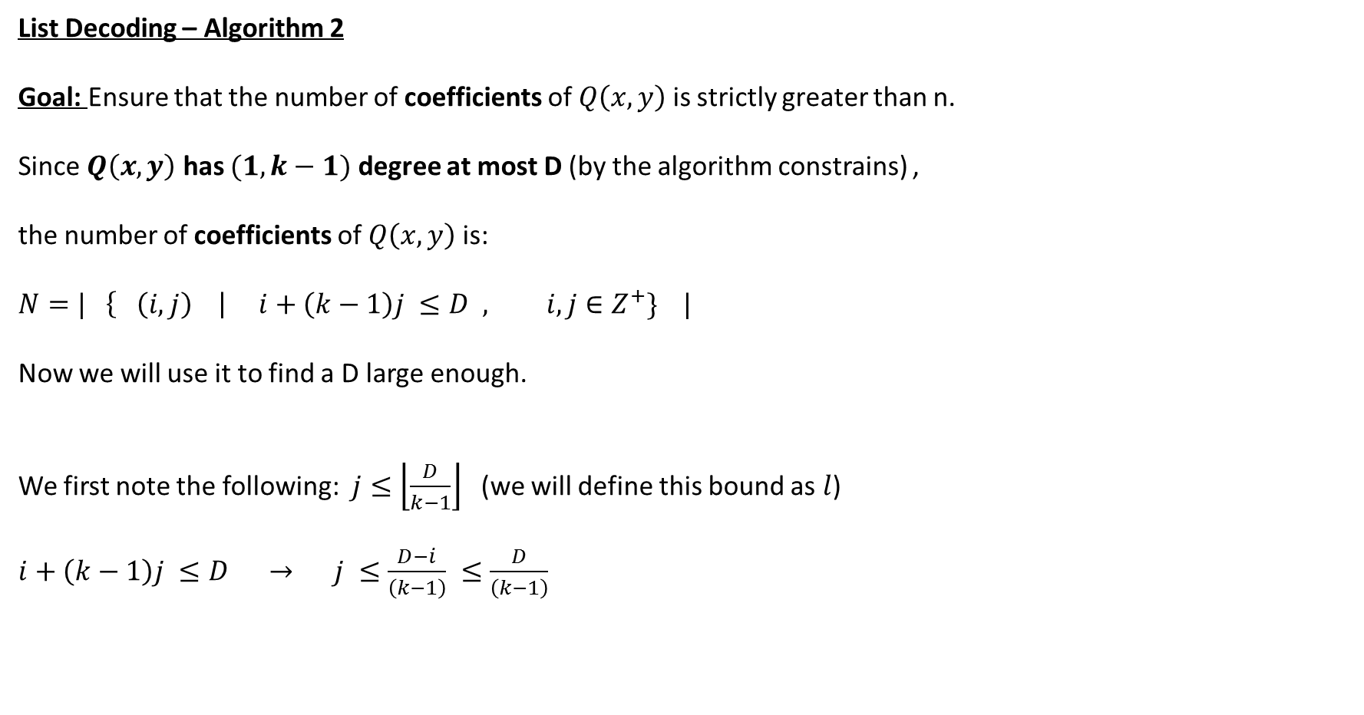
List Decoding – Algorithm 2
Goal: Ensure that the number of coefficients of $Q\left(x,y\right)$ is strictly greater than n.
Since $Q\left(x,y\right)$ has $(1,k−1)$ degree at most D (by the algorithm constrains) ,
the number of coefficients of $Q\left(x,y\right)$ is:
$$N=| \left\{ \left(i,j\right) \right| i+\left(k−1\right)j ≤D , i,j∈Z^{+}\} |$$
Now we will use it to find a D large enough.
We first note the following: $j≤\left\lfloor \frac{D}{k−1}\right\rfloor$ (we will define this bound as $l$)
$i+\left(k−1\right)j ≤D → j ≤\frac{D−i}{\left(k−1\right)} ≤\frac{D}{\left(k−1\right)}$

Slide 33

List Decoding – Algorithm 2
$$N=| \left\{ \left(i,j\right) \right| i+\left(k−1\right)j ≤D , i,j∈Z^{+}\} |$$
$j≤\left\lfloor \frac{D}{k−1}\right\rfloor$ , $l=\left\lfloor \frac{D}{k−1}\right\rfloor$
Let’s compute a lower bound on the size of N:
$$N=\sum_{j=1}^{l}{\sum_{i=0}^{D−\left(k−1\right)j}{1}} = \sum_{j=0}^{l}{(D−\left(k−1\right)j+1)}$$
$$=\sum_{j=0}^{l}{\left(D+1−\left(k−1\right)j\right)}=\sum_{j=0}^{l}{\left(D+1\right)}−\sum_{j=0}^{l}{\left(k−1\right)j}$$
$$=\left(D+1\right)\left(l+1\right)−\left(k−1\right)\sum_{j=0}^{l}{j}=\left(D+1\right)\left(l+1\right)−\left(k−1\right)\frac{l(l+1)}{2}$$

Slide 34
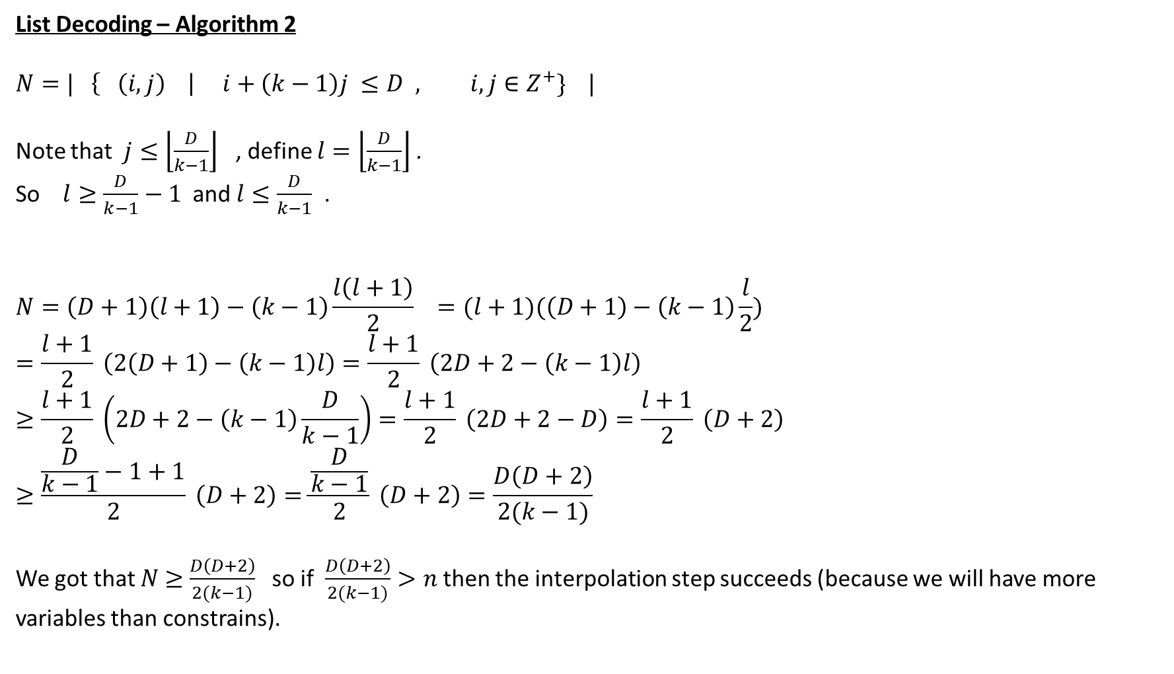
List Decoding – Algorithm 2
$$N=| \left\{ \left(i,j\right) \right| i+\left(k−1\right)j ≤D , i,j∈Z^{+}\} |$$
Note that $j≤\left\lfloor \frac{D}{k−1}\right\rfloor$ , define $l=\left\lfloor \frac{D}{k−1}\right\rfloor$ .
So $l≥\frac{D}{k−1}−1$and $l≤\frac{D}{k−1}$ .
$$N=\left(D+1\right)\left(l+1\right)−\left(k−1\right)\frac{l\left(l+1\right)}{2} =(l+1)(\left(D+1\right)−\left(k−1\right)\frac{l}{2})$$
$$=\frac{l+1}{2} \left(2\left(D+1\right)−\left(k−1\right)l\right)=\frac{l+1}{2} \left(2D+2−\left(k−1\right)l\right)$$
$$≥\frac{l+1}{2} \left(2D+2−\left(k−1\right)\frac{D}{k−1}\right)=\frac{l+1}{2} \left(2D+2−D\right)=\frac{l+1}{2} \left(D+2\right)$$
$$≥\frac{\frac{D}{k−1}−1+1}{2} \left(D+2\right)=\frac{\frac{D}{k−1}}{2} \left(D+2\right)=\frac{D\left(D+2\right)}{2(k−1)}$$
We got that $N$ $≥\frac{D\left(D+2\right)}{2(k−1)}$ so if $\frac{D\left(D+2\right)}{2(k−1)}>n$ then the interpolation step succeeds (because we will have more variables than constrains).

Slide 35
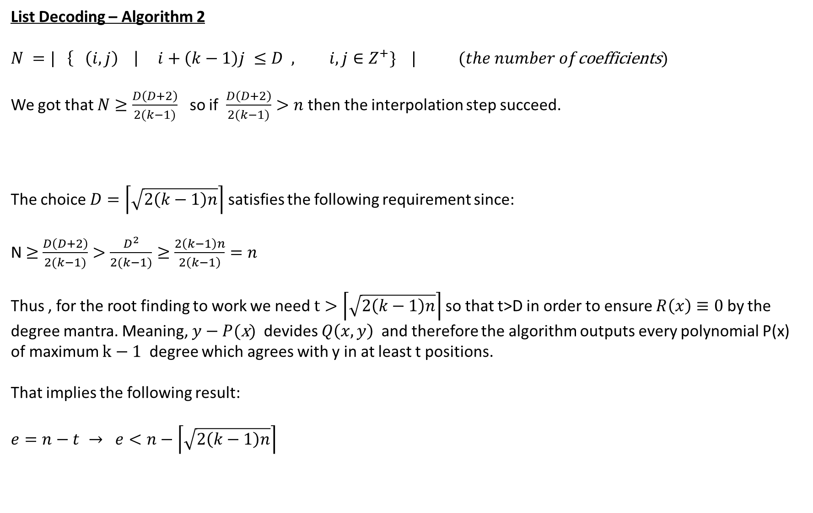
List Decoding – Algorithm 2
$$N =| \left\{ \left(i,j\right) \right| i+\left(k−1\right)j ≤D , i,j∈Z^{+}\} | (the number of\text{coefficients})$$
We got that $N≥\frac{D\left(D+2\right)}{2(k−1)}$ so if $\frac{D\left(D+2\right)}{2(k−1)}>n$ then the interpolation step succeed.
The choice $D=\left\lceil \sqrt{2\left(k−1\right)n}\right\rceil$ satisfies the following requirement since:
N $≥$ $\frac{D\left(D+2\right)}{2(k−1)}>\frac{D^{2}}{2(k−1)}≥\frac{2\left(k−1\right)n}{2\left(k−1\right)}=n$
Thus , for the root finding to work we need $t>\left\lceil \sqrt{2\left(k−1\right)n}\right\rceil$so that t>D in order to ensure $R\left(x\right)≡0$ by the degree mantra. Meaning, $y−P(\text{x})$ devides $Q\left(x,y\right)$ and therefore the algorithm outputs every polynomial P(x) of maximum $k−1$ degree which agrees with y in at least t positions.
That implies the following result:
$$e=n−t → e<n−\left\lceil \sqrt{2\left(k−1\right)n}\right\rceil$$

Slide 36
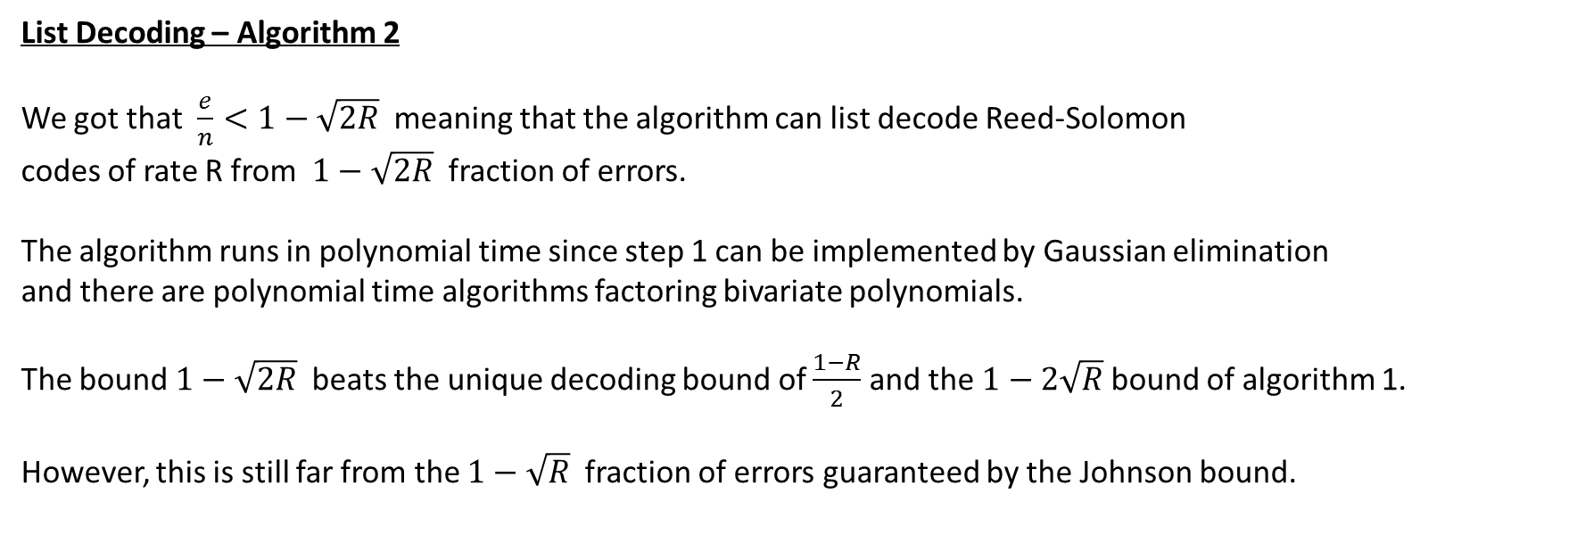
List Decoding – Algorithm 2
We got that $\frac{e}{n}<1−\sqrt{2R}$ meaning that the algorithm can list decode Reed-Solomon
codes of rate R from $1−\sqrt{2R}$ fraction of errors.
The algorithm runs in polynomial time since step 1 can be implemented by Gaussian elimination
and there are polynomial time algorithms factoring bivariate polynomials.
The bound $1−\sqrt{2R}$ beats the unique decoding bound of $\frac{1−R}{2}$ and the $1−2\sqrt{R}$ bound of algorithm 1.
However, this is still far from the $1−\sqrt{R}$ fraction of errors guaranteed by the Johnson bound.

