Slide 1

Auction Seminar
Optimal Mechanism
Presentation by: Alon Resler
Supervised by: Amos Fiat

Slide 2
Review
Myerson Auction for distributions with strictly increasing virtual valuation:
Solicit a bid vector from the agents.
Allocate the item to the bidder with the largest virtual value , if positive, and otherwise, do not allocate.
Charge the winning bidder i, if any, the minimum value she could bid and still win, i.e.

Slide 3
Review
we defined the virtual value of agent i to be:
We saw that when the bidders values drawn from independent distributions with increasing virtual valuations the Myerson auction is optimal, i.e.
it maximized the expected auctioneer revenue in Bayes-Nash equilibrium

Slide 4
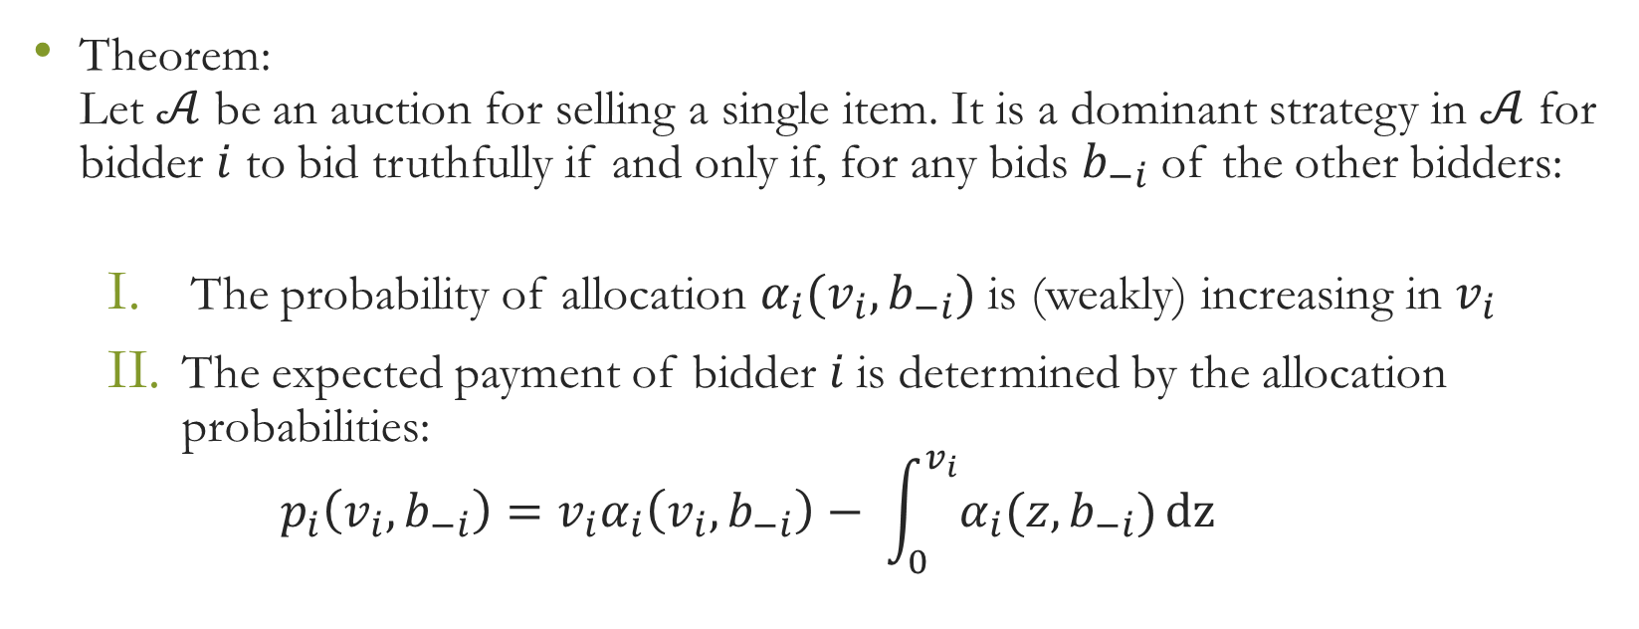
Review

Slide 5
Review
Characterization of BNE:
Let A be an auction for selling a single item, where bidder i’s value is drawn independently from .
If is a BNE, then for each agent i:
The probability of allocation is monotone increasing in
The utility is a convex function of with
The expected payment is determined by the allocation probabilities:

Slide 6
Today issues:
We will show a generalization version of Myerson’s optimal mechanism, that doesn’t require that virtual valuations be increasing.
We will see one examples

Slide 7
Optimal Mechanism
Our goal now is to derived the general version of Myerson’s optimal mechanism, that doesn’t require that virtual valuations be increasing.
We will a change in variables to quantile space, and define:
The payment function:
The allocation function:
Notice that:
Notes:
חשוב: בשני השיויונות האחרונים צד שמאל הוא פשוט סימון של צד ימין.

Slide 8
Optimal Mechanism
Given any and we have:

Slide 9
Optimal Mechanism
From this formula, we derive the expected revenue from this bidder.
Let Q be the random variable representing this bidder’s draw from the distribution in quantile space, i.e., Q=F(V) [Notice that ]. Then,
Reversing the order of integration, we get

Slide 10
Optimal Mechanism
Where is called the revenue curve.
It represents the expected revenue to a seller from offering a price of v(q) to a buyer whose value V is drawn from F.

Slide 11
Optimal Mechanism
Integrating by parts…
Explanation: R(1) = 0 and because is on we get,

Slide 12
Optimal Mechanism
To summarizing, we proved a lemma:
Consider a bidder with value V drawn from distribution F, with Q=F(V). Then his expected payment in a BIC auction is
Where is the revenue curve.

Slide 13
Optimal Mechanism
Lemma: let Then,
Proof:
From and we get:

Slide 14
Optimal Mechanism
As we discussed in David’s class (two weeks ago), allocation to the bidder with the highest virtual value (or equivalently, the largest –R’(q)) yields the optimal auction, provided that virtual valuations are increasing.
Hedva Observation:
Let be the revenue curve with
. Then is (weakly) increasing if and only if R(q) is concave. (a function is concave if it’s derivative is increasing ).
Notes:
אפשר לצייר על הלוח כדי לתת אינטואיציה.

Slide 15
Optimal Mechanism
To derived an optimal mechanism for the case when R(q) is not concave envelope of
Definition: is the infimum over concave functions such that for all .
Passing from to is called ironing.
can also be interpreted as a revenue curve when randomization is allowed.
Definition: The iron virtual value of bidder i with value is:

Slide 16
Myerson auction with ironing
Now we can replace virtual values with ironed virtual values to obtain an optimal auction even when virtual valuations are not increasing.
Definition: The Myerson auction with ironing:
Solicit a bid vector b from the bidders.
Allocate the item to the bidder with the largest value of , if positive, and otherwise do not allocate.
Charge the winning bidder i, if any, her threshold bid, the minimum value she could bid and still win.

Slide 17
Optimal Mechanism
Theorem: The Myerson Auction described above is optimal, i.e., it maximized the expected auctioneer revenue in Bayes-Nash equilibrium when bidders values are drawn from independent distribution.
Proof: The expected profit from a BIC auction is
Notes:
מעברים 1+2: לפי הלמה בשקף 9
מעבר 3:

Slide 18
Proof cont.
(add and subtract
).

Slide 19
Proof cont.
Consider choosing a BIC allocation rule to maximize the first term:
This is optimized by allocating to the bidder with the largest , if positive.
Moreover, because is concave, this is an increasing allocation rule and hence yields a dominant strategy auction.

Slide 20
Proof cont.
Notice also that is constant in each interval of non-concavity of , and hence in each such interval
is constant and thus .
Consider now the second term: In any BIC auction,
must be increasing and hence for all q.
But for all q and hence the second term is non-positive. Since the allocation rule that optimized the first term
has whenever , it ensures that the second term is zero, which is best possible.

Slide 21
The advantage of just one more bidder…
One of the downside of implementing the optimal auction is that it requires that the auctioneer know the distributions from which agents values are drawn.
The following result shows that in instead of knowing the distribution from which n independently and identical distributed bidders are drawn, it suffices to add just one more bidder into the auction.

Slide 22
Theorem
Let F be a distribution for which virtual valuations are increasing. The expected revenue in the optimal auction with independently and identical distributed bidders with values drawn from F is upper bounded by the expected revenue in a Vickrey auction with n+1 independently and identical distributed bidders with values drawn from F.

Slide 23
Proof
The optimal (profit-maximizing) auction that is required to sell the item is the Vichrey auction (this follows from the lemma we saw in previous class, which says that for any auction, the expected profit is equal to the expected virtual value of the winner).
Second, observe that one possible n+1 bidder auction that always sells the item consist of, first, running the optimal auction with n bidders, and then, if the item is unsold, giving the item to the n+1–st bidder for free.

Slide 24
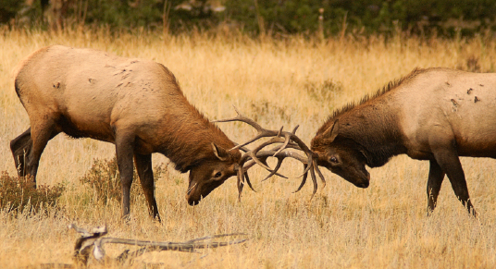
First example:
War of Attrition

Slide 25
War of attrition (Reminder)
In Liran’s class we considered the war of attrition: this single item auction allocates the item to the player that bids the highest, charges the winner the second-highest bid, and charge all others players their bid.
Notice that in this auction the bidders decides at the beginning of the game when to drop out.

Slide 26


War of attrition (Reminder)
Formulas that we derived in Liran’s class that we will need for today: Let be a symmetric strictly increasing equilibrium strategy, Then:
Expected payment of an agent in a war-of-attrition auction in which all bidders use is
And

Slide 27
Dynamic war of attrition
A more natural model is for bidders to dynamically decide when to drop out.
The last player to drop out is then the winner of the item.
With two players this is equivalent to the model discussed in Liran’s class:
The equilibrium strategy := how long a player with value v waits before dropping out.

Slide 28

Dynamic war of attrition
satisfies:
Where is the hazard rate of
the distribution F.
(it followed from the equilibrium we found in Liran’s class:
).

Slide 29
Dynamic war of attrition
We rederive this here without the use of revenue equivalence.
To this end, assume that the opponent plays .
The agent’s utility from playing when his value is v is:
Differentiating with respect to w, we have:

Slide 30
Dynamic war of attrition
For this to be maximized at , we must have
implying

Slide 31
Dynamic war of attrition
With three players strategy has two component, and
.
For a player with value v, he will drop out at time if no one else dropped out earlier.
Otherwise, if another player dropped out at time
, our player will continue until time
.

Slide 32
Dynamic war of attrition
The case of two players applied at time y implies that in equilibrium
Since the update density has the same hazard rate as f.
Unfortunately there is no equilibrium once there are three players…

Slide 33
Dynamic war of attrition
To see this, suppose that players 2 and 3 are playing
and , and player 1 with value v plays instead of . Then
Since with probability , the other two players outlast player 1 and then he pays an additional
for naught.
And with probability for some constant C, both of the others players drop out first.

Slide 34
Dynamic war of attrition
Thus, it must be that
And for any k we have:
  (since is non-increasing function).

Slide 35
Dynamic war of attrition
Summing from k=0 to :
And hence:
Finally, we observe that is not equilibrium since a player, knowing that the other players are going to drop out immediately, will prefer to stay in.

Slide 36
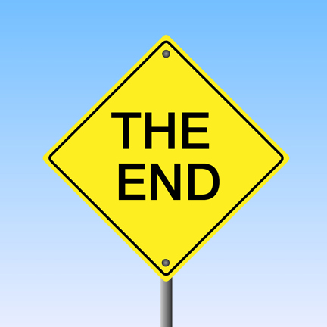
Thanks for listening

