Slide 1
Game Theory Alive:
Myerson’s Optimal Auction
Tel Aviv University
Seminar in Auctions and Mechanism Design
Presentation by: David Franco
Supervised by: Amos Fiat

Slide 2
Today’s lecture topics
Review (refreshing after a long break)
Myerson’s Optimal Auction
Examples

Slide 3
What we’ve learned so far:
Vickery auction with reserve price
Designing auctions to maximize profits
Characterization of Equilibrium (in particular BNE)
When is truthfulness a dominant strategy
The revelation principle

Slide 4
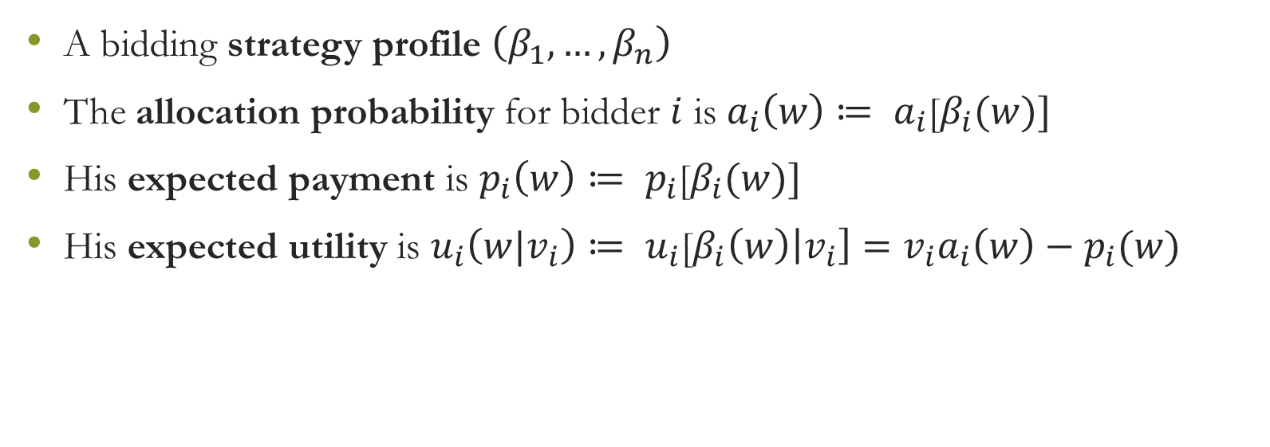
Reminder: definitions and notations
A bidding strategy profile $\left(β_{1}, …,β_{n}\right)$
The allocation probability for bidder $i$ is $a_{i}\left(w\right)≔ a_{i}$[$β_{i}(w)]$
His expected payment is $p_{i}\left(w\right)≔ p_{i}$[$β_{i}(w)]$
His expected utility is $u_{i}\left(w|v_{i}\right)≔ u_{i}$[$β_{i}\left(w\right)\left|v_{i}\right]=v_{i}a_{i}\left(w\right)−p_{i}(w)$

Slide 5
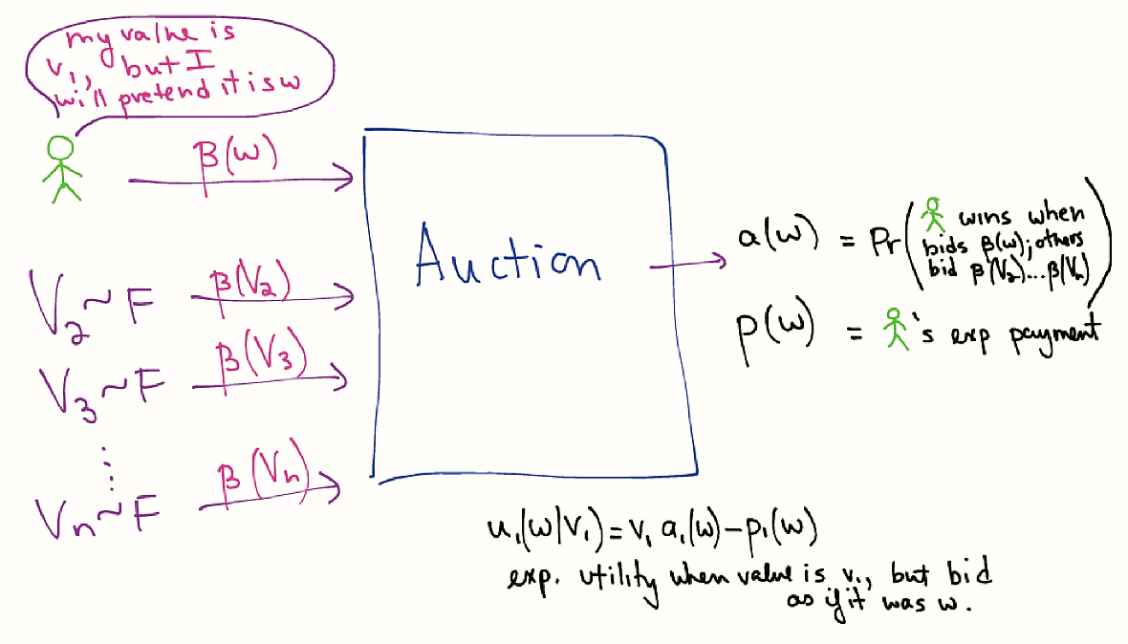

Slide 6
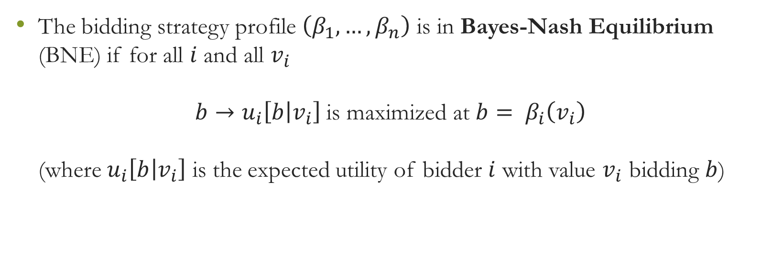
Reminder: Bayes-Nash Equilibrium
The bidding strategy profile $\left(β_{1}, …,β_{n}\right)$ is in Bayes-Nash Equilibrium (BNE) if for all $i$ and all $v_{i}$
$b→u_{i}\left[b | v_{i}\right]$is maximized at $b= β_{i}\left(v_{i}\right)$
(where $u_{i}\left[b | v_{i}\right]$ is the expected utility of bidder $i$ with value $v_{i}$ bidding $b$)

Slide 7

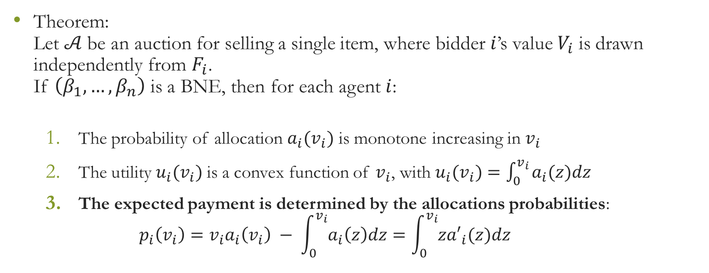
Characterization of BNE
Theorem:
Let $𝒜$be an auction for selling a single item, where bidder $i$’s value $V_{i}$ is drawn independently from $F_{i}$.
If $\left(β_{1}, …, β_{n}\right)$ is a BNE, then for each agent $i$:
  The probability of allocation $a_{i}(v_{i})$ is monotone increasing in $v_{i}$
  The utility$u_{i}(v_{i})$ is a convex function of $v_{i}$, with $u_{i}(v_{i})=\int_{0}^{v_{i}}{a_{i}(z)dz}$
  The expected payment is determined by the allocations probabilities:
  $p_{i}\left(v_{i}\right)=v_{i}a_{i}\left(v_{i}\right) − \int_{0}^{v_{i}}{a_{i}\left(z\right)dz}=\int_{0}^{v_{i}}{{za′}_{i}(z)dz}$

Slide 8
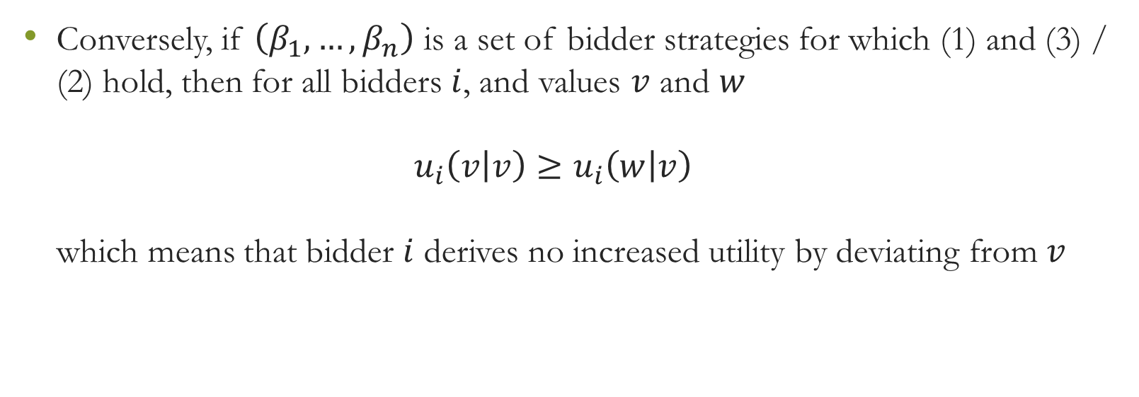
Characterization of BNE
Conversely, if $\left(β_{1}, …,β_{n}\right)$ is a set of bidder strategies for which (1) and (3) / (2) hold, then for all bidders $i$, and values $v$ and $w$
$u_{i}\left(v | v\right)≥u_{i}\left(w | v\right)$
which means that bidder $i$ derives no increased utility by deviating from $v$
Notes:
האסטרטגיות לעיל הן האופטימליות : התועלת של השחקן ה-i הפועל לפי האסטרטגיה המתאימה , כשהוא מציע v בהינתן שהערך האמיתי שלו הוא v, גדולה יותר מכל תועלת שיקבל אם יציע הצעה אחרת

Slide 9
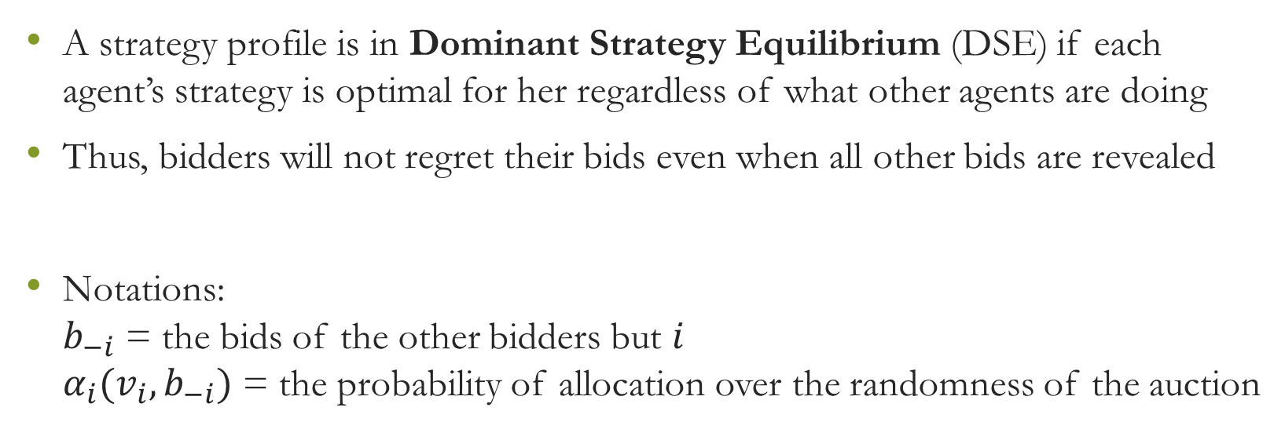
Reminder: When is truthfulness dominant?
A strategy profile is in Dominant Strategy Equilibrium (DSE) if each agent’s strategy is optimal for her regardless of what other agents are doing
Thus, bidders will not regret their bids even when all other bids are revealed
Notations:
$b_{−i}$ = the bids of the other bidders but $i$
$α_{i}(v_{i}, b_{−i})$ = the probability of allocation over the randomness of the auction

Slide 10
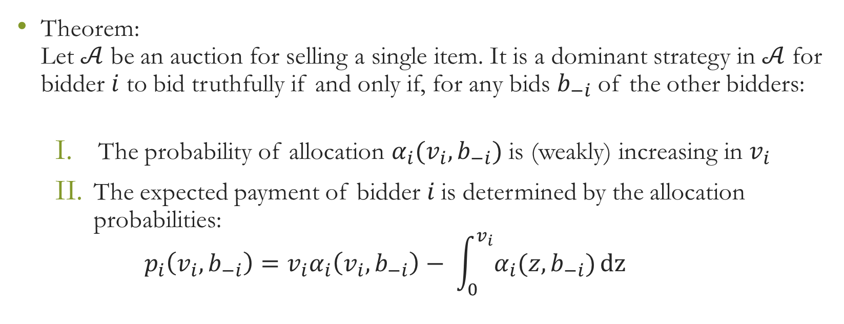
When is truthfulness dominant?
Theorem:
Let $𝒜$ be an auction for selling a single item. It is a dominant strategy in $𝒜$ for bidder $i$ to bid truthfully if and only if, for any bids $b_{−i}$ of the other bidders:
  The probability of allocation $α_{i}(v_{i}, b_{−i})$ is (weakly) increasing in $v_{i}$
  The expected payment of bidder $i$ is determined by the allocation probabilities:
  $p_{i}\left(v_{i}, b_{−i}\right)={v_{i}α}_{i}\left(v_{i}, b_{−i}\right)− \int_{0}^{v_{i}}{α_{i}(z, b_{−i})}dz$

Slide 11
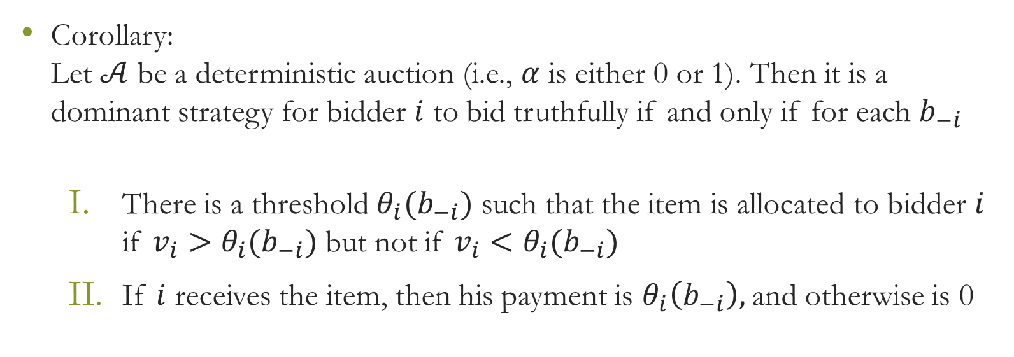
When is truthfulness dominant?
Corollary:
Let $𝒜$ be a deterministic auction (i.e., $α$ is either 0 or 1). Then it is a dominant strategy for bidder $i$ to bid truthfully if and only if for each $b_{−i}$
  There is a threshold $θ_{i}(b_{−i})$ such that the item is allocated to bidder $i$ if $v_{i}>θ_{i}(b_{−i})$ but not if $v_{i}<θ_{i}(b_{−i})$
  If $i$ receives the item, then his payment is $θ_{i}\left(b_{−i}\right),$and otherwise is 0

Slide 12

Reminder: Bayes-Nash incentive compatible
If bidding truthfully (i.e., $β_{i}\left(v\right)=v$ for all $i$) is a Bayes-Nash equilibrium for auction $𝒜$, then $𝒜$ is said to be Bayes-Nash incentive compatible (BIC)
That simplifies the design and analysis of an auction
Notes:
How? In opposed to an arbitrary BNE auction, a BIC auction is a dominant strategy auction and therefore it is less complex from the perspective of the bidder, and so easier to analyze and design.

Slide 13
Summing it all together
BNE – Arbitrary strategies
BIC – Bidding truthfully is a BNE
Bidding truthfully as dominant strategy

Slide 14
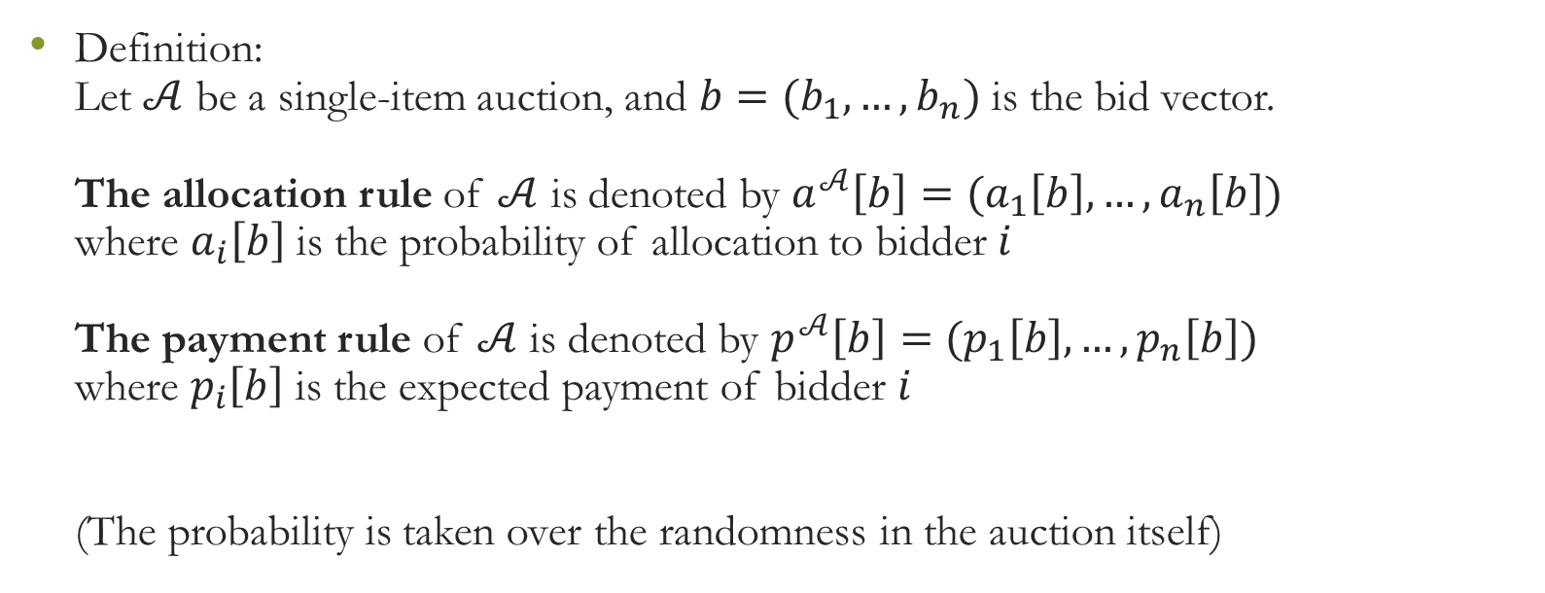
Reminder: The Revelation Principle
Definition:
Let $𝒜$ be a single-item auction, and $b=(b_{1},…,b_{n})$ is the bid vector.
The allocation rule of $𝒜$ is denoted by $a^{𝒜}\left[b\right]=(a_{1}\left[b\right], …, a_{n}\left[b\right])$
where $a_{i}\left[b\right]$ is the probability of allocation to bidder $i$
The payment rule of $𝒜$ is denoted by $p^{𝒜}\left[b\right]=(p_{1}\left[b\right], …, p_{n}\left[b\right])$
where $p_{i}\left[b\right]$ is the expected payment of bidder $i$
(The probability is taken over the randomness in the auction itself)

Slide 15
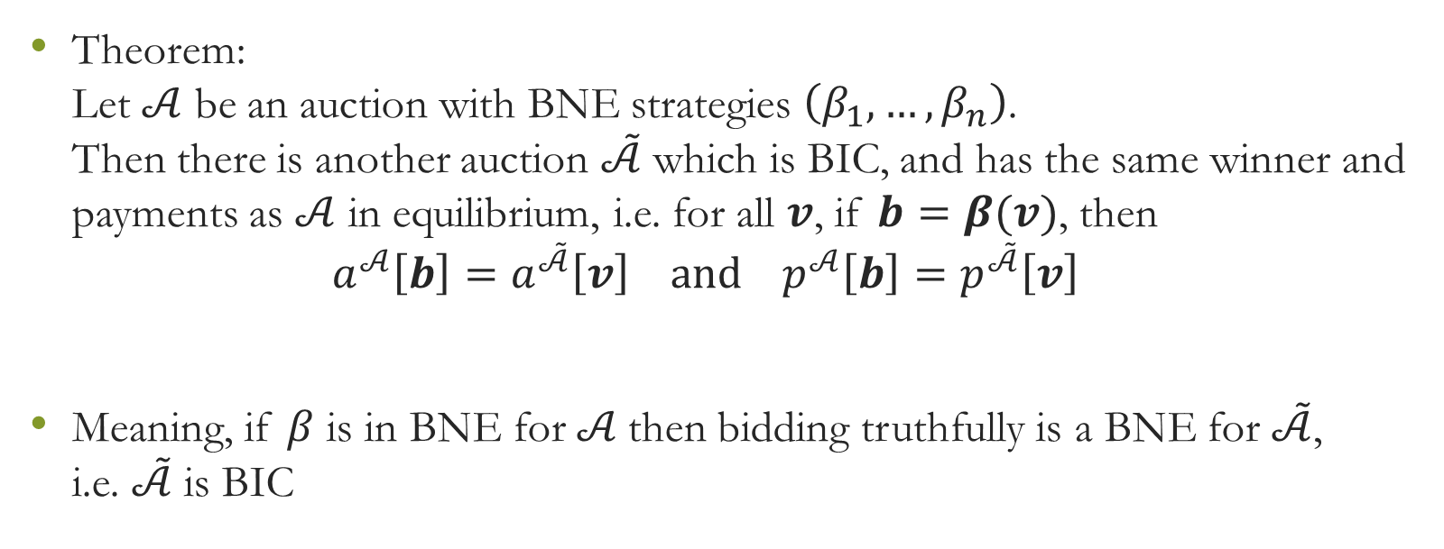
The Revelation Principle
Theorem:
Let $𝒜$ be an auction with BNE strategies $\left(β_{1}, …,β_{n}\right)$.
Then there is another auction $\tilde{𝒜}$ which is BIC, and has the same winner and payments as $𝒜$ in equilibrium, i.e. for all $v$, if $b=β(v)$, then
$a^{𝒜}\left[b\right]=a^{\tilde{𝒜}}\left[v\right] and{ p}^{𝒜}\left[b\right]=p^{\tilde{𝒜}}\left[v\right]$
Meaning, if $β$ is in BNE for $𝒜$then bidding truthfully is a BNE for $\tilde{𝒜}$,
i.e. $\tilde{𝒜}$ is BIC

Slide 16

Now fasten your seat belts and get ready to

Slide 17
Myerson’s Optimal Auction
We now consider the design of optimal auctions
Our purpose is to maximize the auctioneer profit

Slide 18
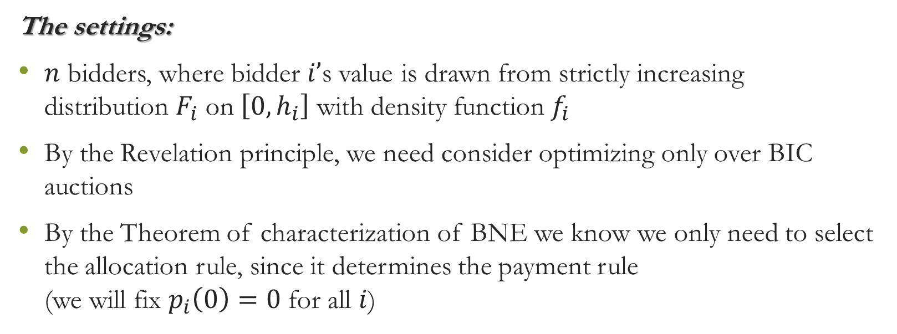
Myerson’s Optimal Auction
The settings:
$n$ bidders, where bidder $i’$s value is drawn from strictly increasing distribution $F_{i}$ on $\left[0, h_{i}\right]$ with density function $f_{i}$
By the Revelation principle, we need consider optimizing only over BIC auctions
By the Theorem of characterization of BNE we know we only need to select the allocation rule, since it determines the payment rule
(we will fix $p_{i}\left(0\right)=0$ for all $i$)

Slide 19
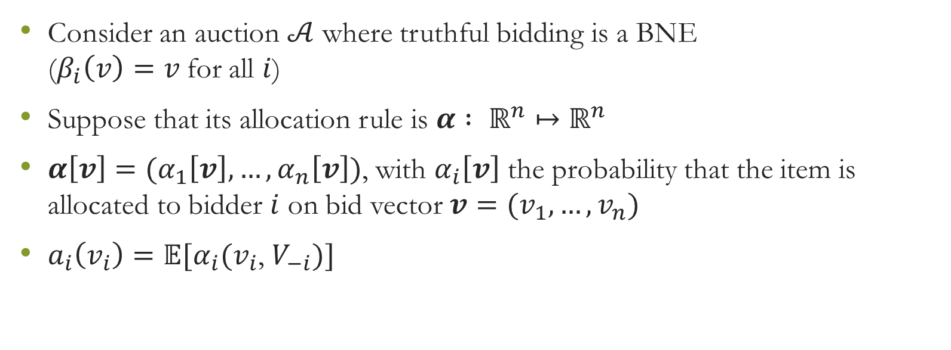
Myerson’s Optimal Auction
Consider an auction $𝒜$ where truthful bidding is a BNE
($β_{i}\left(v\right)=v$for all $i$)
Suppose that its allocation rule is $α : ℝ^{n}↦ℝ^{n}$
${α\left[v\right]=(α}_{1}\left[v\right], …,α_{n}\left[v\right])$, with $α_{i}\left[v\right]$ the probability that the item is allocated to bidder $i$ on bid vector ${v=(v}_{1}, …,v_{n})$
$a_{i}\left(v_{i}\right)=𝔼[α_{i}(v_{i}$, $V_{−i})]$

Slide 20
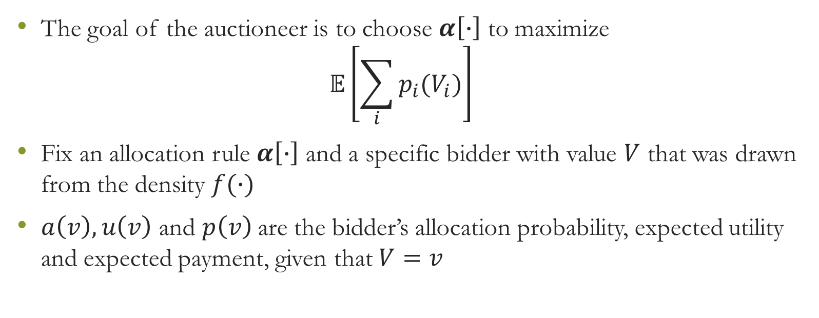
Myerson’s Optimal Auction
The goal of the auctioneer is to choose $α\left[∙\right]$ to maximize
$𝔼\left[\sum_{i}{p_{i}(V_{i})}\right]$
Fix an allocation rule $α\left[∙\right]$ and a specific bidder with value $V$ that was drawn from the density $f(∙)$
$a\left(v\right), u\left(v\right)$ and $p\left(v\right)$are the bidder’s allocation probability, expected utility and expected payment, given that $V=v$

Slide 21
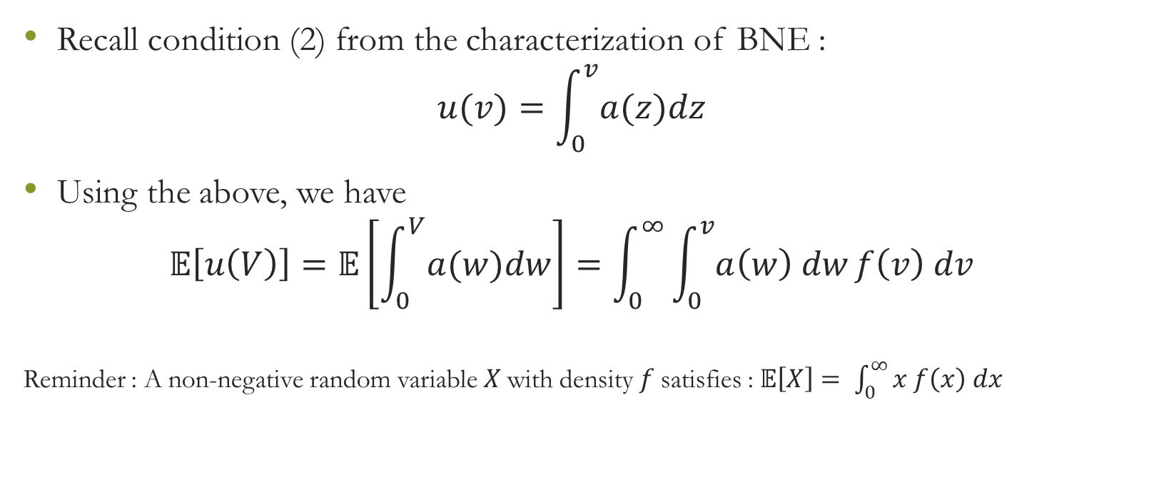
Myerson’s Optimal Auction
Recall condition (2) from the characterization of BNE :
$u(v)=\int_{0}^{v}{a(z)dz}$
Using the above, we have
$𝔼\left[u\left(V\right)\right]=𝔼\left[\int_{0}^{V}{a(w)dw}\right]=\int_{0}^{∞}{\int_{0}^{v}{a\left(w\right) dw}}f\left(v\right) dv$
Reminder : A non-negative random variable $X$with density $f$satisfies : $𝔼\left[X\right]= \int_{0}^{∞}{x f\left(x\right) dx}$

Slide 22
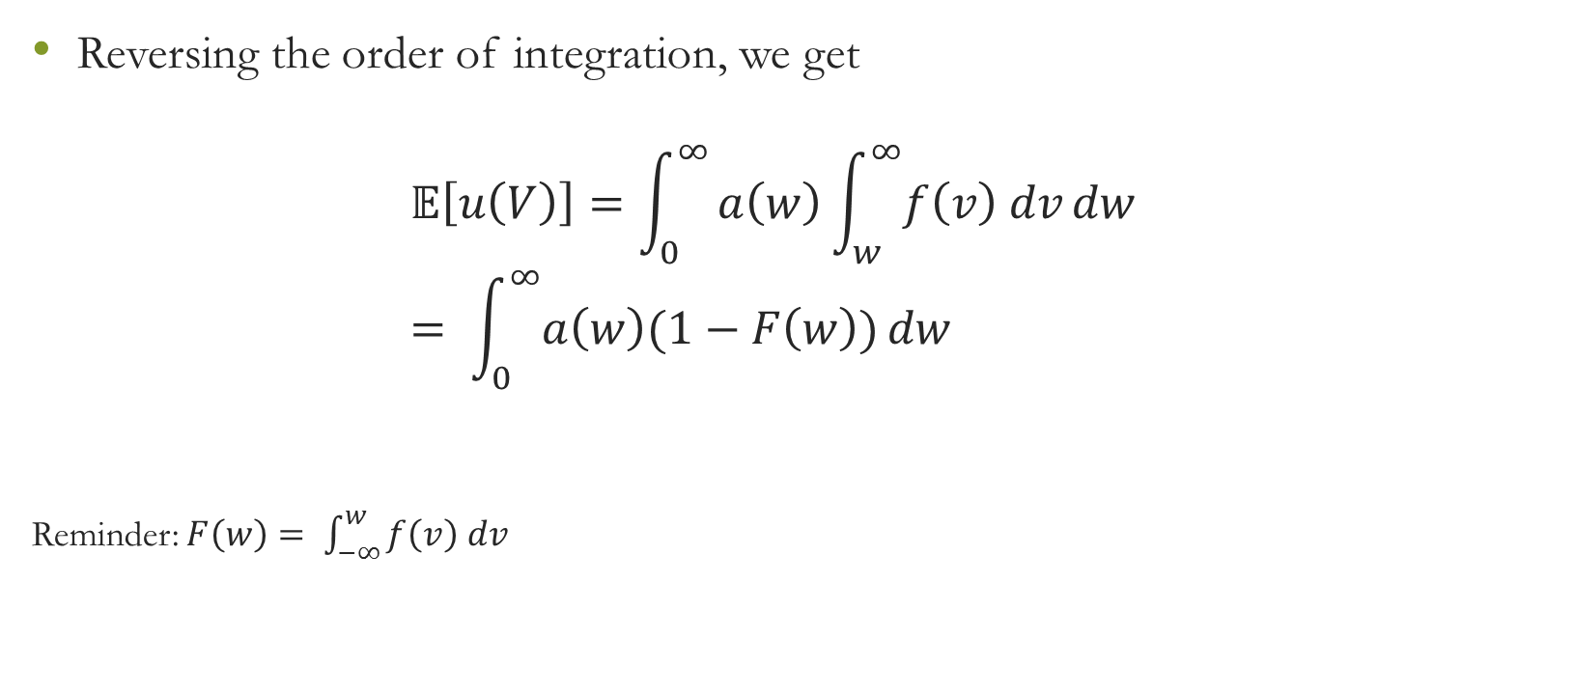
Myerson’s Optimal Auction
Reversing the order of integration, we get
$𝔼\left[u\left(V\right)\right]=\int_{0}^{∞}{a\left(w\right)\int_{w}^{∞}{f\left(v\right) dv}}dw$
$= \int_{0}^{∞}{a\left(w\right)(1−F\left(w\right))}dw$
Reminder: $F\left(w\right)= \int_{−∞}^{w}{f\left(v\right) dv}$

Slide 23
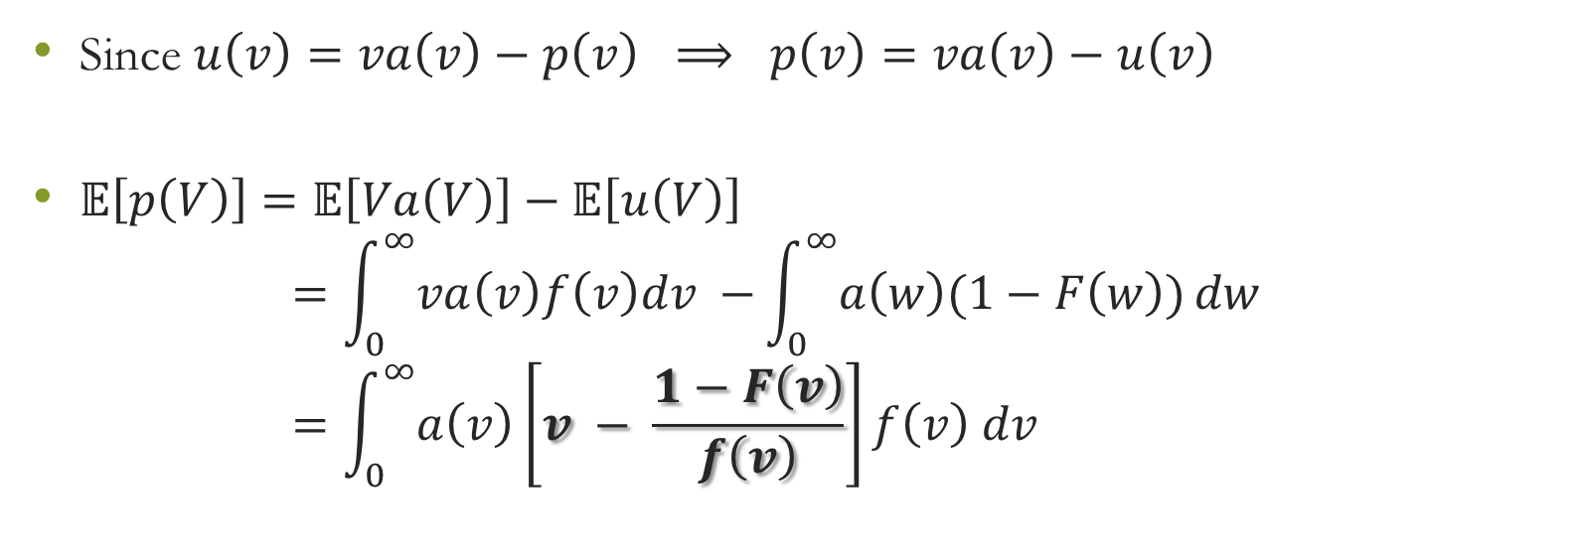
Myerson’s Optimal Auction
Since $u\left(v\right)=va\left(v\right)−p\left(v\right) ⟹ p\left(v\right)=va\left(v\right)−u\left(v\right)$
$𝔼\left[p\left(V\right)\right]=𝔼\left[Va\left(V\right)\right]−𝔼\left[u\left(V\right)\right]$
$=\int_{0}^{∞}{va\left(v\right)f\left(v\right)dv −}\int_{0}^{∞}{a\left(w\right)(1−F\left(w\right))}dw$
$=\int_{0}^{∞}{a\left(v\right)}\left[v − \frac{1−F\left(v\right)}{f\left(v\right)}\right]f\left(v\right) dv$

Slide 24
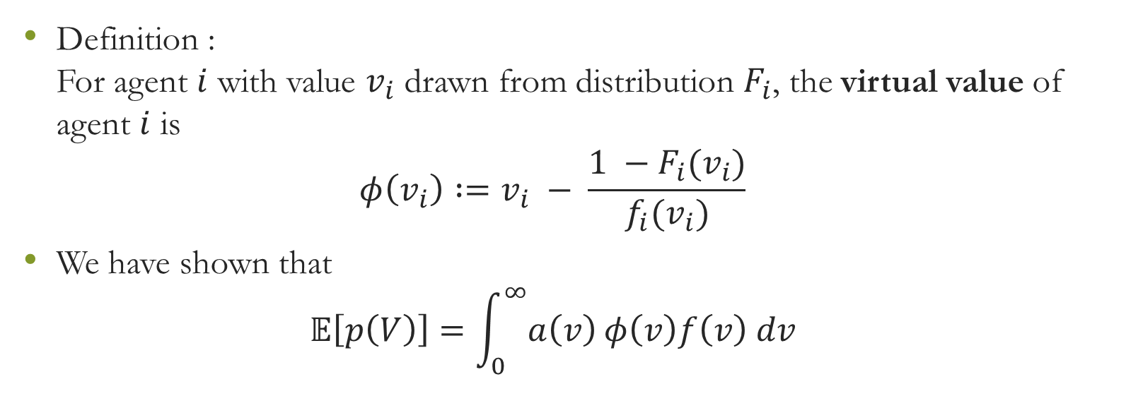
Myerson’s Optimal Auction – Virtual value
Definition :
For agent $i$ with value $v_{i}$ drawn from distribution $F_{i}$, the virtual value of agent $i$ is
$φ\left(v_{i}\right) :=v_{i} − \frac{1 −F_{i}(v_{i})}{f_{i}(v_{i})}$
We have shown that
$𝔼\left[p\left(V\right)\right]=\int_{0}^{∞}{a\left(v\right)}φ\left(v\right)f\left(v\right) dv$

Slide 25
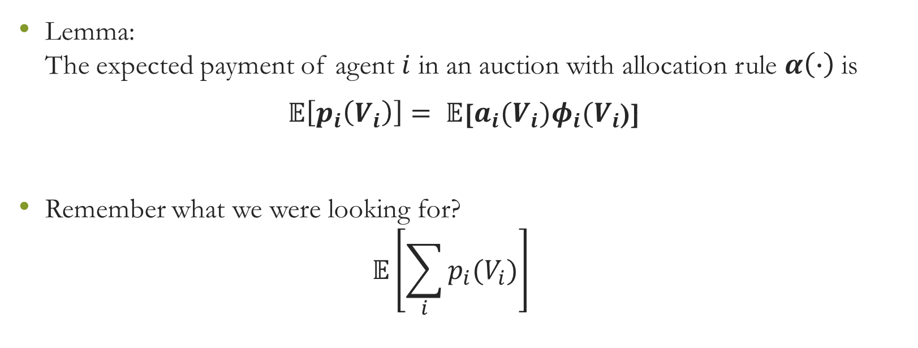
Myerson’s Optimal Auction – Virtual value
Lemma:
The expected payment of agent $i$ in an auction with allocation rule $α\left(∙\right)$ is
$𝔼\left[p_{i}\left(V_{i}\right)\right]= 𝔼$[$a_{i}(V_{i})φ_{i}(V_{i}$)]
Remember what we were looking for?
$𝔼\left[\sum_{i}{p_{i}(V_{i})}\right]$

Slide 26
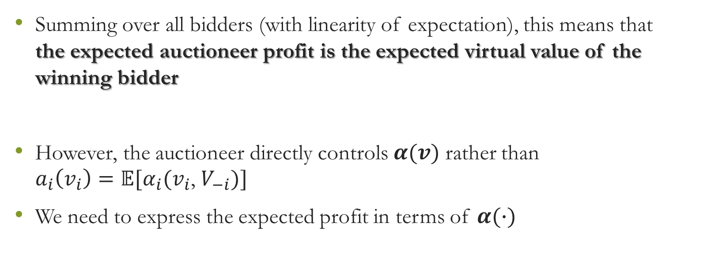
Myerson’s Optimal Auction
Summing over all bidders (with linearity of expectation), this means that
the expected auctioneer profit is the expected virtual value of the winning bidder
However, the auctioneer directly controls $α(v)$ rather than
$a_{i}\left(v_{i}\right)=𝔼[α_{i}(v_{i}$, $V_{−i})]$
We need to express the expected profit in terms of $α(∙)$

Slide 27
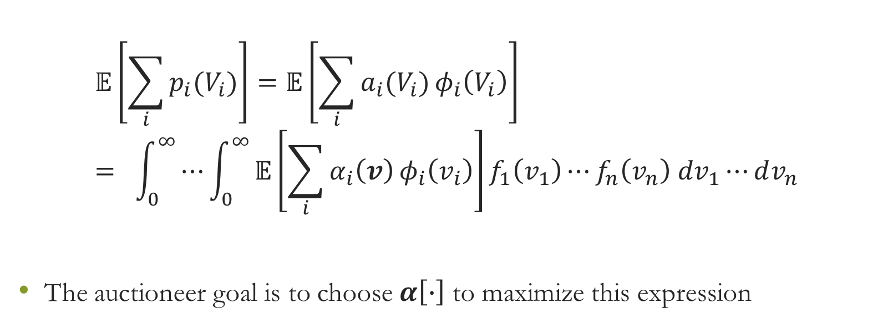
Myerson’s Optimal Auction
$$𝔼\left[\sum_{i}{p_{i}(V_{i})}\right]=𝔼\left[\sum_{i}{a_{i}(V_{i})}φ_{i}\left(V_{i}\right)\right]= \int_{0}^{∞}{⋯\int_{0}^{∞}{𝔼\left[\sum_{i}{α_{i}\left(v\right)}φ_{i}\left(v_{i}\right)\right]f_{1}\left(v_{1}\right)⋯f_{n}\left(v_{n}\right) dv_{1}⋯}}dv_{n}$$
The auctioneer goal is to choose $α\left[∙\right]$ to maximize this expression

Slide 28
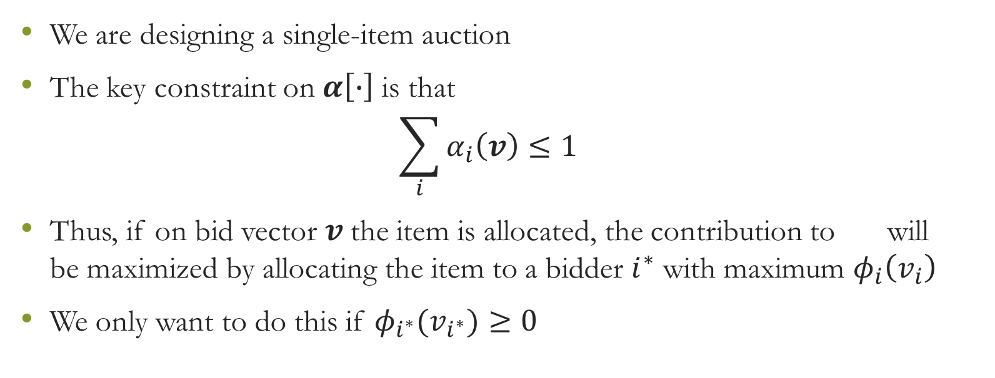
Myerson’s Optimal Auction
We are designing a single-item auction
The key constraint on$α\left[∙\right]$ is that
$\sum_{i}{α_{i}\left(v\right)≤1}$
Thus, if on bid vector $v$the item is allocated, the contribution to will
be maximized by allocating the item to a bidder $i^{∗}$ with maximum $φ_{i}\left(v_{i}\right)$
We only want to do this if $φ_{i^{∗}}(v_{i^{∗}})≥0$

Slide 29
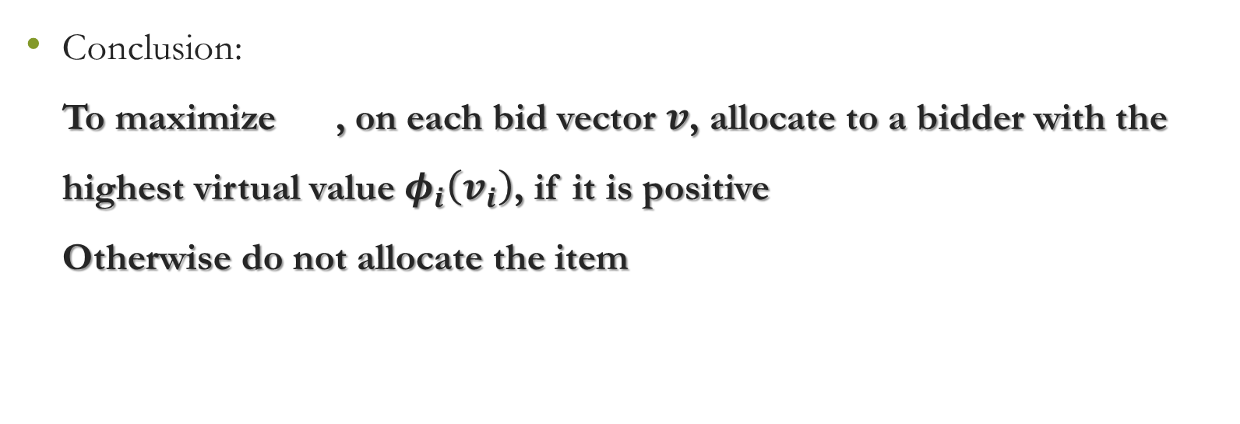
Myerson’s Optimal Auction
Conclusion:
To maximize , on each bid vector $v$, allocate to a bidder with the highest virtual value $φ_{i}\left(v_{i}\right)$, if it is positive
Otherwise do not allocate the item
Notes:
Break ties according to value

Slide 30
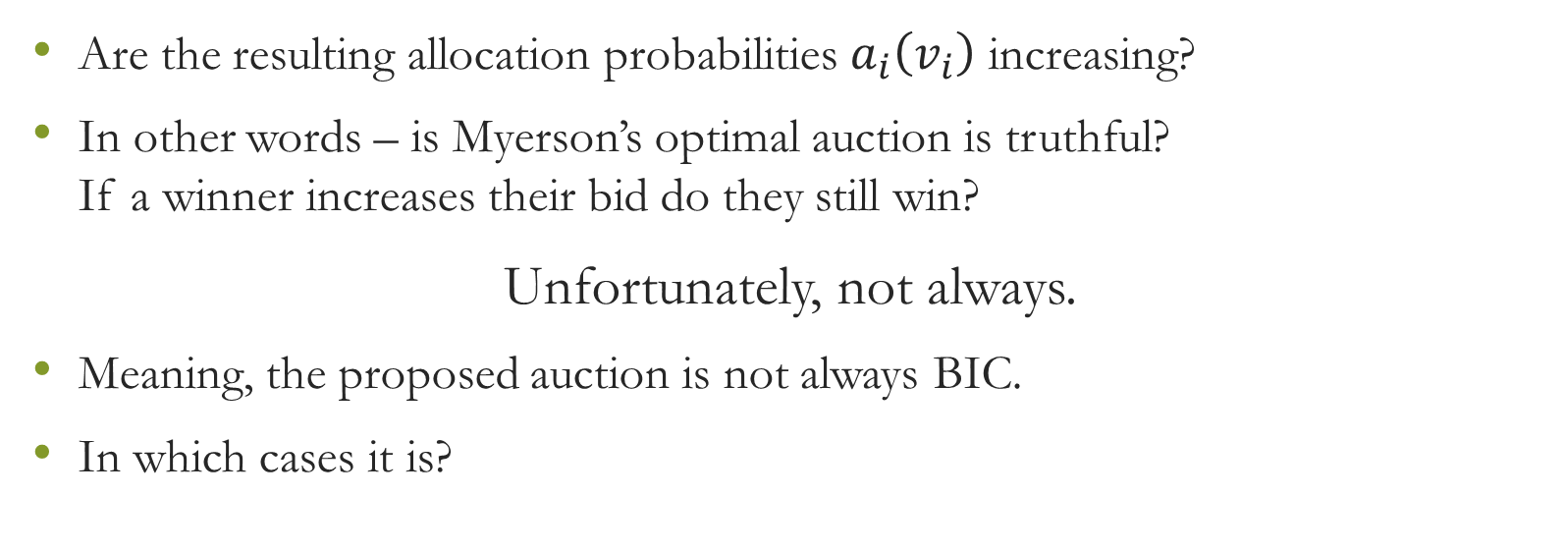
Myerson’s Optimal Auction Vs. Truthfulness
Are the resulting allocation probabilities $a_{i}\left(v_{i}\right)$ increasing?
In other words – is Myerson’s optimal auction is truthful?
If a winner increases their bid do they still win?
Unfortunately, not always.
Meaning, the proposed auction is not always BIC.
In which cases it is?

Slide 31
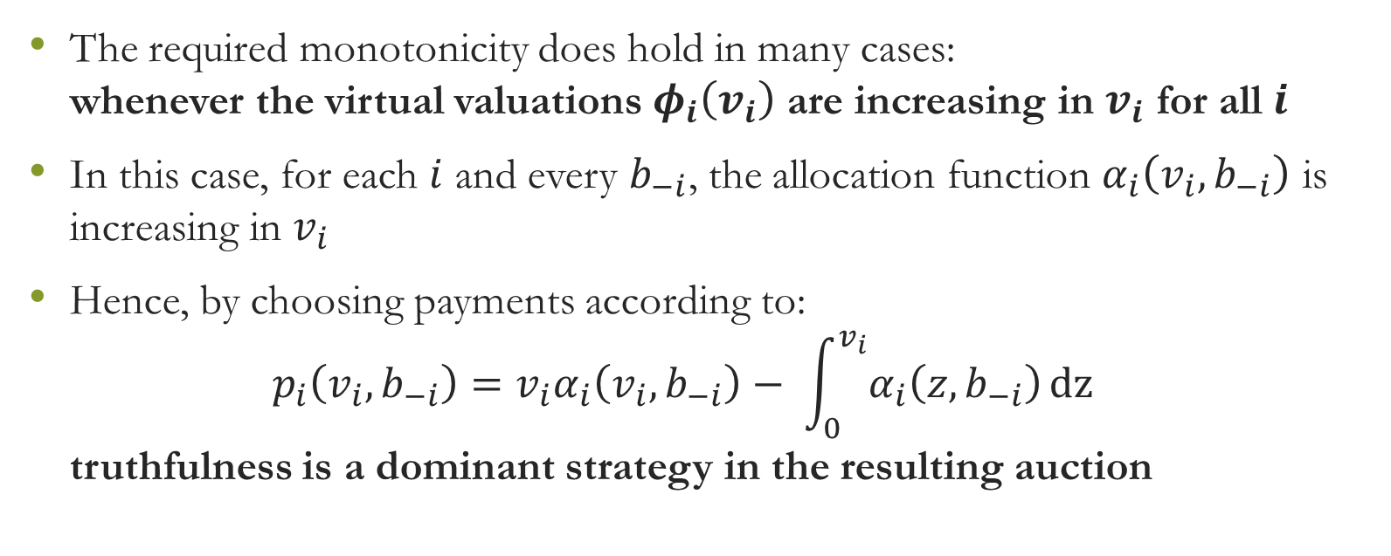
Myerson’s Optimal Auction Vs. Truthfulness
The required monotonicity does hold in many cases:
whenever the virtual valuations $φ_{i}\left(v_{i}\right)$ are increasing in $v_{i}$ for all $i$
In this case, for each $i$ and every $b_{−i}$, the allocation function $α_{i}\left(v_{i}, b_{−i}\right)$ is increasing in $v_{i}$
Hence, by choosing payments according to:
$p_{i}\left(v_{i}, b_{−i}\right)={v_{i}α}_{i}\left(v_{i}, b_{−i}\right)− \int_{0}^{v_{i}}{α_{i}\left(z, b_{−i}\right)}dz$
truthfulness is a dominant strategy in the resulting auction

Slide 32
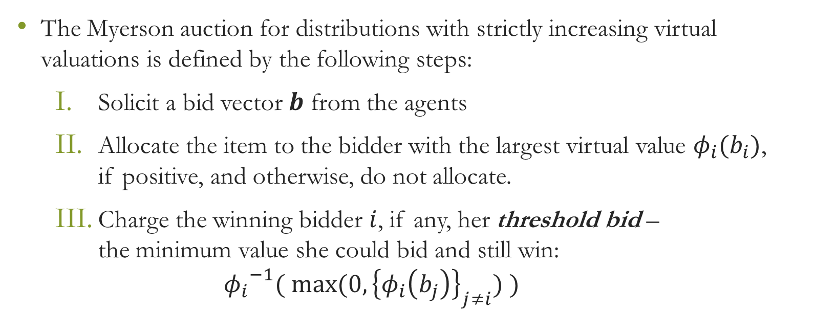
Myerson’s auction - definition
The Myerson auction for distributions with strictly increasing virtual valuations is defined by the following steps:
  Solicit a bid vector $b$ from the agents
  Allocate the item to the bidder with the largest virtual value $φ_{i}(b_{i})$,
  if positive, and otherwise, do not allocate.
  Charge the winning bidder $i$, if any, her threshold bid –
  the minimum value she could bid and still win:
  ${φ_{i}}^{−1}( max⁡(0, {\left\{φ_{i}\left(b_{j}\right)\right\}}_{j≠i}) )$

Slide 33
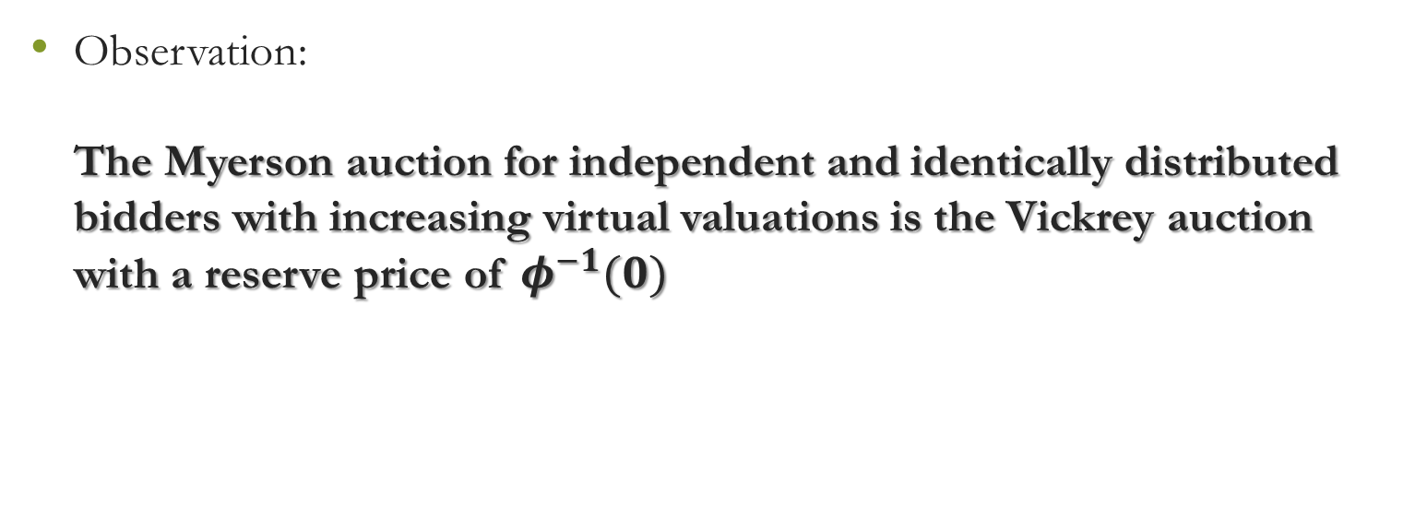
Myerson’s main observation
Observation:
The Myerson auction for independent and identically distributed bidders with increasing virtual valuations is the Vickrey auction with a reserve price of $φ^{−1}(0)$

Slide 34
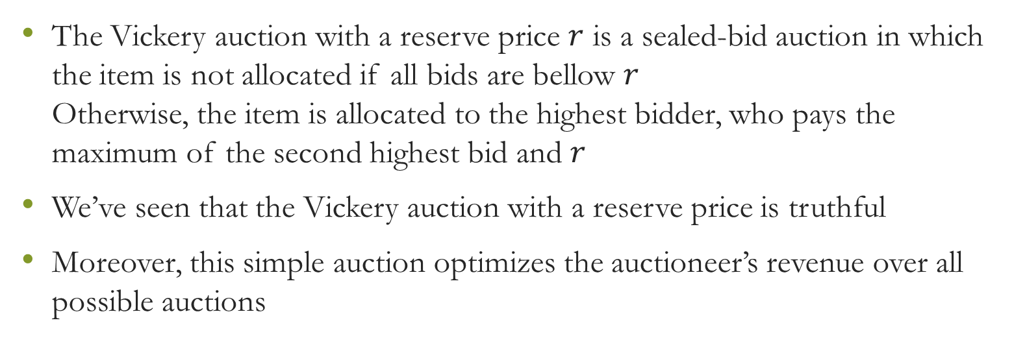
Reminder: Vickery auction with reserve price
The Vickery auction with a reserve price $r$ is a sealed-bid auction in which the item is not allocated if all bids are bellow $r$
Otherwise, the item is allocated to the highest bidder, who pays the maximum of the second highest bid and $r$
We’ve seen that the Vickery auction with a reserve price is truthful
Moreover, this simple auction optimizes the auctioneer’s revenue over all possible auctions

Slide 35
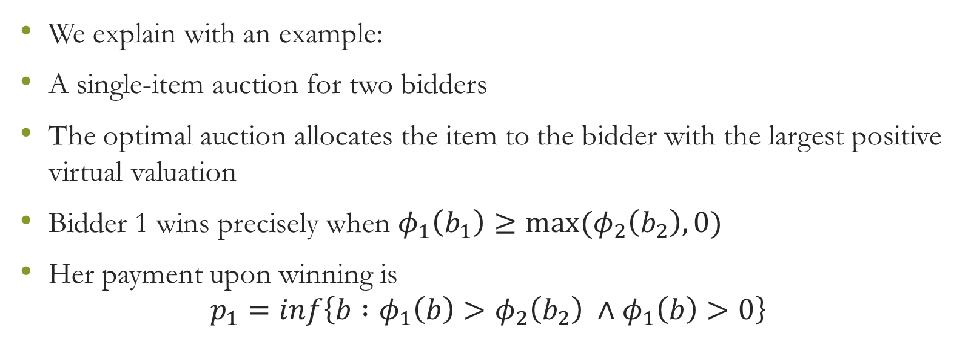
Myerson’s main observation
We explain with an example:
A single-item auction for two bidders
The optimal auction allocates the item to the bidder with the largest positive virtual valuation
Bidder 1 wins precisely when $φ_{1}\left(b_{1}\right)≥\max{(φ_{2}\left(b_{2}\right), 0)}$
Her payment upon winning is
$p_{1}=inf\left\{b :φ_{1}\left(b\right)>φ_{2}\left(b_{2}\right) ∧φ_{1}\left(b\right)>0\right\}$

Slide 36
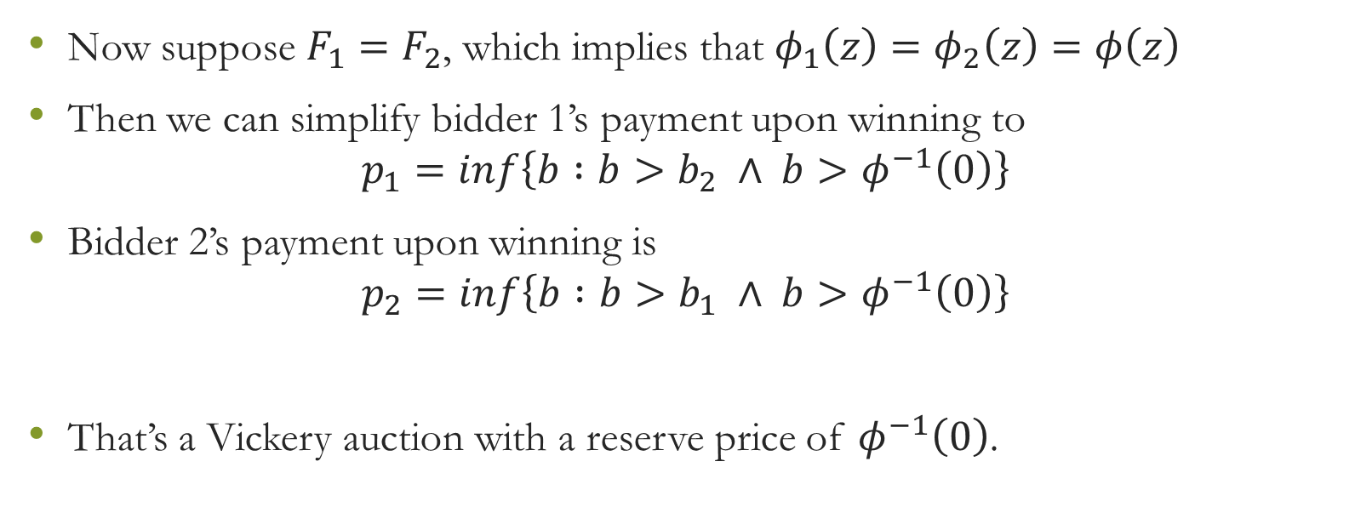
Myerson’s main observation
Now suppose $F_{1}=F_{2}$, which implies that $φ_{1}\left(z\right)=φ_{2}\left(z\right)=φ\left(z\right)$
Then we can simplify bidder 1’s payment upon winning to
$p_{1}=inf\left\{b :b>b_{2} ∧ b>φ^{−1}\left(0\right)\right\}$
Bidder 2’s payment upon winning is
$p_{2}=inf\left\{b :b>b_{1} ∧ b>φ^{−1}\left(0\right)\right\}$
That’s a Vickery auction with a reserve price of $φ^{−1}\left(0\right)$.

Slide 37
Myerson’s Optimal Auction
Our discussion proves the following
Theorem :
The Myerson auction is optimal, i.e., it maximizes the expected auctioneer revenue in Bayes-Nash equilibrium when bidders values are drawn from independent distributions with increasing virtual valuations

Slide 38
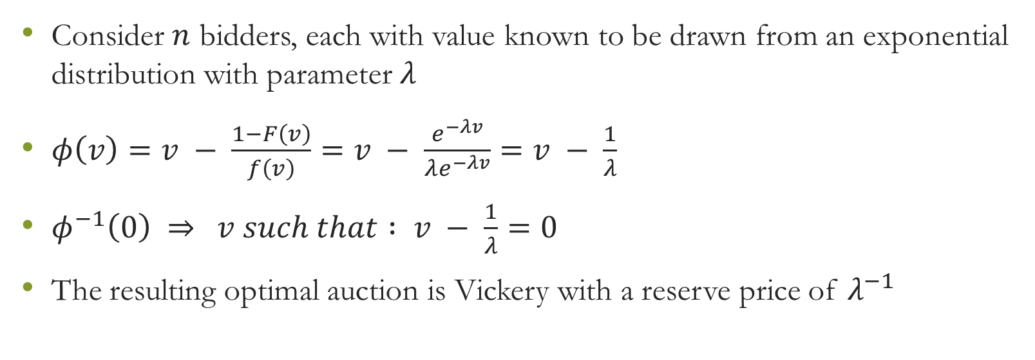
Example: i.i.d. bidders
Consider $n$ bidders, each with value known to be drawn from an exponential distribution with parameter $λ$
$φ\left(v\right)=v − \frac{1−F\left(v\right)}{f\left(v\right)}=v − \frac{e^{−λv}}{λe^{−λv}}=v − \frac{1}{λ}$
$φ^{−1}\left(0\right) ⇒$ $v such that : v − \frac{1}{λ}=0$
The resulting optimal auction is Vickery with a reserve price of $λ^{−1}$

Slide 39
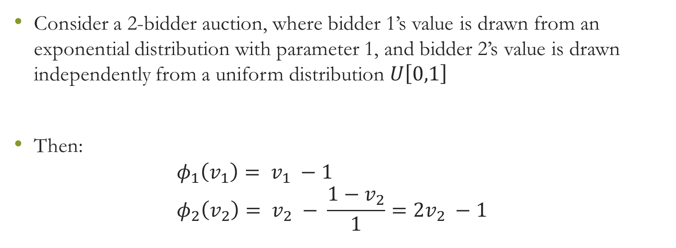
Example: non-i.i.d. bidders
Consider a 2-bidder auction, where bidder 1’s value is drawn from an exponential distribution with parameter 1, and bidder 2’s value is drawn independently from a uniform distribution $U\left[0,1\right]$
Then:
$φ_{1}\left(v_{1}\right)= v_{1} −1$
$φ_{2}\left(v_{2}\right)= v_{2} − \frac{1−v_{2}}{1}=2v_{2} −1$

Slide 40
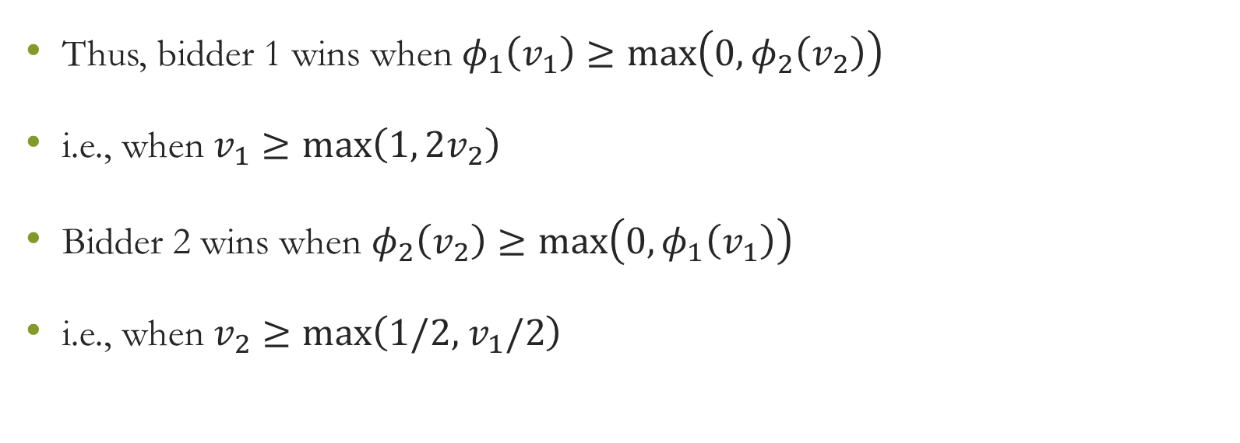
Example: non-i.i.d. bidders
Thus, bidder 1 wins when $φ_{1}\left(v_{1}\right)≥\max\left(0, φ_{2}\left(v_{2}\right)\right)$
i.e., when $v_{1}$ $≥\max\left(1,{2v}_{2}\right)$
Bidder 2 wins when $φ_{2}\left(v_{2}\right)≥\max\left(0, φ_{1}\left(v_{1}\right)\right)$
i.e., when $v_{2}$ $≥\max\left(1/2,{ v}_{1}/2\right)$

Slide 41
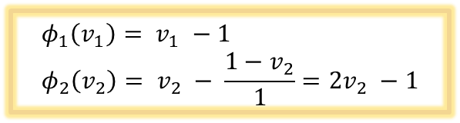
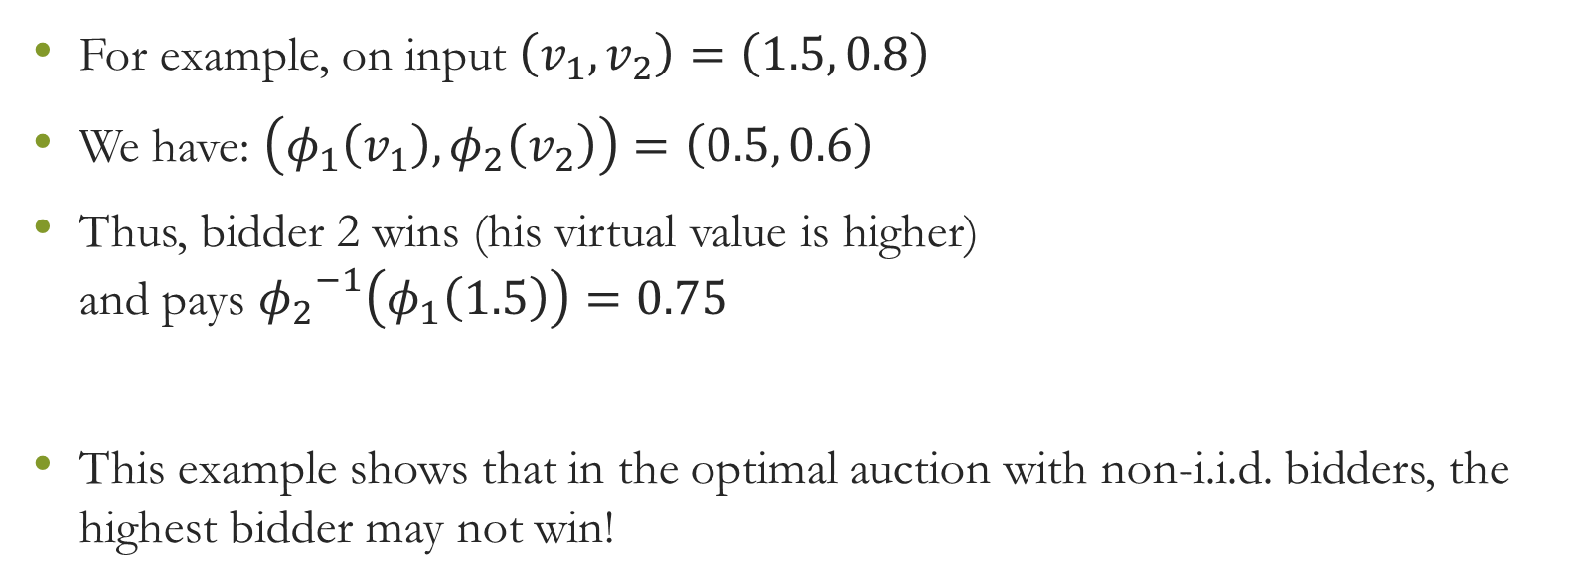
Example: non-i.i.d. bidders
For example, on input $\left(v_{1},v_{2}\right)=\left(1.5, 0.8\right)$
We have: $\left(φ_{1}\left(v_{1}\right), φ_{2}\left(v_{2}\right)\right)=\left(0.5, 0.6\right)$
Thus, bidder 2 wins (his virtual value is higher)
and pays ${φ_{2}}^{−1}\left(φ_{1}\left(1.5\right)\right)=0.75$
This example shows that in the optimal auction with non-i.i.d. bidders, the highest bidder may not win!
$$φ_{1}\left(v_{1}\right)= v_{1} −1 \\ φ_{2}\left(v_{2}\right)= v_{2} − \frac{1−v_{2}}{1}=2v_{2} −1$$

Slide 42
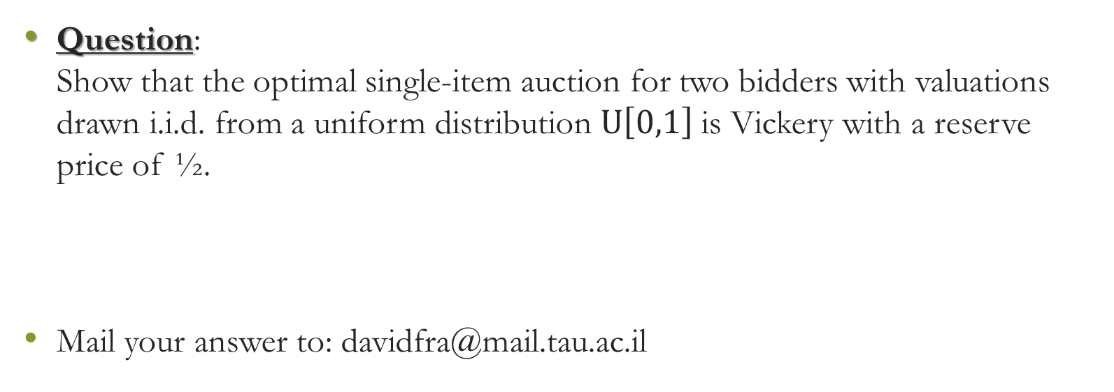
One last thing…
Question:
Show that the optimal single-item auction for two bidders with valuations drawn i.i.d. from a uniform distribution $U\left[0,1\right]$is Vickery with a reserve price of ½.
Mail your answer to: davidfra@mail.tau.ac.il

Slide 43

Thank you for listening

