Slide 1
Game theory, alive: some advanced topics presentation by: Idan Haviv supervised by: Amos Fiat

Slide 2
Today’s lecture preview
characterization of equilibria
Bidding truthfulness as a dominant strategy
the revelation principle

Slide 3

Reminder:
Definitions:
  strategy profile $β_{i}$
  Allocation probability $a_{i}\left(w\right)≔a_{i}\left[β_{i}\left(w\right)\right]$
  Expected payment $p_{i}\left(w\right)≔p_{i}\left[β_{i}\left(w\right)\right]$
  Expected utility $u_{i}\left(w | v_{i}\right)≔u_{i}\left[β_{i}\left(w\right) | v_{i}\right]=v_{i}a_{i}\left(w\right)−p_{i}\left(w\right)$

Slide 4

Reminder:
Bayes – Nash equilibrium:
  We say the a bidding strategy profile $\left(β_{1}, …, β_{n}\right)$ is in BNE if for all i and all $v_{i}$
  The function $b\overset{→}{} u_{i}\left[b | v_{i}\right]$ is maximized at b = $β_{i}(v_{i})$

Slide 5
Assumptions:
For simplicity assume each agent in the auction has one bid. e.g., English Auction
We’ll assume it’s possible to have randomness is the auction itself
for simplicity we’ll lose the subscripts when it’s obvious from context
Notes:
הנחה ראשונה: הטענות ברובן תקפות גם למקרים יותר מורכבים של מכירות פומביות עם אינטראקציה בין המשתתפים ואיטרציות של מתן הצעה, אבל ההנחה הזו מפשטת את הדיון
הנחה שניה: במצב זה יש שני רכיבים הסתברותיים במכירה הפומבית. הרכיב ההסתברותי הראשון הוא ההתפלגויות מהן לקוחים הערכים של המשתתפים. הרכיב השני (אליו מתייחסת ההנחה) הוא הסתברות הקצאת הפריט הנמכר. לאחר שהחלק של המציעים במכרז מסתיים ובידי הauctioneer נתונות כל ההצעות מהמשתתפים הוא יכול להחליט למי להקצות את הפריט כתלות בהטלת מטבע

Slide 6
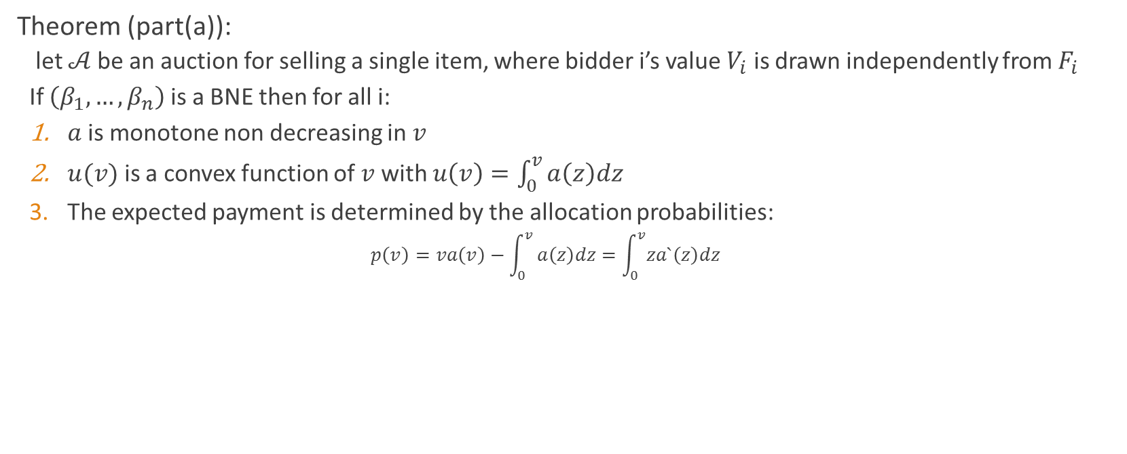
characterization of equilibria in particular BNE
Theorem (part(a)):
  let $𝒜$be an auction for selling a single item, where bidder i’s value $V_{i}$ is drawn independently from $F_{i}$
  If $\left(β_{1}, …, β_{n}\right)$ is a BNE then for all i:
  $a$is monotone non decreasing in $v$
  $u(v)$ is a convex function of $v$ with $u\left(v\right)=\int_{0}^{v}{a\left(z\right)dz }$
  The expected payment is determined by the allocation probabilities:
    $$p\left(v\right)=va\left(v\right)−\int_{0}^{v}{a\left(z\right)dz=\int_{0}^{v}{za`\left(z\right)dz}}$$

Slide 7
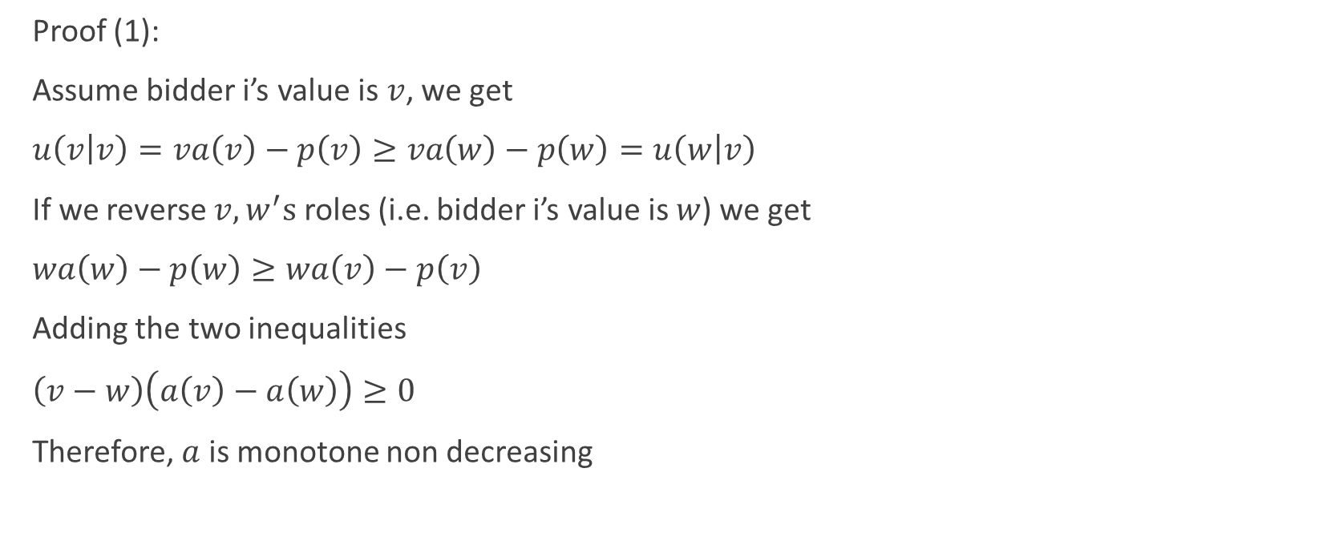
characterization of equilibria in particular BNE
Proof (1):
Assume bidder i’s value is $v$, we get
$u\left(v | v\right)=va\left(v\right)−p\left(v\right)≥va\left(w\right)−p\left(w\right)=u\left(w | v\right)$
If we reverse $v, w^{′}s$ roles (i.e. bidder i’s value is $w$) we get
$wa\left(w\right)−p\left(w\right)≥wa\left(v\right)−p\left(v\right)$
Adding the two inequalities
$\left(v−w\right)\left(a\left(v\right)−a\left(w\right)\right)≥0$
Therefore, $a$ is monotone non decreasing

Slide 8
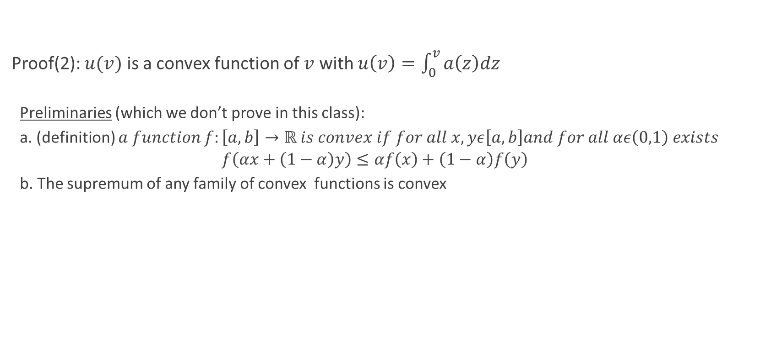
characterization of equilibria in particular BNE
Proof(2): $u(v)$ is a convex function of $v$ with $u\left(v\right)=\int_{0}^{v}{a\left(z\right)dz }$
  Preliminaries (which we don’t prove in this class):
  a. (definition) $a function f:\left[a,b\right]→ℝ is convex if for all x,yε\left[a,b\right]and for all αε\left(0,1\right) exists$
  $$f\left(αx+\left(1−α\right)y\right)≤αf\left(x\right)+\left(1−α\right)f\left(y\right)$$
  b. The supremum of any family of convex functions is convex

Slide 9
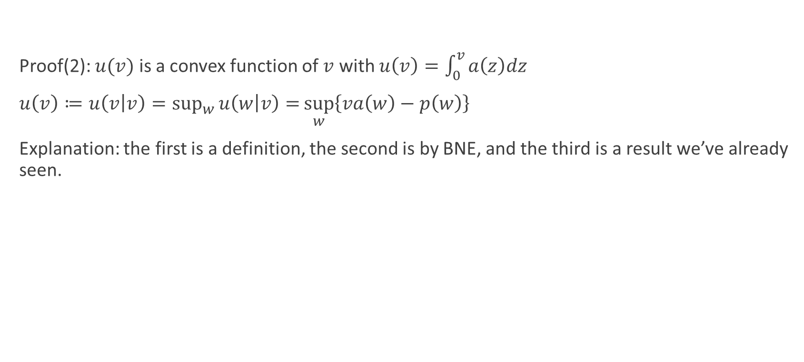
characterization of equilibria in particular BNE
Proof(2): $u(v)$ is a convex function of $v$ with $u\left(v\right)=\int_{0}^{v}{a\left(z\right)dz }$
$u\left(v\right)≔u\left(v | v\right)=\sup_{w}{u\left(w | v\right)=}\sup_{w}\left\{va\left(w\right)−p\left(w\right)\right\}$
Explanation: the first is a definition, the second is by BNE, and the third is a result we’ve already seen.

Slide 10
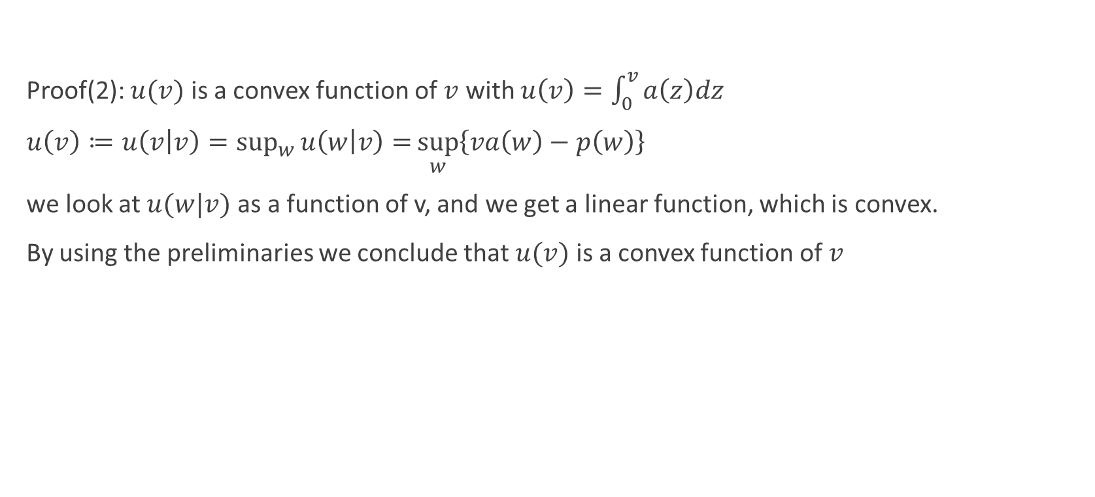
characterization of equilibria in particular BNE
Proof(2): $u(v)$ is a convex function of $v$ with $u\left(v\right)=\int_{0}^{v}{a\left(z\right)dz }$
$u\left(v\right)≔u\left(v | v\right)=\sup_{w}{u\left(w | v\right)=}\sup_{w}\left\{va\left(w\right)−p\left(w\right)\right\}$
we look at $u(w|v)$ as a function of v, and we get a linear function, which is convex.
By using the preliminaries we conclude that $u(v)$ is a convex function of $v$

Slide 11

characterization of equilibria in particular BNE
  Proof(3): The expected payment is determined by the allocation probabilities:
    $$p\left(v\right)=va\left(v\right)−\int_{0}^{v}{a\left(z\right)dz=\int_{0}^{v}{za`\left(z\right)dz}}$$

Slide 12

characterization of equilibria in particular BNE
  Proof(3):
    $$u\left(v\right)≥u\left(w | v\right)=va\left(w\right)−p\left(w\right)=u\left(w\right)+\left(v−w\right)a(w)$$
    By letting $v →w^{+}$ :
    $$\frac{u\left(v\right)−u(w)}{v−w}≥a(w)$$
    $$u_{+}^{`}\left(w\right)≥a\left(w\right)$$
    letting $v →w^{−}$ :
    $u_{−}^{`}\left(w\right)≤a(w)$
    Therefore:
    If $u$ is differentiable $u`\left(v\right)=a(v)$

Slide 13
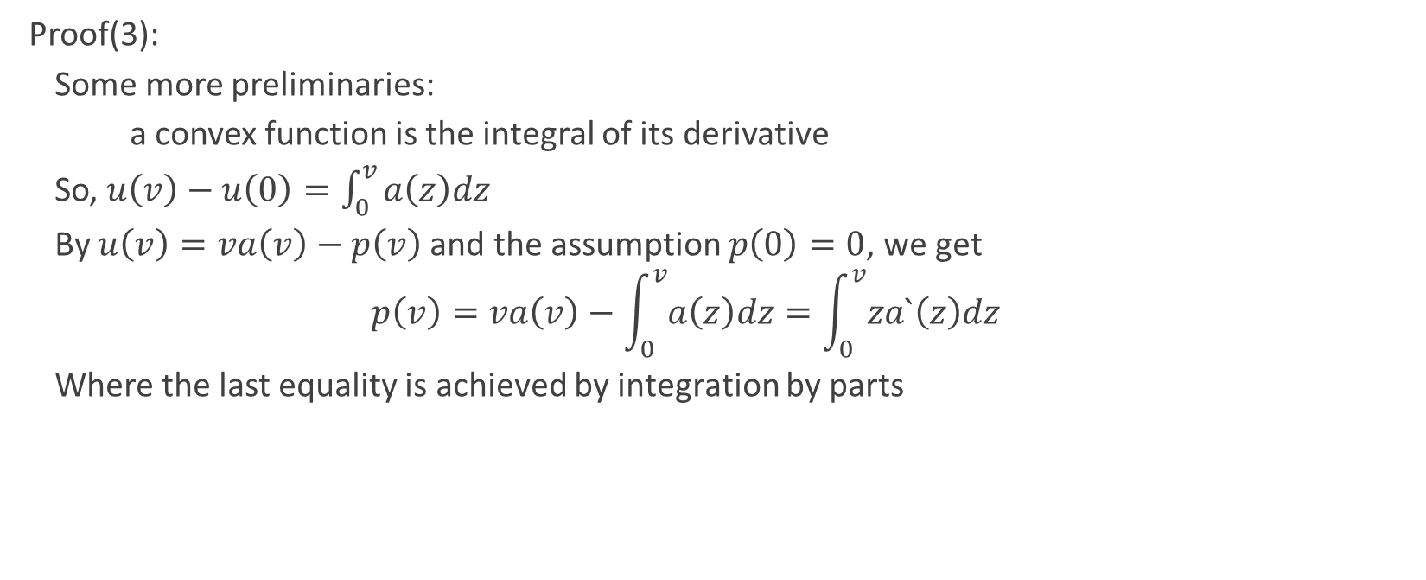
characterization of equilibria in particular BNE
  Proof(3):
    Some more preliminaries:
    a convex function is the integral of its derivative
    So, $u\left(v\right)−u\left(0\right)=\int_{0}^{v}{a\left(z\right)dz}$
    By $u\left(v\right)=va\left(v\right)−p\left(v\right)$and the assumption $p\left(0\right)=0$, we get
    $$p\left(v\right)=va\left(v\right)−\int_{0}^{v}{a\left(z\right)dz}=\int_{0}^{v}{za`\left(z\right)dz}$$
    Where the last equality is achieved by integration by parts

Slide 14

characterization of equilibria in particular BNE
Theorem (part(b)):
  let$\left(β_{1}, …, β_{n}\right)$ be a set of bidder strategies for which conditions 1,3 (from part(a)) applies, then for all bidders and values $v,w:$
  $$u\left(v | v\right)≥u\left(w | v\right)$$
  Note: alternatively it suffices to demand conditions 1,2

Slide 15
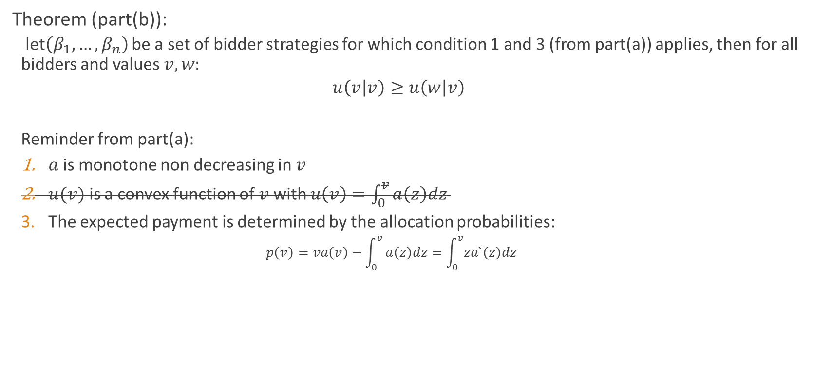
characterization of equilibria in particular BNE
Theorem (part(b)):
  let$\left(β_{1}, …, β_{n}\right)$ be a set of bidder strategies for which condition 1 and 3 (from part(a)) applies, then for all bidders and values $v,w:$
  $$u\left(v | v\right)≥u\left(w | v\right)$$
  Reminder from part(a):
  $a$is monotone non decreasing in $v$
  $u(v)$ is a convex function of $v$ with $u\left(v\right)=\int_{0}^{v}{a\left(z\right)dz }$
  The expected payment is determined by the allocation probabilities:
    $$p\left(v\right)=va\left(v\right)−\int_{0}^{v}{a\left(z\right)dz=\int_{0}^{v}{za`\left(z\right)dz}}$$

Slide 16

characterization of equilibria in particular BNE
proof (part(b)):
  from condition 3 we have $u\left(v\right)=\int_{0}^{v}{a\left(z\right)dz}$
  Whereas,
  $$u\left(w | v\right)=va\left(w\right)−p\left(w\right)=va\left(w\right)−wa\left(w\right)+wa\left(w\right)−p\left(w\right)$$
  $$=\left(v−w\right)a\left(w\right)+u(w)=\left(v−w\right)a\left(w\right)+\int_{0}^{w}{a\left(z\right)dz}$$

Slide 17
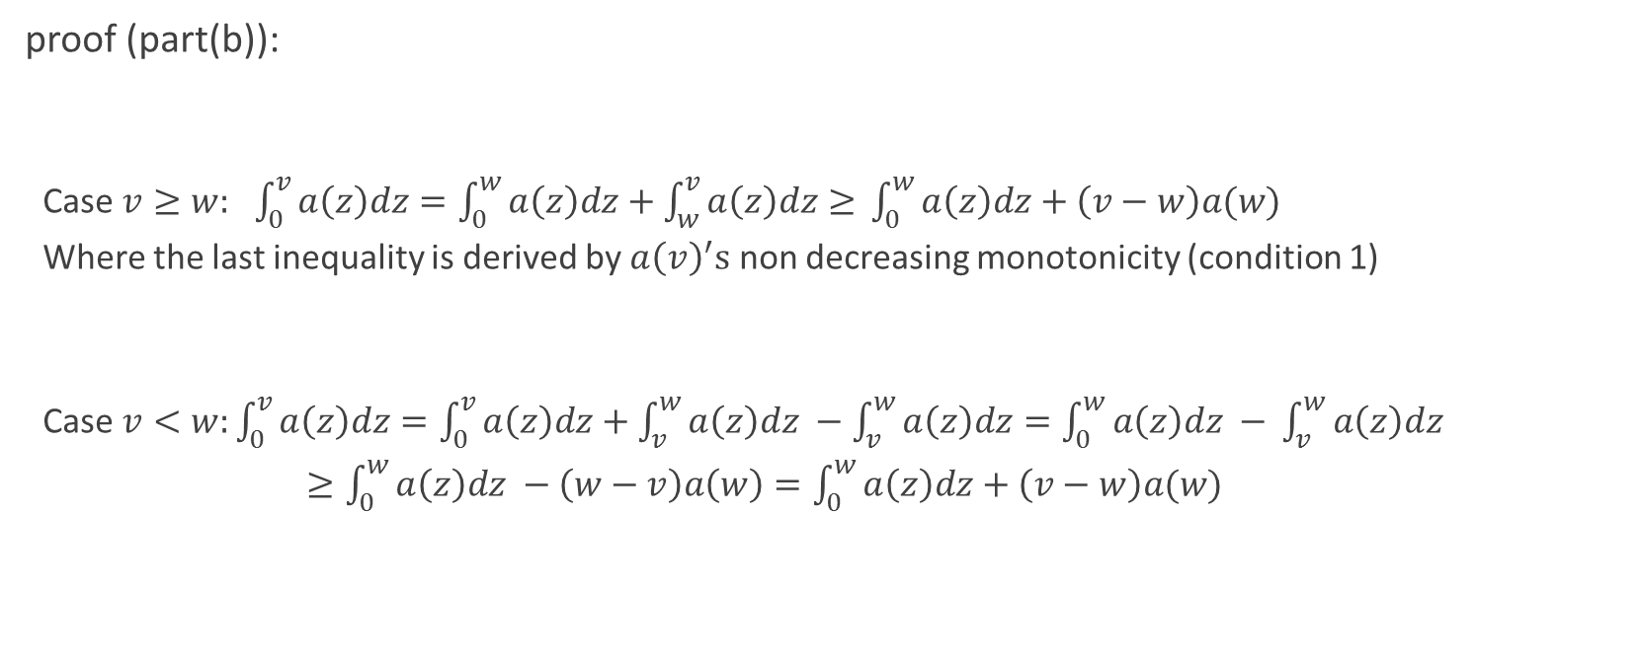
characterization of equilibria in particular BNE
proof (part(b)):
  Case $v≥w:$ $\int_{0}^{v}{a\left(z\right)dz=\int_{0}^{w}{a\left(z\right)dz+\int_{w}^{v}{a\left(z\right)dz≥ }}}\int_{0}^{w}{a\left(z\right)dz+\left(v−w\right)a(w)}$
  Where the last inequality is derived by $a{\left(v\right)}^{′}s$ non decreasing monotonicity (condition 1)
  Case $v<w:\int_{0}^{v}{a\left(z\right)dz=\int_{0}^{v}{a\left(z\right)dz+\int_{v}^{w}{a\left(z\right)dz −\int_{v}^{w}{a\left(z\right)dz=\int_{0}^{w}{a\left(z\right)dz − }}}}}\int_{v}^{w}{a\left(z\right)dz}$
  $≥\int_{0}^{w}{a\left(z\right)dz −\left(w−v\right)a\left(w\right)=\int_{0}^{w}{a\left(z\right)dz+\left(v−w\right)a(w)}}$

Slide 18

characterization of equilibria in particular BNE
proof (part(b)):
  Both cases yield $u\left(v | v\right)≥u\left(w | v\right)$ as required

Slide 19
Take a deep breath….
Any questions?

Slide 20


Slide 21
When is truthfulness dominant?
We’ve seen a dominant strategy auction, namely the Vickrey auction (second price, sealed bids), that delivers the same expected revenue to the auctioneer as in a BNE where the item is allocated to the highest bidder.
A dominant strategy equilibria is more robust since it doesn’t rely on bidders’ knowledge of the distributions other bidders’ values come from.
We are interested in finding out when is bidding truthfully is a dominant strategy.

Slide 22
When is truthfulness dominant?
The next theorem characterized bidding truthfully dominant strategy auctions.

Slide 23

When is truthfulness dominant?
Some notations:
$u\left(v\right)=u\left(v | v\right)=u\left(β\left(v\right) | v\right)$
$b_{−i} −bids by bidders other than i$
$α_{i}\left(v_{i}, b_{−i}\right)−$the probability of allocation over the randomness of the auction

Slide 24
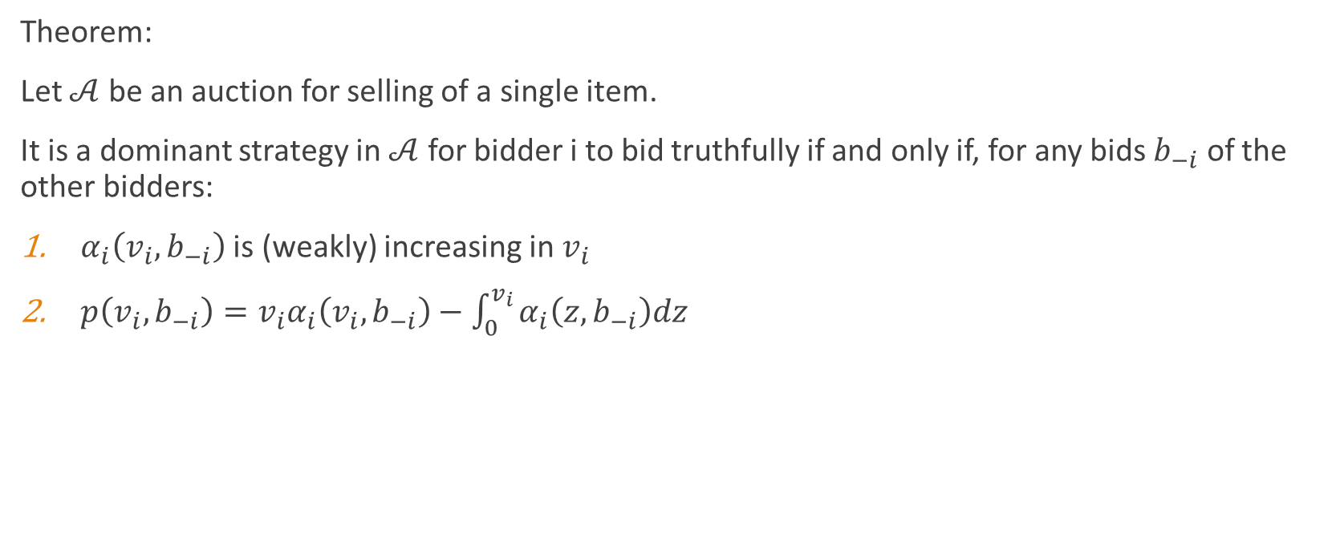
When is truthfulness dominant?
Theorem:
Let $𝒜$ be an auction for selling of a single item.
It is a dominant strategy in $𝒜$ for bidder i to bid truthfully if and only if, for any bids $b_{−i}$ of the other bidders:
$α_{i}\left(v_{i}, b_{−i}\right)$ is (weakly) increasing in $v_{i}$
$p\left(v_{i}, b_{−i}\right)=v_{i}α_{i}\left(v_{i}, b_{−i}\right)−\int_{0}^{v_{i}}{α_{i}\left(z, b_{−i}\right)dz}$

Slide 25
When is truthfulness dominant?
Theorem:
Proof: similar to part (b) of the previous proof. Notice we haven’t used other bidders’ bid or the distributions their values were taken from

Slide 26
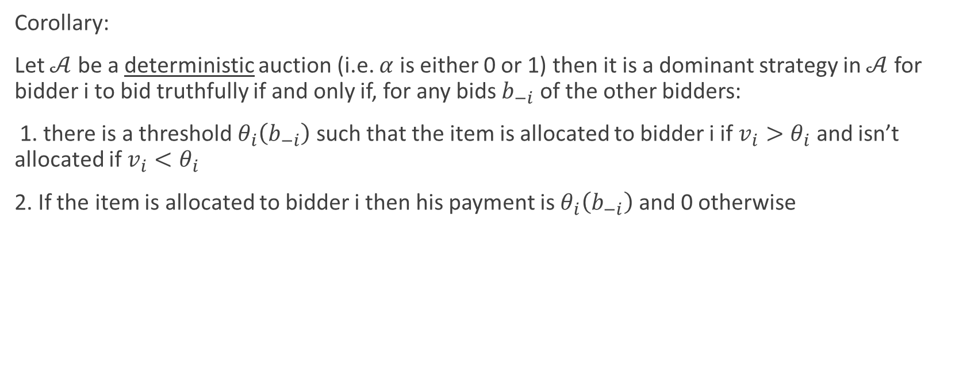
When is truthfulness dominant?
Corollary:
Let $𝒜$ be a deterministic auction (i.e. $α$ is either 0 or 1) then it is a dominant strategy in $𝒜$ for bidder i to bid truthfully if and only if, for any bids $b_{−i}$ of the other bidders:
1. there is a threshold $θ_{i}\left(b_{−i}\right)$ such that the item is allocated to bidder i if $v_{i}>θ_{i}$ and isn’t allocated if $v_{i}<θ_{i}$
2. If the item is allocated to bidder i then his payment is $θ_{i}\left(b_{−i}\right)$ and 0 otherwise

Slide 27
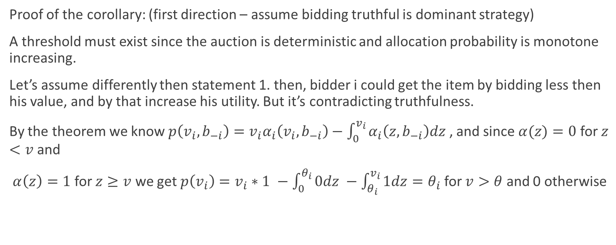
When is truthfulness dominant?
Proof of the corollary: (first direction – assume bidding truthful is dominant strategy)
A threshold must exist since the auction is deterministic and allocation probability is monotone increasing.
Let’s assume differently then statement 1. then, bidder i could get the item by bidding less then his value, and by that increase his utility. But it’s contradicting truthfulness.
By the theorem we know $p\left(v_{i}, b_{−i}\right)=v_{i}α_{i}\left(v_{i}, b_{−i}\right)−\int_{0}^{v_{i}}{α_{i}\left(z, b_{−i}\right)dz}$ , and since $α(z)=0$ for $z<v$ and
$α\left(z\right)=1$ for $z≥v$ we get $p\left(v_{i}\right)=v_{i}∗1 −\int_{0}^{θ_{i}}{0dz −\int_{θ_{i}}^{v_{i}}{1dz=θ_{i}}}$ for $v>θ$ and 0 otherwise

Slide 28
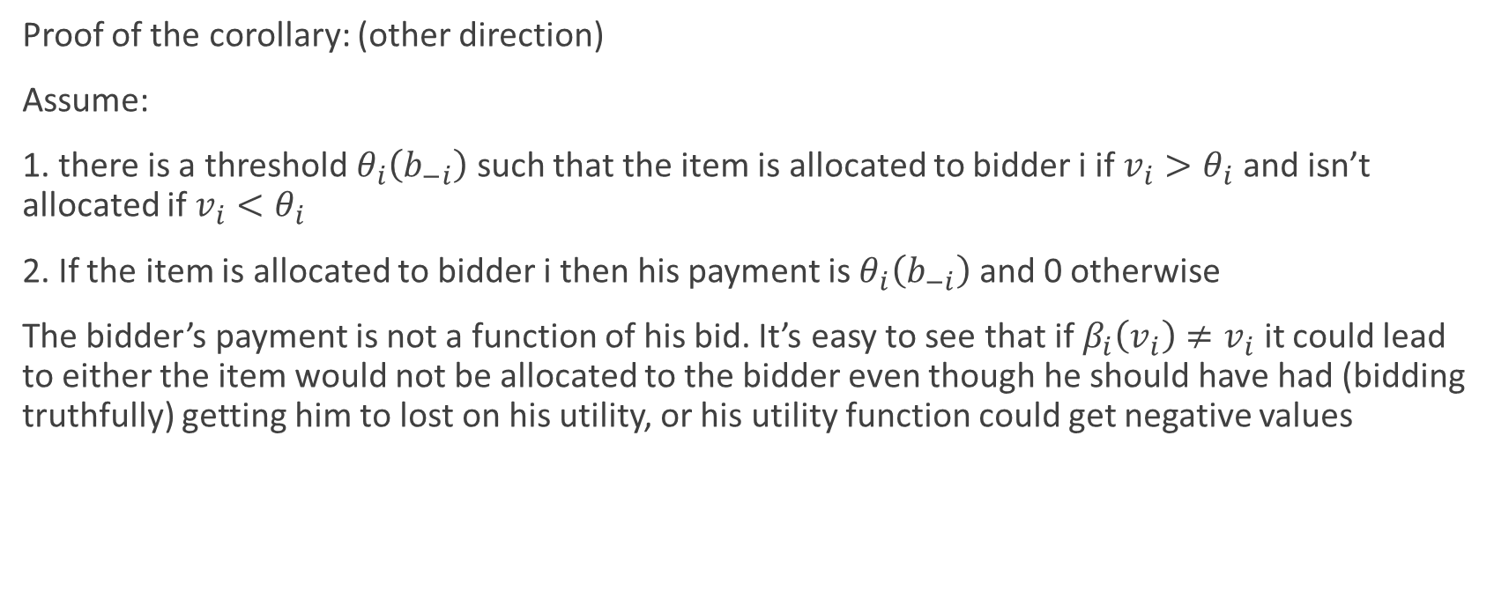
When is truthfulness dominant?
Proof of the corollary: (other direction)
Assume:
1. there is a threshold $θ_{i}\left(b_{−i}\right)$ such that the item is allocated to bidder i if $v_{i}>θ_{i}$ and isn’t allocated if $v_{i}<θ_{i}$
2. If the item is allocated to bidder i then his payment is $θ_{i}\left(b_{−i}\right)$ and 0 otherwise
The bidder’s payment is not a function of his bid. It’s easy to see that if $β_{i}\left(v_{i}\right)≠v_{i}$ it could lead to either the item would not be allocated to the bidder even though he should have had (bidding truthfully) getting him to lost on his utility, or his utility function could get negative values

Slide 29
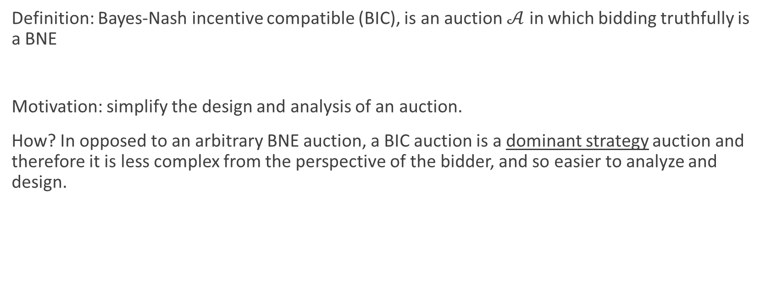
The revelation principle
Definition: Bayes-Nash incentive compatible (BIC), is an auction $𝒜$ in which bidding truthfully is a BNE
Motivation: simplify the design and analysis of an auction.
How? In opposed to an arbitrary BNE auction, a BIC auction is a dominant strategy auction and therefore it is less complex from the perspective of the bidder, and so easier to analyze and design.

Slide 30

The revelation principle
Definition:
Let $𝒜$ be a single-item auction, $a^{𝒜}\left[b\right]=\left(a_{1}\left[b\right], …, a_{n}\left[b\right]\right)$be the allocation rule where $b=(b_{1},…,b_{n})$ is the bid vector, and $p^{𝒜}\left[b\right]=(p_{1}\left[b\right],…,p_{n}\left[b\right])$ the expected price vector. The probability is taken over the randomness in the auction.

Slide 31

The revelation principle
Theorem:
Let $𝒜$ be an auction with BNE strategies $\left(β_{1}, …, β_{n}\right)$, the there is another auction $\tilde{𝒜}$ which has the same winner and payments as $𝒜$ in equilibrium. i.e. for all v, if $b=β(v)$ then
$a^{𝒜}\left[b\right]=a^{\tilde{𝒜}}\left[b\right]$ and $p^{𝒜}\left[b\right]=p^{\tilde{𝒜}}\left[b\right]$

Slide 32
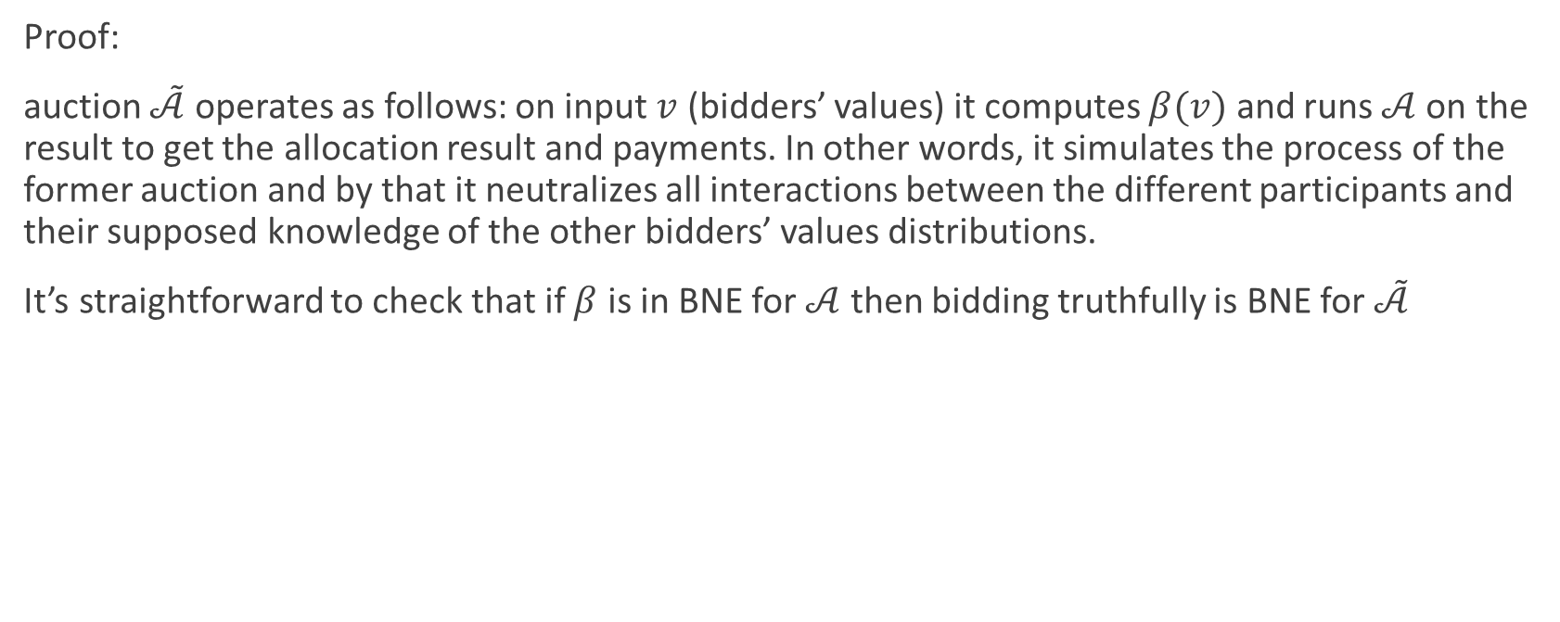
The revelation principle
Proof:
auction $\tilde{𝒜}$ operates as follows: on input $v$ (bidders’ values) it computes $β(v)$ and runs$𝒜$ on the result to get the allocation result and payments. In other words, it simulates the process of the former auction and by that it neutralizes all interactions between the different participants and their supposed knowledge of the other bidders’ values distributions.
It’s straightforward to check that if $β$ is in BNE for $𝒜$ then bidding truthfully is BNE for $\tilde{𝒜}$

Slide 33
Questions?

Slide 34
HW
Prove part(b) of the first theorem presented using conditions 1,2 from the first part of that theorem.
idan.haviv@gmail.com

