Slide 1
Distributional Analysis
Yuval Shem Tov [based on Tim Roughgarden’s book]

Slide 2
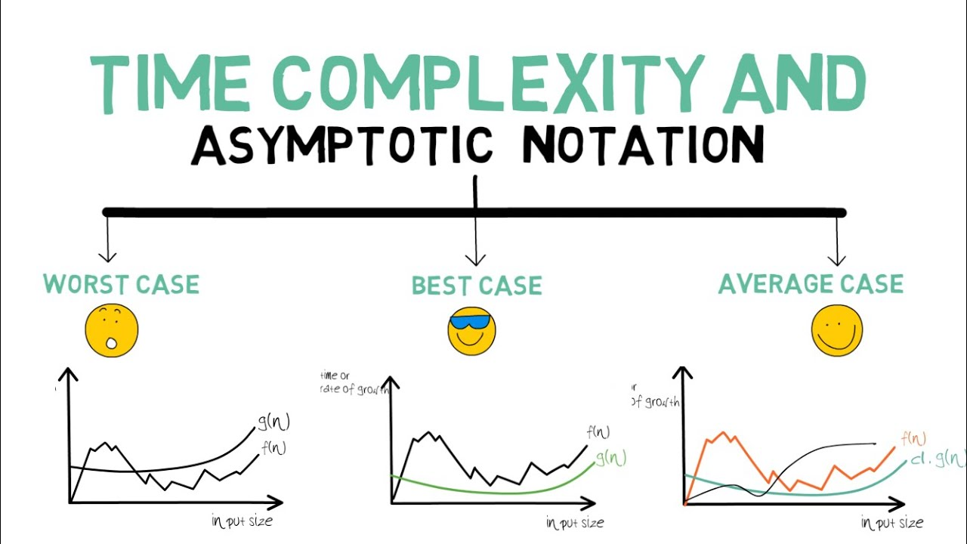
Today

Slide 3
What is Distributional Analysis?
Analyze an algorithm based on its average performance over a specific probability distribution.
Standard use-cases:
Justify why bad worst-case algorithms are good in practice.
Evaluate algorithms in practice.
New distribution-dependent algorithms can perhaps be useful more broadly.

Slide 4
Distributional Analysis – Pros and Cons
Pros:
Better analysis for existing algorithms (given real distribution).
Gap between empirical and worst-case performance => approximate “non pathological” inputs.
New distribution-dependent algorithms can perhaps be useful more broadly.

Slide 5
What can go wrong with Distributional Analysis?

Slide 6
Distributional Analysis –Cons
Hard to design algorithms for complicated distributions (compute-wise). $⇒$ Consider only simple distributions.
Possibly “overfit” to input distribution.

Slide 7
Analyze a Classical Algorithm under a Distribution

Slide 8
Average-Case Justifications of Classical Algorithms
Analyze “bad” worst case, but “good” practical algorithms.
Method:
Create an input distribution $D$, and show algorithm is good in expectation.
$D$ is useful since it “hides” bad inputs within the distribution.
$D$ should be as general as possible.
We do not claim $D$ is the real distribution.

Slide 9
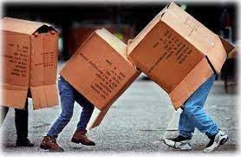
Bin Packing
Input: A set of $n$ items with sizes $s_{1},…, s_{n}∈[0,1]$.
Output: partitioning of the items to bins, such that each bin has total size $≤1$.
Objective: use the least possible number of bins.
Fact – this problem is NP-hard $⇒$ no exact polynomial algorithm $⇒$ approximate algorithms used.

Slide 10
Bin Packing - Example
Input: $\left[0.5, 0.7, 0.5, 0.2, 0.4, 0.2, 0.5, 0.1, 0.6\right]$
0.5
0.7
0.5
0.2
0.4
0.2
0.5
0.1
0.6
0.7
0.2
0.1
0.5
0.5
0.2
0.5
0.6
0.4
Now it is!
Optimal?

Slide 11
Bin Packing - First-Fit Decreasing (FFD) Algorithm
Sort items by decreasing size $s_{1}≥…≥s_{n}$.
For $i=1,…,n$:
If item $i$ with size $s_{i}$fits in some previously used bin (i.e., has current size $≤1−s_{i}$), insert it to the first such bin.
Otherwise, open a new bin, and insert item $i$ to the bin.
?

Slide 12
FFD gets $≥$11/9 approximation Worst Case
Example: 6 * 6 * 6 * 12*
$$\frac{1}{2}+ε$$
$$\frac{1}{4}+2ε$$
$$\frac{1}{4}+ε$$
$$\frac{1}{4}−2ε$$
$$\frac{1}{4}−2ε$$
$$\frac{1}{4}−2ε$$
$$\frac{1}{4}−2ε$$
$$\frac{1}{4}+2ε$$
$$\frac{1}{4}+2ε$$
$$\frac{1}{4}+2ε$$
$$\frac{1}{4}+2ε$$
$$\frac{1}{4}+2ε$$
$$\frac{1}{4}+2ε$$
$$\frac{1}{4}+ε$$
$$\frac{1}{4}+ε$$
$$\frac{1}{4}−2ε$$
$$\frac{1}{4}−2ε$$
$$\frac{1}{4}−2ε$$
$$\frac{1}{2}+ε$$
$$\frac{1}{2}+ε$$
$$\frac{1}{2}+ε$$
$$\frac{1}{2}+ε$$
$$\frac{1}{2}+ε$$
$$\frac{1}{2}+ε$$
$$\frac{1}{4}+ε$$
$$\frac{1}{4}+ε$$
$$\frac{1}{4}−2ε$$
$$\frac{1}{4}−2ε$$
$$\frac{1}{4}−2ε$$
$$\frac{1}{4}+ε$$
$$\frac{1}{4}+ε$$
$$\frac{1}{4}−2ε$$
$$\frac{1}{4}−2ε$$
$$\frac{1}{4}−2ε$$

Slide 13
FFD gets $≥$11/9 approximation Worst Case
Can be packed in 9 bins!
Duplicate items to get $30n$ items for any $n$.
This shows that there are inputs of arbitrary size for which FFD gets $≥$11/9 approximation.
There exists a proof showing an upper bound of 11/9 plus an additive constant.
$⇒$ The bound 11/9 is tight.
$$\frac{1}{4}+ε$$
$$\frac{1}{4}+ε$$
$$\frac{1}{4}+ε$$
$$\frac{1}{4}+ε$$
$$\frac{1}{4}+ε$$
$$\frac{1}{4}+ε$$
$$\frac{1}{4}+2ε$$
$$\frac{1}{4}+2ε$$
$$\frac{1}{4}+2ε$$
$$\frac{1}{4}−2ε$$
$$\frac{1}{4}−2ε$$
$$\frac{1}{4}−2ε$$
$$\frac{1}{4}−2ε$$
$$\frac{1}{4}−2ε$$
$$\frac{1}{4}−2ε$$
$$\frac{1}{4}+2ε$$
$$\frac{1}{4}+2ε$$
$$\frac{1}{4}+2ε$$
$$\frac{1}{2}+ε$$
$$\frac{1}{2}+ε$$
$$\frac{1}{2}+ε$$
$$\frac{1}{2}+ε$$
$$\frac{1}{2}+ε$$
$$\frac{1}{2}+ε$$
$$\frac{1}{4}−2ε$$
$$\frac{1}{4}−2ε$$
$$\frac{1}{4}−2ε$$
$$\frac{1}{4}−2ε$$
$$\frac{1}{4}−2ε$$
$$\frac{1}{4}−2ε$$
Approximate ratio is 11/9!

Slide 14
FFD in Practice
Empirically, the approximation of FFD is much better than 11/9 $⇒$ Use distributional analysis to demonstrate this!

Slide 15
First-Fit Decreasing (FFD) Algorithm – Distributional Analysis
Consider the distribution $D$ where each $s_{i}∼U[0,1]$ independently.
Theorem (Frederickson, 1980): [The approximation $→1$as $n→∞$] “For every $ε>0$, for $n$ items with sizes distributed independently and uniformly in $[0,1]$, with probability $1−o\left(1\right)$ as $n→∞$, the FFD algorithm uses less than $(1+ε)$ times as many bins as an optimal solution.”

Slide 16
FFD Distributional Approximation Proof
Two steps:
Step 1: Show the bound for another algorithm truncate and match (TM).
Step 2: Show that FFD never uses more bins than TM.

Slide 17
Truncate and Match
Pack every item with size $≥1−ε_{n}$ in its own bin ($ε_{n}=\frac{2}{n^{1/4}}$).
Sort and reindex the remaining $k$ items $s_{1}≥…≥s_{k}$.
For each $i≤\frac{k}{2}$ , create a bin with items$[i,k−i+1]$ if they fit, otherwise create 2 separate bins. [wlog k is even]
$…i,i+1,…,k−i,k−i+1…$
$$≥1−ε_{n}$$
$$<1−ε_{n}$$

Slide 18
Truncate and Match - Example
Input: $\left[0.98, 0.8, 0.6, 0.6, 0.5,0.4, 0.4,0.4, 0.3\right]$
0.98
0.8
0.6
0.6
0.5
0.4
0.4
0.4
0.3

Slide 19
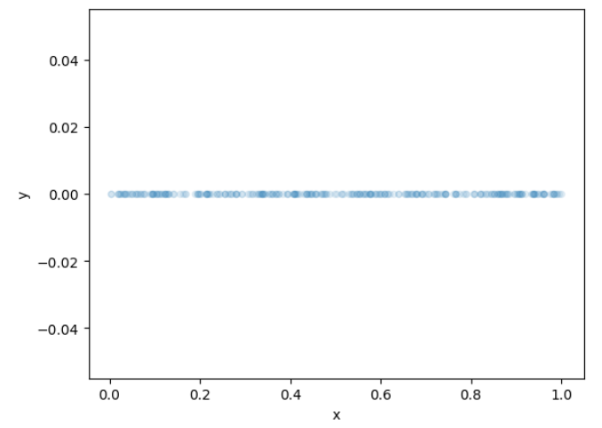
TM Bound Proof Idea
Consider $n$ independent variables $s_{i}∼U\left[0,1\right].$
Sort them $s_{1}≥…≥s_{n}$.
Observe: As $n→∞$, the value of $s_{i}≈\frac{i}{n+1}$. [Without proof]
$⇒s_{i}+s_{n−i+1}≈\frac{i}{n+1}+\frac{n−i+1}{n+1}=1$, so they fill a bin perfectly and optimally.
Problem: often $s_{i}+s_{n−i+1}>1$.
$$x_{n−i+1}$$
$$x_{i}$$

Slide 20
TM Bound Proof Idea
$$ε_{n}$$
Solution:
Put the top elements $s_{j}≥1−ε_{n}$ in their own bins.
Remaining $k$ items are uniform in $\left[0,1−ε_{n}\right)$.
Each pair $(i,k−i+1)$ sum to $≈\left(1−ε_{n}\right)\left(\frac{i}{k+1}+\frac{k−i+1}{k+1}\right)=1−ε_{n}\overset{whp}{\overbrace{<}}1$.
Analysis: Almost all bins are roughly $1−ε_{n}$ full $⇒$ we use at most $≈\frac{\sum_{i}{s_{i}}}{1−ε_{n}}+const$ bins, and $LB=\left\lceil \sum_{i}{s_{i}}\right\rceil$ $⇒$ we get a $\frac{\frac{\sum_{i}{s_{i}}}{1−ε_{n}}}{\left\lceil \sum_{i}{s_{i}}\right\rceil }≈\frac{1}{1−ε_{n}}≈1+ε_{n}$ approximation ratio.
$$x_{n−i+1}$$
$$x_{i}$$

Slide 21
FFD Distributional Approximation Proof
Two steps:
Step 1: Show the bound for another algorithm truncate and match (TM).
Step 2: Show that FFD never uses more bins than TM.
Idea: sort decreasing $s_{1}≥…≥s_{n}$ and induction step on item $i$ inserted (size $s_{i}$). Look at bins used in FFD and TM:
Bins with a single item of size $>1−s_{i}$. [same for both]
Other bins, [TM packs $≤2$ items, and FFD packs $≥2$ items].
Hence, if item $i$ fitted in bins of TM, then in the bins of FFD (plus the spare ones used in TM but not FFD) there is one with enough space and FFD finds it.
Hence the approximation ratio of FFD $→1$ as $n→∞$ over uniform inputs!

Slide 22
Design Useful Geometric Algorithms using a Distribution

Slide 23
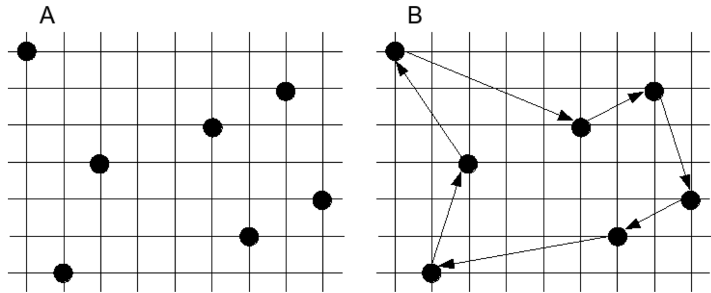
Euclidean Traveling Salesman Problem (ETSP):
Input: $n$ points in $ℝ^{2}$, $d\left(x,y\right)={\left\|x−y\right\|}_{2}$.
Output: A tour of the points (each point once, returning to start).
Objective: Minimize the total length of the tour.

Slide 24
Euclidean TSP with Distributional Analysis
Observe ETSP is NP-Hard.
Hence use approximation algorithms.
Idea: assume an input distribution $X=\left\{x_{1},…,x_{n}\right\}$.
Each $x_{i}∼U({\left[0,1\right]}^{2})$.
Invent an algorithm for this distribution. (The Stitch Algorithm, next slide)
Hopefully, it extends to a general practical algorithm.

Slide 25
Euclidean TSP – Stitch Algorithm
$$\sqrt{\frac{\ln{n}}{n}}$$
1. Divide unit square:
Divide ${\left[0,1\right]}^{2}$ to $s=\frac{n}{\ln{n}}$ sub-squares of side length $x=\sqrt{\frac{\ln{n}}{n}}$.
$$(0,1)$$
$$(1,1)$$
$$(0,0)$$
$$(1,0)$$
$s=\frac{n}{\ln{n}}$ squares

Slide 26
Euclidean TSP – Stitch Algorithm
$$\sqrt{\frac{\ln{n}}{n}}$$
2. Compute a tour within each sub-square: For each sub-square $i=1,…,s$:
If $\#points in subsquare=k≤6\ln{n}$ compute the optimal tour $T_{i}$ of these points. [$time=k^{2}2^{k}$]
Otherwise, return an arbitrary tour $T_{i}$ of these points. [Almost never]
$$(0,1)$$
$$(1,1)$$
$$(0,0)$$
$$(1,0)$$
$$k∼Bin\left(n,\frac{\ln{n}}{n}\right)≈\ln{n}\overset{whp}{\overbrace{<}}6\ln{n}$$
$s=\frac{n}{\ln{n}}$ squares

Slide 27
Euclidean TSP – Stitch Algorithm
$$\sqrt{\frac{\ln{n}}{n}}$$
3. Combine all tours of all squares:
Select a random representative from each sub-square.
Zig-zag through all sub-squares row by row:
Visit each representative, then traverse (except last) the tour.
Finally return to starting point.
$$(0,1)$$
$$(1,1)$$
$$(0,0)$$
$$(1,0)$$
$s=\frac{n}{\ln{n}}$ squares

Slide 28
Stitch Algorithm – Distributional Analysis
Theorem (Karp, 1977): [Approximation $→1$ as $n→∞$] “For every $ε>0$, for $n$ points distributed independently and uniformly in the unit square, with probability $1−o(1)$ as $n→∞$, the Stitch algorithm returns a tour with total length less than $(1+ε)$ times that of an optimal tour.”

Slide 29
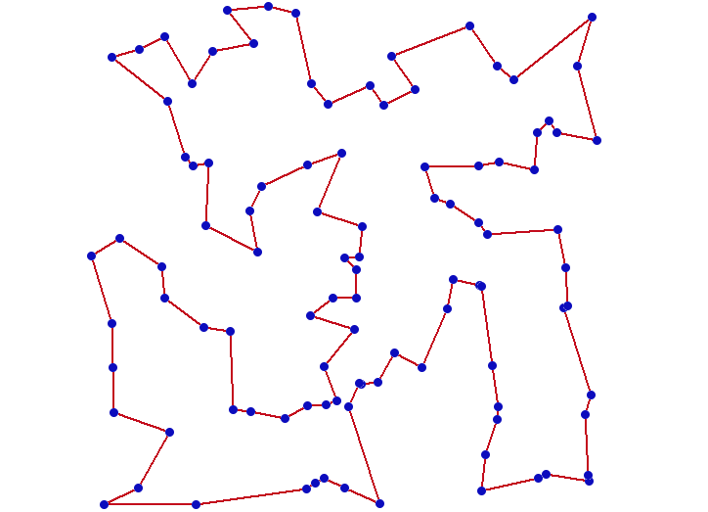
Stitch Algorithm – Proof Outline
Lemma 1: With high probability every sub-square contains $≤6\ln{n}$ points.
Lemma 2 [no proof]: Within each sub-square $i$, the length of the optimal tour of its points $P_{i}$ is at most: $6\sqrt{\frac{\ln{n}}{n}}+$The length of the optimal tour of$X$within sub-square$\text{i}$
Lemma 3: The length of the tour between the representatives is $O\left(\sqrt{\frac{n}{\ln{n}}}\right)$.
Bound
tour
within sub-squares
$$\sqrt{\frac{\ln{n}}{n}}$$
Bound
tour
between sub-squares

Slide 30
Stitch Algorithm – Proof Outline
Analyze tour without short-circuiting (by triangle ineq only longer)
Lemma 1: With high probability every sub-square contains $≤6\ln{n}$ points.
Lemma 2: Within each sub-square $i$, the length of the optimal tour of its points $P_{i}$ is at most: $6\sqrt{\frac{\ln{n}}{n}}+$The length of the optimal tour of$X$within sub-square$\text{i}$
Lemma 3: The length of the tour between the representatives is $O\left(\sqrt{\frac{n}{\ln{n}}}\right)$.
Bound
tour
within sub-squares
Bound
tour
between sub-squares

Slide 31
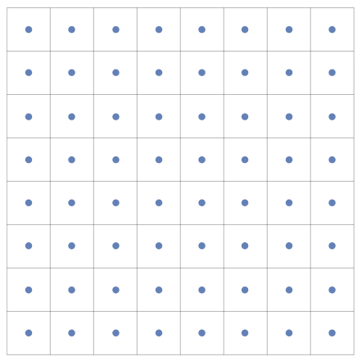
Euclidean TSP – Stitch Algorithm – Distributional Analysis
Proof using Lemmas: We sum the total length (within sub-squares and between representatives) :
$$≤\sum_{i=1…\frac{n}{\ln{n}}}{\left(\text{Length} \text{of} \text{opt} \text{tour} \text{of} \text{X} \text{within} \text{i}+6\sqrt{\frac{\ln{n}}{n}}\right)} +O\left(\sqrt{\frac{n}{\ln{n}}}\right)=$$ $OPT+6\sqrt{\frac{\ln{n}}{n}}⋅\frac{n}{\ln{n}}+O\left(\sqrt{\frac{n}{\ln{n}}}\right)=OPT+o\left(\sqrt{n}\right)=OPT+o\left(OPT\right)=(1+o(1))OPT$.
$$\frac{1}{\sqrt{n}}$$
Lemma 1,2
Lemma 3
The optimal tour of $n$ uniform points is of length $Ω(\sqrt{n})$.
$∀$tour, $∀$ 2 points, distance $≥\frac{1}{\sqrt{n}}$ $⇒total length≥\frac{1}{\sqrt{n}}⋅n=Ω(\sqrt{n})$

Slide 32
Euclidean TSP – Stitch Algorithm – Distributional Analysis
$$\sqrt{\frac{\ln{n}}{n}}$$
Lemma 2: Every sub-square contains at most $6\ln{n}$ points whp as $n→∞$.
$$(0,1)$$
$$(1,1)$$
$$(0,0)$$
$$(1,0)$$
$\frac{n}{\ln{n}}$ squares

Slide 33
Euclidean TSP – Stitch Algorithm – Distributional Analysis
$$\sqrt{\frac{\ln{n}}{n}}$$
Proof:
We have $n$ uniform points over $\frac{n}{\ln{n}}$ squares.
#Points in each square $∼Bin\left(n,\frac{\ln{n}}{n}\right)$.
By Chernoff, each sub-square contains $≤6n⋅\frac{\ln{n}}{n}=6\ln{n}$ points whp.
By a union bound, all sub-squares contain at most $6\ln{n}$ points whp.
$$(0,1)$$
$$(1,1)$$
$$(0,0)$$
$$(1,0)$$
$\frac{n}{\ln{n}}$ squares
$Bin\left(n,p\right)=\left(1±o\left(1\right)\right)⋅np$ as $n→∞$

Slide 34
Stitch Algorithm – Lemma 2
Lemma 2: Within each sub-square $i$, the length of the optimal tour of its points $P_{i}$ is at most: $6\sqrt{\frac{\ln{n}}{n}}+$The length of the optimal tour of$X$within sub-square$\text{i}$.
$$\sqrt{\frac{\ln{n}}{n}}$$

Slide 35
Stitch Algorithm – Lemma 3
Lemma 3: The length of the tour between the representatives is $O\left(\sqrt{\frac{n}{\ln{n}}}\right)$.
$$\sqrt{\frac{\ln{n}}{n}}$$
$\frac{n}{\ln{n}}$ squares
$$(0,1)$$
$$(1,1)$$
$$(0,0)$$
$$(1,0)$$

Slide 36
Stitch Algorithm – Lemma 3
Proof:
We traverse each of $\frac{n}{\ln{n}}$ squares once and return to start.
Observe: each sub-square intersects with $≤5$ segments $⇒$ Total length of segments intersected with each sub-square $≤$ $5\left|largest segment length in square\right|≤5\sqrt{2}\left|square side\right|=5\sqrt{2}\sqrt{\frac{\ln{n}}{n}}$.
$⇒$ Total length $≤5\sqrt{2}\sqrt{\frac{\ln{n}}{n}}⋅\frac{n}{\ln{n}}≤10\sqrt{\frac{n}{\ln{n}}}$.
$$\sqrt{\frac{\ln{n}}{n}}$$
$\frac{n}{\ln{n}}$ squares
$$(0,1)$$
$$(1,1)$$
$$(0,0)$$
$$(1,0)$$

Slide 37
Stitch Algorithm – Discussion
How much is it tailored to the uniform square distribution?
Appeared only in the grid selection.
Generalize to general points, through a recursive partition of a bounding box.
$⇒$ New polynomial time algorithms for Euclidean TSP with $1+ε$ approximation.

Slide 38
How to Select the Distribution for a Problem?

Slide 39
Random Graphs and Planted Models
How to design distributions for Distributional Analysis?
Consider an NP-hard optimization problem (Minimum Bisection), and design a distribution (over graphs) which:
Enables finding new algorithms for the problem over the distribution.
Allows to quantify how good an algorithm is.
Is a good proxy for the distribution in reality $⇒$ practical.

Slide 40
The Minimum Bisection Problem
Input: An undirected graph $G=(V,E)$ where $|V|$ is even.
Output: A partition of $V$ to two equal size sets $T,S$ ($T∪S=V,T∩S=∅,\left|T\right|=|S|$).
Objective: Minimize the size of the cut (the total number of crossing edges in the partition).
$$S$$
T
$$S$$
T
Input graph Bisection of size 7 Bisection of size 5

Slide 41
Random Graphs and Planted Models for Minimum Bisection
We study two distribution models:
Erdos-Rényi Random Graphs:
For almost all random graphs, all bisections have $≈$ same size. $⇒$ Good and bad algorithms return roughly the same bisection size.
Planted Models:
We “plant” a clearly optimal bisection in each graph. $⇒$ Quantify if an algorithm is good if it returned this bisection.

Slide 42
Erdos-Rényi Random Graphs
Definition: A family of distributions $\{G_{n,p}\}$ over undirected graphs with $n∈ℕ$ vertices, and edge density $p∈[0,1]$.
A random graph from $G_{n,p}$ is a result of the following process:
Create a graph over $n$ vertices.
Include each of the potential $\left({n \atop 2}\right)$ edges independently with probability $p$.

Slide 43
Why Erdos-Rényi Random Graphs are Bad for Minimum Bisection
$$S$$
T
$$S$$
Consider $G_{n,\frac{1}{2}}$ over the vertices $V=\{1,…,n\}$.
Let the bisection $S=\left\{1,…,\frac{n}{2}\right\}, T=\left\{\frac{n}{2}+1,…,n\right\}$.
Observe: $|Cut(S,T)|\sim Bin\left({\left(\frac{n}{2}\right)}^{2},\frac{1}{2}\right)$ over $G∼G_{n,\frac{1}{2}}$.
Chernoff $⇒\left|Cut\left(S,T\right)\right|≈\left(1±o\left(1\right)\right)⋅ {\left(\frac{n}{2}\right)}^{2}⋅\frac{1}{2}≈\left(1±o\left(1\right)\right)\frac{n^{2}}{8}$ whp as $n→∞$.
Union bound $⇒$This is true over all graph bisections as $n→∞$.

Slide 44
Why Erdos-Rényi Random Graphs are Bad for Minimum Bisection
Problem:
All bisections are roughly the same size.
Even the algorithm which computes a maximum bisection is almost optimal.

Slide 45
Planted Graph Models
Build a graph distribution $D$ such that:
$D$ is as general as possible.
$D$ allows for good algorithms (polynomial, optimal whp).
We “plant” a specific bisection which is $≪$ others in each $d∼D$.
$⇒$ A good algorithm finds the “planted” bisection in a random $d∼D$ whp.

Slide 46
Planted Graph Model for Minimum Bisection - Intuition
Idea:
Divide vertices into 2 equal size sets $S$ and $T$.
Add a few edges crossing $S$ and $T$.
Add many edges within $S$ and within $T$.
Then, the “planted” minimum bisection is $S,T$ with high probability, and any other bisection is large.
S
T

Slide 47
Planted Graph Model for Minimum Bisection - Formally
Let $p>q$ where $p,q∈[0,1]$, and let $\left|V\right|=2n$.
Create a random graph:
Bisect $V$ randomly into $T,S$ ($\left|T\right|=\left|S\right|=n$).
For each $(v,u)$:
If ($v∈T$ and $u∈S$) or ($v∈S$ and $u∈T$): [crossing edge]
Include $(v,u)$ with probability $q$.
Else: [internal edge]
Include $(v,u)$ with probability $p$.
S
T
$$Ber(p)$$
$$Ber(q)$$

Slide 48
Planted Graph Model for Minimum Bisection – which p and q are good?
Try #1: If $p=1$ and $q=0$:
$G=$ two cliques $⇒$ recover $S,T$ using DFS.
Too easy $⇒$ Not useful for Minimum Bisection in general.
S
T

Slide 49
Planted Graph Model for Minimum Bisection – which p and q are good?
Try #2: If $p=q$:
All edges appear with probability $p$.
The random graphs discard $S,T$ $⇒$ Impossible to recover S,T.
S
T

Slide 50
Planted Graph Model for Minimum Bisection – which p and q are good?
Try #3: If $p,q,p−q≥c$ where $c>0$ is a constant independent of $n$.
Algorithm:
Select a random vertex $v∈V$.
Sort all other vertices $u_{1}≥…≥u_{n−1}$by decreasing number of common neighbors with $v$.
Return the bisection $S=\left\{v\right\}∪\{u_{1},…,u_{\frac{n}{2}−1}\}$, $T=\{u_{\frac{n}{2}},…,u_{n−1}\}$.
v
2
1
1
S
3
T
0
0
2
3
0
2
0
Claim: with high probability the algorithm recovers the planted $S,T$ as $n→∞$!

Slide 51
Planted Graph Model for Minimum Bisection – which p and q are good?
$$p^{2}$$
Claim: with high probability the algorithm recovers the planted $S,T$ as $n→∞$.
Proof:
WLOG $v∈T$.
For any $u∈T$, the probability a vertex $x∉\{u,v\}$ is a common neighbor is $p^{2}$ if $x∈T$, and otherwise $q^{2}$. Therefore, the $\#common neighbors(u,v) \sim Bin\left(\frac{n}{2}−2,p^{2}\right)+Bin\left(\frac{n}{2},q^{2}\right)$.
For any $u∈S$, the probability a vertex $x∉\{u,v\}$ is a common neighbor is $pq$. Therefore, the $\#common neighbors(u,v) \sim Bin\left(n−2,pq\right)$.
By Chernoff, as $n→∞$, $Bin\left(\frac{n}{2}−2,p^{2}\right)+Bin\left(\frac{n}{2},q^{2}\right)≈n\left(\frac{p^{2}}{2}+\frac{q^{2}}{2}\right)=n\left(\frac{{\left(p−q\right)}^{2}}{2}+pq\right)$ $≥\frac{c^{2}}{2}n+npq≫npq≈Bin\left(n−2,pq\right)$.
Therefore, $∀u∈T$, the number of common neighbors with $v$ is substantially more than for any $u′∈S$. $⇒$ Top half of vertices with most common neighbors with $v$ is $T∖\{v\}$ whp. $⇒$ The algorithm recovers $S,T$ whp.
$$v$$
T
$$x$$
S
$$u$$
$$q^{2}$$
$$v$$
T
S
$$u$$
$$x$$
$$pq$$
$$v$$
$$x$$
T
S
$$x$$
$$u$$

Slide 52
Planted Graph Model for Minimum Bisection – which p and q are good?
Proof: WLOG $v∈T$. For any $u∈T$, $P_{G}\left[x is a common neighbor\right]=P_{G}\left[\left(v,x\right)∈E∧\left(u,x\right)∈E\right]= \left\{\begin{aligned}\begin{matrix}q^{2} & x∈S\end{matrix} \\ \begin{matrix}p^{2} & x∈T\end{matrix}\end{aligned}\right.$.
$\#common neighbors∼Bin\left(\frac{n}{2},q^{2}\right)+Bin\left(\frac{n}{2}−2,p^{2}\right)≈n\left(\frac{p^{2}}{2}+\frac{q^{2}}{2}\right)$.
$$q^{2}$$
$$p^{2}$$
$$v$$
$$x$$
S
$$v$$
T
T
$$x$$
S
$$u$$
$$u$$

Slide 53
Planted Graph Model for Minimum Bisection – which p and q are good?
Proof: WLOG $v∈T$. For any $u∈S$, $P_{G}\left[x is a common neighbor\right]=P_{G}\left[\left(v,x\right)∈E∧\left(u,x\right)∈E\right]=\left\{\begin{aligned}\begin{matrix}pq & x∈S\end{matrix} \\ \begin{matrix}pq & x∈T\end{matrix}\end{aligned}\right.$. $$\#common neighbors∼Bin\left(n−2,pq\right)≈npq$$
$$pq$$
$$pq$$
$$v$$
$$x$$
S
$$v$$
T
T
$$x$$
S
$$u$$
$$u$$

Slide 54
Planted Graph Model for Minimum Bisection – which p and q are good?
Proof: WLOG $v∈T$. We saw:
For any $u∈T$, $\#common neighbors(u,v)≈n\left(\frac{p^{2}}{2}+\frac{q^{2}}{2}\right)$ $=n\left(\frac{{\left(p−q\right)}^{2}}{2}+pq\right)≥\frac{c^{2}}{2}n+npq$.
For any $u∈S$, $\#common neighbors(u,v)≈npq$.
Therefore, $∀u∈T$, the number of common neighbors with $v$ is substantially more than for any $u′∈S$. $⇒$ Top half of vertices with most common neighbors with $v$ is $T∖\{v\}$ whp. $⇒$ The algorithm recovers $S,T$ whp.
$p−q≥c$

Slide 55
Planted Graph Model for Minimum Bisection – which p and q are good?
Unfortunately: the algorithm does not work well in practice.
Hence our distribution is not realistic. Specifically, the edge probability should tend to $0$ as $\left|V\right|=n→∞$, as in reality.

Slide 56
Planted Graph Model for Minimum Bisection – which p and q are good?
Try #4 [works!]: Consider: $p,q,p−q→0$ as $n→∞$.
Theorem (Abbe et al., 2016; Hajek et al., 2016): If $p=\frac{α\ln{n}}{n}$ and $q=\frac{β\ln{n}}{n}$ with $α>β$, then:
If $\sqrt{α}−\sqrt{β}≥\sqrt{2}$, there is a polynomial-time algorithm that recovers the planted bisection $S,T$ with probability $1−o(1)$ as $n→∞$.
If $\sqrt{α}−\sqrt{β}<\sqrt{2}$, then no polynomial-time algorithm recovers the planted bisection $S,T$ with constant probability as $n→∞$.
[Relax to a Semi-Definite Program (polynomial!) over the nodes (mapped to vectors), and the bisection size is a quadratic function of the vectors.]
The algorithm above for $\sqrt{α}−\sqrt{β}≥\sqrt{2}$ is information-theoretically optimal, and is found to work well in practice!

Slide 57
Thank You! Questions?

Slide 62
Design an Algorithm for a Distribution

Slide 63
Optimal Stopping Problem
Setting:
Let $n∈ℕ$ be a known number of rounds, and $D_{1},…,D_{n}$ be known distributions over $ℝ_{+}.$
For each stage $i=1,…,n$:
Sample independent $v_{i}∼D_{i}$.
Decide between
Take $v_{i}$, and stop (with score $v_{i}$), or
Continue to the next stage $i+1$, and discard $v_{i}$.

Slide 64
Optimal Stopping Problem - Example
$n=6, D_{1},…,D_{6}$are below.
Algorithm: Going through $i=1,…,6,$ when to stop?
Objective: maximize $E_{D_{1},…,D_{6}}[selected value]$.
$v_{1}=0.2$
$$v_{2}=0.8$$
$v_{3}=0.42$
$v_{4}=0.21$
$v_{5}=0.82$
$v_{6}=0.34$
i=1 i=2 i=3 i=4 i=5 i=6

Slide 65
Optimal Stopping Problem – Optimal Algorithm
For $i=n$, since each $v_{i}≥0$, it’s always best to select $v_{n}$.
For $i<n$: [assuming optimal algorithm for larger i’s]
Given a concrete sample $v_{i}∼D_{i}$:
Either take it: $selected value=v_{i}$.
Or continue: $E\left[selected value\right]={OPT}_{i+1,…,n}$.
i=4 i=5 i=6

Slide 66
Optimal Stopping Problem – Optimal Algorithm
Optimal Algorithm:
Define each $T_{i}={OPT}_{i+1,…,n}$
At step $i$, stop with $v_{i}$ if $v_{i}>T_{i}$, and otherwise continue.
i=4 i=5 i=6

Slide 67
Optimal Stopping Problem – Cons
Complicated to compute the $T_{i}$’s.
Overfit: strong dependence in each $D_{i}$ and $n$ thresholds.
No broader novel idea (except “working backwards” in steps).
Can we design a simpler algorithm with good guarantees which is more robust to distribution changes?

Slide 68
Threshold Rules
A threshold rule is defined by a single threshold$t∈ℝ.$
Rule: stop at the first step $i$ with $v_{i}≥t$. [Receive no prize if $∀i v_{i}<t$]
Non-optimal since we may never accept (if all $v_{i}<t$).
$v_{1}=0.2$
$$v_{2}=0.6$$
$v_{3}=0.42$
$v_{4}=0.21$
$v_{5}=0.82$
$$t=0.7$$
i=1 i=2 i=3 i=4 i=5 i=6

Slide 69
The Prophet Inequality
Prophet: sees all the values $v_{i}$ before the algorithm runs.
For each run, can take $\max_{i}{v_{i}}$: $⇒$ Expected value: $E_{D_{1},…,D_{n}}[\max_{i}{v_{i}}]$.
Observation: no algorithm can perform better than the prophet.
$v_{1}=0.2$
$$v_{2}=0.6$$
$v_{3}=0.42$
$v_{4}=0.21$
$v_{5}=0.82$
$v_{6}=0.53$
$$t=0.7$$
i=1 i=2 i=3 i=4 i=5 i=6

Slide 70
Threshold rules give a $\frac{1}{2}$-approximation for Prophets

Slide 71
Prophet Inequality - Proof
Recall: the threshold rule stops at the first step $i$ with $v_{i}≥t$.
Objective: show existence of a good $t∈ℝ$.
Analysis:
The probability space is over $D_{1},…,D_{n}$.
Let $q\left(t\right)=P_{D}\left[at least one v_{i}≥t\right]$, the probability that the rule receives any prize. Select $t$ such that $q\left(t\right)=0.5$. (For simplicity assume exists. $q\left(−∞\right)=1, q\left(∞\right)=0, q\left(⋅\right)$ decreasing)
$E\left[value\right]=\left[law of total expectation\right]$
$E\left[value \right|exactly one v_{i}≥t]⋅P[exactly one v_{i}≥t]+$ $E\left[value \right|more than one v_{i}≥t]⋅P[more than one v_{i}≥t]+E\left[value \right| no v_{i}≥t]⋅P[no v_{i}≥t]≥[Expectation is bounded by t]$
$(t+E\left[value−t \right|exactly one v_{i}≥t])⋅P[exactly one v_{i}≥t]+$ $t⋅P\left[more than one v_{i}≥t\right]+0=\left[union of disjoint events\right]$
$t⋅P\left[at least one v_{i}≥t\right]+E\left[value−t \right|exactly one v_{i}≥t]⋅P[exactly one v_{i}≥t]=[q\left(t\right)=0.5,lte]$
$0.5t+\sum_{i=1…n}{E\left[v_{i}−t | v_{i}≥t,∀j≠i v_{j}<t\right]⋅P\left[v_{i}≥t\right]⋅P[∀j≠i v_{j}<t]}≥\left[v_{i}, v_{j} ind., mono.\right]$
$0.5t+\sum_{i=1…n}{E\left[v_{i}−t | v_{i}≥t\right]⋅P\left[v_{i}≥t\right]⋅P[∀j v_{j}<t]}$

Slide 72
Prophet Inequality – Proof Cont’d
Recall: the threshold rule stops at the first step $i$ with $v_{i}≥t$.
Objective: show exist a good $t∈ℝ$.
Analysis:
$E\left[value\right]≥ …≥$
$0.5t+\sum_{i=1…n}{E\left[v_{i}−t | v_{i}≥t\right]⋅P\left[v_{i}≥t\right]⋅P[∀j v_{j}<t]}=\left[q\left(t\right) def\right]$
$0.5t+0.5\sum_{i=1…n}{E\left[v_{i}−t | v_{i}≥t\right]⋅P\left[v_{i}≥t\right]}=\left[a^{+}:=\max\left(a,0\right), 2nd term is 0\right]$
$0.5t+0.5\sum_{i=1…n}{(E\left[{\left(v_{i}−t\right)}^{+}| v_{i}≥t\right]⋅P\left[v_{i}≥t\right]+E\left[{\left(v_{i}−t\right)}^{+}| v_{i}<t\right]⋅P\left[v_{i}<t\right]})=\left[lte\right]$
$0.5t+0.5\sum_{i=1…n}{E\left[{\left(v_{i}−t\right)}^{+}\right]}=[linearity of expectation]$
$0.5t+0.5E\left[\sum_{i=1…n}{{\left(v_{i}−t\right)}^{+}}\right]≥\left[sum of x_{i}≥0 is≥max \right]$
$0.5t+0.5 E\left[\max_{i}{\left(v_{i}−t\right)}^{+}\right]≥\left[linearity of expectation\right]$
$0.5 E\left[t+\max_{i}\left(v_{i}−t\right)\right]=0.5 E[\max_{i}{ v}_{i}]$

Slide 73
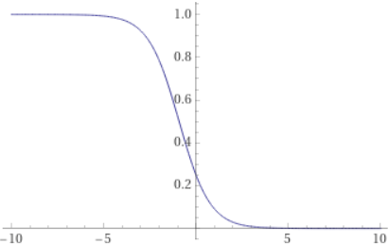
Prophet Inequality - Proof
The probability space is over $D_{1},…,D_{n}$.
Let $q\left(t\right)=P_{D}\left[at least one v_{i}≥t\right]=P_{D}\left[\max_{i}{v_{i}}≥t\right]$, the probability that the rule receives any prize.
Select $t$ such that $q\left(t\right)=0.5$.
$$q\left(⋅\right)$$
1/2
$$t$$

Slide 74
Prophet Inequality - Proof
$E\left[value\right]=$ $E\left[value \right|exactly one v_{i}≥t]⋅P[exactly one v_{i}≥t]+$ $E\left[value \right|more than one v_{i}≥t]⋅P[more than one v_{i}≥t]+$ $E\left[value \right| no v_{i}≥t]⋅P[no v_{i}≥t]$ $≥(t+E\left[value−t \right|exactly one v_{i}≥t])⋅P[exactly one v_{i}≥t]+$ $t⋅P\left[more than one v_{i}≥t\right]+$ $0$ $≥ t⋅P\left[at least one v_{i}≥t\right]+E\left[value−t \right|exactly one v_{i}≥t]⋅P[exactly one v_{i}≥t]$ $=0.5t+\sum_{i=1…n}{E\left[v_{i}−t | v_{i}≥t,∀j≠i v_{j}<t\right]⋅P\left[v_{i}≥t\right]⋅P[∀j≠i v_{j}<t]}≥0.5t+\sum_{i=1…n}{E\left[v_{i}−t | v_{i}≥t\right]⋅P\left[v_{i}≥t\right]⋅P[∀j v_{j}<t]}$

Slide 75
Prophet Inequality – Proof Cont’d
$$1−q\left(t\right)=0.5$$
$$E\left[value\right] \\ ≥0.5t+\sum_{i=1…n}{E\left[v_{i}−t | v_{i}≥t\right]⋅P\left[v_{i}≥t\right]⋅P\left[∀j v_{j}<t\right]} \\ =0.5t+0.5\sum_{i=1…n}{E\left[v_{i}−t | v_{i}≥t\right]⋅P\left[v_{i}≥t\right]} \\ =0.5t+0.5\sum_{i=1…n}{(E\left[{\left(v_{i}−t\right)}^{+}| v_{i}≥t\right]⋅P\left[v_{i}≥t\right]+E\left[{\left(v_{i}−t\right)}^{+}| v_{i}<t\right]⋅P\left[v_{i}<t\right]})=0.5t+0.5\sum_{i=1…n}{E\left[{\left(v_{i}−t\right)}^{+}\right]}=0.5t+0.5E\left[\sum_{i=1…n}{{\left(v_{i}−t\right)}^{+}}\right]≥0.5t+0.5 E\left[\max_{i}{\left(v_{i}−t\right)}^{+}\right]≥0.5 E\left[t+\max_{i}\left(v_{i}−t\right)\right]=0.5 E[\max_{i}{ v}_{i}]$$
$$a^{+}:=\max\left(a,0\right)$$
$$=0$$

Slide 76
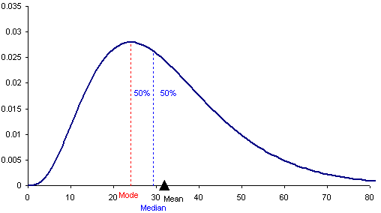
Prophet Inequality – Finding the threshold $t$
Problem: $t$ is not given explicitly.
Objective: find $t$ s.t. $P_{D}\left[\max_{i}{v_{i}}≥t\right]=0.5$.
Solution: Let $Z=\max_{i}{v_{i}}$, and approximate $Z$’s median by $t^{′}=$ (median of a sample of size $k$).
$⇒$ By Hoeffding, if $k=O(ε^{−2})$, whp $P_{D}\left[\max_{i}{v_{i}}≥t′\right]= 0.5±2ε$.
$⇒$ We can show that $t′$ yields approximation $=\frac{1}{2+ε}$.
$$\max_{i}{v_{i}}$$
$$t$$

Slide 77
Threshold Rule– Pros
Depends only on a single threshold.
Reordering distributions does not change the algorithm.
General algorithmic idea - threshold rules with a $p>0$ probability of “success”.

Slide 78
Threshold Rule– Cons
The algorithm is not optimal (no reward if $∀i v_{i}<t$).

Slide 79
QuickSort

Slide 80
Average-Case Justifications of Classical Algorithms - QuickSort
Input: an array $X=[x_{1},…,x_{n}]$ where $∀i x_{i}∈ℝ$, and wlog all elements are distinct.
Algorithm:
Select a pivot element $p∈X$.
Partition $X$ around p, rearranging elements $x<p$ before it and $x>p$after it.
Recursively sort array of all $x<p$ and all $x>p$.
If $\left|X\right|≤1$, stop.
9 | 6 | 3 | 7 | 2 | 12 | 5 | 1
3 | 2 | 5 | 1
6
9 | 7 | 12
2 | 1
3
5
7
9
12
1
2

Slide 81
QuickSort - Pivot Selection & Runtime
Partition always takes linear time $Θ(n)$, since we traverse the whole array $X$.
If we select $p$ smartly (e.g., the median), the algorithm takes $O\left(nlogn\right)$ worst-case.
If we select $p$ poorly, the algorithm can take $O\left(n^{2}\right)$ worst-case.
Randomized QuickSort: select $p$ uniformly at random.
Deterministic QuickSort: select $p$ as the first element. Runtime in practice: $O\left(nlogn\right)$ Worst-case runtime: $O(n^{2})$ [sorted array].
To justify the empirical $O(nlogn)$ runtime, we introduce a distribution and analyze the average case!
6 | 3 | 7 | 2 | 12 | 5 | 1
6 | 3 | 7 | 2 | 12 | 5 | 1

Slide 82
Deterministic QuickSort – Average Case Runtime
Deterministic QuickSort: select $p$ as the first element.
WLOG all elements are distinct, and Deterministic QuickSort cares only about the order $(>,<)$.
$⇒$ Each input is equivalent to some permutation of $\{1,…,n\}$.
$⇒$ Select the input distribution $D$ as a uniformly random permutation of $\{1,…,n\}$.
2 | 12 | 7 | 3
1 | 4 | 3 | 2
1 | 4 | 3 | 2
2 | 1 | 3 | 4
3 | 2 | 1 | 4
3 | 4 | 1 | 2

Slide 83
Deterministic QuickSort – Average Case Runtime
Theorem (Hoare, 1962): “The expected running time of Deterministic QuickSort on a random permutation of $\left\{1,…,n\right\}$ is $O(nlogn)$.”

Slide 84
Deterministic QuickSort – Average Case Runtime - Proof
Recall all comparisons are performed with the pivot element $p$.
Lemma 1: $∀i,j$, $i$ and $j$ are compared at most once by quicksort.
Proof: Since we compare only to pivots, if $i$ or $j$ are selected as pivot, they can potentially be compared, after which we recurse on each partition without the pivot.
Lemma 2: $∀i<j$, the probability that $i$ and $j$ are compared is $\frac{2}{j−i+1}$.
Proof: next slide.
6 | 3 | 4 | 2 | 7 | 5 | 1
6 | 3 | 4 | 2 | 7 | 5 | 1

Slide 85
Deterministic QuickSort – Average Case Runtime - Proof
Lemma 2 [rephrased]: $∀i<j$’th smallest elements, the probability that they are compared is $\frac{2}{j−i+1}$.
Proof [by induction over the array length $n$]:
If $n=2$, then $i<j →i=1,j=2$, and they are indeed compared.
Step [assume for all $<n$]:
$P\left[i,j compared\right]=\left[ltp, pivot is k^{′}th smallest element\right]$ $P\left[i,j compared \right|k<i]⋅P\left[k<i\right]+$ $P\left[i,j compared \right|i≤k≤j]⋅P\left[ i≤k≤j\right]+$ $P\left[i,j compared \right|k>j]⋅P\left[k>j\right]=$
$P[i−k,j−k compared in right partition]⋅P\left[k<i\right]$ $P\left[i,j compared \right|i≤k≤j]⋅P\left[i≤k≤j\right]+$ $P\left[i,j compared in left partition\right]⋅P\left[k>j\right]=[induction,$ $if i≤k≤j, i and j are only compared if k=i or k=j]$
$\frac{2}{j−k−\left(i−k\right)+1}⋅P\left[k<i\right]+\frac{2}{j−i+1}⋅P\left[i≤k≤j\right]+\frac{2}{j−i+1}⋅P\left[k>j\right]=\frac{2}{j−i+1}$.
1 | 2

Slide 86
Deterministic QuickSort – Average Case Runtime - Proof
Lemma 2: $∀i<j$’th smallest elements, $P[\text{they} \text{are} \text{compared}\text{]=}\frac{2}{j−i+1}$.
Proof [by induction over the array length $n$]: $$P\left[i,j compared\right] \\ =P\left[i,j compared \right|k<i]⋅P\left[k<i\right]+ \\ P\left[i,j compared \right|i≤k≤j]⋅P\left[ i≤k≤j\right]+ \\ P\left[i,j compared \right|k>j]⋅P\left[k>j\right]=P[i−k,j−k compared in right partition]⋅P\left[k<i\right] \\ P\left[i,j compared \right|i≤k≤j]⋅P\left[i≤k≤j\right]+ \\ P\left[i,j compared in left partition\right]⋅P\left[k>j\right]$$ $=\frac{2}{j−k−\left(i−k\right)+1}⋅P\left[k<i\right]+\frac{2}{j−i+1}⋅P\left[i≤k≤j\right]+\frac{2}{j−i+1}⋅P\left[k>j\right]=\frac{2}{j−i+1}$.
k=? | … | … | i=3 | … | j=5 | …

Slide 87
Deterministic QuickSort – Average Case Runtime – Proof Continued
Lemma 1: $∀i,j$, $i$ and $j$ are compared at most once by quicksort.
Lemma 2: $∀i<j$, the probability that $i$ and $j$ are compared is $\frac{2}{j−i+1}$.
$⇒$ total number of comparisons is $E\left[\#comparisons\right]=E\left[\sum_{i<j}{Indicator\left(i,j compared\right)}\right]=\sum_{i<j}{E[Indicator\left(i,j compared\right)]}=\sum_{i<j}{P[i,j compared]}=\sum_{i=1…n−1}{\sum_{j=i+1…n}{\frac{2}{j−i+1}}}≤2n⋅\sum_{k=2…n}{\frac{1}{k}}=O(nlogn)$.

