Slide 1
From Adaptive Analysis to Instance Optimality
Presented by: Moria Nachmany
2023, Tel Aviv University
By Jeremy Barby

Slide 2
Agenda
Defining the purpose of the lesson.
Defining the problem, we will work with.
Jarvis march algorithm.
Graham's scan algorithm.
Algorithm Marriage Before Conquest.
Vertical Entropy.
Structural entropy.
Instance optimality.
Extension to the general case.

Slide 3
Agenda
Defining the purpose of the lesson.
Defining the problem, we will work with.
Jarvis march algorithm.
Graham's scan algorithm.
Algorithm Marriage Before Conquest.
Vertical Entropy.
Structural entropy.
Instance optimality.
Extension to the general case.

Slide 4
The goal
Define an extremely fine-grained parametrization of a problem’s instance space in order to argue that a particular algorithm for the problem is “optimal” in a very strong sense.

Slide 5
Agenda
Defining the purpose of the lesson.
Defining the problem, we will work with.
Jarvis march algorithm.
Graham's scan algorithm.
Algorithm Marriage Before Conquest.
Vertical Entropy.
Structural entropy.
Instance optimality.
Extension to the general case.

Slide 6
Maxima Sets

Slide 7
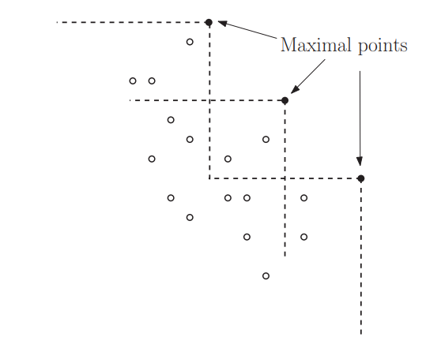
Maximal: point in S that none of the other points in S dominates it in every coordinate.

Slide 8
The problem - Formal
Input: set S of n points in the plane.
Maximal: point in S that none of the other points in S dominates it in every coordinate.
The goal: identify all the maximal points.
Output: h maximal points in S.

Slide 9
Agenda
Defining the purpose of the lesson.
Defining the problem, we will work with.
Jarvis march algorithm.
Graham's scan algorithm.
Algorithm Marriage Before Conquest.
Vertical Entropy.
Structural entropy.
Instance optimality.
Extension to the general case.

Slide 10
Jarvis March
We will compare the points:
1. The rightmost point, i.e. the one with the highest x-value must be maximal-point.
2. We will get rid of all the points that are to the left of it and whose y-value is lower than it.
3. We will continue to the point with the highest x-value among the remaining points.
4. We will get rid of the points in the same way and continue to the next point and so on..

Slide 12
Jarvis March - complexity
The number of comparisons is O(nh) in the worst case.
This running time ranges from O(n) to O($n^{2}$), depending on the output size h.

Slide 13
Agenda
Defining the purpose of the lesson.
Defining the problem, we will work with.
Jarvis march algorithm.
Graham's scan algorithm.
Algorithm Marriage Before Conquest.
Vertical Entropy.
Structural entropy.
Instance optimality.
Extension to the general case.

Slide 14
Graham’s scan
Sort the n points by their x-value.

Slide 15
Graham’s scan
Sort the n points by their x-value.
The first point of this list is the point with the maximum x-value and necessarily a maximal point.

Slide 16
Graham’s scan
Sort the n points by their x-value.
Scan each point and if it’s y-value is greater than the y-value of the last point in the output – it’s a maximal point, otherwise it can be removed.
The first point of this list is the point with the maximum x-value and necessarily a maximal point.

Slide 17
y
x

Slide 18
Graham’s scan - complexity
Sort the n points by their x-value – O(nlog n).
Scan each point – O(n).
Total running time – O(nlog n + n) = O(nlog n).

Slide 19
Comparison-Based Lower Bound Theorem
By reduction from SORTING - in the comparison model of computation, no algorithm uses asymptotically fewer comparisons in the worst case.

Slide 20
Comparison-Based Lower Bound Theorem - Proof
Suppose we have a set of 5 points
(5,4)
(7,2)
(8,1)
(4,5)
(6,3)

Slide 21
(4,5)
(5,4)
(6,3)
In order to find the maximal points, we will have to sort the points according to both axis.
So that in fact it is a sorting problem that takes $Ω\left(n\log{n}\right)$ time.
(7,2)
(8,1)
(7,2)
(6,3)
(8,1)
(5,4)

Slide 22
Graham’s scan vs. Jarvis March
Jarvis march : O(nh).
Graham’s scan: O(nlog n).
So, Jarvis march is superior to Graham’s scan if and only if h = o(log n).
Run both algorithms in parallel yield a run time of O(n · min{h, log n}).

Slide 23
Agenda
Defining the purpose of the lesson.
Defining the problem, we will work with.
Jarvis march algorithm.
Graham's scan algorithm.
Algorithm Marriage Before Conquest.
Vertical Entropy.
Structural entropy.
Instance optimality.
Extension to the general case.

Slide 25
Marriage Before Conquest
Kirkpatrick and Seidel (1985) described a clever solution that performs O(n log h) point comparisons in the worst case.

Slide 26
Algorithm Marriage Before Conquest:
If |S| = 1 then return S.

Slide 27
y
x

Slide 28
Algorithm Marriage Before Conquest:
If |S| = 1 then return S.
Divide S into the left and right halves $S_{l}$ and $S_{r}$ by the median x-coordinate.

Slide 29
y
$$S_{l}$$
$$S_{r}$$
x

Slide 30
Algorithm Marriage Before Conquest:
If |S| = 1 then return S.
Divide S into the left and right halves $S_{l}$ and $S_{r}$ by the median x-coordinate.
Discover the point q with the maximum y-coordinate in $S_{r}$.

Slide 31
y
$$S_{l}$$
$$S_{r}$$
x

Slide 32
Algorithm Marriage Before Conquest:
If |S| = 1 then return S.
Divide S into the left and right halves $S_{l}$ and $S_{r}$ by the median x-coordinate.
Discover the point q with the maximum y-coordinate in $S_{r}$.
Prune all points in $S_{l}$ and $S_{r}$ that are dominated by q.

Slide 33
y
$$S_{l}$$
$$S_{r}$$
x

Slide 34
y
$$S_{l}$$
$$S_{r}$$
x

Slide 35
y
$$S_{l}$$
$$S_{r}$$
x

Slide 36
Algorithm Marriage Before Conquest:
If |S| = 1 then return S.
Divide S into the left and right halves $S_{l}$ and $S_{r}$ by the median x-coordinate.
Discover the point q with the maximum y-coordinate in $S_{r}$.
Prune all points in $S_{l}$ and $S_{r}$ that are dominated by q.
Return the concatenation of Marriage Before Conquest($S_{l}$) and Marriage Before Conquest($S_{r}$).

Slide 37
y
x

Slide 38
Marriage Before Conquest - complexity
The running time is O(n log h)

Slide 39
Proof Sketch - the balance case
n points, h candidate points
$\frac{n}{2}$ points, $\frac{h}{2}$ candidate points
$\frac{n}{2}$ points, $\frac{h}{2}$ candidate points
$$\log{h}$$
$\frac{n}{4}$ points,
$\frac{h}{4}$ candidate points
$\frac{n}{4}$ points,
$\frac{h}{4}$ candidate points
$\frac{n}{4}$ points,
$\frac{h}{4}$ candidate points
$\frac{n}{4}$ points,
$\frac{h}{4}$ candidate points
=> O(n log h)

Slide 40
Proof Sketch - the unbalance case
n points, h candidate points
$\frac{n}{2}$ points, $1$candidate points
$\frac{n}{2}$ points, $h−2$ candidate points
h
$c∙n+c∙\frac{n}{2}+…+1$
$$= \sum_{i=1}^{h}{c∙\frac{n}{2^{i}}}$$
$\frac{n}{4}$ points,
$1$candidate points
$\frac{n}{4}$ points,
$h−4$candidate points
$=c∙n∙$ $\sum_{i=1}^{h}{\frac{1}{2^{i}}}$
=> O(n)

Slide 41
Proof Sketch – in general
n points, h candidate points
$\frac{n}{2}$ points, $r$candidate points
$\frac{n}{2}$ points, $h−r−1$ candidate points
=> $T\left(n,h\right)=c∙n+T\left(\frac{n}{2}, r\right)+T\left(\frac{n}{2},h−r−1\right)$
=> O(n log h)

Slide 42
Lower bound
Every algorithm in the comparison model has a running time $Ω\left(n\log{h}\right)$

Slide 43
Lower bound - intuition
Suppose we have a set of 6 points
(5,3)
(6,2)
(8,1)
(4,4)
(6,3)
(7,1)

Slide 44
(4,4)
(5,3)
(6,3)
Each maximal point dominates the non-maximal points.
Therefore, for each point we will only have to compare it against the maximal points.
(6,2)
(7,1)
(8,1)
(4,4)
(8,1)
(6,2)
(7,1)
(5,3)
(6,3)

Slide 46
Agenda
Defining the purpose of the lesson.
Defining the problem, we will work with.
Jarvis march algorithm.
Graham's scan algorithm.
Algorithm Marriage Before Conquest.
Vertical Entropy.
Structural entropy.
Instance optimality.
Extension to the general case.

Slide 47
Finer-grained parameterizations
It turns out there are natural finer-grained parameterizations of the input space for the MAXIMA SET (and CONVEX HULL) problem, which enable stronger notions of algorithm optimality.
For example - consider an instance with output size h = o(n) – we will get running time of O(h log h) .

Slide 48
Vertical Entropy
$n_{i}$ = the number of noncandidate points dominated
by the $i_{th}$ x-value candidate point.

Slide 49
y
2
5
0
1
x

Slide 50
The vertical entropy of an instance as the entropy of the distribution of {$n_{i}$},i∈[1,...,h]:
$$H_{v}\left(n_{1},…,n_{h}\right)=\sum_{i=1}^{h}{\frac{n_{i}}{n}\log\left(\frac{n}{n_{i}}\right)}$$

Slide 51
Let’s see a case of equal distribution

Slide 52
y
$$\frac{n−h}{h}$$
$$\frac{n−h}{h}$$
$$\frac{n−h}{h}$$
$$\frac{n−h}{h}$$
x

Slide 53
Equal distribution
$$H_{v}\left(n_{1},…,n_{h}\right)=\sum_{i=1}^{h}{\frac{n_{i}}{n}\log\left(\frac{n}{n_{i}}\right)}=\sum_{i=1}^{h}{\frac{\left(\frac{n−h}{h}\right)}{n}log\left(\frac{n}{\left(\frac{n−h}{h}\right)}\right)}$$
Suppose h=$\frac{n}{2}:$
$$H_{v}\left(n_{1},…,n_{h}\right)=\sum_{i=1}^{h}{\frac{\left(\frac{n−h}{h}\right)}{n}log\left(\frac{n}{\left(\frac{n−h}{h}\right)}\right)}=\sum_{i=1}^{h}{\frac{\left(\frac{n−\frac{n}{2}}{\frac{n}{2}}\right)}{n}log\left(\frac{n}{\left(\frac{n−\frac{n}{2}}{\frac{n}{2}}\right)}\right)}=\sum_{i=1}^{h}{\frac{1}{n}log\left(n\right)=nlog h}$$

Slide 54
Let’s see a case of unbalanced distribution

Slide 55
y
$$n−h$$
x

Slide 56
Unbalanced distribution
$$H_{v}\left(n_{2},…,n_{h}\right)=\sum_{i=1}^{h}{\frac{n_{i}}{n}\log\left(\frac{n}{n_{i}}\right)}=0+0+\frac{n−h}{n}\log\left(\frac{n}{n−h}\right)+0$$
Suppose h=$\frac{n}{2}:$
$H_{v}\left(n_{2},…,n_{h}\right)=\frac{n−h}{n}\log\left(\frac{n}{n−h}\right)=\frac{n−\frac{n}{2}}{n}log\left(\frac{n}{n−\frac{n}{2}}\right)=\frac{1}{2}log 2$=c

Slide 57
Theorem - Sen and Gupta, 1999
The Marriage Before Conquest algorithm computes the maxima set in O(${n∙H}_{v}$) time
We will see the proof later

Slide 58
Vertical Entropy – Lower bound
Every algorithm in the comparison model has a running time $Ω$(${n∙H}_{v}$).

Slide 59
Vertical Entropy – Lower bound – intuition
In the case of the equal distrubtion we saw that $H_{v}=\log{h}.$
So, there is necessarily a case where the lower bound is required.

Slide 60
Agenda
Defining the purpose of the lesson.
Defining the problem, we will work with.
Jarvis march algorithm.
Graham's scan algorithm.
Algorithm Marriage Before Conquest.
Vertical Entropy.
Structural entropy.
Instance optimality.
Extension to the general case.

Slide 61
Structural entropy
Consider a partition of the set S of n input points into disjoint subsets $S_{1},…,S_{t}$.
The partition is respectful if each subset $S_{k}$ is either a singleton or can be enclosed by an axis-aligned box $B_{k}$ whose interior is completely below the staircase of S.

Slide 62
Let $π$ be a respectful partition of S.
Consider a nonsingleton subset $S_{k}$ in $π$.
Let $B_{k}$ be a box enclosing $S_{k}$ whose interior lies below the staircase of S.
H$\left(π\right)= \sum_{k=1}^{t}{\left(\frac{\left|S_{k}\right|}{n}\right)log⁡(\frac{n}{\left|S_{k}\right|})}$

Slide 63
The structural entropy H(S) of the input set S:
$$H(s)=min \text{H}\left(π\right)=\min_{s∈S}\sum_{k=1}^{t}{\left(\frac{\left|S_{k}\right|}{n}\right)log⁡(\frac{n}{\left|S_{k}\right|})}$$

Slide 64
For example, suppose we have a set of 8 points with the following coordinates:
{(1, 1), (2, 3), (3, 4), (4, 5), (5, 4), (6, 2), (7, 1), (8, 3)}

Slide 65
(4,5)
(3,4)
(5,4)
(2,3)
(8,3)
(6,2)
(1,1)
(7,1)

Slide 66
(4,5)
(3,4)
(5,4)
(2,3)
(8,3)
(6,2)
(1,1)
(7,1)

Slide 67
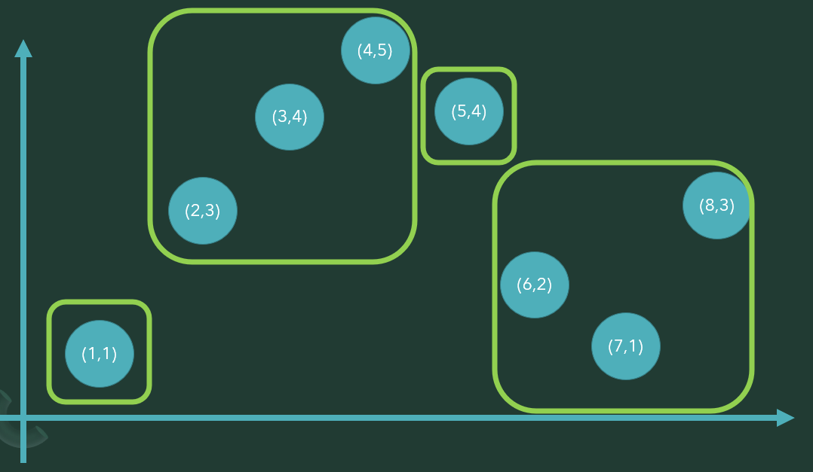
We have a partition of the input points into 4 disjoint subsets.
We can calculate the structural entropy of this partition using the equation above:
H$\left(π\right)= \sum_{k=1}^{t}{\left(\frac{\left|S_{k}\right|}{n}\right)log⁡(\frac{n}{\left|S_{k}\right|})}$
H$\left(π\right)=\left(\frac{\left|1\right|}{8}\right)log⁡\left(\frac{8}{\left|1\right|}\right)$(+ $\left(\frac{3}{8}\right)$ $log⁡\left(\frac{8}{\left|3\right|}\right)$ + $\left(\frac{\left|1\right|}{8}\right)log\left(\frac{8}{\left|1\right|}\right)$+ $\left(\frac{\left|3\right|}{8}\right)log\left(\frac{8}{\left|3\right|}\right)⁡$=1.81
We can use this measure to compare the quality of different partitions and select the one with the lowest structural entropy.

Slide 68
Intuition
Once we know the maxima point, we can remove all the other points in the same box.
In particular, the larger the $S_{i}^{′}s$, the simpler the algorithm can be expected to take.

Slide 69
Observation
The structural entropy is always at most the vertical entropy.

Slide 70
Theorem - Afshani et al., 2017
The algorithm Marriage Before Conquest computes the maxima set
in O(n(H(S) + 1)) time

Slide 71
Proof
Consider the recursion tree of the algorithm.
Let $X_{j}$ denote the sub-list of all maximal points of S discovered during the first j recursion levels.
Let L(j) be the subset of points of S that survive recursion level j.
Let $n_{j}$ = |L(j) |.

Slide 72
$$J=1$$
$$S_{r0}$$
$$S_{l0}$$
(3,5)
(4,4)
(6,4)
$$X_{1}$$
(6,4)
(1,3)
(5,3)
(9,3)
(2,2)
(7,2)
(8,2)
(7,1)
(8,1)
(3,1)

Slide 73
$$J=1$$
$$S_{r0}$$
$$S_{l0}$$
(3,5)
(4,4)
(6,4)
$$X_{1}$$
(6,4)
(1,3)
(5,3)
(9,3)
(2,2)
(7,2)
(8,2)
(7,1)
(8,1)
(3,1)
$$n_{1}=\text{|}\text{L}\text{(}\text{1}\text{) |}\text{=}\text{6}$$

Slide 74
$$J=2$$
$$S_{r0}$$
$$S_{l0}$$
(3,5)
(6,4)
$$X_{2}$$
(5,4)
(9,3)
(7,2)
(8,2)
(7,1)
(8,1)

Slide 75
$$J=2$$
$$S_{r0}$$
$$S_{l0}$$
(3,5)
(6,4)
$$X_{2}$$
(5,4)
$$S_{l1}$$
(9,3)
(3,5)
(7,2)
(8,2)
$$S_{r1}$$
(7,1)
(8,1)
(9,3)

Slide 76
$$J=1$$
$$S_{r0}$$
$$S_{l0}$$
(3,5)
(6,4)
$$X_{1}$$
(5,4)
(9,3)
$$S_{l1}$$
(3,5)
(7,2)
(8,2)
$$S_{r1}$$
(9,3)
(7,1)
(8,1)
$$n_{2}=\text{|}\text{L}\text{(}\text{2}\text{) }\text{|}\text{=}\text{0}$$

Slide 77
The algorithm performs O($n_{j}$) operations to refine level j into level j + 1.
There are at most log(n) such levels in the computation.
So, the total running time is $O\left(\sum_{j=1}^{\left\lceil \log{n}\right\rceil }{n_{j}}\right)$.

Slide 78
There can be at most $\left\lceil \frac{n}{2^{j}}\right\rceil$points of S(j) with x-coordinates between any two consecutive points in $X_{j}$
All points of S that are strictly below the staircase of $X_{j}$ have been pruned during levels 1,...,j of the recursion.
The only points in $B_{k}$ that can survive level j must have x-coordinates between $q_{i}$ and $q_{i+1}$ .
(4,4)
(5,3)
(7,3)
(6,2)
(8,2)
(9,1)

Slide 79
Thus, the number of points in $S_{k}$ that survive level j is at most:
min $\left\{\left|S_{k}\right|,\left\lceil \frac{n}{2^{j}}\right\rceil \right\}$

Slide 80
Because the $S_{k}$’s cover the entire point set, with a double summation we have
$$\sum_{j=0}^{\left\lceil \log{n}\right\rceil }{n_{j}}≤\sum_{j=1}^{\left\lceil \log{n}\right\rceil }{\sum_{k}{\text{min} \left\{\left|S_{k}\right|,\left\lceil \frac{n}{2^{j}}\right\rceil \right\}}}$$
$$=\sum_{k}{\sum_{j=1}^{\left\lceil \log{n}\right\rceil }{\text{min} \left\{\left|S_{k}\right|,\left\lceil \frac{n}{2^{j}}\right\rceil \right\}}}$$

Slide 81
$$S_{i}$$
$$\text{min} \left\{\left|S_{k}\right|,\left\lceil \frac{n}{2^{j}}\right\rceil \right\}$$
$\left|S_{k}\right|$= $\left\lceil \frac{n}{2^{j}}\right\rceil$
$j$=$\log\left(\frac{n}{S_{j}}\right)$
$$S_{k}$$
$$\frac{S_{k}}{2}$$
$$\frac{S_{k}}{4}$$
$$\frac{S_{k}}{8}$$
$$\frac{S_{k}}{16}$$
$$j$$
$j$=1
$j$=$\log\left(\frac{n}{S_{j}}\right)$
$j$=4
$j$=5

Slide 82
Because the $S_{k}$’s cover the entire point set, with a double summation we have
$$\sum_{j=0}^{\left\lceil \log{n}\right\rceil }{n_{j}}≤\sum_{j=1}^{\left\lceil \log{n}\right\rceil }{\sum_{k}{\text{min} \left\{\left|S_{k}\right|,\left\lceil \frac{n}{2^{j}}\right\rceil \right\}}}$$
$$=\sum_{k}{\sum_{j=1}^{\left\lceil \log{n}\right\rceil }{\text{min} \left\{\left|S_{k}\right|,\left\lceil \frac{n}{2^{j}}\right\rceil \right\}}}$$
$$≤\sum_{k}{\left(\left|S_{k}\right|\left\lceil \log\left(\frac{n}{\left|S_{k}\right|}\right)\right\rceil +\left|S_{k}\right|+\frac{\left|S_{k}\right|}{2}+\frac{\left|S_{k}\right|}{4}+…+1\right)}$$
$$≤\sum_{k}{\left(\left|S_{k}\right|\left(\left\lceil \log\left(\frac{n}{\left|S_{k}\right|}\right)\right\rceil +2\right)\right)}$$
$$=O\left(n\left(Η\left(π\right)+1\right)\right)$$

Slide 83
Theorem
For every correct algorithm A for the MAXIMA SET problem and every set S of n points, there exists an ordering of the points in S such that A uses $Ω$(n(H(S) + 1)) comparisons to solve the corresponding instance of MAXIMA SET.

Slide 84
Vertical entropy complexity– Proof
We saw that structural entropy performs O(n(H(S) + 1)) comparisons.
Therefore, the algorithm performs O(n(Hv + 2)) comparisons.
Therefore, the Marriage Before Conquest algorithm runs in O($n∙H_{v}$) time, which is optimal in the comparison model.

Slide 85
Agenda
Defining the purpose of the lesson.
Defining the problem, we will work with.
Jarvis march algorithm.
Graham's scan algorithm.
Algorithm Marriage Before Conquest.
Vertical Entropy.
Structural entropy.
Instance optimality.
Extension to the general case.

Slide 86
Instance optimality
Let A be an algorithm that solves a problem P and let OPT(I) be the optimal solution for instance I of problem P that A computes.
Then, A is said to be instance-optimal if it runs asymptotically equivalent as OPT(I) for every input instance I of P.

Slide 87
Instance optimality is a strong notion of optimality, as it requires an algorithm to perform optimally on every input instance of a problem, rather than just on average or in the worst case.
It is particularly relevant for problems with a large variety of input instances, where worst-case or average-case analysis may not accurately capture the algorithm's performance.

Slide 88
Instance optimality – Maximal Set
For every instance, the running time of the Marriage Before Conquest algorithm is $Ω$($nH(s)$).
Hv is the entropy for a specific division, so it is necessarily greater than/equal to the minimum entropy for each division.
The Marriage Before Conquest algorithm is instance optimal among order-oblivious algorithms.

Slide 89
Theorem - Afshani et al., 2017
There is no instance-optimal algorithm for the MAXIMA SET problem

Slide 90
Proof Sketch
Assume in the negative that for every algorithm A for the MAXIMA SET problem, there is another algorithm B for the problem and an infinite family of inputs z such that A runs in (n log n) time on these inputs while B runs in O(n) time.

Slide 91
For any given instance I, there is at least one competing algorithm that correctly guesses an order in which to process the input so that the Graham’s scan algorithm computes the maxima set of I in linear time.
Furthermore, no algorithm in the comparison model can solve all instances of size n in o(n log n) time.
Hence, no algorithm can compute the maxima set for every instance I in time bounded by a constant factor times that of the best algorithm for I.

Slide 92
Conclusion
We saw that the “order-oblivious” qualifier is necessary for an instance optimality result for the MAXIMA SET problem.
Thus, the Marriage Before Conquest algorithm is the best candidate around: it is instance optimal among order-oblivious algorithms, which would seem to be the next best thing to a truly instance-optimal algorithm.

Slide 93
Agenda
Defining the purpose of the lesson.
Defining the problem, we will work with.
Jarvis march algorithm.
Graham's scan algorithm.
Algorithm Marriage Before Conquest.
Vertical Entropy.
Structural entropy.
Instance optimality.
Extension to the general case.

Slide 94
Theorem - Barbay and Rojas-Ledesma, 2017
Consider a set S of n points in Rd, let be a respectful partition of S into subsets S1,...,St of sizes n1,...,nt, respectively. There is an algorithm that computes the maximal points of S in time:
$$O\left(n+\sum_{k=1}^{t}{n_{k}\log^{d−2}\left(\frac{n}{n_{k}}\right)}\right)$$

Slide 95
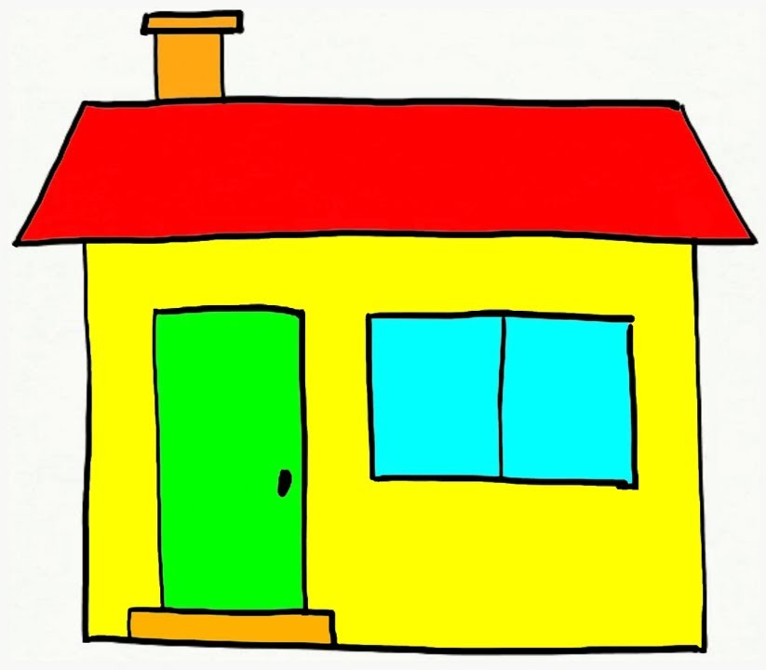
Cheaper
Close to work

Slide 96
שאלות
???

