Slide 1
Resource Augmentation
Amit Sandler, original Episode by Tim Roughgarden

Slide 2
Today
Online Algorithms!
Online (And Offline) Paging
How the two relate
Different bound on Online Paging
Offline (“And Online”) Routing
How the two relate
Online and offline Scheduling
You know the deal

Slide 3
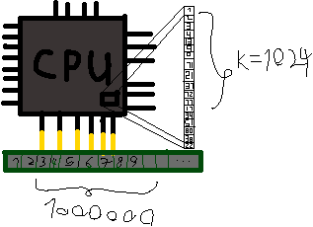
Paging
We have a Slow memory with N pages
We have a Fast memory with k<<N pages
A series of Page requests $z=z₁,z₂,…,zₘ$ come over time, and we want to minimize slow memory access
We measure an algorithm by how many page faults it makes – Less is better. $Perf\left(Alg,k,z\right)=\#Page−Faults$

Slide 4
CPU wants to read 7

Slide 5
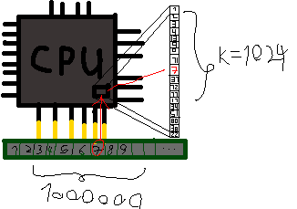

Slide 6
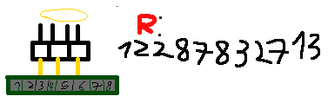
Simple Optimal Solution
Simple Optimal algorithm can solve it in linear time (With some assumptions)

Slide 7
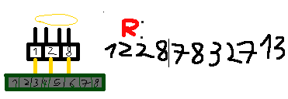

Slide 8
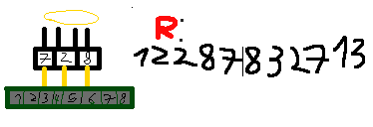

Slide 10
Furthest in Future Algorithm

Slide 11
Problem
In real life, we don’t have access to the whole memory request stream
Need to use an online method, such as LRU – Least Recently Used

Slide 17
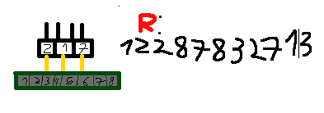

Slide 19
Comparison
Competitive Ratio – Ratio of performance of an online to an offline algorithm in the worst case on all inputs - ${Max}_{z}\left(\frac{Perf\left(Alg,k,z\right)}{Perf\left(OPT,k,z\right)}\right)$
In our specific example the ratio was 2

Slide 20
Comparing our Algorithms
The competitive ratio of LRU is k
Lower bound for the ratio – If cache size is k, a stream of 1,2,3,...k,k+1,1,... causes every read to fault on LRU but FIF just trashes k+1 accesses
(Actually wrong, but its still the right example – Pictures show wrong behevior)
We will see:

Slide 22
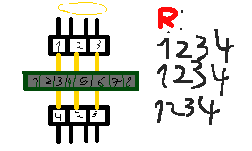

Slide 25
Very bad
We wish to compare FIF and LRU in a way that doesn’t make LRU, a good algorithm in practice, so bad
Many non practical algorithms have identical bounds
Need to use Resource Augmentation

Slide 26
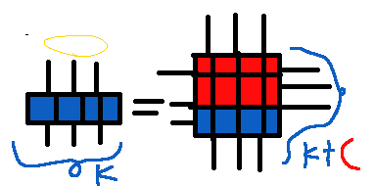
Resource Augmentation
Can’t compare FIF to LRU
But what if we weaken FIF in some way to make it comparable?

Slide 27
Theorem
Theorem (Sleator and Tarjan 1985) –
$$Perf\left(LRU,k+c,z\right)≤\frac{k+c}{c+1}Perf\left(FIF,k,z\right)+k+c$$
Notably, for $k=c$, we have $Perf\left(LRU,2·k,z\right)¸≤2·Perf\left(FIF,k,z\right)+2·k$

Slide 28
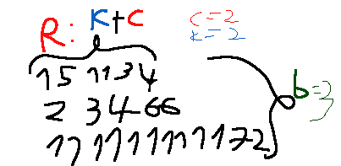
Proof of bound
Take random sequence, break it into b maximal blocks of k+c distinct pages
Bound page faults from above and below

Slide 29
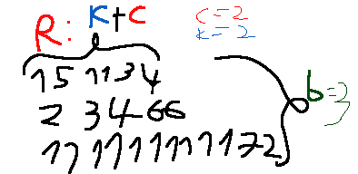
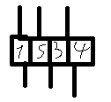
Upper Bound
LRU evicts at most k+c pages each block – Each page is evicted once from the cache
$$Perf\left(LRU,k+c,z\right)≤b\left(k+c\right)$$

Slide 30
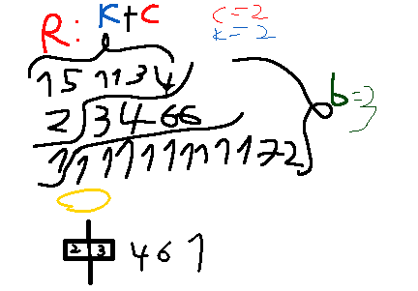
Lower Bound
In each shifted block, k+c new pages come
Only k-1 may have been stored
FIF needs to evict c+1 pages per block
Last block is of unknown size
$$\left(b−1\right)\left(c+1\right)≤Perf\left(FIF,k,z\right)$$

Slide 31
Putting it all together
$$Perf\left(LRU,k+c,z\right)≤b\left(k+c\right)$$
$$\left(b−1\right)\left(c+1\right)≤Perf\left(FIF,k,z\right)$$
$$b\left(c+1\right)≤Perf\left(FIF,k,z\right)+1+c$$
$$Perf\left(LRU,k+c,z\right)≤b\left(k+c\right)≤\frac{k+c}{c+1}Perf\left(FIF,k,z\right)+k+c$$

Slide 32
Other Bound
Different connection between Offline and Online Algos
Theorem (Young, 2002) -
For every page request sequence z, and for every $ε,δ>0$ , we have for a given cache size $k$
In probability≤δ, we know nothing
$Perf\left(LRU,k,z\right)=O\left(\frac{1}{δ}·\log{\frac{1}{ε}}\right)·Perf\left(FIF,k,z\right)$
$Perf\left(LRU,k,z\right)≤ε·\left|z\right|$
Either our cache size is bad, or it’s fast compared to FIF, or its just fast.

Slide 33
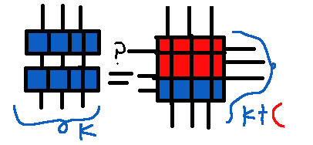
Proof
We will use some positive constant c to be defined later
Separate our cache sizes into two, wherever $Perf\left(LRU,k+c,z\right)≥\frac{1}{2}Perf\left(LRU,k,z\right)$ or not

Slide 34
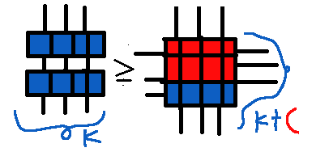
The good Case
Our bigger cache doesn’t help us much
$$Perf\left(LRU,k+c,z\right)≥\frac{1}{2}Perf\left(LRU,k,z\right)$$
$$Perf\left(LRU,k+c,z\right)≤\frac{k+c}{c+1}Perf\left(FIF,k,z\right)+k+c$$
If yes than we have “good” cache size and a bound on $Perf\left(LRU,k,z\right)$ with ratio $\frac{2(k+c)}{c+1}$ and we are done
$Perf\left(LRU,k,z\right)=O\left(\frac{1}{δ}·\log{\frac{1}{ε}}\right)·Perf\left(FIF,k,z\right)$
Need to show our choice of $c$ satisfies - Later

Slide 35
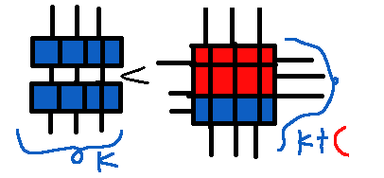
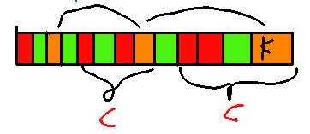
The Bad Case
Adding $c$ improves us at least twice
If our $k$ is larger than $c·d$ other “bad” cache sizes, than we note
There’s a series of $d+1$ bad sizes ending in k
Difference of c between each one
Denote series by $kᵢ$, with $k=k_{d+1}$
$Perf\left(LRU,k_{d+1},z\right)<\frac{1}{2}·Perf\left(LRU,k_{d},z\right)<…2^{−d}·Perf\left(LRU,k_{1},z\right)≤2^{−d}·\left|z\right|$

Slide 36
Calculations
$Perf\left(LRU,k,z\right)≤ε·\left|z\right|$
$Perf\left(LRU,k,z\right)<2^{−d}·\left|z\right|$
We want $2^{−d}≤ε$ so we get $d≥\log_{2}{\frac{1}{ε}}$ after dividing and taking log
In probability≤δ, we know nothing
We want $c·d$ to be $δn$ at most, so we get $c≤\frac{δn }{\log_{2}{\frac{1}{ε}}}$ and we’re done

Slide 37
More Calculations
$c=\frac{δn }{\log_{2}{\frac{1}{ε}}}$
$Perf\left(LRU,k,z\right)=O\left(\frac{1}{δ}·\log{\frac{1}{ε}}\right)·Perf\left(FIF,k,z\right)$
$$Perf\left(LRU,k+c,z\right)≤\frac{k+c}{c+1}Perf\left(FIF,k,z\right)+k+c$$
$$\frac{2(k+c)}{c+1}≤\frac{\frac{2δn }{\log_{2}{\frac{1}{ε}}}+2n}{\frac{δn }{\log_{2}{\frac{1}{ε}}}}=2+\frac{2·\log_{2}{\frac{1}{ε}}}{δ}$$

Slide 38
Selfish Routing
Another common online problem is selfish routing
Given a DAG graph (V,E), with source s and sink t nodes, with each of its edges having a cost function
Cost function might be dependent of how many units of “Flow” we are passing through it – May be thought of as traffic
Want to transfer r (Usually 1) units from source to sink
Offline –Minimize average, $\sum{ₑcostₑ}\left(rₑ\right)·rₑ$
Online – If we cannot improve the cost by moving ε flow from one route to another
“No person in traffic can change their route”

Slide 39
Example 1
t
Optimal Flow is flowing half through 1 and half through x – Minima of $\left(1−x\right)+x²$
Gets us $\frac{3}{4}$
Equilibrium is all through x – “Everyone wants the faster path”
Gets us 1
Ratio of $\frac{4}{3}$
1
s
$$x$$

Slide 40
Example 2
t
Optimal Flow is flowing $\sqrt[d]{\frac{1}{d+1}}$through $x^{d}$ and the rest through 1 – Minima of $\left(1−x\right)+x^{d+1}$
Gets us something that gets to 0 as d goes to infinity
Equilibrium is all through $x^{d}$ – “Everyone wants the faster path” - Gets us 1
Ratio goes to infinity with $d$
1
s
$$x^{d}$$

Slide 41
Example 3
1
$$x$$
Optimal flow – Half choose the top path, half bottom, again, by minimizing a function
s
0
t
Gets us 1.5
By equilibrium everyone chooses the $x$ paths
1
$$x$$
Gets us 2, With Ratio of $\frac{4}{3}$

Slide 42
Example 4
1
$$x$$
s
t
Optimal flow and Equilibrium are equal!
Minimizes $x\left(1+x\right)+\left(1−x\right)·(1+(1−x))$
Ratio 1!
$$x$$
1

Slide 43
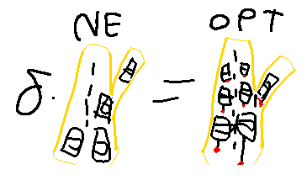
Theorem
Roughgarden and Tardos(2002) – For every network with non negative, continuous, and nondecreasing edge weights, for every traffic rate $r>0$ and every $δ>0$ we have $δ·NE\left(G,r\right)≤OPT(G,\left(1+δ\right)·r)$
For $δ=1$, we have $NE\left(G,r\right)≤OPT(G, 2r)$
“A less busy road network is as busy as a busy road network where you can control all the cars”

Slide 44
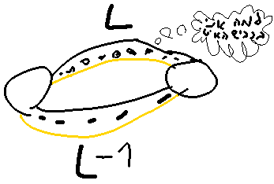
Proof – Parallel edges
We note in the equilibrium there’s a number, L, such that every edge we took has cost L, and every edge we didn’t take has cost at least L
Total Cost is $r·L$

Slide 45
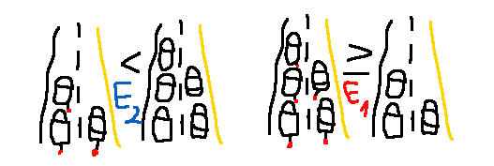
Calculation
$$E_{1}≔\left\{e|Opt_{e}≥NE_{e}\right\}$$
$$E_{2}≔\left\{e|Opt_{e}<NE_{e}\right\}$$

Slide 46
Calculation
$$Opt\left(G,r·\left(1+δ\right)\right)≥\sum_{e∈E₁}{Optₑ·Costₑ\left(Optₑ\right)}≥\sum_{e∈E₁}{Optₑ·Costₑ\left(NEₑ\right)}=L·\sum_{e∈E₁}{Optₑ}=L·\left(\left(1+δ\right)r−\sum_{e∈E₂}{Optₑ}\right)≥L·\left(\left(1+δ\right)r−\sum_{e∈E₂}{NEₑ}\right)≥L·\left(\left(1+δ\right)r−r\right)≥L·r·δ$$

Slide 47
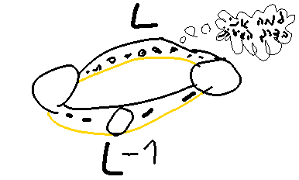
Proof – General Graphs
We note in the equilibrium there’s a number, L, such that every path we took has cost L, and every path we didn’t take has cost at least L
Total Cost is $r·L$

Slide 48
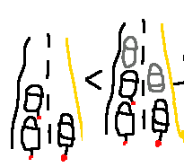
Proof – General Graphs
Replace cost function by the maximal number generated from the cost and Equilibrium Flow, instead of decomposing
${Costₑ}^{∗}\left(x\right)≔Max\left(Costₑ\left(x\right),Costₑ(NEₑ)\right)$
Lower bound of real optimum with fake functions is $L·\left(1+δ\right)r$
Why? Shortest path is L
Explicitly slowed down with “Ghost Cars”

Slide 49
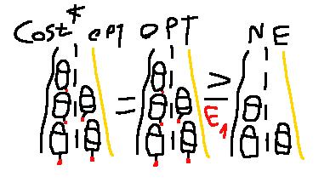
How much did we slow down OPT?
Let’s look at every edge
For edges E₁ where we routed more than the equilibrium flow, this is 0
$∀e∈\text{E}\text{₁},Costₑ\left(Optₑ\right)={Costₑ}^{∗}\left(Optₑ\right)$, ${Costₑ}^{∗}\left(x\right)=Max\left(Costₑ\left(x\right),Cost(NEₑ)\right)$
$$\sum_{e∈E₁}{Optₑ·Costₑ(Optₑ)}$$
$$=\sum_{e∈E₁}{Optₑ·{Costₑ}^{∗}\left(Optₑ\right)}$$

Slide 50
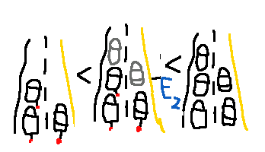
How much did we slow down?
For roads E₂ where we didn’t go over the equilibrium flow, its bounded by the equilibrium flow, from monotonicity
∀e∈E₂,$Optₑ·{Costₑ}^{∗}\left(Optₑ\right)≤Optₑ·Costₑ\left(NEₑ\right)$
∀e∈E₂,$Optₑ·{Costₑ}^{∗}\left(Optₑ\right)−Optₑ·Costₑ\left(Optₑ\right)≤Optₑ·Costₑ\left(NEₑ\right)≤NEₑ·Costₑ(NEₑ)$
$$\sum_{e∈E₂}{Optₑ·Costₑ(Optₑ)}≥\sum_{e∈E₂}{Optₑ·{Costₑ}^{∗}\left(Optₑ\right)−NEₑ·Costₑ\left(NEₑ\right)}$$

Slide 51
Calculation
Putting it all together,
$$Opt\left(G,r·\left(1+δ\right)\right)=\sum_{e∈E₁}{Optₑ·Costₑ(Optₑ)}+\sum_{e∈E₂}{Optₑ·Costₑ(Optₑ)}$$
$$≥\sum_{e∈E₁}{Optₑ·{Costₑ}^{∗}\left(Optₑ\right)}+\sum_{e∈E₂}{Optₑ·{Costₑ}^{∗}\left(Optₑ\right)−NEₑ·Costₑ\left(NEₑ\right)}$$
$$=\sum_{e∈E}{Optₑ·{Costₑ}^{∗}\left(Optₑ\right)}−\sum_{e∈E₂}{NEₑ·Costₑ\left(NEₑ\right)}$$
$$≥\left(1+δ\right)·r·L−\sum_{e∈E}{NEₑ·Costₑ\left(NEₑ\right)=\left(1+δ\right)·r·L−r·L=δ·r·L}$$

Slide 52
Scheduling
Another classic example is scheduling
Get $m$ jobs, and need to minimize time to finish them
Formally, we minimize $Perf(Alg,r,s)≔\sum_{j=1}^{m}{{\left(C_{j}−r_{j}\right)}^{2}}$, where Cⱼ is the completion time of job j, and rⱼ is From when you could start working on job j, with s being our work speed

Slide 57
Algorithm
Ideal Algorithm is online!
SRPT – Shortest Remaining Processing time
Complete task closest to completion
But what if we don’t know how long our tasks take?

Slide 58
Non Clairvoyant Algorithm
Do least processed task – Shortest elapsed time first – SETF
Similar motive to LRU
However, things might not be as so bright...

Slide 63
Resource Augmentation!
Theorem (Kalyanasundaram and Pruhs (2000))
$$∀r,Perf\left(SETF,r,1+ε\right)≤\left(1+\frac{1}{ε}\right)·Perf(SPRT,r,1)$$
For ε=1, we get
$$∀r,Perf\left(SETF,r,2\right)≤2Perf(SPRT,r,1)$$

Slide 64
Thanks for coming!
Any questions?
May your resources be augmented

