Slide 1
Seminar in Algorithms
Topics in Online Algorithms
Haim Kaplan
Tel Aviv University

Slide 2


LP in standard form
min ${c_{1}x}_{1}+c_{2}x_{2}+…+c_{n}x_{n}$
subject to:
$${a_{1,1}x}_{1} + a_{1,2}y_{2} +…+ a_{1,n}x_{n}≥b_{1} \\ {a_{2,1}x}_{1} + a_{2,2}x_{2} +…+ a_{2,n}x_{n}≥b_{2} \\ {a_{3,1}x}_{1} + a_{3,2}x_{2} +…+ a_{3,n}x_{n}≥b_{3}$$
$⋮$ $⋮$ $⋮$ $⋮$
$${a_{m,1}x}_{1}+a_{m,2}x_{2} +… +a_{m,n}x_{n}≥b_{m}$$
$$x_{1},x_{2},…,x_{n}≥0$$
All constraints are $≥$ inequalities.
All variables are constrained to be non-negative.
(Very special linear inequalities.)
There are $n$ variables, $m$ linear inequalities,
(And additional $n$ non-negativity constraints.)

Slide 3






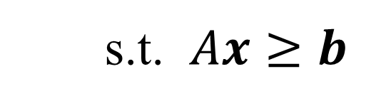



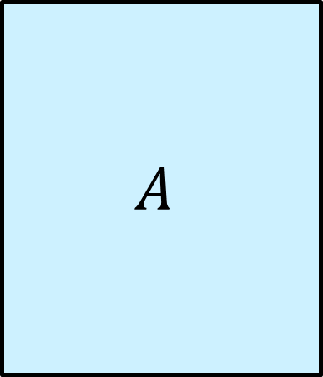

LP in standard form
min $\sum_{j=1}^{n}{c_{j}x_{j}}$
s.t. $\sum_{j=1}^{n}{a_{i,j}x_{j}}≥b_{i}$ , $i=1,2,…,m$
$x_{j}≥0$ , $j=1,2,…,n$
min $c^{T}x$
$$c^{T}$$
s.t. $Ax≥b$
$$A$$
$$b$$
$x≥0$
$$n$$
$$m$$
$$m$$
$$≥$$
$$x$$
$$n$$

Slide 4
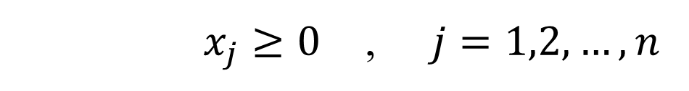


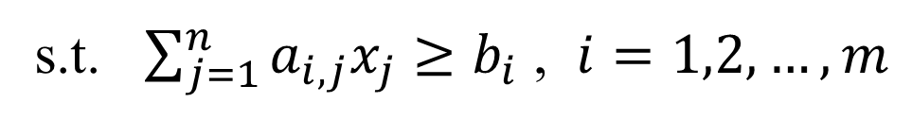


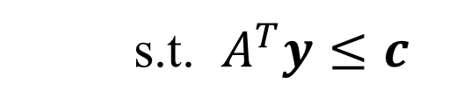

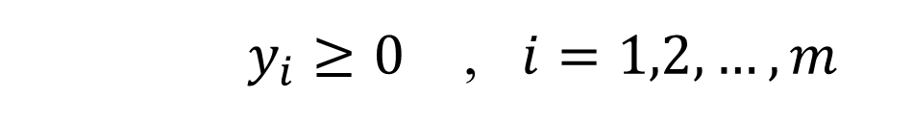

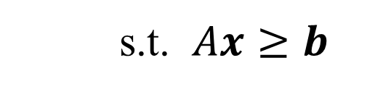
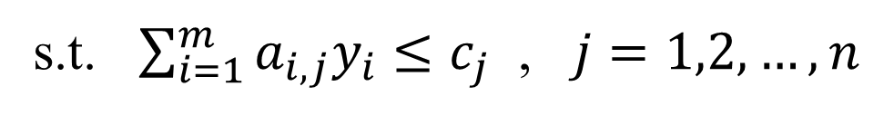
LP duality
To every LP in standard form we define a dual:
min $\sum_{j=1}^{n}{c_{j}x_{j}}$
min $c^{T}x$
primal
s.t. $\sum_{j=1}^{n}{a_{i,j}x_{j}}≥b_{i}$ , $i=1,2,…,m$
s.t. $Ax≥b$
$x_{j}≥0$ , $j=1,2,…,n$
$x≥0$
max $\sum_{i=1}^{m}{b_{i}y_{i}}$
max $b^{T}y$
dual
s.t. $\sum_{i=1}^{m}{a_{i,j}y_{i}}≤c_{j}$ , $j=1,2,…,n$
s.t. $A^{T}y≤c$
$y_{i}≥0$ , $i=1,2,…,m$
$y≥0$
A dual variable $y_{i}$ for each constraint of the primal.
A constraint in the dual for each primal variable $x_{j}$.
The vectors $b$ and $c$ swap roles. The matrix $A$ is transposed.
$≥$-inequalities become $≤$-inequalities.
min becomes max

Slide 5




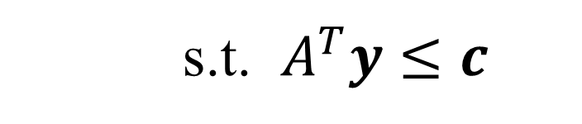







LP duality
min $c^{T}x$
s.t. $Ax≥b$
$x≥0$
$$c^{T}$$
$$≥$$
$$y^{T}$$
$$A$$
$$b$$
$$m$$
$$n$$
$$m$$
$$m$$
$$≥$$
$$x$$
max $b^{T}y$
s.t. $A^{T}y≤c$
$$n$$
$y≥0$

Slide 6

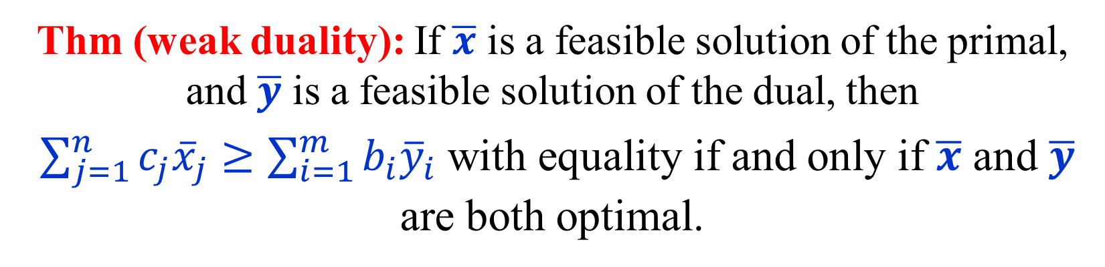
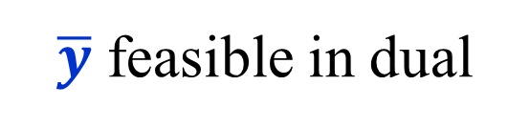
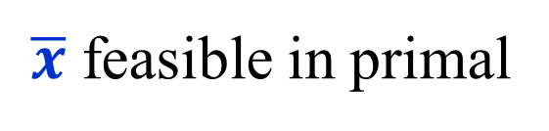

Weak duality
Thm (weak duality): If $\overline{x}$ is a feasible solution of the primal,
and $\overline{y}$ is a feasible solution of the dual, then
$\sum_{j=1}^{n}{c_{j}{\overline{x}}_{j}}≥\sum_{i=1}^{m}{b_{i}{\overline{y}}_{i}}$ with equality if and only if $\overline{x}$ and $\overline{y}$ are both optimal.
$$c^{T}\overline{x}$$
Proof:
Suppose $A\overline{x}≥b$ , $\overline{x}≥0$ and $A^{T}\overline{y}≤c$ , $\overline{y}≥0$
$$b^{T}\overline{y}$$
$\overline{x}$ feasible in primal
$\overline{y}$ feasible in dual
then $c^{T}\overline{x} ≥ {\left(A^{T}\overline{y}\right)}^{T}\overline{x} = {\overline{y}}^{T}\left(A\overline{x}\right)≥ {\overline{y}}^{T}b = b^{T}\overline{y}$

Slide 7
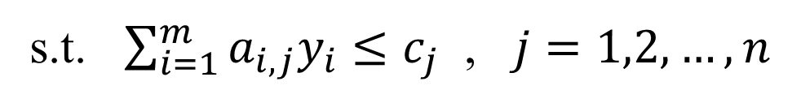
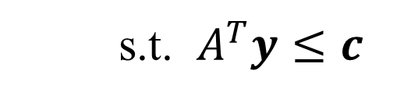



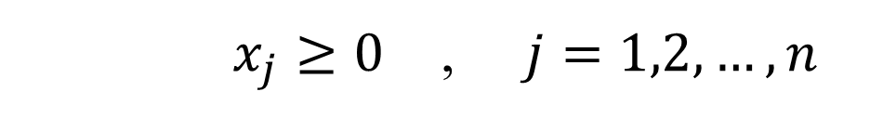

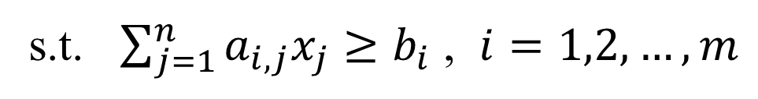
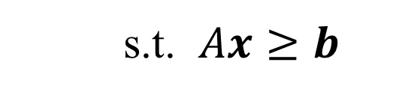

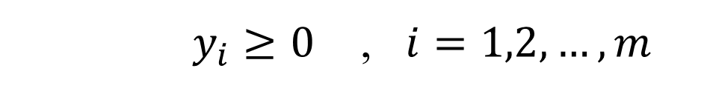

Strong duality
min $\sum_{j=1}^{n}{c_{j}x_{j}}$
min $c^{T}x$
(P)
s.t. $\sum_{j=1}^{n}{a_{i,j}x_{j}}≥b_{i}$ , $i=1,2,…,m$
s.t. $Ax≥b$
$x_{j}≥0$ , $j=1,2,…,n$
$x≥0$
max $\sum_{i=1}^{m}{b_{i}y_{i}}$
max $b^{T}y$
(D)
s.t. $\sum_{i=1}^{m}{a_{i,j}y_{i}}≤c_{j}$ , $j=1,2,…,n$
s.t. $A^{T}y≤c$
$y_{i}≥0$ , $i=1,2,…,m$
$y≥0$
(1) If (P) is feasible and bounded, then so is (D), and vice verse.
(P) and (D) have optimal values and their optimal values are equal.
(2) If (P) is feasible but unbounded, then (D) is infeasible.
(3) If (D) is feasible but unbounded, then (P) is infeasible.
(It is possible that both (P) and (D) are infeasible.)

Slide 8
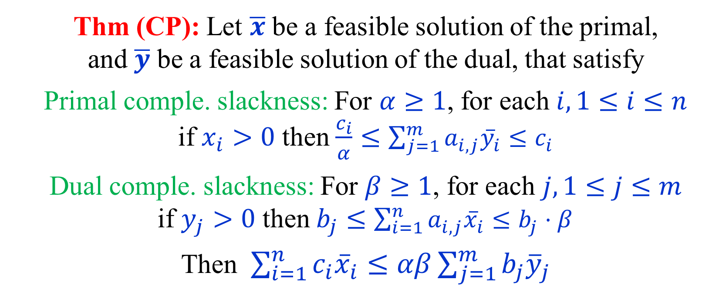

Complementary Slackness
Thm (CP): Let $\overline{x}$ be a feasible solution of the primal,
and $\overline{y}$ be a feasible solution of the dual, that satisfy
Primal comple. slackness: For $α≥1$, for each $i, 1≤i≤n$ if $x_{i}>0$ then $\frac{c_{i}}{α}≤\sum_{j=1}^{m}{a_{i,j}{\overline{y}}_{i}}≤c_{i}$
Dual comple. slackness: For $β≥1$, for each $j, 1≤j≤m$ if $y_{j}>0$ then $b_{j}≤\sum_{i=1}^{n}{a_{i,j}{\overline{x}}_{i}}≤b_{j}⋅β$
Then $\sum_{i=1}^{n}{c_{i}{\overline{x}}_{i}}≤αβ\sum_{j=1}^{m}{b_{j}{\overline{y}}_{j}}$
Note that if CP hold with $α=β=1$ then $\overline{x}$ and $\overline{y}$ are optimal primal and dual solutions

Slide 9
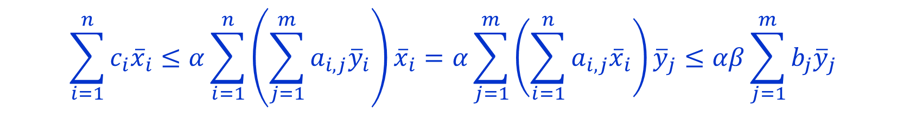
Complementary Slackness
Thm (CP): Let $\overline{x}$ be a feasible solution of the primal,
and $\overline{y}$ be a feasible solution of the dual, that satisfy
Primal comple. slackness: For $α≥1$, for each $i, 1≤i≤n$ if $x_{i}>0$ then $\frac{c_{i}}{α}≤\sum_{j=1}^{m}{a_{i,j}{\overline{y}}_{i}}≤c_{i}$
Dual comple. slackness: For $β≥1$, for each $j, 1≤j≤m$ if $y_{j}>0$ then $b_{j}≤\sum_{i=1}^{n}{a_{i,j}{\overline{x}}_{i}}≤b_{j}⋅β$
Then $\sum_{i=1}^{n}{c_{i}{\overline{x}}_{i}}≤αβ\sum_{j=1}^{m}{b_{j}{\overline{y}}_{j}}$
Proof:
$$\sum_{i=1}^{n}{c_{i}{\overline{x}}_{i}}≤α\sum_{i=1}^{n}{\left(\sum_{j=1}^{m}{a_{i,j}{\overline{y}}_{i}}\right){\overline{x}}_{i}}=α\sum_{j=1}^{m}{\left(\sum_{i=1}^{n}{a_{i,j}{\overline{x}}_{i}}\right){\overline{y}}_{j}}≤αβ\sum_{j=1}^{m}{b_{j}{\overline{y}}_{j}}$$

Slide 10
Linear Programming
vs.
Integer Programming

Slide 11
Integer (Linear) Programs
min $\sum_{j=1}^{n}{c_{j}x_{j}}$
(IP)
s.t. $\sum_{j=1}^{n}{a_{i,j}x_{j}}≥b_{i}$ , $i=1,2,…,m$
$x_{j}≥0$ , $x_{j}∈ℤ$ , $j=1,2,…,n$
Linear programming relaxation:
min $\sum_{j=1}^{n}{c_{j}x_{j}}$
(LP)
s.t. $\sum_{j=1}^{n}{a_{i,j}x_{j}}≥b_{i}$ , $i=1,2,…,m$
$x_{j}≥0$ , $j=1,2,…,n$
Solution of IP is larger
Integrality gap (how much larger can it be?)

Slide 12
Set cover
Input: A set $X=e_{1},e_{2},…,e_{n}$
A family $S=s_{1},s_{2},…,s_{m}$ of subsets of $X$
Each set $s∈S$ has cost $c_{s}$
Find a subset $C⊆S$ that covers $X$ ($∪_{s∈C}s=X$) of min cost
min $\sum_{s∈S}{c_{s}x_{s}}$
(ILP-SC)
$∀e∈X$ $\sum_{s∣e∈s}{x_{s}}≥1$
$∀s∈S$ $x_{s}∈\left\{0,1\right\}$

Slide 13
Set cover
min $\sum_{s∈S}{c_{s}x_{s}}$
(SC)
$∀e∈X$ $\sum_{s∣e∈s}{x_{s}}≥1$
$∀s∈S$ $x_{s}∈\left\{0,1\right\}$
Linear programming relaxation:
min $\sum_{s∈S}{c_{s}x_{s}}$
(FC)
$∀e∈X$ $\sum_{s∣e∈s}{x_{s}}≥1$
$∀s∈S$ $x_{s}≥0$
Note that we do not need to requires $x_{s}≤1$
A solution to this LP is called a fractional set cover

Slide 14
The dual
min $\sum_{s∈S}{c_{s}x_{s}}$
(FC)
$∀e∈X$ $\sum_{s∣e∈s}{x_{s}}≥1$
$∀s∈S$ $x_{s}≥0$
max $\sum_{e∈X}{y_{e}}$
(FP)
$∀s∈S$ $\sum_{e∈S}{y_{e}}≤c_{s}$
$∀e∈X$ $y_{e}≥0$

Slide 15
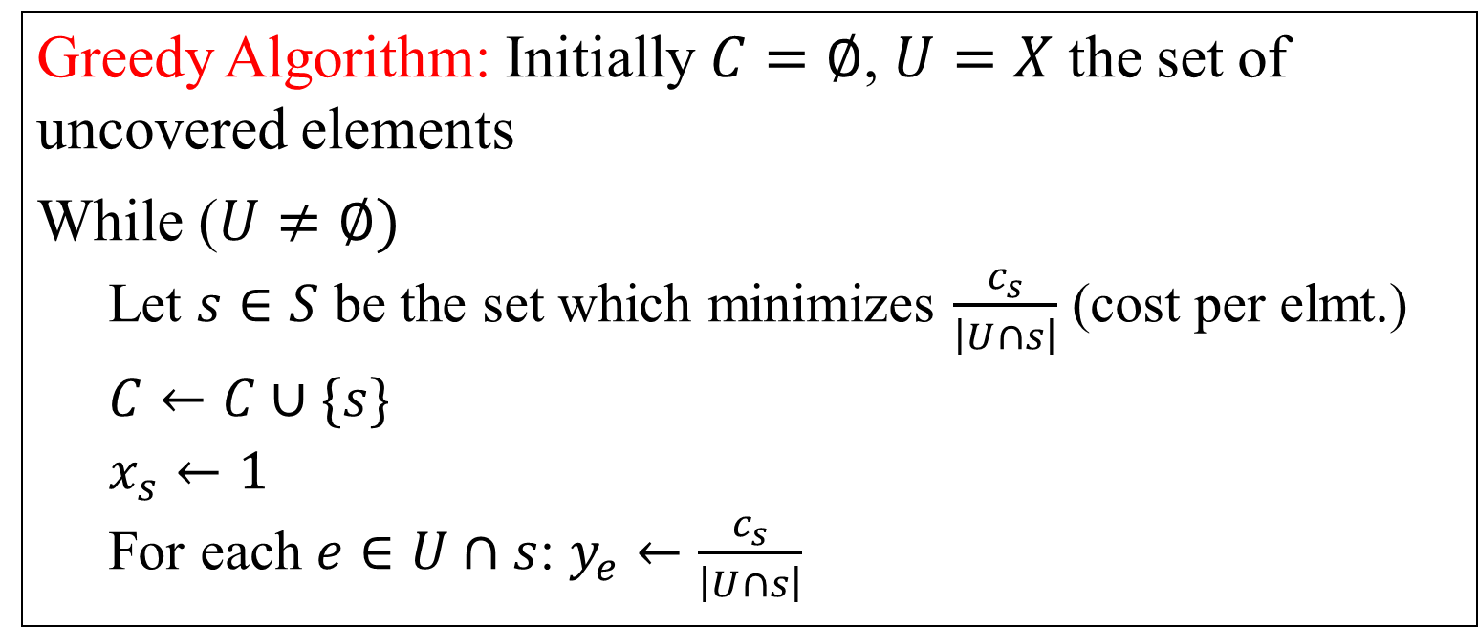
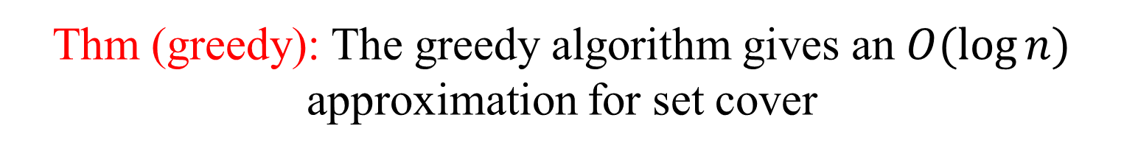
Approximation Algorithms
Greedy Algorithm: Initially $C=∅$, $U=X$ the set of uncovered elements
While ($U≠∅)$
Let $s∈S$ be the set which minimizes $\frac{c_{s}}{\left|U∩s\right|}$ (cost per elmt.)
$C←C∪\{s\}$
$x_{s}←1$
For each $e∈U∩s$: $y_{e}←\frac{c_{s}}{\left|U∩s\right|}$
Thm (greedy): The greedy algorithm gives an $O(\log{n})$ approximation for set cover

Slide 16
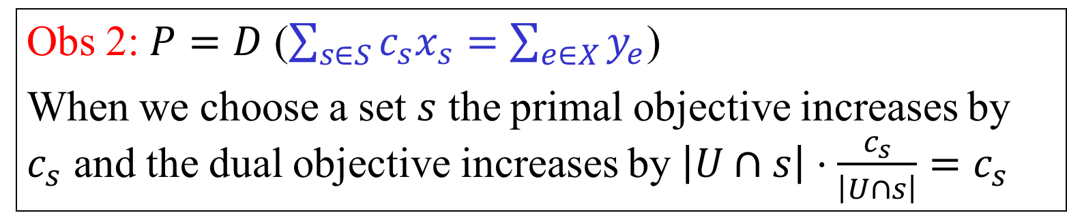
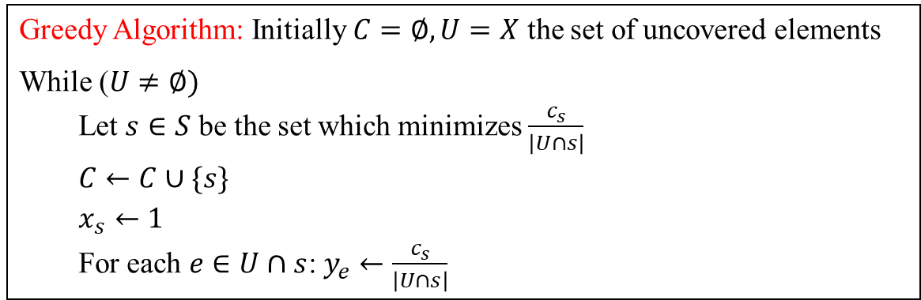
Proof dual fitting
Greedy Algorithm: Initially $C=∅, U=X$ the set of uncovered elements
While ($U≠∅)$
Let $s∈S$ be the set which minimizes $\frac{c_{s}}{\left|U∩s\right|}$
$C←C∪\{s\}$
$x_{s}←1$
For each $e∈U∩s$: $y_{e}←\frac{c_{s}}{\left|U∩s\right|}$
Obs 1: Greedy produces a feasible primal solution (assuming there is one)
Obs 2: $P=D$ ($\sum_{s∈S}{c_{s}x_{s}}=\sum_{e∈X}{y_{e}}$)
When we choose a set $s$ the primal objective increases by $c_{s}$ and the dual objective increases by $\left|U∩s\right|⋅\frac{c_{s}}{\left|U∩s\right|}=c_{s}$

Slide 17

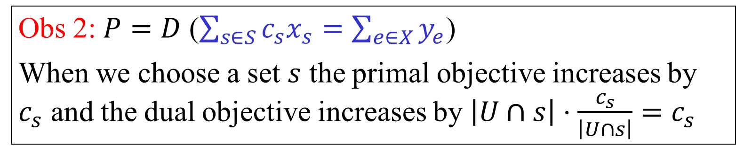
Proof ($O(\log{n})$ approx.)
Obs 1: Greedy produces a feasible primal solution (assuming there is one)
Obs 2: $P=D$ ($\sum_{s∈S}{c_{s}x_{s}}=\sum_{e∈X}{y_{e}}$)
When we choose a set $s$ the primal objective increases by $c_{s}$ and the dual objective increases by $\left|U∩s\right|⋅\frac{c_{s}}{\left|U∩s\right|}=c_{s}$
Obs 3: $\sum_{e∈s}{y_{e}}≤H_{k}⋅c_{s}=O\left(\log{n}\right)⋅c_{s}$ Here $k=|s|$

Slide 18
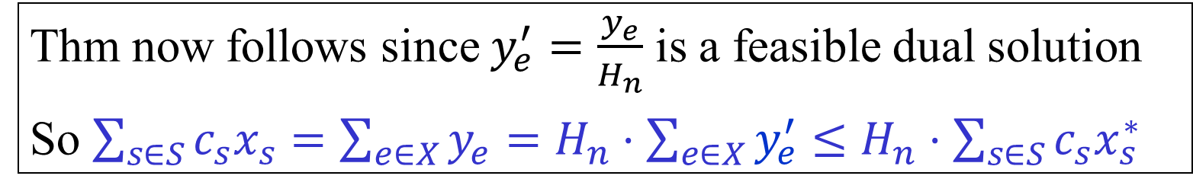
Proof ($O(\log{n})$ approx.)
Obs 1: Greedy produces a feasible primal solution (assuming there is one)
Obs 2: $P=D$ ($\sum_{s∈S}{c_{s}x_{s}}=\sum_{e∈X}{y_{e}}$)
When we choose a set $s$ the primal objective increases by $c_{s}$ and the dual objective increases by $\left|U∩s\right|⋅\frac{c_{s}}{\left|U∩s\right|}=c_{s}$
Obs 3: $\sum_{e∈s}{y_{e}}≤H_{k}⋅c_{s}=O\left(\log{n}\right)⋅c_{s}$ Here $k=|s|$
Thm now follows since $y_{e}^{′}=\frac{y_{e}}{H_{n}}$ is a feasible dual solution
So $\sum_{s∈S}{c_{s}x_{s}}=\sum_{e∈X}{y_{e}}=H_{n}⋅\sum_{e∈X}{y_{e}^{′}}≤H_{n}⋅\sum_{s∈S}{c_{s}x_{s}^{∗}}$

Slide 19
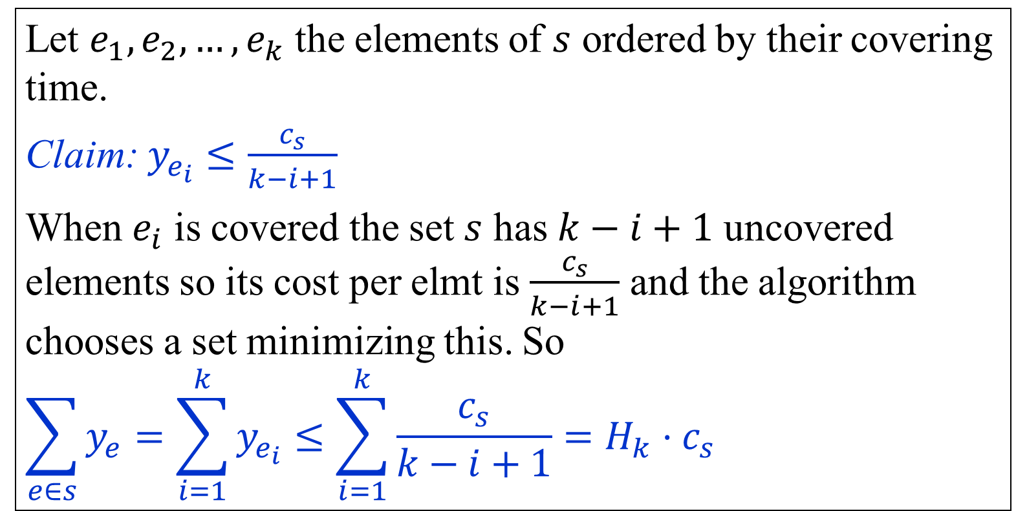
Proof ($O(\log{n})$ approx.)
Obs 3: $\sum_{e∈s}{y_{e}}≤H_{k}⋅c_{s}=O\left(\log{n}\right)⋅c_{s}$ $k=|s|$
Let $e_{1},e_{2},…,e_{k}$ the elements of $s$ ordered by their covering time.
Claim: $y_{e_{i}}≤\frac{c_{s}}{k−i+1}$
When $e_{i}$ is covered the set $s$ has $k−i+1$ uncovered elements so its cost per elmt is $\frac{c_{s}}{k−i+1}$ and the algorithm chooses a set minimizing this. So
$$\sum_{e∈s}{y_{e}}=\sum_{i=1}^{k}{y_{e_{i}}}≤\sum_{i=1}^{k}{\frac{c_{s}}{k−i+1}}=H_{k}⋅c_{s}$$

Slide 20
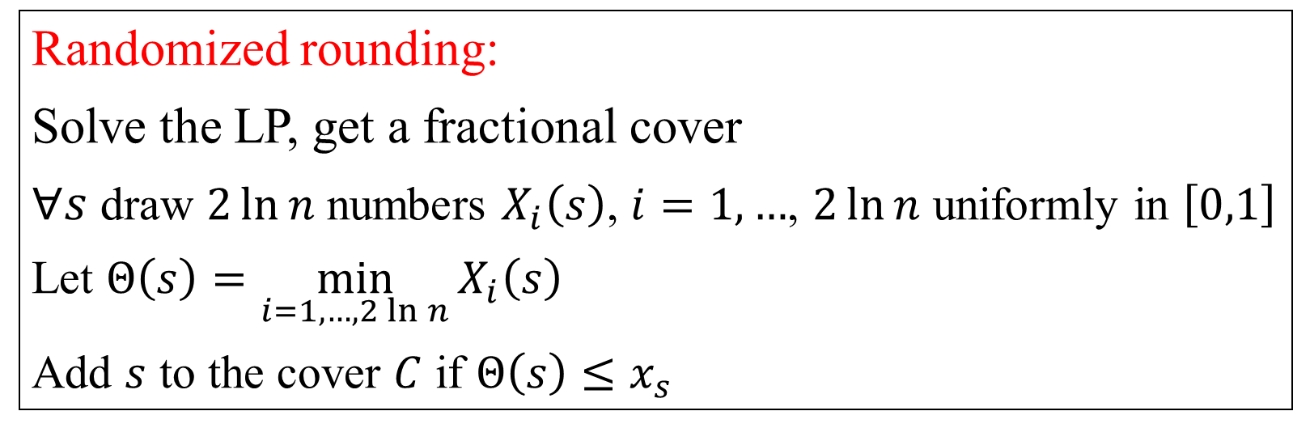
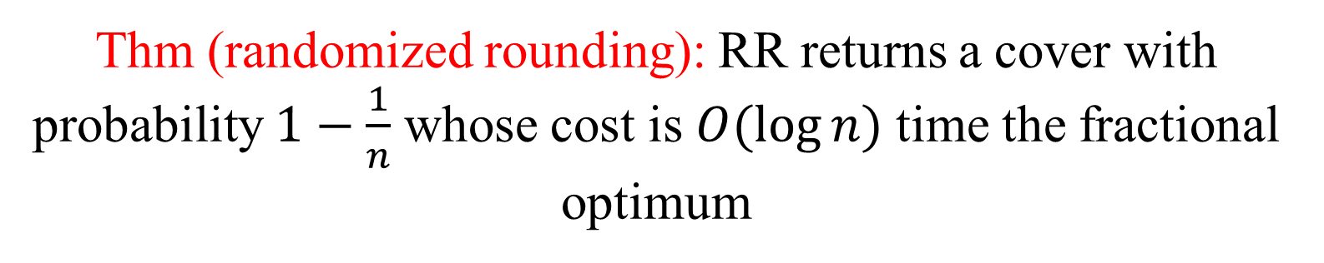
Randomized rounding
Randomized rounding:
Solve the LP, get a fractional cover
$∀s$ draw $2\ln{n}$ numbers $X_{i}\left(s\right)$, $i=1,…$, $2\ln{n}$ uniformly in $\left[0,1\right]$
Let $Θ\left(s\right)=\min_{i=1,…,2\ln{n}}{X_{i}\left(s\right)}$
Add $s$ to the cover $C$ if $Θ\left(s\right)≤x_{s}$
Thm (randomized rounding): RR returns a cover with probability $1−\frac{1}{n}$ whose cost is $O(\log{n)}$ time the fractional optimum

Slide 21
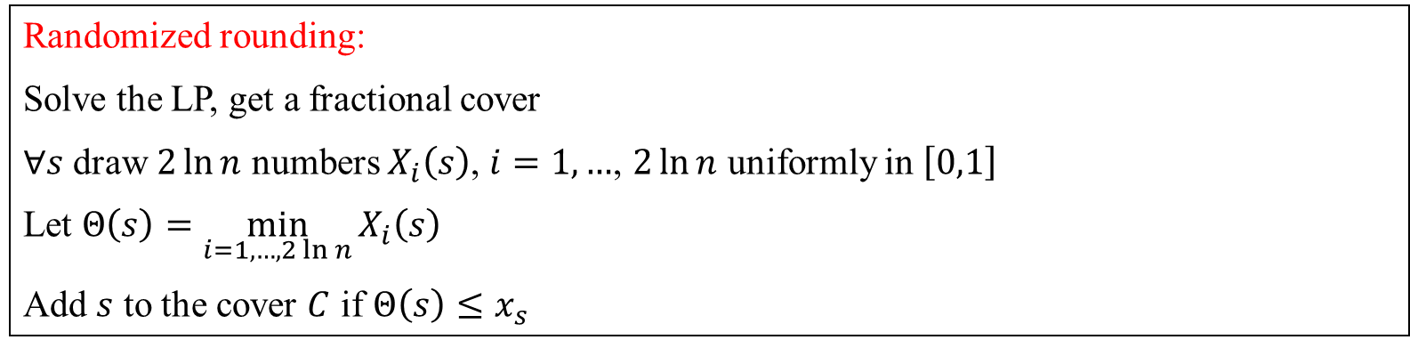

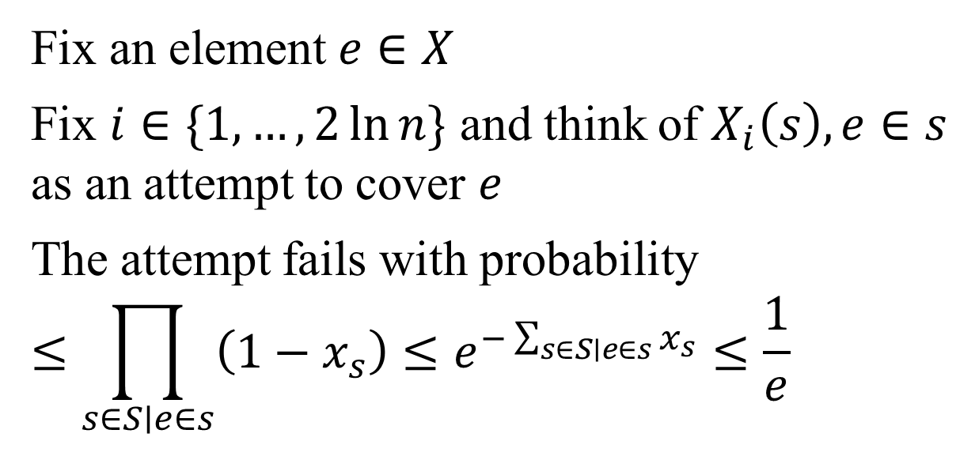
Proof (randomized rounding)
Randomized rounding:
Solve the LP, get a fractional cover
$∀s$ draw $2\ln{n}$ numbers $X_{i}\left(s\right)$, $i=1,…$, $2\ln{n}$ uniformly in $\left[0,1\right]$
Let $Θ\left(s\right)=\min_{i=1,…,2\ln{n}}{X_{i}\left(s\right)}$
Add $s$ to the cover $C$ if $Θ\left(s\right)≤x_{s}$
Fix an element $e∈X$
Fix $i∈\{1,…,2\ln{n}\}$ and think of $X_{i}\left(s\right), e∈s$ as an attempt to cover $e$
The attempt fails with probability
$$≤\prod_{s∈S∣e∈s}{\left(1−x_{s}\right)}≤e^{−\sum_{s∈S∣e∈s}{x_{s}}}≤\frac{1}{e}$$
$$e$$

Slide 22
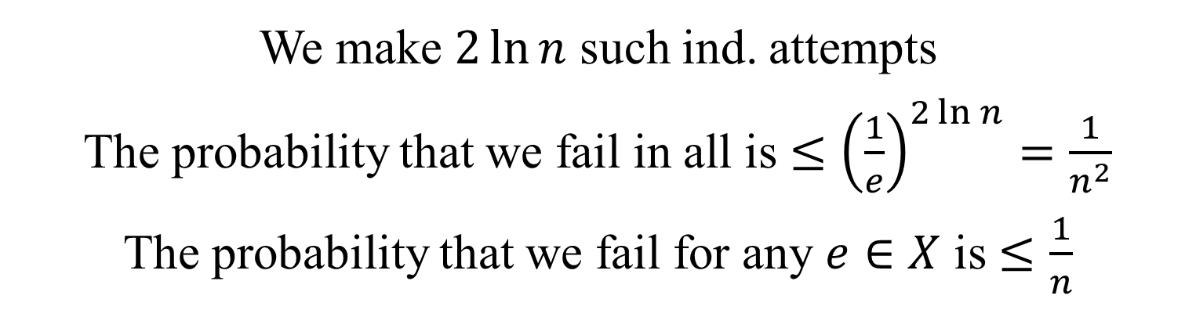

Proof (randomized rounding)
We make $2\ln{n}$ such ind. attempts
The probability that we fail in all is $≤{\left(\frac{1}{e}\right)}^{2\ln{n}}=\frac{1}{n^{2}}$
The probability that we fail for any $e∈X$ is $≤\frac{1}{n}$
$$e$$

Slide 23
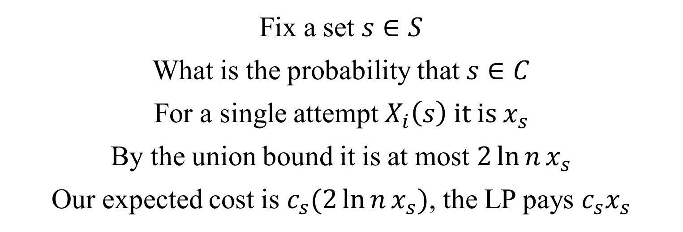
Proof (randomized rounding)
Fix a set $s∈S$
What is the probability that $s∈C$
For a single attempt $X_{i}\left(s\right)$ it is $x_{s}$
By the union bound it is at most $2\ln{n}x_{s}$
Our expected cost is $c_{s}(2\ln{n}x_{s})$, the LP pays $c_{s}x_{s}$
$$e$$

Slide 24
The dual
min $\sum_{s∈S}{c_{s}x_{s}}$
(FC)
$∀e∈X$ $\sum_{s∣e∈s}{x_{s}}≥1$
$∀s∈S$ $x_{s}≥0$
max $\sum_{e∈X}{y_{e}}$
(FP)
$∀s∈S$ $\sum_{e∈S}{y_{e}}≤c_{s}$
$∀e∈X$ $y_{e}≥0$

Slide 25
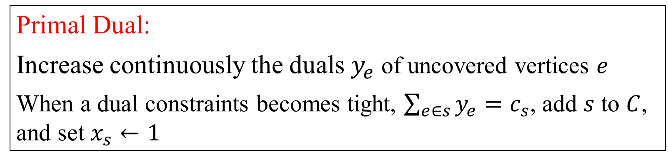
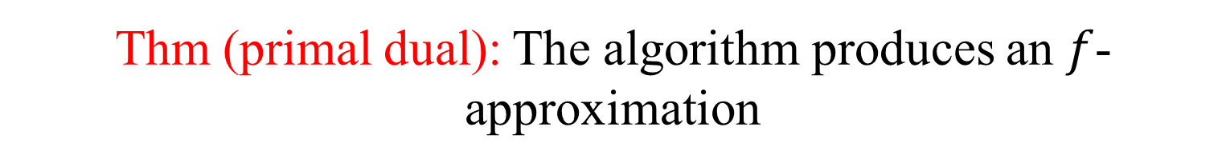
Primal-Dual scheme
Primal Dual:
Increase continuously the duals $y_{e}$ of uncovered vertices $e$
When a dual constraints becomes tight, $\sum_{e∈s}{y_{e}}=c_{s}$, add $s$ to $C$, and set $x_{s}←1$
Let $f$ be the max number of sets containing an element
Thm (primal dual): The algorithm produces an $f$- approximation

Slide 26
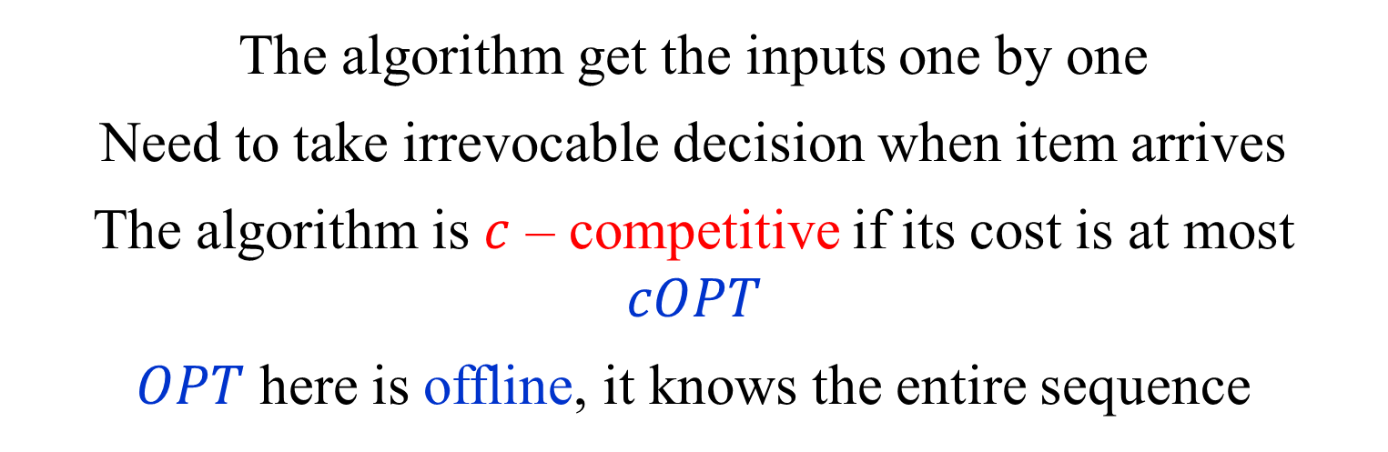
Online algorithms
The algorithm get the inputs one by one
Need to take irrevocable decision when item arrives
The algorithm is $c$ – competitive if its cost is at most $cOPT$
$OPT$ here is offline, it knows the entire sequence

Slide 27
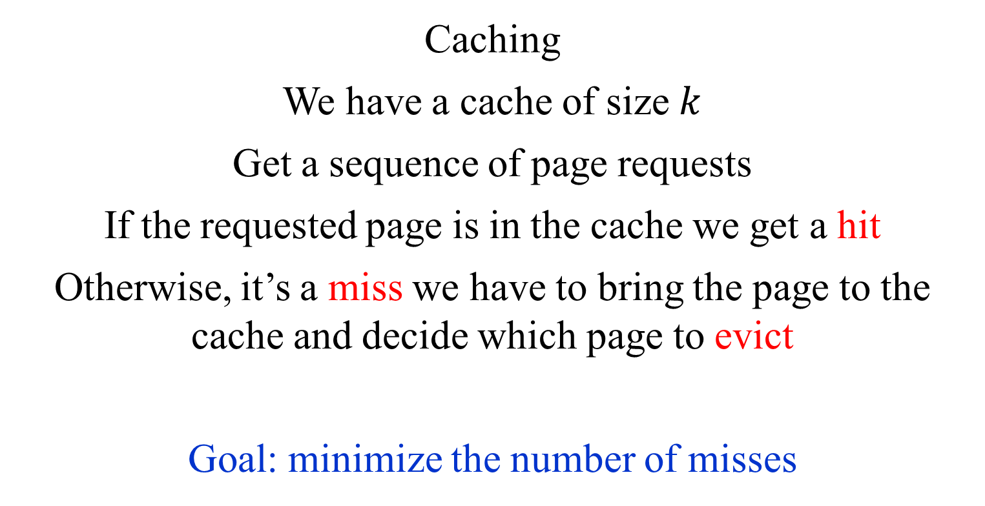
Caching
Caching
We have a cache of size $k$
Get a sequence of page requests
If the requested page is in the cache we get a hit
Otherwise, it’s a miss we have to bring the page to the cache and decide which page to evict
Goal: minimize the number of misses

Slide 28
Set cover
A family $S=s_{1},s_{2},…,s_{m}$ of subsets of some universe $X$
Each set $s∈S$ has cost $c_{s}$
Elements from $X$ arrive online (not all $X$ will arrive)
When an uncovered element arrives we need to pick a set that covers it
Goal: minimize the total cost of the cover

Slide 29
MTF, Balanced binary trees
Maintain a set of element in a linked list
Request for elements arrive online
To serve the request we have to scan the list until we reach the element
Then we can rearrange the part of the list we scanned
Goal: minimize the total # of elmts scanned

Slide 30
Ski rental
Renting skis cost $1
Buying them costs $B
You are going to ski for an unknown # of days
Each day you have to decide of you rent or buy
If you buy the game essentially ends

Slide 31


Ski rental, integer program
min $B⋅x+\sum_{j=1}^{k}{z_{j}}$
(SR-I)
$∀j∈1,…,k,$ $x+z_{j}≥1$
$x∈\left\{0,1\right\}$,$∀j∈1,…,k,z_{j}∈\{0,1\}$
$x=1$ iff we buy the skis
$z_{j}=1$ iff we rent the skis on day $j$

Slide 32
Ski rental, linear relaxation
min $B⋅x+\sum_{j=1}^{k}{z_{j}}$
(SR-LP)
$∀j∈1,…,k, x+z_{j}≥1$
$x≥0$, $∀j∈1,…,k,z_{j}≥0$

Slide 33

Ski rental, the dual
min $B⋅x+\sum_{j=1}^{k}{z_{j}}$
(SR-LP)
$∀j∈1,…,k, x+z_{j}≥1$
$x≥0$, $∀j∈1,…,k,z_{j}≥0$
max $\sum_{j=1}^{k}{y_{j}}$
(SR-D)
$$\sum_{j=1}^{k}{y_{j}}≤B$$
$$∀j∈1,…,k,0≤y_{j}≤1$$

Slide 34

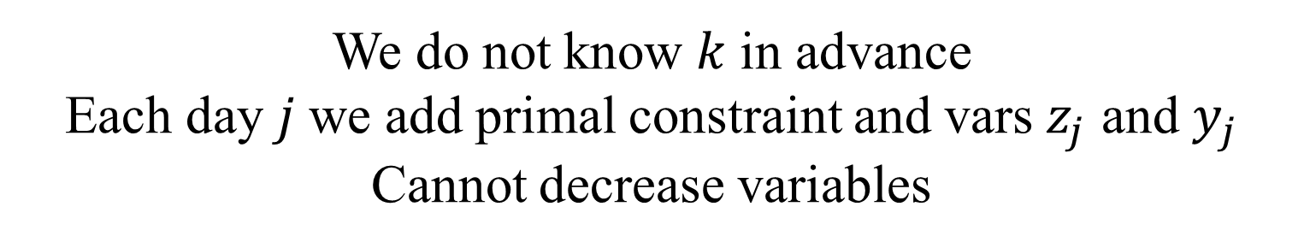
Ski rental, online
min $B⋅x+\sum_{j=1}^{k}{z_{j}}$
(SR-LP)
$∀j∈1,…,k, x+z_{j}≥1$
$x≥0$, $∀j∈1,…,k,z_{j}≥0$
max $\sum_{j=1}^{k}{y_{j}}$
(SR-D)
$$\sum_{j=1}^{k}{y_{j}}≤B$$
$$∀j∈1,…,k,0≤y_{j}≤1$$
We do not know $k$ in advance
Each day $j$ we add primal constraint and vars $z_{j}$ and $y_{j}$
Cannot decrease variables

Slide 35
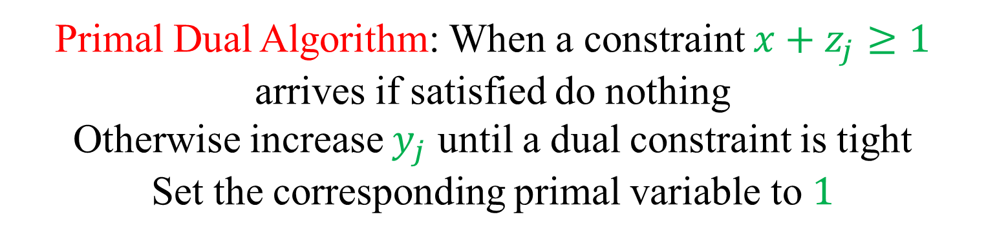
Ski rental, online
min $B⋅x+\sum_{j=1}^{k}{z_{j}}$
(SR-LP)
$∀j∈1,…,k, x+z_{j}≥1$
$x≥0$, $∀j∈1,…,k,z_{j}≥0$
max $\sum_{j=1}^{k}{y_{j}}$
(SR-D)
$$\sum_{j=1}^{k}{y_{j}}≤B$$
$$∀j∈1,…,k,0≤y_{j}≤1$$
Primal Dual Algorithm: When a constraint $x+z_{j}≥1$ arrives if satisfied do nothing
Otherwise increase $y_{j}$ until a dual constraint is tight
Set the corresponding primal variable to $1$

Slide 36
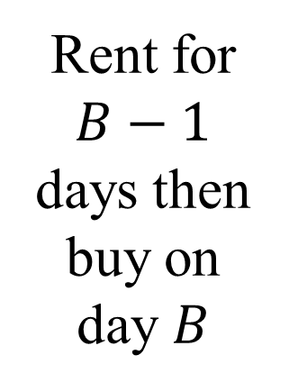
Ski rental, online
min $B⋅x+\sum_{j=1}^{k}{z_{j}}$
(SR-LP)
$∀j∈1,…,k, x+z_{j}≥1$
Rent for $B−1$ days then buy on day $B$
$x≥0$, $∀j∈1,…,k,z_{j}≥0$
max $\sum_{j=1}^{k}{y_{j}}$
(SR-D)
$$\sum_{j=1}^{k}{y_{j}}≤B$$
$$∀j∈1,…,k,0≤y_{j}≤1$$
Primal Dual Algorithm: When a constraint $x+z_{j}≥1$ arrives if satisfied do nothing
Otherwise increase $y_{j}$ until a dual constraint is tight
Set the corresponding primal variable to $1$

Slide 37
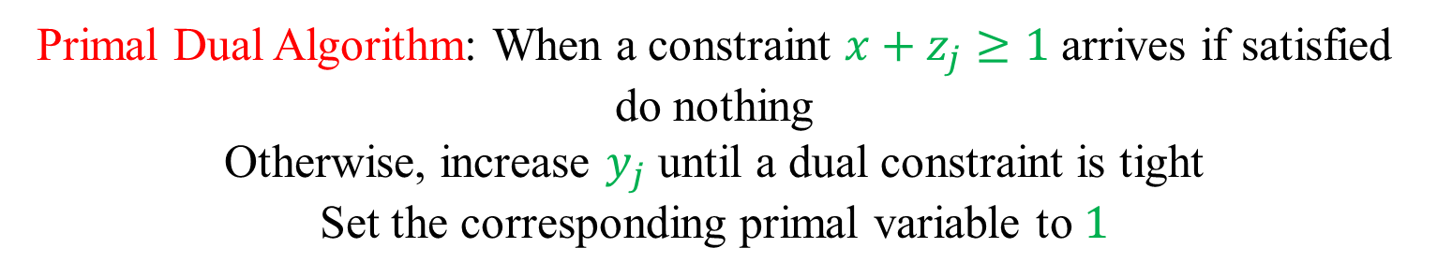
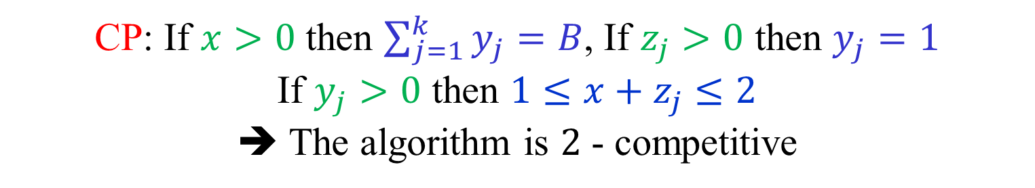
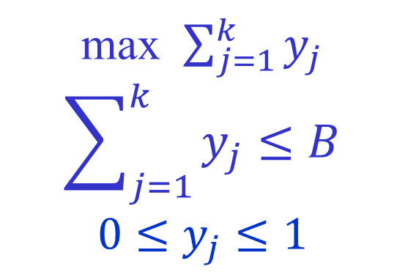
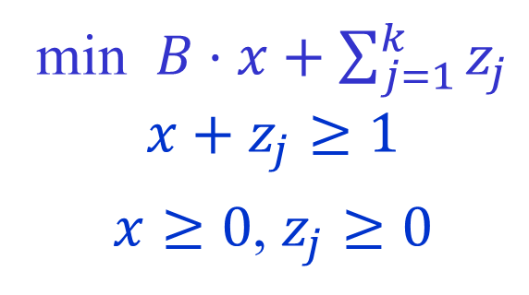
Analysis using CP
min $B⋅x+\sum_{j=1}^{k}{z_{j}}$
$$x+z_{j}≥1$$
$x≥0$, $z_{j}≥0$
max $\sum_{j=1}^{k}{y_{j}}$
$$\sum_{j=1}^{k}{y_{j}}≤B$$
$$0≤y_{j}≤1$$
Primal Dual Algorithm: When a constraint $x+z_{j}≥1$ arrives if satisfied do nothing
Otherwise, increase $y_{j}$ until a dual constraint is tight
Set the corresponding primal variable to $1$
CP: If $x>0$ then $\sum_{j=1}^{k}{y_{j}}=B$, If $z_{j}>0$ then $y_{j}=1$
If $y_{j}>0$ then $1≤x+z_{j}≤2$
➔ The algorithm is $2$ - competitive

Slide 38
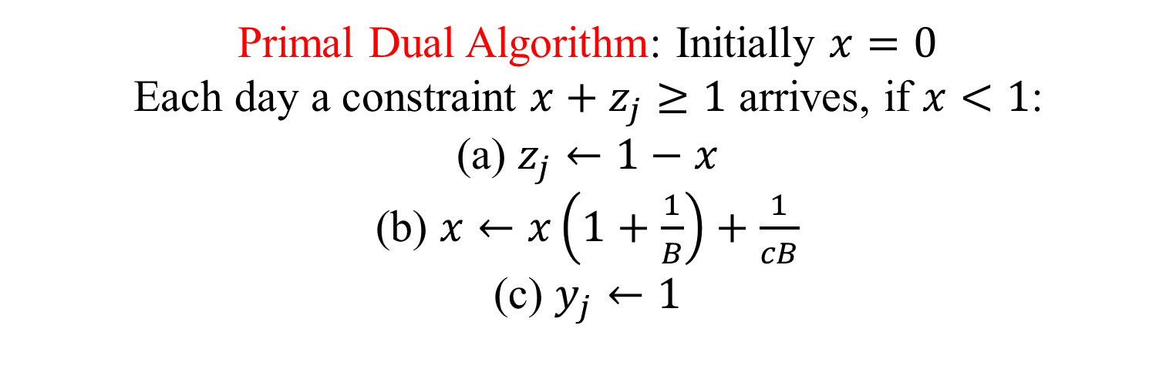
Fractional algorithm
min $B⋅x+\sum_{j=1}^{k}{z_{j}}$
$$x+z_{j}≥1$$
$x≥0$, $z_{j}≥0$
max $\sum_{j=1}^{k}{y_{j}}$
$$\sum_{j=1}^{k}{y_{j}}≤B$$
$$0≤y_{j}≤1$$
Primal Dual Algorithm: Initially $x=0$
Each day a constraint $x+z_{j}≥1$ arrives, if $x<1$:
(a) $z_{j}←1−x$
(b) $x←x\left(1+\frac{1}{B}\right)+\frac{1}{cB}$
(c) $y_{j}←1$

Slide 39
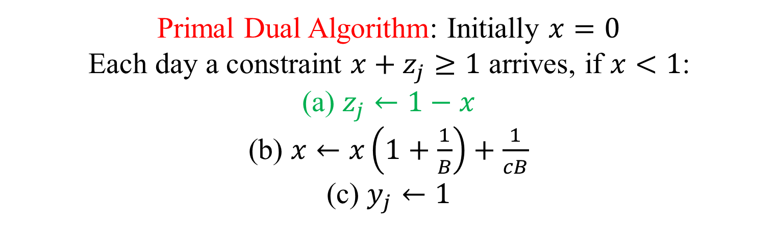
Fractional algorithm/analysis
min $B⋅x+\sum_{j=1}^{k}{z_{j}}$
$$x+z_{j}≥1$$
$x≥0$, $z_{j}≥0$
max $\sum_{j=1}^{k}{y_{j}}$
$$\sum_{j=1}^{k}{y_{j}}≤B$$
$$0≤y_{j}≤1$$
Primal Dual Algorithm: Initially $x=0$
Each day a constraint $x+z_{j}≥1$ arrives, if $x<1$:
(a) $z_{j}←1−x$
(b) $x←x\left(1+\frac{1}{B}\right)+\frac{1}{cB}$
(c) $y_{j}←1$
Obs 1: Primal feasibility is clear

Slide 40
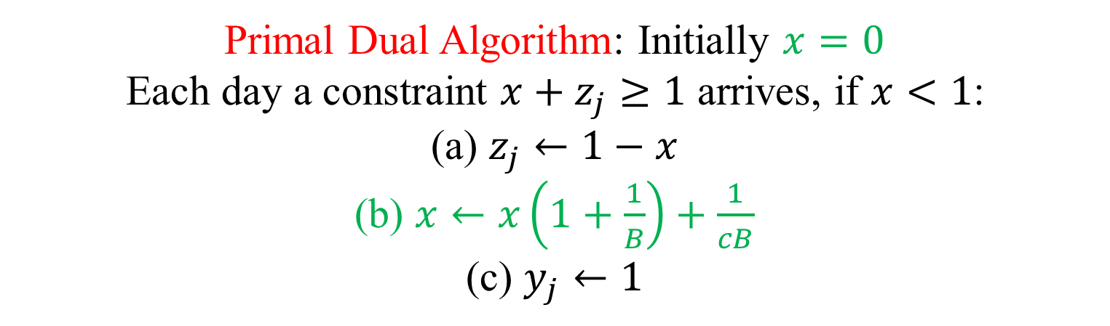

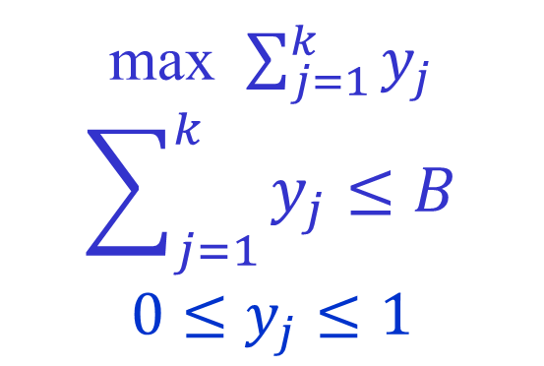
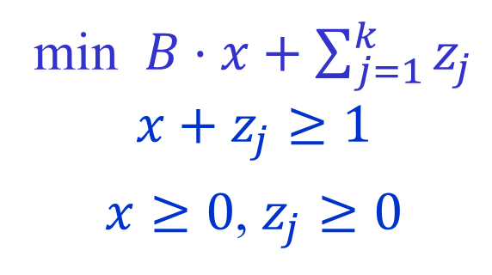
Fractional algorithm/analysis
min $B⋅x+\sum_{j=1}^{k}{z_{j}}$
$$x+z_{j}≥1$$
$x≥0$, $z_{j}≥0$
max $\sum_{j=1}^{k}{y_{j}}$
$$\sum_{j=1}^{k}{y_{j}}≤B$$
$$0≤y_{j}≤1$$
Primal Dual Algorithm: Initially $x=0$
Each day a constraint $x+z_{j}≥1$ arrives, if $x<1$:
(a) $z_{j}←1−x$
(b) $x←x\left(1+\frac{1}{B}\right)+\frac{1}{cB}$
(c) $y_{j}←1$
Obs 2: The values of $x$: $0,\frac{1}{cB},\frac{1}{cB}\left(1+\frac{1}{B}\right)+\frac{1}{cB},$
$\frac{1}{cB}{\left(1+\frac{1}{B}\right)}^{2}+\frac{1}{cB}\left(1+\frac{1}{B}\right)+\frac{1}{cB}$

Slide 41

Fractional algorithm/analysis
min $B⋅x+\sum_{j=1}^{k}{z_{j}}$
$$x+z_{j}≥1$$
$x≥0$, $z_{j}≥0$
max $\sum_{j=1}^{k}{y_{j}}$
$$\sum_{j=1}^{k}{y_{j}}≤B$$
$$0≤y_{j}≤1$$
Primal Dual Algorithm: Initially $x=0$
Each day a constraint $x+z_{j}≥1$ arrives, if $x<1$:
(a) $z_{j}←1−x$
(b) $x←x\left(1+\frac{1}{B}\right)+\frac{1}{cB}$
(c) $y_{j}←1$
Obs 2: After $B$ days: $\frac{1}{cB}\frac{{\left(1+\frac{1}{B}\right)}^{B}−1}{\frac{1}{B}}=\frac{{\left(1+\frac{1}{B}\right)}^{B}−1}{c}$

Slide 42
Fractional algorithm/analysis
min $B⋅x+\sum_{j=1}^{k}{z_{j}}$
$$x+z_{j}≥1$$
$x≥0$, $z_{j}≥0$
max $\sum_{j=1}^{k}{y_{j}}$
$$\sum_{j=1}^{k}{y_{j}}≤B$$
$$0≤y_{j}≤1$$
Primal Dual Algorithm: Initially $x=0$
Each day a constraint $x+z_{j}≥1$ arrives, if $x<1$:
(a) $z_{j}←1−x$
(b) $x←x\left(1+\frac{1}{B}\right)+\frac{1}{cB}$
(c) $y_{j}←1$
Obs 2: Set $c={\left(1+\frac{1}{B}\right)}^{B}−1$ ➔ dual is feasible

Slide 43




Fractional algorithm/analysis
min $B⋅x+\sum_{j=1}^{k}{z_{j}}$
$$x+z_{j}≥1$$
$x≥0$, $z_{j}≥0$
max $\sum_{j=1}^{k}{y_{j}}$
$$\sum_{j=1}^{k}{y_{j}}≤B$$
$$0≤y_{j}≤1$$
Primal Dual Algorithm: Initially $x=0$
Each day a constraint $x+z_{j}≥1$ arrives, if $x<1$:
(a) $z_{j}←1−x$
(b) $x←x\left(1+\frac{1}{B}\right)+\frac{1}{cB}$
(c) $y_{j}←1$
Obs 3: Each iteration dual objective increase by 1, primal increases by $BΔx+\left(1−x\right)=B\left(x\left(1+\frac{1}{B}\right)+\frac{1}{cB}−x\right)+\left(1−x\right)=$
$$x+\frac{1}{c}+\left(1−x\right)=1+\frac{1}{c}=1+\frac{1}{{\left(1+\frac{1}{B}\right)}^{B}−1}≈\frac{e}{e−1}$$

Slide 44

From fractional to randomized
min $B⋅x+\sum_{j=1}^{k}{z_{j}}$
$$x+z_{j}≥1$$
$x≥0$, $z_{j}≥0$
max $\sum_{j=1}^{k}{y_{j}}$
$$\sum_{j=1}^{k}{y_{j}}≤B$$
$$0≤y_{j}≤1$$
Primal Dual Algorithm: Initially $x=0$
Each day a constraint $x+z_{j}≥1$ arrives, if $x<1$:
(a) $z_{j}←1−x$
(b) $x←x\left(1+\frac{1}{B}\right)+\frac{1}{cB}$
(c) $y_{j}←1$
Randomized alg: choose $α∈\left[0,1\right]$ uniformly.
Run the frac pd algorithm and buy the skis on the day when $x$ passes $α$

Slide 45



Analysis of randomized alg
min $B⋅x+\sum_{j=1}^{k}{z_{j}}$
$$x+z_{j}≥1$$
$x≥0$, $z_{j}≥0$
max $\sum_{j=1}^{k}{y_{j}}$
$$\sum_{j=1}^{k}{y_{j}}≤B$$
$$0≤y_{j}≤1$$
$$x(1)$$
0
$$α$$
1
Randomized alg: choose $α∈\left[0,1\right]$ uniformly.
Run the frac pd algorithm and buy the skis on the day when $x$ passes $α$

Slide 46

Analysis of randomized alg
min $B⋅x+\sum_{j=1}^{k}{z_{j}}$
$$x+z_{j}≥1$$
$x≥0$, $z_{j}≥0$
max $\sum_{j=1}^{k}{y_{j}}$
$$\sum_{j=1}^{k}{y_{j}}≤B$$
$$0≤y_{j}≤1$$
$$x(2)$$
0
$$α$$
1
Randomized alg: choose $α∈\left[0,1\right]$ uniformly.
Run the frac pd algorithm and buy the skis on the day when $x$ passes $α$

Slide 47

Analysis of randomized alg
min $B⋅x+\sum_{j=1}^{k}{z_{j}}$
$$x+z_{j}≥1$$
$x≥0$, $z_{j}≥0$
max $\sum_{j=1}^{k}{y_{j}}$
$$\sum_{j=1}^{k}{y_{j}}≤B$$
$$0≤y_{j}≤1$$
$$x(j)$$
0
$$α$$
1
Randomized alg: choose $α∈\left[0,1\right]$ uniformly.
Run the frac pd algorithm and buy the skis on the day when $x$ passes $α$

Slide 48


Analysis of randomized alg
min $B⋅x+\sum_{j=1}^{k}{z_{j}}$
$$x+z_{j}≥1$$
$x≥0$, $z_{j}≥0$
max $\sum_{j=1}^{k}{y_{j}}$
$$\sum_{j=1}^{k}{y_{j}}≤B$$
$$0≤y_{j}≤1$$
$$x$$
0
$$α$$
1
Randomized alg: choose $α∈\left[0,1\right]$ uniformly.
Run the frac pd algorithm and buy the skis on the day when $x$ passes $α$
We buy with probability $x$ ➔ expected buying cost is $Bx$
We rent on day $j$ with probability $1−x\left(j\right)≤1−x\left(j−1\right)=z_{j}$
➔ Expected cost of randomized alg. is at most the fractional cost

Slide 49
Our web site
Topics in Online Algorithms

