Slide 1
Deterministic Paging Algorithms
Seminar on Online Algorithms
Prof. Haim Kaplan
02.03.2022
Shachaf Cohen

Slide 2
Table of Contents
Deterministic Paging
  Common deterministic algorithms
  An optimal algorithm
  Lower bound for competitive algorithms
  Marking & Conservative algorithms
The List Accessing problem
  A competitive online algorithm

Slide 3
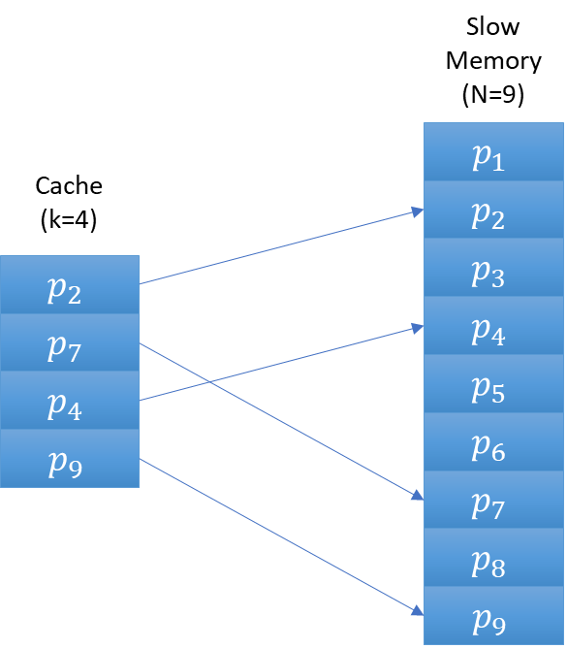
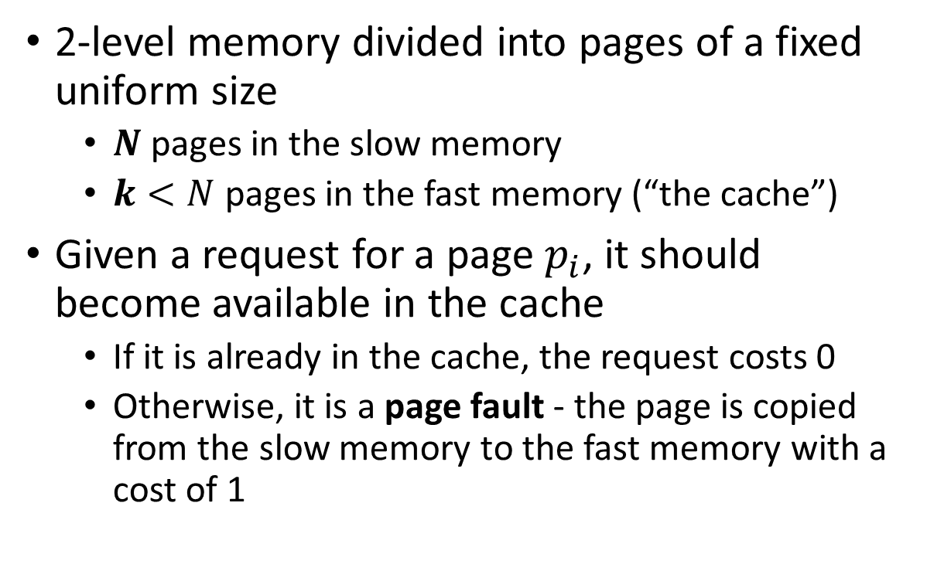
Paging
2-level memory divided into pages of a fixed uniform size
  $N$ pages in the slow memory
  $k<N$ pages in the fast memory (“the cache”)
Given a request for a page $p_{i}$, it should become available in the cache
  If it is already in the cache, the request costs 0
  Otherwise, it is a page fault - the page is copied from the slow memory to the fast memory with a cost of 1

Slide 4
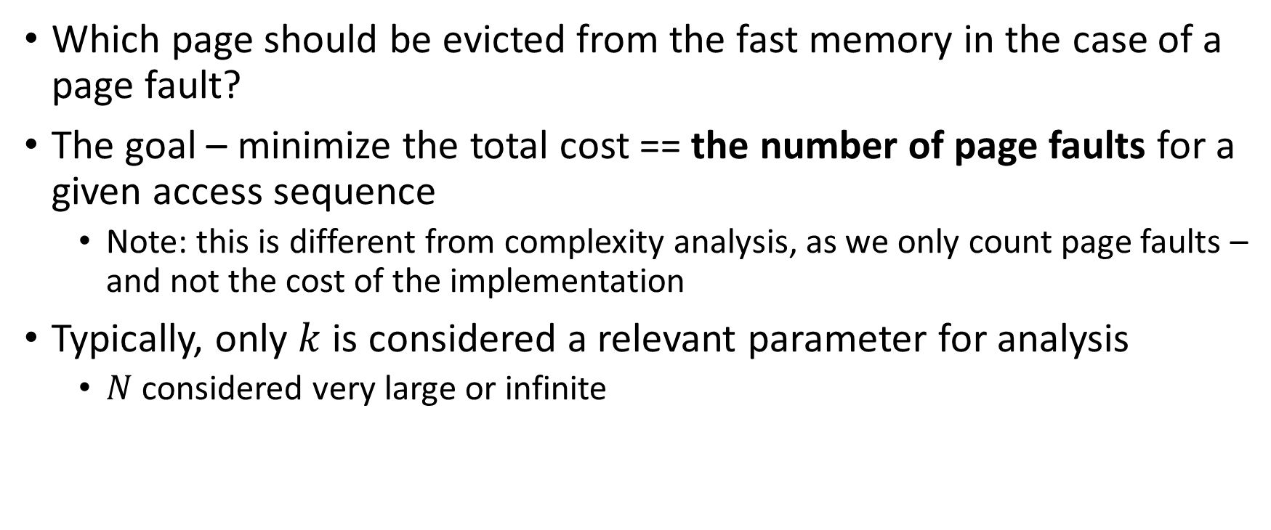
The Problem
Which page should be evicted from the fast memory in the case of a page fault?
The goal – minimize the total cost == the number of page faults for a given access sequence
  Note: this is different from complexity analysis, as we only count page faults – and not the cost of the implementation
Typically, only $k$ is considered a relevant parameter for analysis
  $N$ considered very large or infinite

Slide 5
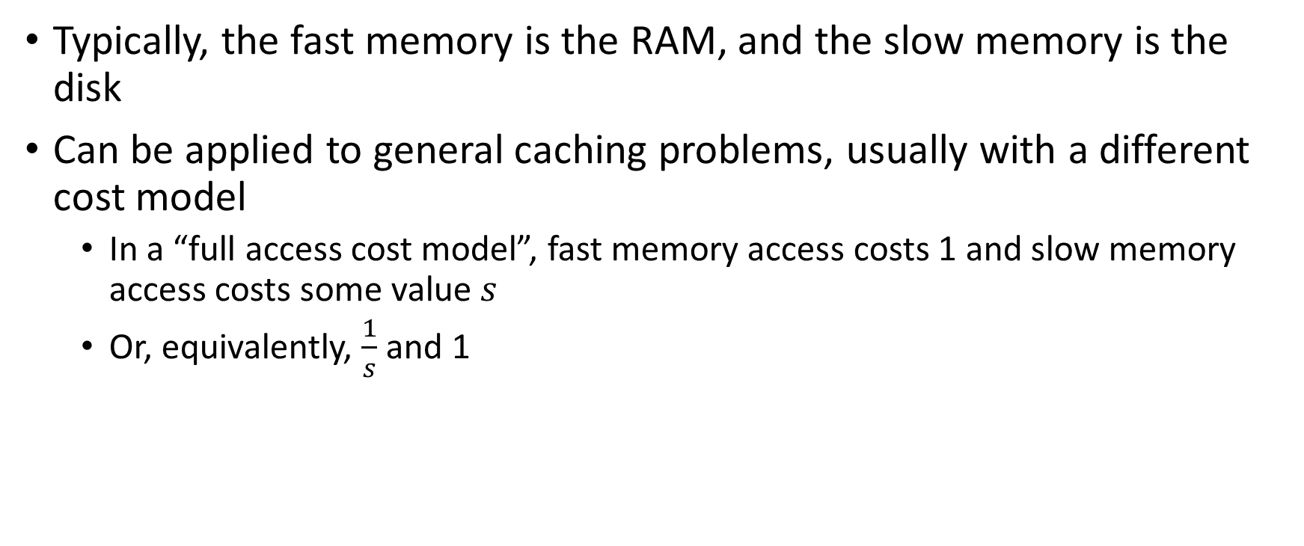
“In the real world”
Typically, the fast memory is the RAM, and the slow memory is the disk
Can be applied to general caching problems, usually with a different cost model
  In a “full access cost model”, fast memory access costs 1 and slow memory access costs some value $s$
  Or, equivalently, $\frac{1}{s}$ and 1

Slide 6
Some Notes
Paging is an online problem
  Algorithms don’t know future requests
Today we will discuss only deterministic paging algorithms
  Randomized algorithms will be discussed in future lectures

Slide 7
Some Deterministic Paging Algorithms
FIFO (First-In, First-Out)
  Replace the page that’s been in the cache longest
LIFO (Last-In, First-Out)
  Replace the page most recently moved to the cache
LRU (Least Recently Used)
  Replace the page whose most recent access is earliest
LFU (Least Frequently Used)
  Replace the page that has been accessed the least
LFD (Longest Forward Distance)
  Replace the page whose next access is the latest
Notes:
***LFD is not online, of course

Slide 8
Some Deterministic Paging Algorithms
FIFO (First-In, First-Out)
  Replace the page that’s been in the cache longest
LIFO (Last-In, First-Out)
  Replace the page most recently moved to the cache
LRU (Least Recently Used)
  Replace the page whose most recent access is earliest
LFU (Least Frequently Used)
  Replace the page that has been accessed the least
LFD (Longest Forward Distance)***
  Replace the page whose next access is the latest
Notes:
***LFD is not online, of course

Slide 9
Demand Paging
All these algorithms are demand paging algorithms
  They never evict a page unless room is needed for another page
Pre-mature paging can’t reduce the number of page faults
  Intuitively, you can just keep the pages in memory instead of evicting them, and replace them only when they are required – at the same cost

Slide 10
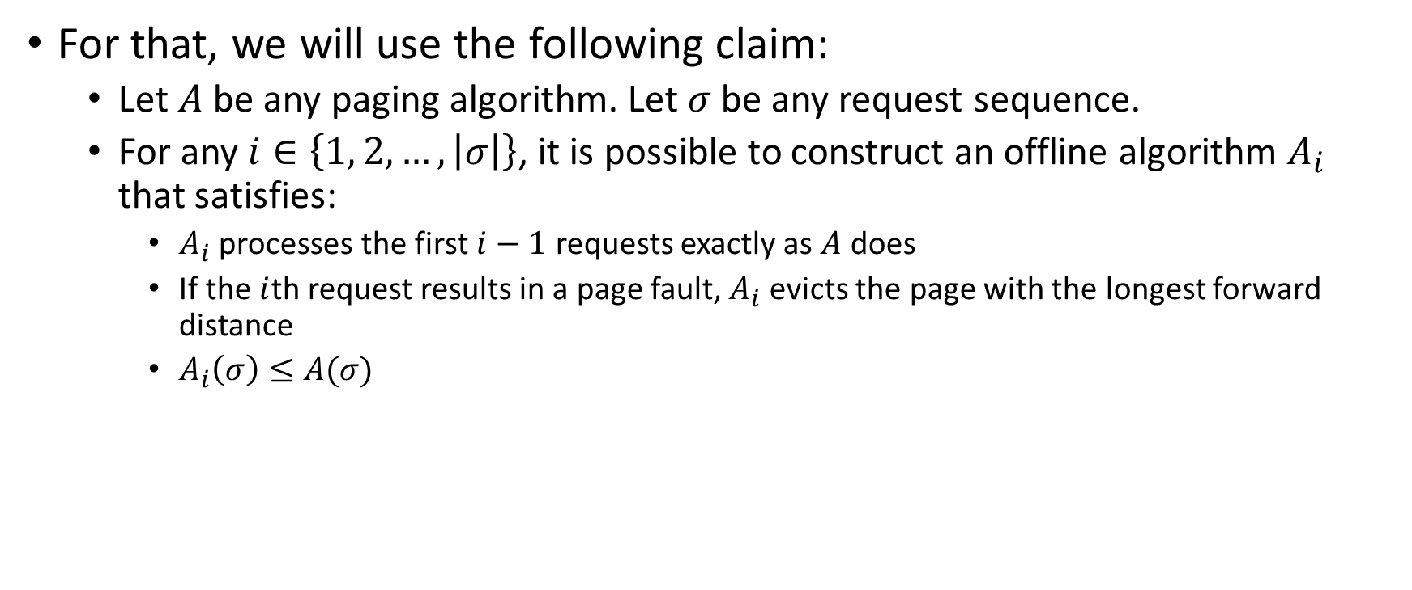
LFD is an optimal offline algorithm
For that, we will use the following claim:
  Let $A$ be any paging algorithm. Let $σ$ be any request sequence.
  For any $i∈\left\{1, 2, …, \left|σ\right|\right\}$, it is possible to construct an offline algorithm $A_{i}$ that satisfies:
    $A_{i}$ processes the first $i−1$ requests exactly as $A$ does
    If the $i$th request results in a page fault, $A_{i}$ evicts the page with the longest forward distance
    $A_{i}\left(σ\right)≤A(σ)$

Slide 11
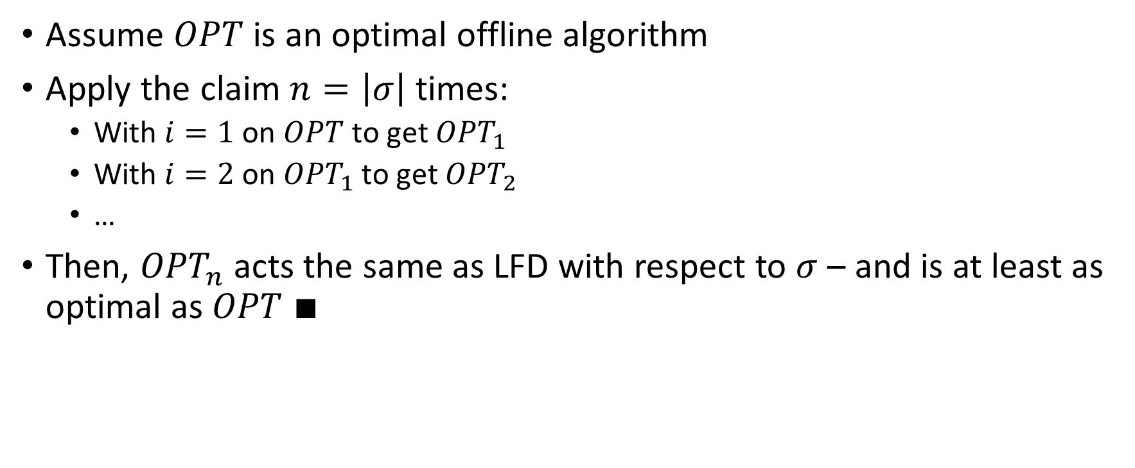
Proof that LFD is optimal
Assume $OPT$ is an optimal offline algorithm
Apply the claim $n=\left|σ\right|$ times:
  With $i=1$ on $OPT$ to get ${OPT}_{1}$
  With $i=2$ on ${OPT}_{1}$ to get ${OPT}_{2}$
  …
Then, ${OPT}_{n}$ acts the same as LFD with respect to $σ$ – and is at least as optimal as $OPT$ $∎$

Slide 12





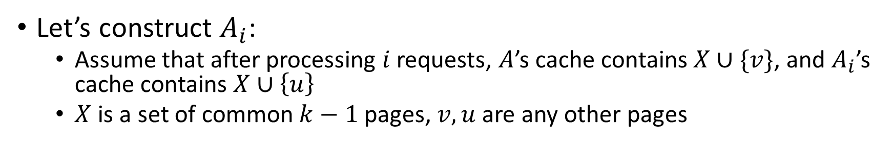






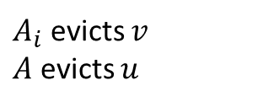
Claim Proof (1)
Let’s construct $A_{i}$:
  Assume that after processing $i$ requests, $A$’s cache contains $X∪\{v\}$, and $A_{i}$’s cache contains $X∪\left\{u\right\}$
  $X$ is a set of common $k−1$ pages, $v, u$ are any other pages
$$A_{i}$$
$$A_{i}$$
$$r$$
… | $$u$$ | $$v$$ | … | $$p$$ | $$…$$
… | $$u$$ | $$r$$ | … | $$p$$ | $$…$$
$A_{i}$ evicts $v$
$A$ evicts $u$
$$A$$
$$A$$
… | $$u$$ | $$v$$ | … | $$p$$ | $$…$$
… | $$r$$ | $$v$$ | … | $$p$$ | $$…$$
$$i−1$$
$$i$$

Slide 13
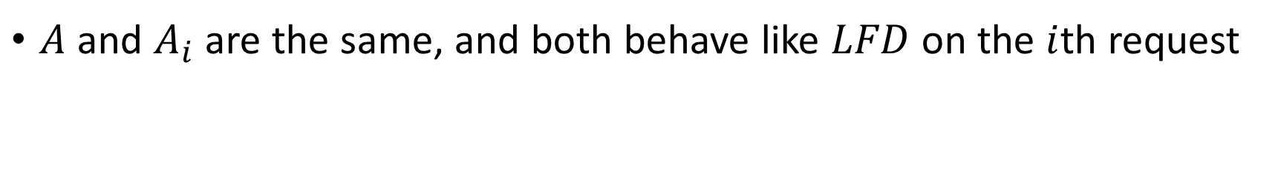
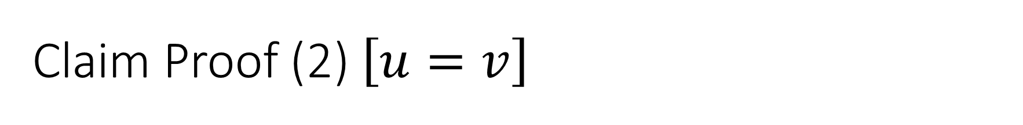


Claim Proof (2) $\left[u=v\right]$
$A$ and $A_{i}$ are the same, and both behave like $LFD$ on the $i$th request
$$A_{i}$$
$$A_{i}$$
… | $$u$$ | $$v$$ | … | $$p$$ | $$…$$
… | $$u$$ | $$r$$ | … | $$p$$ | $$…$$
$$A$$
$$A$$
… | $$u$$ | $$v$$ | … | $$p$$ | $$…$$
… | $$u$$ | $$r$$ | … | $$p$$ | $$…$$
$$i−1$$
$$i$$

Slide 14

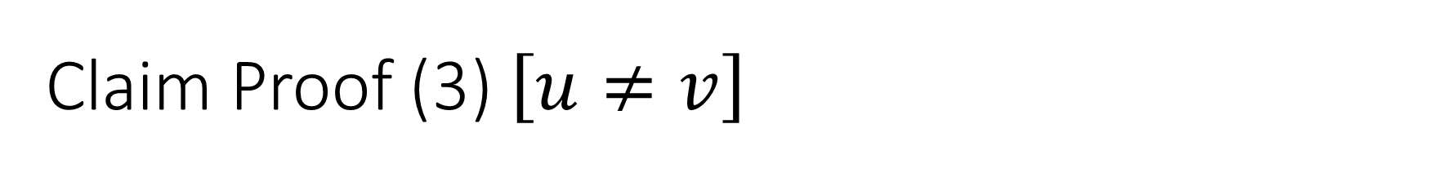



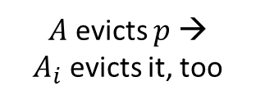



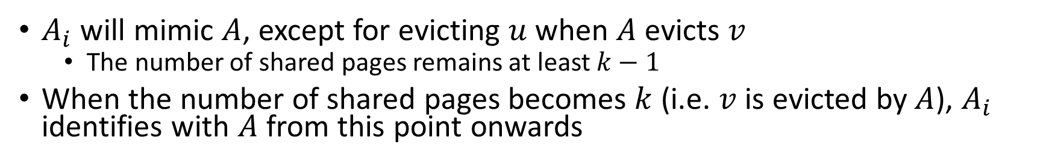
Claim Proof (3) $\left[u≠v\right]$
$A_{i}$ will mimic $A$, except for evicting $u$ when $A$ evicts $v$
  The number of shared pages remains at least $k−1$
When the number of shared pages becomes $k$ (i.e. $v$ is evicted by $A$), $A_{i}$ identifies with $A$ from this point onwards
$$q$$
$$A_{i}$$
$$A_{i}$$
$$A_{i}$$
… | $$u$$ | $$v$$ | … | $$p$$ | $$…$$
… | $$u$$ | $$r$$ | … | $$p$$ | $$…$$
… | $$u$$ | $$r$$ | … | $$q$$ | $$…$$
$A$ evicts $p$ →
$A_{i}$ evicts it, too
$$A$$
$$A$$
$$A$$
… | $$u$$ | $$v$$ | … | $$p$$ | $$…$$
… | $$v$$ | $$r$$ | … | $$p$$ | $$…$$
… | $$v$$ | $$r$$ | … | $$q$$ | $$…$$
$$i−1$$
$$i$$
$$i+…$$

Slide 15
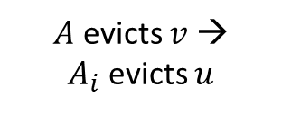
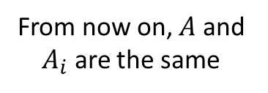


Claim Proof (4)
$A_{i}$ will mimic $A$, except for evicting $u$ when $A$ evicts $v$
  The number of shared pages remains at least $k−1$
When the number of shared pages becomes $k$ (i.e. $v$ is evicted by $A$), $A_{i}$ identifies with $A$ from this point onwards
$$q$$
$$A_{i}$$
$$A_{i}$$
$$A_{i}$$
… | $$u$$ | $$v$$ | … | $$p$$ | $$…$$
… | $$u$$ | $$r$$ | … | $$p$$ | $$…$$
… | $$q$$ | $$r$$ | … | $$p$$ | $$…$$
$A$ evicts $v$ →
$A_{i}$ evicts $u$
$$A$$
$$A$$
$$A$$
… | $$u$$ | $$v$$ | … | $$p$$ | $$…$$
… | $$v$$ | $$r$$ | … | $$p$$ | $$…$$
… | $$q$$ | $$r$$ | … | $$p$$ | $$…$$
From now on, $A$ and $A_{i}$ are the same
$$i−1$$
$$i$$
$$i+…$$

Slide 16

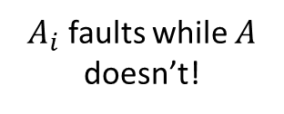
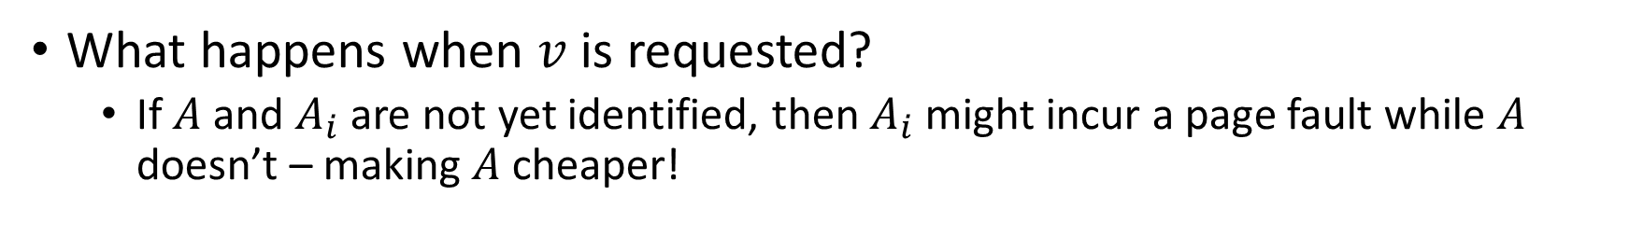



Claim Proof (5)
What happens when $v$ is requested?
  If $A$ and $A_{i}$ are not yet identified, then $A_{i}$ might incur a page fault while $A$ doesn’t – making $A$ cheaper!
$$v$$
$$A_{i}$$
$$A_{i}$$
$$A_{i}$$
… | $$u$$ | $$v$$ | … | $$p$$ | $$…$$
… | $$u$$ | $$r$$ | … | $$p$$ | $$…$$
… | $$v$$ | $$r$$ | … | $$p$$ | $$…$$
$A_{i}$ faults while $A$ doesn’t!
$$A$$
$$A$$
$$A$$
… | $$u$$ | $$v$$ | … | $$p$$ | $$…$$
… | $$v$$ | $$r$$ | … | $$p$$ | $$…$$
… | $$v$$ | $$r$$ | … | $$p$$ | $$…$$
$$i−1$$
$$i$$
$$i+…$$

Slide 17

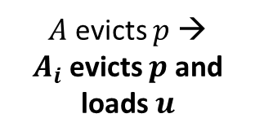
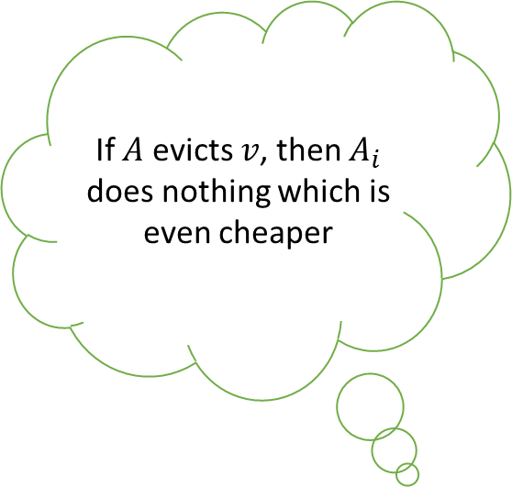



Claim Proof (6)
If $A$ evicts $v$, then $A_{i}$ does nothing which is even cheaper
Recall that $v$ had the longest forward distance when evicted by $A_{i}$
  There must have been at least one request for $u$ after the $i$th request and before the request for $v$!
$$u$$
$$A_{i}$$
$$A_{i}$$
$$A_{i}$$
… | $$u$$ | $$v$$ | … | $$p$$ | $$…$$
… | $$u$$ | $$r$$ | … | $$p$$ | $$…$$
… | $$u$$ | $$r$$ | … | $$v$$ | $$…$$
$A$ evicts $p$ →
$A_{i}$ evicts $p$ and loads $u$
$$A$$
$$A$$
$$A$$
… | $$u$$ | $$v$$ | … | $$p$$ | $$…$$
… | $$v$$ | $$r$$ | … | $$p$$ | $$…$$
… | $$v$$ | $$r$$ | … | $$u$$ | $$…$$
From now on, $A$ and $A_{i}$ are the same
$$i−1$$
$$i$$
$$i+…$$

Slide 18

Claim Proof (7)
In every case we saw that $ALG\left(A_{i}\right)≤ALG\left(A\right)$, as required $∎$

Slide 19
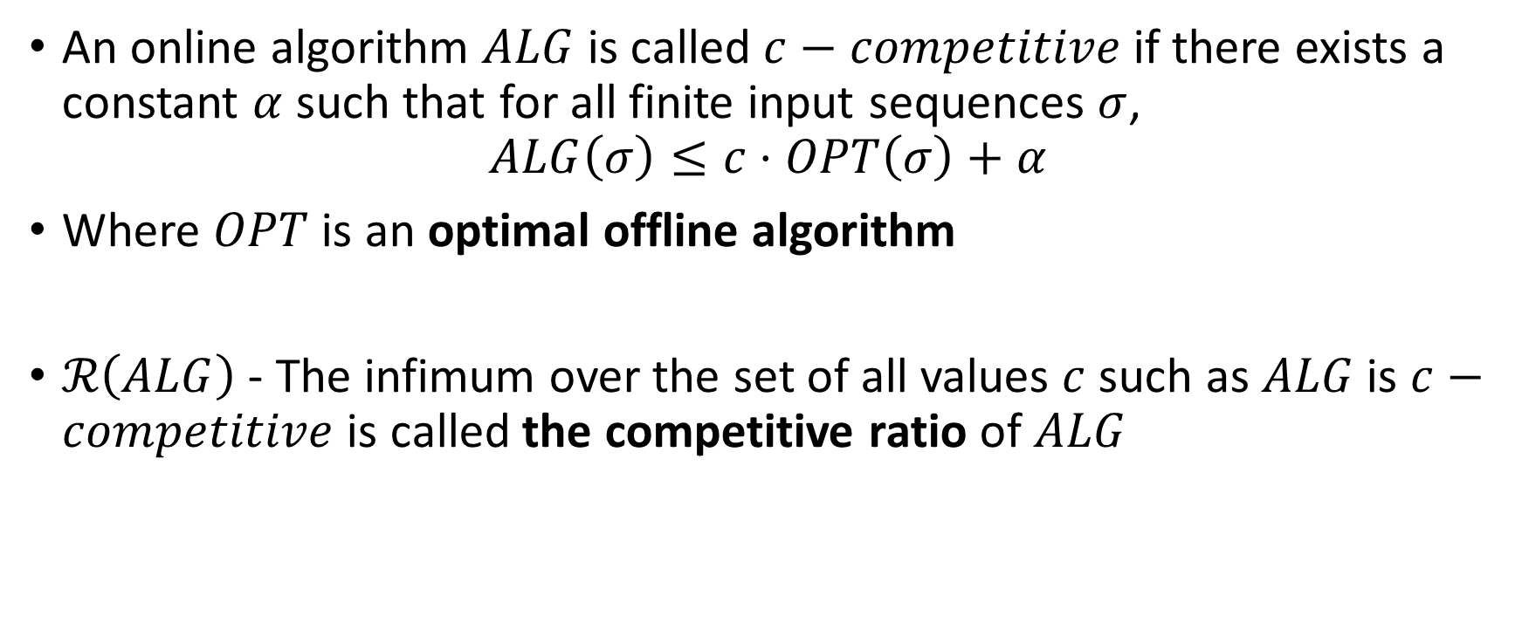
Reminder: Competitive Ratio
An online algorithm $ALG$ is called $c−competitive$ if there exists a constant $α$ such that for all finite input sequences $σ$,
$$ALG\left(σ\right)≤c⋅OPT\left(σ\right)+α$$
Where $OPT$ is an optimal offline algorithm
$ℛ\left(ALG\right)$ - The infimum over the set of all values $c$ such as $ALG$ is $c−competitive$ is called the competitive ratio of $ALG$

Slide 20


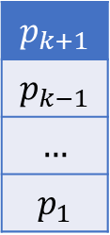
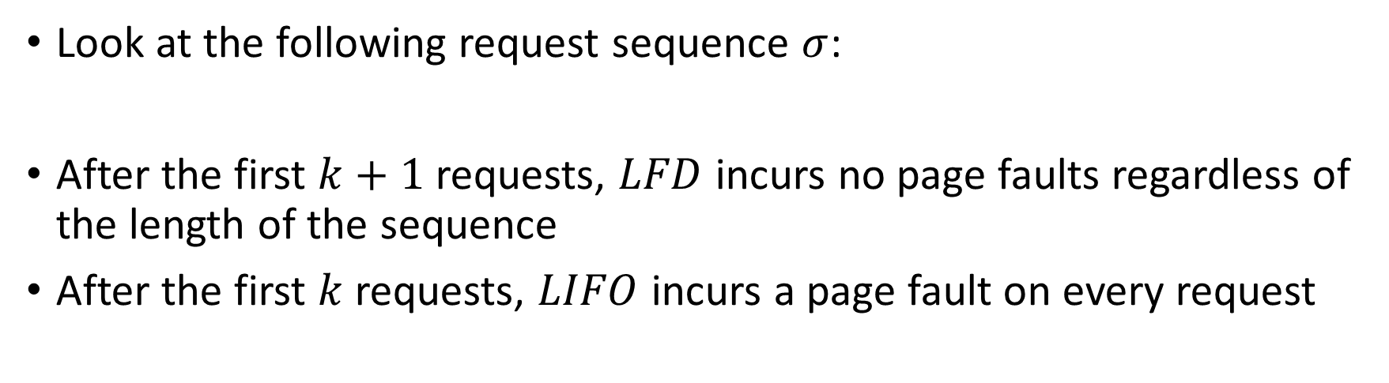
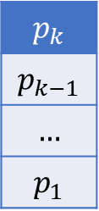
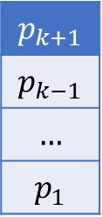

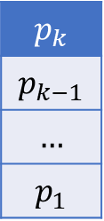

LIFO is not competitive
Look at the following request sequence $σ$:
After the first $k+1$ requests, $LFD$ incurs no page faults regardless of the length of the sequence
After the first $k$ requests, $LIFO$ incurs a page fault on every request
$$p_{1}$$ | $$p_{2}$$ | … | $$p_{k}$$ | $$p_{k+1}$$ | $$p_{k}$$ | $$p_{k+1}$$ | $$p_{k}$$ | …
$$p_{k}$$
$$p_{k−1}$$
$$…$$
$$p_{1}$$
$$p_{k+1}$$
$$p_{k−1}$$
$$…$$
$$p_{1}$$
$$p_{k}$$
$$p_{k−1}$$
$$…$$
$$p_{1}$$
$$p_{k+1}$$
$$p_{k−1}$$
$$…$$
$$p_{1}$$
$$p_{k+1}$$
$$p_{k}$$
$$p_{k+1}$$
…

Slide 21
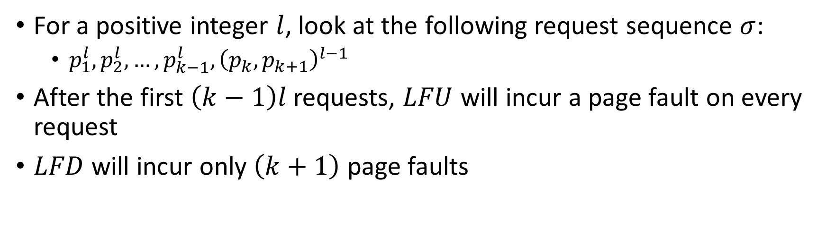
LFU is not competitive
For a positive integer $l$, look at the following request sequence $σ$:
  $p_{1}^{l}, p_{2}^{l}, …,p_{k−1}^{l}, {\left(p_{k},p_{k+1}\right)}^{l−1}$
After the first $\left(k−1\right)l$ requests, $LFU$ will incur a page fault on every request
$LFD$ will incur only $\left(k+1\right)$ page faults
$$p_{k}$$
$$p_{k−1}$$
$$…$$
$$p_{1}$$
$$p_{k+1}$$
$$p_{k−1}$$
$$…$$
$$p_{1}$$
$$p_{k}$$
$$p_{k−1}$$
$$…$$
$$p_{1}$$
$$p_{k+1}$$
$$p_{k−1}$$
$$…$$
$$p_{1}$$
$$p_{k+1}$$
$$p_{k}$$
$$p_{k+1}$$
…

Slide 22

A Lower Bound
Let $A$ be a (competitive) deterministic paging algorithm. Then $ℛ\left(ALG\right)≥k$.
  Note: this lower bound is only for deterministic algorithms, there are better randomized algorithms

Slide 23



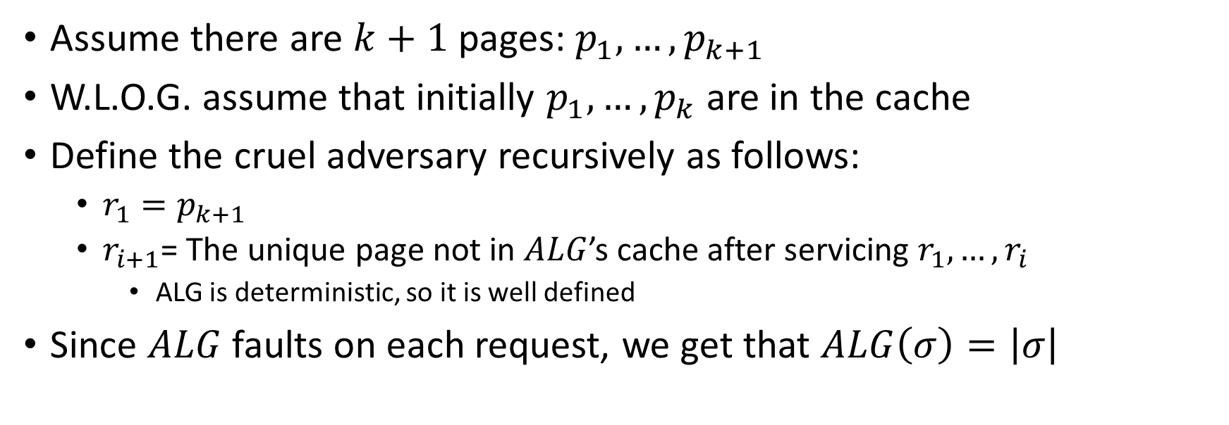



Proof of Lower Bound
Assume there are $k+1$ pages: $p_{1},…, p_{k+1}$
W.L.O.G. assume that initially $p_{1},…, p_{k}$ are in the cache
Define the cruel adversary recursively as follows:
  $r_{1}=p_{k+1}$
  $r_{i+1}$= The unique page not in $ALG$’s cache after servicing $r_{1},…, r_{i}$
    ALG is deterministic, so it is well defined
Since $ALG$ faults on each request, we get that $ALG\left(σ\right)=\left|σ\right|$
$$r_{1}=p_{k+1}$$
$$r_{2}=p_{2}$$
$$r_{3}=p_{1}$$
$$p_{1}$$ | $$p_{2}$$ | $$p_{3}$$ | … | $$p_{k}$$
$$p_{1}$$ | $$p_{k+1}$$ | $$p_{3}$$ | … | $$p_{k}$$
$$p_{2}$$ | $$p_{k+1}$$ | $$p_{3}$$ | … | $$p_{k}$$
…

Slide 24
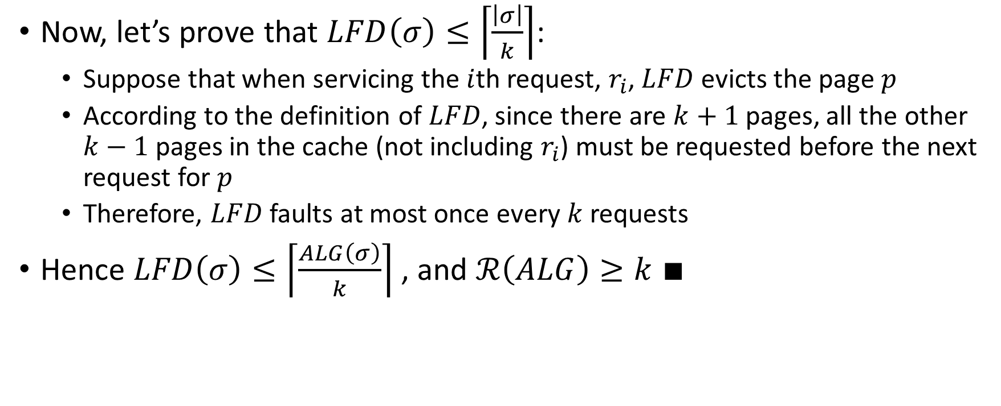
Proof of Lower Bound (2)
Now, let’s prove that $LFD\left(σ\right)≤\left\lceil \frac{\left|σ\right|}{k}\right\rceil$:
  Suppose that when servicing the $i$th request, $r_{i}$, $LFD$ evicts the page $p$
  According to the definition of $LFD$, since there are $k+1$ pages, all the other $k−1$ pages in the cache (not including $r_{i}$) must be requested before the next request for $p$
  Therefore, $LFD$ faults at most once every $k$ requests
Hence $LFD\left(σ\right)≤\left\lceil \frac{ALG\left(σ\right)}{k}\right\rceil$ , and $ℛ\left(ALG\right)≥k$ $∎$

Slide 25

Marking Paging Algorithms
Let $σ$ be any request sequence. We divide $σ$ into phases as follows:
  phase 0 is the empty sequence
  phase $i$ is the maximal sequence following phase $i−1$ that contains at most $k$ distinct page requests
For example, with $k=3$
1 | 2 | 3 | 3 | 4 | 3 | 4 | 1 | 2 | 2 | 5 | 1 | 2

Slide 26
Marking Paging Algorithms
Let $σ$ be any request sequence. We divide $σ$ into phases as follows:
  phase 0 is the empty sequence
  phase $i$ is the maximal sequence following phase $i−1$ that contains at most $k$ distinct page requests
For example, with $k=3$
1 | 2 | 3 | 3 | 4 | 3 | 4 | 1 | 2 | 2 | 5 | 1 | 2

Slide 27
Marking Paging Algorithms
Let $σ$ be any request sequence. We divide $σ$ into phases as follows:
  phase 0 is the empty sequence
  phase $i$ is the maximal sequence following phase $i−1$ that contains at most $k$ distinct page requests
For example, with $k=3$
1 | 2 | 3 | 3 | 4 | 3 | 4 | 1 | 2 | 2 | 5 | 1 | 2

Slide 28
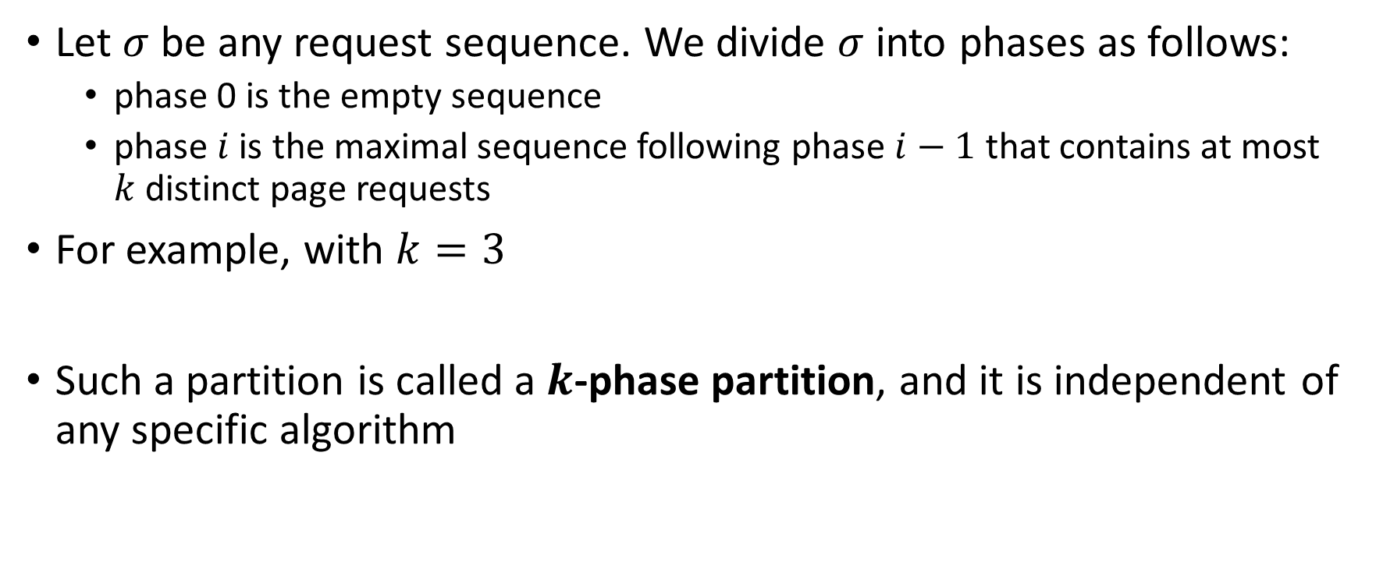
Marking Paging Algorithms
Let $σ$ be any request sequence. We divide $σ$ into phases as follows:
  phase 0 is the empty sequence
  phase $i$ is the maximal sequence following phase $i−1$ that contains at most $k$ distinct page requests
For example, with $k=3$
Such a partition is called a $k$-phase partition, and it is independent of any specific algorithm
1 | 2 | 3 | 3 | 4 | 3 | 4 | 1 | 2 | 2 | 5 | 1 | 2

Slide 29
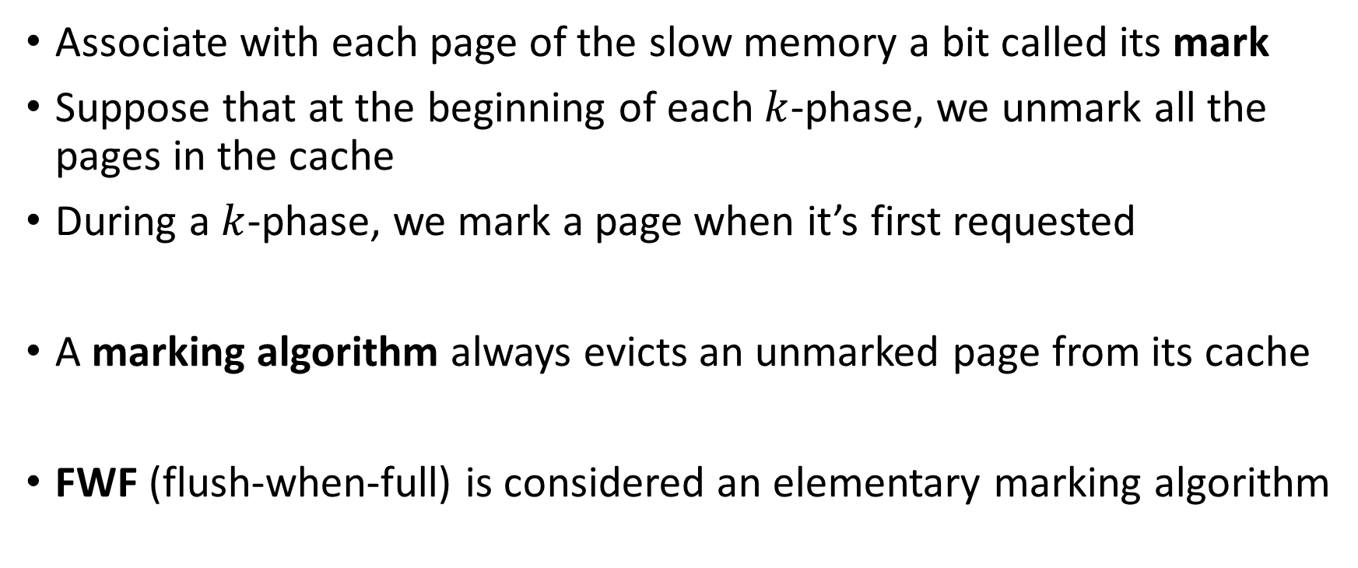
Marking Paging Algorithms
Associate with each page of the slow memory a bit called its mark
Suppose that at the beginning of each $k$-phase, we unmark all the pages in the cache
During a $k$-phase, we mark a page when it’s first requested
A marking algorithm always evicts an unmarked page from its cache
FWF (flush-when-full) is considered an elementary marking algorithm

Slide 30
FWF is a marking algorithm (example)
1 | 2 | 3 | 3 | 4 | 3 | 4 | 1 | 2 | 2 | 5 | 1 | 2
1
1
2
1 | 2
3
1 | 2 | 3
3
1 | 2 | 3
4
3
4
1
4 | 3 | 1
4
4 | 3
4 | 3
2
2
5
1
2
2
2
2 | 5
2 | 5 | 1
2 | 5 | 1

Slide 31
LRU is a marking algorithm (example)
1 | 2 | 3 | 3 | 4 | 3 | 4 | 1 | 2 | 2 | 5 | 1 | 2
1
1
2
1 | 2
3
1 | 2 | 3
3
1 | 2 | 3
4
3
4
1
4 | 1 | 3
1 | 2 | 3
4 | 2 | 3
4 | 2 | 3
4 | 2 | 3
2
2
5
1
2
4 | 1 | 3
4 | 1 | 2
4 | 1 | 2
5 | 1 | 2
5 | 1 | 2
5 | 1 | 2

Slide 32

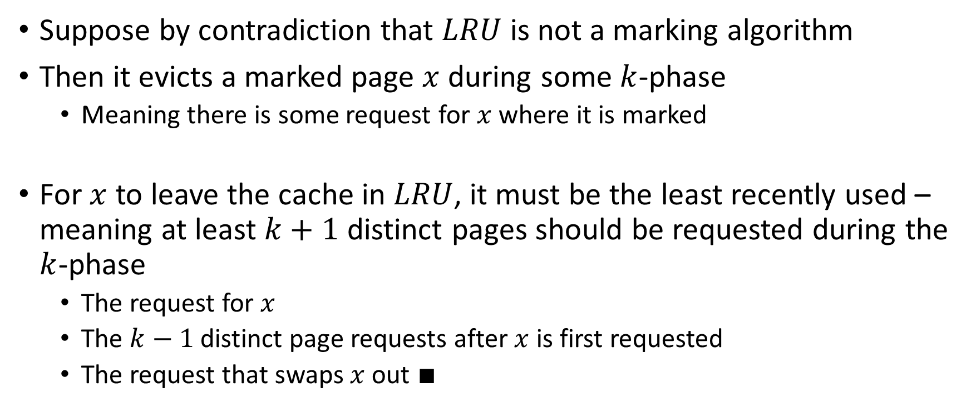

LRU is a marking algorithm (Proof)
Suppose by contradiction that $LRU$ is not a marking algorithm
Then it evicts a marked page $x$ during some $k$-phase
  Meaning there is some request for $x$ where it is marked
For $x$ to leave the cache in $LRU$, it must be the least recently used – meaning at least $k+1$ distinct pages should be requested during the $k$-phase
  The request for $x$
  The $k−1$ distinct page requests after $x$ is first requested
  The request that swaps $x$ out $∎$
$x$ is removed
… | $$x$$ | … | * | …

Slide 33
FIFO is not a marking algorithm (example)
1 | 2 | 3 | 3 | 4 | 2 | 1
1
1
2
1 | 2
3
1 | 2 | 3
3
1 | 2 | 3
4
2
1
1 | 2 | 3
4 | 2 | 3
4 | 2 | 3
4 | 1 | 3

Slide 34

An Upper Bound for Marking Algorithms
Let $ALG$ be any marking algorithm with a cache of size $k$. Then $ALG$ is $k−competitive$.

Slide 35
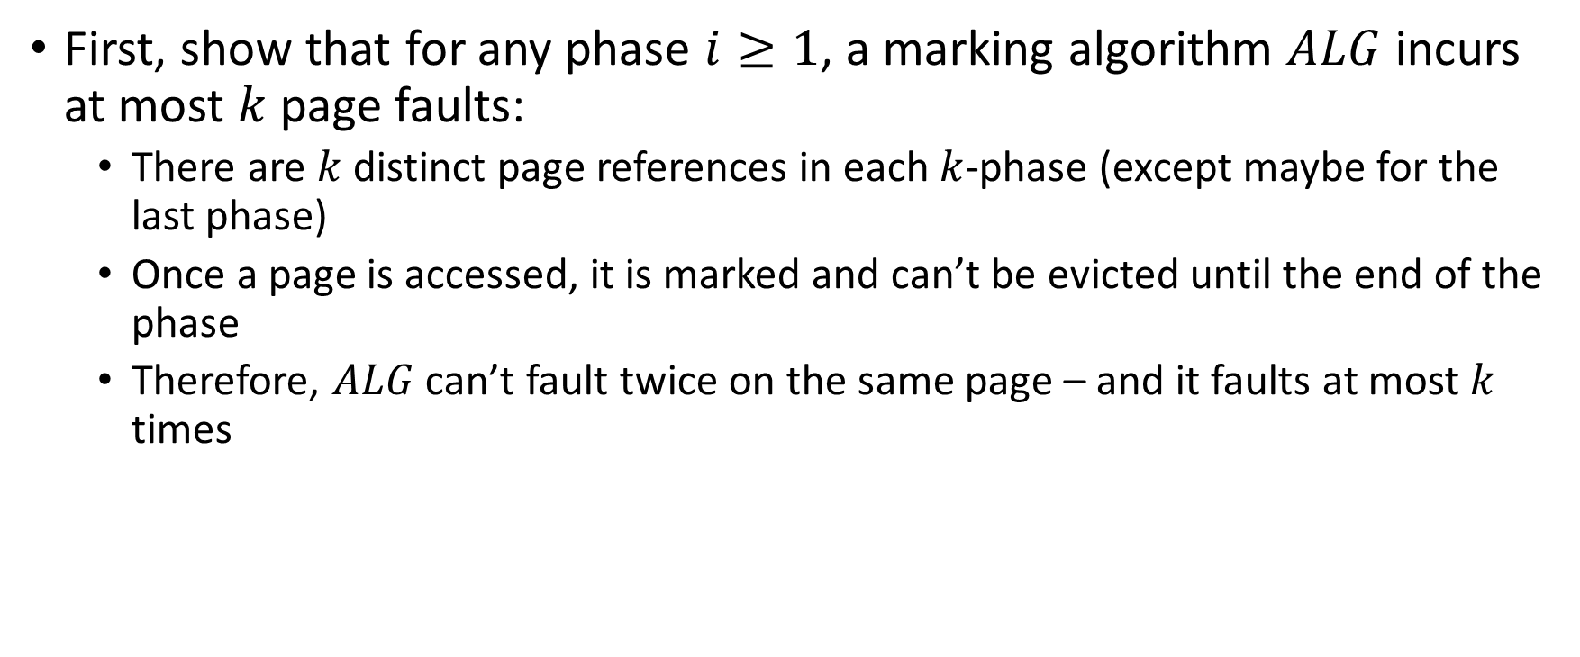
Proof (1)
First, show that for any phase $i≥1$, a marking algorithm $ALG$ incurs at most $k$ page faults:
  There are $k$ distinct page references in each $k$-phase (except maybe for the last phase)
  Once a page is accessed, it is marked and can’t be evicted until the end of the phase
  Therefore, $ALG$ can’t fault twice on the same page – and it faults at most $k$ times

Slide 36

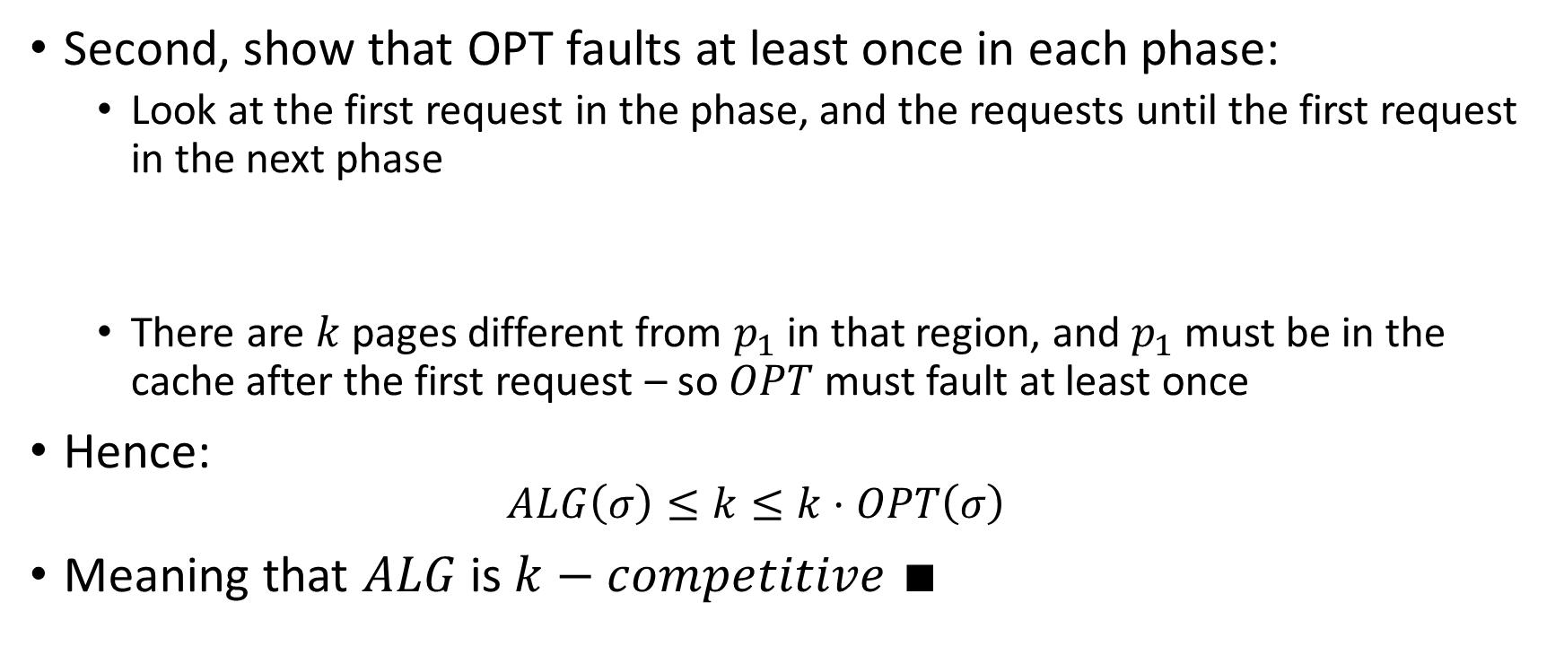

Proof (2)
Second, show that OPT faults at least once in each phase:
  Look at the first request in the phase, and the requests until the first request in the next phase
  There are $k$ pages different from $p_{1}$ in that region, and $p_{1}$ must be in the cache after the first request – so $OPT$ must fault at least once
Hence:
  $$ALG\left(σ\right)≤k≤k⋅OPT\left(σ\right)$$
Meaning that $ALG$ is $k−competitive$ $∎$
$k$ different pages
… | $$p_{1}$$ | $$p_{2}$$ | … | $$p_{k}$$ | $$p_{k+1}$$ | …

Slide 37

Corollary
Every marking algorithm has the optimal competitive ratio possible for a deterministic algorithm
  Both $FWF$ and $LRU$ are “optimal” in that sense

Slide 38
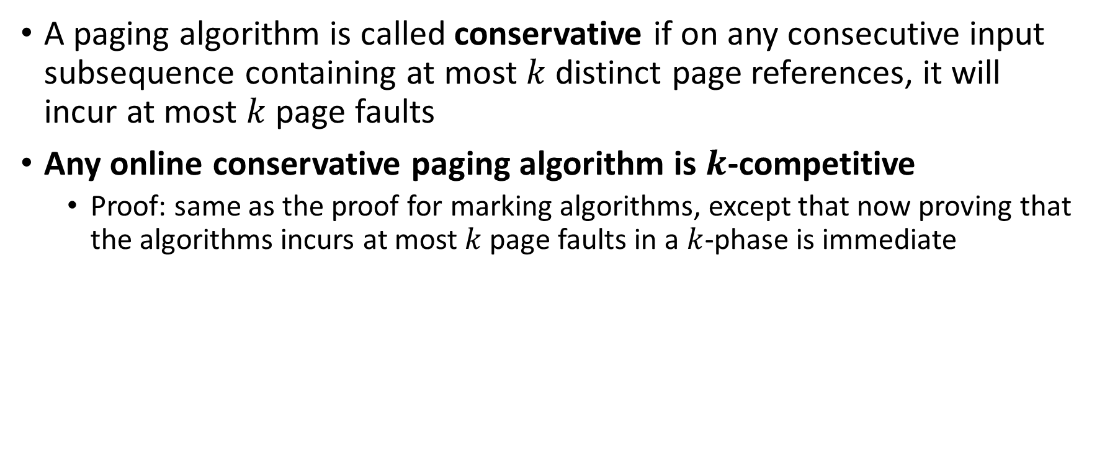
Conservative Algorithms
A paging algorithm is called conservative if on any consecutive input subsequence containing at most $k$ distinct page references, it will incur at most $k$ page faults
Any online conservative paging algorithm is $k$-competitive
  Proof: same as the proof for marking algorithms, except that now proving that the algorithms incurs at most $k$ page faults in a $k$-phase is immediate

Slide 39
Conservative vs Marking Algorithms
LRU is both conservative and marking
FIFO is conservative
  Trivial to show
  → Not every conservative algorithm is marking
FWF is not conservative
  → Not every marking algorithm is conservative

Slide 40
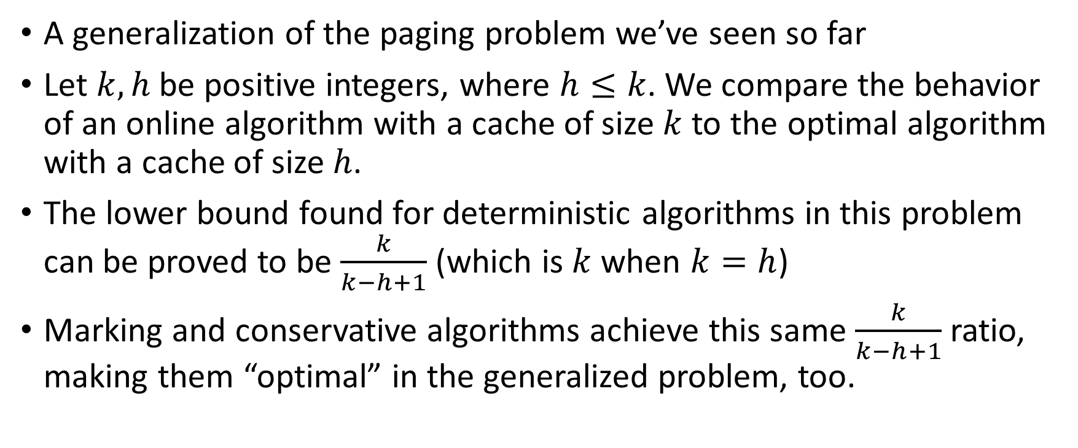
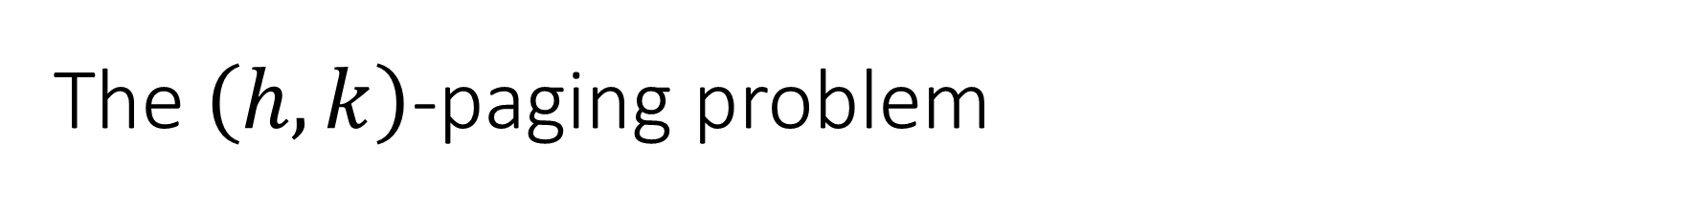
The $\left(h,k\right)$-paging problem
A generalization of the paging problem we’ve seen so far
Let $k, h$ be positive integers, where $h≤k$. We compare the behavior of an online algorithm with a cache of size $k$ to the optimal algorithm with a cache of size $h$.
The lower bound found for deterministic algorithms in this problem can be proved to be $\frac{k}{k−h+1}$ (which is $k$ when $k=h$)
Marking and conservative algorithms achieve this same $\frac{k}{k−h+1}$ ratio, making them “optimal” in the generalized problem, too.

Slide 41
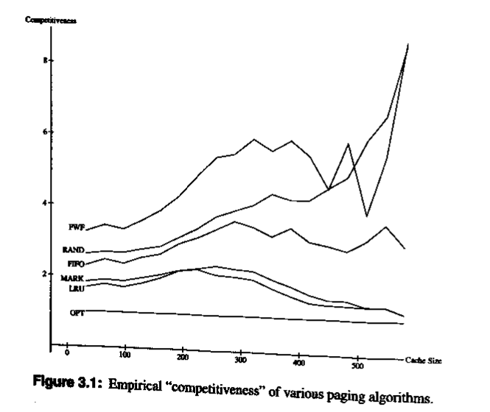
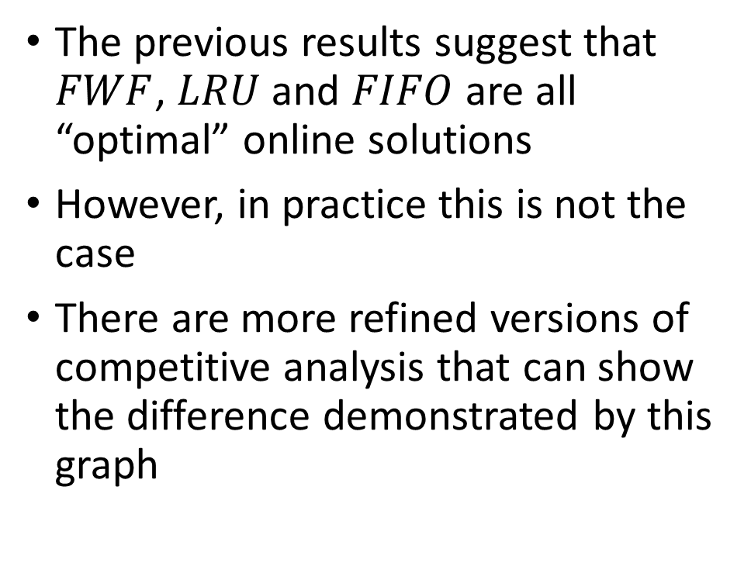
Theory vs Practice
The previous results suggest that $FWF$, $LRU$ and $FIFO$ are all “optimal” online solutions
However, in practice this is not the case
There are more refined versions of competitive analysis that can show the difference demonstrated by this graph

Slide 42
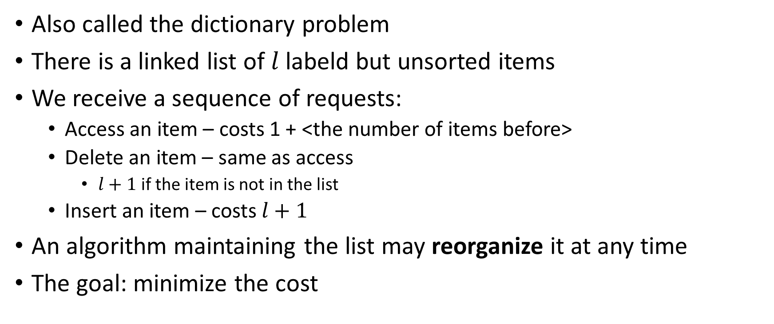
The List Accessing Problem
Also called the dictionary problem
There is a linked list of $l$ labeld but unsorted items
We receive a sequence of requests:
  Access an item – costs 1 + <the number of items before>
  Delete an item – same as access
    $l+1$ if the item is not in the list
  Insert an item – costs $l+1$
An algorithm maintaining the list may reorganize it at any time
The goal: minimize the cost

Slide 43

Free exchanges
After accessing an item, it may be moved anywhere closer to the front
For example, when requesting $c$, the cost is $3$ – and then it can be moved back to be before $a$ or $b$ for free
$$a$$
𝑎
$$b$$
𝑏
$$c$$
𝑐
…
$$e$$
𝑒
$$d$$
𝑑

Slide 44
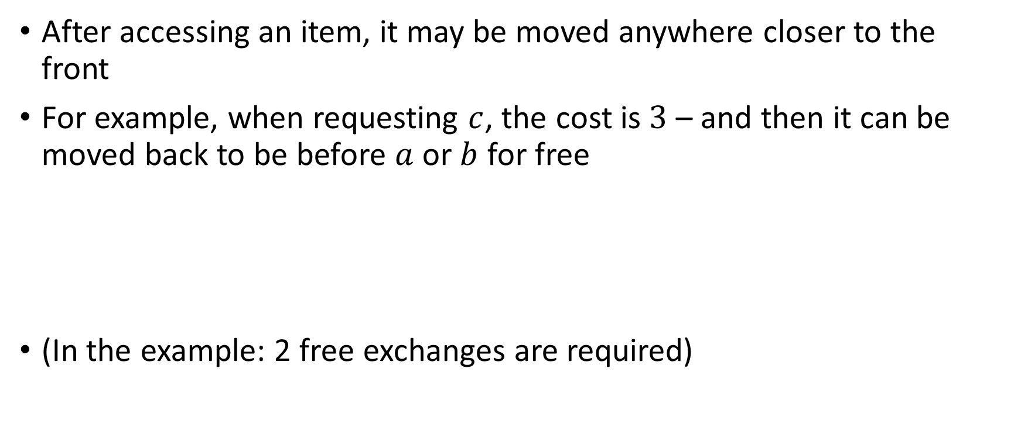
Free exchanges
After accessing an item, it may be moved anywhere closer to the front
For example, when requesting $c$, the cost is $3$ – and then it can be moved back to be before $a$ or $b$ for free
(In the example: 2 free exchanges are required)
$$a$$
𝑎
$$b$$
𝑏
$$c$$
𝑐
…
$$e$$
𝑒
$$d$$
𝑑

Slide 45
Paid Exchanges
Any other exchange of two consecutive elements is called a paid exchange and costs 1
$$a$$
𝑎
$$b$$
𝑏
$$c$$
𝑐
…
$$e$$
𝑒
$$d$$
𝑑

Slide 46
Paid Exchanges
Any other exchange of two consecutive elements is called a paid exchange and costs 1
A little bit hard to justify this cost, but in practice common online algorithms don’t use paid exchanges
$$a$$
𝑎
$$b$$
𝑏
$$c$$
𝑐
…
$$e$$
𝑒
$$d$$
𝑑

Slide 47
Some Deterministic Algorithms
MTF (Move to Front)
  After accessing / inserting an item, move it to the front of the list
TRANSPOSE
  After accessing / inserting an item, exchange it with the preceding item
FC (Frequency Count)
  Maintain the list by nonincreasing order of frequency
OPT
  The optimal offline algorithm is NP-Hard

Slide 48
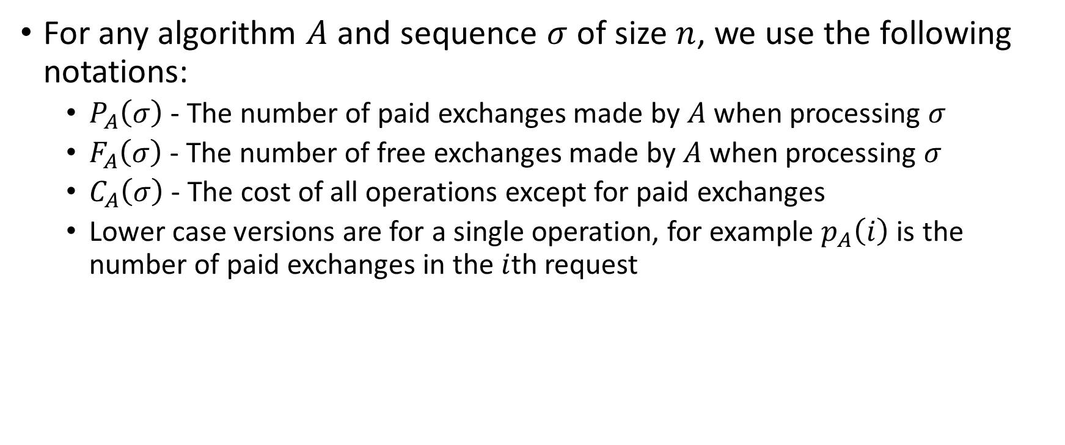
Some Notations
For any algorithm $A$ and sequence $σ$ of size $n$, we use the following notations:
  $P_{A}\left(σ\right)$ - The number of paid exchanges made by $A$ when processing $σ$
  $F_{A}\left(σ\right)$ - The number of free exchanges made by $A$ when processing $σ$
  $C_{A}\left(σ\right)$ - The cost of all operations except for paid exchanges
  Lower case versions are for a single operation, for example $p_{A}\left(i\right)$ is the number of paid exchanges in the $i$th request

Slide 49

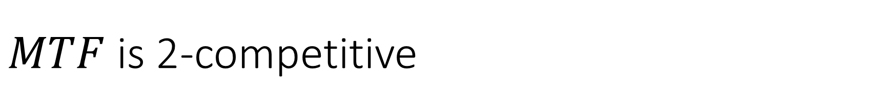
$MTF$ is 2-competitive
We will prove that
  $$MTF\left(σ\right)≤2⋅C_{OPT}\left(σ\right)+P_{OPT}\left(σ\right)−F_{OPT}\left(σ\right)−n$$
Showing that $MTF$ is 2-competitive

Slide 50

Inversions
Let $Φ_{i}$ be the number of inversions in $MTF$’s list with respect to $OPT$’s list after processing the $i$th request
An inversion is a pair $a, b$ of items, where $a$ precedes $b$ in $MTF$’s list but $b$ precedes $a$ in $OPT$’s
In the example, there are 3 inversions: $\left(a, b\right), \left(a,c\right), \left(b,c\right)$
$$a$$
𝑎
$$c$$
𝑐
$$b$$
𝑏
$$c$$
𝑐
$$a$$
𝑎
$$b$$
𝑏

Slide 51

Amortized Cost
Assume that $MTF$ and $OPT$ start with an empty list
Let $t_{i}=c_{MTF}\left(i\right)+p_{MTF}\left(i\right)=c_{MTF}\left(i\right)$ be the cost $MTF$ incurs in the $i$th request
Let $a_{i}=t_{i}+Φ_{i}−Φ_{i−1}$ the “amortized cost” of the $i$th request
We know that:
$$MTF\left(σ\right)=\sum_{i=1}^{n}{t_{i}}=\sum_{i=1}^{n}{\left(a_{i}−Φ_{i}+Φ_{i−1}\right)}=Φ_{0}−Φ_{n}+\sum_{i=1}^{n}{a_{i}}≤\sum_{i=1}^{n}{a_{i}}$$
[Since $Φ_{0}=0$ (both lists start empty) and $Φ_{n}≥0$]

Slide 52

Proof
Claim: $∀i, a_{i}≤2⋅c_{OPT}\left(i\right)−1+p_{OPT}\left(i\right)−f_{OPT}\left(i\right)$
Hence:
$$MTF\left(σ\right)≤\sum_{i=1}^{n}{a_{i}}≤\sum_{i=1}^{n}{\left(2⋅c_{OPT}\left(i\right)−1+p_{OPT}\left(i\right)−f_{OPT}\left(i\right)\right)}=$$
$$=2⋅C_{OPT}\left(σ\right)+P_{OPT}\left(σ\right)−F_{OPT}\left(σ\right)−n$$

Slide 53




Proof of Claim
Let $X$ be the item at location $j$ in $OPT$’s list (and position $k$ in $MTF$’s list) just after processing request $i−1$
Assume there are $v$ items before $X$ in $MTF^{′}s$ list, but after $X$ in $OPT$’s list
There are at least $k−1−v$ common elements before $X$ in both lists
1
$$k$$
#
*
#
*
#
#
$$X$$
𝑋
*
MTF
1
$$j$$
#
#
$$X$$
𝑋
*
*
#
*
#
OPT
$$j−1$$

Slide 54




$MTF$’s effect on inversions
$MTF$ moves $X$ to the front, creating $k−1−v$ new inversions, and destroying $v$ inversions
1
$$k$$
#
*
#
*
#
#
$$X$$
𝑋
*
MTF
1
$$j$$
#
#
$$X$$
𝑋
*
*
#
*
#
OPT

Slide 55


$MTF$’s effect on inversions
$MTF$ moves $X$ to the front, creating $k−1−v$ new inversions, and destroying $v$ inversions
In total, $k−1−v−v=k−2v−1$ inversions
1
$$k$$
#
*
#
*
#
#
$$X$$
𝑋
*
MTF
1
$$j$$
#
#
$$X$$
𝑋
*
*
#
*
#
OPT

Slide 56




$OPT$’s effect on inversions
Every free exchange in $OPT$ removes exactly one inversion
1
$$k$$
$$X$$
𝑋
#
MTF
1
$$j$$
$$X$$
𝑋
*
#
OPT

Slide 57


$OPT$’s effect on inversions
Every free exchange in $OPT$ removes exactly one inversion
$f_{OPT}\left(i\right)$ inversions removed
At most $p_{OPT}\left(i\right)$ inversions added by paid exchanges
1
$$k$$
$$X$$
𝑋
#
MTF
1
$$j$$
$$X$$
𝑋
*
#
OPT

Slide 58


Bounding $a_{i}$
From the previous slides we get that:
$$Φ_{i}−Φ_{i−1}≤k−2v−1+p_{OPT}\left(i\right)−f_{OPT}\left(i\right)$$
Therefore:
$$a_{i}=c_{MTF}\left(i\right)+Φ_{i}−Φ_{i−1}≤$$
$$≤k+k−2v−1+p_{OPT}\left(i\right)−f_{OPT}\left(i\right)=$$
$$=2⋅\left(k−v\right)−1+p_{OPT}\left(i\right)−f_{OPT}\left(i\right)$$

Slide 59




Bounding $a_{i}$ (2)
Recall that $k−v≤j$ and that $c_{OPT}\left(i\right)=j$
And we get:
  $$a_{i}≤2j−1+p_{OPT}\left(i\right)−f_{OPT}\left(i\right)=2⋅c_{OPT}\left(i\right)−1+p_{OPT}\left(i\right)−f_{OPT}\left(i\right) ∎$$
1
$$j$$
#
#
$$X$$
𝑋
*
*
#
*
#
OPT
$$j−1$$

Slide 60

Some Interesting Notes
It can be proved that $MTF$ is an optimal deterministic algorithm for the list accessing problem
There is a known lower bound of $\frac{3}{2}$ for randomized algorithms
  There are known $\frac{7}{4}$ and $\frac{8}{5}$-competitive randomized algorithms
List accessing algorithms can be used for compression
  $MTF$ was found to be better than Huffman encoding in some cases

Slide 61
Bibliography
Allan Borodin and Ran El-Yaniv. 1998. Online computation and competitive analysis. Cambridge University Press, USA.
  Chapters 1+3
Daniel D. Sleator and Robert E. Tarjan. 1985. Amortized efficiency of list update and paging rules. Commun. ACM 28, 2 (Feb. 1985), 202–208. DOI:https://doi.org/10.1145/2786.2793

