Slide 1
Learning Augmented Weighted Paging
Nikhil Bansal, Christian Coester, ravi kumar, manish purohit, erik vee
Nov 2021
Seminar in algorithms 2022, Michael sehaik

Slide 2
Plan
LFD, Weighted Paging
Learning-Augmented Setting
Deterministic weighted paging with predictions
Randomized weighted paging with predictions

Slide 3



























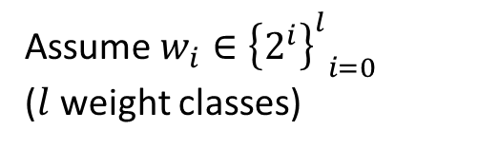




Weighted Paging
Set of $n$ pages
1
2
3
4
5
6
7
8
9
10
Each page has a weight (cost of fetching)
$$w_{1}$$
$$w_{2}$$
$$w_{3}$$
$$w_{4}$$
$$w_{5}$$
$$w_{6}$$
$$w_{7}$$
$$w_{8}$$
$$w_{9}$$
$$w_{10}$$
$$=$$
$$=$$
$$=$$
$$=$$
$$=$$
$$=$$
$$=$$
$$=$$
$$=$$
$$=$$
Assume $w_{i}∈{{\left\{2^{i}\right\}}^{l}}_{i=0}$
($l$ weight classes)
$$2$$
$$4$$
$$2$$
$$8$$
$$32$$
$$4$$
$$1$$
$$8$$
$$1$$
$$16$$
Cache of size $k<n$

Slide 4









Weighted Paging
Request Sequence $σ=1,2,3,2,4,1,2,…$
1
1 | 2
1 | 2 | 3
1 | 2 | 3
1 | 2 | 4
1 | 2 | 4
1 | 2 | 4
$$Miss \\ Pay w_{1}$$
$$Miss \\ Pay w_{2}$$
$$Miss \\ Pay w_{3}$$
$$Hit$$
$$Miss \\ Pay w_{4}$$
$$Hit$$
$$Hit$$
Total cost on $σ=w_{1}+w_{2}+w_{3}+w_{4}+…$
Goal: Minimize Cost

Slide 5


LFD
Optimal offline Algorithm for unweighted paging
Enough to know the next request time for each page
Request Sequence $σ=1,2,3,2,4,1,2,…$
1
1 | 2
1 | 2 | 3
1 | 2 | 3
1 | 2 | 4
1 | 2 | 4
1 | 2 | 4
Page $3$ is requested furthest in future$→$ Evict it
Notes:
Longest Forward Distance
LFD can be calculated online with predictions

Slide 6

Learning-Augmented Setting
Motivated by advancements in machine learning
At each step $t$, along with the current page request $σ_{t}:$
  we are also given $τ_{t}$: the predicted arrival time for the next request of the same page.
Note: Predictions can be incorrect
Notes:
Learning-augmented algorithms have received a lot of attention recently. Besides paging [45], they have been
considered for a wide range of problems such as ski-rental [33, 40], scheduling [8, 34, 40, 48], load balancing [42, 44],
secretary [7], metrical task systems [6], set cover [9], flow and matching [43], and bin packing

Slide 7

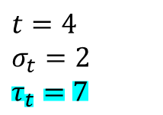




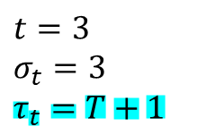
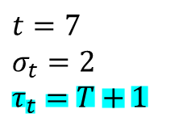


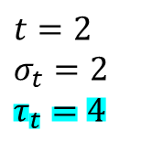


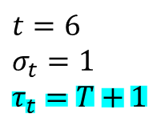

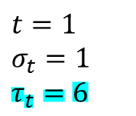





Learning-Augmented Setting
Request Sequence $σ=1,2,3,2,4,1,2,…$
$$t=1$$
$$σ_{t}=1$$
$$τ_{t}=6$$
$$t=2$$
$$σ_{t}=2$$
$$τ_{t}=4$$
$$t=3$$
$$σ_{t}=3$$
$$τ_{t}=T+1$$
$$t=4$$
$$σ_{t}=2$$
$$τ_{t}=7$$
$$t=5$$
$$σ_{t}=4$$
$$τ_{t}=T+1$$
$$t=6$$
$$σ_{t}=1$$
$$τ_{t}=T+1$$
$$t=7$$
$$σ_{t}=2$$
$$τ_{t}=T+1$$
1
1 | 2
1 | 2 | 3
1 | 2 | 3
1 | 2 | 4
1 | 2 | 4
1 | 2 | 4
$$Miss \\ Pay w_{1}$$
$$Miss \\ Pay w_{2}$$
$$Miss \\ Pay w_{3}$$
$$Hit$$
$$Miss \\ Pay w_{4}$$
$$Hit$$
$$Hit$$
$$t=1$$
$$t=2$$
$$t=3$$
$$t=4$$
$$t=5$$
$$t=6$$
$$t=7$$

Slide 8




















Inversion
Let $a_{t}$ be the actual next arrival time of $σ_{t}$
Call $s,t∈T$ an inversion iff $σ_{s},σ_{t}$ belong to the same weight class and $τ_{s}≥τ_{t}$ but $a_{s}<a_{t}$
10
25
34
10
25
34
10
25
34
$$w=2 \\ τ=4$$
$$w=4 \\ τ=5$$
$$w=2 \\ τ=6$$
$$w=2 \\ τ=7$$
$$w=4 \\ τ=8$$
$$w=2 \\ τ=9$$
$$w=2 \\ τ=10$$
$$w=4 \\ τ=11$$
$$w=2 \\ τ=12$$
$$1$$
$$2$$
$$3$$
$$4$$
$$5$$
$$6$$
$$7$$
$$8$$
$$9$$
$$t$$
No Inversions

Slide 9

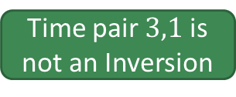

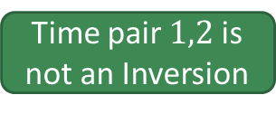
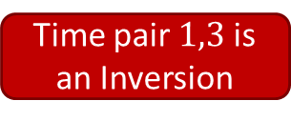
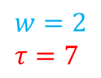
Inversion
predicted
actual
10
25
34
10
25
34
10
25
34
$$w=2 \\ τ=7$$
$$w=4 \\ τ=5$$
$$w=2 \\ τ=6$$
$$w=2 \\ τ=7$$
$$w=4 \\ τ=8$$
$$w=2 \\ τ=9$$
$$w=2 \\ τ=10$$
$$w=4 \\ τ=11$$
$$w=2 \\ τ=12$$
$$1$$
$$2$$
$$3$$
$$4$$
$$5$$
$$6$$
$$7$$
$$8$$
$$9$$
$$t$$
Time pair $1,3$ is an Inversion
Time pair $1,2$ is not an Inversion
Time pair $3,1$ is not an Inversion
Different weight class
$$a_{3}>a_{1}$$
Notes:
Page of time 1 (10) and of time 3 (34) are same weight, and page 10 comes before page 34.

Slide 10

Prediction Error
Let $ε_{i}\left(σ,τ\right)$ be the number of inversions within class $i$
The prediction error is defined as:
$$ε≔ε\left(σ,τ\right)≔\sum_{i}{w_{i}⋅ε_{i}\left(σ,τ\right)}$$

Slide 11

Previous Work (Without Predictions)
There is an $O(k)$-competitive deterministic algorithm for weighted paging
There is an $O(\log{k})$-competitive randomized algorithm for weighted paging
See reference in paper $\left[11\right],\left[13\right],\left[24\right]$
Notes:
Primal dual with entropic regularization

Slide 12

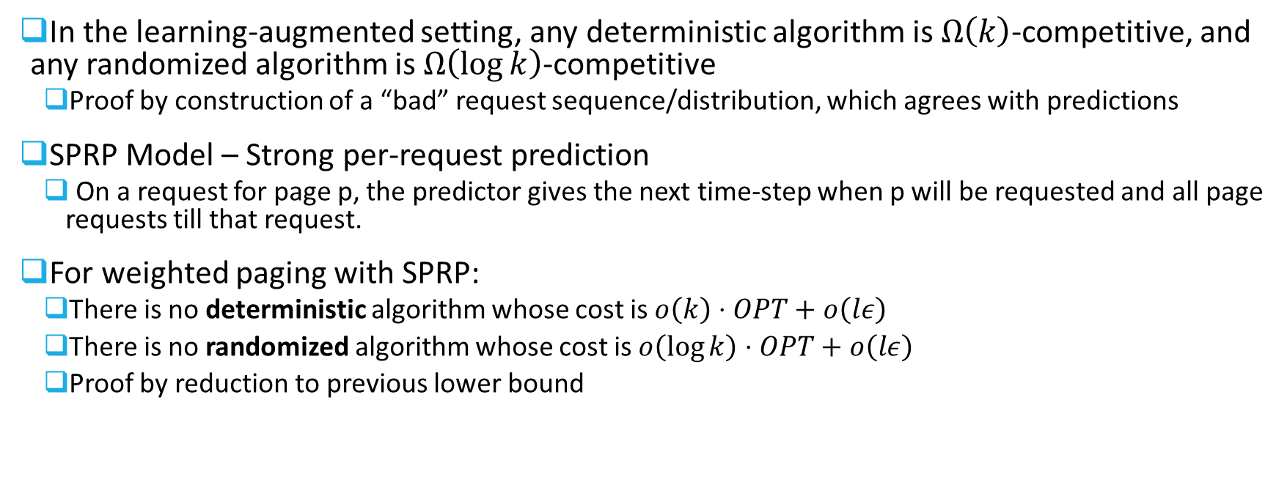
Lower Bound ($l=k+1$)
In the learning-augmented setting, any deterministic algorithm is $Ω\left(k\right)$-competitive, and any randomized algorithm is $Ω\left(\log{k}\right)$-competitive
  Proof by construction of a “bad” request sequence/distribution, which agrees with predictions
SPRP Model – Strong per-request prediction
  On a request for page p, the predictor gives the next time-step when p will be requested and all page requests till that request.
For weighted paging with SPRP:
  There is no deterministic algorithm whose cost is $o\left(k\right)⋅OPT+o\left(lε\right)$
  There is no randomized algorithm whose cost is $o\left(\log{k}\right)⋅OPT+o\left(lε\right)$
  Proof by reduction to previous lower bound
Z. Jiang, D. Panigrahi, and K. Sun. Online algorithms for weighted paging with predictions. In ICALP, pages 69:1–69:18, 2020

Slide 13

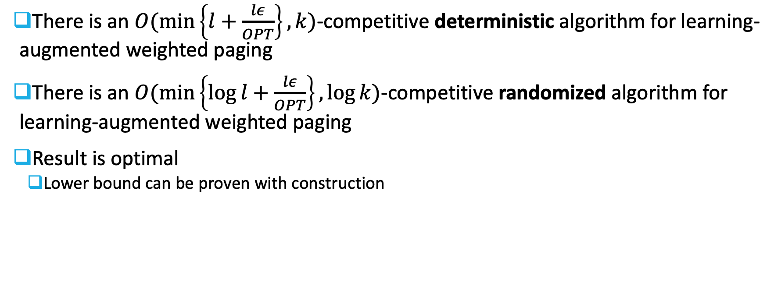




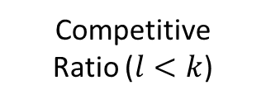

Results (With Predictions)
There is an $O(\min\left\{l+\frac{lε}{OPT}\right\},k)$-competitive deterministic algorithm for learning-augmented weighted paging
There is an $O(\min\left\{\log{l}+\frac{lε}{OPT}\right\},\log{k})$-competitive randomized algorithm for learning-augmented weighted paging
Result is optimal
  Lower bound can be proven with construction
Competitive
Ratio ($l<k$)
$$deterministic$$
$$k$$
$$l$$
$$randomized$$
$$\log{k}$$
$$\log{l}$$
Prediction Error
Notes:
Robust
Note l=1 with perfect predictions is LFD
The competitive ration degrades smoothly from $O\left(l\right)$ and $O\left(\log{l}\right)$ to $O\left(k\right)$ and $O\left(\log{k}\right)$, respectively, as the prediction error increases
Using standard techniques to combine online algorithms

Slide 14

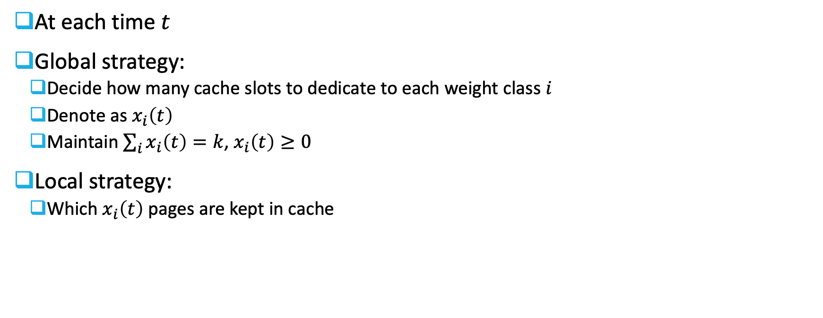






Algorithm High-Level Description
At each time $t$
Global strategy:
  Decide how many cache slots to dedicate to each weight class $i$
  Denote as $x_{i}\left(t\right)$
  Maintain $\sum_{i}{x_{i}\left(t\right)=k}$, $x_{i}\left(t\right)≥0$
Local strategy:
  Which $x_{i}\left(t\right)$ pages are kept in cache
$$Global Strategy:$$
$$x_{1}=3$$
$$x_{2}=2$$
$$x_{3}=4$$
$$x_{4}=3$$
1 | 4 | 6 | 3 | 2 | 7 | 22 | 14 | 5 | 8 | 9 | 12
$$Local Strategy:$$
evict
$$σ_{t}=13$$

Slide 15



















Deterministic Algorithm
Global Strategy:
  Init water-level $∀i:α_{i}={w_{i}=2}^{i}$
$$Request:$$
Page: $23$ Class: $1$ $τ=68$
$$α_{1}=1$$
$$α_{2}=2$$
$$α_{3}=8$$
$$α_{4}=16$$
1 | 4 | 6 | 3 | 2 | 7 | 22 | 14 | 5 | 8 | 9 | 12
$$τ=20$$
$$τ=40$$
$$τ=47$$
$$τ=2$$
$$τ=13$$
$$τ=90$$
$$τ=9$$
$$τ=4$$
$$τ=15$$
$$τ=16$$
$$τ=5$$
$$τ=45$$

Slide 16





Deterministic Algorithm
Global Strategy:
  Evict from class$i^{′}=\arg{\min{α_{i}}}$ (only if $x_{i}>0$)
Local Strategy:
  Evict page with furthest predicted next arrival time
$$Request:$$
Page: $23$ Class: $1$ $τ=68$
$$α_{1}=1$$
$$α_{2}=2$$
$$α_{3}=8$$
$$α_{4}=16$$
1 | 4 | 6 | 3 | 2 | 7 | 22 | 14 | 5 | 8 | 9 | 12
$$τ=20$$
$$τ=40$$
$$τ=47$$
$$τ=2$$
$$τ=13$$
$$τ=90$$
$$τ=9$$
$$τ=4$$
$$τ=15$$
$$τ=16$$
$$τ=5$$
$$τ=45$$

Slide 17









Deterministic Algorithm
Global Strategy:
  Set $∀i≠i^{′}(in cache):α_{i}\left(t+1\right)=α_{i}\left(t\right)−α_{i^{′}}$
$$Request:$$
Page: $23$ Class: $1$ $τ=68$
$$α_{1}=0$$
$$α_{2}=1$$
$$α_{3}=7$$
$$α_{4}=15$$
1 | 4 | 6 | 3 | 2 | 7 | 22 | 14 | 5 | 8 | 9 | 12
$$τ=20$$
$$τ=40$$
$$τ=47$$
$$τ=2$$
$$τ=13$$
$$τ=90$$
$$τ=9$$
$$τ=4$$
$$τ=15$$
$$τ=16$$
$$τ=5$$
$$τ=45$$

Slide 18




Deterministic Algorithm
Global Strategy:
  Reset $α_{i^{′}}=w_{i^{′}}=2^{i^{′}}$
$$Request:$$
Page: $23$ Class: $1$ $τ=68$
$$α_{1}=1$$
$$α_{2}=1$$
$$α_{3}=7$$
$$α_{4}=15$$
1 | 4 | 6 | 3 | 2 | 7 | 22 | 14 | 5 | 8 | 9 | 12
$$τ=20$$
$$τ=40$$
$$τ=47$$
$$τ=2$$
$$τ=13$$
$$τ=90$$
$$τ=9$$
$$τ=4$$
$$τ=15$$
$$τ=16$$
$$τ=5$$
$$τ=45$$

Slide 19


Deterministic Algorithm
Local Strategy:
  Replace the page
$$Request:$$
Page: $23$ Class: $1$ $τ=68$
$$α_{1}=1$$
$$α_{2}=1$$
$$α_{3}=7$$
$$α_{4}=15$$
1 | 4 | 23 | 3 | 2 | 7 | 22 | 14 | 5 | 8 | 9 | 12
$$τ=20$$
$$τ=40$$
$$τ=68$$
$$τ=2$$
$$τ=13$$
$$τ=90$$
$$τ=9$$
$$τ=4$$
$$τ=15$$
$$τ=16$$
$$τ=5$$
$$τ=45$$

Slide 20







Deterministic Algorithm
Init water-level $∀i:α_{i}=2^{i}$
Evict from class$i^{′}=\arg{\min{α_{i}}}$,
page with with furthest predicted next arrival time
  Reset $α_{i^{′}}=2^{i^{′}}$
  Set $∀i≠i^{′}:α_{i}\left(t+1\right)=α_{i}\left(t\right)−α_{i^{′}}$
$$Request:$$
Page: $87$ Class: $2$ $τ=5$
(Break ties)
$$α_{1}=1$$
$$α_{2}=1$$
$$α_{3}=7$$
$$α_{4}=15$$
1 | 4 | 23 | 3 | 2 | 7 | 22 | 14 | 5 | 8 | 9 | 12
$$τ=20$$
$$τ=40$$
$$τ=68$$
$$τ=2$$
$$τ=13$$
$$τ=90$$
$$τ=9$$
$$τ=4$$
$$τ=15$$
$$τ=16$$
$$τ=5$$
$$τ=45$$

Slide 21















Deterministic Algorithm
Init water-level $∀i:α_{i}=2^{i}$
Evict from class$i^{′}=\arg{\min{α_{i}}}$,
page with with furthest predicted next arrival time
  Reset $α_{i^{′}}=2^{i^{′}}$
  Set $∀i≠i^{′}:α_{i}\left(t+1\right)=α_{i}\left(t\right)−α_{i^{′}}$
$$Request:$$
Page: $87$ Class: $2$ $τ=5$
(Break ties)
$$α_{1}=0$$
$$α_{2}=0$$
$$α_{3}=6$$
$$α_{4}=14$$
1 | 4 | 23 | 3 | 2 | 7 | 22 | 14 | 5 | 8 | 9 | 12
$$τ=20$$
$$τ=40$$
$$τ=68$$
$$τ=2$$
$$τ=13$$
$$τ=90$$
$$τ=9$$
$$τ=4$$
$$τ=15$$
$$τ=16$$
$$τ=5$$
$$τ=45$$

Slide 22



Deterministic Algorithm
Init water-level $∀i:α_{i}=2^{i}$
Evict from class$i^{′}=\arg{\min{α_{i}}}$,
page with with furthest predicted next arrival time
  Reset $α_{i^{′}}=2^{i^{′}}$
  Set $∀i≠i^{′}:α_{i}\left(t+1\right)=α_{i}\left(t\right)−α_{i^{′}}$
$$Request:$$
Page: $87$ Class: $2$ $τ=5$
(Break ties)
$$α_{1}=1$$
$$α_{2}=0$$
$$α_{3}=6$$
$$α_{4}=14$$
1 | 4 | 23 | 3 | 2 | 7 | 22 | 14 | 5 | 8 | 9 | 12
$$τ=20$$
$$τ=40$$
$$τ=68$$
$$τ=2$$
$$τ=13$$
$$τ=90$$
$$τ=9$$
$$τ=4$$
$$τ=15$$
$$τ=16$$
$$τ=5$$
$$τ=45$$

Slide 23

Deterministic Algorithm
Init water-level $∀i:α_{i}=2^{i}$
Evict from class$i^{′}=\arg{\min{α_{i}}}$,
page with with furthest predicted next arrival time
  Reset $α_{i^{′}}=2^{i^{′}}$
  Set $∀i≠i^{′}:α_{i}\left(t+1\right)=α_{i}\left(t\right)−α_{i^{′}}$
$$Request:$$
Page: $87$ Class: $2$ $τ=5$
(Break ties)
$$α_{1}=1$$
$$α_{2}=0$$
$$α_{3}=6$$
$$α_{4}=14$$
1 | 4 | 87 | 3 | 2 | 7 | 22 | 14 | 5 | 8 | 9 | 12
$$τ=20$$
$$τ=40$$
$$τ=5$$
$$τ=2$$
$$τ=13$$
$$τ=90$$
$$τ=9$$
$$τ=4$$
$$τ=15$$
$$τ=16$$
$$τ=5$$
$$τ=45$$

Slide 24







Deterministic Algorithm
Init water-level $∀i:α_{i}=2^{i}$
Evict from class$i^{′}=\arg{\min{α_{i}}}$,
page with with furthest predicted next arrival time
  Reset $α_{i^{′}}=2^{i^{′}}$
  Set $∀i≠i^{′}:α_{i}\left(t+1\right)=α_{i}\left(t\right)−α_{i^{′}}$
$$Request:$$
Page: $23$ Class: $4$ $τ=8$
(Break ties)
$$α_{1}=1$$
$$α_{2}=0$$
$$α_{3}=6$$
$$α_{4}=14$$
1 | 4 | 87 | 3 | 2 | 7 | 22 | 14 | 5 | 8 | 9 | 12
$$τ=20$$
$$τ=40$$
$$τ=5$$
$$τ=2$$
$$τ=13$$
$$τ=90$$
$$τ=9$$
$$τ=4$$
$$τ=15$$
$$τ=16$$
$$τ=5$$
$$τ=45$$

Slide 25




Deterministic Algorithm
Init water-level $∀i:α_{i}=2^{i}$
Evict from class$i^{′}=\arg{\min{α_{i}}}$,
page with with furthest predicted next arrival time
  Reset $α_{i^{′}}=2^{i^{′}}$
  Set $∀i≠i^{′}:α_{i}\left(t+1\right)=α_{i}\left(t\right)−α_{i^{′}}$
$$Request:$$
Page: $23$ Class: $4$ $τ=8$
(Break ties)
$$α_{1}=1$$
$$α_{2}=0$$
$$α_{3}=6$$
$$α_{4}=14$$
1 | 4 | 87 | 3 | 2 | 7 | 22 | 14 | 5 | 8 | 9 | 12
$$τ=20$$
$$τ=40$$
$$τ=5$$
$$τ=2$$
$$τ=13$$
$$τ=90$$
$$τ=9$$
$$τ=4$$
$$τ=15$$
$$τ=16$$
$$τ=5$$
$$τ=45$$

Slide 26

Deterministic Algorithm
Init water-level $∀i:α_{i}=2^{i}$
Evict from class$i^{′}=\arg{\min{α_{i}}}$,
page with with furthest predicted next arrival time
  Reset $α_{i^{′}}=2^{i^{′}}$
  Set $∀i≠i^{′}:α_{i}\left(t+1\right)=α_{i}\left(t\right)−α_{i^{′}}$
$$Request:$$
Page: $23$ Class: $4$ $τ=8$
(Break ties)
$$α_{1}=1$$
$$α_{2}=2$$
$$α_{3}=6$$
$$α_{4}=14$$
1 | 4 | 87 | 3 | 2 | 7 | 22 | 14 | 5 | 8 | 9 | 12
$$τ=20$$
$$τ=40$$
$$τ=5$$
$$τ=2$$
$$τ=13$$
$$τ=90$$
$$τ=9$$
$$τ=4$$
$$τ=15$$
$$τ=16$$
$$τ=5$$
$$τ=45$$

Slide 27






Deterministic Algorithm
Init water-level $∀i:α_{i}=2^{i}$
Evict from class$i^{′}=\arg{\min{α_{i}}}$,
page with with furthest predicted next arrival time
  Reset $α_{i^{′}}=2^{i^{′}}$
  Set $∀i≠i^{′}:α_{i}\left(t+1\right)=α_{i}\left(t\right)−α_{i^{′}}$
$$Request:$$
Page: $23$ Class: $4$ $τ=8$
(Break ties)
$$α_{1}=1$$
$$α_{2}=2$$
$$α_{3}=6$$
$$α_{4}=14$$
1 | 4 | 87 | 3 | 7 | 22 | 14 | 5 | 23 | 8 | 9 | 12
$$τ=20$$
$$τ=40$$
$$τ=5$$
$$τ=2$$
$$τ=90$$
$$τ=9$$
$$τ=4$$
$$τ=15$$
$$τ=8$$
$$τ=16$$
$$τ=5$$
$$τ=45$$
Notes:
Intuition – we pay much more to bring larger weights, so we prefer to evict the smaller weights
We want to distribute the misses evenly.
For every 2 misses of previous weight level we have one miss of our weight level so npace is about 1/wi. Very similar to coins!

Slide 28





Analysis
Let $On$ be the presented online algorithm, and let $OPT$ be some optimal offline algorithm
Let $n_{i}$ be the number of pages with weight $i$ in cache
Denote the excess for weight $i$: $e_{i}=\max\left\{n_{i}^{On}−n_{i}^{OPT},0\right\}$
$$Online:$$
$$e_{i}∈ℕ$$
$$Offline:$$
$$e_{i}:$$
1
0
0
2
0

Slide 29


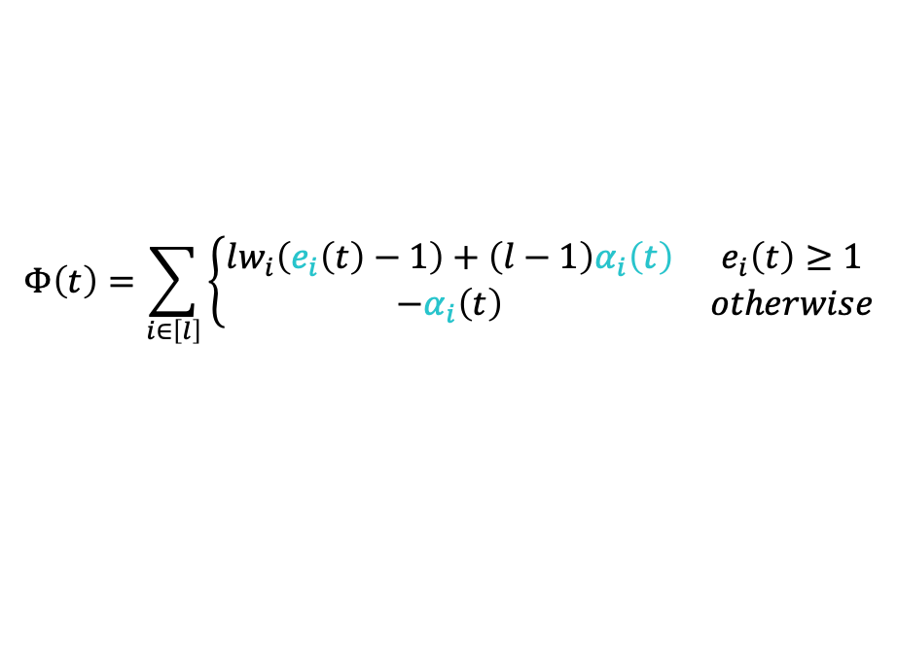











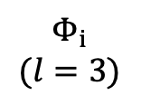


Analysis
Define potential $Φ\left(t\right)$
$${3w}_{3}$$
Potential is increasing
in each $e_{i}$
$$Φ_{i}$$
$$(l=3)$$
$${3w}_{2}$$
$$Φ\left(t\right)=\sum_{i∈\left[l\right]}{\left\{\begin{matrix}lw_{i}\left(e_{i}\left(t\right)−1\right)+\left(l−1\right)α_{i}\left(t\right) & e_{i}\left(t\right)≥1 \\ −α_{i}\left(t\right) & otherwise\end{matrix}\right.}$$
$${2α}_{3}$$
$Φ=$ + +
$${2α}_{2}$$
$${3w}_{1}$$
$${2α}_{1}$$
$$1$$
$$e_{i}$$
$${−α}_{1}$$
$$k$$
$${−α}_{2}$$
$${−α}_{3}$$
Notes:
Place for larger weight in cache increases potential faster (also freeing decreases faster)
If e=0 we are not storing energy for this weight class.
Potential is function of alpha and excess – we consider only these changes when analyzing

Slide 30
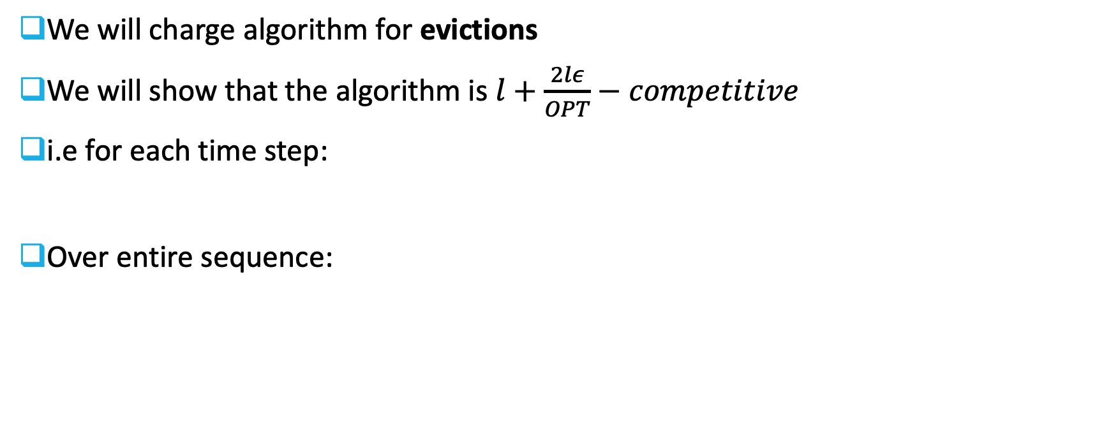
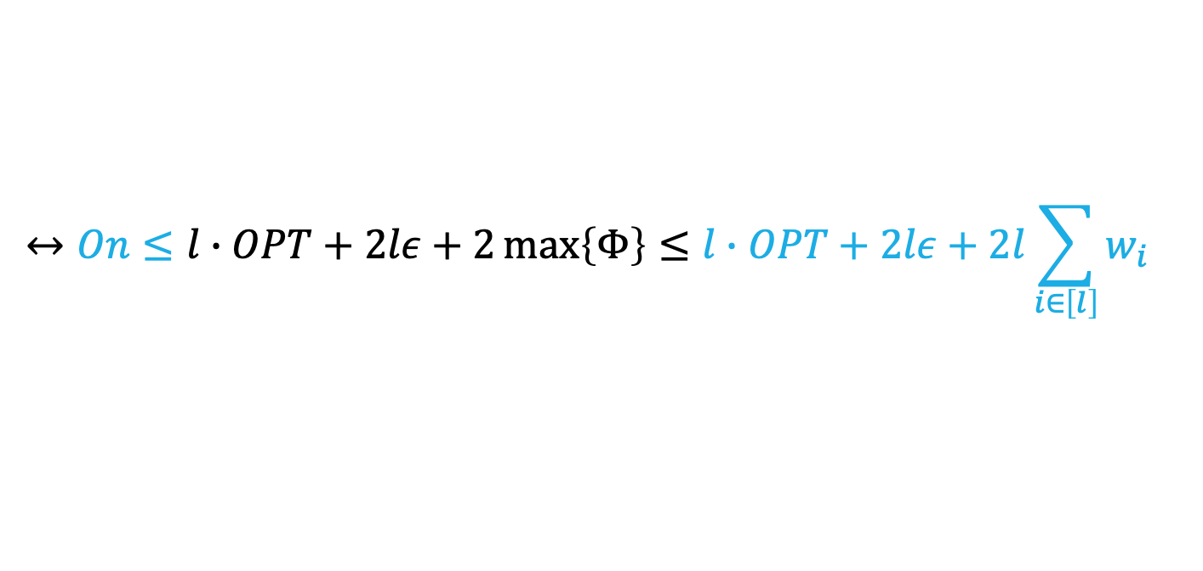


Analysis
We will charge algorithm for evictions
We will show that the algorithm is $l+\frac{2lε}{OPT}−competitive$
i.e for each time step:
Over entire sequence:
$$ΔOn+ΔΦ≤lΔOPT+2lΔε$$
$$On+Φ_{T}−Φ_{0}≤l∙OPT+2lε$$
$$↔On≤l∙OPT+2lε+2\max\left\{Φ\right\}≤l∙OPT+2lε+2l\sum_{i∈\left[l\right]}{w_{i}}$$
Notes:
Delta phi – increase in potential
Delta epsilon – increase in prediction error
If OPT has miss on every weight class additive constant can be ignored

Slide 31




Analysis
Split events of time $t$ to steps:
  Offline algorithm serves the request
  Online algorithm serves the request and possible increase in $ε$
$$Step 1: Δ_{OPT}Φ≤lΔOPT$$
$$+$$
$$Step 2: ΔOn+Δ_{ON}Φ≤2lΔε$$
$$ΔOn+Δ_{OPT}Φ+Δ_{ON}Φ≤lΔOPT+2lΔε$$

Slide 32


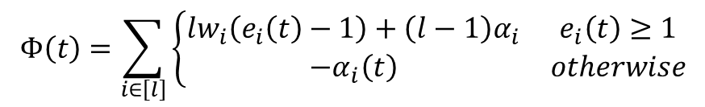
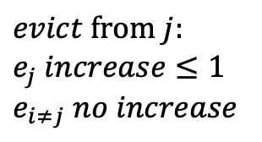



Analysis
$$Φ\left(t\right)=\sum_{i∈\left[l\right]}{\left\{\begin{matrix}lw_{i}\left(e_{i}\left(t\right)−1\right)+\left(l−1\right)α_{i} & e_{i}\left(t\right)≥1 \\ −α_{i}\left(t\right) & otherwise\end{matrix}\right.}$$
$$Step 1: Δ_{OPT}Φ≤lΔOPT$$
If $σ_{t}$ is in the offline cache:
  $Δ_{OPT}Φ=0$
  $ΔOPT=0$
Otherwise:
  $ΔOPT=w_{j}$ (page from $j$is evicted)
$σ_{t}$ from class $r$
$$Offline:$$
1 | 4 | 6 | 3 | 2 | 7 | 22 | 14 | 5 | 8 | 9 | 12
$$evict from j:$$
$$e_{j} increase≤1$$
$$e_{i≠j} no increase$$
$$ΔΦ_{OPT}≤lw_{j}=lΔ_{OPT}$$
Notes:
Offline can change the excess. Potential is rising in excess
𝑒𝑗 can increase by at most 1 and no other 𝑒𝑖 can increase

Slide 33


Analysis
$$Φ\left(t\right)=\sum_{i∈\left[l\right]}{\left\{\begin{matrix}lw_{i}\left(e_{i}\left(t\right)−1\right)+\left(l−1\right)α_{i} & e_{i}\left(t\right)≥1 \\ −α_{i}\left(t\right) & otherwise\end{matrix}\right.}$$
$$Step 2: ΔOn+Δ_{ON}Φ≤2lΔε$$
If $σ_{t}$ is already in Online cache:
  $ΔOn=0$
  $Δ_{ON}Φ=0$
Notes:
i’ is like before – minimum alpha i

Slide 34






Analysis
$$Φ\left(t\right)=\sum_{i∈\left[l\right]}{\left\{\begin{matrix}lw_{i}\left(e_{i}\left(t\right)−1\right)+\left(l−1\right)α_{i} & e_{i}\left(t\right)≥1 \\ −α_{i}\left(t\right) & otherwise\end{matrix}\right.}$$
$$Step 2: ΔOn+Δ_{ON}Φ≤2lΔε$$
Otherwise, we consider the sub-steps:
  Level of each $α_{i}\left(t\right)$ is decreased by $α_{i^{′}}\left(t\right)$
  Page evicted from class $i^{′}$ and $α_{i^{′}}$ is reset from $0$ to $w_{i^{′}}$
  Page $σ_{t}$ is fetched to the cache
$$Step 2.a: Δ_{ON,a}Φ≤lΔε$$
$$+$$
$$Step 2.b: ΔOn+Δ_{ON,b}Φ≤0$$
$$+$$
$$Step 2.c: Δ_{ON,c}Φ≤lΔε$$
$$ΔOn+Δ_{ON,a}Φ+Δ_{ON,b}Φ+Δ_{ON,c}Φ≤lΔε+lΔε$$
Notes:
i’ is like before – minimum alpha I
Alpha is like coins, when its 0 we can evict ”for free”

Slide 35
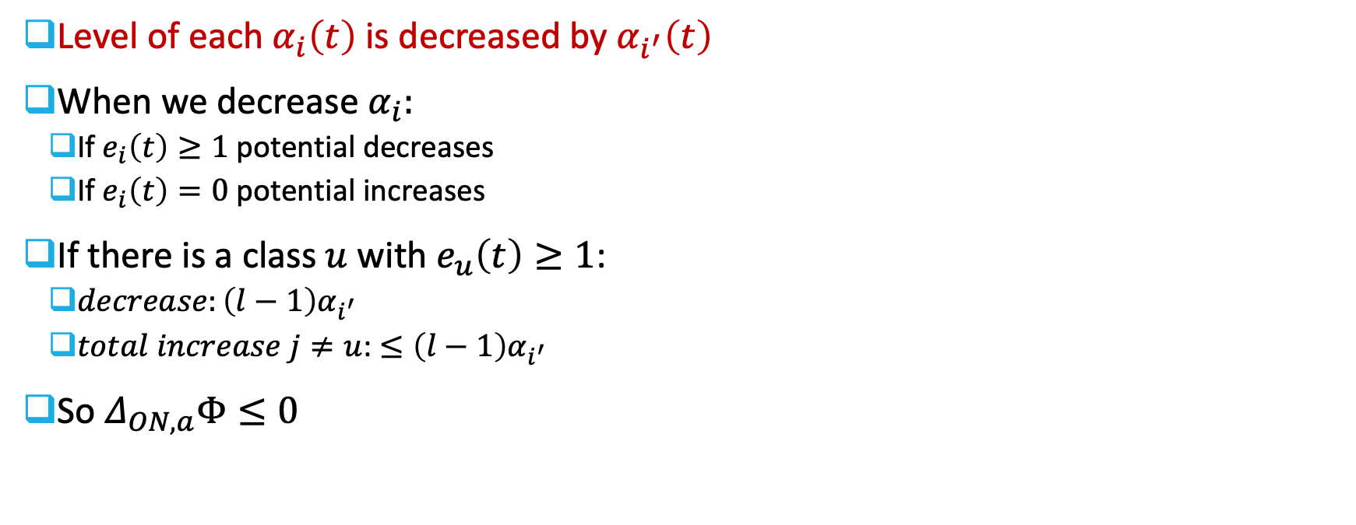

Analysis
$$Φ\left(t\right)=\sum_{i∈\left[l\right]}{\left\{\begin{matrix}lw_{i}\left(e_{i}\left(t\right)−1\right)+\left(l−1\right)α_{i} & e_{i}\left(t\right)≥1 \\ −α_{i}\left(t\right) & otherwise\end{matrix}\right.}$$
$$Step 2.a: Δ_{ON,a}Φ≤lΔε$$
Level of each $α_{i}\left(t\right)$ is decreased by $α_{i^{′}}\left(t\right)$
When we decrease $α_{i}:$
  If $e_{i}\left(t\right)≥1$ potential decreases
  If $e_{i}\left(t\right)=0$ potential increases
If there is a class $u$ with $e_{u}\left(t\right)≥1$:
  $decrease:\left(l−1\right)α_{i^{′}}$
  $total increase j≠u$: $≤\left(l−1\right)α_{i^{′}}$
So $Δ_{ON,a}Φ≤0$

Slide 36
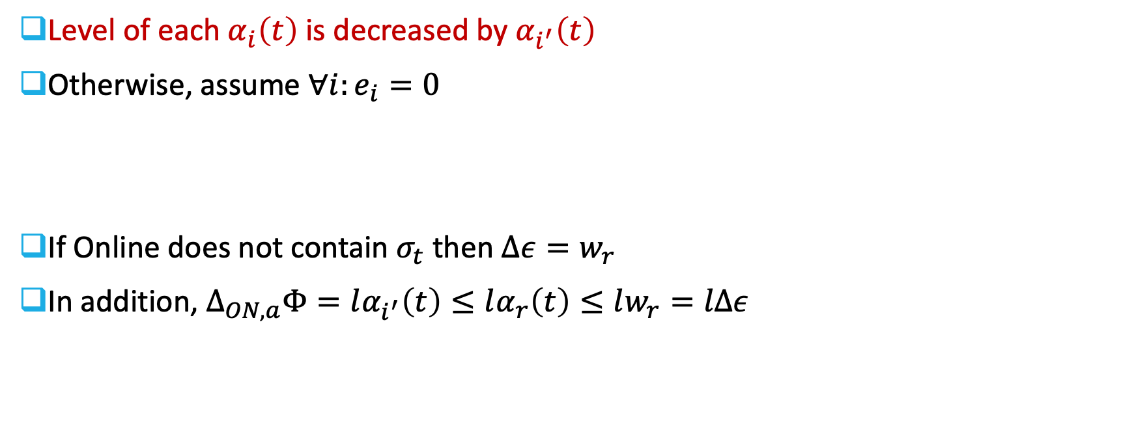


Analysis
$$Φ\left(t\right)=\sum_{i∈\left[l\right]}{\left\{\begin{matrix}lw_{i}\left(e_{i}\left(t\right)−1\right)+\left(l−1\right)α_{i} & e_{i}\left(t\right)≥1 \\ −α_{i}\left(t\right) & otherwise\end{matrix}\right.}$$
$$Step 2.a: Δ_{ON,a}Φ≤lΔε$$
Level of each $α_{i}\left(t\right)$ is decreased by $α_{i^{′}}\left(t\right)$
Otherwise, assume $∀i:e_{i}=0$
If Online does not contain $σ_{t}$ then $Δε=w_{r}$
In addition, $Δ_{ON,a}Φ=lα_{i^{′}}\left(t\right)≤lα_{r}\left(t\right)≤lw_{r}=lΔε$
$$Online:$$
? | ? | ?
$$Offline:$$
$$σ_{t}$$
Notes:
i’ is argmin
We init alpha to w, and alpha goes down.
Explain why we know that each class xi is the same: if one is smaller ther is one larger -> contradiction.

Slide 37














Analysis
$$Φ\left(t\right)=\sum_{i∈\left[l\right]}{\left\{\begin{matrix}lw_{i}\left(e_{i}\left(t\right)−1\right)+\left(l−1\right)α_{i} & e_{i}\left(t\right)≥1 \\ −α_{i}\left(t\right) & otherwise\end{matrix}\right.}$$
$$Step 2.b: ΔOn+Δ_{ON,b}Φ≤0$$
Page evicted from class $i^{′}$ and $α_{i^{′}}$ is reset from $0$ to $w_{i^{′}}$
$ΔOn=w_{i^{′}}$ (cost of eviction)
Potential change:
  $Δ_{ON,b}Φ=−w_{i^{′}}$
Total: $ΔOn+Δ_{ON,b}Φ=0$
$$α_{i^{′}}=w_{i^{′}}$$
$Φ_{i^{′}}$
$$α_{i^{′}}=0$$
$$lw_{i^{′}}$$
$$\left(l−1\right)w_{i^{′}}$$
$$1$$
$$2$$
$$k$$
$$e_{i}$$
$$−w_{i^{′}}$$
$$e_{i}=0$$
$$e_{i}≥1$$
Notes:
We either payed with the coins when excess=0, or excess was large (we had advantage over OPT on weight class) and we loss some advantage got closer to OPT.

Slide 38




Analysis
$$Φ\left(t\right)=\sum_{i∈\left[l\right]}{\left\{\begin{matrix}lw_{i}\left(e_{i}\left(t\right)−1\right)+\left(l−1\right)α_{i} & e_{i}\left(t\right)≥1 \\ −α_{i}\left(t\right) & otherwise\end{matrix}\right.}$$
$$Step 2.c: Δ_{ON,c}Φ≤lΔε$$
Page $σ_{t}$ is fetched to the cache
If $x_{r}$ was $0$ at time $t$ :
no change $e_{r}$ so $Δ_{ON,c}Φ=0$
$$Online:$$
$$Offline:$$
$$σ_{t}$$
Notes:
Online has 0 and Offline has at least 1.

Slide 39

Analysis
$$Φ\left(t\right)=\sum_{i∈\left[l\right]}{\left\{\begin{matrix}lw_{i}\left(e_{i}\left(t\right)−1\right)+\left(l−1\right)α_{i} & e_{i}\left(t\right)≥1 \\ −α_{i}\left(t\right) & otherwise\end{matrix}\right.}$$
$$Step 2.c: Δ_{ON,c}Φ≤lΔε$$
Page $σ_{t}$ is fetched to the cache
Otherwise, if $x_{r}>0$ and $σ_{t}$ was not in cache at time $t$:
  $Δε=w_{r}$
  $e_{r}$ increases by at the most $1$ so $Δ_{ON,c}Φ≤lw_{r}=lΔε$
Notes:
If we had room we would keep sigma_t in it.

Slide 40
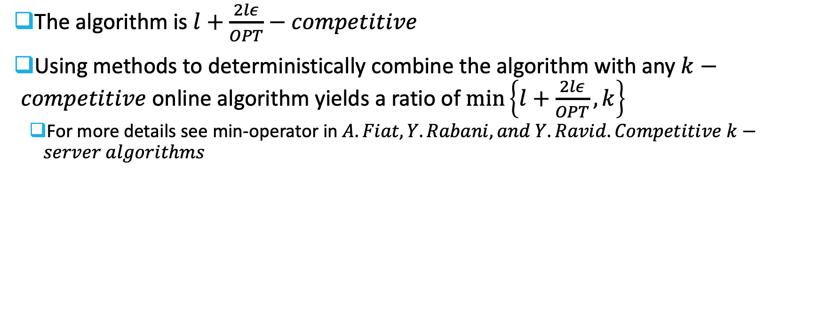
Analysis
The algorithm is $l+\frac{2lε}{OPT}−competitive$
Using methods to deterministically combine the algorithm with any $k−competitive$ online algorithm yields a ratio of $\min\left\{l+\frac{2lε}{OPT},k\right\}$
  For more details see min-operator in $A. Fiat, Y. Rabani, and Y. Ravid. Competitive k−server algorithms$

Slide 41









Page Ranks
Fix weight class $i$
$σ_{|i}=1,2,3,2,1$
$τ_{|i} =5,4,6,6,6 (perfect predictions)$
Run LFD according to predicted times on different cache sizes:
$$k=1$$
1
2
3
2
1
$$k=2$$
1
1 | 2
3 | 2
3 | 2
1 | 2
$$k=3$$
1
1 | 2
1 | 2 | 3
1 | 2 | 3
1 | 2 | 3
$$p_{1}=1 \\ p_{2}= \\ p_{3}=$$
$$p_{1}=2 \\ p_{2}=1 \\ p_{3}=$$
$$p_{1}=3 \\ p_{2}=2 \\ p_{3}=1$$
$$p_{1}=2 \\ p_{2}=3 \\ p_{3}=1$$
$$p_{1}=1 \\ p_{2}=2 \\ p_{3}=3$$
Notes:
Rank r: in cache for size r but not r-1
For accurate predictions this is exactly LFD. Breaking ties arbitrarily
Note: identity of page changes

Slide 42





Page Ranks
Page ranks for weight class $i$ are well defined
  Proof by induction on $t$
Page with rank $h$ has the furthest predicted arrival time among pages with ranks $2,…,h$
5
$$⊂$$
5
24
$$⊂$$
5
24
34
$$⊂$$
5
24
34
55
$$⊂$$
5
24
34
55
12
Notes:
Explain: If a page is in cache of LFDPred(m) it will be in the cache also for m’>m

Slide 43










Rank Update
Rank:
Rank:
$$1$$
$$2$$
$$3$$
$$4$$
$$5$$
$$1$$
$$2$$
$$3$$
$$4$$
$$5$$
5
24
34
7
55
7
5
24
34
55
Request page 7
5
24
34
7
7
5
24
34
Does not change!
5
24
34
7
5
24
5
24
7
5
5
7
Notes:
Page 7 will have rank 1. looking at cache with k=2, we will evict 24 and keep 5 so 5 new rank is 2.

Slide 44

Repeat Property
Lemma 2.4. Repeat Property (No Proof)
  Assuming perfect predictions, between any two requests to the same rank $h$, every rank $2,…,h−1$ must be requested at least once
  Example: $3,1,2,2,1,3$
Repeat Violation
  Rank $h$ was requested earlier and some rank $h^{′}∈\{2,…,h−1\}$ has not been requested since then
Lemma 2.5 (Bounded Repeat Violations)
  The number of repeat violations during requests to pages of weight class $i$ is at the most $ε_{i}$
Notes:
Can charge each violation to an inversion

Slide 45








Repeat Property
We will show that for every violation there must be at least on inversion in $σ_{|i},τ_{|i}$
Rankh
Rank h
Rank h’
$$t_{1}$$
$$t_{2}$$
$$t$$
$$…$$
$$t_{h^{′}}$$
Rank h’
Not requested between $t_{1},t_{2}$!

Slide 46



Repeat Property
Rankh
Rank h
Rank h’
Last time identity of page with rank $h$ changed
$$t_{1}$$
$$t^{′}$$
$$t_{2}$$
$$t$$
$$…$$
$$t_{h^{′}}$$
At time $t′$ page with rank $h$ has furthest predicted time among pages with ranks $2,…,h$
Rank h’
Not requested between $t_{1},t_{2}$!
Notes:
Page is evicted by LFD on cache size h-1

Slide 47




Repeat Property
There were no requests to rank $h′$:
  The predicted arrival time can only decrease (due to requests to pages with larger rank)
Rankh
Rank h
Rank h’
$$τ_{h^{′}}<τ_{h}$$
$$t_{1}$$
$$t^{′}$$
$$t_{2}−1$$
$$t_{2}$$
$$t$$
$$…$$
$$t_{h^{′}}$$
$t_{2},t_{h^{′}}$is an inversion
Rank h’
Not requested between $t_{1},t_{2}$!

Slide 48

Randomized Algorithm Overview
Consider the local strategy that keeps pages with ranks $1$ to $x_{i}\left(t\right)$ in the cache at time $t$
If $x_{i}\left(t\right)$ is fractional: cache contains $x_{i}\left(t\right)−\left\lfloor x_{i}\left(t\right)\right\rfloor$ fraction of the page with rank $\left\lfloor x_{i}\left(t\right)\right\rfloor +1$
Remark: The cache distribution can be converted into a randomized algorithm with integer $x_{i}\left(t\right),\text{losing} \text{only} \text{a} \text{constant} \text{factor} \text{in} \text{the} \text{competitive} \text{ratio}\text{.}$
Ranks in cache:
1 | 2 | 3 | 4 | 5 | 4 | 1 | 2 | 3 | 1 | 2 | 3
Seen in Barak Ugav’s lecture: N. Bansal, N. Buchbinder, and J. S. Naor. A primal-dual randomized algorithm for weighted paging. JACM, 59(4):19,2012.

Slide 49






Randomized Algorithm Overview
Denote by $\left[\right]′$ the derivative of
Cache miss on a request to page with rank $q$ of weight class $r$:
  We increase $x_{r}\left(t\right)$
  Maintain $x_{r}^{′}\left(t\right)=−\sum_{i≠r}{x_{i}^{′}\left(t\right)}$
Rate of Change in $x_{i}\left(t\right)$:
  For each weight class $i$ maintain a variable $μ_{i}\left(t\right)$:$\left|x_{i}^{′}\left(t\right)\right|\sim \frac{μ_{i}\left(t\right)}{w_{i}}$
$$x_{r}$$
$$x_{2}$$
$$x_{5}$$
$$x_{7}$$
$$x_{9}$$
Notes:
Mu_i is used also to increase and also to decrease
Similar to deterministic.

Slide 50

Working Set
Adversary repeats requests in cyclic order to a fixed set $P_{i}$
Assuming $\left|P_{i}\right|≥x_{i}$ update each $x_{i}$ with proportion to $\left|P_{i}\right|−x_{i}$:
  $\left|P_{i}\right|≫x_{i}:$ Anyway, we must pay a lot so ALG should evict more aggressively
  $\left|P_{i}\right|\sim x_{i}:$ Cache is nearly correct
How will we define the working set $P_{i}$ if it varies in time?
  By maintaining a memory of recent requests

Slide 51













Randomized Algorithm Overview
Memory:
  For each weight class keep a memory of the past in the form of a set $S_{i}⊆\left[x_{i},∞\right)$, consisting of a union of intervals
  $S_{i}$ is an approximate memory the ranks of recently requested pages (not in the cache)
  Working set $P_{i}$ corresponds to $\left(0,x_{i}\right]∪S_{i}$
Set $μ_{i}=\left|S_{i}\right|$
$$x_{i}=3$$
$$S_{i}=\left\{\left[3,5\right],\left[5.8,6.1\right],\left[7.2,10.2\right],\left[16,17\right],\left[22.2,25.3\right]\right\}$$
$$μ_{i}=2+0.3+3+1+3.1=9.4$$
$$0$$
$$3$$
$$5$$
$$5.8$$
$$6.1$$
$$7.2$$
$$10.2$$
$$16$$
$$17$$
$$22.2$$
$$25.3$$
*Numbers are just for example
Notes:
Si approximates Pi-xi

Slide 52

Randomized Algorithm Overview
Serving a request to rank $q$ of weight class $r$:
  If $x_{r}≤q−1$ the page is fully missing
  If $x_{r}≥q$ the page is fully present
  If $q−1<x_{r}<q$ the page is fractionally present
We break request to infinitesimally small requests to $p∈\left(q−1,q\right]$
  While moving $p$ from $q−1$ to $q$ we update $x,S,μ$
Notes:
Look at p as bringing an infinitesimally small amount of page with rank q

Slide 53

Randomized Algorithm
At each moment we will update $x_{i}$ and $S_{i}$ for every weight class
  We will maintain $μ_{i}=\left|S_{i}\right|$, and $S_{i}⊂\left[x_{i},∞\right)$
  We initialize $S_{i},μ_{i}$ arbitrarily $\left(S_{i}≔\left[x_{i},x_{i}+μ_{i}\right)\right)$
Rates of change will be:
  $\left|x_{i}^{′}\right|\sim \frac{μ_{i}}{w_{i}}$
  $\left|S_{i}^{′}\right|=\left|μ_{i}^{′}\right|\sim \frac{μ_{i}}{w_{i}}$
Notes:
$β_{i}$ is proportional to $\frac{1}{w_{i}}$ (like deterministic algorithm)

Slide 54



Randomized Algorithm
$x_{i}∈\left[0,k\right]$ is the page mass from weight class $i$
Maintain $μ_{i}$
Maintain $S_{i}⊆\left[x_{i},∞\right)$ for weight class $i$
$x_{i},μ_{i},S_{i}$ are functions of time $t$
Serving a request to rank $q$ of weight class $r$:
  Initialize $p≔q−1$
  While $p<q$ increase $p$ at rate $p^{′}=8$
  If $p<x_{r}$ do nothing
Notes:
Tell them to look at top corner, Si is invariant we keep.

Slide 55







Randomized Algorithm
$x_{i}∈\left[0,k\right]$ is the page mass from weight class $i$
Maintain $μ_{i}$
Maintain $S_{i}⊆\left[x_{i},∞\right)$ for weight class $i$
$x_{i},μ_{i},S_{i}$ are functions of time $t$
$β_{i}\sim \frac{μ_{i}}{w_{i}}$
Serving a request to rank $q$ of weight class $r$:
  If $p>x_{r}$ for $i≠r$ update $x,μ$:
  Add to $S_{i}$ the points that $x_{i}$ moves past:
$$−\frac{β_{i}}{B}$$
$$add to S_{i}$$
$$x_{i}$$
Notes:
We add to Si ranks we evict from cache.
Note that Si increases at same rate of mu_i

Slide 56












Randomized Algorithm
$x_{i}∈\left[0,k\right]$ is the page mass from weight class $i$
Maintain $μ_{i}$
Maintain $S_{i}⊆\left[x_{i},∞\right)$ for weight class $i$
$x_{i},μ_{i},S_{i}$ are functions of time $t$
$β_{i}\sim \frac{μ_{i}}{w_{i}}$
Serving a request to rank $q$ of weight class $r$:
  If $p>x_{r}$, and $p∈S_{r}$ for $i=r$ update $x_{r},μ_{r}$:
  Remove points from the left and right of $S_{r}$ at rates $x_{r}^{′}$ and $1:$
$$x_{r}^{′}$$
$$x_{r}^{′}$$
$$8$$
$$1$$
$$q−1$$
$$remove \\ from S_{r}$$
$$x_{r}$$
$$remove \\ from S_{r}$$
$$p$$
$$q$$
Notes:
We remove from Sr ranks we add to xr, we remove points expiring from memory

Slide 57







Randomized Algorithm
$x_{i}∈\left[0,k\right]$ is the page mass from weight class $i$
Maintain $μ_{i}$
Maintain $S_{i}⊆\left[x_{i},∞\right)$ for weight class $i$
$x_{i},μ_{i},S_{i}$ are functions of time $t$
$β_{i}\sim \frac{μ_{i}}{w_{i}}$
Serving a request to rank $q$ of weight class $r$:
  If $p>x_{r}$, and $p∉S_{r}$ for $i=r$ update $x_{r},μ_{r}$:
  Remove points from the left and right of $S_{r}$ at rates $x_{r}^{′}$ and $1$
  Add points from $\left(q−1,p\right]∖S_{r}$ to $S_{r}$ at rate $2$
$$μ_{r} increases!$$
$$x_{r}^{′}$$
$$x_{r}^{′}$$
$$2$$
$$8$$
$$1$$
$$x_{r}$$
$$remove \\ from S_{r}$$
$$q−1$$
$$p$$
$$q$$
$$remove \\ from S_{r}$$
$$add to S_{r}$$
Notes:
Now we also add points that p goes through

Slide 58







Randomized Algorithm
$x_{i}∈\left[0,k\right]$ is the page mass from weight class $i$
Maintain $μ_{i}$
Maintain $S_{i}⊆\left[x_{i},∞\right)$ for weight class $i$
$x_{i},μ_{i},S_{i}$ are functions of time $t$
$β_{i}\sim \frac{μ_{i}}{w_{i}}$
Serving a request to rank $q$ of weight class $r$:
$i=r and p∈S_{r}$:
Move $p$
$$i≠r$$
$i=r and p∉S_{r}$:
Notes:
Intuitions:
1. For i!=r we remove from cache and add those points to Si. WS is larger than the cache space for rank, so we increase the mu and we can catch up later
2. For i=r we increase cache space. Rate increases if p in Sr – it means that WS almost xr so we decrease mu. Otherwise WS>xr so we increase

Slide 59

Randomized Algorithm Summary
For $i≠r$:
  We decrease size of $x_{i}$ and add those points to $S_{i}$
For $i=r$:
  We increase size $x_{r}$ s.t. $x_{r}^{′}=−\sum_{i}{x_{i}^{′}}$
  We remove points from $S_{r}$ which are added to the cache (from the left)
  We remove points expiring from our recently requested memory (from the right)
  If $p∉S_{r}$ we add it to $S_{r}$ (middle)
Remark: Not obvious why algorithm is well defined – but possible to show
Notes:
Not so easy to explain why we always have points to remove or add to Sr if p not in Sr

Slide 60

Boundary Conditions
We need to ensure that $x_{r}≥1$, and that $∀i≠r:x_{i}≥0$
Add $l$ dummy pages to the cache and increase cache size to $k+l$:
  Extra cache space shall always hold the dummy pages
  Replace any request to page $v$ with request sequence $v{\left(d_{1},…,d_{l}\right)}^{z }, z∈ℕ$
  For $\lim{z}→∞$ algorithm converges to a state with:
    $x_{i}≥1$
    $x_{r}≥2$
A valid algorithm for the original request sequence is obtained by removing the dummy pages and resetting the cache size to $k$
Notes:
Xr>=1 is enough – since rank becomes 1 after the request
Xi can be negative: we remove point from Si iff i=r. otherwise when we decrease xi we have mui>0. if we have 1 request at beginning for class i and than none- we will get negative xi.

Slide 61

Thank You

Slide 62


Analysis
Goal is to prove that:
  $The algorithm is O\left(\log{l}+\frac{lε}{OPT}\right)−competitive for learning−augmented weighted paging$
Let $y_{i}$ denote the state of a trustful offline algorithm
Let ${\left(x_{i}−y_{i}\right)}_{+}≔\max\left\{0,x_{i}−y_{i}\right\}$
Let $R_{iu}$ for a weight class $i$ and $u≥0$ consist of all the points that were visited by the pointer $p$ since the last request at $u$ (for class $i$)
  Assuming no repeat violations, just before $p$ reaches $u$:$\left[1,u\right)⊆R_{iu}$
  After reaching $u:$ $R_{iu}$ is empty
$$Rank Sequence i$$ | $$4$$ | $$3$$ | $$2$$ | $$2$$ | $$4$$
$$R_{i4}$$ | $$0$$ | $$\left[2,3\right)$$ | $$\left[1,3\right)$$ | $$\left[1,3\right)$$ | $$0$$

Slide 63

Analysis
Potential function $Φ$:
  Entropic potential:$ℰ≔\sum_{i}{w_{i}\left[5\left[μ_{i}+{\left(x_{i}−y_{i}\right)}_{+}\right]\log{\frac{\left(1+δ\right)\left[μ_{i}+{\left(x_{i}−y_{i}\right)}_{+}\right]}{μ_{i}+δ\left[μ_{i}+{\left(x_{i}−y_{i}\right)}_{+}\right]}+{\left[μ_{i}+2\left(x_{i}−y_{i}\right)\right]}_{+}}\right] }$
  Repeat potential: $ℛ≔\sum_{i}{w_{i}\int_{S_{i}}{\frac{\left|\left(y_{i},x_{i}\right]∩R_{iu}\right|}{μ_{i}+δ\left(μ_{i}+\left|\left(y_{i},x_{i}\right]∩R_{iu}\right|\right)}du}}$
  Scatter potential: $S≔\sum_{i}{w_{i}\left(\left|S_{i}∩\left[y_{i},∞\right)\right|+{\left(x_{i}−y_{i}\right)}_{+}\right)}$
  Overall potential:$Φ≔2ℰ+5ℛ+4S$
We will show:
  $OnlineCost^{′}+Φ^{′}≤O\left(\log{l}\right)⋅OfflineCost^{′}+O\left(l\right)ε^{′}$
Notes:
We will analyze each function later. Meanwhile let’s understand the symbols…
We will bound rate of change

Slide 64

Trustful Algorithms
FIX! + drawing of build
Consider the local strategy that keeps pages with ranks $1$ to ${m=x}_{i}\left(t\right)$ in the cache at time $t$
  i.e. $C_{i,t}^{m}$
  If $m$ is fractional: cache contains $m−\left\lfloor m\right\rfloor$ fraction of the page with rank $\left\lfloor m\right\rfloor +1$
Trustful algorithm:
  At each time $t$ configuration is of the form $∪_{i=1}^{l}C_{i,t}^{x_{i}(t)}$ for some $\left(x_{1}\left(t\right),…,x_{l}\left(t\right)\right)$
Lemma 2.3 (No Proof):
  Let $x_{i}(t)$ be the cache space used by an arbitrary offline paging algorithm $A$. For any $σ,τ$, let $A^{∗}$ be the trustful algorithm. Then, $cost_{A^{∗}}\left(σ,τ\right)≤3⋅cost_{A}\left(σ\right)+ε\left(σ,τ\right)+O\left(1\right)$
$→$We can restrict our attention to trustful algorithms, without loss of generality.
Notes:
we can assume that the offline algorithm is trustful at the expense of misjudging its cost by an O(1+eps/OPT) factor.

Slide 65

Offline Algorithm Cost
We charge offline algorithm both the weights of pages it fetches as well as pages it evicts
Let $y_{i}$ denote the state of a trustful offline algorithm
Offline algorithm proceeds in two steps:
  Change $y$ and update cache according to old ranks
  Update cache content to reflect new ranks
  i.e. algorithm might replace a page fetched at the first step
Notes:
this overestimates the offline cost by only a constant factor

Slide 66

Offline Algorithm Cost
When offline changes $y_{i}$ at $y_{i}^{′}$ it incurs cost $w_{i}\left|y_{i}^{′}\right|$
By taking the derivative for each potential we can show:
  $ℰ^{′}≤O\left(\log{l}\right)w_{i}\left|y_{i}^{′}\right|$
  $S^{′}≤2w_{i}\left|y_{i}^{′}\right|$
  $ℛ^{′}≤w_{i}\left|y_{i}^{′}\right|$
$→$ When $y$ changes we can charge the overall potential to $O\left(\log{l}\right)$ the offline cost

Slide 67

Offline Algorithm Cost
When offline updates cache content to reflect new ranks:
  If $q≤y_{r}$ no cost (correct page is in cache)
  Otherwise, when $p$ moves between $\left[q−1,q\right]$charge at rate: $𝟙_{y_{r}<p}⋅8w_{r}$

Slide 68

Online Pseudo-Cost
The online cost is the weighted page mass loaded to its cache
  Increase of $x_{r}$
  Change of ranks
We will bound the Online cost with the following quantity:
  $\int_{0}^{∞}{\frac{1}{B\left(t\right)}⋅𝟙_{x^{′}\left(t\right)≠0}dt}$
Lemma 4.1
  $Up to a bounded additive error, the total cost of the online algorithm is at the most 18 times the online pseudo−cost$

Slide 69

Online Pseudo-Cost
If rank $q$ of class $r$ is requested cost is $w_{r}\min{{\left\{1,q−x_{r}\right\}}_{+}}$
If we increase $x_{r}$:
  $x_{i}^{′}=𝟙_{i=r}−\frac{β_{i}}{B}≤𝟙_{i=r}$
  $p$ moves at speed $8$ across $\left(q−1,q\right]$ and changes $x$ while $p>x_{r}$
  $→$Online cost for increasing $x_{r}$ is $\frac{1}{8}w_{r}{\min\left\{1,q−x_{r}\right\}}_{+}$
Hence, we can bound the total online cost by $9$ times the cost of increase in $x_{r}$
Remembering increase rate of $x_{r}′$ equals decrease rate we bound the online cost by:
  $\sum_{i}{\frac{w_{i}β_{i}}{B}}=\sum_{i}{\frac{μ_{i+δM}}{Bw_{i}M}}=\frac{M+M}{BM}=\frac{2}{B}$
Notes:
If x_r=q we don’t pay. Otherwise at the most one page fetch to cache

Slide 70

New Goal
Upper bound the rate of change of each potential to show that:
  $\underset{\begin{aligned}Online \\ Pseudo−Cost\end{aligned}}{\underbrace{\frac{1}{B}⋅ 𝟙_{x^{′}≠0}}}+Φ^{′}≤O\left(\log{l}\right)⋅\underset{\begin{aligned}Trustful Offline \\ Cost up to \\ Additive Factor\end{aligned}}{\underbrace{𝟙_{y_{r}<p}w_{r}}}+O\left(l\right)ε^{′}$
Note:
  We assumed offline is trustful, which misjudges the offline cost by at the most $O\left(1+\frac{ε}{OPT}\right)$
Notes:
We integrate to get the final result

Slide 71

Entropic Potential
$ℰ≔\sum_{i}{w_{i}\left[5\left[μ_{i}+{\left(x_{i}−y_{i}\right)}_{+}\right]\log{\frac{\left(1+δ\right)\left[μ_{i}+{\left(x_{i}−y_{i}\right)}_{+}\right]}{μ_{i}+δ\left[μ_{i}+{\left(x_{i}−y_{i}\right)}_{+}\right]}+{\left[μ_{i}+2\left(x_{i}−y_{i}\right)\right]}_{+}}\right] }$
Measures distance between $x,y$ (divergence)
  Increases when $x_{i}>y_{i}$ and $x_{i}−y_{i}$ increases
Can be shown that:
  $ℰ^{′}≤\underset{A}{\underbrace{−\frac{1}{2B}}}+\underset{B}{\underbrace{𝟙_{y_{r}<p }w_{r}O\left(\log{l}\right)}}+\underset{C}{\underbrace{−\frac{5}{2}\sum_{i≠r}{\frac{w_{i}{\left(x_{i}−y_{i}\right)}_{+}μ_{i}^{′}}{μ_{i}+δ\left(μ_{i}+x_{i}−y_{i}\right)}}}}+\underset{D}{\underbrace{𝟙_{p∈S_{r}}\frac{15w_{r}{\left(x_{r}−y_{r}\right)}_{+}}{μ_{r}+δ\left(μ_{r}+x_{r}−y_{r}\right)}}}+\underset{E}{\underbrace{𝟙_{y_{r}<x_{r}+μ_{r} and p∉S_{r}}2w_{r}}}$
Charge $A$ to online pseudo-cost
Charge $B$ to offline cost from change of ranks
$C$ is negative
Charge $D$ to repeat potential
Charge $E$ to scatter potential

Slide 72

Scatter Potential
$S≔\sum_{i}{w_{i}\left(\left|S_{i}∩\left[y_{i},∞\right)\right|+{\left(x_{i}−y_{i}\right)}_{+}\right)}$
  Remember $S_{i}⊂\left[x_{i},∞\right)$
Lemma 4.4.
  $S^{′}≤{−𝟙}_{y_{r}<x_{r}+μ_{r}}w_{r}+𝟙_{y_{r}<p}2w_{r}$
  First term cancels out with Entropic potential
  Second term can be charged to the offline cost from change of ranks
Notes:
The scatter potential is mostly for technical reasons to handle that the intervals in 𝑆𝑖 may be non-contiguous

Slide 73







Scatter Potential
$S≔\sum_{i}{w_{i}\left(\left|S_{i}∩\left[y_{i},∞\right)\right|+{\left(x_{i}−y_{i}\right)}_{+}\right)}$
For $i≠r:$
  Points are added to $S_{i}$ at $x_{i}$
  ${\left(x_{i}−y_{i}\right)}_{+}$ is non-increasing
  $\left|S_{i}∩\left[y_{i},∞\right)\right|$ increases if $x_{r}>y_{r}$, but canceled by previous decrease
$$\left(i≠r\right)$$
$$−\frac{β_{i}}{B}$$
$$0$$
$$add to S_{i}$$
$$x_{i}$$
$$μ_{i}^{′}=\frac{β_{i}}{B}$$

Slide 74




Scatter Potential
$S≔\sum_{i}{w_{i}\left(\left|S_{i}∩\left[y_{i},∞\right)\right|+{\left(x_{i}−y_{i}\right)}_{+}\right)}$
For $i=r$:
  Increase in ${\left(x_{i}−y_{i}\right)}_{+}$ is cancelled by decrease of $\left|S_{i}∩\left[y_{i},∞\right)\right|$ since $S_{r}⊂\left[x_{r},∞\right)$
  Removal from the right of $S_{r}$ at rate $1$ contributes decrease of $w_{r}$
  Adding points from $\left(q−1,p\right]$ to $S_{r}$ at rate $2$ contributes $2w_{r}$ only if $y_{r}<p$
$$0$$
$$2w_{r}$$
$$−w_{r}$$
$$x_{r}^{′}$$
$$x_{r}^{′}$$
$$2$$
$$8$$
$$1$$
$$\left(i=r\right)$$
$$x_{r}$$
$$q−1$$
$$p$$
$$q$$

Slide 75

Repeat Potential
$ℛ≔\sum_{i}{w_{i}\int_{S_{i}}{\frac{\left|\left(y_{i},x_{i}\right]∩R_{iu}\right|}{μ_{i}+δ\left(μ_{i}+\left|\left(y_{i},x_{i}\right]∩R_{iu}\right|\right)}du}≔\sum_{i}{w_{i}ℛ_{i}}}$
Reminder:
  Assuming no repeat violations since the last request to rank 𝑞 of weight class 𝑟, every rank less than 𝑞 has been requested at least once
  For each weight class $i$ and $u∈ℝ_{+}$:
    $R_{iu}$ is the set $\left(u,\left\lceil u\right\rceil \right]∪\bigcup_{s}{\left[s−1,s\right]}$ where $s$ is the ranks that have been requested after last request to $\left\lceil u\right\rceil$ of class $i$
    If pointer $p$ was never at $u$ define $R_{iu}≔ℝ_{+}$
When online moves $ℛ_{i}$ changes due to changes in $x_{i},μ_{i},S_{i},R_{iu}$

Slide 76


Repeat Potential
$ℛ≔\sum_{i}{w_{i}ℛ_{i}}$
$ℛ_{i}≔\int_{S_{i}}{\frac{\left|\left(y_{i},x_{i}\right]∩R_{iu}\right|}{μ_{i}+δ\left(μ_{i}+\left|\left(y_{i},x_{i}\right]∩R_{iu}\right|\right)}du}$
For $i≠r$:
  $x_{i}$ decreases: Does not increase $ℛ_{i}$
  $μ_{i}$ increases: Does not increase $ℛ_{i}$
  Sets $R_{iu}$ do not change (request is for rank of weight class $r$)
  Set $S_{i}$ increases at rate $μ_{i}^{′}$
Overall:
  $ℛ_{i}^{′}≤\frac{{\left(x_{i}−y_{i}\right)}_{+}μ_{i}^{′}}{μ_{i}+δ\left(μ_{i}+x_{i}−y_{i}\right)}$
$$\left(i≠r\right)$$
$$−\frac{β_{i}}{B}$$
$$add to S_{i}$$
$$x_{i}$$
$$μ_{i}^{′}=\frac{β_{i}}{B}$$

Slide 77

Repeat Potential
$ℛ≔\sum_{i}{w_{i}ℛ_{i}}$
$ℛ_{i}≔\int_{S_{i}}{\frac{\left|\left(y_{i},x_{i}\right]∩R_{iu}\right|}{μ_{i}+δ\left(μ_{i}+\left|\left(y_{i},x_{i}\right]∩R_{iu}\right|\right)}du}$
Effect of changing $x_{r}:$
  Increases at rate $x_{r}^{′}≤1$ (when $y_{r}<x_{r}<p$)
Integrand rate of change is at the most:
  $\frac{x_{r}^{′}}{μ_{i}+δ\left(μ_{i}+\left|\left(y_{i},x_{i}\right]∩R_{iu}\right|\right)}≤\frac{1}{μ_{r}}$
Since $\left|S_{r}\right|=μ_{r}$ the contribution of the change is at the most $𝟙_{y_{r}<p}$
$$x_{r}^{′}$$
$$x_{r}^{′}$$
$$2$$
$$8$$
$$1$$
$$\left(i=r\right)$$
$$x_{r}$$
$$q−1$$
$$p$$
$$q$$

Slide 78

Repeat Potential
$ℛ≔\sum_{i}{w_{i}ℛ_{i}}$
$ℛ_{i}≔\int_{S_{i}}{\frac{\left|\left(y_{i},x_{i}\right]∩R_{iu}\right|}{μ_{i}+δ\left(μ_{i}+\left|\left(y_{i},x_{i}\right]∩R_{iu}\right|\right)}du}$
Effect of changing $μ_{r}:$
  $μ_{r}^{′}≤0$ iff $p∈S_{r}$ (no green in drawing)
By taking the derivative on the integrand:
  $Integrand’≤\frac{−\left(1+δ\right)\left|\left(y_{r},x_{r}\right]∩R_{ru}\right|μ_{r}^{′}}{{\left(μ_{i}+δ\left(μ_{i}+\left|\left(y_{i},x_{i}\right]∩R_{iu}\right|\right) \right)}^{2}}≤𝟙_{p∈S_{r}}⋅\frac{1}{μ_{r}}⋅\frac{2{\left(x_{r}−y_{r}\right)}_{+}}{μ_{r}+δ\left(μ_{r}+x_{r}−y_{r}\right)}$
  Integrand is not dependent on $u$ and $\left|S_{r}\right|=μ_{r}$
The contribution of the change is at the most $𝟙_{p∈S_{r}}⋅\frac{2{\left(x_{r}−y_{r}\right)}_{+}}{μ_{r}+δ\left(μ_{r}+x_{r}−y_{r}\right)}$
$$x_{r}^{′}$$
$$x_{r}^{′}$$
$$2$$
$$8$$
$$1$$
$$\left(i=r\right)$$
$$x_{r}$$
$$q−1$$
$$p$$
$$q$$

Slide 79

Repeat Potential
$ℛ≔\sum_{i}{w_{i}ℛ_{i}}$
$ℛ_{i}≔\int_{S_{i}}{\frac{\left|\left(y_{i},x_{i}\right]∩R_{iu}\right|}{μ_{i}+δ\left(μ_{i}+\left|\left(y_{i},x_{i}\right]∩R_{iu}\right|\right)}du}$
Effect of changing $S_{r}:$
  Removing points from $S_{r}$ decreases $ℛ_{r}$
  We only add points from $\left(q−1,p\right]$
    Such points are in $\left[x_{r},∞\right)$
    Thus, the contribution to $\left|\left(y_{i},x_{i}\right]∩R_{iu}\right|$ is $0$
Overall changing $S_{r}$ does not increase the Repeat potential
$$x_{r}^{′}$$
$$x_{r}^{′}$$
$$2$$
$$8$$
$$1$$
$$\left(i=r\right)$$
$$x_{r}$$
$$q−1$$
$$p$$
$$q$$

Slide 80

Repeat Potential
$ℛ≔\sum_{i}{w_{i}ℛ_{i}}$
$ℛ_{i}≔\int_{S_{i}}{\frac{\left|\left(y_{i},x_{i}\right]∩R_{iu}\right|}{μ_{i}+δ\left(μ_{i}+\left|\left(y_{i},x_{i}\right]∩R_{iu}\right|\right)}du}$
Changing $R_{ru}$:
  Increase in potential when adding points to some $R_{ru}$
  The only point added to any $R_{ru}$ is the current pointer position $p$
  $\left|\left(y_{r},x_{r}\right]∩R_{ru}\right|$ increases only if $y_{r}<p≤x_{r}$ ($x_{r}$ is not changing)
  The integrand increase rate is at the most $\frac{8}{μ_{r}}$
Total increase to $ℛ_{i}$ is at the most $𝟙_{y_{r}<p}⋅8$
$$x_{r}^{′}$$
$$x_{r}^{′}$$
$$2$$
$$8$$
$$1$$
$$\left(i=r\right)$$
$$x_{r}$$
$$q−1$$
$$p$$
$$q$$

Slide 81

Repeat Potential
$ℛ≔\sum_{i}{w_{i}ℛ_{i}}$
$ℛ_{i}≔\int_{S_{i}}{\frac{\left|\left(y_{i},x_{i}\right]∩R_{iu}\right|}{μ_{i}+δ\left(μ_{i}+\left|\left(y_{i},x_{i}\right]∩R_{iu}\right|\right)}du}$
Changing $R_{ru}$ assuming no repeat violations:
  Just before reaching $p: \left(1,p\right)⊂R_{rp}$
  Once we reach $p$ then $R_{rp}$ is empty
  $y_{r}≥1$
  $x_{r}$ changes only if $x_{r}<p$
$→\left|\left(y_{r},x_{r}\right]∩R_{rp}\right|$ changes from ${\left(x_{r}−y_{r}\right)}_{+}$ to $0$
The contribution of $R_{rp}$ to $ℛ_{r}^{′}$ is:
  $−𝟙_{p∈S_{r}}⋅\frac{8{\left(x_{r}−y_{r}\right)}_{+}}{μ_{r}+δ\left(μ_{r}+x_{r}−y_{r}\right)}$

Slide 82

Repeat Potential
$ℛ≔\sum_{i}{w_{i}ℛ_{i}}$
$ℛ_{i}≔\int_{S_{i}}{\frac{\left|\left(y_{i},x_{i}\right]∩R_{iu}\right|}{μ_{i}+δ\left(μ_{i}+\left|\left(y_{i},x_{i}\right]∩R_{iu}\right|\right)}du}$
Changing $R_{ru}$ assuming there is a repeat violation:
  In the worst case $R_{rp}$ is already empty and does not contribute to$ℛ_{r}^{′}$
  In this case $ε_{r}$ increases by $1$ due to the request
Hence regardless of violation or not, when $x_{r}$ is changing:
$ℛ_{r}^{′}≤−𝟙_{p∈S_{r}}⋅\frac{8{\left(x_{r}−y_{r}\right)}_{+}}{μ_{r}+δ\left(μ_{r}+x_{r}−y_{r}\right)}+lε_{r}^{′}$

Slide 83

Repeat Potential
$ℛ≔\sum_{i}{w_{i}ℛ_{i}}$
$ℛ_{i}≔\int_{S_{i}}{\frac{\left|\left(y_{i},x_{i}\right]∩R_{iu}\right|}{μ_{i}+δ\left(μ_{i}+\left|\left(y_{i},x_{i}\right]∩R_{iu}\right|\right)}du}$
Summary:
  If $x_{r}$ is changing:
    $ℛ^{′}≤𝟙_{y_{r}<p}w_{r}+lε^{′}−𝟙_{p∈S_{r}}⋅\frac{6w_{r}{\left(x_{r}−y_{r}\right)}_{+}}{μ_{r}+δ\left(μ_{r}+x_{r}−y_{r}\right)}+\sum_{i≠r}{\frac{w_{i}{\left(x_{i}−y_{i}\right)}_{+}μ_{i}^{′}}{μ_{i}+δ\left(μ_{i}+x_{i}−y_{i}\right)}}$
  If $p$ is moving and $x_{r}$ is not changing:
    $ℛ^{′}≤𝟙_{y_{r}<p}8w_{r}$
The terms $𝟙_{y_{r}<p}8w_{r}$ can be charged to the offline cost
The other terms are the same but with opposite signs as those in the bound of $ℰ^{′}$

Slide 84


Summary
Considering the overall potential:
We showed that:
  $\underset{}{\frac{1}{B}⋅ 𝟙_{x^{′}≠0}}+Φ^{′}≤O\left(\log{l}\right)⋅𝟙_{y_{r}<p}w_{r}+O\left(l\right)ε^{′}$

Slide 85


Summary
We defined ranks for each weight class and showed that the rank sequence is predictable
Using the repeat property, we were able to design an optimal competitive online algorithm
There is an $O(\min\left\{\log{l}+\frac{lε}{OPT}\right\},\log{k})$-competitive randomized algorithm for learning-augmented weighted paging

Slide 86























$$p$$
$$x_{i}$$
$$μ_{i}$$
$$q$$
$$p\left(t\right)$$
$$μ_{i}\left(t\right)$$
$$8$$
$$\frac{β_{i}\left(t\right)}{B\left(t\right)}$$
$$x_{r}$$
$$−\frac{β_{i}\left(t\right)}{B\left(t\right)}$$
$$q−1$$
$$x_{i}\left(t\right)$$
$$0$$
Already in cache
$$\frac{1}{8}$$
$$t$$
$$p<x_{r}$$
$$p<x_{r}$$
$$0$$
$$\frac{1}{8}$$
$$t$$
$$0$$
$$\frac{1}{8}$$
$$t$$

Slide 87







$$p$$
$$x_{r}$$
$$μ_{r}$$
$$q$$
$$p\left(t\right)$$
$$1−\frac{β_{r}\left(t\right)}{B\left(t\right)}$$
$$x_{r}\left(t\right)$$
$$μ_{r}\left(t\right)$$
$$\frac{β_{r}\left(t\right)}{B\left(t\right)}$$
$$x_{r}$$
$$q−1$$
$$0$$
Already in cache
$$\frac{1}{8}$$
$$t$$
$$p<x_{r}$$
$$p<x_{r}$$
$$0$$
$$\frac{1}{8}$$
$$t$$
$$0$$
$$\frac{1}{8}$$
$$t$$

Slide 88



$$p$$
$$x_{r}$$
$$μ_{r}$$
$$q$$
$$p\left(t\right)$$
$$x_{r}\left(t\right)$$
$$1−\frac{β_{r}\left(t\right)}{B\left(t\right)}$$
$$\frac{β_{r}\left(t\right)}{B\left(t\right)}−2$$
$$x_{r}$$
$$q−1$$
$$μ_{r}\left(t\right)$$
$$0$$
Already in cache
$$\frac{1}{8}$$
$$t$$
$$p<x_{r}$$
$$p<x_{r}$$
$$0$$
$$\frac{1}{8}$$
$$t$$
$$0$$
$$\frac{1}{8}$$
$$t$$

Slide 89

New Problem Statement
Online and offline algorithms are trustful
  specified fully by a vector $\left(x_{1}\left(t\right),…,x_{l}\left(t\right)\right)$
We allow $x_{i}\left(t\right)$ to be fractional
  This can be converted into a randomized integral algorithm
At time $t∈T$ some rank $p$ in some weight class $r$ is requested.
  If $x_{r}\left(t\right)<p$ there is a cache miss and algorithm incurs cost $w_{r}⋅\min\left\{1,p−x_{r}\left(t\right)\right\}$
  Otherwise, no cost
Goal:
  Update $x_{i}\left(t\right)$ to minimize the total cost

Slide 90

Algorithm High-Level Description
We will focus on the case of perfect predictions
Split cache into $l$ parts, one for each weight class.
Within each class select cached pages according to ranking induced by running several LFD copies with different cache sizes

Slide 91





Inversion
$1,2$ is an inversion
$$p_{1},w$$
$$p_{2},w$$
$$p_{1},w$$
$$p_{2},w$$

