Slide 1
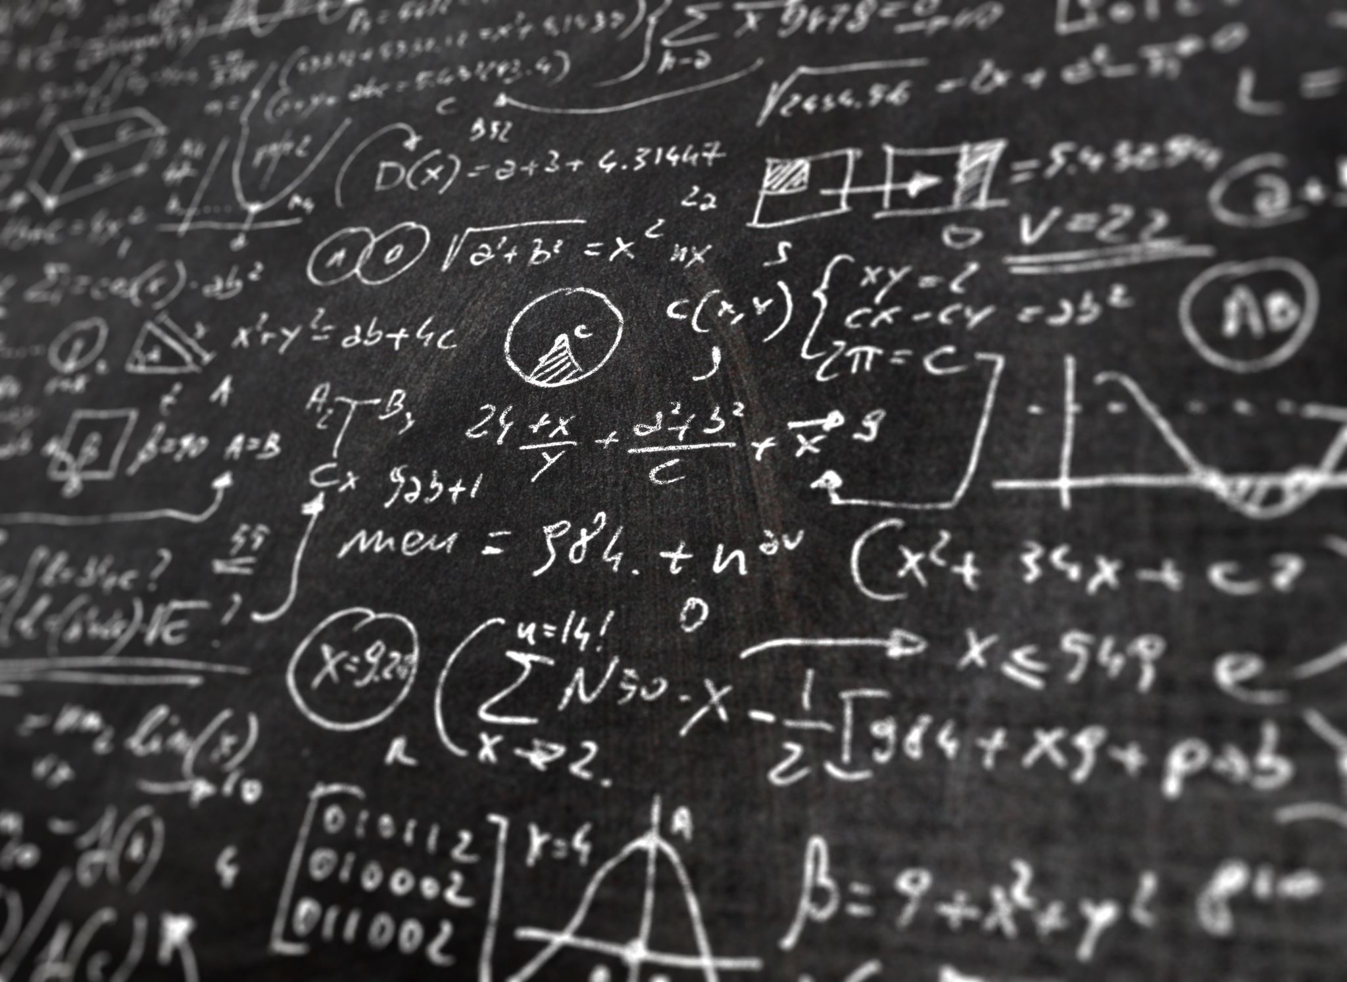
Metrical Task Systems

Slide 2

An abstract model for competitive analysis
Framework that generalizes and captures a variety of online problems
Weaker result
First evidence that a general theory of competitive online algorithms exists

Slide 3
Lecture Timeline
Definition of MTS
Paging as MTS
Continuous Time Algorithms
Traversal algorithms and their competitive bounds
Lower bound for deterministic MTS Algorithms
Randomized MTS Algorithms

Slide 4
Lecture Timeline
Definition of MTS
Paging as MTS
Continuous Time Algorithms
Traversal algorithms and their competitive bounds
Lower bound for deterministic MTS Algorithms
Randomized MTS Algorithms

Slide 5

General concept and settings

Slide 6
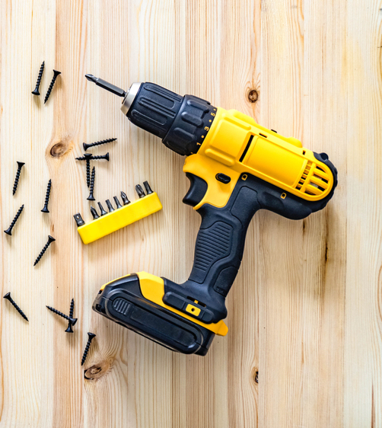

The Metrical aspect of MTS
$M$ - a pair $(S,d)$:
1
2
2
6
5
5
3
4
2
3

Slide 7

The Metrical aspect of MTS
$$\left|S\right|=N$$
1
2
2
6
5
5
3
4
2
3

Slide 8

The Metrical aspect of MTS
$$d\left(1,3\right)=d(3,1)=5$$
1
2
2
6
5
5
3
4
2
3

Slide 9

The Metrical aspect of MTS
$$≤$$
1
2
2
6
5
5
3
4
2
3

Slide 10
Task
1
2
2
6
5
5
3
4
2
3

Slide 11


Task
5
2
0
1
2
6
5
5
3
4
$$∞$$
2
3
12

Slide 12

MTS – Game flow
1
2
2
6
5
5
3
4
2
3
$$S_{0}$$
Timeline
0
1
2
3
4
5
6
7
8
Notes:
Getting an $n$ long, sequence of tasks $σ=r_{1},r_{2}…r_{n}$ to be processed sequentially (one at the time without knowing what are the following tasks in the sequence $σ$)

Slide 13


MTS – Game flow
5
1
2
0
2
6
5
5
$$r_{1}$$
3
4
$$∞$$
2
3
$$S_{0}$$
12
Timeline
0
1
2
3
4
5
6
7
8
Notes:
Getting an $n$ long, sequence of tasks $σ=r_{1},r_{2}…r_{n}$ to be processed sequentially (one at the time without knowing what are the following tasks in the sequence $σ$)

Slide 14

MTS – Game flow
5
1
2
0
2
6
5
5
3
4
$$∞$$
Move or Stay?
2
3
$$S_{0}$$
12
Timeline
0
1
2
3
4
5
6
7
8
Notes:
Getting an $n$ long, sequence of tasks $σ=r_{1},r_{2}…r_{n}$ to be processed sequentially (one at the time without knowing what are the following tasks in the sequence $σ$)

Slide 15


MTS – Game flow
5
1
2
0
2
$$S_{1}$$
6
5
5
3
4
$$∞$$
2
3
12
3
Timeline
0
1
2
3
4
5
6
7
8
Notes:
Getting an $n$ long, sequence of tasks $σ=r_{1},r_{2}…r_{n}$ to be processed sequentially (one at the time without knowing what are the following tasks in the sequence $σ$)

Slide 16
MTS – Game flow
5
1
2
0
2
$$S_{1}$$
6
5
5
3
4
$$∞$$
2
3
12
Timeline
0
1
2
3
4
5
6
7
8
Notes:
Getting an $n$ long, sequence of tasks $σ=r_{1},r_{2}…r_{n}$ to be processed sequentially (one at the time without knowing what are the following tasks in the sequence $σ$)

Slide 17
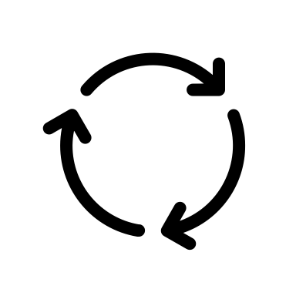
MTS – Game flow
5
1
2
0
2
$$S_{1}$$
6
5
5
Processing...
3
4
$$∞$$
2
3
12
Timeline
0
1
2
3
4
5
6
7
8
Notes:
Getting an $n$ long, sequence of tasks $σ=r_{1},r_{2}…r_{n}$ to be processed sequentially (one at the time without knowing what are the following tasks in the sequence $σ$)

Slide 18
MTS – Game flow
5
1
2
0
2
$$S_{1}$$
6
5
5
Processing...
3
4
$$∞$$
2
3
12
Timeline
0
1
2
3
4
5
6
7
8
Notes:
Getting an $n$ long, sequence of tasks $σ=r_{1},r_{2}…r_{n}$ to be processed sequentially (one at the time without knowing what are the following tasks in the sequence $σ$)

Slide 19
MTS – Game flow
5
1
2
0
2
$$S_{1}$$
6
5
5
Processing...
3
4
$$∞$$
2
3
12
Timeline
0
1
2
3
4
5
6
7
8
Notes:
Getting an $n$ long, sequence of tasks $σ=r_{1},r_{2}…r_{n}$ to be processed sequentially (one at the time without knowing what are the following tasks in the sequence $σ$)

Slide 20
MTS – Game flow
1
2
2
$$S_{1}$$
6
5
5
3
4
2
3
Timeline
0
1
2
3
4
5
6
7
8
Notes:
Getting an $n$ long, sequence of tasks $σ=r_{1},r_{2}…r_{n}$ to be processed sequentially (one at the time without knowing what are the following tasks in the sequence $σ$)

Slide 21


MTS – Game flow
8
1
2
9
2
$$S_{1}$$
6
5
5
$$r_{2}$$
3
4
2
$$21$$
3
12
Timeline
0
1
2
3
4
5
6
7
8
Notes:
Getting an $n$ long, sequence of tasks $σ=r_{1},r_{2}…r_{n}$ to be processed sequentially (one at the time without knowing what are the following tasks in the sequence $σ$)

Slide 22
MTS – Game flow
8
1
2
9
2
$$S_{1}$$
6
5
5
3
4
2
$$21$$
Move or Stay?
3
12
Timeline
0
1
2
3
4
5
6
7
8
Notes:
Getting an $n$ long, sequence of tasks $σ=r_{1},r_{2}…r_{n}$ to be processed sequentially (one at the time without knowing what are the following tasks in the sequence $σ$)

Slide 23
MTS – Game flow
8
1
2
9
2
$$S_{1}$$
6
5
5
Stay!
3
4
2
$$21$$
3
12
Timeline
0
1
2
3
4
5
6
7
8
Notes:
Getting an $n$ long, sequence of tasks $σ=r_{1},r_{2}…r_{n}$ to be processed sequentially (one at the time without knowing what are the following tasks in the sequence $σ$)

Slide 24

MTS – Game flow
8
1
2
9
2
$$S_{2}$$
6
5
5
Processing...
3
4
2
$$21$$
3
12
Timeline
0
1
2
3
4
5
6
7
8
Notes:
Getting an $n$ long, sequence of tasks $σ=r_{1},r_{2}…r_{n}$ to be processed sequentially (one at the time without knowing what are the following tasks in the sequence $σ$)

Slide 25
MTS – Game flow
8
1
2
9
2
$$S_{2}$$
6
5
5
And it goes on…
3
4
2
$$21$$
3
12
Timeline
0
1
2
3
4
5
6
7
8
Notes:
Getting an $n$ long, sequence of tasks $σ=r_{1},r_{2}…r_{n}$ to be processed sequentially (one at the time without knowing what are the following tasks in the sequence $σ$)

Slide 26
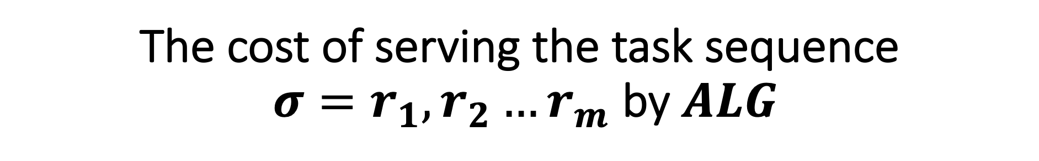
The cost of serving the task sequence
$σ=r_{1},r_{2}…r_{m}$ by $ALG$

Slide 27
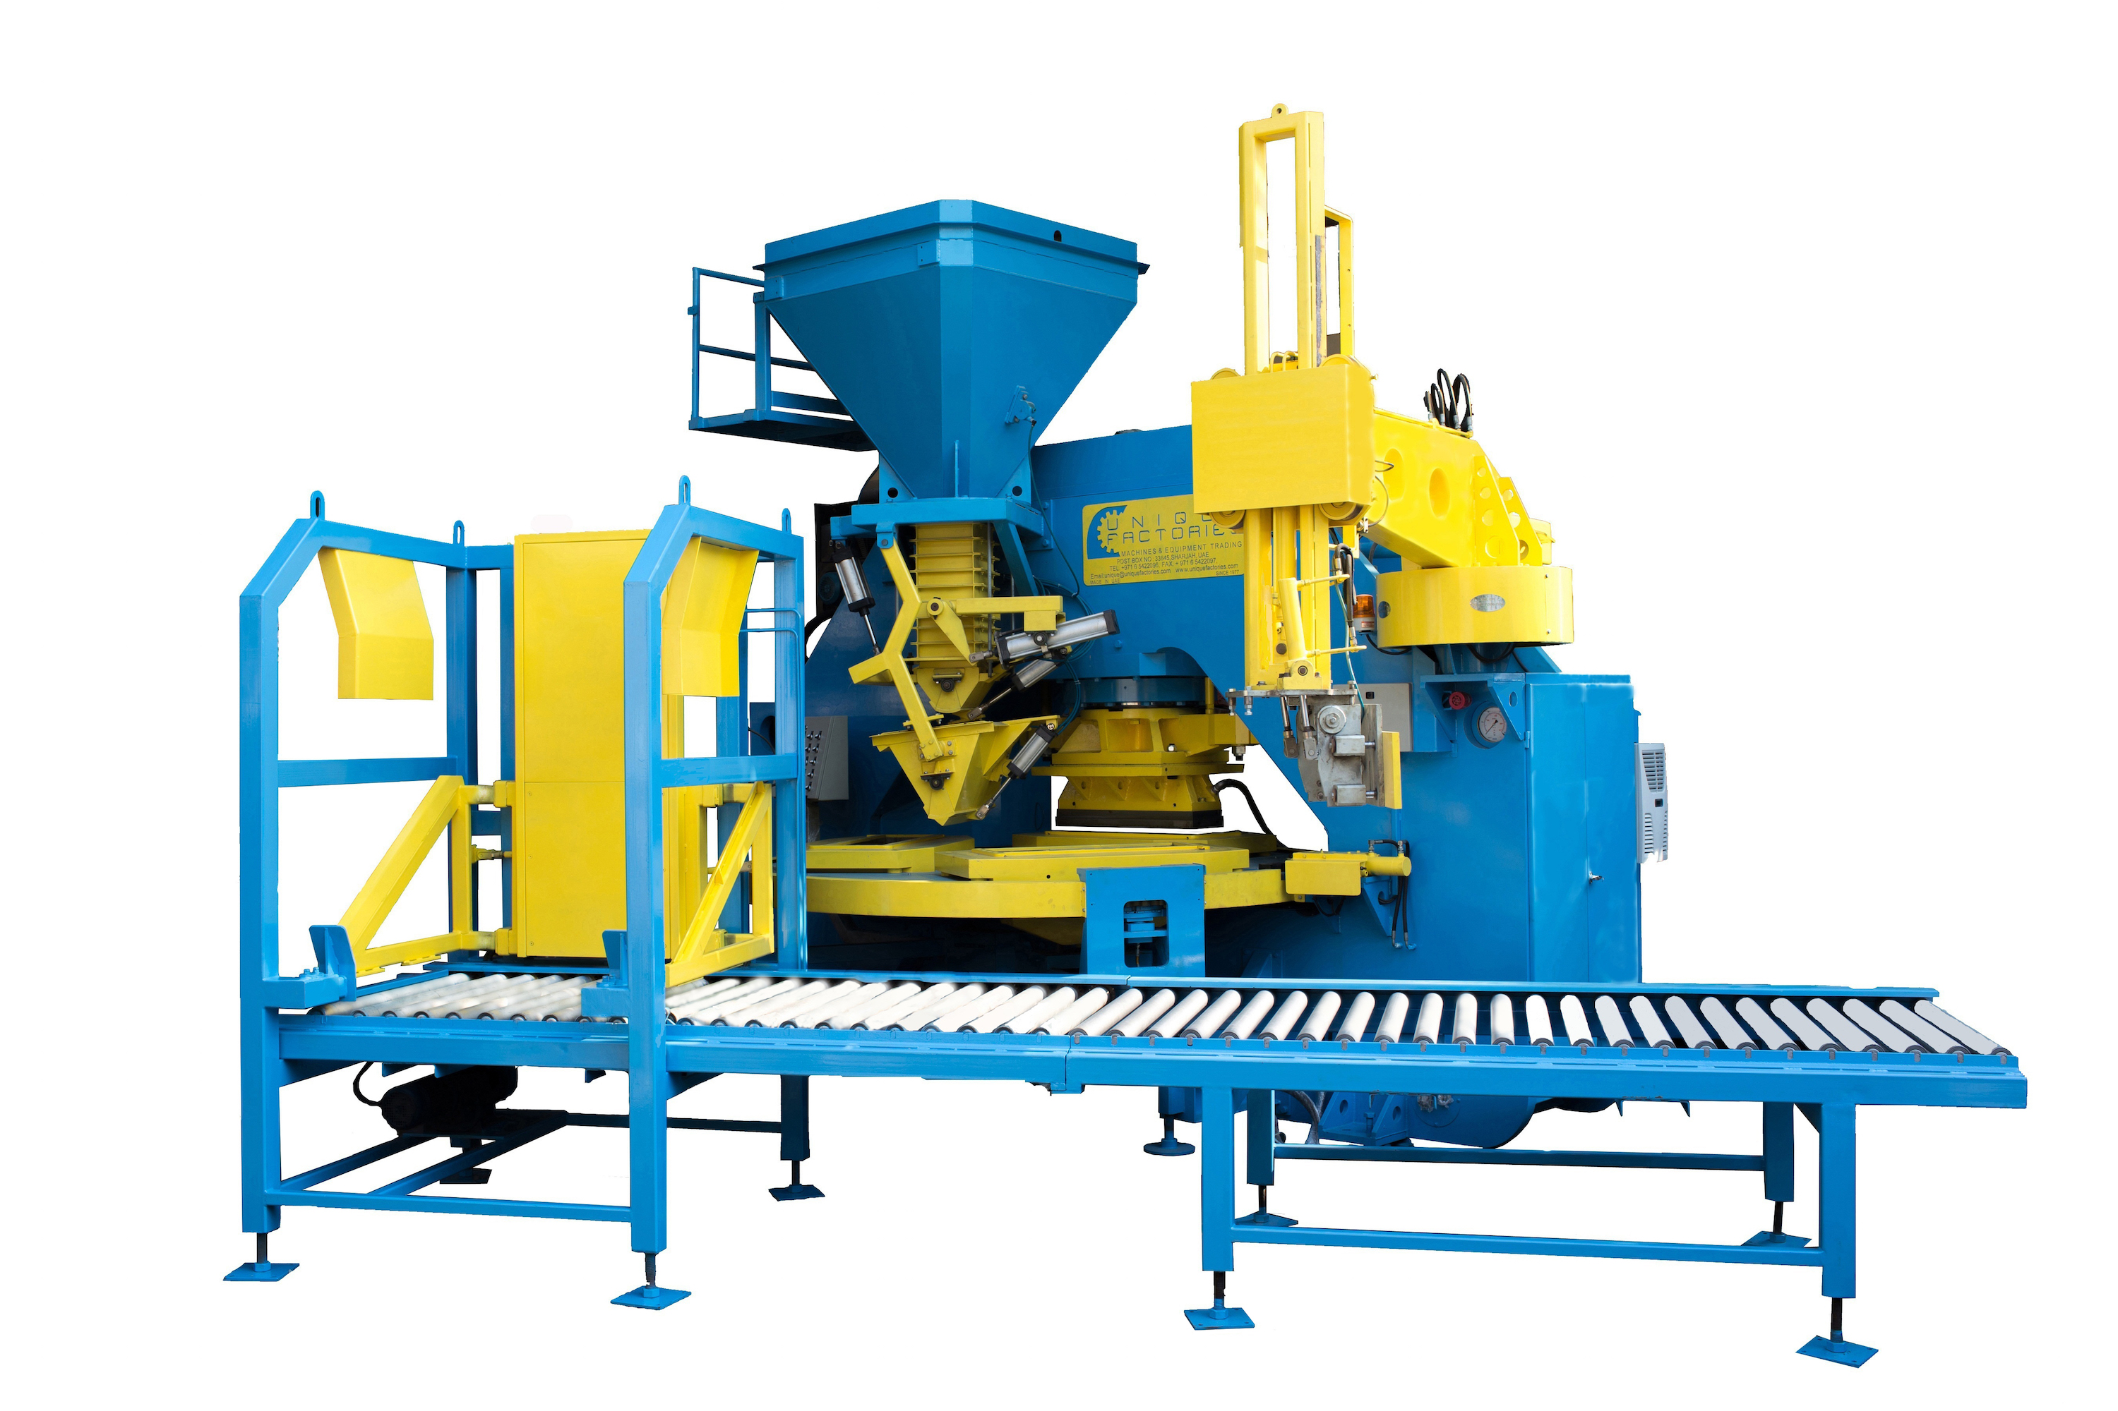

The cost of serving the task sequence
$σ=r_{1},r_{2}…r_{m}$ by $ALG$
Transition cost
Processing cost

Slide 28
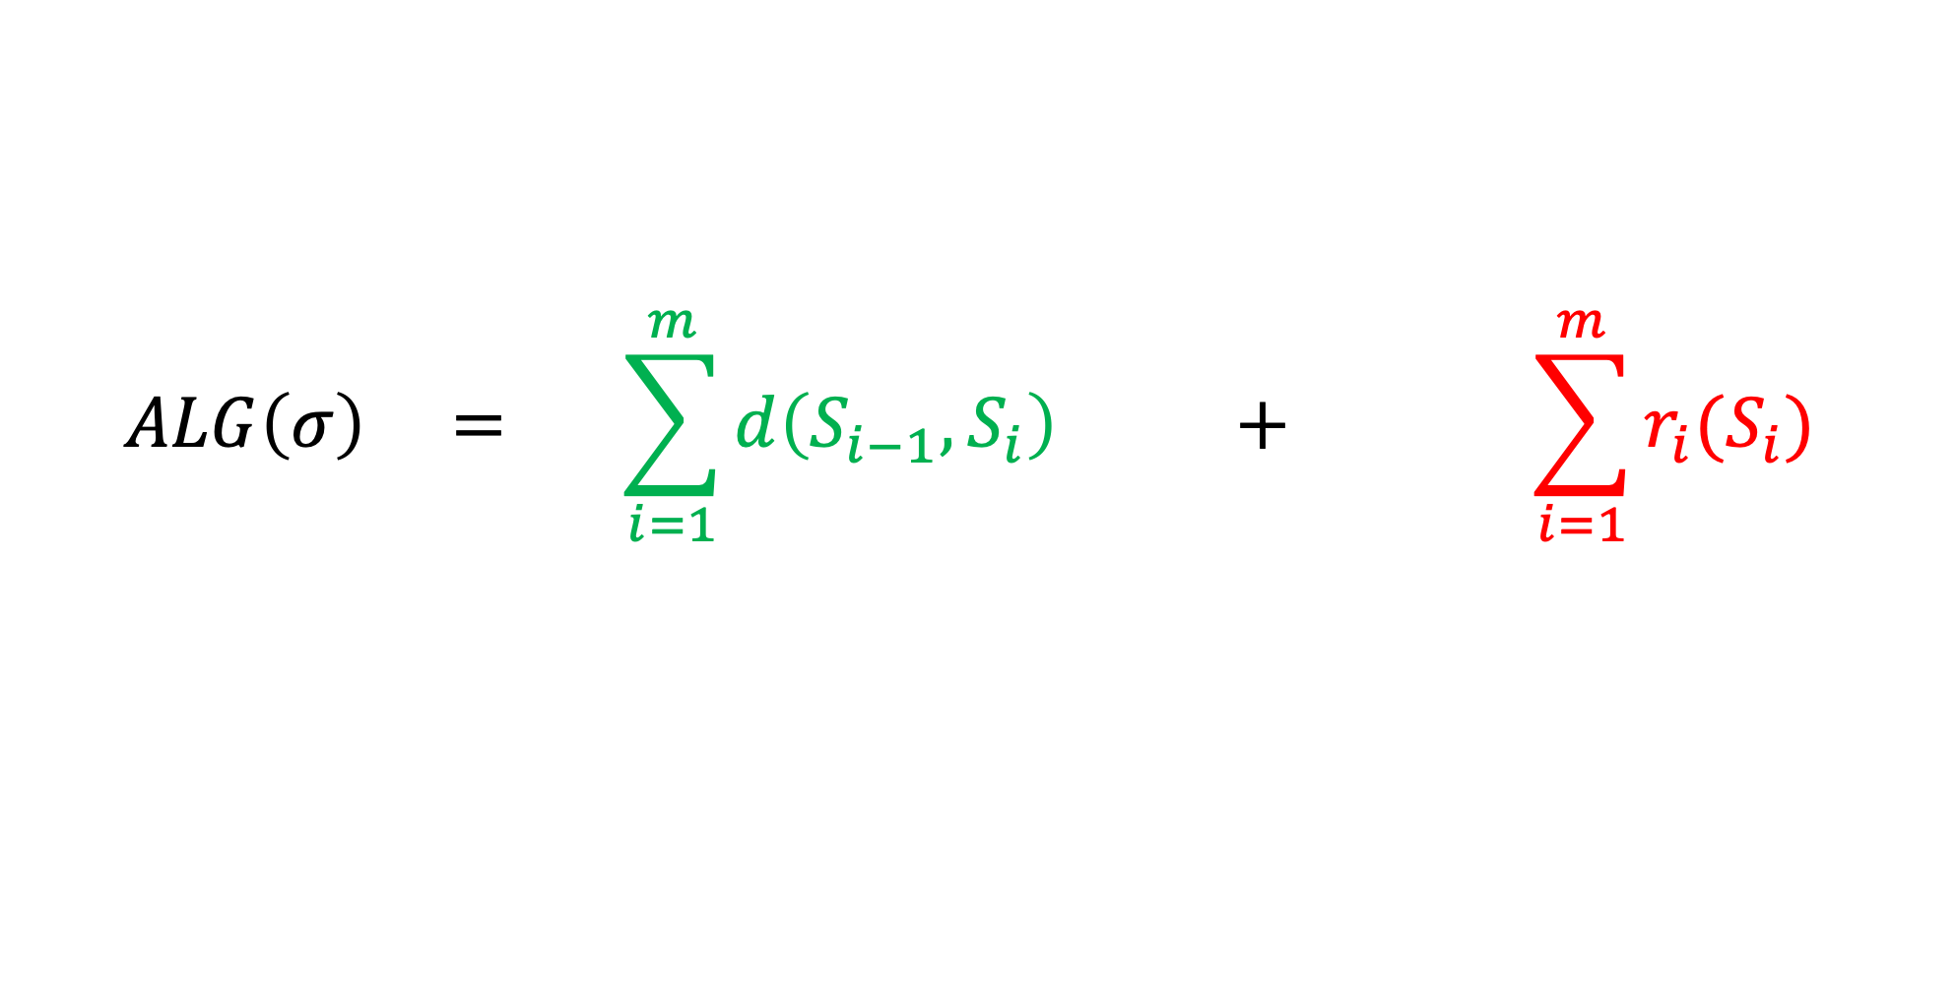
$$ALG\left(σ\right) = \sum_{i=1}^{m}{d\left(S_{i−1},S_{i}\right) }+ \sum_{i=1}^{m}{r_{i}(S_{i})}$$
The cost of serving the task sequence
$σ=r_{1},r_{2}…r_{m}$ by $ALG$
Total transition cost
Total processing cost

Slide 29

Lecture Timeline
Definition of MTS
Paging as MTS
Continues Time Algorithms
Traversal algorithms and their competitive bounds
Lower bound for deterministic MTS Algorithms
Randomized MST Algorithms

Slide 30

Paging as an MTS
Slow memory that contains $n$ pages $\{p_{1},p_{2}…p_{n}\}$
Fast memory that contains a K size subset of $n$
What is the set S of possible states for our player?

Slide 31

Paging as an MTS
What is the set S of possible states for our player?
Each K size subset of different pages defines a state and so we have $(\begin{matrix}n \\ K\end{matrix})$ states

Slide 32




$$P_{1},P_{2},P_{3} and k=2$$
$${\{P}_{1},P_{2}\}$$
1
1
1
$${\{P}_{1},P_{3}\}$$
1
2
3
$${\{P}_{2},P_{3}\}$$

Slide 33

$$P_{1},P_{2},P_{3} and k=2$$
$${\{P}_{1},P_{2}\}$$
1
1
1
$${\{P}_{1},P_{3}\}$$
1
2
3
$${\{P}_{2},P_{3}\}$$
$$S_{0}$$
Timeline
0
1
2
3
4
5
6
7
8

Slide 34


$$P_{1},P_{2},P_{3} and k=2$$
$${\{P}_{1},P_{2}\}$$
0
1
1
1
$${r_{1}= Give me page P}_{2}$$
$$∞$$
$${\{P}_{1},P_{3}\}$$
1
0
2
3
$${\{P}_{2},P_{3}\}$$
$$S_{0}$$
Timeline
0
1
2
3
4
5
6
7
8

Slide 35

$$P_{1},P_{2},P_{3} and k=2$$
$${\{P}_{1},P_{2}\}$$
0
1
1
1
$$∞$$
$${\{P}_{1},P_{3}\}$$
1
0
2
3
$${\{P}_{2},P_{3}\}$$
$$S_{1}$$
Timeline
0
1
2
3
4
5
6
7
8

Slide 36



$$P_{1},P_{2},P_{3} and k=2$$
$${\{P}_{1},P_{2}\}$$
$$∞$$
1
1
1
$${r_{2}= Give me P}_{3}$$
$$0$$
0
$${\{P}_{1},P_{3}\}$$
1
2
3
$${\{P}_{2},P_{3}\}$$
$$S_{1}$$
Timeline
0
1
2
3
4
5
6
7
8

Slide 37

$$P_{1},P_{2},P_{3} and k=2$$
$${\{P}_{1},P_{2}\}$$
$$∞$$
1
1
1
$$0$$
0
$${\{P}_{1},P_{3}\}$$
1
2
3
$${\{P}_{2},P_{3}\}$$
$$S_{2}$$
Timeline
0
1
2
3
4
5
6
7
8

Slide 38
$$P_{1},P_{2},P_{3} and k=2$$
$${\{P}_{1},P_{2}\}$$
$$∞$$
1
1
1
$$0$$
0
$${\{P}_{1},P_{3}\}$$
1
2
3
$${\{P}_{2},P_{3}\}$$
$$S_{2}$$
Timeline
0
1
2
3
4
5
6
7
8

Slide 39
Lecture Timeline
Definition of MTS
Paging as MTS
Continuous Time Algorithms
Traversal algorithms and their competitive bounds
Lower bound for deterministic MTS Algorithms
Randomized MST Algorithms

Slide 40
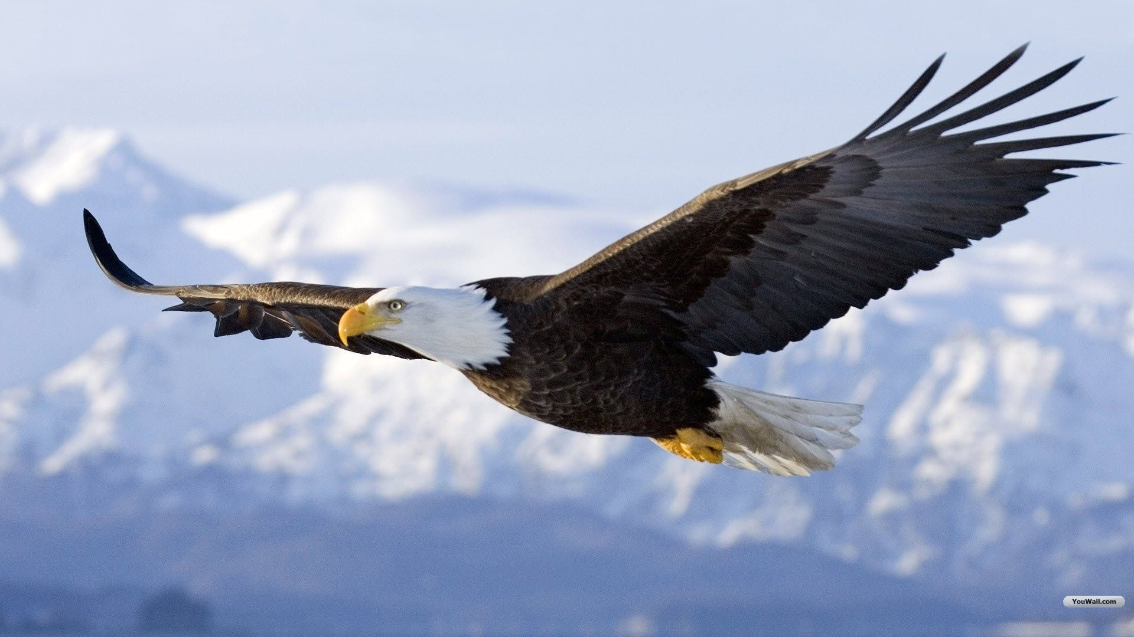
Zoom out
The MTS algorithms decision policy, the “When and Where”:
  These 2 aspects Will determine the total cost

Slide 41

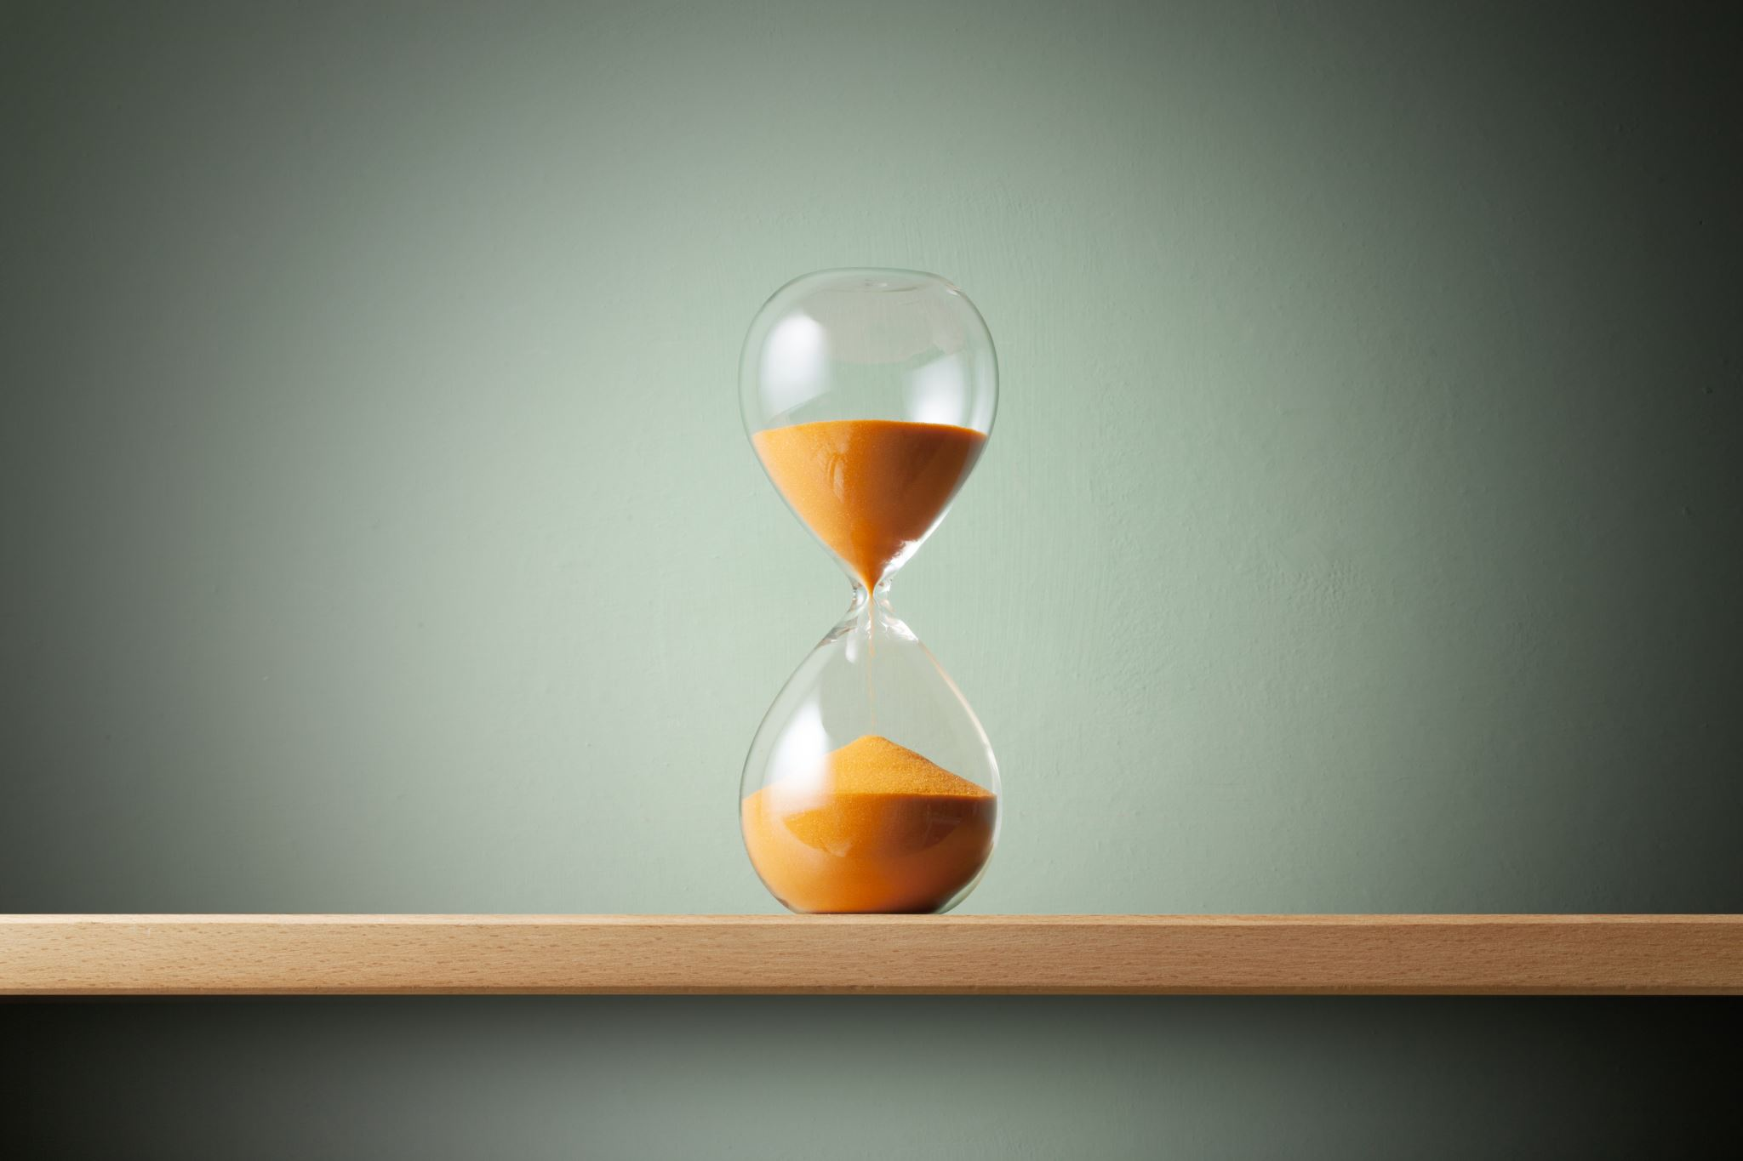
Continuous Time Algorithms
Motivation
8
Notes:
להדגיש

Slide 42
Continuous Time Algorithms
Up until now
Timeline
0
1
2
3
4
5
6
7
8
Notes:
להדגיש

Slide 43







Continuous Time Algorithms
$$r_{1}$$
$$r_{2}$$
$$r_{3}$$
$$r_{4}$$
$$r_{5}$$
$$r_{6}$$
$$r_{7}$$
Timeline
0
1
2
3
4
5
6
7
8
Notes:
להדגיש

Slide 44







MTS – Game flow
5
1
2
0
2
6
5
5
$$r_{1}$$
3
4
$$∞$$
2
3
12
Timeline
0
1
1.5
2
3
4
5
6
7
8
$$r_{1}$$
$$r_{2}$$
$$r_{3}$$
$$r_{4}$$
$$r_{5}$$
$$r_{6}$$
$$r_{7}$$
Notes:
Getting an $n$ long, sequence of tasks $σ=r_{1},r_{2}…r_{n}$ to be processed sequentially (one at the time without knowing what are the following tasks in the sequence $σ$)

Slide 45
MTS – Game flow
5
1
2
0
2
6
5
5
3
4
$$∞$$
2
3
12
Timeline
3
0
1
1.5
2
3
4
5
6
7
8
$$r_{1}$$
$$r_{2}$$
$$r_{3}$$
$$r_{4}$$
$$r_{5}$$
$$r_{6}$$
$$r_{7}$$
Notes:
Getting an $n$ long, sequence of tasks $σ=r_{1},r_{2}…r_{n}$ to be processed sequentially (one at the time without knowing what are the following tasks in the sequence $σ$)

Slide 46
MTS – Game flow
5
1
2
0
2
6
5
5
3
4
$$∞$$
2
3
12
Timeline
3
0
1
1.5
2
3
4
5
6
7
8
$$r_{1}$$
$$r_{2}$$
$$r_{3}$$
$$r_{4}$$
$$r_{5}$$
$$r_{6}$$
$$r_{7}$$
Notes:
Getting an $n$ long, sequence of tasks $σ=r_{1},r_{2}…r_{n}$ to be processed sequentially (one at the time without knowing what are the following tasks in the sequence $σ$)

Slide 47
MTS – Game flow
5
1
2
0
2
6
5
5
$$r_{2}$$
3
4
$$∞$$
2
3
12
Timeline
3
1
0
1
1.5
2
3
4
5
6
7
8
Notes:
Getting an $n$ long, sequence of tasks $σ=r_{1},r_{2}…r_{n}$ to be processed sequentially (one at the time without knowing what are the following tasks in the sequence $σ$)

Slide 48
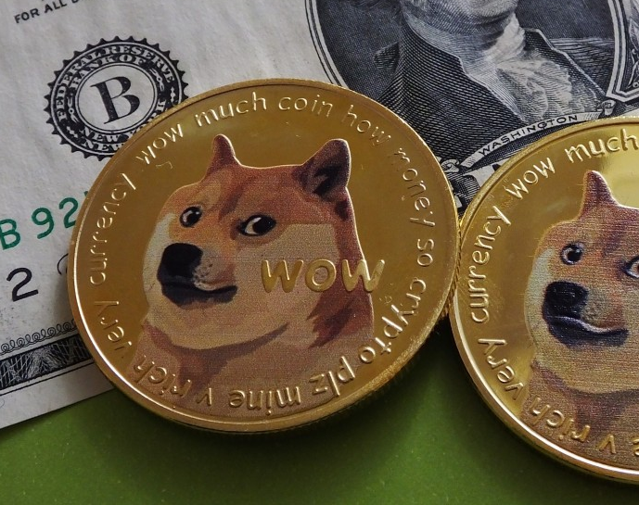
How do we charge?

Slide 49

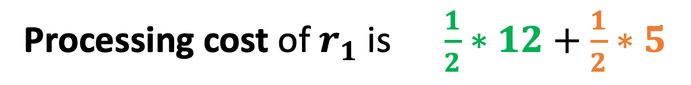
Processing cost – Continuous time
Processing cost of $r_{1}$is $\frac{1}{2}∗12+\frac{1}{2}∗5$
5
2
0
1
2
6
5
5
3
4
$$∞$$
2
3
12
Timeline
3
1
0
1
1.5
2
3
4
5
6
7
8
Notes:
Getting an $n$ long, sequence of tasks $σ=r_{1},r_{2}…r_{n}$ to be processed sequentially (one at the time without knowing what are the following tasks in the sequence $σ$)

Slide 50








Continuous Time Algorithms
Models' translation
$$Cost(disc)≤Cost(cont)$$
$$5$$
$$12$$
$$1$$
$$9$$
3
1
2
5
$$i$$
$$i+1$$

Slide 51
Lecture Timeline
Definition of MTS
Paging as MTS
Continuous Time Algorithms
Traversal algorithms and their competitive bounds
Lower bound for deterministic MTS Algorithms
Randomized MTS Algorithms

Slide 52
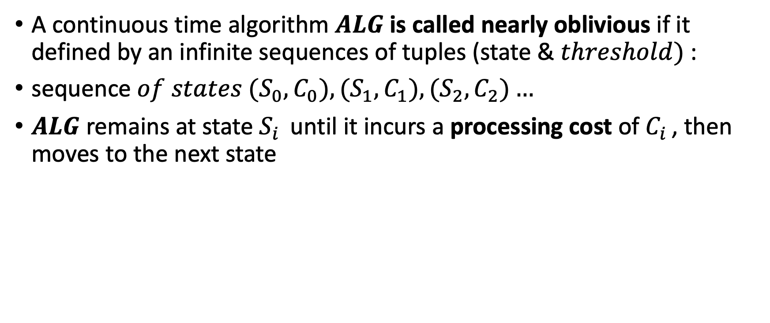
Nearly Oblivious and Traversal Algorithms
A continuous time algorithm $ALG$ is called nearly oblivious if it defined by an infinite sequences of tuples (state & $threshold)$ :
${\text{sequence} of states (S}_{0},C_{0}),{(S}_{1},C_{1}),(S_{2},C_{2})…$
$ALG$ remains at state $S_{i }$ until it incurs a processing cost of $C_{i }$, then moves to the next state
Notes:
להוסיף אולי אילוסטרציה של משימות מגיעות, להגיד שזה אומר שהחלפה יכולה אם כן להתבצע בזמן טאסק ספציפי או למשל לא להתבצע במהלך כל הטאסק.

Slide 53





Nearly Oblivious and Traversal Algorithms
$${(S}_{0},C_{0})$$
$${(S}_{1},C_{1})$$
$${(S}_{2},C_{2})$$
$${(S}_{3},C_{3})$$
$${(S}_{4},C_{4})$$
Notes:
להוסיף אולי אילוסטרציה של משימות מגיעות, להגיד שזה אומר שהחלפה יכולה אם כן להתבצע בזמן טאסק ספציפי או למשל לא להתבצע במהלך כל הטאסק.

Slide 54





Nearly Oblivious and Traversal Algorithms
$${(S}_{0},C_{0})$$
$${(S}_{1},C_{1})$$
$${(S}_{2},C_{2})$$
$${(S}_{3},C_{3})$$
$${(S}_{4},C_{4})$$
When
Notes:
להוסיף אולי אילוסטרציה של משימות מגיעות, להגיד שזה אומר שהחלפה יכולה אם כן להתבצע בזמן טאסק ספציפי או למשל לא להתבצע במהלך כל הטאסק.

Slide 55





Nearly Oblivious and Traversal Algorithms
$${(S}_{0},C_{0})$$
$${(S}_{1},C_{1})$$
$${(S}_{2},C_{2})$$
$${(S}_{3},C_{3})$$
$${(S}_{4},C_{4})$$
Where
Notes:
להוסיף אולי אילוסטרציה של משימות מגיעות, להגיד שזה אומר שהחלפה יכולה אם כן להתבצע בזמן טאסק ספציפי או למשל לא להתבצע במהלך כל הטאסק.

Slide 56

Illustration

Slide 57

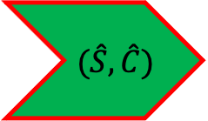


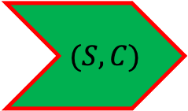






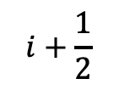
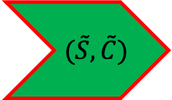
Say we’ve just moved to state $\hat{S}$ with its respective $\hat{C}$
$$(S,C)$$
$$(\hat{S},\hat{C})$$
$$(\tilde{S},\tilde{C})$$
M$oving to \hat{S}$ while processing $r_{i}$
Timeline
S
$$i$$
$$i+\frac{1}{2}$$
$i$+1
$i$+2
$i$+3
$i$+4
$i$+5
$i$+6
$i$+7

Slide 58
Say we’ve just moved to state $\hat{S}$ with its respective $\hat{C}$
$$(S,C)$$
$$(\hat{S},\hat{C})$$
$$(\tilde{S},\tilde{C})$$
M$oving to \hat{S}$ while processing $r_{i}$
Timeline
S
$$i$$
$$i+\frac{1}{2}$$
$i$+1
$i$+2
$i$+3
$i$+4
$i$+5
$i$+6
$i$+7

Slide 59

Say we’ve just moved to state $\hat{S}$ with its respective $\hat{C}$
$$(S,C)$$
$$(\hat{S},\hat{C})$$
$$(\tilde{S},\tilde{C})$$
0
$$\hat{C}$$
Timeline
S
$$i$$
$$i+\frac{1}{2}$$
$i$+1
$i$+2
$i$+3
$i$+4
$i$+5
$i$+6
$i$+7

Slide 60

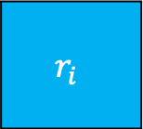
Say we’ve just moved to state $\hat{S}$ with its respective $\hat{C}$
$$(S,C)$$
$$(\hat{S},\hat{C})$$
$$(\tilde{S},\tilde{C})$$
$$r_{i}$$
0
$$\hat{C}$$
Timeline
S
$$\hat{S}$$
$$i$$
$$i+\frac{1}{2}$$
$i$+1
$i$+2
$i$+3
$i$+4
$i$+5
$i$+6
$i$+7

Slide 61

Say we’ve just moved to state $\hat{S}$ with its respective $\hat{C}$
$$(S,C)$$
$$(\hat{S},\hat{C})$$
$$(\tilde{S},\tilde{C})$$
$$r_{i}$$
$$r_{i+1}$$
0
$$\hat{C}$$
Timeline
S
$$\hat{S}$$
$$i$$
$$i+\frac{1}{2}$$
$i$+1
$i$+2
$i$+3
$i$+4
$i$+5
$i$+6
$i$+7

Slide 62


Say we’ve just moved to state $\hat{S}$ with its respective $\hat{C}$
$$(S,C)$$
$$(\hat{S},\hat{C})$$
$$(\tilde{S},\tilde{C})$$
$$r_{i}$$
$$r_{i+1}$$
0
$$\hat{C}$$
Timeline
S
$$\hat{S}$$
$$\hat{S}$$
$$i$$
$$i+\frac{1}{2}$$
$i$+1
$i$+2
$i$+3
$i$+4
$i$+5
$i$+6
$i$+7

Slide 63

Say we’ve just moved to state $\hat{S}$ with its respective $\hat{C}$
$$(S,C)$$
$$(\hat{S},\hat{C})$$
$$(\tilde{S},\tilde{C})$$
$$r_{i}$$
$$r_{i+1}$$
$$r_{i+2}$$
0
$$\hat{C}$$
Timeline
S
$$\hat{S}$$
$$\hat{S}$$
$$i$$
$$i+\frac{1}{2}$$
$i$+1
$i$+2
$i$+3
$i$+4
$i$+5
$i$+6
$i$+7

Slide 64
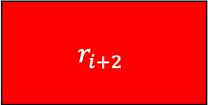

Say we’ve just moved to state $\hat{S}$ with its respective $\hat{C}$
$$(S,C)$$
$$(\hat{S},\hat{C})$$
$$(\tilde{S},\tilde{C})$$
$$r_{i}$$
$$r_{i+1}$$
$$r_{i+2}$$
0
$$\hat{C}$$
Timeline
S
$$\hat{S}$$
$$\hat{S}$$
$$\hat{S}$$
$$i$$
$$i+\frac{1}{2}$$
$i$+1
$i$+2
$i$+3
$i$+4
$i$+5
$i$+6
$i$+7

Slide 65
Say we’ve just moved to state $\hat{S}$ with its respective $\hat{C}$
$$(S,C)$$
$$(\hat{S},\hat{C})$$
$$(\tilde{S},\tilde{C})$$
Move to the next state!
$$r_{i}$$
$$r_{i+1}$$
$$r_{i+2}$$
0
$$\hat{C}$$
Timeline
S
$$\hat{S}$$
$$\hat{S}$$
$$\hat{S}$$
$$i$$
$$i+\frac{1}{2}$$
$i$+1
$i$+2
$i$+3
$i$+4
$i$+5
$i$+6
$i$+7

Slide 66
Say we’ve just moved to state $\hat{S}$ with its respective $\hat{C}$
$$(S,C)$$
$$(\hat{S},\hat{C})$$
$$(\tilde{S},\tilde{C})$$
Timeline
S
$$\hat{S}$$
$$\hat{S}$$
$$\hat{S}$$
$$i$$
$$i+\frac{1}{2}$$
$i$+1
$i$+2
$i$+3
$i$+4
$i$+5
$i$+6
$i$+7

Slide 67
Periodic MTS algorithm
$$s_{1},C_{1}$$
𝑠_1,𝐶_1
$$s_{2},C_{2}$$
𝑠_2,𝐶_2
$$s_{3},C_{3}$$
𝑠_3,𝐶_3
$$s_{4},C_{4}$$
𝑠_4,𝐶_4
$$s_{0},C_{0}$$
𝑠_0,𝐶_0

Slide 68
Periodic MTS algorithm
$$s_{1},C_{1}$$
𝑠_1,𝐶_1
$$s_{2},C_{2}$$
𝑠_2,𝐶_2
$$s_{3},C_{3}$$
𝑠_3,𝐶_3
$$s_{4},C_{4}$$
𝑠_4,𝐶_4
$$s_{0},C_{0}$$
𝑠_0,𝐶_0
Period of K=5
We call the length of this cycle the period of the algorithm

Slide 69

Periodic MTS algorithm
$$1 Cycle$$
$$s_{1},C_{1}$$
𝑠_1,𝐶_1
$$s_{2},C_{2}$$
𝑠_2,𝐶_2
$$s_{3},C_{3}$$
𝑠_3,𝐶_3
$$s_{4},C_{4}$$
𝑠_4,𝐶_4
$$s_{0},C_{0}$$
𝑠_0,𝐶_0

Slide 70






Traversal MTS algorithm
$$∀i C_{i}=d(S_{i},S_{i+1})$$
$$d(S_{0},S_{1})$$
$$s_{1},C_{1}$$
𝑠_1,𝐶_1
$$s_{2},C_{2}$$
𝑠_2,𝐶_2
$$s_{3},C_{3}$$
𝑠_3,𝐶_3
$$s_{4},C_{4}$$
𝑠_4,𝐶_4
$$s_{0},C_{0}$$
𝑠_0,𝐶_0
$$d(S_{1},S_{2})$$
$$d(S_{4},S_{0})$$
$$d(S_{3},S_{4})$$
$$d(S_{2},S_{3})$$

Slide 71
Traversal MTS algorithm
$$∀i C_{i}=d(S_{i},S_{i+1})$$
$$d(S_{0},S_{1})$$
$$s_{1},C_{1}$$
𝑠_1,𝐶_1
$$s_{2},C_{2}$$
𝑠_2,𝐶_2
$$s_{3},C_{3}$$
𝑠_3,𝐶_3
$$s_{4},C_{4}$$
𝑠_4,𝐶_4
$$s_{0},C_{0}$$
𝑠_0,𝐶_0
$$d(S_{1},S_{2})$$
What is the total cost (transition and processing) during each cycle?
$$d(S_{4},S_{0})$$
$$d(S_{3},S_{4})$$
$$d(S_{2},S_{3})$$

Slide 72
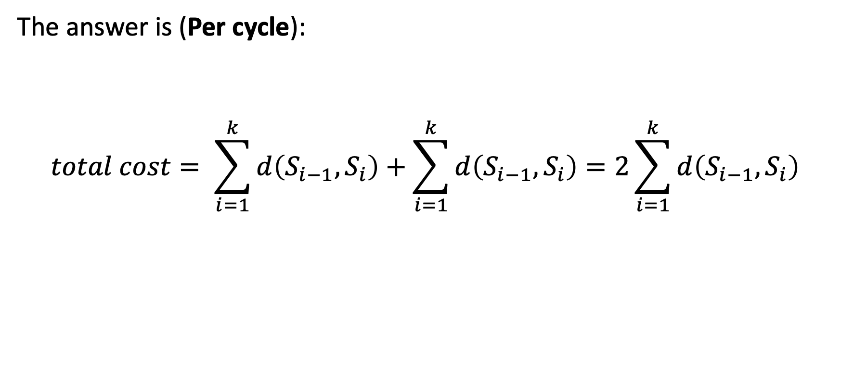
Traversal Algorithm
The answer is (Per cycle):
$$total cost= \sum_{i=1}^{k}{d\left(S_{i−1},S_{i}\right)+\sum_{i=1}^{k}{d\left(S_{i−1},S_{i}\right)=2\sum_{i=1}^{k}{d\left(S_{i−1},S_{i}\right)}}}$$
Transition cost
Processing cost
Notes:
Which is also called the traversal of ALG.

Slide 73
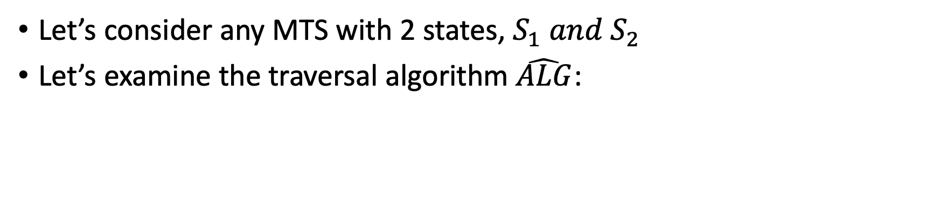
Traversal Algorithm – A Simple Example
Let’s consider any MTS with 2 states, $S_{1} and S_{2}$
Let’s examine the traversal algorithm $\hat{ALG}$:
$$S_{2},C_{2}$$
𝑆_2,𝐶_2
$$S_{1},C_{1}$$
𝑆_1,𝐶_1
$$\hat{ALG} incurs a total cost of 4d\left(S_{1},S_{2}\right) per cycle$$
Notes:
Which is also called the traversal of ALG.

Slide 74
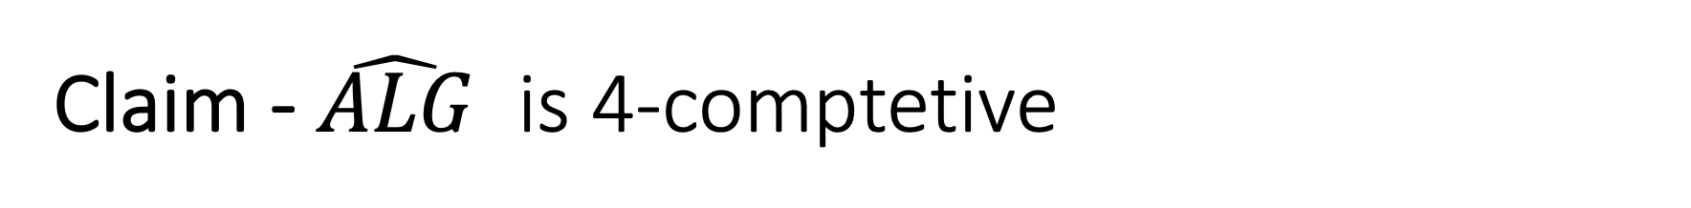
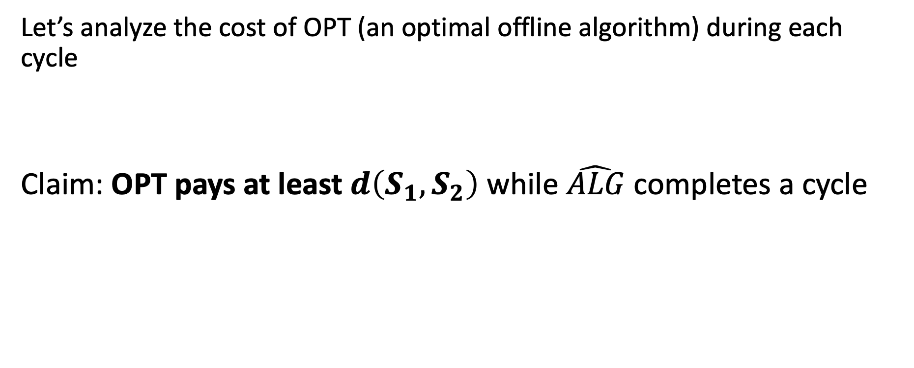
Claim - $\hat{ALG}$ is 4-comptetive
Let’s analyze the cost of OPT (an optimal offline algorithm) during each cycle
Claim: OPT pays at least $d\left(S_{1},S_{2}\right)$ while $\hat{ALG}$ completes a cycle
Notes:
Which is also called the traversal of ALG.

Slide 75


Claim - $\hat{ALG}$ is 4-comptetive
Two cases:
Case 1: if OPT moves during the cycle:
Pays $d\left(S_{1},S_{2}\right)$ on transition
Notes:
Which is also called the traversal of ALG.

Slide 76


Claim - $\hat{ALG}$ is 4-comptetive
Two cases:
Case 2: OPT stays at the same state from the beginning of the cycle
$$S_{2},C_{2}$$
𝑆_2,𝐶_2
$$S_{1},C_{1}$$
𝑆_1,𝐶_1
$$S_{1}$$
$$S_{2}$$
Notes:
Which is also called the traversal of ALG.

Slide 77

Claim - $\hat{ALG}$ is 4-comptetive
Two cases:
Case 2: OPT stays at the same state from the beginning of the cycle
$$S_{2},C_{2}$$
𝑆_2,𝐶_2
$$S_{1},C_{1}$$
𝑆_1,𝐶_1
$$S_{1}$$
$$S_{2}$$
Notes:
Which is also called the traversal of ALG.

Slide 78

Claim - $\hat{ALG}$ is 4-comptetive
Two cases:
Case 2: OPT stays at the same state from the beginning of the cycle
$$S_{2},C_{2}$$
𝑆_2,𝐶_2
$$S_{1},C_{1}$$
𝑆_1,𝐶_1
$$S_{1}$$
$$S_{2}$$
$$d\left(S_{1},S_{2}\right)$$
Notes:
Which is also called the traversal of ALG.

Slide 79


Claim - $\hat{ALG}$ is 4-comptetive
Conclusion:
$$S_{2},C_{2}$$
𝑆_2,𝐶_2
$$S_{1},C_{1}$$
𝑆_1,𝐶_1
$d\left(S_{1},S_{2}\right)$ $≤$
$$=4d\left(S_{1},S_{2}\right)$$
Notes:
Which is also called the traversal of ALG.

Slide 80
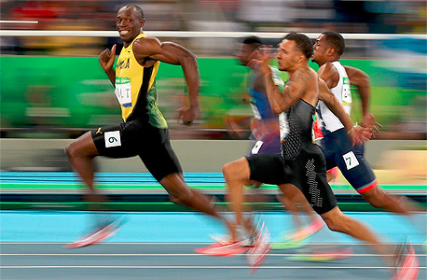

An $8(N−1)−$competitive Traversal Algorithm
*N is the number of possible states

Slide 81
Building the traversal recursively
1
1
2
8
15
16
3
4
2
3

Slide 82
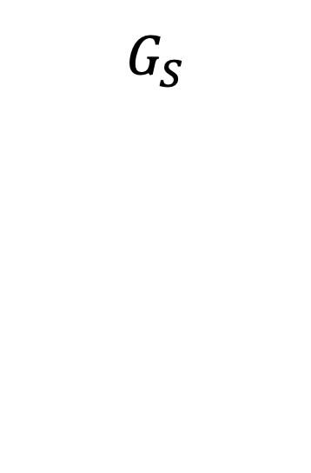
Building the traversal recursively
1
1
1
1
2
2
8
8
16
16
15
16
4
4
3
4
2
2
3
3
$$G_{S}$$

Slide 83
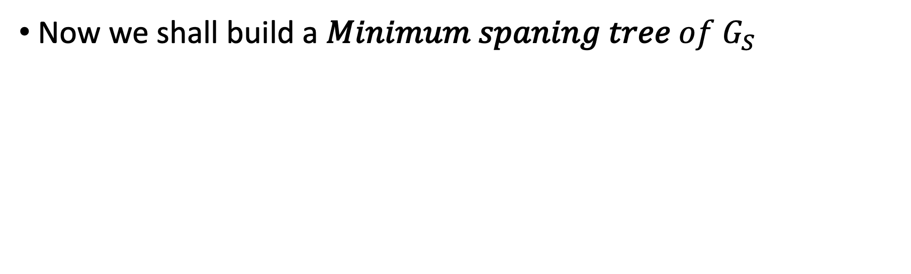
Building the traversal recursively
Now we shall build a 𝑀𝑖𝑛𝑖𝑚𝑢𝑚 𝑠𝑝𝑎𝑛𝑖𝑛𝑔 𝑡𝑟𝑒𝑒 𝑜𝑓 $G_{S}$
1
1
1
1
2
2
8
16
16
4
4
4
4
2
2
3
3

Slide 84
Building the traversal recursively
2
1
4
1
3
2
4

Slide 85
Picking a maximum weight edge
2
1
4
1
3
2
4

Slide 86
Picking a maximum weight edge
2
1
4
1
3
2
4

Slide 87





Building the traversal recursively
2
2
3
$2^{M}=$4
$$2^{M_{2}}=2$$
$$2^{M_{1}}=1$$
3
4
1
$T_{1}$
$T_{2}$

Slide 88









2
2
3
$2^{M}=$4
$$2^{M_{2}}=2$$
$$2^{M_{1}}=1$$
3
4
1
$T_{1}$
$2^{M}=$4
$T_{2}$
$2^{M}=$4
2
2
3
3
………
………
$$2^{M−M_{1}}=2^{2−0}=4$$
$$2^{M−M_{2}}=2^{2−1}=2$$

Slide 89

Base case
$$v,d(u,v)$$
𝑣,𝑑(𝑢,𝑣)
$$u,d(u,v)$$
𝑢,𝑑(𝑢,𝑣)
v
$$2^{M}$$
u

Slide 90

Proving the 8(N-1)-competitive ratio
We shall prove that during each cycle :
  $ALG$ incurs a total cost of at most $4\left(N−1\right)2^{M}$
  $OPT$ incurs a total cost of at least $2^{M−1}$

Slide 91
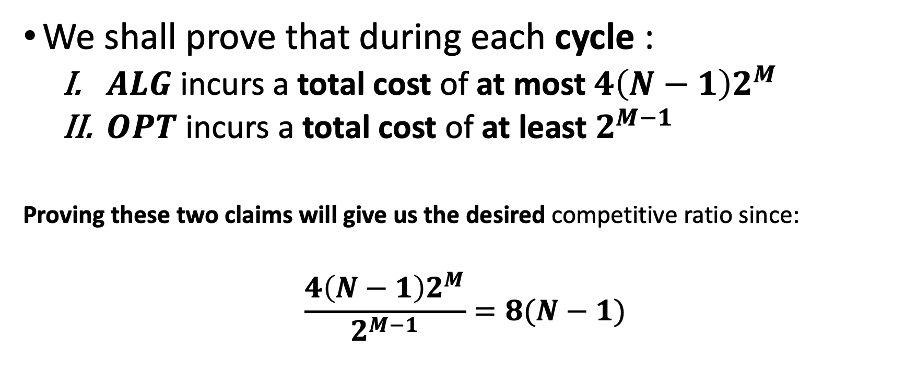
Proving the 8(N-1)-competitive ratio
We shall prove that during each cycle :
  $ALG$ incurs a total cost of at most $4\left(N−1\right)2^{M}$
  $OPT$ incurs a total cost of at least $2^{M−1}$
Proving these two claims will give us the desired competitive ratio since:
$$\frac{4\left(N−1\right)2^{M}}{2^{M−1}}=8(N−1)$$

Slide 92

Proving the First claim
During each cycle $ALG$ incurs a total cost of at most $4\left(N−1\right)2^{M}$

Slide 93

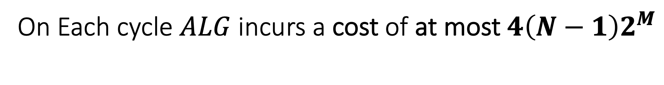
On Each cycle $ALG$ incurs a cost of at most $4\left(N−1\right)2^{M}$
We will prove that an edge of rounded wight $2^{k}$is traversed exactly ${2∗2}^{M−k}$ during a cycle of $ALG$

Slide 94

An edge of wight $2^{k}$is traversed $2^{M−k}$ in each direction per cycle
By induction on $\left|E\right|$ (number of edges in the subtree that created T):
Base case $\left|E\right|$ = 1:
Indeed, it is traversed ${2∗2}^{M−M=0}=2$

Slide 95





An edge of wight $2^{k}$is traversed ${2∗2}^{M−k}$ per cycle
Let’s assume the claim holds for $<\left|E_{S}\right|$ and recall our traversal:
By assumption, each edge in $T_{1}$ is traversed ${2∗2}^{M_{1}−k}$
Now since we traverse $T_{1}$, $2^{M−M_{1}}$ times, in our traversal, we traverse such edge a total of:
$2^{M−M_{1}}$* ${2∗2}^{M_{1}−k}={2∗2}^{M−k}$
$$T_{1}$$
$$T_{1}$$
$$T_{2}$$
$$T_{2}$$

Slide 96

Back to the Cost analysis

Slide 97

Total cost caused by a single edge traverse
$$2^{k}$$
u
v
Notes:
we have N-1 edges in the original MST we get

Slide 98



Total cost caused by a single edge traverse
$$2^{k}$$
u
v
Processing cost of exactly $2^{k}$
Transition cost of at most $2^{k}$
Total cost of at most ${2∗2}^{k}$
Notes:
we have N-1 edges in the original MST we get

Slide 99


On Each cycle $ALG$ incurs a cost of at most $4\left(N−1\right)2^{M}$
An edge of wight $2^{k}$is traversed ${2∗2}^{M−k}$ per cycle
Each traversal is responsible for a cost of at most ${2∗2}^{k}$
And we have N-1 edges:
$$cost≤\sum_{i=1}^{N−1}{\left(2∗2^{k}\right)∗2∗2^{M−k}=\sum_{i=1}^{N−1}{4∗2^{M}=\left(N−1\right)∗4∗2^{M}}}$$
Cost
Traversals
Notes:
we have N-1 edges in the original MST we get

Slide 100

Now we prove our second claim
During the time that $ALG$ completes a cycle, $OPT$ incurs a total cost of at least $2^{M−1}$

Slide 101


  $OPT$ incurs a total cost of at least $2^{M−1}$
Again, by induction on $|E|$:
Notes:
Which is also called the traversal of ALG.

Slide 102


$OPT$ incurs a total cost of at least $2^{M−1}$
Again, by induction on $|E|$:
Base case $\left|E\right|$ = 1:
$$S_{2},C_{2}$$
𝑆_2,𝐶_2
$$S_{1},C_{1}$$
𝑆_1,𝐶_1
$$S_{1}$$
$$S_{2}$$
Notes:
Which is also called the traversal of ALG.

Slide 103

$OPT$ incurs a total cost of at least $2^{M−1}$
Again, by induction on $|E|$:
Base case $\left|E\right|$ = 1:
transition = cost of at least $2^{M−1}$
$$S_{2},C_{2}$$
𝑆_2,𝐶_2
$$S_{1},C_{1}$$
𝑆_1,𝐶_1
$$S_{1}$$
$$S_{2}$$
Notes:
Which is also called the traversal of ALG.

Slide 104

$OPT$ incurs a total cost of at least $2^{M−1}$
Again, by induction on $|E|$:
Base case $\left|E\right|$ = 1:
Staying = cost of at least $2^{M}$
$$S_{2},C_{2}$$
𝑆_2,𝐶_2
$$S_{1},C_{1}$$
𝑆_1,𝐶_1
$$S_{1}$$
$$S_{2}$$
Notes:
Which is also called the traversal of ALG.

Slide 105




$OPT$ incurs a total cost of at least $2^{M−1}$
Let’s assume that it holds for $<\left|E_{s}\right|$
Case 1: OPT moves between states of $T_{1}$ and $T_{2}$ during the cycle:
$T_{1}$
$T_{2}$

Slide 106






$OPT$ incurs a total cost of at least $2^{M−1}$
Let’s assume that it holds for $<\left|E\right|$
Case 1: OPT moves between states of $T_{1}$ and $T_{2}$ during the cycle:
MST of $G_{s}$
$$2^{M}$$
u
v
u
v
$$T_{1}$$
$$T_{2}$$
$T_{1}$
$T_{2}$
OPT will incur a transition cost of at least $2^{M−1}$

Slide 107


$OPT$ incurs a total cost of at least $2^{M−1}$
Case 2: OPT stays only in states from $T_{1}$ or from $T_{2}$ during the whole cycle:
u
v
$T_{1}$
$T_{2}$
Notes:
הבניה נעשתה מעל עפ״מ – הדרך הזלה ביותר לעבור בין תתי הסטים של המצבים היא דרך הקשת הראשונה שהורדנו – שהמשקל שלה הוא 2 במ׳, ולכן כל דרך אחרת תעלה בהכרח יותר

Slide 108



$OPT$ incurs a total cost of at least $2^{M−1}$
Case 2: OPT stays only in states from $T_{1}$ or from $T_{2}$ during the whole cycle:
u
v
$T_{1}$
$T_{2}$

Slide 109








$OPT$ incurs a total cost of at least $2^{M−1}$
Subcase 1: $T_{1}$ is composed of a single node\State u :
$$ALG at state u$$
$$2^{M}$$
$$u$$
$$u$$
$T_{1}$
$T_{2}$
OPT will incur a processing cost of at least $2^{M}$

Slide 110

$OPT$ incurs a total cost of at least $2^{M−1}$
Status: $OPT$stays in $T_{1}$ during the cycle
Subcase 2: $T_{1}$ is composed of more than a single node
$T_{1}$

Slide 111

$OPT$ incurs a total cost of at least $2^{M−1}$
Status: $OPT$stays in $T_{1}$ during the cycle
Subcase 2: $T_{1}$ is composed of more than a single node
By assumption, $OPT$ incurs a cost of at least $2^{M_{1}−1} per cycle of T_{1}$
$T_{1}$

Slide 112





$OPT$ incurs a total cost of at least $2^{M−1}$
Status: $OPT$stays in $T_{1}$ during the cycle
By assumption, $OPT$ incurs a cost of at least $2^{M_{1}−1} per cycle of T_{1}$
Each cycle of $ALG$ contains $2^{M−M_{1}}$ cycles of $T_{1}$
$→OPT$ pays at least $2^{M−M_{1}}$* $2^{M_{1}−1}=2^{M−1}$ $per cycle$ of $ALG$
$T_{1}$
$T_{1}$
$T_{2}$
$T_{2}$

Slide 113

Proving the 8(N-1)-competitive ratio
We have proved that during each cycle :
  $ALG$ incurs a total cost of at most $4\left(N−1\right)2^{M}$
  $OPT$ incurs a total cost of at least $2^{M−1}$
And so, we got the competitive ratio:
$$\frac{4\left(N−1\right)2^{M}}{2^{M−1}}=8(N−1)$$

Slide 114
Lecture Timeline
Definition of MTS
Paging as MTS
Continuous Time Algorithms
Traversal algorithms and their competitive bounds
Lower bound for deterministic MTS Algorithms
Randomized MTS Algorithms

Slide 115


A $(2N−1)−$competitive Lower bound
For deterministic* MST online Algorithm

Slide 116


A (2$N−1)−$competitive Lower bound
For any N state MTS, an online deterministic Algorithm $ALG,$ and $ε>0 ,$there exist a task sequence $σ_{m}$ :
$$\frac{ALG(σ_{m})}{OPT(σ_{m})}≥\frac{2N−1}{1+2ε}$$
*By scaling processing and transition costs, we can always assume that $\min_{i≠j}{d\left(s_{i},s_{j}\right)=1}$

Slide 117


A (2$N−1)−$competitive Lower bound
$$Our task sequence − elementary tasks$$
0
2
0
1
2
6
5
5
3
4
$$ε$$
2
3
0

Slide 118


A (2$N−1)−$competitive Lower bound
$$Our task sequence − elementary tasks$$
$$ε$$
2
0
1
2
6
5
5
3
4
$$\text{0}$$
2
3
0

Slide 119








The sequence $σ_{m}$ produced by the adversary
1
2
2
6
5
5
3
4
2
3
Timeline
0
1
2
3
4
5
6
7
8
$$r_{1}$$
$$r_{2}$$
$$r_{3}$$
$$r_{4}$$
$$r_{5}$$
$$r_{6}$$
$$r_{7}$$

Slide 120





The sequence $σ_{m}$ produced by the adversary
$$ε$$
2
0
1
2
6
5
5
3
4
$$\text{0}$$
2
$$r_{1}$$
3
0
Timeline
0
1
2
3
4
5
6
7
8
$$r_{1}$$
$$r_{2}$$
$$r_{3}$$
$$r_{4}$$
$$r_{5}$$
$$r_{6}$$
$$r_{7}$$

Slide 121


The sequence $σ_{m}$ produced by the adversary
$$ε$$
2
0
1
2
6
5
5
3
4
$$\text{0}$$
2
3
0
Timeline
0
1
2
3
4
5
6
7
8
$$r_{1}$$
$$r_{2}$$
$$r_{3}$$
$$r_{4}$$
$$r_{5}$$
$$r_{6}$$
$$r_{7}$$

Slide 122
The sequence $σ_{m}$ produced by the adversary
1
2
2
6
5
5
3
4
2
3
Timeline
0
1
2
3
4
5
6
7
8
$$r_{1}$$
$$r_{2}$$
$$r_{3}$$
$$r_{4}$$
$$r_{5}$$
$$r_{6}$$
$$r_{7}$$

Slide 123

The sequence $σ_{m}$ produced by the adversary
$$ε$$
2
0
1
2
6
5
5
3
4
$$\text{0}$$
2
3
0
$$r_{2}$$
Timeline
0
1
2
3
4
5
6
7
8
$$r_{1}$$
$$r_{2}$$
$$r_{3}$$
$$r_{4}$$
$$r_{5}$$
$$r_{6}$$
$$r_{7}$$

Slide 124
The sequence $σ_{m}$ produced by the adversary
$$ε$$
2
0
1
2
6
5
5
3
4
$$\text{0}$$
2
3
0
Timeline
0
1
2
3
4
5
6
7
8
$$r_{1}$$
$$r_{2}$$
$$r_{3}$$
$$r_{4}$$
$$r_{5}$$
$$r_{6}$$
$$r_{7}$$

Slide 125
The sequence $σ_{m}$ produced by the adversary
1
2
2
6
5
5
3
4
2
3
Timeline
0
1
2
3
4
5
6
7
8
$$r_{1}$$
$$r_{2}$$
$$r_{3}$$
$$r_{4}$$
$$r_{5}$$
$$r_{6}$$
$$r_{7}$$

Slide 126


The sequence $σ_{m}$ produced by the adversary
$$\text{0}$$
2
$$ε$$
1
2
6
5
5
3
4
$$\text{0}$$
2
3
0
$$r_{2}$$
Timeline
0
1
2
3
4
5
6
7
8
$$r_{1}$$
$$r_{2}$$
$$r_{3}$$
$$r_{4}$$
$$r_{5}$$
$$r_{6}$$
$$r_{7}$$

Slide 127
The sequence $σ_{m}$ produced by the adversary
The adversary makes us pay something – every round!
The total cost depends only on the number of transitions made by ALG

Slide 128


A (2$N−1)−$competitive Lower bound
Suppose that $ALG$made exactly k transitions then the total cost of $ALG$ is:
$$ALG\left(σ_{m}\right)=\sum_{i∈K}{d\left(S_{i−1},S_{i}\right)+(m−k)ε}$$
Notes:
בכל איטרציה נשלם אפסילון או 1

Slide 129





A (2$N−1)−$competitive Lower bound
Now we will bound $OPT\left(σ_{m}\right)$ from above
The averaging technique
Set B of Offline algorithms
$$\frac{B(σ_{m})}{|B|}$$
$B\left(σ_{m}\right)≔\sum_{\check{ALG}∈B}{\check{ALG}(σ_{m})}$
At least one 𝒂𝒍𝒈𝒐𝒓𝒊𝒕𝒉𝒎 𝒊𝒏 𝑩 must incur a total cost $≤$ Average
$$OPT(σ_{m})≤\frac{B(σ_{m})}{|B|}$$
Notes:
בכל איטרציה נשלם אפסילון או 1

Slide 130









A (2$N−1)−$competitive Lower bound
B will be a set with 2$N−1$ algorithms
$$1$$
$$3$$
$$6$$
$$2$$
$$4$$
$$5$$
11 offline players
Notes:
בכל איטרציה נשלם אפסילון או 1

Slide 131




















A (2$N−1)−$competitive Lower bound
$$1$$
B will be a set with 2$N−1$ algorithms
$$2$$
$$3$$
$$ALG$$
$$4$$
$$5$$
$$1$$
$$2$$
$$3$$
$$4$$
$$5$$
$$6$$
$$6$$
Timeline
0
1
2
3
4
5
6
7
8
$$r_{1}$$
$$r_{2}$$
$$r_{3}$$
$$r_{4}$$
$$r_{5}$$
$$r_{6}$$
$$r_{7}$$
Notes:
בכל איטרציה נשלם אפסילון או 1

Slide 132




A (2$N−1)−$competitive Lower bound
$$1$$
$$0$$
B will be a set with 2$N−1$ algorithms
$$2$$
$$0$$
$$3$$
$$0$$
$$ALG$$
$$4$$
$$0$$
$$5$$
$$0$$
$$1$$
$$2$$
$$3$$
$$4$$
$$5$$
$$6$$
$$ε$$
$$6$$
Timeline
0
1
2
3
4
5
6
7
8
$$r_{1}$$
$$r_{2}$$
$$r_{3}$$
$$r_{4}$$
$$r_{5}$$
$$r_{6}$$
$$r_{7}$$
Notes:
בכל איטרציה נשלם אפסילון או 1

Slide 133


A (2$N−1)−$competitive Lower bound
$$1$$
$$0$$
B will be a set with 2$N−1$ algorithms
$$2$$
$$0$$
$$3$$
$$0$$
$$ALG$$
$$4$$
$$0$$
$$5$$
$$0$$
$$1$$
$$2$$
$$3$$
$$4$$
$$5$$
$$6$$
$$ε$$
$$6$$
Timeline
0
1
2
3
4
5
6
7
8
$$r_{1}$$
$$r_{2}$$
$$r_{3}$$
$$r_{4}$$
$$r_{5}$$
$$r_{6}$$
$$r_{7}$$
Notes:
בכל איטרציה נשלם אפסילון או 1

Slide 134
A (2$N−1)−$competitive Lower bound
$$1$$
$$0$$
B will be a set with 2$N−1$ algorithms
$$2$$
$$0$$
$$3$$
$$0$$
$$ALG$$
$$4$$
$$0$$
$$5$$
$$0$$
$$1$$
$$2$$
$$3$$
$$4$$
$$5$$
$$6$$
$$ε$$
$$6$$
Timeline
0
1
2
3
4
5
6
7
8
$$r_{1}$$
$$r_{2}$$
$$r_{3}$$
$$r_{4}$$
$$r_{5}$$
$$r_{6}$$
$$r_{7}$$
Notes:
בכל איטרציה נשלם אפסילון או 1

Slide 135
A (2$N−1)−$competitive Lower bound
$$1$$
B will be a set with 2$N−1$ algorithms
$$2$$
$$3$$
$$ALG$$
$$4$$
$$5$$
$$1$$
$$2$$
$$3$$
$$4$$
$$5$$
$$6$$
$$6$$
Timeline
0
1
2
3
4
5
6
7
8
$$r_{1}$$
$$r_{2}$$
$$r_{3}$$
$$r_{4}$$
$$r_{5}$$
$$r_{6}$$
$$r_{7}$$
Notes:
בכל איטרציה נשלם אפסילון או 1

Slide 136


A (2$N−1)−$competitive Lower bound
$$ε$$
$$1$$
B will be a set with 2$N−1$ algorithms
$$2$$
$$0$$
$$3$$
$$0$$
$$ALG$$
$$4$$
$$0$$
$$5$$
$$0$$
$$1$$
$$2$$
$$3$$
$$4$$
$$5$$
$$6$$
$$6$$
$$0$$
Timeline
0
1
2
3
4
5
6
7
8
$$r_{1}$$
$$r_{2}$$
$$r_{3}$$
$$r_{4}$$
$$r_{5}$$
$$r_{6}$$
$$r_{7}$$
Notes:
בכל איטרציה נשלם אפסילון או 1

Slide 137
A (2$N−1)−$competitive Lower bound
$$ε$$
$$1$$
B will be a set with 2$N−1$ algorithms
$$2$$
$$0$$
$$3$$
$$0$$
$$ALG$$
$$4$$
$$0$$
$$5$$
$$0$$
$$1$$
$$2$$
$$3$$
$$4$$
$$5$$
$$6$$
$$6$$
$$0$$
Timeline
0
1
2
3
4
5
6
7
8
$$r_{1}$$
$$r_{2}$$
$$r_{3}$$
$$r_{4}$$
$$r_{5}$$
$$r_{6}$$
$$r_{7}$$
Notes:
בכל איטרציה נשלם אפסילון או 1

Slide 138
A (2$N−1)−$competitive Lower bound
$$1$$
B will be a set with 2$N−1$ algorithms
$$2$$
$$3$$
$$ALG$$
$$4$$
$$5$$
$$1$$
$$2$$
$$3$$
$$4$$
$$5$$
$$6$$
$$6$$
Timeline
0
1
2
3
4
5
6
7
8
$$r_{1}$$
$$r_{2}$$
$$r_{3}$$
$$r_{4}$$
$$r_{5}$$
$$r_{6}$$
$$r_{7}$$
Notes:
בכל איטרציה נשלם אפסילון או 1

Slide 139
A (2$N−1)−$competitive Lower bound
$$ε$$
$$1$$
B will be a set with 2$N−1$ algorithms
$$2$$
$$0$$
$$3$$
$$0$$
$$ALG$$
$$4$$
$$0$$
$$5$$
$$0$$
$$1$$
$$2$$
$$3$$
$$4$$
$$5$$
$$6$$
$$6$$
$$0$$
Timeline
0
1
2
3
4
5
6
7
8
$$r_{1}$$
$$r_{2}$$
$$r_{3}$$
$$r_{4}$$
$$r_{5}$$
$$r_{6}$$
$$r_{7}$$
Notes:
בכל איטרציה נשלם אפסילון או 1

Slide 140


A (2$N−1)−$competitive Lower bound
$$ε$$
$$1$$
B will be a set with 2$N−1$ algorithms
$$2$$
$$0$$
$$3$$
$$0$$
$$ALG$$
$$4$$
$$0$$
$$5$$
$$0$$
$$1$$
$$2$$
$$3$$
$$4$$
$$5$$
$$6$$
$$6$$
$$0$$
Timeline
0
1
2
3
4
5
6
7
8
$$r_{1}$$
$$r_{2}$$
$$r_{3}$$
$$r_{4}$$
$$r_{5}$$
$$r_{6}$$
$$r_{7}$$
Notes:
בכל איטרציה נשלם אפסילון או 1

Slide 141
A (2$N−1)−$competitive Lower bound
$$ε$$
$$1$$
B will be a set with 2$N−1$ algorithms
$$2$$
$$0$$
$$3$$
$$0$$
$$ALG$$
$$4$$
$$0$$
$$5$$
$$0$$
$$1$$
$$2$$
$$3$$
$$4$$
$$5$$
$$6$$
$$6$$
$$0$$
Timeline
0
1
2
3
4
5
6
7
8
$$r_{1}$$
$$r_{2}$$
$$r_{3}$$
$$r_{4}$$
$$r_{5}$$
$$r_{6}$$
$$r_{7}$$
Notes:
בכל איטרציה נשלם אפסילון או 1

Slide 142
A (2$N−1)−$competitive Lower bound
$$ε$$
$$1$$
B will be a set with 2$N−1$ algorithms
$$2$$
$$0$$
$$3$$
$$0$$
$$ALG$$
$$4$$
$$0$$
$$5$$
$$0$$
$$1$$
$$2$$
$$3$$
$$4$$
$$5$$
$$6$$
$$6$$
$$0$$
Timeline
0
1
2
3
4
5
6
7
8
$$r_{1}$$
$$r_{2}$$
$$r_{3}$$
$$r_{4}$$
$$r_{5}$$
$$r_{6}$$
$$r_{7}$$
Notes:
בכל איטרציה נשלם אפסילון או 1

Slide 143
A (2$N−1)−$competitive Lower bound
$$1$$
B will be a set with 2$N−1$ algorithms
$$2$$
$$3$$
$$ALG$$
$$4$$
$$5$$
$$1$$
$$2$$
$$3$$
$$4$$
$$5$$
$$6$$
$$6$$
Timeline
0
1
2
3
4
5
6
7
8
$$r_{1}$$
$$r_{2}$$
$$r_{3}$$
$$r_{4}$$
$$r_{5}$$
$$r_{6}$$
$$r_{7}$$
Notes:
בכל איטרציה נשלם אפסילון או 1

Slide 144

A (2$N−1)−$competitive Lower bound
Analysis of $B\left(σ_{m}\right)$:
Transition cost:
We made the exact same amount and type of transitions:
$$\sum_{i∈K}{d\left(S_{i−1},S_{i}\right)}$$
Notes:
בגלל שעל כל מעבר יש לנו אלגוריתם בקבוצה שביצע את המעבר הסימטרי.

Slide 145

A (2$N−1)−$competitive Lower bound
Processing cost:
At each iteration we have 1 algorithm at the same state as $ALG$ thus it gives us
$$(m−k)ε$$
Notes:
בגלל שעל כל מעבר יש לנו אלגוריתם בקבוצה שביצע את המעבר הסימטרי.

Slide 146

A (2$N−1)−$competitive Lower bound
Processing cost:
At each iteration we have 1 algorithm at the same state as $ALG$ thus it gives us
$$(m−k)ε$$
K iterations in which $ALG$ doesn’t incur Processing cost
In each such iteration we have exactly 2 algorithms in B that are in a state that pays $ε$, thus we have an additional cost of:
$2kε$
Notes:
בגלל שעל כל מעבר יש לנו אלגוריתם בקבוצה שביצע את המעבר הסימטרי.

Slide 147


A (2$N−1)−$competitive Lower bound
$B\left(σ_{m}\right)$- putting it all together we get:
$$B\left(σ_{m}\right)=2kε+\sum_{i∈K}{d\left(S_{i−1},S_{i}\right)+(m−k)ε}$$
And so, we get that:
$$OPT(σ_{m})≤\frac{2kε+ALG(σ_{m})}{2N−1}$$
$$=ALG(σ_{m})$$
Notes:
בגלל שעל כל מעבר יש לנו אלגוריתם בקבוצה שביצע את המעבר הסימטרי.

Slide 148


A (2$N−1)−$competitive Lower bound
$$OPT(σ_{m})≤\frac{2kε+ALG(σ_{m})}{2N−1}$$
$$ALG\left(σ_{m}\right)=\sum_{i∈K}{d\left(S_{i−1},S_{i}\right)+(m−k)ε≥\sum_{i∈K}{d\left(S_{i−1},S_{i}\right)≥k}}$$
$$OPT(σ_{m})≤\frac{2ALG(σ_{m})ε+ALG(σ_{m})}{2N−1}$$
$$⟹\left(2N−1\right)OPT(σ_{m})≤(2ε+1) ALG\left(σ_{m}\right)$$
$$⟹\frac{ALG\left(σ_{m}\right)}{OPT(σ_{m})}≥\frac{2N−1}{1+2ε}$$
Notes:
בגלל שעל כל מעבר יש לנו אלגוריתם בקבוצה שביצע את המעבר הסימטרי.
We have assumed that $\min_{i≠j}{d\left(s_{i},s_{j}\right)=1}$ and so:

Slide 149

There exist such algorithm

Slide 150
The existence of 2N-1 deterministic MST online Algorithm

Slide 151

Keep track of the optimal offline algorithm
A sometime useful principle of decision making for the online player can be to try to follow, in a sense, the optimal offline algorithm
For the MTS framework, an optimal offline algorithm can work in the following dynamic programing way:
  Let (S,d) be an MTS, $S_{0}$ the initial state and $σ_{n}=r_{1},r_{2}…,r_{n}$ a task sequence.
  Let $σ_{i}=r_{1},r_{2}…r_{i}$the prefix of the first I tasks in $σ_{n}$
  For each state $s′∈S$ we define $w_{i}(s^{′})$ to be the minimum offline cost of processing $σ_{i}, starting from S_{0} and ending at s^{′}$

Slide 152

Keep track of the optimal offline algorithm
Clearly, we have that ${OPT(σ}_{n})=\min_{s′∈S}{w_{n}(s^{′})}$
This value can be calculated in a dynamic programing fashion:
Base case:
$$W_{0}\left(s^{′}\right)=d(S_{0},S^{′})$$
And making progress by:
$$W_{i+1}\left(s^{′}\right)=\min_{x∈S}\left\{W_{i}\left(x\right)+d\left(x,s^{′}\right)+r_{i+1}(s^{′})\right\}$$

Slide 153

Keep track of the optimal offline algorithm
The way we calculate that value offline is via a matrix of nXN starting from the first row and advancing towards the last one
In order to calculate the i+1’th row we need only to have the i row completed
When receiving the i+1 task we can try to decide what would our next state (and the state in which the task will be processed in) by:
$$S_{i+1}=arg\min_{s′}{\{w_{i+1}\left(s^{′}\right)+d(s_{i},s^{′})\}}$$

Slide 154

Keep track of the optimal offline algorithm
$$S_{i+1}=arg\min_{s′}{\{w_{i+1}\left(s^{′}\right)+d(s_{i},s^{′})\}}$$
Where
$$w_{i+1}\left(S_{i+1}\right)=w_{i}\left(S_{i+1}\right)+r_{i+1}\left(S_{i+1}\right)+d(S_{i+1},S_{i+1})$$
Data that we have
=0

Slide 155
Lecture Timeline
Definition of MTS
Paging as MTS
Continuous Time Algorithms
Traversal algorithms and their competitive bounds
Lower bound for deterministic MTS Algorithms
Randomized MTS Algorithms

Slide 156


Randomized MTS Algorithms

Slide 157

Randomized MTS Algorithms
$2H_{N}−Competitive ratio$ against an oblivious adversary* over a Uniform MTS**
*oblivious adversary:
  Must create the sequence in advance
  Knows our algorithms code but doesn’t know what would be the value of our coin tosses

Slide 158

Randomized MTS Algorithms
$2H_{N}−Competitive ratio$ against an oblivious adversary* over a Uniform MTS**
1
1
2
1
1
1
1
4
1
3

Slide 159

Our randomized online player
State transition decisions would be based on a probabilistic function
Continuous time algorithm
Notes:
קיימת הכללה פולילוג

Slide 160

Analysis framework – Phases and saturation

Slide 161

















Illustration- Beginning of phase 1
Unsaturated area
$$1$$
$$1$$
$$1$$
$$1$$
$$1$$
$$1$$
$$1$$
$$1$$
$$0$$
$$2$$
$$0$$
$$3$$
$$0$$
$$4$$
$$0$$
$$5$$
$$0$$
$$6$$
$$0$$
$$7$$
$$0$$
Saturated area
Timeline
0
1
2
3
4
5
6
7
8

Slide 162

Illustration- Beginning of phase 1
Unsaturated area
$$1$$
$$1$$
$$1$$
$$1$$
$$1$$
$$1$$
$$1$$
$$1$$
$$0$$
$$2$$
$$0$$
$$3$$
$$0$$
$$4$$
$$0$$
$$5$$
$$0$$
$$6$$
$$0$$
$$7$$
$$0$$
Saturated area
Timeline
0
1
2
3
4
5
6
7
8

Slide 163
Illustration- Beginning of phase 1
Unsaturated area
$$1$$
$$1$$
$$1$$
$$1$$
$$1$$
$$1$$
$$1$$
$$1$$
$$0$$
$$2$$
$$0$$
$$3$$
$$0$$
$$4$$
$$0$$
$$5$$
$$0$$
$$6$$
$$0$$
$$7$$
$$0$$
Saturated area
Timeline
0
1
2
3
4
5
6
7
8

Slide 164







Illustration- Run of phase 1
Unsaturated area
$$1$$
$$1$$
$$1$$
$$1$$
$$1$$
$$1$$
$$1$$
$$0.5$$
$$0$$
$$0.25$$
$$0.33$$
$$0.75$$
$$0.75$$
$$0.45$$
$$1$$
$$0$$
$$2$$
$$0$$
$$3$$
$$0$$
$$4$$
$$0$$
$$5$$
$$0$$
$$6$$
$$0$$
$$7$$
$$0$$
Saturated area
Timeline
0
1
2
3
4
5
6
7
8

Slide 165
Illustration- Beginning of phase 1
Unsaturated area
$$1$$
$$1$$
$$1$$
$$1$$
$$1$$
$$1$$
$$1$$
$$0.5$$
$$0$$
$$0.25$$
$$0.33$$
$$0.75$$
$$0.75$$
$$0.45$$
$$1$$
$$0$$
$$2$$
$$0$$
$$3$$
$$0$$
$$4$$
$$0$$
$$5$$
$$0$$
$$6$$
$$0$$
$$7$$
$$0$$
Saturated area
Timeline
0
1
2
3
4
5
6
7
8

Slide 166
Illustration- Run of phase 1
Unsaturated area
$$1$$
$$1$$
$$1$$
$$1$$
$$1$$
$$1$$
$$1$$
$$1$$
$$0$$
$$2$$
$$0$$
$$3$$
$$0$$
$$4$$
$$0$$
$$5$$
$$0$$
$$6$$
$$0$$
$$7$$
$$0$$
Saturated area
Timeline
0
1
2
3
4
5
6
7
8

Slide 167




Illustration- Run of phase 1
Unsaturated area
$$1$$
$$1$$
$$1$$
$$1$$
$$1$$
$$1$$
$$1$$
$$1$$
$$0$$
$$0.25$$
$$0.67$$
$$0$$
$$0.1$$
$$0.45$$
$$1$$
$$0$$
$$2$$
$$0$$
$$3$$
$$0$$
$$4$$
$$0$$
$$5$$
$$0$$
$$6$$
$$0$$
$$7$$
$$0$$
Saturated area
Timeline
0
1
2
3
4
5
6
7
8

Slide 168
Illustration- Run of phase 1
Unsaturated area
$$1$$
$$1$$
$$1$$
$$1$$
$$1$$
$$1$$
$$1$$
$$1$$
$$0$$
$$0.25$$
$$0.67$$
$$0$$
$$0.1$$
$$0.45$$
$$1$$
$$0$$
$$2$$
$$0$$
$$3$$
$$0$$
$$4$$
$$0$$
$$5$$
$$0$$
$$6$$
$$0$$
$$7$$
$$0$$
Saturated area
Timeline
0
1
2
3
4
5
6
7
8

Slide 169

Illustration- Run of phase 1
Unsaturated area
$$1$$
$$1$$
$$1$$
$$1$$
$$1$$
$$1$$
$$0$$
$$0.25$$
$$0.67$$
$$0$$
$$0.1$$
$$0.45$$
$$2$$
$$0$$
$$3$$
$$0$$
$$4$$
$$0$$
$$5$$
$$0$$
$$6$$
$$0$$
$$7$$
$$0$$
Saturated area
$$1$$
Timeline
0
1
2
3
4
5
6
7
8

Slide 170
Illustration- Run of phase 1
Unsaturated area
$$1$$
$$1$$
$$1$$
$$1$$
$$1$$
$$1$$
$$0$$
$$0.25$$
$$0.67$$
$$0$$
$$0.1$$
$$0.45$$
$$2$$
$$0$$
$$3$$
$$0$$
$$4$$
$$0$$
$$5$$
$$0$$
$$6$$
$$0$$
$$7$$
$$0$$
Saturated area
$$1$$
Timeline
0
1
2
3
4
5
6
7
8

Slide 171

Illustration- Run of phase 1
Unsaturated area
$$1$$
$$1$$
$$1$$
$$1$$
$$1$$
$$0$$
$$0.25$$
$$0$$
$$0.1$$
$$0.45$$
$$2$$
$$0$$
$$3$$
$$0$$
$$5$$
$$0$$
$$6$$
$$0$$
$$7$$
$$0$$
Saturated area
$$1$$
$$4$$
Timeline
0
1
2
3
4
5
6
7
8

Slide 172
Illustration- Run of phase 1
Unsaturated area
$$1$$
$$1$$
$$1$$
$$1$$
$$1$$
$$0$$
$$0.25$$
$$0$$
$$0.1$$
$$0.45$$
$$2$$
$$0$$
$$3$$
$$0$$
$$5$$
$$0$$
$$6$$
$$0$$
$$7$$
$$0$$
Saturated area
$$1$$
$$4$$
Timeline
0
1
2
3
4
5
6
7
8

Slide 173

Fast forward

Slide 174






Illustration- End of phase 1
Unsaturated area
$$1$$
$$1$$
$$2$$
$$0$$
Saturated area
$$1$$
$$3$$
$$4$$
$$5$$
$$6$$
$$7$$
Timeline
0
1
2
3
4
5
6
7
8

Slide 175





Illustration- End of phase 1
Unsaturated area
Saturated area
$$1$$
$$2$$
$$3$$
$$4$$
$$5$$
$$6$$
$$7$$
Timeline
0
1
2
3
4
5
6
7
8

Slide 176
Illustration- End of phase 1
Unsaturated area
$$1$$
$$1$$
$$1$$
$$1$$
$$1$$
$$1$$
$$1$$
$$1$$
$$0$$
$$2$$
$$0$$
$$3$$
$$0$$
$$4$$
$$0$$
$$5$$
$$0$$
$$6$$
$$0$$
$$7$$
$$0$$
Saturated area
Timeline
0
1
2
3
4
5
6
7
8

Slide 177
Illustration- End of phase 1
Unsaturated area
$$1$$
$$1$$
$$1$$
$$1$$
$$1$$
$$1$$
$$1$$
$$1$$
$$0$$
$$2$$
$$0$$
$$3$$
$$0$$
$$4$$
$$0$$
$$5$$
$$0$$
$$6$$
$$0$$
$$7$$
$$0$$
Saturated area
Timeline
0
1
2
3
4
5
6
7
8

Slide 178
Illustration- Beginning of phase 2
Unsaturated area
$$1$$
$$1$$
$$1$$
$$1$$
$$1$$
$$1$$
$$1$$
$$1$$
$$0$$
$$2$$
$$0$$
$$3$$
$$0$$
$$4$$
$$0$$
$$5$$
$$0$$
$$6$$
$$0$$
$$7$$
$$0$$
Saturated area
Timeline
0
1
2
3
4
5
6
7
8

Slide 179

Cost analysis - Per phase
$OPT$ - must incur a cost of at least 1 during a phase:

Slide 180

Cost analysis - Per phase
$OPT$ - must incur a cost of at least 1 during a phase:
  If $OPT$ moved during the phase – trivial 1 for transition cost

Slide 181





Cost analysis - Per phase
$OPT$ - must incur a cost of at least 1 during a phase:
  If $OPT$ stayed at the same state:
    Phase begin
    Phase can’t end before this happens
$$1$$
$$1$$
$$3$$
$$0$$
$$3$$
$$0$$

Slide 182





Uniform MTS and the $2H_{N}−$Competitive ratio
$ALG$ - Expected cost - Per phase:
Let’s note that for every state transition that we make we will pay at most 1 in processing cost:
$$1$$
$$1$$
$$0$$
$$0$$

Slide 183

Uniform MTS and the $2H_{N}−$Competitive ratio
$ALG$ - Expected cost - Per phase:
$⇒$ If we could bound the number of transitions, we could bound the total cost! By a factor of 2

Slide 184

Uniform MTS and the $2H_{N}−$Competitive ratio
$ALG$ - bounding the number of transitions:
$f\left(k\right)≔$ The expected number of transitions until the end of the phase
K=5 unsaturated states

Slide 185

Uniform MTS and the $2H_{N}−$Competitive ratio
$ALG$ - bounding the number of transitions:
Clearly $f\left(1\right)=1$

Slide 186
Illustration- Beginning of next phase
Unsaturated area
$$1$$
$$1$$
$$1$$
$$1$$
$$1$$
$$1$$
$$1$$
$$1$$
$$0$$
$$2$$
$$0$$
$$3$$
$$0$$
$$4$$
$$0$$
$$5$$
$$0$$
$$6$$
$$0$$
$$7$$
$$0$$
Saturated area
Timeline
0
1
2
3
4
5
6
7
8

Slide 187

Uniform MTS and the $2H_{N}−$Competitive ratio
$$Calculating f\left(k\right)$$
The probability that we will choose a state such that it will be the first one to become saturated is $\frac{1}{k}$ :

Slide 188

Uniform MTS and the $2H_{N}−$Competitive ratio
If we choose such state, then we would have $1+f(k−1)$ expected transitions
Otherwise, the next saturated state will not result in a state transition and so we would have $0+f(k−1)$ expected transitions

Slide 189

Uniform MTS and the $2H_{N}−$Competitive ratio
$$f\left(k\right)=\frac{1}{k}\left(1+f\left(k−1\right)\right)+\frac{k−1}{k}(f(k−1))$$
$$f\left(k\right)=\frac{1}{k}+ f(k−1)$$

Slide 190

Uniform MTS and the $2H_{N}−$Competitive ratio
$ALG$ - bounding the number of transitions:
Finally – the expected number of transitions in a phase is:
$$f\left(N\right)=\frac{1}{N}+ f\left(N−1\right)=H_{N}$$

Slide 191

Uniform MTS and the $2H_{N}−$Competitive ratio
$ALG expected number of \text{transitions}=H_{N}$
𝑒𝑎𝑐ℎ 𝑟𝑒𝑠𝑝𝑜𝑛𝑠𝑖𝑏𝑙𝑒 𝑓𝑜𝑟 𝑎 𝑡𝑜𝑡𝑎𝑙 𝑐𝑜𝑠𝑡 𝑜𝑓 𝑎𝑡 𝑚𝑜𝑠𝑡 2
$⇒$ 𝒆𝒙𝒑𝒆𝒄𝒕𝒆𝒅 𝒄𝒐𝒔𝒕 𝒐𝒇 𝒂𝒕 𝒎𝒐𝒔𝒕 $2H_{N}$ per phase, compared with the at least 1 of total cost per phase incurred by $OPT$
We get the $2H_{N}−$Competitive ratio

