Slide 1
Randomized Primal-Dual Analysis of RANKING
Oren levy, 11/5/22

Slide 2
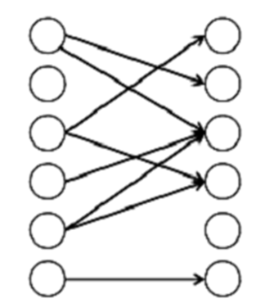
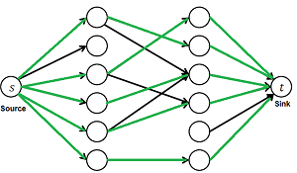
Bipartite matching:
G = (L, R, E) unweighted we want max matches.
We’re familiar with the offline problem, which is solved using Flow Network.

Slide 3
Online bipartite matching problem
G = (L, R, E)
we want max matches
This time, every turn a new vertex reveals itself and its edges, in fixed order. We’ll need to decide who to match it with, if at all.
Vertices always appear on the right side, therefore R is online, L is offline.
Unmatched Vertices in R will forever be unmatched.
Matches cannot be revoked.

Slide 4
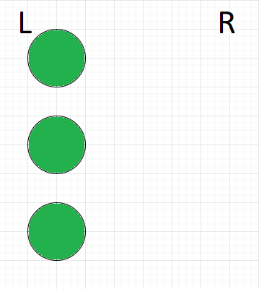
Online bipartite matching problem
G = (L, R, E)
we want max matches
This time, every turn a new vertex reveals itself and its edges. We’ll need to decide who to match it with, if at all.
Vertices always appear on the right side, therefore R is online, L is offline.
Unmatched Vertices are lost.
Matches cannot be revoked.

Slide 5
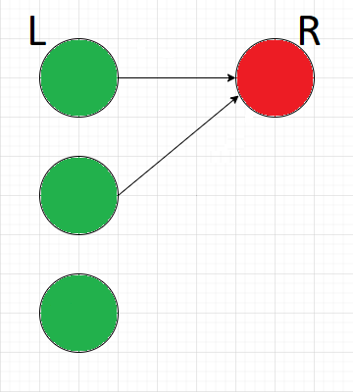
Online bipartite matching problem
G = (L, R, E)
we want max matches
This time, every turn a new vertex reveals itself and its edges. We’ll need to decide who to match it with, if at all.
Vertices always appear on the right side, therefore R is online, L is offline.
Unmatched Vertices are lost.
Matches cannot be revoked.

Slide 6
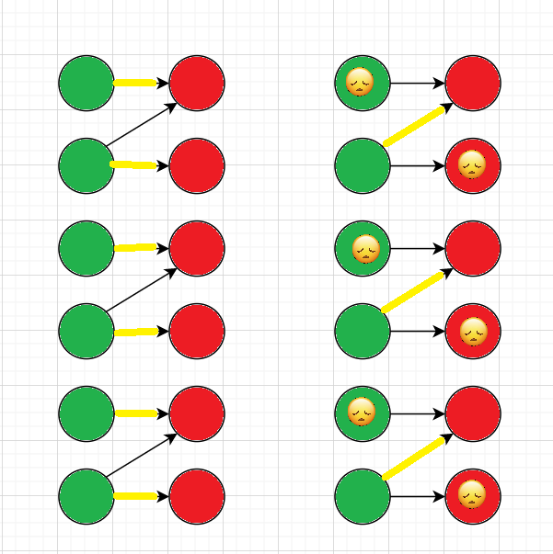
Greedy solution:
OPT matching:
Possible Greedy:
Every turn, match the new vertex with an arbitrary, unmatched neighbor.
This solution will yield at least half the matches as the optimal matching would.
this is true for every “bad” matching, online is irrelevant.

Slide 7




In 1990 they suggested a randomized algorithm, known as RANKING or KVV90, ensuring in expectation at least 1 – 1/e (=0.632) of the maximum matching.

Slide 8
RANKING algorithm:
For each vertex i ∈ L:
select Yi ∈ [0,1] at random
when each vertex j ∈ R arrives:
if j has no unmatched neighbors:
j remains unmatched.
else:
match j to its lowest Yi neighbor.

Slide 9
RANKING algorithm:
For each vertex i ∈ L:
select Yi ∈ [0,1] at random
when each vertex j ∈ R arrives:
if j has no unmatched neighbors:
j remains unmatched.
else:
match j to its lowest Yi neighbor.

Slide 10
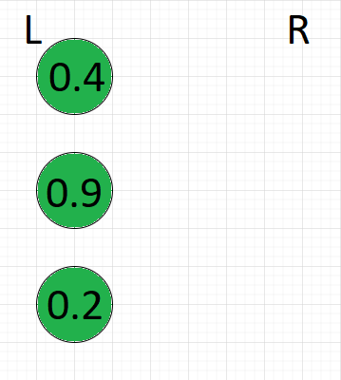

RANKING algorithm:
For each vertex i ∈ L:
select Yi ∈ [0,1] at random
when each vertex j ∈ R arrives:
if j has no unmatched neighbors:
j remains unmatched.
else:
match j to its lowest Yi neighbor.

Slide 11
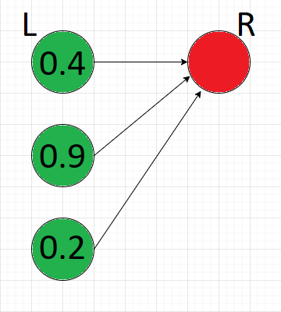
RANKING algorithm:
For each vertex i ∈ L:
select Yi ∈ [0,1] at random
when each vertex j ∈ R arrives:
if j has no unmatched neighbors:
j remains unmatched.
else:
match j to its lowest Yi neighbor.

Slide 12
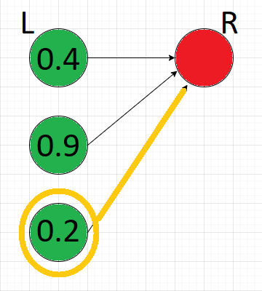
RANKING algorithm:
For each vertex i ∈ L:
select Yi ∈ [0,1] at random
when each vertex j ∈ R arrives:
if j has no unmatched neighbors:
j remains unmatched.
else:
match j to its lowest Yi neighbor.

Slide 13
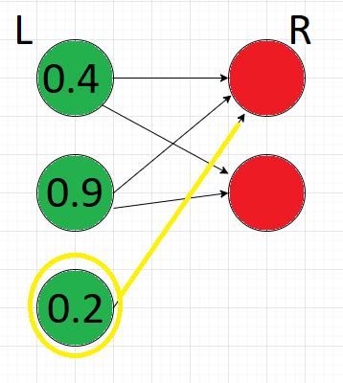
RANKING algorithm:
For each vertex i ∈ L:
select Yi ∈ [0,1] at random
when each vertex j ∈ R arrives:
if j has no unmatched neighbors:
j remains unmatched.
else:
match j to its lowest Yi neighbor.

Slide 14
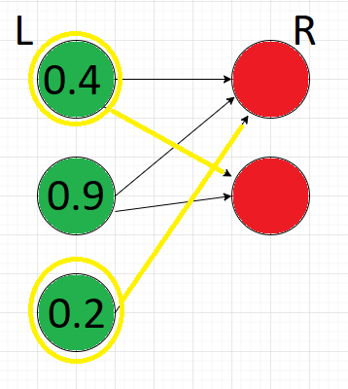
RANKING algorithm:
For each vertex i ∈ L:
select Yi ∈ [0,1] at random
when each vertex j ∈ R arrives:
if j has no unmatched neighbors:
j remains unmatched.
else:
match j to its lowest Yi neighbor.

Slide 15
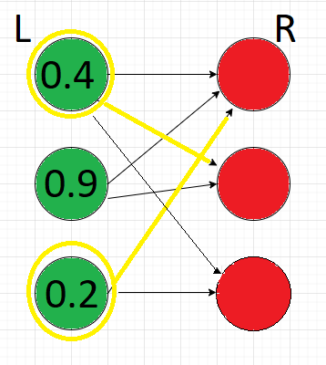
RANKING algorithm:
For each vertex i ∈ L:
select Yi ∈ [0,1] at random
when each vertex j ∈ R arrives:
if j has no unmatched neighbors:
j remains unmatched.
else:
match j to its lowest Yi neighbor.

Slide 16
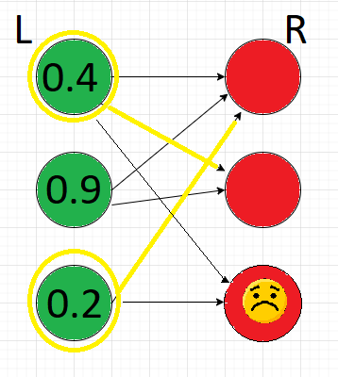
RANKING algorithm:
For each vertex i ∈ L:
select Yi ∈ [0,1] at random
when each vertex j ∈ R arrives:
if j has no unmatched neighbors:
j remains unmatched.
else:
match j to its lowest Yi neighbor.

Slide 17
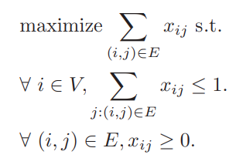
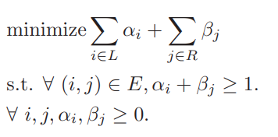
Algorithm analysis:
Primal problem:
Dual problem:

Slide 18
RANKING’s competitive ratio
Reminder – our competitive ratio is the number of pairs our algorithm gets, divided by the number of pairs the OPT (offline) algorithm makes.
Let’s mark our ratio as F ∈ [0,1], and try to find it.
As mentioned, RANKING’s competitive ratio is going to be 1 – 1/e expected.

Slide 19
Why 1 -1/e?
the value of the dual solution is always a factor of 1/F of the size of the matching found
The dual problem exists only for analysis purposes.
The expectations of the duals is feasible – that will be our focus.

Slide 20
Lemma (*)
Assume:
  Primal is feasible, achieves value P (=number of pairs).
  Dual solution, not necessarily feasible, achieves value D.
If:
  Exists some c such that P ≥ cD always.
  In expectation, dual is feasible too.
Then:
  E[P] ≥ F * OPT

Slide 21
Proof that In expectation, P ≥ F * OPT :
Choose c = F.
P ≥ FD always.
E[P] ≥ F * E[D]
Cost of the dual solution, obtained by taking the expectations of the randomized dual variables, is E[D], and the variable form a feasible dual solution, in expectation.
E[D] ≥ OPT ➔
F * E[D] ≥ F * OPT ➔
E[P] ≥ F * OPT.

Slide 22
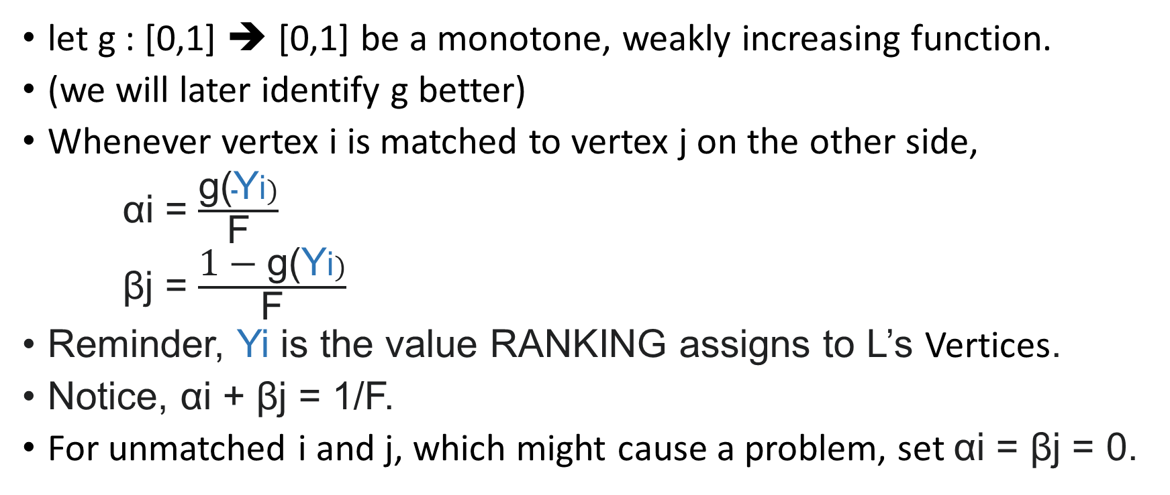
Construction of the duals
let g : [0,1] ➔ [0,1] be a monotone, weakly increasing function.
(we will later identify g better)
Whenever vertex i is matched to vertex j on the other side,
αi = $\frac{\text{g}\text{(}\text{Y}\text{i})}{\text{F}}$
βj = $\frac{\text{1 }\text{− }\text{g}\text{(}\text{Y}\text{i})}{\text{F}}$
Reminder, Yi is the value RANKING assigns to L’s Vertices.
Notice, αi + βj = 1/F.
For unmatched i and j, which might cause a problem, set αi = βj = 0.

Slide 23
On matching i and j:
Add value of 1 to the primal
Add value 1/F to the dual

Slide 24
Definitions
We will now deal with G\{i}, our same graph with same Yi values, with vertex i from L deleted.
Vertex i was matched with vertex j on R.
Now, j is matched to i’, which has Yi value of y^{c}.
y^{c} = 1 if j unmatched.

Slide 25
Dominance Lemma:
Let y^{c} be the value of Yi for the vertex i that is matched to j.
Given Yi’ for all other i’ ∈ L, i gets matched if Yi < y^{c}
Proof:
Assume i is unmatched when j arrives.
The run of the algorithm until this point would have been the same, regardless of i’s existence.
In a run without i, j would be matched to some i’ with Yi’ = y^{c}.
Since Yi < y^{c}, j would in fact be matched with i.

Slide 26
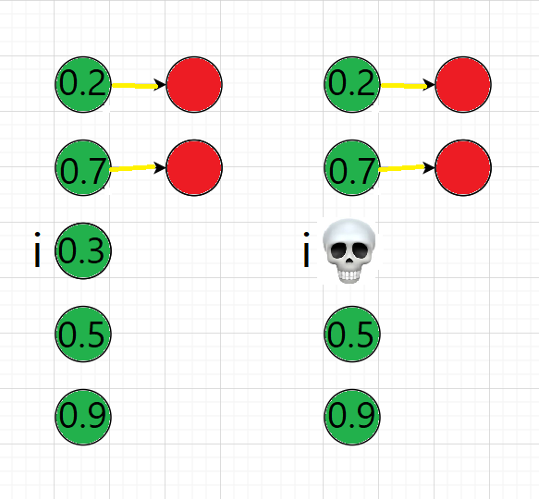
Dominance Lemma:
i gets matched if Yi < y^{c}.
Simply put, upon deleting a vertex in L, the vertex in R that was connected to it in the original graph, will now be connected to a vertex of higher Yi.

Slide 27
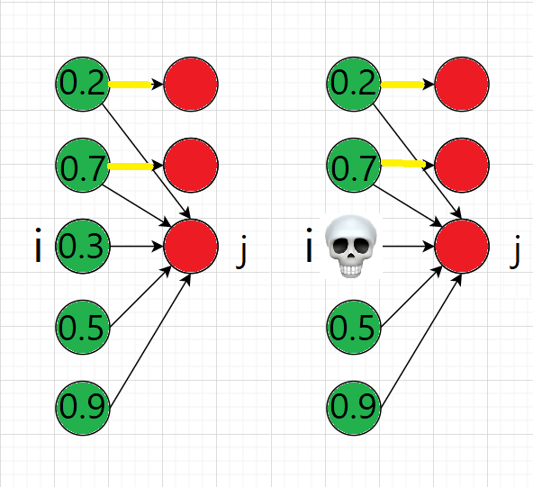
Dominance Lemma:
i gets matched if Yi < y^{c}.
Simply put, upon deleting a vertex in L, the vertex in R that was connected to it in the original graph, will now be connected to a vertex of higher Yi.

Slide 28
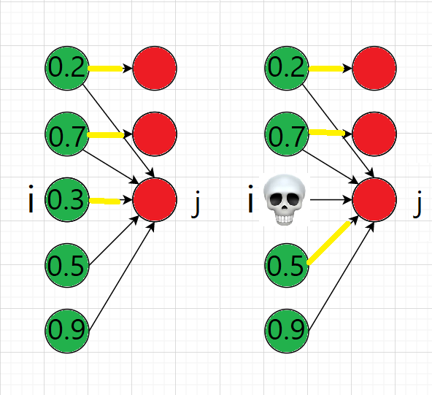
Dominance Lemma:
i gets matched if Yi < y^{c}.
Simply put, upon deleting a vertex in L, the vertex in R that was connected to it in the original graph, will now be connected to a vertex of higher Yi.

Slide 29
Dominance Lemma:
i gets matched if Yi < y^{c}.
Simply put, upon deleting a vertex in L, the vertex in R that was connected to it in the original graph, will now be connected to a vertex of higher Yi.
In G, j matched Yi of 0.3, and in G\{i} j matched to 0.5

Slide 30
Definitions
We will now deal with G\{i}, our same graph with same Yi values, with vertex i from L deleted.
Vertex i was matched with vertex j on R.
Now, j is matched to i’, which has Yi value of y^{c}.
y^{c} = 1 if j unmatched.
βj^{c} = βj in G\{i}.
g(1) = 1, βj^{c} = (1 - g(y^{c})) / F.
  We need g(1)=1 for the case βj^{c}=0.

Slide 31
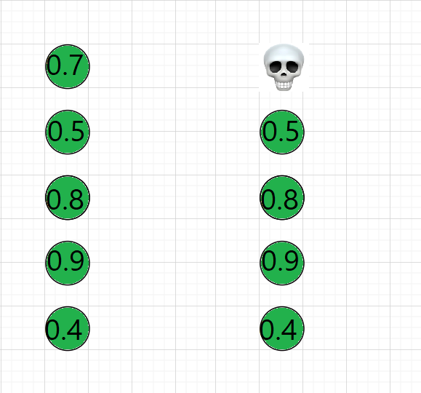
Monotonicity Lemma:
βj ≥ βj^{c}
  Simply put, our βj can only decrease in G\{i}.
  The unmatched Vertices in L\{i} will be a subset of the unmatched Vertices in L.

Slide 32
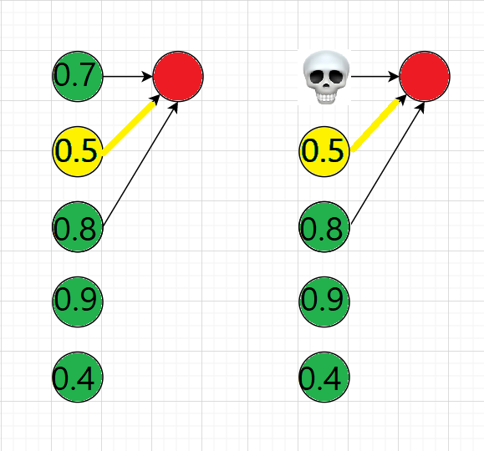
Monotonicity Lemma:
βj ≥ βj^{c}
  Simply put, our βj can only decrease in G\{i}.
  The unmatched Vertices in L\{i} will be a subset of the unmatched Vertices in L.

Slide 33
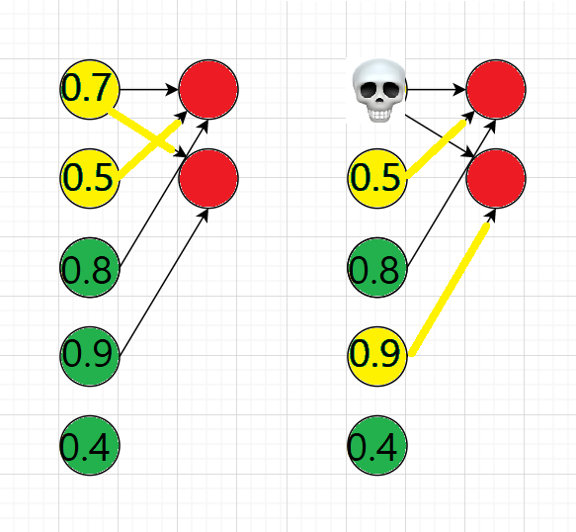
Monotonicity Lemma:
βj ≥ βj^{c}
  Simply put, our βj can only decrease in G\{i}.
  The unmatched Vertices in L\{i} will be a subset of the unmatched Vertices in L.

Slide 34
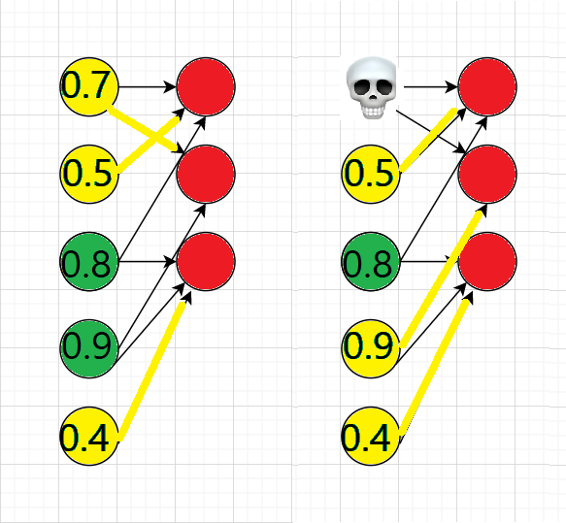
Monotonicity Lemma:
βj ≥ βj^{c}
  Simply put, our βj can only decrease in G\{i}.
  The unmatched Vertices in L\{i} will be a subset of the unmatched Vertices in L.

Slide 35

Lemma (****)
if
Then the duals are feasible in expectation.
Meaning, we’d like to show that for every edge (i,j), E [αi + βj] ≥ 1 for all Yi’ choices.

Slide 36

Lemma (****)
if
Then the duals are feasible in expectation.
Meaning, we’d like to show that for every edge (i,j), E [αi + βj] ≥ 1 for all Yi’ choices.
Proof:
By Dominance Lemma i is matched whenever Yi ≤ y^{c}.
Hence

Slide 37
By Monotonicity Lemma, βj ≥ βj^{c} = (1 – g(y^{c})) / F, for every Yi.
Add boundary - g(1) = 1.
we’d now like to solve the previous lemma’s equation
while maxing F:
By calculation , we’ll get g(y) = e^{(y-1)}, F = 1 – 1/e.
These max F while keeping the duals feasible in expectation – easy to verify.
Therefore, RANKING is 1 – 1/e competitive.

Slide 38
Algorithm 2: vertex weighted
Now, we’ll try to apply RANKING to a slightly different problem, in which each vertex i in L has a given weight, Vi, and our objective is to max the sum of those weights in matched Vertices.
  We will get again 1 – 1/e competitive ratio.

Slide 39
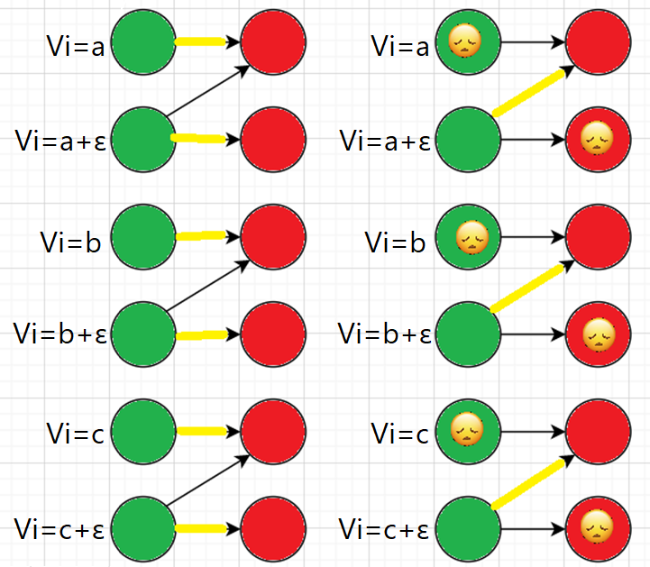
Greedy solution:
OPT matching:
Greedy:
Every turn, match the new vertex with it’s highest weight unmatched neighbor.
This solution will yield, on “bad” graphs, close to half the total weight as the optimal matching would.

Slide 40
Algorithm 2: vertex weighted
For each vertex i ∈ L:
select Yi ∈ [0,1] at random
when each vertex j ∈ R arrives:
if j has no unmatched neighbors:
j remains unmatched.
else:
match j to min{vi (1 – g(Yi)) for every i unmatched neighbor of j.

Slide 41
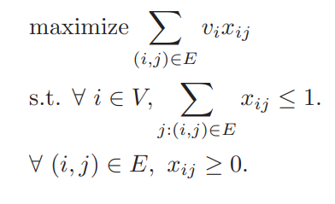
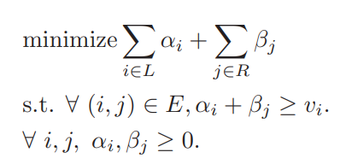
Algorithm analysis:
Primal problem:
Dual problem:

Slide 42


