Slide 1
Online Primal-Dual for Covering and Packing

Slide 2

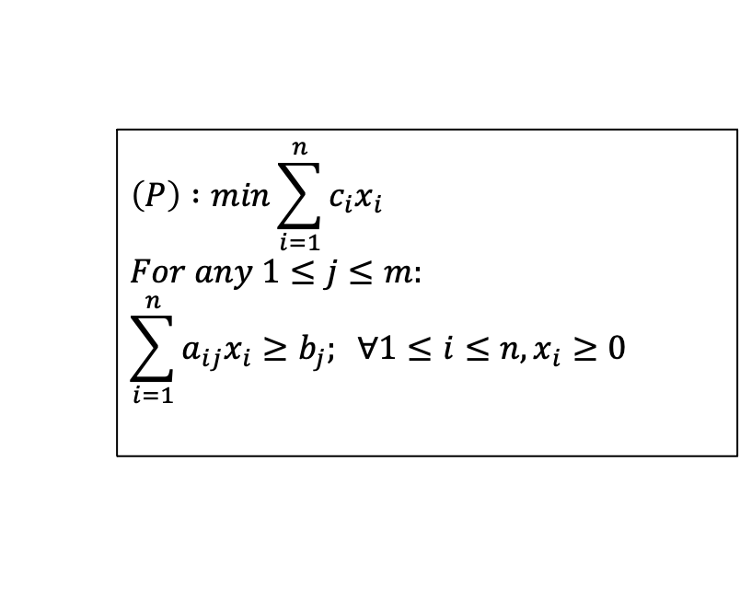









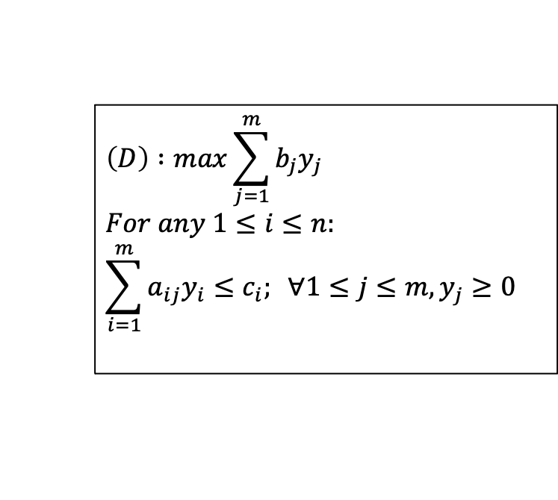
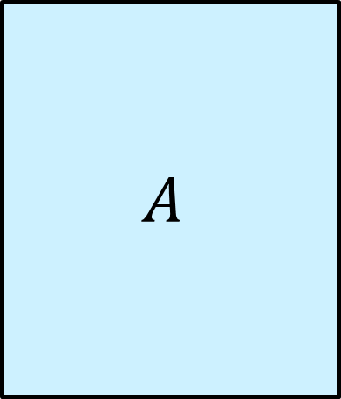

Linear Programing and Duality
$$\left(P\right) :min\sum_{i=1}^{n}{c_{i}x_{i}}$$
$$For any 1≤j≤m:$$
$$\sum_{i=1}^{n}{a_{ij}x_{i}≥b_{j}; ∀1≤i≤n, x_{i}≥0}$$
$$c^{T}$$
$$≥$$
$$y^{T}$$
$$A$$
$$b$$
$$m$$
$$n$$
$$m$$
$$m$$
$$≥$$
$$x$$
$$\left(D\right) :max\sum_{j=1}^{m}{{b_{j}y}_{j}}$$
$$For any 1≤i≤n:$$
$$\sum_{i=1}^{m}{a_{ij}y_{i}≤c_{i}; ∀1≤j≤m, y_{j}≥0}$$
$$n$$

Slide 3
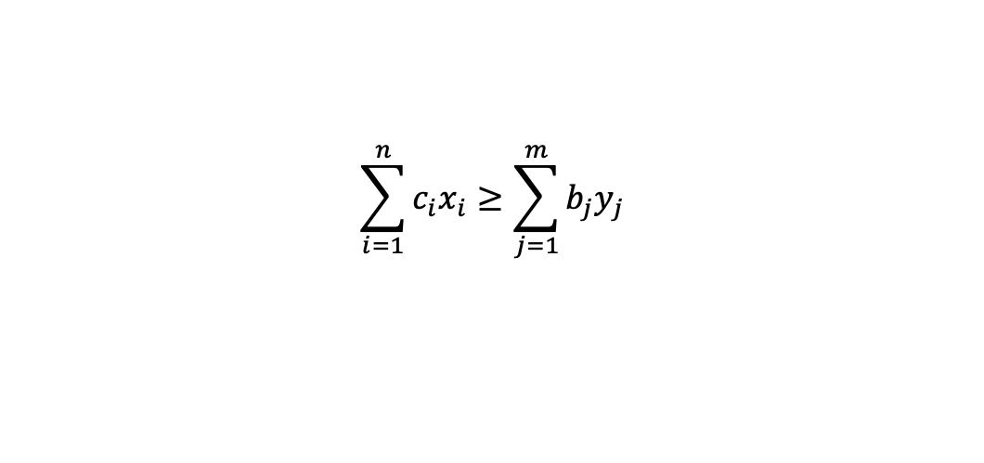
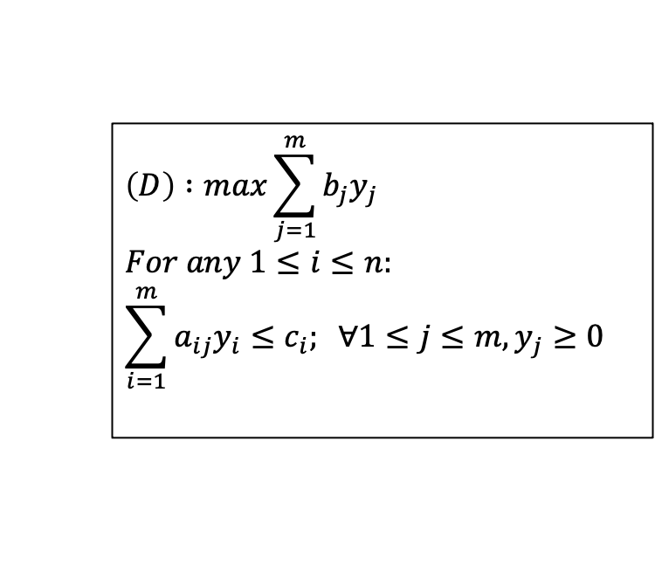
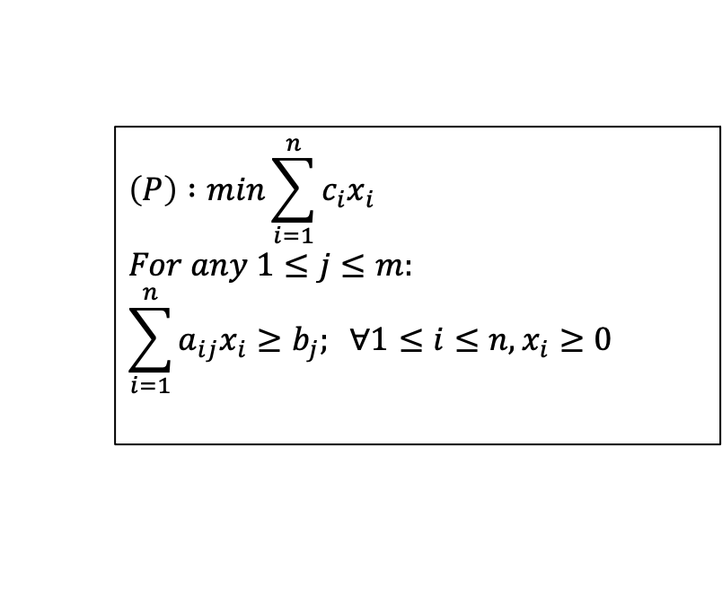
Linear Programing and Duality
$$\left(P\right) :min\sum_{i=1}^{n}{c_{i}x_{i}}$$
$$For any 1≤j≤m:$$
$$\sum_{i=1}^{n}{a_{ij}x_{i}≥b_{j}; ∀1≤i≤n, x_{i}≥0}$$
$$\left(D\right) :max\sum_{j=1}^{m}{b_{j}y_{j}}$$
$$For any 1≤i≤n:$$
$$\sum_{i=1}^{m}{a_{ij}y_{i}≤c_{i}; ∀1≤j≤m, y_{j}≥0}$$
Weak duality (if the Primal and Dual are feasible):
$$\sum_{i=1}^{n}{c_{i}x_{i}≥\sum_{j=1}^{m}{b_{j}y_{j}}}$$

Slide 4
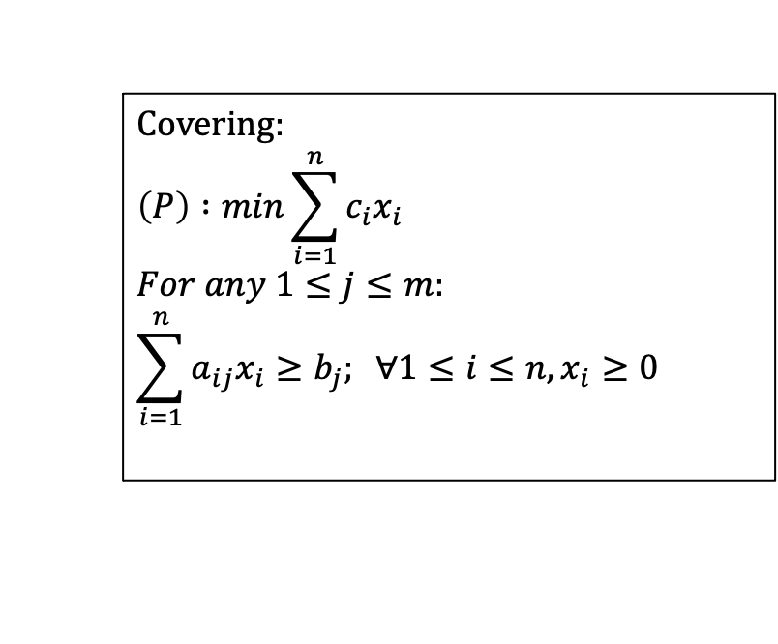

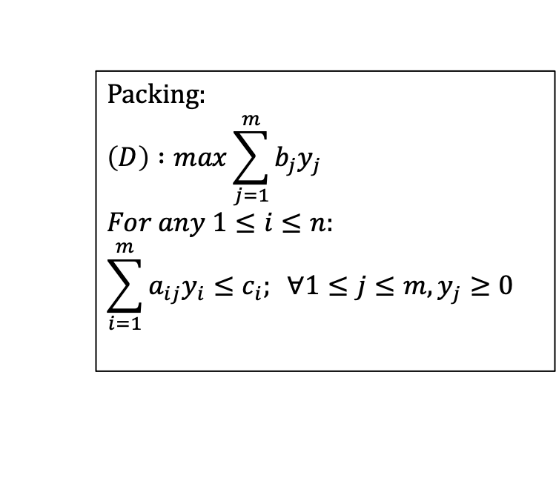
Offline Cover and Packing
$a_{ij}, b_{j}, c_{i}≥0$
Covering:
$$\left(P\right) :min\sum_{i=1}^{n}{c_{i}x_{i}}$$
$$For any 1≤j≤m:$$
$$\sum_{i=1}^{n}{a_{ij}x_{i}≥b_{j}; ∀1≤i≤n, x_{i}≥0}$$
Packing:
$$\left(D\right) :max\sum_{j=1}^{m}{{b_{j}y}_{j}}$$
$$For any 1≤i≤n:$$
$$\sum_{i=1}^{m}{a_{ij}y_{i}≤c_{i}; ∀1≤j≤m, y_{j}≥0}$$

Slide 5
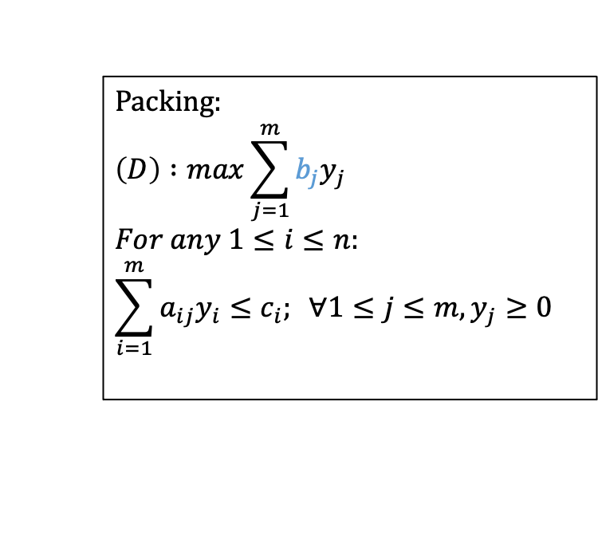
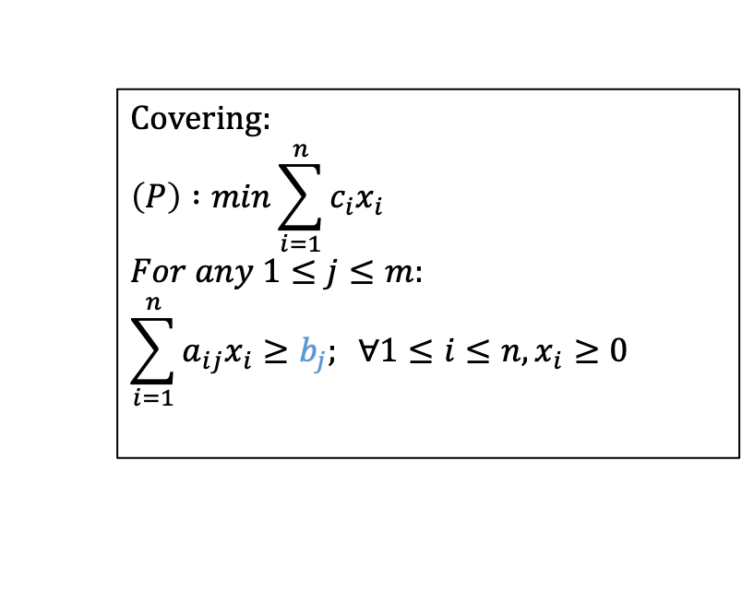
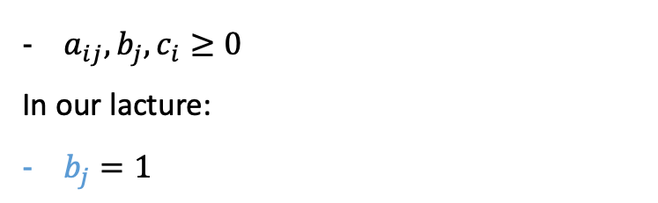
Offline Cover and Packing
$a_{ij}, b_{j}, c_{i}≥0$
In our lacture:
$b_{j}=1$
Covering:
$$\left(P\right) :min\sum_{i=1}^{n}{c_{i}x_{i}}$$
$$For any 1≤j≤m:$$
$$\sum_{i=1}^{n}{a_{ij}x_{i}≥b_{j}; ∀1≤i≤n, x_{i}≥0}$$
Packing:
$$\left(D\right) :max\sum_{j=1}^{m}{{b_{j}y}_{j}}$$
$$For any 1≤i≤n:$$
$$\sum_{i=1}^{m}{a_{ij}y_{i}≤c_{i}; ∀1≤j≤m, y_{j}≥0}$$

Slide 6
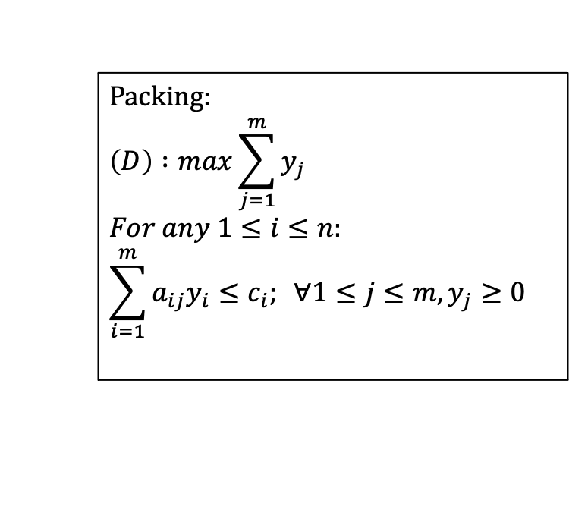
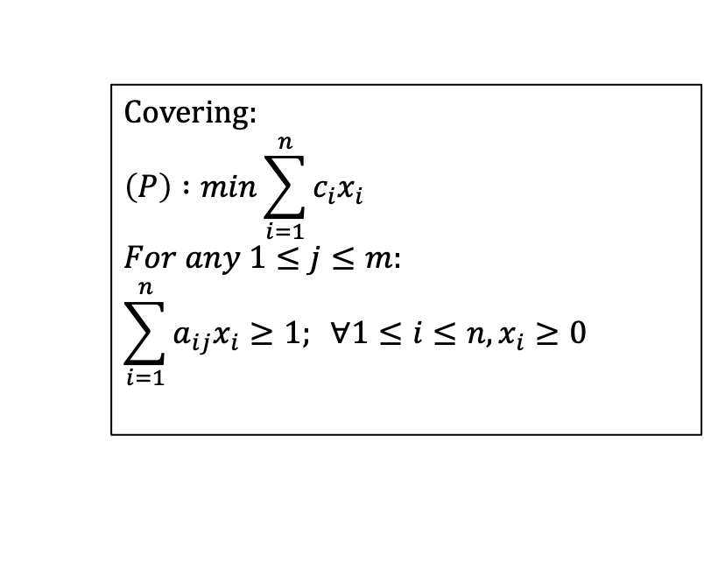
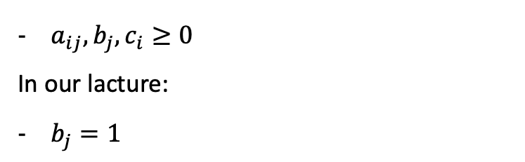
Offline Cover and Packing
$a_{ij}, b_{j}, c_{i}≥0$
In our lacture:
$b_{j}=1$
Covering:
$$\left(P\right) :min\sum_{i=1}^{n}{c_{i}x_{i}}$$
$$For any 1≤j≤m:$$
$$\sum_{i=1}^{n}{a_{ij}x_{i}≥1; ∀1≤i≤n, x_{i}≥0}$$
Packing:
$$\left(D\right) :max\sum_{j=1}^{m}{y_{j}}$$
$$For any 1≤i≤n:$$
$$\sum_{i=1}^{m}{a_{ij}y_{i}≤c_{i}; ∀1≤j≤m, y_{j}≥0}$$

Slide 7

Offline Cover and Packing
$a_{ij}, b_{j}, c_{i}≥0$
In our lacture:
$b_{j}=1$
$a_{ij}∈\{0, 1\}$
Covering:
$$\left(P\right) :min\sum_{i=1}^{n}{c_{i}x_{i}}$$
$$For any 1≤j≤m:$$
$$\sum_{i=1}^{n}{a_{ij}x_{i}≥1; ∀1≤i≤n, x_{i}≥0}$$
Packing:
$$\left(D\right) :max\sum_{j=1}^{m}{y_{j}}$$
$$For any 1≤i≤n:$$
$$\sum_{i=1}^{m}{a_{ij}y_{i}≤c_{i}; ∀1≤j≤m, y_{j}≥0}$$

Slide 8
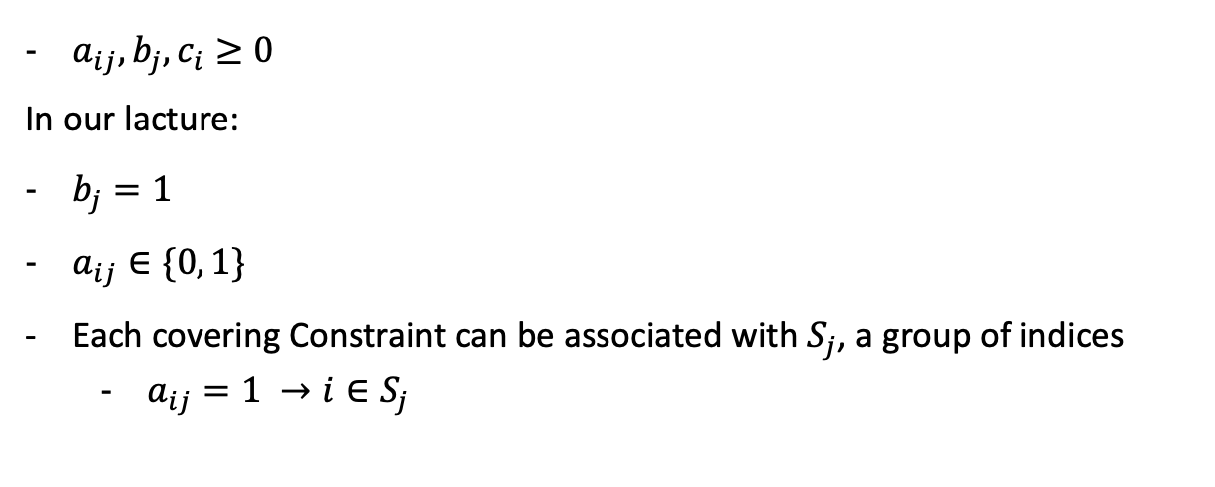
Offline Cover and Packing
$a_{ij}, b_{j}, c_{i}≥0$
In our lacture:
$b_{j}=1$
$a_{ij}∈\{0, 1\}$
Each covering Constraint can be associated with $S_{j}$, a group of indices
  $a_{ij}=1 →i∈S_{j}$
Covering:
$$\left(P\right) :min\sum_{i=1}^{n}{c_{i}x_{i}}$$
$$For any 1≤j≤m:$$
$$\sum_{i=1}^{n}{a_{ij}x_{i}≥1; ∀1≤i≤n, x_{i}≥0}$$
Packing:
$$\left(D\right) :max\sum_{j=1}^{m}{y_{j}}$$
$$For any 1≤i≤n:$$
$$\sum_{i=1}^{m}{a_{ij}y_{i}≤c_{i}; ∀1≤j≤m, y_{j}≥0}$$

Slide 9
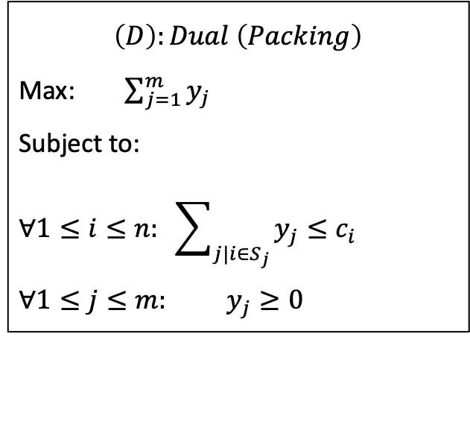
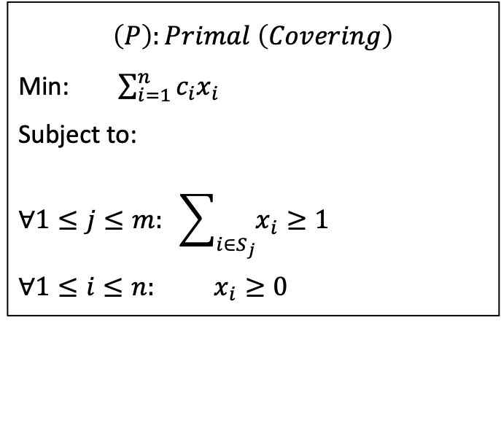

Offline Cover and Packing
$a_{ij}, b_{j}, c_{i}≥0$
In our lacture:
$b_{j}=1$
$a_{ij}∈\{0, 1\}$
Each covering Constraint can be associated with $S_{j}$, a group of indices
  $i∈S_{j} if a_{ij}=1$
$$\left(P\right):Primal \left(Covering\right)$$
Min:$\sum_{i=1}^{n}{c_{i}x_{i}}$
Subject to:
$$∀1≤j≤m: \sum_{i∈S_{j}}{x_{i}≥1}$$
$$∀1≤i≤n: x_{i}≥0$$
$$\left(D\right):Dual \left(Packing\right)$$
Max:$\sum_{j=1}^{m}{y_{j}}$
Subject to:
$$∀1≤i≤n: \sum_{j|i∈S_{j}}{y_{j}≤c_{i}}$$
$$∀1≤j≤m: y_{j}≥0$$

Slide 10
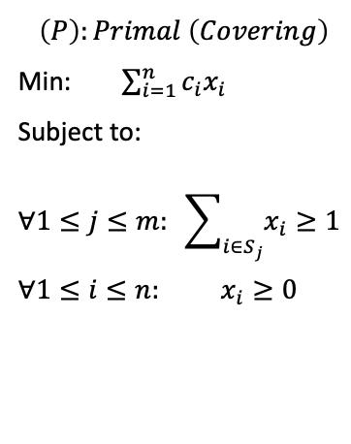
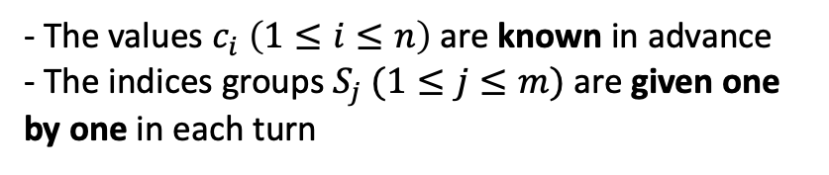
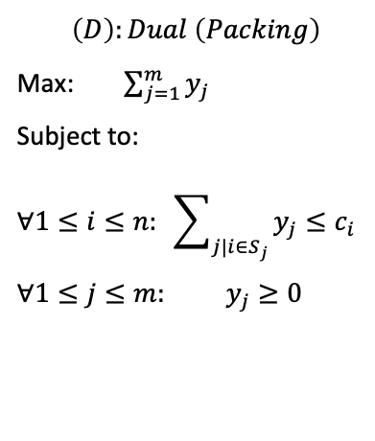
Online Cover and Packing
$$\left(P\right):Primal \left(Covering\right)$$
Min:$\sum_{i=1}^{n}{c_{i}x_{i}}$
Subject to:
$$∀1≤j≤m: \sum_{i∈S_{j}}{x_{i}≥1}$$
$$∀1≤i≤n: x_{i}≥0$$
$$\left(D\right):Dual \left(Packing\right)$$
Max:$\sum_{j=1}^{m}{y_{j}}$
Subject to:
$$∀1≤i≤n: \sum_{j|i∈S_{j}}{y_{j}≤c_{i}}$$
$$∀1≤j≤m: y_{j}≥0$$
- The values $c_{i} \left(1≤i≤n\right)$ are known in advance
- The indices groups $S_{j} (1≤j≤m)$ are given one by one in each turn

Slide 11
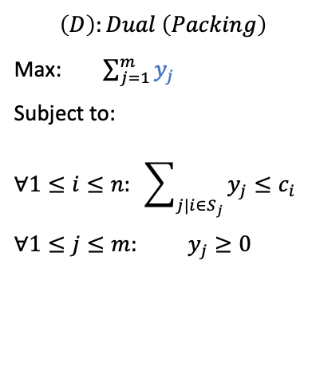
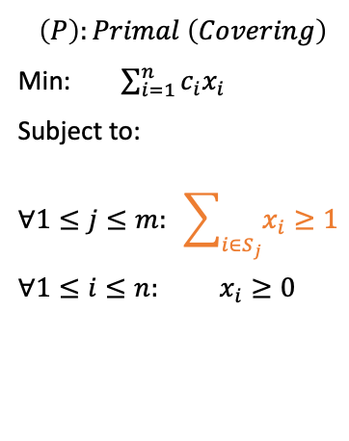
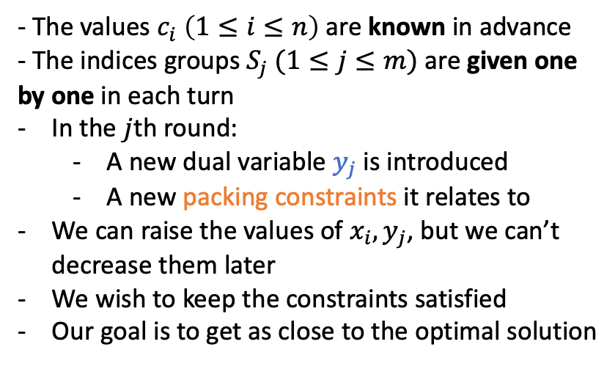
Online Cover and Packing
$$\left(P\right):Primal \left(Covering\right)$$
Min:$\sum_{i=1}^{n}{c_{i}x_{i}}$
Subject to:
$$∀1≤j≤m: \sum_{i∈S_{j}}{x_{i}≥1}$$
$$∀1≤i≤n: x_{i}≥0$$
$$\left(D\right):Dual \left(Packing\right)$$
Max:$\sum_{j=1}^{m}{y_{j}}$
Subject to:
$$∀1≤i≤n: \sum_{j|i∈S_{j}}{y_{j}≤c_{i}}$$
$$∀1≤j≤m: y_{j}≥0$$
- The values $c_{i} \left(1≤i≤n\right)$ are known in advance
- The indices groups $S_{j} (1≤j≤m)$ are given one by one in each turn
In the $j$th round:
  A new dual variable $y_{j}$ is introduced
  A new packing constraints it relates to
We can raise the values of $x_{i}, y_{j}$, but we can’t decrease them later
We wish to keep the constraints satisfied
Our goal is to get as close to the optimal solution

Slide 12


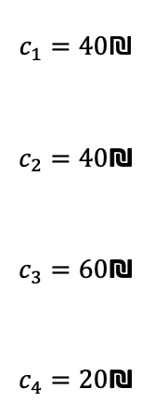
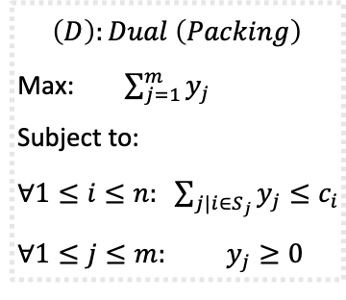
Online Covering example
$$\left(P\right):Primal \left(Covering\right)$$
Min:$\sum_{i=1}^{n}{c_{i}x_{i}}$
Subject to:
$∀1≤j≤m: \sum_{i∈S_{j}}{x_{i}≥1}$
$∀1≤i≤n: x_{i}≥0$
$$\left(D\right):Dual \left(Packing\right)$$
Max:$\sum_{j=1}^{m}{y_{j}}$
Subject to:
$∀1≤i≤n: \sum_{j|i∈S_{j}}{y_{j}≤c_{i}}$
$∀1≤j≤m: y_{j}≥0$
$$c_{1}=40\text{₪}$$
$$c_{2}=40\text{₪}$$
$$c_{3}=60\text{₪}$$
$$c_{4}=20\text{₪}$$
$$x_{1}=0$$
$$x_{2}=0$$
$$x_{3}=0$$
$$x_{4}=0$$
We will demonstrait the online problem while giving a feasible solution to the Covering problem
We want to draw a painting but don’t have a clue how to start

Slide 13
Online Covering example
$$\left(P\right):Primal \left(Covering\right)$$
Min:$\sum_{i=1}^{n}{c_{i}x_{i}}$
Subject to:
$∀1≤j≤m: \sum_{i∈S_{j}}{x_{i}≥1}$
$∀1≤i≤n: x_{i}≥0$
$$\left(D\right):Dual \left(Packing\right)$$
Max:$\sum_{j=1}^{m}{y_{j}}$
Subject to:
$∀1≤i≤n: \sum_{j|i∈S_{j}}{y_{j}≤c_{i}}$
$∀1≤j≤m: y_{j}≥0$
$$c_{1}=40\text{₪}$$
$$c_{2}=40\text{₪}$$
$$c_{3}=60\text{₪}$$
$$c_{4}=20\text{₪}$$
$$x_{1}=0$$
$$x_{2}=0$$
$$x_{3}=0$$
$$x_{4}=0$$
We will demonstrait the online problem while giving a feasible solution to the Covering problem
We want to draw a painting but don’t have a clue how to start
4 sets of colors are presented

Slide 14
Online Covering example
$$\left(P\right):Primal \left(Covering\right)$$
Min:$\sum_{i=1}^{n}{c_{i}x_{i}}$
Subject to:
$∀1≤j≤m: \sum_{i∈S_{j}}{x_{i}≥1}$
$∀1≤i≤n: x_{i}≥0$
$$\left(D\right):Dual \left(Packing\right)$$
Max:$\sum_{j=1}^{m}{y_{j}}$
Subject to:
$∀1≤i≤n: \sum_{j|i∈S_{j}}{y_{j}≤c_{i}}$
$∀1≤j≤m: y_{j}≥0$
$$c_{1}=40\text{₪}$$
$$c_{2}=40\text{₪}$$
$$c_{3}=60\text{₪}$$
$$c_{4}=20\text{₪}$$
$$x_{1}=0$$
$$x_{2}=0$$
$$x_{3}=0$$
$$x_{4}=0$$
We will demonstrait the online problem while giving a feasible solution to the Covering problem
We want to draw a painting but don’t have a clue how to start
4 sets of colors are presented
The cashier tells us what colors we have to buy for our painting

Slide 15
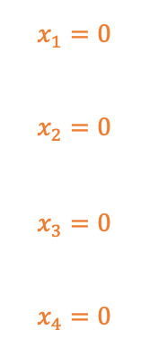
Online Covering example
$$\left(P\right):Primal \left(Covering\right)$$
Min:$\sum_{i=1}^{n}{c_{i}x_{i}}$
Subject to:
$∀1≤j≤m: \sum_{i∈S_{j}}{x_{i}≥1}$
$∀1≤i≤n: x_{i}≥0$
$$\left(D\right):Dual \left(Packing\right)$$
Max:$\sum_{j=1}^{m}{y_{j}}$
Subject to:
$∀1≤i≤n: \sum_{j|i∈S_{j}}{y_{j}≤c_{i}}$
$∀1≤j≤m: y_{j}≥0$
$$c_{1}=40\text{₪}$$
$$c_{2}=40\text{₪}$$
$$c_{3}=60\text{₪}$$
$$c_{4}=20\text{₪}$$
$$x_{1}=0$$
$$x_{2}=0$$
$$x_{3}=0$$
$$x_{4}=0$$
We will demonstrait the online problem while giving a feasible solution to the Covering problem
We want to draw a painting but don’t have a clue how to start
4 sets of colors are presented
The cashier tells us what colors we have to buy for our painting
We can buy a fraction of a color set

Slide 16
Online Covering example
$$\left(P\right):Primal \left(Covering\right)$$
Min:$\sum_{i=1}^{n}{c_{i}x_{i}}$
Subject to:
$∀1≤j≤m: \sum_{i∈S_{j}}{x_{i}≥1}$
$∀1≤i≤n: x_{i}≥0$
$$\left(D\right):Dual \left(Packing\right)$$
Max:$\sum_{j=1}^{m}{y_{j}}$
Subject to:
$∀1≤i≤n: \sum_{j|i∈S_{j}}{y_{j}≤c_{i}}$
$∀1≤j≤m: y_{j}≥0$
$$c_{1}=40\text{₪}$$
$$c_{2}=40\text{₪}$$
$$c_{3}=60\text{₪}$$
$$c_{4}=20\text{₪}$$
$$x_{1}=0$$
$$x_{2}=0$$
$$x_{3}=0$$
$$x_{4}=0$$
We will demonstrait the online problem while giving a feasible solution to the Covering problem
We want to draw a painting but don’t have a clue how to start
4 sets of colors are presented
The cashier tells us what colors we have to buy for our painting
We can buy a fraction of a color set
We must buy at least 1 unit of the necessary colors

Slide 17
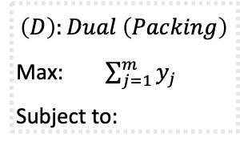
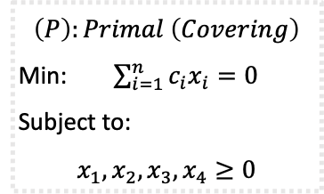
Online Covering example
$$\left(P\right):Primal \left(Covering\right)$$
Min:$\sum_{i=1}^{n}{c_{i}x_{i}}$
Subject to:
$∀1≤j≤m: \sum_{i∈S_{j}}{x_{i}≥1}$
$∀1≤i≤n: x_{i}≥0$
$$\left(D\right):Dual \left(Packing\right)$$
Max:$\sum_{j=1}^{m}{y_{j}}$
Subject to:
$∀1≤i≤n: \sum_{j|i∈S_{j}}{y_{j}≤c_{i}}$
$∀1≤j≤m: y_{j}≥0$
$$c_{1}=40\text{₪}$$
$$c_{2}=40\text{₪}$$
$$c_{3}=60\text{₪}$$
$$c_{4}=20\text{₪}$$
$$x_{1}=0$$
$$x_{2}=0$$
$$x_{3}=0$$
$$x_{4}=0$$
$$\left(P\right):Primal \left(Covering\right)$$
Min:$\sum_{i=1}^{n}{c_{i}x_{i}}=0$
Subject to:
$$x_{1}, x_{2}, x_{3}, x_{4}≥0$$
$$\left(D\right):Dual \left(Packing\right)$$
Max:$\sum_{j=1}^{m}{y_{j}}$
Subject to:

Slide 18
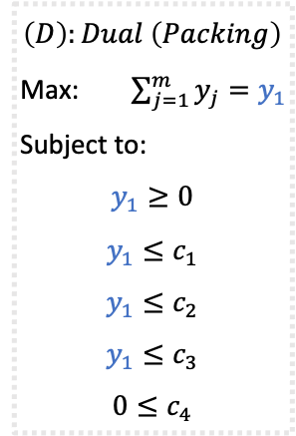
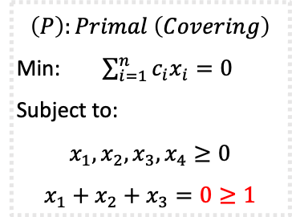
Online Covering example
$$\left(P\right):Primal \left(Covering\right)$$
Min:$\sum_{i=1}^{n}{c_{i}x_{i}}$
Subject to:
$∀1≤j≤m: \sum_{i∈S_{j}}{x_{i}≥1}$
$∀1≤i≤n: x_{i}≥0$
$$\left(D\right):Dual \left(Packing\right)$$
Max:$\sum_{j=1}^{m}{y_{j}}$
Subject to:
$∀1≤i≤n: \sum_{j|i∈S_{j}}{y_{j}≤c_{i}}$
$∀1≤j≤m: y_{j}≥0$
$$c_{1}=40\text{₪}$$
$$c_{2}=40\text{₪}$$
$$c_{3}=60\text{₪}$$
$$c_{4}=20\text{₪}$$
$$x_{1}=0$$
$$x_{2}=0$$
$$x_{3}=0$$
$$x_{4}=0$$
$$\left(P\right):Primal \left(Covering\right)$$
Min:$\sum_{i=1}^{n}{c_{i}x_{i}}=0$
Subject to:
$$x_{1}, x_{2}, x_{3}, x_{4}≥0$$
$$x_{1}+x_{2}+x_{3}=0≥1$$
$$\left(D\right):Dual \left(Packing\right)$$
Max:$\sum_{j=1}^{m}{y_{j}}=y_{1}$
Subject to:
$$y_{1}≥0$$
$$y_{1}≤c_{1}$$
$$y_{1}≤c_{2}$$
$$y_{1}≤c_{3}$$
$$0≤c_{4}$$

Slide 19
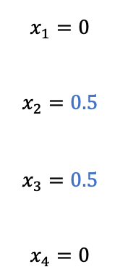
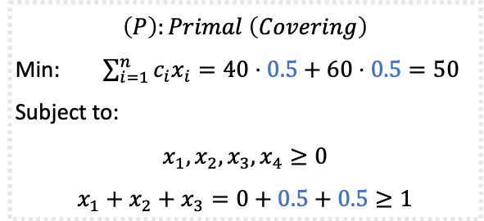
Online Covering example
$$\left(P\right):Primal \left(Covering\right)$$
Min:$\sum_{i=1}^{n}{c_{i}x_{i}}$
Subject to:
$∀1≤j≤m: \sum_{i∈S_{j}}{x_{i}≥1}$
$∀1≤i≤n: x_{i}≥0$
$$\left(D\right):Dual \left(Packing\right)$$
Max:$\sum_{j=1}^{m}{y_{j}}$
Subject to:
$∀1≤i≤n: \sum_{j|i∈S_{j}}{y_{j}≤c_{i}}$
$∀1≤j≤m: y_{j}≥0$
$$c_{1}=40\text{₪}$$
$$c_{2}=40\text{₪}$$
$$c_{3}=60\text{₪}$$
$$c_{4}=20\text{₪}$$
$$x_{1}=0$$
$$x_{2}=0.5$$
$$x_{3}=0.5$$
$$x_{4}=0$$
$$\left(P\right):Primal \left(Covering\right)$$
Min:$\sum_{i=1}^{n}{c_{i}x_{i}}=40⋅0.5+60⋅0.5=50$
Subject to:
$$x_{1}, x_{2}, x_{3}, x_{4}≥0$$
$$x_{1}+x_{2}+x_{3}=0+0.5+0.5≥1$$
$$\left(D\right):Dual \left(Packing\right)$$
Max:$\sum_{j=1}^{m}{y_{j}}=y_{1}$
Subject to:
$$y_{1}≥0$$
$$y_{1}≤c_{1}$$
$$y_{1}≤c_{2}$$
$$y_{1}≤c_{3}$$
$$0≤c_{4}$$

Slide 20
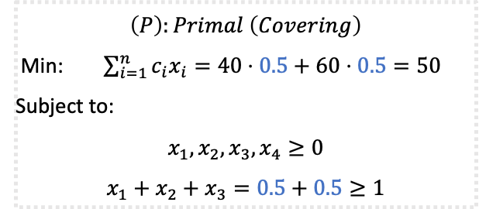
Online Covering example
$$\left(P\right):Primal \left(Covering\right)$$
Min:$\sum_{i=1}^{n}{c_{i}x_{i}}$
Subject to:
$∀1≤j≤m: \sum_{i∈S_{j}}{x_{i}≥1}$
$∀1≤i≤n: x_{i}≥0$
$$\left(D\right):Dual \left(Packing\right)$$
Max:$\sum_{j=1}^{m}{y_{j}}$
Subject to:
$∀1≤i≤n: \sum_{j|i∈S_{j}}{y_{j}≤c_{i}}$
$∀1≤j≤m: y_{j}≥0$
$$c_{1}=40\text{₪}$$
$$c_{2}=40\text{₪}$$
$$c_{3}=60\text{₪}$$
$$c_{4}=20\text{₪}$$
$$x_{1}=0$$
$$x_{2}=0.5$$
$$x_{3}=0.5$$
$$x_{4}=0$$
$$\left(P\right):Primal \left(Covering\right)$$
Min:$\sum_{i=1}^{n}{c_{i}x_{i}}=40⋅0.5+60⋅0.5=50$
Subject to:
$$x_{1}, x_{2}, x_{3}, x_{4}≥0$$
$$x_{1}+x_{2}+x_{3}=0.5+0.5≥1$$
$$\left(D\right):Dual \left(Packing\right)$$
Max:$\sum_{j=1}^{m}{y_{j}}=y_{1}$
Subject to:
$$y_{1}≥0$$
$$y_{1}≤c_{1}$$
$$y_{1}≤c_{2}$$
$$y_{1}≤c_{3}$$
$$0≤c_{4}$$

Slide 21
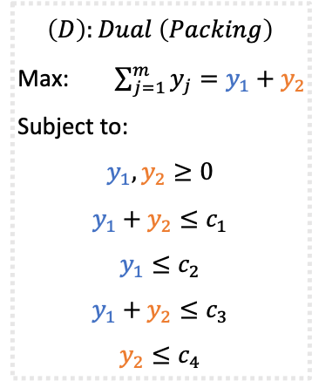
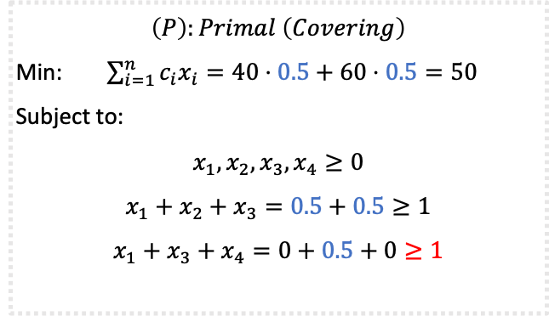
Online Covering example
$$\left(P\right):Primal \left(Covering\right)$$
Min:$\sum_{i=1}^{n}{c_{i}x_{i}}$
Subject to:
$∀1≤j≤m: \sum_{i∈S_{j}}{x_{i}≥1}$
$∀1≤i≤n: x_{i}≥0$
$$\left(D\right):Dual \left(Packing\right)$$
Max:$\sum_{j=1}^{m}{y_{j}}$
Subject to:
$∀1≤i≤n: \sum_{j|i∈S_{j}}{y_{j}≤c_{i}}$
$∀1≤j≤m: y_{j}≥0$
$$c_{1}=40\text{₪}$$
$$c_{2}=40\text{₪}$$
$$c_{3}=60\text{₪}$$
$$c_{4}=20\text{₪}$$
$$x_{1}=0$$
$$x_{2}=0.5$$
$$x_{3}=0.5$$
$$x_{4}=0$$
$$\left(P\right):Primal \left(Covering\right)$$
Min:$\sum_{i=1}^{n}{c_{i}x_{i}}=40⋅0.5+60⋅0.5=50$
Subject to:
$$x_{1}, x_{2}, x_{3}, x_{4}≥0$$
$$x_{1}+x_{2}+x_{3}=0.5+0.5≥1$$
$$x_{1}+x_{3}+x_{4}=0+0.5+0≥1$$
$$\left(D\right):Dual \left(Packing\right)$$
Max:$\sum_{j=1}^{m}{y_{j}}=y_{1}+y_{2}$
Subject to:
$$y_{1},y_{2}≥0$$
$$y_{1}+y_{2}≤c_{1}$$
$$y_{1}≤c_{2}$$
$$y_{1}+y_{2}≤c_{3}$$
$$y_{2}≤c_{4}$$

Slide 22
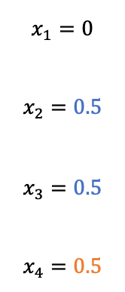
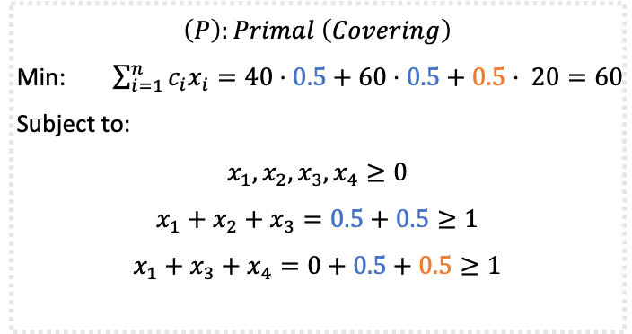
Online Covering example
$$\left(P\right):Primal \left(Covering\right)$$
Min:$\sum_{i=1}^{n}{c_{i}x_{i}}$
Subject to:
$∀1≤j≤m: \sum_{i∈S_{j}}{x_{i}≥1}$
$∀1≤i≤n: x_{i}≥0$
$$\left(D\right):Dual \left(Packing\right)$$
Max:$\sum_{j=1}^{m}{y_{j}}$
Subject to:
$∀1≤i≤n: \sum_{j|i∈S_{j}}{y_{j}≤c_{i}}$
$∀1≤j≤m: y_{j}≥0$
$$c_{1}=40\text{₪}$$
$$c_{2}=40\text{₪}$$
$$c_{3}=60\text{₪}$$
$$c_{4}=20\text{₪}$$
$$x_{1}=0$$
$$x_{2}=0.5$$
$$x_{3}=0.5$$
$$x_{4}=0.5$$
$$\left(P\right):Primal \left(Covering\right)$$
Min:$\sum_{i=1}^{n}{c_{i}x_{i}}=40⋅0.5+60⋅0.5+0.5⋅ 20=60$
Subject to:
$$x_{1}, x_{2}, x_{3}, x_{4}≥0$$
$$x_{1}+x_{2}+x_{3}=0.5+0.5≥1$$
$$x_{1}+x_{3}+x_{4}=0+0.5+0.5≥1$$
$$\left(D\right):Dual \left(Packing\right)$$
Max:$\sum_{j=1}^{m}{y_{j}}=y_{1}+y_{2}$
Subject to:
$$y_{1},y_{2}≥0$$
$$y_{1}+y_{2}≤c_{1}$$
$$y_{1}≤c_{2}$$
$$y_{1}+y_{2}≤c_{3}$$
$$y_{2}≤c_{4}$$

Slide 23
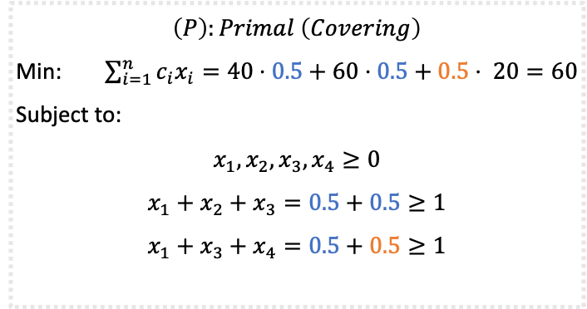
Online Covering example
$$\left(P\right):Primal \left(Covering\right)$$
Min:$\sum_{i=1}^{n}{c_{i}x_{i}}$
Subject to:
$∀1≤j≤m: \sum_{i∈S_{j}}{x_{i}≥1}$
$∀1≤i≤n: x_{i}≥0$
$$\left(D\right):Dual \left(Packing\right)$$
Max:$\sum_{j=1}^{m}{y_{j}}$
Subject to:
$∀1≤i≤n: \sum_{j|i∈S_{j}}{y_{j}≤c_{i}}$
$∀1≤j≤m: y_{j}≥0$
$$c_{1}=40\text{₪}$$
$$c_{2}=40\text{₪}$$
$$c_{3}=60\text{₪}$$
$$c_{4}=20\text{₪}$$
$$x_{1}=0$$
$$x_{2}=0.5$$
$$x_{3}=0.5$$
$$x_{4}=0.5$$
$$\left(P\right):Primal \left(Covering\right)$$
Min:$\sum_{i=1}^{n}{c_{i}x_{i}}=40⋅0.5+60⋅0.5+0.5⋅ 20=60$
Subject to:
$$x_{1}, x_{2}, x_{3}, x_{4}≥0$$
$$x_{1}+x_{2}+x_{3}=0.5+0.5≥1$$
$$x_{1}+x_{3}+x_{4}=0.5+0.5≥1$$
$$\left(D\right):Dual \left(Packing\right)$$
Max:$\sum_{j=1}^{m}{y_{j}}=y_{1}+y_{2}$
Subject to:
$$y_{1},y_{2}≥0$$
$$y_{1}+y_{2}≤c_{1}$$
$$y_{1}≤c_{2}$$
$$y_{1}+y_{2}≤c_{3}$$
$$y_{2}≤c_{4}$$

Slide 24
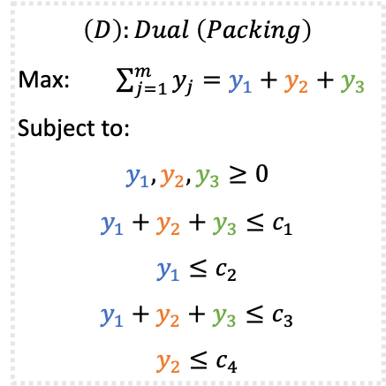

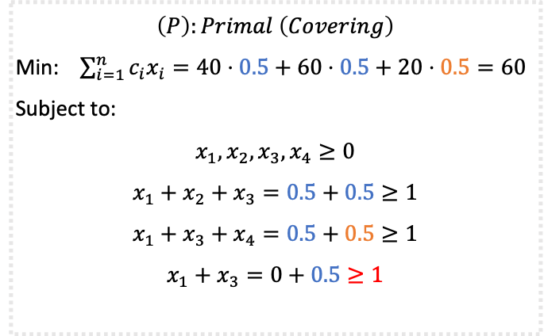
Online Covering example
$$\left(P\right):Primal \left(Covering\right)$$
Min:$\sum_{i=1}^{n}{c_{i}x_{i}}$
Subject to:
$∀1≤j≤m: \sum_{i∈S_{j}}{x_{i}≥1}$
$∀1≤i≤n: x_{i}≥0$
$$\left(D\right):Dual \left(Packing\right)$$
Max:$\sum_{j=1}^{m}{y_{j}}$
Subject to:
$∀1≤i≤n: \sum_{j|i∈S_{j}}{y_{j}≤c_{i}}$
$∀1≤j≤m: y_{j}≥0$
$$c_{1}=40\text{₪}$$
$$c_{2}=40\text{₪}$$
$$c_{3}=60\text{₪}$$
$$c_{4}=20\text{₪}$$
$$x_{1}=0$$
$$x_{2}=0.5$$
$$x_{3}=0.5$$
$$x_{4}=0.5$$
$$\left(P\right):Primal \left(Covering\right)$$
Min:$\sum_{i=1}^{n}{c_{i}x_{i}}=40⋅0.5+60⋅0.5+20⋅0.5=60$
Subject to:
$$x_{1}, x_{2}, x_{3}, x_{4}≥0$$
$$x_{1}+x_{2}+x_{3}=0.5+0.5≥1$$
$$x_{1}+x_{3}+x_{4}=0.5+0.5≥1$$
$$x_{1}+x_{3}=0+0.5≥1$$
$$\left(D\right):Dual \left(Packing\right)$$
Max:$\sum_{j=1}^{m}{y_{j}}=y_{1}+y_{2}+y_{3}$
Subject to:
$$y_{1},y_{2},y_{3}≥0$$
$$y_{1}+y_{2}+y_{3}≤c_{1}$$
$$y_{1}≤c_{2}$$
$$y_{1}+y_{2}+y_{3}≤c_{3}$$
$$y_{2}≤c_{4}$$

Slide 25
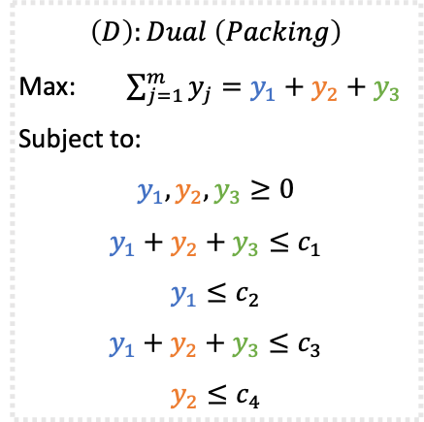
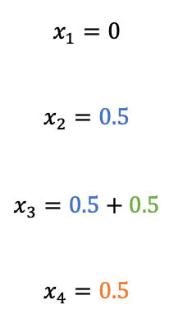
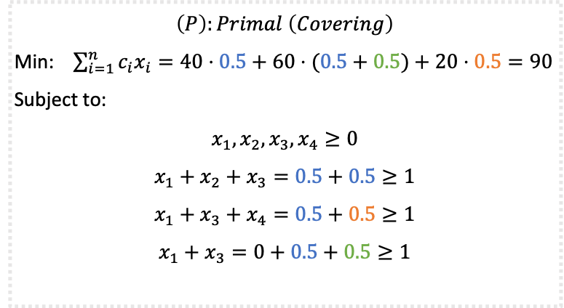
Online Covering example
$$\left(P\right):Primal \left(Covering\right)$$
Min:$\sum_{i=1}^{n}{c_{i}x_{i}}$
Subject to:
$∀1≤j≤m: \sum_{i∈S_{j}}{x_{i}≥1}$
$∀1≤i≤n: x_{i}≥0$
$$\left(D\right):Dual \left(Packing\right)$$
Max:$\sum_{j=1}^{m}{y_{j}}$
Subject to:
$∀1≤i≤n: \sum_{j|i∈S_{j}}{y_{j}≤c_{i}}$
$∀1≤j≤m: y_{j}≥0$
$$c_{1}=40\text{₪}$$
$$c_{2}=40\text{₪}$$
$$c_{3}=60\text{₪}$$
$$c_{4}=20\text{₪}$$
$$x_{1}=0$$
$$x_{2}=0.5$$
$$x_{3}=0.5+0.5$$
$$x_{4}=0.5$$
$$\left(P\right):Primal \left(Covering\right)$$
Min:$\sum_{i=1}^{n}{c_{i}x_{i}}=40⋅0.5+60⋅(0.5+0.5)+20⋅0.5=90$
Subject to:
$$x_{1}, x_{2}, x_{3}, x_{4}≥0$$
$$x_{1}+x_{2}+x_{3}=0.5+0.5≥1$$
$$x_{1}+x_{3}+x_{4}=0.5+0.5≥1$$
$$x_{1}+x_{3}=0+0.5+0.5≥1$$
$$\left(D\right):Dual \left(Packing\right)$$
Max:$\sum_{j=1}^{m}{y_{j}}=y_{1}+y_{2}+y_{3}$
Subject to:
$$y_{1},y_{2},y_{3}≥0$$
$$y_{1}+y_{2}+y_{3}≤c_{1}$$
$$y_{1}≤c_{2}$$
$$y_{1}+y_{2}+y_{3}≤c_{3}$$
$$y_{2}≤c_{4}$$

Slide 26
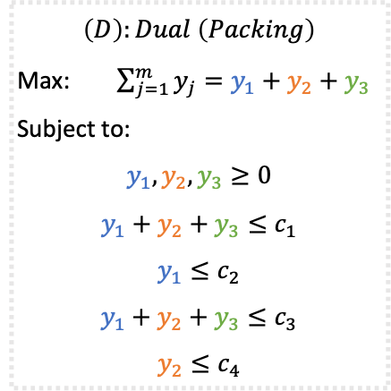
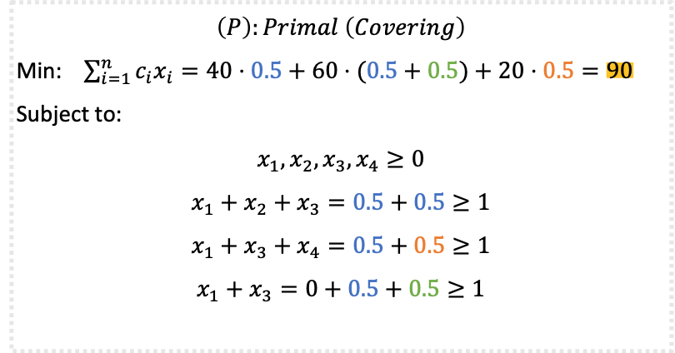
Online Covering example
$$\left(P\right):Primal \left(Covering\right)$$
Min:$\sum_{i=1}^{n}{c_{i}x_{i}}$
Subject to:
$∀1≤j≤m: \sum_{i∈S_{j}}{x_{i}≥1}$
$∀1≤i≤n: x_{i}≥0$
$$\left(D\right):Dual \left(Packing\right)$$
Max:$\sum_{j=1}^{m}{y_{j}}$
Subject to:
$∀1≤i≤n: \sum_{j|i∈S_{j}}{y_{j}≤c_{i}}$
$∀1≤j≤m: y_{j}≥0$
$$c_{1}=40\text{₪}$$
$$c_{2}=40\text{₪}$$
$$c_{3}=60\text{₪}$$
$$c_{4}=20\text{₪}$$
$$x_{1}=0$$
$$x_{2}=0.5$$
$$x_{3}=0.5+0.5$$
$$x_{4}=0.5$$
$$\left(P\right):Primal \left(Covering\right)$$
Min:$\sum_{i=1}^{n}{c_{i}x_{i}}=40⋅0.5+60⋅(0.5+0.5)+20⋅0.5=90$
Subject to:
$$x_{1}, x_{2}, x_{3}, x_{4}≥0$$
$$x_{1}+x_{2}+x_{3}=0.5+0.5≥1$$
$$x_{1}+x_{3}+x_{4}=0.5+0.5≥1$$
$$x_{1}+x_{3}=0+0.5+0.5≥1$$
$$\left(D\right):Dual \left(Packing\right)$$
Max:$\sum_{j=1}^{m}{y_{j}}=y_{1}+y_{2}+y_{3}$
Subject to:
$$y_{1},y_{2},y_{3}≥0$$
$$y_{1}+y_{2}+y_{3}≤c_{1}$$
$$y_{1}≤c_{2}$$
$$y_{1}+y_{2}+y_{3}≤c_{3}$$
$$y_{2}≤c_{4}$$

Slide 27



Online Covering example
$$\left(P\right):Primal \left(Covering\right)$$
Min:$\sum_{i=1}^{n}{c_{i}x_{i}}$
Subject to:
$∀1≤j≤m: \sum_{i∈S_{j}}{x_{i}≥1}$
$∀1≤i≤n: x_{i}≥0$
$$\left(D\right):Dual \left(Packing\right)$$
Max:$\sum_{j=1}^{m}{y_{j}}$
Subject to:
$∀1≤i≤n: \sum_{j|i∈S_{j}}{y_{j}≤c_{i}}$
$∀1≤j≤m: y_{j}≥0$
$$c_{1}=40\text{₪}$$
$$c_{2}=40\text{₪}$$
$$c_{3}=60\text{₪}$$
$$c_{4}=20\text{₪}$$
$$x_{1}=0$$
$$x_{2}=0$$
$$x_{3}=1$$
$$x_{4}=0$$
$$\left(P\right):Primal \left(Covering\right)$$
Min:$\sum_{i=1}^{n}{c_{i}x_{i}}=60⋅(1) =60$
Subject to:
$$x_{1}, x_{2}, x_{3}, x_{4}≥0$$
$$x_{1}+x_{2}+x_{3}=1≥1$$
$$x_{1}+x_{3}+x_{4}=1≥1$$
$$x_{1}+x_{3}=1≥1$$
$$\left(D\right):Dual \left(Packing\right)$$
Max:$\sum_{j=1}^{m}{y_{j}}=y_{1}+y_{2}+y_{3}$
Subject to:
$$y_{1},y_{2},y_{3}≥0$$
$$y_{1}+y_{2}+y_{3}≤c_{1}$$
$$y_{1}≤c_{2}$$
$$y_{1}+y_{2}+y_{3}≤c_{3}$$
$$y_{2}≤c_{4}$$

Slide 28



Online Covering example
$$\left(P\right):Primal \left(Covering\right)$$
Min:$\sum_{i=1}^{n}{c_{i}x_{i}}$
Subject to:
$∀1≤j≤m: \sum_{i∈S_{j}}{x_{i}≥1}$
$∀1≤i≤n: x_{i}≥0$
$$\left(D\right):Dual \left(Packing\right)$$
Max:$\sum_{j=1}^{m}{y_{j}}$
Subject to:
$∀1≤i≤n: \sum_{j|i∈S_{j}}{y_{j}≤c_{i}}$
$∀1≤j≤m: y_{j}≥0$
$$c_{1}=40\text{₪}$$
$$c_{2}=40\text{₪}$$
$$c_{3}=60\text{₪}$$
$$c_{4}=20\text{₪}$$
$$x_{1}=1$$
$$x_{2}=0$$
$$x_{3}=0$$
$$x_{4}=0$$
$$\left(P\right):Primal \left(Covering\right)$$
Min:$\sum_{i=1}^{n}{c_{i}x_{i}}=40⋅(1) =40$
Subject to:
$$x_{1}, x_{2}, x_{3}, x_{4}≥0$$
$$x_{1}+x_{2}+x_{3}=1≥1$$
$$x_{1}+x_{3}+x_{4}=1≥1$$
$$x_{1}+x_{3}=1≥1$$
$$\left(D\right):Dual \left(Packing\right)$$
Max:$\sum_{j=1}^{m}{y_{j}}=y_{1}+y_{2}+y_{3}$
Subject to:
$$y_{1},y_{2},y_{3}≥0$$
$$y_{1}+y_{2}+y_{3}≤c_{1}$$
$$y_{1}≤c_{2}$$
$$y_{1}+y_{2}+y_{3}≤c_{3}$$
$$y_{2}≤c_{4}$$

Slide 29

Algorithm for Online Set Cover
$$\left(P\right):Primal \left(Covering\right)$$
Min:$\sum_{i=1}^{n}{c_{i}x_{i}}$
Subject to:
$∀1≤j≤m: \sum_{i∈S_{j}}{x_{i}≥1}$
$∀1≤i≤n: x_{i}≥0$
$$\left(D\right):Dual \left(Packing\right)$$
Max:$\sum_{j=1}^{m}{y_{j}}$
Subject to:
$∀1≤i≤n: \sum_{j|i∈S_{j}}{y_{j}≤c_{i}}$
$∀1≤j≤m: y_{j}≥0$
Upon arrival of a new primal constraint, $\sum_{i∈S_{j}}{x_{i}≥1}$, and the corresponding dual variable:
$$\left(1\right) While \sum_{i∈S_{j}}{x_{i}}<1:$$
$\left(a\right) For each i∈S_{j}:x_{i}←x_{i}\left(1+\frac{1}{c_{i}}\right)+\frac{1}{\left|S_{j}\right|{⋅c}_{i}}$
$$\left(b\right){ y}_{j}←y_{j}+1$$

Slide 30


Algorithm for Online Set Cover
$$\left(P\right):Primal \left(Covering\right)$$
Min:$\sum_{i=1}^{n}{c_{i}x_{i}}$
Subject to:
$∀1≤j≤m: \sum_{i∈S_{j}}{x_{i}≥1}$
$∀1≤i≤n: x_{i}≥0$
$$\left(D\right):Dual \left(Packing\right)$$
Max:$\sum_{j=1}^{m}{y_{j}}$
Subject to:
$∀1≤i≤n: \sum_{j|i∈S_{j}}{y_{j}≤c_{i}}$
$∀1≤j≤m: y_{j}≥0$
Upon arrival of a new primal constraint, $\sum_{i∈S_{j}}{x_{i}≥1}$, and the corresponding dual variable:
$$\left(1\right) While \sum_{i∈S_{j}}{x_{i}}<1:$$
$\left(a\right) For each i∈S_{j}:x_{i}←x_{i}\left(1+\frac{1}{c_{i}}\right)+\frac{1}{\left|S_{j}\right|{⋅c}_{i}}$
$$\left(b\right){ y}_{j}←y_{j}+1$$

Slide 31

Algorithm for Online Set Cover
$$\left(P\right):Primal \left(Covering\right)$$
Min:$\sum_{i=1}^{n}{c_{i}x_{i}}$
Subject to:
$∀1≤j≤m: \sum_{i∈S_{j}}{x_{i}≥1}$
$∀1≤i≤n: x_{i}≥0$
$$\left(D\right):Dual \left(Packing\right)$$
Max:$\sum_{j=1}^{m}{y_{j}}$
Subject to:
$∀1≤i≤n: \sum_{j|i∈S_{j}}{y_{j}≤c_{i}}$
$∀1≤j≤m: y_{j}≥0$
Upon arrival of a new primal constraint, $\sum_{i∈S_{j}}{x_{i}≥1}$, and the corresponding dual variable:
$$\left(1\right) While \sum_{i∈S_{j}}{x_{i}}<1:$$
$\left(a\right) For each i∈S_{j}:x_{i}←x_{i}\left(1+\frac{1}{c_{i}}\right)+\frac{1}{\left|S_{j}\right|{⋅c}_{i}}$
$$\left(b\right){ y}_{j}←y_{j}+1$$

Slide 32





Algorithm for Online Set Cover
$$\left(P\right):Primal \left(Covering\right)$$
Min:$\sum_{i=1}^{n}{c_{i}x_{i}}$
Subject to:
$∀1≤j≤m: \sum_{i∈S_{j}}{x_{i}≥1}$
$∀1≤i≤n: x_{i}≥0$
$$\left(D\right):Dual \left(Packing\right)$$
Max:$\sum_{j=1}^{m}{y_{j}}$
Subject to:
$∀1≤i≤n: \sum_{j|i∈S_{j}}{y_{j}≤c_{i}}$
$∀1≤j≤m: y_{j}≥0$
Upon arrival of a new primal constraint, $\sum_{i∈S_{j}}{x_{i}≥1}$, and the corresponding dual variable:
$$\left(1\right) While \sum_{i∈S_{j}}{x_{i}}<1:$$
$\left(a\right) For each i∈S_{j}:x_{i}←x_{i}\left(1+\frac{1}{c_{i}}\right)+\frac{1}{\left|S_{j}\right|{⋅c}_{i}}$
$$\left(b\right){ y}_{j}←y_{j}+1$$
$$\left(P\right):Primal \left(Covering\right)$$
Min:$\sum_{i=1}^{n}{c_{i}x_{i}}=0$
Subject to:
$$x_{1}, x_{2}, x_{3}≥0$$
$$\left(D\right):Dual \left(Packing\right)$$
Max:$\sum_{j=1}^{m}{y_{j}}$
Subject to:
$$c_{1}=1$$
$$c_{2}=4$$
$$c_{3}=6$$
$$x_{1}=0$$
$$x_{2}=0$$
$$x_{3}=0$$

Slide 33




Algorithm for Online Set Cover
$$\left(P\right):Primal \left(Covering\right)$$
Min:$\sum_{i=1}^{n}{c_{i}x_{i}}$
Subject to:
$∀1≤j≤m: \sum_{i∈S_{j}}{x_{i}≥1}$
$∀1≤i≤n: x_{i}≥0$
$$\left(D\right):Dual \left(Packing\right)$$
Max:$\sum_{j=1}^{m}{y_{j}}$
Subject to:
$∀1≤i≤n: \sum_{j|i∈S_{j}}{y_{j}≤c_{i}}$
$∀1≤j≤m: y_{j}≥0$
Upon arrival of a new primal constraint, $\sum_{i∈S_{j}}{x_{i}≥1}$, and the corresponding dual variable:
$$\left(1\right) While\sum_{i∈S_{1}}{x_{i}}=x_{1}+x_{2}=0<1:$$
$\left(a\right) For each i∈S_{j}:x_{i}←x_{i}\left(1+\frac{1}{c_{i}}\right)+\frac{1}{\left|S_{j}\right|{⋅c}_{i}}$
$$\left(b\right){ y}_{j}←y_{j}+1$$
$$\left(P\right):Primal \left(Covering\right)$$
Min:$\sum_{i=1}^{n}{c_{i}x_{i}}=0$
Subject to:
$$x_{1}, x_{2}, x_{3}≥0$$
$$x_{1}+x_{2}=0≥1$$
$$\left(D\right):Dual \left(Packing\right)$$
Max:$\sum_{j=1}^{m}{y_{j}}=y_{1}$
Subject to:
$$y_{1}≤c_{1}$$
$$y_{1}≤c_{2}$$
$$c_{1}=1$$
$$c_{2}=4$$
$$c_{3}=6$$
$$x_{1}=0$$
$$x_{2}=0$$
$$x_{3}=0$$

Slide 34




Algorithm for Online Set Cover
$$\left(P\right):Primal \left(Covering\right)$$
Min:$\sum_{i=1}^{n}{c_{i}x_{i}}$
Subject to:
$∀1≤j≤m: \sum_{i∈S_{j}}{x_{i}≥1}$
$∀1≤i≤n: x_{i}≥0$
$$\left(D\right):Dual \left(Packing\right)$$
Max:$\sum_{j=1}^{m}{y_{j}}$
Subject to:
$∀1≤i≤n: \sum_{j|i∈S_{j}}{y_{j}≤c_{i}}$
$∀1≤j≤m: y_{j}≥0$
Upon arrival of a new primal constraint, $\sum_{i∈S_{j}}{x_{i}≥1}$, and the corresponding dual variable:
$$\left(1\right) While \sum_{i∈S_{1}}{x_{i}}=x_{1}+x_{2}=\frac{1}{2}+\frac{1}{8}<1:$$
$\left(a\right) For each i∈S_{j}:x_{i}←x_{i}\left(1+\frac{1}{c_{i}}\right)+\frac{1}{\left|S_{j}\right|{⋅c}_{i}}$
$$\left(b\right){ y}_{j}←y_{j}+1$$
$$\left(P\right):Primal \left(Covering\right)$$
Min:$\sum_{i=1}^{n}{c_{i}x_{i}}=0$
Subject to:
$$x_{1}, x_{2}, x_{3}≥0$$
$$x_{1}+x_{2}=\frac{1}{2}+\frac{1}{8}≥1$$
$$\left(D\right):Dual \left(Packing\right)$$
Max:$\sum_{j=1}^{m}{y_{j}}=y_{1}$
Subject to:
$$y_{1}=1≤c_{1}=1$$
$$y_{1}=1≤c_{2}=4$$
$$c_{1}=1$$
$$c_{2}=4$$
$$c_{3}=6$$
$$x_{1}=\frac{1}{2⋅1}=\frac{1}{2}$$
$$x_{2}=\frac{1}{2⋅4}=\frac{1}{8}$$
$$x_{3}=0$$

Slide 35




Algorithm for Online Set Cover
$$\left(P\right):Primal \left(Covering\right)$$
Min:$\sum_{i=1}^{n}{c_{i}x_{i}}$
Subject to:
$∀1≤j≤m: \sum_{i∈S_{j}}{x_{i}≥1}$
$∀1≤i≤n: x_{i}≥0$
$$\left(D\right):Dual \left(Packing\right)$$
Max:$\sum_{j=1}^{m}{y_{j}}$
Subject to:
$∀1≤i≤n: \sum_{j|i∈S_{j}}{y_{j}≤c_{i}}$
$∀1≤j≤m: y_{j}≥0$
Upon arrival of a new primal constraint, $\sum_{i∈S_{j}}{x_{i}≥1}$, and the corresponding dual variable:
$$\left(1\right) While \sum_{i∈S_{1}}{x_{i}}=x_{1}+x_{2}=1.78<1:$$
$\left(a\right) For each i∈S_{j}:x_{i}←x_{i}\left(1+\frac{1}{c_{i}}\right)+\frac{1}{\left|S_{j}\right|{⋅c}_{i}}$
$$\left(b\right){ y}_{j}←y_{j}+1$$
$$\left(P\right):Primal \left(Covering\right)$$
Min:$\sum_{i=1}^{n}{c_{i}x_{i}}=0$
Subject to:
$$x_{1}, x_{2}, x_{3}≥0$$
$$x_{1}+x_{2}=1.5+0.28≥1$$
$$\left(D\right):Dual \left(Packing\right)$$
Max:$\sum_{j=1}^{m}{y_{j}}=y_{1}$
Subject to:
$$y_{1}=1+1≤c_{1}=1$$
$$y_{1}=1+1≤c_{2}=4$$
$$c_{1}=1$$
$$c_{2}=4$$
$$c_{3}=6$$
$$x_{1}=\frac{1}{2}\left(1+\frac{1}{1}\right)+\frac{1}{2⋅1}=1.5$$
$$x_{2}=\frac{1}{8}\left(1+\frac{1}{4}\right)+\frac{1}{2⋅4}=0.28$$
$$x_{3}=0$$

Slide 36




Algorithm for Online Set Cover
$$\left(P\right):Primal \left(Covering\right)$$
Min:$\sum_{i=1}^{n}{c_{i}x_{i}}$
Subject to:
$∀1≤j≤m: \sum_{i∈S_{j}}{x_{i}≥1}$
$∀1≤i≤n: x_{i}≥0$
$$\left(D\right):Dual \left(Packing\right)$$
Max:$\sum_{j=1}^{m}{y_{j}}$
Subject to:
$∀1≤i≤n: \sum_{j|i∈S_{j}}{y_{j}≤c_{i}}$
$∀1≤j≤m: y_{j}≥0$
Upon arrival of a new primal constraint, $\sum_{i∈S_{j}}{x_{i}≥1}$, and the corresponding dual variable:
$$\left(1\right) While \sum_{i∈S_{2}}{x_{i}}=x_{2}+x_{3}=0.28<1:$$
$\left(a\right) For each i∈S_{j}:x_{i}←x_{i}\left(1+\frac{1}{c_{i}}\right)+\frac{1}{\left|S_{j}\right|{⋅c}_{i}}$
$$\left(b\right){ y}_{j}←y_{j}+1$$
$$\left(P\right):Primal \left(Covering\right)$$
Min:$\sum_{i=1}^{n}{c_{i}x_{i}}=0$
Subject to:
$$x_{1}, x_{2}, x_{3}≥0$$
$$x_{1}+x_{2}=1.5+0.28≥1$$
$$x_{2}+x_{3}=0.28≥1$$
$$\left(D\right):Dual \left(Packing\right)$$
Max:$\sum_{j=1}^{m}{y_{j}}=y_{1}+y_{2}$
Subject to:
$$y_{1}=2≤c_{1}=1$$
$$y_{1}=2≤c_{2}=4$$
$$c_{1}=1$$
$$c_{2}=4$$
$$c_{3}=6$$
$$x_{1}=1.5$$
$$x_{2}=0.28$$
$$x_{3}=0$$
And so on…

Slide 37


Algorithm for Online Set Cover
$$\left(P\right):Primal \left(Covering\right)$$
Min:$\sum_{i=1}^{n}{c_{i}x_{i}}$
Subject to:
$∀1≤j≤m: \sum_{i∈S_{j}}{x_{i}≥1}$
$∀1≤i≤n: x_{i}≥0$
$$\left(D\right):Dual \left(Packing\right)$$
Max:$\sum_{j=1}^{m}{y_{j}}$
Subject to:
$∀1≤i≤n: \sum_{j|i∈S_{j}}{y_{j}≤c_{i}}$
$∀1≤j≤m: y_{j}≥0$
Upon arrival of a new primal constraint, $\sum_{i∈S_{j}}{x_{i}≥1}$, and the corresponding dual variable:
$$\left(1\right) While \sum_{i∈S_{j}}{x_{i}}<1:$$
$\left(a\right) For each i∈S_{j}:x_{i}←x_{i}\left(1+\frac{1}{c_{i}}\right)+\frac{1}{\left|S_{j}\right|{⋅c}_{i}}$
$$\left(b\right){ y}_{j}←y_{j}+1$$
We assume that each $c_{i}≥1$.
Let $d=\max_{j}{|S_{j}|}$.

Slide 38


Algorithm for Online Set Cover
$$\left(P\right):Primal \left(Covering\right)$$
Min:$\sum_{i=1}^{n}{c_{i}x_{i}}$
Subject to:
$∀1≤j≤m: \sum_{i∈S_{j}}{x_{i}≥1}$
$∀1≤i≤n: x_{i}≥0$
$$\left(D\right):Dual \left(Packing\right)$$
Max:$\sum_{j=1}^{m}{y_{j}}$
Subject to:
$∀1≤i≤n: \sum_{j|i∈S_{j}}{y_{j}≤c_{i}}$
$∀1≤j≤m: y_{j}≥0$
Upon arrival of a new primal constraint, $\sum_{i∈S_{j}}{x_{i}≥1}$, and the corresponding dual variable:
$$\left(1\right) While \sum_{i∈S_{j}}{x_{i}}<1:$$
$\left(a\right) For each i∈S_{j}:x_{i}←x_{i}\left(1+\frac{1}{c_{i}}\right)+\frac{1}{\left|S_{j}\right|{⋅c}_{i}}$
$$\left(b\right){ y}_{j}←y_{j}+1$$
We assume that each $c_{i}≥1$.
Let $d=\max_{j}{|S_{j}|}$.
The algorithm preduces:
Feasible fractional covering solution

Slide 39


Algorithm for Online Set Cover
$$\left(P\right):Primal \left(Covering\right)$$
Min:$\sum_{i=1}^{n}{c_{i}x_{i}}$
Subject to:
$∀1≤j≤m: \sum_{i∈S_{j}}{x_{i}≥1}$
$∀1≤i≤n: x_{i}≥0$
$$\left(D\right):Dual \left(Packing\right)$$
Max:$\sum_{j=1}^{m}{y_{j}}$
Subject to:
$∀1≤i≤n: \sum_{j|i∈S_{j}}{y_{j}≤c_{i}}$
$∀1≤j≤m: y_{j}≥0$
Upon arrival of a new primal constraint, $\sum_{i∈S_{j}}{x_{i}≥1}$, and the corresponding dual variable:
$$\left(1\right) While \sum_{i∈S_{j}}{x_{i}}<1:$$
$\left(a\right) For each i∈S_{j}:x_{i}←x_{i}\left(1+\frac{1}{c_{i}}\right)+\frac{1}{\left|S_{j}\right|{⋅c}_{i}}$
$$\left(b\right){ y}_{j}←y_{j}+1$$
We assume that each $c_{i}≥1$.
Let $d=\max_{j}{|S_{j}|}$.
The algorithm preduces:
Feasible fractional covering solution
Integral Packing solution which is 2-competitive

Slide 40


Algorithm for Online Set Cover
$$\left(P\right):Primal \left(Covering\right)$$
Min:$\sum_{i=1}^{n}{c_{i}x_{i}}$
Subject to:
$∀1≤j≤m: \sum_{i∈S_{j}}{x_{i}≥1}$
$∀1≤i≤n: x_{i}≥0$
$$\left(D\right):Dual \left(Packing\right)$$
Max:$\sum_{j=1}^{m}{y_{j}}$
Subject to:
$∀1≤i≤n: \sum_{j|i∈S_{j}}{y_{j}≤c_{i}}$
$∀1≤j≤m: y_{j}≥0$
Upon arrival of a new primal constraint, $\sum_{i∈S_{j}}{x_{i}≥1}$, and the corresponding dual variable:
$$\left(1\right) While \sum_{i∈S_{j}}{x_{i}}<1:$$
$\left(a\right) For each i∈S_{j}:x_{i}←x_{i}\left(1+\frac{1}{c_{i}}\right)+\frac{1}{\left|S_{j}\right|{⋅c}_{i}}$
$$\left(b\right){ y}_{j}←y_{j}+1$$
We assume that each $c_{i}≥1$.
Let $d=\max_{j}{|S_{j}|}$.
The algorithm preduces:
Feasible fractional covering solution
Integral Packing solution which is 2-competitive
Violates each packing constraint by at most a factor of $O\left(\log{d}\right)$

Slide 41

Algorithm for Online Set Cover
$$\left(P\right):Primal \left(Covering\right)$$
Min:$\sum_{i=1}^{n}{c_{i}x_{i}}$
Subject to:
$∀1≤j≤m: \sum_{i∈S_{j}}{x_{i}≥1}$
$∀1≤i≤n: x_{i}≥0$
$$\left(D\right):Dual \left(Packing\right)$$
Max:$\sum_{j=1}^{m}{y_{j}}$
Subject to:
$∀1≤i≤n: \sum_{j|i∈S_{j}}{y_{j}≤c_{i}}$
$∀1≤j≤m: y_{j}≥0$
Upon arrival of a new primal constraint, $\sum_{i∈S_{j}}{x_{i}≥1}$, and the corresponding dual variable:
$$\left(1\right) While \sum_{i∈S_{j}}{x_{i}}<1:$$
$\left(a\right) For each i∈S_{j}:x_{i}←x_{i}\left(1+\frac{1}{c_{i}}\right)+\frac{1}{\left|S_{j}\right|{⋅c}_{i}}$
$$\left(b\right){ y}_{j}←y_{j}+1$$
We assume that each $c_{i}≥1$.
Let $d=\max_{j}{|S_{j}|}$.
The algorithm preduces:
Feasible fractional covering solution
Integral Packing solution which is 2-competitive
Violates each packing constraint by at most a factor of $O\left(\log{d}\right)$
Fractional covering solution which is $O\left(\log{d}\right)$-competitive

Slide 42


$$\left(1\right) While \sum_{i∈S_{j}}{x_{i}}<1:$$
$\left(a\right) For each i∈S_{j}:x_{i}←x_{i}\left(1+\frac{1}{c_{i}}\right)+\frac{1}{\left|S_{j}\right|{⋅c}_{i}}$
$$\left(b\right){ y}_{j}←y_{j}+1$$
$$\left(P\right):Primal \left(Covering\right)$$
Min:$\sum_{i=1}^{n}{c_{i}x_{i}}$
Subject to:
$∀1≤j≤m: \sum_{i∈S_{j}}{x_{i}≥1}$
$∀1≤i≤n: x_{i}≥0$
$$\left(D\right):Dual \left(Packing\right)$$
Max:$\sum_{j=1}^{m}{y_{j}}$
Subject to:
$∀1≤i≤n: \sum_{j|i∈S_{j}}{y_{j}≤c_{i}}$
$∀1≤j≤m: y_{j}≥0$
1. Feasible fractional covering solution – Proof:
In each iteration of the loop, the values of $x_{i} (i∈S_{j})$ increases.
The loop won’t stop until the primal constraint is set.
The constrain for previous $S_{j}$ is not violated by increasing $x_{i}$ values.
All constraint will be valid at the end of each turn. $∎$

Slide 43
$$\left(1\right) While \sum_{i∈S_{j}}{x_{i}}<1:$$
$\left(a\right) For each i∈S_{j}:x_{i}←x_{i}\left(1+\frac{1}{c_{i}}\right)+\frac{1}{\left|S_{j}\right|{⋅c}_{i}}$
$$\left(b\right){ y}_{j}←y_{j}+1$$
$$\left(P\right):Primal \left(Covering\right)$$
Min:$\sum_{i=1}^{n}{c_{i}x_{i}}$
Subject to:
$∀1≤j≤m: \sum_{i∈S_{j}}{x_{i}≥1}$
$∀1≤i≤n: x_{i}≥0$
$$\left(D\right):Dual \left(Packing\right)$$
Max:$\sum_{j=1}^{m}{y_{j}}$
Subject to:
$∀1≤i≤n: \sum_{j|i∈S_{j}}{y_{j}≤c_{i}}$
$∀1≤j≤m: y_{j}≥0$
2. Integral packing solution which is 2-competitive – Proof:

Slide 44

$$\left(1\right) While \sum_{i∈S_{j}}{x_{i}}<1:$$
$\left(a\right) For each i∈S_{j}:x_{i}←x_{i}\left(1+\frac{1}{c_{i}}\right)+\frac{1}{\left|S_{j}\right|{⋅c}_{i}}$
$$\left(b\right){ y}_{j}←y_{j}+1$$
$$\left(P\right):Primal \left(Covering\right)$$
Min:$\sum_{i=1}^{n}{c_{i}x_{i}}$
Subject to:
$∀1≤j≤m: \sum_{i∈S_{j}}{x_{i}≥1}$
$∀1≤i≤n: x_{i}≥0$
$$\left(D\right):Dual \left(Packing\right)$$
Max:$\sum_{j=1}^{m}{y_{j}}$
Subject to:
$∀1≤i≤n: \sum_{j|i∈S_{j}}{y_{j}≤c_{i}}$
$∀1≤j≤m: y_{j}≥0$
2. Integral packing solution which is 2-competitive – Proof:
It is clear that the packing solution will be integral.

Slide 45

$$\left(1\right) While \sum_{i∈S_{j}}{x_{i}}<1:$$
$\left(a\right) For each i∈S_{j}:x_{i}←x_{i}\left(1+\frac{1}{c_{i}}\right)+\frac{1}{\left|S_{j}\right|{⋅c}_{i}}$
$$\left(b\right){ y}_{j}←y_{j}+1$$
$$\left(P\right):Primal \left(Covering\right)$$
Min:$\sum_{i=1}^{n}{c_{i}x_{i}}$
Subject to:
$∀1≤j≤m: \sum_{i∈S_{j}}{x_{i}≥1}$
$∀1≤i≤n: x_{i}≥0$
$$\left(D\right):Dual \left(Packing\right)$$
Max:$\sum_{j=1}^{m}{y_{j}}$
Subject to:
$∀1≤i≤n: \sum_{j|i∈S_{j}}{y_{j}≤c_{i}}$
$∀1≤j≤m: y_{j}≥0$
2. Integral packing solution which is 2-competitive – Proof:
It is clear that the packing solution will be integral.
Let $ΔP, ΔD$ be the change in the primal and dual cost at each iteration.

Slide 46



$$\left(1\right) While \sum_{i∈S_{j}}{x_{i}}<1:$$
$\left(a\right) For each i∈S_{j}:x_{i}←x_{i}\left(1+\frac{1}{c_{i}}\right)+\frac{1}{\left|S_{j}\right|{⋅c}_{i}}$
$$\left(b\right){ y}_{j}←y_{j}+1$$
$$\left(P\right):Primal \left(Covering\right)$$
Min:$\sum_{i=1}^{n}{c_{i}x_{i}}$
Subject to:
$∀1≤j≤m: \sum_{i∈S_{j}}{x_{i}≥1}$
$∀1≤i≤n: x_{i}≥0$
$$\left(D\right):Dual \left(Packing\right)$$
Max:$\sum_{j=1}^{m}{y_{j}}$
Subject to:
$∀1≤i≤n: \sum_{j|i∈S_{j}}{y_{j}≤c_{i}}$
$∀1≤j≤m: y_{j}≥0$
2. Integral packing solution which is 2-competitive – Proof:
It is clear that the packing solution will be integral.
Let $ΔP, ΔD$ be the change in the primal and dual cost at each iteration.
$$ΔD=1$$

Slide 47


$$\left(1\right) While \sum_{i∈S_{j}}{x_{i}}<1:$$
$\left(a\right) For each i∈S_{j}:x_{i}←x_{i}\left(1+\frac{1}{c_{i}}\right)+\frac{1}{\left|S_{j}\right|{⋅c}_{i}}$
$$\left(b\right){ y}_{j}←y_{j}+1$$
$$\left(P\right):Primal \left(Covering\right)$$
Min:$\sum_{i=1}^{n}{c_{i}x_{i}}$
Subject to:
$∀1≤j≤m: \sum_{i∈S_{j}}{x_{i}≥1}$
$∀1≤i≤n: x_{i}≥0$
$$\left(D\right):Dual \left(Packing\right)$$
Max:$\sum_{j=1}^{m}{y_{j}}$
Subject to:
$∀1≤i≤n: \sum_{j|i∈S_{j}}{y_{j}≤c_{i}}$
$∀1≤j≤m: y_{j}≥0$
2. Integral packing solution which is 2-competitive – Proof:
It is clear that the packing solution will be integral.
Let $ΔP, ΔD$ be the change in the primal and dual cost at each iteration.
$$ΔD=1 \\ ΔP=\sum_{i∈S_{j}}{c_{i}Δx_{i}}$$

Slide 48


$$\left(1\right) While \sum_{i∈S_{j}}{x_{i}}<1:$$
$\left(a\right) For each i∈S_{j}:x_{i}←x_{i}\left(1+\frac{1}{c_{i}}\right)+\frac{1}{\left|S_{j}\right|{⋅c}_{i}}$
$$\left(b\right){ y}_{j}←y_{j}+1$$
$$\left(P\right):Primal \left(Covering\right)$$
Min:$\sum_{i=1}^{n}{c_{i}x_{i}}$
Subject to:
$∀1≤j≤m: \sum_{i∈S_{j}}{x_{i}≥1}$
$∀1≤i≤n: x_{i}≥0$
$$\left(D\right):Dual \left(Packing\right)$$
Max:$\sum_{j=1}^{m}{y_{j}}$
Subject to:
$∀1≤i≤n: \sum_{j|i∈S_{j}}{y_{j}≤c_{i}}$
$∀1≤j≤m: y_{j}≥0$
2. Integral packing solution which is 2-competitive – Proof:
It is clear that the packing solution will be integral.
Let $ΔP, ΔD$ be the change in the primal and dual cost at each iteration.
$$ΔD=1 \\ ΔP=\sum_{i∈S_{j}}{c_{i}Δx_{i}}=\sum_{i∈S_{j}}{c_{i}\left(\frac{x_{i}}{c_{i}}+\frac{1}{\left|S_{j}\right|⋅c_{i}}\right)}=$$

Slide 49


$$\left(1\right) While \sum_{i∈S_{j}}{x_{i}}<1: \\ \left(a\right) For each i∈S_{j}:x_{i}←x_{i}\left(1+\frac{1}{c_{i}}\right)+\frac{1}{\left|S_{j}\right|{⋅c}_{i}} \\ \left(b\right){ y}_{j}←y_{j}+1$$
$$\left(P\right):Primal \left(Covering\right)$$
Min:$\sum_{i=1}^{n}{c_{i}x_{i}}$
Subject to:
$∀1≤j≤m: \sum_{i∈S_{j}}{x_{i}≥1}$
$∀1≤i≤n: x_{i}≥0$
$$\left(D\right):Dual \left(Packing\right)$$
Max:$\sum_{j=1}^{m}{y_{j}}$
Subject to:
$∀1≤i≤n: \sum_{j|i∈S_{j}}{y_{j}≤c_{i}}$
$∀1≤j≤m: y_{j}≥0$
2. Integral packing solution which is 2-competitive – Proof:
It is clear that the packing solution will be integral.
Let $ΔP, ΔD$ be the change in the primal and dual cost at each iteration.
$$ΔD=1 \\ ΔP=\sum_{i∈S_{j}}{c_{i}Δx_{i}}=\sum_{i∈S_{j}}{c_{i}\left(\frac{x_{i}}{c_{i}}+\frac{1}{\left|S_{j}\right|⋅c_{i}}\right)}=$$
$$=\sum_{i∈S_{j}}{x_{i}}+\sum_{i∈S_{j}}{\frac{1}{\left|S_{j}\right|}}≤1+1=2⋅ΔD$$

Slide 50


$$\left(1\right) While \sum_{i∈S_{j}}{x_{i}}<1: \\ \left(a\right) For each i∈S_{j}:x_{i}←x_{i}\left(1+\frac{1}{c_{i}}\right)+\frac{1}{\left|S_{j}\right|{⋅c}_{i}} \\ \left(b\right){ y}_{j}←y_{j}+1$$
$$\left(P\right):Primal \left(Covering\right)$$
Min:$\sum_{i=1}^{n}{c_{i}x_{i}}$
Subject to:
$∀1≤j≤m: \sum_{i∈S_{j}}{x_{i}≥1}$
$∀1≤i≤n: x_{i}≥0$
$$\left(D\right):Dual \left(Packing\right)$$
Max:$\sum_{j=1}^{m}{y_{j}}$
Subject to:
$∀1≤i≤n: \sum_{j|i∈S_{j}}{y_{j}≤c_{i}}$
$∀1≤j≤m: y_{j}≥0$
2. Integral packing solution which is 2-competitive – Proof:
It is clear that the packing solution will be integral.
Let $ΔP, ΔD$ be the change in the primal and dual cost at each iteration.
$$ΔD=1 \\ ΔP=\sum_{i∈S_{j}}{c_{i}Δx_{i}}=\sum_{i∈S_{j}}{c_{i}\left(\frac{x_{i}}{c_{i}}+\frac{1}{\left|S_{j}\right|⋅c_{i}}\right)}=$$
$$=\sum_{i∈S_{j}}{x_{i}}+\sum_{i∈S_{j}}{\frac{1}{\left|S_{j}\right|}}≤1+1=2⋅ΔD$$
$$ΔP≤2ΔD$$

Slide 51

$$\left(1\right) While \sum_{i∈S_{j}}{x_{i}}<1:$$
$\left(a\right) For each i∈S_{j}:x_{i}←x_{i}\left(1+\frac{1}{c_{i}}\right)+\frac{1}{\left|S_{j}\right|{⋅c}_{i}}$
$$\left(b\right){ y}_{j}←y_{j}+1$$
$$\left(P\right):Primal \left(Covering\right)$$
Min:$\sum_{i=1}^{n}{c_{i}x_{i}}$
Subject to:
$∀1≤j≤m: \sum_{i∈S_{j}}{x_{i}≥1}$
$∀1≤i≤n: x_{i}≥0$
$$\left(D\right):Dual \left(Packing\right)$$
Max:$\sum_{j=1}^{m}{y_{j}}$
Subject to:
$∀1≤i≤n: \sum_{j|i∈S_{j}}{y_{j}≤c_{i}}$
$∀1≤j≤m: y_{j}≥0$
2. Integral packing solution which is 2-competitive – Proof:
$$ΔP≤2ΔD$$
Initially, $P=0, D=0.$
$$\sum_{all rounds}{ΔP}≤2⋅\sum_{all rounds}{ΔD}$$
$$P≤2D$$
P is feasible.
$$2D≥P$$

Slide 52

$$\left(1\right) While \sum_{i∈S_{j}}{x_{i}}<1:$$
$\left(a\right) For each i∈S_{j}:x_{i}←x_{i}\left(1+\frac{1}{c_{i}}\right)+\frac{1}{\left|S_{j}\right|{⋅c}_{i}}$
$$\left(b\right){ y}_{j}←y_{j}+1$$
$$\left(P\right):Primal \left(Covering\right)$$
Min:$\sum_{i=1}^{n}{c_{i}x_{i}}$
Subject to:
$∀1≤j≤m: \sum_{i∈S_{j}}{x_{i}≥1}$
$∀1≤i≤n: x_{i}≥0$
$$\left(D\right):Dual \left(Packing\right)$$
Max:$\sum_{j=1}^{m}{y_{j}}$
Subject to:
$∀1≤i≤n: \sum_{j|i∈S_{j}}{y_{j}≤c_{i}}$
$∀1≤j≤m: y_{j}≥0$
2. Integral packing solution which is 2-competitive – Proof:
$$ΔP≤2ΔD$$
Initially, $P=0, D=0.$
$$\sum_{all rounds}{ΔP}≤2⋅\sum_{all rounds}{ΔD}$$
$$P≤2D$$
P is feasible.
$$2D≥P≥P_{opt}$$

Slide 53

$$\left(1\right) While \sum_{i∈S_{j}}{x_{i}}<1:$$
$\left(a\right) For each i∈S_{j}:x_{i}←x_{i}\left(1+\frac{1}{c_{i}}\right)+\frac{1}{\left|S_{j}\right|{⋅c}_{i}}$
$$\left(b\right){ y}_{j}←y_{j}+1$$
$$\left(P\right):Primal \left(Covering\right)$$
Min:$\sum_{i=1}^{n}{c_{i}x_{i}}$
Subject to:
$∀1≤j≤m: \sum_{i∈S_{j}}{x_{i}≥1}$
$∀1≤i≤n: x_{i}≥0$
$$\left(D\right):Dual \left(Packing\right)$$
Max:$\sum_{j=1}^{m}{y_{j}}$
Subject to:
$∀1≤i≤n: \sum_{j|i∈S_{j}}{y_{j}≤c_{i}}$
$∀1≤j≤m: y_{j}≥0$
2. Integral packing solution which is 2-competitive – Proof:
$$ΔP≤2ΔD$$
Initially, $P=0, D=0.$
$$\sum_{all rounds}{ΔP}≤2⋅\sum_{all rounds}{ΔD}$$
$$P≤2D$$
P is feasible.
$$2D≥P≥P_{opt}≥D_{opt}$$
$$D≥\frac{1}{2}D_{opt}$$
Packing is maximization problem, so the packing solution is 2-competitive. $∎$

Slide 54

$$\left(1\right) While \sum_{i∈S_{j}}{x_{i}}<1:$$
$\left(a\right) For each i∈S_{j}:x_{i}←x_{i}\left(1+\frac{1}{c_{i}}\right)+\frac{1}{\left|S_{j}\right|{⋅c}_{i}}$
$$\left(b\right){ y}_{j}←y_{j}+1$$
$$\left(P\right):Primal \left(Covering\right)$$
Min:$\sum_{i=1}^{n}{c_{i}x_{i}}$
Subject to:
$∀1≤j≤m: \sum_{i∈S_{j}}{x_{i}≥1}$
$∀1≤i≤n: x_{i}≥0$
$$\left(D\right):Dual \left(Packing\right)$$
Max:$\sum_{j=1}^{m}{y_{j}}$
Subject to:
$∀1≤i≤n: \sum_{j|i∈S_{j}}{y_{j}≤c_{i}}$
$∀1≤j≤m: y_{j}≥0$
3. Violates each packing constraint by at most a factor of $O\left(\log{d}\right)$ – Proof:
Goal: $\sum_{j|i∈S_{j}}{y_{j}}≤c_{i}⋅O(\log{d})$

Slide 55

$$\left(1\right) While \sum_{i∈S_{j}}{x_{i}}<1:$$
$\left(a\right) For each i∈S_{j}:x_{i}←x_{i}\left(1+\frac{1}{c_{i}}\right)+\frac{1}{\left|S_{j}\right|{⋅c}_{i}}$
$$\left(b\right){ y}_{j}←y_{j}+1$$
$$\left(P\right):Primal \left(Covering\right)$$
Min:$\sum_{i=1}^{n}{c_{i}x_{i}}$
Subject to:
$∀1≤j≤m: \sum_{i∈S_{j}}{x_{i}≥1}$
$∀1≤i≤n: x_{i}≥0$
$$\left(D\right):Dual \left(Packing\right)$$
Max:$\sum_{j=1}^{m}{y_{j}}$
Subject to:
$∀1≤i≤n: \sum_{j|i∈S_{j}}{y_{j}≤c_{i}}$
$∀1≤j≤m: y_{j}≥0$
3. Violates each packing constraint by at most a factor of $O\left(\log{d}\right)$ – Proof:
Goal: $\sum_{j|i∈S_{j}}{y_{j}}≤c_{i}⋅O(\log{d})$
We will prove soon that $x_{i}$ is bounded by:
$${3≥x}_{i}≥\frac{1}{d}\left({\left(1+\frac{1}{c_{i}}\right)}^{\sum_{j|i∈S_{j}}{y_{j}}}−1\right)$$

Slide 56

$$\left(1\right) While \sum_{i∈S_{j}}{x_{i}}<1:$$
$\left(a\right) For each i∈S_{j}:x_{i}←x_{i}\left(1+\frac{1}{c_{i}}\right)+\frac{1}{\left|S_{j}\right|{⋅c}_{i}}$
$$\left(b\right){ y}_{j}←y_{j}+1$$
$$\left(P\right):Primal \left(Covering\right)$$
Min:$\sum_{i=1}^{n}{c_{i}x_{i}}$
Subject to:
$∀1≤j≤m: \sum_{i∈S_{j}}{x_{i}≥1}$
$∀1≤i≤n: x_{i}≥0$
$$\left(D\right):Dual \left(Packing\right)$$
Max:$\sum_{j=1}^{m}{y_{j}}$
Subject to:
$∀1≤i≤n: \sum_{j|i∈S_{j}}{y_{j}≤c_{i}}$
$∀1≤j≤m: y_{j}≥0$
3. Violates each packing constraint by at most a factor of $O\left(\log{d}\right)$ – Proof:
Goal: $\sum_{j|i∈S_{j}}{y_{j}}≤c_{i}⋅O(\log{d})$
$${3≥x}_{i}≥\frac{1}{d}\left({\left(1+\frac{1}{c_{i}}\right)}^{\sum_{j|i∈S_{j}}{y_{j}}}−1\right)$$
$$3d+1≥{\left(1+\frac{1}{c_{i}}\right)}^{\sum_{j|i∈S_{j}}{y_{j}}}$$
$$\log_{2}\left(3d+1\right)≥\log_{2}\left(1+\frac{1}{c_{i}}\right)\sum_{j|i∈S_{j}}{y_{j}}≥\frac{1}{c_{i}}\sum_{j|i∈S_{j}}{y_{j}}$$

Slide 57


$$\left(1\right) While \sum_{i∈S_{j}}{x_{i}}<1:$$
$\left(a\right) For each i∈S_{j}:x_{i}←x_{i}\left(1+\frac{1}{c_{i}}\right)+\frac{1}{\left|S_{j}\right|{⋅c}_{i}}$
$$\left(b\right){ y}_{j}←y_{j}+1$$
$$\left(P\right):Primal \left(Covering\right)$$
Min:$\sum_{i=1}^{n}{c_{i}x_{i}}$
Subject to:
$∀1≤j≤m: \sum_{i∈S_{j}}{x_{i}≥1}$
$∀1≤i≤n: x_{i}≥0$
$$\left(D\right):Dual \left(Packing\right)$$
Max:$\sum_{j=1}^{m}{y_{j}}$
Subject to:
$∀1≤i≤n: \sum_{j|i∈S_{j}}{y_{j}≤c_{i}}$
$∀1≤j≤m: y_{j}≥0$
3. Violates each packing constraint by at most a factor of $O\left(\log{d}\right)$ – Proof:
Goal: $\sum_{j|i∈S_{j}}{y_{j}}≤c_{i}⋅O(\log{d})$
$${3≥x}_{i}≥\frac{1}{d}\left({\left(1+\frac{1}{c_{i}}\right)}^{\sum_{j|i∈S_{j}}{y_{j}}}−1\right)$$
$$3d+1≥{\left(1+\frac{1}{c_{i}}\right)}^{\sum_{j|i∈S_{j}}{y_{j}}}$$
$$\log_{2}\left(3d+1\right)≥\log_{2}\left(1+\frac{1}{c_{i}}\right)\sum_{j|i∈S_{j}}{y_{j}}≥\frac{1}{c_{i}}\sum_{j|i∈S_{j}}{y_{j}}$$
$$\sum_{j|i∈S_{j}}{y_{j}}≤c_{i}⋅O(\log{d})$$
$$∎$$

Slide 58


$$\left(1\right) While \sum_{i∈S_{j}}{x_{i}}<1:$$
$\left(a\right) For each i∈S_{j}:x_{i}←x_{i}\left(1+\frac{1}{c_{i}}\right)+\frac{1}{\left|S_{j}\right|{⋅c}_{i}}$
$$\left(b\right){ y}_{j}←y_{j}+1$$
$$\left(P\right):Primal \left(Covering\right)$$
Min:$\sum_{i=1}^{n}{c_{i}x_{i}}$
Subject to:
$∀1≤j≤m: \sum_{i∈S_{j}}{x_{i}≥1}$
$∀1≤i≤n: x_{i}≥0$
$$\left(D\right):Dual \left(Packing\right)$$
Max:$\sum_{j=1}^{m}{y_{j}}$
Subject to:
$∀1≤i≤n: \sum_{j|i∈S_{j}}{y_{j}≤c_{i}}$
$∀1≤j≤m: y_{j}≥0$
3. Violates each packing constraint by at most a factor of $O\left(\log{d}\right)$ – Proof:
Goal: $\sum_{j|i∈S_{j}}{y_{j}}≤c_{i}⋅O(\log{d})$
First, observe that the algorithm won’t update any variable $x_{i}≥1$.

Slide 59


$$\left(1\right) While \sum_{i∈S_{j}}{x_{i}}<1:$$
$\left(a\right) For each i∈S_{j}:x_{i}←x_{i}\left(1+\frac{1}{c_{i}}\right)+\frac{1}{\left|S_{j}\right|{⋅c}_{i}}$
$$\left(b\right){ y}_{j}←y_{j}+1$$
$$\left(P\right):Primal \left(Covering\right)$$
Min:$\sum_{i=1}^{n}{c_{i}x_{i}}$
Subject to:
$∀1≤j≤m: \sum_{i∈S_{j}}{x_{i}≥1}$
$∀1≤i≤n: x_{i}≥0$
$$\left(D\right):Dual \left(Packing\right)$$
Max:$\sum_{j=1}^{m}{y_{j}}$
Subject to:
$∀1≤i≤n: \sum_{j|i∈S_{j}}{y_{j}≤c_{i}}$
$∀1≤j≤m: y_{j}≥0$
3. Violates each packing constraint by at most a factor of $O\left(\log{d}\right)$ – Proof:
Goal: $\sum_{j|i∈S_{j}}{y_{j}}≤c_{i}⋅O(\log{d})$
First, observe that the algorithm won’t update any variable $x_{i}≥1$.
In the last iteration of the loop:
$x_{i}=x_{i_prev}\left(1+\frac{1}{c_{i}}\right)+\frac{1}{\left|S_{j}\right|{⋅c}_{i}}≤1\left(1+1\right)+1=3$
$$x_{i}≤3$$

Slide 60

$$\left(1\right) While \sum_{i∈S_{j}}{x_{i}}<1:$$
$\left(a\right) For each i∈S_{j}:x_{i}←x_{i}\left(1+\frac{1}{c_{i}}\right)+\frac{1}{\left|S_{j}\right|{⋅c}_{i}}$
$$\left(b\right){ y}_{j}←y_{j}+1$$
$$\left(P\right):Primal \left(Covering\right)$$
Min:$\sum_{i=1}^{n}{c_{i}x_{i}}$
Subject to:
$∀1≤j≤m: \sum_{i∈S_{j}}{x_{i}≥1}$
$∀1≤i≤n: x_{i}≥0$
$$\left(D\right):Dual \left(Packing\right)$$
Max:$\sum_{j=1}^{m}{y_{j}}$
Subject to:
$∀1≤i≤n: \sum_{j|i∈S_{j}}{y_{j}≤c_{i}}$
$∀1≤j≤m: y_{j}≥0$
3. Violates each packing constraint by at most a factor of $O\left(\log{d}\right)$ – Proof:
Goal: $\sum_{j|i∈S_{j}}{y_{j}}≤c_{i}⋅O(\log{d})$
Now, we will show that $x_{i}$ is bounded from below by the sum of a geometric sequence with: $a_{1}=\frac{1}{d⋅c_{i}}; q=\left(1+\frac{1}{c_{i}}\right); n=\sum_{j|i∈S_{j}}{y_{j}}$.
Initialy $x_{i}=0$.

Slide 61


$$\left(1\right) While \sum_{i∈S_{j}}{x_{i}}<1:$$
$\left(a\right) For each i∈S_{j}:x_{i}←x_{i}\left(1+\frac{1}{c_{i}}\right)+\frac{1}{\left|S_{j}\right|{⋅c}_{i}}$
$$\left(b\right){ y}_{j}←y_{j}+1$$
$$\left(P\right):Primal \left(Covering\right)$$
Min:$\sum_{i=1}^{n}{c_{i}x_{i}}$
Subject to:
$∀1≤j≤m: \sum_{i∈S_{j}}{x_{i}≥1}$
$∀1≤i≤n: x_{i}≥0$
$$\left(D\right):Dual \left(Packing\right)$$
Max:$\sum_{j=1}^{m}{y_{j}}$
Subject to:
$∀1≤i≤n: \sum_{j|i∈S_{j}}{y_{j}≤c_{i}}$
$∀1≤j≤m: y_{j}≥0$
3. Violates each packing constraint by at most a factor of $O\left(\log{d}\right)$ – Proof:
Goal: $\sum_{j|i∈S_{j}}{y_{j}}≤c_{i}⋅O(\log{d})$
Now, we will show that $x_{i}$ is bounded from below by the sum of a geometric sequence with: $a_{1}=\frac{1}{d⋅c_{i}}; q=\left(1+\frac{1}{c_{i}}\right); n=\sum_{j|i∈S_{j}}{y_{j}}$.
Initialy $x_{i}=0$.
After one increase in the loop:
$$x_{i}=\frac{1}{\left|S_{j}\right|⋅c_{i}}≥\frac{1}{d⋅c_{i}}$$

Slide 62


$$\left(1\right) While \sum_{i∈S_{j}}{x_{i}}<1:$$
$\left(a\right) For each i∈S_{j}:x_{i}←x_{i}\left(1+\frac{1}{c_{i}}\right)+\frac{1}{\left|S_{j}\right|{⋅c}_{i}}$
$$\left(b\right){ y}_{j}←y_{j}+1$$
$$\left(P\right):Primal \left(Covering\right)$$
Min:$\sum_{i=1}^{n}{c_{i}x_{i}}$
Subject to:
$∀1≤j≤m: \sum_{i∈S_{j}}{x_{i}≥1}$
$∀1≤i≤n: x_{i}≥0$
$$\left(D\right):Dual \left(Packing\right)$$
Max:$\sum_{j=1}^{m}{y_{j}}$
Subject to:
$∀1≤i≤n: \sum_{j|i∈S_{j}}{y_{j}≤c_{i}}$
$∀1≤j≤m: y_{j}≥0$
3. Violates each packing constraint by at most a factor of $O\left(\log{d}\right)$ – Proof:
Goal: $\sum_{j|i∈S_{j}}{y_{j}}≤c_{i}⋅O(\log{d})$
After one increase in the loop:
$$x_{i}=\frac{1}{d⋅|S_{j}|}≥\frac{1}{d⋅c_{i}}$$

Slide 63

$$\left(1\right) While \sum_{i∈S_{j}}{x_{i}}<1:$$
$\left(a\right) For each i∈S_{j}:x_{i}←x_{i}\left(1+\frac{1}{c_{i}}\right)+\frac{1}{\left|S_{j}\right|{⋅c}_{i}}$
$$\left(b\right){ y}_{j}←y_{j}+1$$
$$\left(P\right):Primal \left(Covering\right)$$
Min:$\sum_{i=1}^{n}{c_{i}x_{i}}$
Subject to:
$∀1≤j≤m: \sum_{i∈S_{j}}{x_{i}≥1}$
$∀1≤i≤n: x_{i}≥0$
$$\left(D\right):Dual \left(Packing\right)$$
Max:$\sum_{j=1}^{m}{y_{j}}$
Subject to:
$∀1≤i≤n: \sum_{j|i∈S_{j}}{y_{j}≤c_{i}}$
$∀1≤j≤m: y_{j}≥0$
3. Violates each packing constraint by at most a factor of $O\left(\log{d}\right)$ – Proof:
Goal: $\sum_{j|i∈S_{j}}{y_{j}}≤c_{i}⋅O(\log{d})$
After one increase in the loop:
$$x_{i}=\frac{1}{d⋅|S_{j}|}≥\frac{1}{d⋅c_{i}}$$
And another:
$$x_{i}≥\left(\frac{1}{d⋅c_{i}}\right)⋅\left(1+\frac{1}{c_{i}}\right)+\frac{1}{d{⋅c}_{i}}$$

Slide 64

$$\left(1\right) While \sum_{i∈S_{j}}{x_{i}}<1:$$
$\left(a\right) For each i∈S_{j}:x_{i}←x_{i}\left(1+\frac{1}{c_{i}}\right)+\frac{1}{\left|S_{j}\right|{⋅c}_{i}}$
$$\left(b\right){ y}_{j}←y_{j}+1$$
$$\left(P\right):Primal \left(Covering\right)$$
Min:$\sum_{i=1}^{n}{c_{i}x_{i}}$
Subject to:
$∀1≤j≤m: \sum_{i∈S_{j}}{x_{i}≥1}$
$∀1≤i≤n: x_{i}≥0$
$$\left(D\right):Dual \left(Packing\right)$$
Max:$\sum_{j=1}^{m}{y_{j}}$
Subject to:
$∀1≤i≤n: \sum_{j|i∈S_{j}}{y_{j}≤c_{i}}$
$∀1≤j≤m: y_{j}≥0$
3. Violates each packing constraint by at most a factor of $O\left(\log{d}\right)$ – Proof:
Goal: $\sum_{j|i∈S_{j}}{y_{j}}≤c_{i}⋅O(\log{d})$
After one increase in the loop:
$$x_{i}=\frac{1}{d⋅|S_{j}|}≥\frac{1}{d⋅c_{i}}$$
And another:
$$x_{i}≥\left(\frac{1}{d⋅c_{i}}\right)⋅\left(1+\frac{1}{c_{i}}\right)+\frac{1}{d{⋅c}_{i}}$$
$$x_{i}≥\left(\left(\frac{1}{d⋅c_{i}}\right)⋅\left(1+\frac{1}{c_{i}}\right)+\frac{1}{d{⋅c}_{i}}\right)⋅\left(1+\frac{1}{c_{i}}\right)+\frac{1}{d{⋅c}_{i}}= \\ =\left(\frac{1}{d⋅c_{i}}\right)⋅{\left(1+\frac{1}{c_{i}}\right)}^{2}+\left(\frac{1}{d⋅c_{i}}\right)⋅{\left(1+\frac{1}{c_{i}}\right)}^{1}+\frac{1}{d⋅c_{i}}$$

Slide 65

$$\left(1\right) While \sum_{i∈S_{j}}{x_{i}}<1:$$
$\left(a\right) For each i∈S_{j}:x_{i}←x_{i}\left(1+\frac{1}{c_{i}}\right)+\frac{1}{\left|S_{j}\right|{⋅c}_{i}}$
$$\left(b\right){ y}_{j}←y_{j}+1$$
$$\left(P\right):Primal \left(Covering\right)$$
Min:$\sum_{i=1}^{n}{c_{i}x_{i}}$
Subject to:
$∀1≤j≤m: \sum_{i∈S_{j}}{x_{i}≥1}$
$∀1≤i≤n: x_{i}≥0$
$$\left(D\right):Dual \left(Packing\right)$$
Max:$\sum_{j=1}^{m}{y_{j}}$
Subject to:
$∀1≤i≤n: \sum_{j|i∈S_{j}}{y_{j}≤c_{i}}$
$∀1≤j≤m: y_{j}≥0$
3. Violates each packing constraint by at most a factor of $O\left(\log{d}\right)$ – Proof:
Goal: $\sum_{j|i∈S_{j}}{y_{j}}≤c_{i}⋅O(\log{d})$
We've got the sum of a geometric series with:
$$a_{1}=\frac{1}{d⋅c_{i}}; q=\left(1+\frac{1}{c_{i}}\right)$$

Slide 66


$$\left(1\right) While \sum_{i∈S_{j}}{x_{i}}<1:$$
$\left(a\right) For each i∈S_{j}:x_{i}←x_{i}\left(1+\frac{1}{c_{i}}\right)+\frac{1}{\left|S_{j}\right|{⋅c}_{i}}$
$$\left(b\right){ y}_{j}←y_{j}+1$$
$$\left(P\right):Primal \left(Covering\right)$$
Min:$\sum_{i=1}^{n}{c_{i}x_{i}}$
Subject to:
$∀1≤j≤m: \sum_{i∈S_{j}}{x_{i}≥1}$
$∀1≤i≤n: x_{i}≥0$
$$\left(D\right):Dual \left(Packing\right)$$
Max:$\sum_{j=1}^{m}{y_{j}}$
Subject to:
$∀1≤i≤n: \sum_{j|i∈S_{j}}{y_{j}}≤c_{i}$
$∀1≤j≤m: y_{j}≥0$
3. Violates each packing constraint by at most a factor of $O\left(\log{d}\right)$ – Proof:
Goal: $\sum_{j|i∈S_{j}}{y_{j}}≤c_{i}⋅O(\log{d})$
We've got the sum of a geometric series with:
$$a_{1}=\frac{1}{d⋅c_{i}}; q=\left(1+\frac{1}{c_{i}}\right)$$
Every time we increase $x_{i}$ we also increase the current dual variable, $y_{j}$ if $i∈y_{j}$,
Which means $x_{i}$ will increase $\sum_{j|i∈S_{j}}{y_{j}}$ times.
Or in total:
$$x_{i}≥a_{1}\frac{1−q^{n}}{1−q}=\frac{1}{d⋅c_{i}}\frac{1−{\left(1+\frac{1}{c_{i}}\right)}^{\sum_{j|i∈S_{j}}{y_{j}}}}{1−\left(1+\frac{1}{c_{i}}\right)}=\frac{1}{d}\left({\left(1+\frac{1}{c_{i}}\right)}^{\sum_{j|i∈S_{j}}{y_{j}}}−1\right)$$

Slide 67

$$\left(1\right) While \sum_{i∈S_{j}}{x_{i}}<1:$$
$\left(a\right) For each i∈S_{j}:x_{i}←x_{i}\left(1+\frac{1}{c_{i}}\right)+\frac{1}{\left|S_{j}\right|{⋅c}_{i}}$
$$\left(b\right){ y}_{j}←y_{j}+1$$
$$\left(P\right):Primal \left(Covering\right)$$
Min:$\sum_{i=1}^{n}{c_{i}x_{i}}$
Subject to:
$∀1≤j≤m: \sum_{i∈S_{j}}{x_{i}≥1}$
$∀1≤i≤n: x_{i}≥0$
$$\left(D\right):Dual \left(Packing\right)$$
Max:$\sum_{j=1}^{m}{y_{j}}$
Subject to:
$∀1≤i≤n: \sum_{j|i∈S_{j}}{y_{j}≤c_{i}}$
$∀1≤j≤m: y_{j}≥0$
3. Violates each packing constraint by at most a factor of $O\left(\log{d}\right)$ – Proof:
Goal: $\sum_{j|i∈S_{j}}{y_{j}}≤c_{i}⋅O(\log{d})$
We proved that:
$${3≥x}_{i}≥\frac{1}{d}\left({\left(1+\frac{1}{c_{i}}\right)}^{\sum_{j|i∈S_{j}}{y_{j}}}−1\right)$$
And as we’ve seen, it proves our goal.
$$∎$$

Slide 68
$$\left(1\right) While \sum_{i∈S_{j}}{x_{i}}<1:$$
$\left(a\right) For each i∈S_{j}:x_{i}←x_{i}\left(1+\frac{1}{c_{i}}\right)+\frac{1}{\left|S_{j}\right|{⋅c}_{i}}$
$$\left(b\right){ y}_{j}←y_{j}+1$$
$$\left(P\right):Primal \left(Covering\right)$$
Min:$\sum_{i=1}^{n}{c_{i}x_{i}}$
Subject to:
$∀1≤j≤m: \sum_{i∈S_{j}}{x_{i}≥1}$
$∀1≤i≤n: x_{i}≥0$
$$\left(D\right):Dual \left(Packing\right)$$
Max:$\sum_{j=1}^{m}{y_{j}}$
Subject to:
$∀1≤i≤n: \sum_{j|i∈S_{j}}{y_{j}≤c_{i}}$
$∀1≤j≤m: y_{j}≥0$
4. Fractional covering solution which is $O\left(\log{d}\right)$-competitive – Proof:

Slide 69

$$\left(1\right) While \sum_{i∈S_{j}}{x_{i}}<1:$$
$\left(a\right) For each i∈S_{j}:x_{i}←x_{i}\left(1+\frac{1}{c_{i}}\right)+\frac{1}{\left|S_{j}\right|{⋅c}_{i}}$
$$\left(b\right){ y}_{j}←y_{j}+1$$
$$\left(P\right):Primal \left(Covering\right)$$
Min:$\sum_{i=1}^{n}{c_{i}x_{i}}$
Subject to:
$∀1≤j≤m: \sum_{i∈S_{j}}{x_{i}≥1}$
$∀1≤i≤n: x_{i}≥0$
$$\left(D\right):Dual \left(Packing\right)$$
Max:$\sum_{j=1}^{m}{y_{j}}$
Subject to:
$∀1≤i≤n: \sum_{j|i∈S_{j}}{y_{j}≤c_{i}}$
$∀1≤j≤m: y_{j}≥0$
4. Fractional covering solution which is $O\left(\log{d}\right)$-competitive – Proof:
We proved: $\sum_{j|i∈S_{j}}{y_{j}}≤c_{i}⋅\log{d}$
If we devide each $y_{i}$ with $\log{d}$ we will get a feasible fractional packing solution which is $\log{d}−competative$.

Slide 70


$$\left(1\right) While \sum_{i∈S_{j}}{x_{i}}<1:$$
$\left(a\right) For each i∈S_{j}:x_{i}←x_{i}\left(1+\frac{1}{c_{i}}\right)+\frac{1}{\left|S_{j}\right|{⋅c}_{i}}$
$$\left(b\right){ y}_{j}←y_{j}+1$$
$$\left(P\right):Primal \left(Covering\right)$$
Min:$\sum_{i=1}^{n}{c_{i}x_{i}}$
Subject to:
$∀1≤j≤m: \sum_{i∈S_{j}}{x_{i}≥1}$
$∀1≤i≤n: x_{i}≥0$
$$\left(D\right):Dual \left(Packing\right)$$
Max:$\sum_{j=1}^{m}{y_{j}}$
Subject to:
$∀1≤i≤n: \sum_{j|i∈S_{j}}{y_{j}≤c_{i}}$
$∀1≤j≤m: y_{j}≥0$
4. Fractional covering solution which is $O\left(\log{d}\right)$-competitive – Proof:
We proved: $\sum_{j|i∈S_{j}}{y_{j}}≤c_{i}⋅\log{d}$
If we devide each $y_{i}$ with $\log{d}$ we will get a feasible fractional packing solution which is $\log{d}−competative$.
$y_{j}^{′}=\frac{y_{j}}{\log{d}}; D^{′}=\sum_{j=1}^{m}{y_{j}′}→$ a feasible solution
$$P≤2D$$

Slide 71

$$\left(1\right) While \sum_{i∈S_{j}}{x_{i}}<1:$$
$\left(a\right) For each i∈S_{j}:x_{i}←x_{i}\left(1+\frac{1}{c_{i}}\right)+\frac{1}{\left|S_{j}\right|{⋅c}_{i}}$
$$\left(b\right){ y}_{j}←y_{j}+1$$
$$\left(P\right):Primal \left(Covering\right)$$
Min:$\sum_{i=1}^{n}{c_{i}x_{i}}$
Subject to:
$∀1≤j≤m: \sum_{i∈S_{j}}{x_{i}≥1}$
$∀1≤i≤n: x_{i}≥0$
$$\left(D\right):Dual \left(Packing\right)$$
Max:$\sum_{j=1}^{m}{y_{j}}$
Subject to:
$∀1≤i≤n: \sum_{j|i∈S_{j}}{y_{j}≤c_{i}}$
$∀1≤j≤m: y_{j}≥0$
4. Fractional covering solution which is $O\left(\log{d}\right)$-competitive – Proof:
We proved: $\sum_{j|i∈S_{j}}{y_{j}}≤c_{i}⋅\log{d}$
If we devide each $y_{i}$ with $\log{d}$ we will get a feasible fractional packing solution.
$y_{j}^{′}=\frac{y_{j}}{\log{d}}; D^{′}=\sum_{j=1}^{m}{y_{j}′}→$ a feasible solution
$$P≤2D=2\log{d}⋅D^{′}$$

Slide 72

$$\left(1\right) While \sum_{i∈S_{j}}{x_{i}}<1:$$
$\left(a\right) For each i∈S_{j}:x_{i}←x_{i}\left(1+\frac{1}{c_{i}}\right)+\frac{1}{\left|S_{j}\right|{⋅c}_{i}}$
$$\left(b\right){ y}_{j}←y_{j}+1$$
$$\left(P\right):Primal \left(Covering\right)$$
Min:$\sum_{i=1}^{n}{c_{i}x_{i}}$
Subject to:
$∀1≤j≤m: \sum_{i∈S_{j}}{x_{i}≥1}$
$∀1≤i≤n: x_{i}≥0$
$$\left(D\right):Dual \left(Packing\right)$$
Max:$\sum_{j=1}^{m}{y_{j}}$
Subject to:
$∀1≤i≤n: \sum_{j|i∈S_{j}}{y_{j}≤c_{i}}$
$∀1≤j≤m: y_{j}≥0$
4. Fractional covering solution which is $O\left(\log{d}\right)$-competitive – Proof:
We proved: $\sum_{j|i∈S_{j}}{y_{j}}≤c_{i}⋅\log{d}$
If we devide each $y_{i}$ with $\log{d}$ we will get a feasible fractional packing solution.
$y_{j}^{′}=\frac{y_{j}}{\log{d}}; D^{′}=\sum_{j=1}^{m}{y_{j}′}→$ a feasible solution
$$P≤2D=2\log{d}⋅D^{′}≤2\log{d}⋅D_{opt}$$

Slide 73

$$\left(1\right) While \sum_{i∈S_{j}}{x_{i}}<1:$$
$\left(a\right) For each i∈S_{j}:x_{i}←x_{i}\left(1+\frac{1}{c_{i}}\right)+\frac{1}{\left|S_{j}\right|{⋅c}_{i}}$
$$\left(b\right){ y}_{j}←y_{j}+1$$
$$\left(P\right):Primal \left(Covering\right)$$
Min:$\sum_{i=1}^{n}{c_{i}x_{i}}$
Subject to:
$∀1≤j≤m: \sum_{i∈S_{j}}{x_{i}≥1}$
$∀1≤i≤n: x_{i}≥0$
$$\left(D\right):Dual \left(Packing\right)$$
Max:$\sum_{j=1}^{m}{y_{j}}$
Subject to:
$∀1≤i≤n: \sum_{j|i∈S_{j}}{y_{j}≤c_{i}}$
$∀1≤j≤m: y_{j}≥0$
4. Fractional covering solution which is $O\left(\log{d}\right)$-competitive – Proof:
We proved: $\sum_{j|i∈S_{j}}{y_{j}}≤c_{i}⋅\log{d}$
If we devide each $y_{i}$ with $\log{d}$ we will get a feasible fractional packing solution.
$y_{j}^{′}=\frac{y_{j}}{\log{d}}; D^{′}=\sum_{j=1}^{m}{y_{j}′}→$ a feasible solution
$$P≤2D=2\log{d}⋅D^{′}≤2\log{d}⋅D_{opt}≤2\log{d}⋅P_{opt}$$
$P≤O\left(\log{d}\right)P_{opt}→$ Covering solution is $O(\log{d)−competative}$.
$$∎$$

Slide 74

$$\left(1\right) While \sum_{i∈S_{j}}{x_{i}}<1:$$
$\left(a\right) For each i∈S_{j}:x_{i}←x_{i}\left(1+\frac{1}{c_{i}}\right)+\frac{1}{\left|S_{j}\right|{⋅c}_{i}}$
$$\left(b\right){ y}_{j}←y_{j}+1$$
$$\left(P\right):Primal \left(Covering\right)$$
Min:$\sum_{i=1}^{n}{c_{i}x_{i}}$
Subject to:
$∀1≤j≤m: \sum_{i∈S_{j}}{x_{i}≥1}$
$∀1≤i≤n: x_{i}≥0$
$$\left(D\right):Dual \left(Packing\right)$$
Max:$\sum_{j=1}^{m}{y_{j}}$
Subject to:
$∀1≤i≤n: \sum_{j|i∈S_{j}}{y_{j}≤c_{i}}$
$∀1≤j≤m: y_{j}≥0$
We proved that the algorithm preduces:
Feasible fractional covering solution
Integral packing solution which is 2-competitive
Violates each packing constraint by at most a factor of $O\left(\log{d}\right)$
Fractional covering solution which is $O\left(\log{d}\right)$-competitive

Slide 75

Online Routing Problem
An example of an online Packing problem.
We are given a graph with capacities $u(e)$ on the edges
A set of requests $r_{i}=\left(s_{i}, t_{i}\right)(1≤i≤n)$ arrives in an online fashion ($s_{i}, t_{i}∈V)$
To serve a request, the algorithm chooses a paths between $s_{i}$ and $t_{i}$ and allocates a total bandwidth in the range $[0, 1]$ on these paths (it might split it between more then one path)
the total bandwidth allocated on any edge should not exceed its capacity
The total profit of the algorithm is the total bandwidth served

Slide 76















Online Routing Problem
$$\left(u, f\right)=(2, 0)$$
$$c$$
$$a$$
$$(3, 0)$$
$$(2, 0)$$
$$(\frac{1}{2}, 0)$$
$$g$$
$$b$$
$$e$$
$$(\frac{1}{2}, 0)$$
$$(1, 0)$$
$$(1, 0)$$
$$f$$
$$(2, 0)$$
$$d$$

Slide 77

Online Routing Problem
$$\left(u, f\right)=(2, 0)$$
$$c$$
$$a$$
$$(3, 0)$$
$$(2, 0)$$
$$(\frac{1}{2}, 0)$$
$$g$$
$$b$$
$$r_{1}=(d, c)$$
$$e$$
$$(\frac{1}{2}, 0)$$
$$(1, 0)$$
$$(1, 0)$$
$$f$$
$$(2, 0)$$
$$d$$

Slide 78
Online Routing Problem
$$\left(u, f\right)=(2, 0)$$
$$c$$
$$a$$
$$(3, 0)$$
$$(2, 0)$$
$$(\frac{1}{2}, 0)$$
$$g$$
$$b$$
$$r_{1}=(d, c)$$
$$e$$
$$(\frac{1}{2}, 0)$$
$$(1, 0)$$
$$(1, 0)$$
$$f$$
$$(2, 0)$$
$$d$$

Slide 79





Online Routing Problem
$$\left(u, f\right)=(2, 0)$$
$$c$$
$$a$$
$$(3, 0)$$
$$(2,\frac{1}{2})$$
$$(\frac{1}{2},\frac{1}{2})$$
$$g$$
$$b$$
$$r_{1}=(d, c)$$
$$f\left(r_{1}, \left\{d, e, c\right\}\right)=\frac{1}{2}$$
$$f\left(r_{1}, \left\{d, b, c\right\}\right)=\frac{1}{2}$$
$$e$$
$$(\frac{1}{2}, 0)$$
$$(1,\frac{1}{2})$$
$$(1,\frac{1}{2})$$
$$f$$
$$(2, 0)$$
$$d$$

Slide 80

Online Routing Problem
$$\left(u, f\right)=(2, 0)$$
$$c$$
$$a$$
$$(3, 0)$$
$$(2,\frac{1}{2})$$
$$(\frac{1}{2},\frac{1}{2})$$
$$g$$
$$b$$
$$r_{1}=(d, c)$$
$$f\left(r_{1}, \left\{d, e, c\right\}\right)=\frac{1}{2}$$
$$f\left(r_{1}, \left\{d, b, c\right\}\right)=\frac{1}{2}$$
$$r_{2}=(b, g)$$
$$e$$
$$(\frac{1}{2}, 0)$$
$$(1,\frac{1}{2})$$
$$(1,\frac{1}{2})$$
$$f$$
$$(2, 0)$$
$$d$$

Slide 81
Online Routing Problem
$$\left(u, f\right)=(2, 0)$$
$$c$$
$$a$$
$$(3, 0)$$
$$(2,\frac{1}{2})$$
$$(\frac{1}{2},\frac{1}{2})$$
$$g$$
$$b$$
$$r_{1}=(d, c)$$
$$f\left(r_{1}, \left\{d, e, c\right\}\right)=\frac{1}{2}$$
$$f\left(r_{1}, \left\{d, b, c\right\}\right)=\frac{1}{2}$$
$$r_{2}=(b, g)$$
$$e$$
$$(\frac{1}{2}, 0)$$
$$(1,\frac{1}{2})$$
$$(1,\frac{1}{2})$$
$$f$$
$$(2, 0)$$
$$d$$

Slide 82




Online Routing Problem
$$\left(u, f\right)=(2, 0)$$
$$c$$
$$a$$
$$(3, 0)$$
$$(2,\frac{1}{2})$$
$$(\frac{1}{2},\frac{1}{2})$$
$$g$$
$$b$$
$$r_{1}=(d, c)$$
$$f\left(r_{1}, \left\{d, e, c\right\}\right)=\frac{1}{2}$$
$$f\left(r_{1}, \left\{d, b, c\right\}\right)=\frac{1}{2}$$
$$r_{2}=(b, g)$$
$$f\left(r_{2},\left\{b, d, f, g\right\}\right)=\frac{1}{2}$$
$$e$$
$$(\frac{1}{2},\frac{1}{2})$$
$$(1,\frac{1}{2}+\frac{1}{2})$$
$$(1,\frac{1}{2})$$
$$f$$
$$(2,\frac{1}{2})$$
$$d$$

Slide 83

Online Routing Problem
$$\left(u, f\right)=(2, 0)$$
$$c$$
$$a$$
$$(3, 0)$$
$$(2,\frac{1}{2})$$
$$(\frac{1}{2},\frac{1}{2})$$
$$g$$
$$b$$
$$r_{1}=(d, c)$$
$$f\left(r_{1}, \left\{d, e, c\right\}\right)=\frac{1}{2}$$
$$f\left(r_{1}, \left\{d, b, c\right\}\right)=\frac{1}{2}$$
$$r_{2}=(b, g)$$
$$f\left(r_{2},\left\{b, d, f, g\right\}\right)=\frac{1}{2}$$
$$r_{3}=(e, b)$$
$$e$$
$$(\frac{1}{2},\frac{1}{2})$$
$$(1,\frac{1}{2}+\frac{1}{2})$$
$$(1,\frac{1}{2})$$
$$f$$
$$(2,\frac{1}{2})$$
$$d$$

Slide 84

Online Routing Problem
$$\left(u, f\right)=(2, 0)$$
$$c$$
$$a$$
$$(3, 0)$$
$$(2,\frac{1}{2})$$
$$(\frac{1}{2},\frac{1}{2})$$
$$g$$
$$b$$
$$r_{1}=(d, c)$$
$$f\left(r_{1}, \left\{d, e, c\right\}\right)=\frac{1}{2}$$
$$f\left(r_{1}, \left\{d, b, c\right\}\right)=\frac{1}{2}$$
$$r_{2}=(b, g)$$
$$f\left(r_{2},\left\{b, d, f, g\right\}\right)=\frac{1}{2}$$
$$r_{3}=(e, b)$$
Can’t server
The request
$$e$$
$$(\frac{1}{2},\frac{1}{2})$$
$$(1,\frac{1}{2}+\frac{1}{2})$$
$$(1,\frac{1}{2})$$
$$f$$
$$(2,\frac{1}{2})$$
$$d$$

Slide 85

Online Routing Problem
$$\left(u, f\right)=(2, 0)$$
$$c$$
$$a$$
$$(3, 0)$$
$$(2,\frac{1}{2})$$
$$(\frac{1}{2},\frac{1}{2})$$
$$g$$
$$b$$
$$r_{1}=(d, c)$$
$$f\left(r_{1}, \left\{d, e, c\right\}\right)=\frac{1}{2}$$
$$f\left(r_{1}, \left\{d, b, c\right\}\right)=\frac{1}{2}$$
$$r_{2}=(b, g)$$
$$f\left(r_{2},\left\{b, d, f, g\right\}\right)=\frac{1}{2}$$
$$r_{3}=(e, b)$$
Can’t server
The request
$$e$$
$$(\frac{1}{2},\frac{1}{2})$$
$$(1,\frac{1}{2}+\frac{1}{2})$$
$$(1,\frac{1}{2})$$
$$f$$
$$(2,\frac{1}{2})$$
$$d$$
$$Total profit=\frac{1}{2}+\frac{1}{2}+\frac{1}{2}$$

Slide 86



Routing Cover fomulation
Set Cover and Packing problem suits the Packing problem formulation.
For $r_{i}=\left(s_{i}, t_{i}\right)$, let $ℙ(r_{i})$ be the set of simple paths between $s_{i}$ and $t_{i}$.
For each $P ∈ℙ(r_{i})$, the variable $f(r_{i}, P)$ corresponds to the amount of flow given to request $r_{i}$ on the path $P$.
$$\left(P\right):Primal \left(Covering\right)$$
Min: $\sum_{e∈E}{u\left(e\right)x\left(e\right)+ \sum_{r_{i}}{z(r_{i})}}$
Subject to:
$$∀r_{i}∈ℝ, P∈ℙ\left(r_{i}\right): \sum_{e∈P}{x(e)}+z\left(r_{i}\right)≥1$$
$$∀r_{i} :z\left(r_{i}\right)≥0 ; ∀e :x\left(e\right)≥0$$
$$\left(D\right):Dual \left(Packing\right)$$
Max: $\sum_{r_{i}}{\sum_{P∈ℙ(r_{i})}{f(r_{i}, P)}}$
Subject to:
$$∀r_{i}∈ℝ : \sum_{P∈ℙ\left(r_{i}\right)}{f\left(r_{i}, P\right)}≤1$$
$$∀e∈E : \sum_{r_{i}∈ℝ, P∈ℙ(r_{i})|e∈P}{f\left(r_{i},P\right)}≤u\left(e\right)$$
$$∀r_{i},P :f\left(r_{i}, P\right)≥0$$

Slide 87




Routing Algorithm
$$\left(P\right):Primal \left(Covering\right)$$
Min: $\sum_{e∈E}{u\left(e\right)x\left(e\right)+ \sum_{r_{i}}{z(r_{i})}}$
Subject to:
$$∀r_{i}∈ℝ, P∈ℙ\left(r_{i}\right): \sum_{e∈P}{x(e)}+z\left(r_{i}\right)≥1$$
$$∀r_{i} :z\left(r_{i}\right)≥0 ; ∀e :x\left(e\right)≥0$$
$$\left(D\right):Dual \left(Packing\right)$$
Max: $\sum_{r_{i}}{\sum_{P∈ℙ(r_{i})}{f(r_{i}, P)}}$
Subject to:
$$∀r_{i}∈ℝ : \sum_{P∈ℙ\left(r_{i}\right)}{f\left(r_{i}, P\right)}≤1$$
$$∀e∈E : \sum_{r_{i}∈ℝ, P∈ℙ(r_{i})|e∈P}{f\left(r_{i},P\right)}≤u\left(e\right)$$
$$∀r_{i},P :f\left(r_{i}, P\right)≥0$$
Let $d<n$ be the length of the longest simple path between any two vertices in the graph.
$\left|P\right| is the length of the path P$.
We assume $u\left(e\right)≥1$.
When a new request, $r_{i}=\left(s_{i}, t_{i}\right)$, arrives:
(1) If there exists a path $P∈ℙ\left(r_{i}\right)$ such that $\sum_{e∈P}{x(e)}<1$:
(a) Route the request on $P$ and set $f\left(r_{i}, P\right)←1$
(b) Set $z(r_{i})←1$
(c) For each $e∈P:x\left(e\right)←x\left(e\right)\left(1+\frac{1}{u\left(e\right)}\right)+\frac{1}{\left|P\right|⋅u\left(e\right)}$

Slide 88

Routing Algorithm
$$\left(P\right):Primal \left(Covering\right)$$
Min: $\sum_{e∈E}{u\left(e\right)x\left(e\right)+ \sum_{r_{i}}{z(r_{i})}}$
Subject to:
$$∀r_{i}∈ℝ, P∈ℙ\left(r_{i}\right): \sum_{e∈P}{x(e)}+z\left(r_{i}\right)≥1$$
$$∀r_{i} :z\left(r_{i}\right)≥0 ; ∀e :x\left(e\right)≥0$$
$$\left(D\right):Dual \left(Packing\right)$$
Max: $\sum_{r_{i}}{\sum_{P∈ℙ(r_{i})}{f(r_{i}, P)}}$
Subject to:
$$∀r_{i}∈ℝ : \sum_{P∈ℙ\left(r_{i}\right)}{f\left(r_{i}, P\right)}≤1$$
$$∀e∈E : \sum_{r_{i}∈ℝ, P∈ℙ(r_{i})|e∈P}{f\left(r_{i},P\right)}≤u\left(e\right)$$
$$∀r_{i},P :f\left(r_{i}, P\right)≥0$$
Let $d<n$ be the length of the longest simple path between any two vertices in the graph.
$\left|P\right| is the length of the path P$.
We assume $u\left(e\right)≥1$.
When a new request, $r_{i}=\left(s_{i}, t_{i}\right)$, arrives:
(1) If there exists a path $P∈ℙ\left(r_{i}\right)$ such that $\sum_{e∈P}{x(e)}<1$:
(a) Route the request on $P$ and set $f\left(r_{i}, P\right)←1$
(b) Set $z(r_{i})←1$
(c) For each $e∈P:x\left(e\right)←x\left(e\right)\left(1+\frac{1}{u\left(e\right)}\right)+\frac{1}{\left|P\right|⋅u\left(e\right)}$
The algorithm preduces:
Packing solution which is 3-competitive

Slide 89


Routing Algorithm
$$\left(P\right):Primal \left(Covering\right)$$
Min: $\sum_{e∈E}{u\left(e\right)x\left(e\right)+ \sum_{r_{i}}{z(r_{i})}}$
Subject to:
$$∀r_{i}∈ℝ, P∈ℙ\left(r_{i}\right): \sum_{e∈P}{x(e)}+z\left(r_{i}\right)≥1$$
$$∀r_{i} :z\left(r_{i}\right)≥0 ; ∀e :x\left(e\right)≥0$$
$$\left(D\right):Dual \left(Packing\right)$$
Max: $\sum_{r_{i}}{\sum_{P∈ℙ(r_{i})}{f(r_{i}, P)}}$
Subject to:
$$∀r_{i}∈ℝ : \sum_{P∈ℙ\left(r_{i}\right)}{f\left(r_{i}, P\right)}≤1$$
$$∀e∈E : \sum_{r_{i}∈ℝ, P∈ℙ(r_{i})|e∈P}{f\left(r_{i},P\right)}≤u\left(e\right)$$
$$∀r_{i},P :f\left(r_{i}, P\right)≥0$$
Let $d<n$ be the length of the longest simple path between any two vertices in the graph.
$\left|P\right| is the length of the path P$.
We assume $u\left(e\right)≥1$.
When a new request, $r_{i}=\left(s_{i}, t_{i}\right)$, arrives:
(1) If there exists a path $P∈ℙ\left(r_{i}\right)$ such that $\sum_{e∈P}{x(e)}<1$:
(a) Route the request on $P$ and set $f\left(r_{i}, P\right)←1$
(b) Set $z(r_{i})←1$
(c) For each $e∈P:x\left(e\right)←x\left(e\right)\left(1+\frac{1}{u\left(e\right)}\right)+\frac{1}{\left|P\right|⋅u\left(e\right)}$
The algorithm preduces:
Packing solution which is 3-competitive
Violates the capacity of each edge by at most a factor of$O(\log{d})$

Slide 90


If there exists a path $P∈ℙ\left(r_{i}\right)$ such that $\sum_{e∈P}{x(e)}<1$:
(a) Route the request on $P$ and set $f\left(r_{i}, P\right)←1$
(b) Set $z(r_{i})←1$
(c) For each $e∈P:x\left(e\right)←x\left(e\right)\left(1+\frac{1}{u\left(e\right)}\right)+\frac{1}{\left|P\right|⋅u\left(e\right)}$
$$\left(P\right):Primal \left(Covering\right)$$
Min: $\sum_{e∈E}{u\left(e\right)x\left(e\right)+ \sum_{r_{i}}{z(r_{i})}}$
Subject to:
$$∀r_{i}∈ℝ, P∈ℙ\left(r_{i}\right): \sum_{e∈P}{x(e)}+z\left(r_{i}\right)≥1$$
$$∀r_{i} :z\left(r_{i}\right)≥0 ; ∀e :x\left(e\right)≥0$$
$$\left(D\right):Dual \left(Packing\right)$$
Max: $\sum_{r_{i}}{\sum_{P∈ℙ(r_{i})}{f(r_{i}, P)}}$
Subject to:
$$∀r_{i}∈ℝ : \sum_{P∈ℙ\left(r_{i}\right)}{f\left(r_{i}, P\right)}≤1$$
$$∀e∈E : \sum_{r_{i}∈ℝ, P∈ℙ(r_{i})|e∈P}{f\left(r_{i},P\right)}≤u\left(e\right)$$
$$∀r_{i},P :f\left(r_{i}, P\right)≥0$$
1. Packing solution which is 3-competitive – Proof:
It is clear that the Primal solution is feasible.

Slide 91




If there exists a path $P∈ℙ\left(r_{i}\right)$ such that $\sum_{e∈P}{x(e)}<1$:
(a) Route the request on $P$ and set $f\left(r_{i}, P\right)←1$
(b) Set $z(r_{i})←1$
(c) For each $e∈P:x\left(e\right)←x\left(e\right)\left(1+\frac{1}{u\left(e\right)}\right)+\frac{1}{\left|P\right|⋅u\left(e\right)}$
$$\left(P\right):Primal \left(Covering\right)$$
Min: $\sum_{e∈E}{u\left(e\right)x\left(e\right)+ \sum_{r_{i}}{z(r_{i})}}$
Subject to:
$$∀r_{i}∈ℝ, P∈ℙ\left(r_{i}\right): \sum_{e∈P}{x(e)}+z\left(r_{i}\right)≥1$$
$$∀r_{i} :z\left(r_{i}\right)≥0 ; ∀e :x\left(e\right)≥0$$
$$\left(D\right):Dual \left(Packing\right)$$
Max: $\sum_{r_{i}}{\sum_{P∈ℙ(r_{i})}{f(r_{i}, P)}}$
Subject to:
$$∀r_{i}∈ℝ : \sum_{P∈ℙ\left(r_{i}\right)}{f\left(r_{i}, P\right)}≤1$$
$$∀e∈E : \sum_{r_{i}∈ℝ, P∈ℙ(r_{i})|e∈P}{f\left(r_{i},P\right)}≤u\left(e\right)$$
$$∀r_{i},P :f\left(r_{i}, P\right)≥0$$
1. Packing solution which is 3-competitive – Proof:
It is clear that the Primal solution is feasible.
In each iteration of the loop:
$$ΔD=1$$
$ΔP=$ $\sum_{e∈P}{u\left(e\right)Δx\left(e\right)+ \sum_{r_{i}}{Δz(r_{i})}}$

Slide 92


If there exists a path $P∈ℙ\left(r_{i}\right)$ such that $\sum_{e∈P}{x(e)}<1$:
(a) Route the request on $P$ and set $f\left(r_{i}, P\right)←1$
(b) Set $z(r_{i})←1$
(c) For each $e∈P:x\left(e\right)←x\left(e\right)\left(1+\frac{1}{u\left(e\right)}\right)+\frac{1}{\left|P\right|⋅u\left(e\right)}$
$$\left(P\right):Primal \left(Covering\right)$$
Min: $\sum_{e∈E}{u\left(e\right)x\left(e\right)+ \sum_{r_{i}}{z(r_{i})}}$
Subject to:
$$∀r_{i}∈ℝ, P∈ℙ\left(r_{i}\right): \sum_{e∈P}{x(e)}+z\left(r_{i}\right)≥1$$
$$∀r_{i} :z\left(r_{i}\right)≥0 ; ∀e :x\left(e\right)≥0$$
$$\left(D\right):Dual \left(Packing\right)$$
Max: $\sum_{r_{i}}{\sum_{P∈ℙ(r_{i})}{f(r_{i}, P)}}$
Subject to:
$$∀r_{i}∈ℝ : \sum_{P∈ℙ\left(r_{i}\right)}{f\left(r_{i}, P\right)}≤1$$
$$∀e∈E : \sum_{r_{i}∈ℝ, P∈ℙ(r_{i})|e∈P}{f\left(r_{i},P\right)}≤u\left(e\right)$$
$$∀r_{i},P :f\left(r_{i}, P\right)≥0$$
1. Packing solution which is 3-competitive – Proof:
It is clear that the Primal solution is feasible.
In each iteration of the loop:
$$ΔD=1$$
$ΔP=$ $\sum_{e∈P}{u\left(e\right)Δx\left(e\right)+ \sum_{r_{i}}{Δz(r_{i})}}=\sum_{e∈P}{u\left(e\right)\left(\frac{x_{prev}\left(e\right)}{u\left(e\right)}+\frac{1}{\left|P\right|⋅u\left(e\right)}\right)+1}$
$$≤\sum_{e∈P}{\left(x_{prev}\left(e\right)+\frac{1}{d}\right)}+1≤1+1+1=3=3⋅ΔD$$
$$ΔP≤3ΔD$$

Slide 93

If there exists a path $P∈ℙ\left(r_{i}\right)$ such that $\sum_{e∈P}{x(e)}<1$:
(a) Route the request on $P$ and set $f\left(r_{i}, P\right)←1$
(b) Set $z(r_{i})←1$
(c) For each $e∈P:x\left(e\right)←x\left(e\right)\left(1+\frac{1}{u\left(e\right)}\right)+\frac{1}{\left|P\right|⋅u\left(e\right)}$
$$\left(P\right):Primal \left(Covering\right)$$
Min: $\sum_{e∈E}{u\left(e\right)x\left(e\right)+ \sum_{r_{i}}{z(r_{i})}}$
Subject to:
$$∀r_{i}∈ℝ, P∈ℙ\left(r_{i}\right): \sum_{e∈P}{x(e)}+z\left(r_{i}\right)≥1$$
$$∀r_{i} :z\left(r_{i}\right)≥0 ; ∀e :x\left(e\right)≥0$$
$$\left(D\right):Dual \left(Packing\right)$$
Max: $\sum_{r_{i}}{\sum_{P∈ℙ(r_{i})}{f(r_{i}, P)}}$
Subject to:
$$∀r_{i}∈ℝ : \sum_{P∈ℙ\left(r_{i}\right)}{f\left(r_{i}, P\right)}≤1$$
$$∀e∈E : \sum_{r_{i}∈ℝ, P∈ℙ(r_{i})|e∈P}{f\left(r_{i},P\right)}≤u\left(e\right)$$
$$∀r_{i},P :f\left(r_{i}, P\right)≥0$$
1. Packing solution which is 3-competitive – Proof:
$$ΔP≤3ΔD ⟹P≤3D$$
$$3D≥P$$

Slide 94

If there exists a path $P∈ℙ\left(r_{i}\right)$ such that $\sum_{e∈P}{x(e)}<1$:
(a) Route the request on $P$ and set $f\left(r_{i}, P\right)←1$
(b) Set $z(r_{i})←1$
(c) For each $e∈P:x\left(e\right)←x\left(e\right)\left(1+\frac{1}{u\left(e\right)}\right)+\frac{1}{\left|P\right|⋅u\left(e\right)}$
$$\left(P\right):Primal \left(Covering\right)$$
Min: $\sum_{e∈E}{u\left(e\right)x\left(e\right)+ \sum_{r_{i}}{z(r_{i})}}$
Subject to:
$$∀r_{i}∈ℝ, P∈ℙ\left(r_{i}\right): \sum_{e∈P}{x(e)}+z\left(r_{i}\right)≥1$$
$$∀r_{i} :z\left(r_{i}\right)≥0 ; ∀e :x\left(e\right)≥0$$
$$\left(D\right):Dual \left(Packing\right)$$
Max: $\sum_{r_{i}}{\sum_{P∈ℙ(r_{i})}{f(r_{i}, P)}}$
Subject to:
$$∀r_{i}∈ℝ : \sum_{P∈ℙ\left(r_{i}\right)}{f\left(r_{i}, P\right)}≤1$$
$$∀e∈E : \sum_{r_{i}∈ℝ, P∈ℙ(r_{i})|e∈P}{f\left(r_{i},P\right)}≤u\left(e\right)$$
$$∀r_{i},P :f\left(r_{i}, P\right)≥0$$
1. Packing solution which is 3-competitive – Proof:
$$ΔP≤3ΔD ⟹P≤3D$$
$$3D≥P≥P_{opt}$$

Slide 95

If there exists a path $P∈ℙ\left(r_{i}\right)$ such that $\sum_{e∈P}{x(e)}<1$:
(a) Route the request on $P$ and set $f\left(r_{i}, P\right)←1$
(b) Set $z(r_{i})←1$
(c) For each $e∈P:x\left(e\right)←x\left(e\right)\left(1+\frac{1}{u\left(e\right)}\right)+\frac{1}{\left|P\right|⋅u\left(e\right)}$
$$\left(P\right):Primal \left(Covering\right)$$
Min: $\sum_{e∈E}{u\left(e\right)x\left(e\right)+ \sum_{r_{i}}{z(r_{i})}}$
Subject to:
$$∀r_{i}∈ℝ, P∈ℙ\left(r_{i}\right): \sum_{e∈P}{x(e)}+z\left(r_{i}\right)≥1$$
$$∀r_{i} :z\left(r_{i}\right)≥0 ; ∀e :x\left(e\right)≥0$$
$$\left(D\right):Dual \left(Packing\right)$$
Max: $\sum_{r_{i}}{\sum_{P∈ℙ(r_{i})}{f(r_{i}, P)}}$
Subject to:
$$∀r_{i}∈ℝ : \sum_{P∈ℙ\left(r_{i}\right)}{f\left(r_{i}, P\right)}≤1$$
$$∀e∈E : \sum_{r_{i}∈ℝ, P∈ℙ(r_{i})|e∈P}{f\left(r_{i},P\right)}≤u\left(e\right)$$
$$∀r_{i},P :f\left(r_{i}, P\right)≥0$$
1. Packing solution which is 3-competitive – Proof:
$$ΔP≤3ΔD ⟹P≤3D$$
$$3D≥P≥P_{opt}≥D_{opt}$$
$$D≥\frac{1}{3}D_{opt}$$
$$∎$$

Slide 96


If there exists a path $P∈ℙ\left(r_{i}\right)$ such that $\sum_{e∈P}{x(e)}<1$:
(a) Route the request on $P$ and set $f\left(r_{i}, P\right)←1$
(b) Set $z(r_{i})←1$
(c) For each $e∈P:x\left(e\right)←x\left(e\right)\left(1+\frac{1}{u\left(e\right)}\right)+\frac{1}{\left|P\right|⋅u\left(e\right)}$
$$\left(P\right):Primal \left(Covering\right)$$
Min: $\sum_{e∈E}{u\left(e\right)x\left(e\right)+ \sum_{r_{i}}{z(r_{i})}}$
Subject to:
$$∀r_{i}∈ℝ, P∈ℙ\left(r_{i}\right): \sum_{e∈P}{x(e)}+z\left(r_{i}\right)≥1$$
$$∀r_{i} :z\left(r_{i}\right)≥0 ; ∀e :x\left(e\right)≥0$$
$$\left(D\right):Dual \left(Packing\right)$$
Max: $\sum_{r_{i}}{\sum_{P∈ℙ(r_{i})}{f(r_{i}, P)}}$
Subject to:
$$∀r_{i}∈ℝ : \sum_{P∈ℙ\left(r_{i}\right)}{f\left(r_{i}, P\right)}≤1$$
$$∀e∈E : \sum_{r_{i}∈ℝ, P∈ℙ(r_{i})|e∈P}{f\left(r_{i},P\right)}≤u\left(e\right)$$
$$∀r_{i},P :f\left(r_{i}, P\right)≥0$$
2. Violates the capacity of each edge by at most a factor of$O(\log{d})$ – Proof:
We will show that $x(e)$ is bounded by:
$$3≥x\left(e\right)≥\frac{1}{d}\left({\left(1+\frac{1}{u\left(e\right)}\right)}^{\sum_{r_{i}∈ℝ, P∈ℙ(r_{i})|e∈P}{f\left(r_{i},P\right)}}−1\right)$$
And as we’ve seen:
$$\sum_{r_{i}∈ℝ, P∈ℙ(r_{i})|e∈P}{f\left(r_{i},P\right)}≤u(e)⋅O(\log{d})$$
$$∎$$

Slide 97


If there exists a path $P∈ℙ\left(r_{i}\right)$ such that $\sum_{e∈P}{x(e)}<1$:
(a) Route the request on $P$ and set $f\left(r_{i}, P\right)←1$
(b) Set $z(r_{i})←1$
(c) For each $e∈P:x\left(e\right)←x\left(e\right)\left(1+\frac{1}{u\left(e\right)}\right)+\frac{1}{\left|P\right|⋅u\left(e\right)}$
$$\left(P\right):Primal \left(Covering\right)$$
Min: $\sum_{e∈E}{u\left(e\right)x\left(e\right)+ \sum_{r_{i}}{z(r_{i})}}$
Subject to:
$$∀r_{i}∈ℝ, P∈ℙ\left(r_{i}\right): \sum_{e∈P}{x(e)}+z\left(r_{i}\right)≥1$$
$$∀r_{i} :z\left(r_{i}\right)≥0 ; ∀e :x\left(e\right)≥0$$
$$\left(D\right):Dual \left(Packing\right)$$
Max: $\sum_{r_{i}}{\sum_{P∈ℙ(r_{i})}{f(r_{i}, P)}}$
Subject to:
$$∀r_{i}∈ℝ : \sum_{P∈ℙ\left(r_{i}\right)}{f\left(r_{i}, P\right)}≤1$$
$$∀e∈E : \sum_{r_{i}∈ℝ, P∈ℙ(r_{i})|e∈P}{f\left(r_{i},P\right)}≤u\left(e\right)$$
$$∀r_{i},P :f\left(r_{i}, P\right)≥0$$
2. Violates the capacity of each edge by at most a factor of$O(\log{d})$ – Proof:
Notice that the algorithm will only increase $x(e)$ values if $x\left(e\right)<1$.

Slide 98


If there exists a path $P∈ℙ\left(r_{i}\right)$ such that $\sum_{e∈P}{x(e)}<1$:
(a) Route the request on $P$ and set $f\left(r_{i}, P\right)←1$
(b) Set $z(r_{i})←1$
(c) For each $e∈P:x\left(e\right)←x\left(e\right)\left(1+\frac{1}{u\left(e\right)}\right)+\frac{1}{\left|P\right|⋅u\left(e\right)}$
$$\left(P\right):Primal \left(Covering\right)$$
Min: $\sum_{e∈E}{u\left(e\right)x\left(e\right)+ \sum_{r_{i}}{z(r_{i})}}$
Subject to:
$$∀r_{i}∈ℝ, P∈ℙ\left(r_{i}\right): \sum_{e∈P}{x(e)}+z\left(r_{i}\right)≥1$$
$$∀r_{i} :z\left(r_{i}\right)≥0 ; ∀e :x\left(e\right)≥0$$
$$\left(D\right):Dual \left(Packing\right)$$
Max: $\sum_{r_{i}}{\sum_{P∈ℙ(r_{i})}{f(r_{i}, P)}}$
Subject to:
$$∀r_{i}∈ℝ : \sum_{P∈ℙ\left(r_{i}\right)}{f\left(r_{i}, P\right)}≤1$$
$$∀e∈E : \sum_{r_{i}∈ℝ, P∈ℙ(r_{i})|e∈P}{f\left(r_{i},P\right)}≤u\left(e\right)$$
$$∀r_{i},P :f\left(r_{i}, P\right)≥0$$
2. Violates the capacity of each edge by at most a factor of$O(\log{d})$ – Proof:
Notice that the algorithm will only increase $x(e)$ values if $x\left(e\right)<1$.
On the last increase:
$$x\left(e\right)=x_{prev}\left(e\right)\left(1+\frac{1}{u\left(e\right)}\right)+\frac{1}{\left|P\right|⋅u\left(e\right)}$$

Slide 99

If there exists a path $P∈ℙ\left(r_{i}\right)$ such that $\sum_{e∈P}{x(e)}<1$:
(a) Route the request on $P$ and set $f\left(r_{i}, P\right)←1$
(b) Set $z(r_{i})←1$
(c) For each $e∈P:x\left(e\right)←x\left(e\right)\left(1+\frac{1}{u\left(e\right)}\right)+\frac{1}{\left|P\right|⋅u\left(e\right)}$
$$\left(P\right):Primal \left(Covering\right)$$
Min: $\sum_{e∈E}{u\left(e\right)x\left(e\right)+ \sum_{r_{i}}{z(r_{i})}}$
Subject to:
$$∀r_{i}∈ℝ, P∈ℙ\left(r_{i}\right): \sum_{e∈P}{x(e)}+z\left(r_{i}\right)≥1$$
$$∀r_{i} :z\left(r_{i}\right)≥0 ; ∀e :x\left(e\right)≥0$$
$$\left(D\right):Dual \left(Packing\right)$$
Max: $\sum_{r_{i}}{\sum_{P∈ℙ(r_{i})}{f(r_{i}, P)}}$
Subject to:
$$∀r_{i}∈ℝ : \sum_{P∈ℙ\left(r_{i}\right)}{f\left(r_{i}, P\right)}≤1$$
$$∀e∈E : \sum_{r_{i}∈ℝ, P∈ℙ(r_{i})|e∈P}{f\left(r_{i},P\right)}≤u\left(e\right)$$
$$∀r_{i},P :f\left(r_{i}, P\right)≥0$$
2. Violates the capacity of each edge by at most a factor of$O(\log{d})$ – Proof:
Notice that the algorithm will only increase $x(e)$ values if $x\left(e\right)<1$.
On the last increase:
$$x\left(e\right)=x_{prev}\left(e\right)\left(1+\frac{1}{u\left(e\right)}\right)+\frac{1}{\left|P\right|⋅u\left(e\right)}≤1+1+1=3$$
$$x\left(e\right)≤3$$

Slide 100

If there exists a path $P∈ℙ\left(r_{i}\right)$ such that $\sum_{e∈P}{x(e)}<1$:
(a) Route the request on $P$ and set $f\left(r_{i}, P\right)←1$
(b) Set $z(r_{i})←1$
(c) For each $e∈P:x\left(e\right)←x\left(e\right)\left(1+\frac{1}{u\left(e\right)}\right)+\frac{1}{\left|P\right|⋅u\left(e\right)}$
$$\left(P\right):Primal \left(Covering\right)$$
Min: $\sum_{e∈E}{u\left(e\right)x\left(e\right)+ \sum_{r_{i}}{z(r_{i})}}$
Subject to:
$$∀r_{i}∈ℝ, P∈ℙ\left(r_{i}\right): \sum_{e∈P}{x(e)}+z\left(r_{i}\right)≥1$$
$$∀r_{i} :z\left(r_{i}\right)≥0 ; ∀e :x\left(e\right)≥0$$
$$\left(D\right):Dual \left(Packing\right)$$
Max: $\sum_{r_{i}}{\sum_{P∈ℙ(r_{i})}{f(r_{i}, P)}}$
Subject to:
$$∀r_{i}∈ℝ : \sum_{P∈ℙ\left(r_{i}\right)}{f\left(r_{i}, P\right)}≤1$$
$$∀e∈E : \sum_{r_{i}∈ℝ, P∈ℙ(r_{i})|e∈P}{f\left(r_{i},P\right)}≤u\left(e\right)$$
$$∀r_{i},P :f\left(r_{i}, P\right)≥0$$
2. Violates the capacity of each edge by at most a factor of$O(\log{d})$ – Proof:
Now, we will show that $x(e)$ is bounded from below by the sum of a geometric sequence with: $a_{1}=\frac{1}{d⋅u(e)}; q=\left(1+\frac{1}{u(e)}\right); n=\sum_{r_{i}∈ℝ, P∈ℙ(r_{i})|e∈P}{f\left(r_{i},P\right)}$
Initialy $x(e)=0$.

Slide 101


If there exists a path $P∈ℙ\left(r_{i}\right)$ such that $\sum_{e∈P}{x(e)}<1$:
(a) Route the request on $P$ and set $f\left(r_{i}, P\right)←1$
(b) Set $z(r_{i})←1$
(c) For each $e∈P:x\left(e\right)←x\left(e\right)\left(1+\frac{1}{u\left(e\right)}\right)+\frac{1}{\left|P\right|⋅u\left(e\right)}$
$$\left(P\right):Primal \left(Covering\right)$$
Min: $\sum_{e∈E}{u\left(e\right)x\left(e\right)+ \sum_{r_{i}}{z(r_{i})}}$
Subject to:
$$∀r_{i}∈ℝ, P∈ℙ\left(r_{i}\right): \sum_{e∈P}{x(e)}+z\left(r_{i}\right)≥1$$
$$∀r_{i} :z\left(r_{i}\right)≥0 ; ∀e :x\left(e\right)≥0$$
$$\left(D\right):Dual \left(Packing\right)$$
Max: $\sum_{r_{i}}{\sum_{P∈ℙ(r_{i})}{f(r_{i}, P)}}$
Subject to:
$$∀r_{i}∈ℝ : \sum_{P∈ℙ\left(r_{i}\right)}{f\left(r_{i}, P\right)}≤1$$
$$∀e∈E : \sum_{r_{i}∈ℝ, P∈ℙ(r_{i})|e∈P}{f\left(r_{i},P\right)}≤u\left(e\right)$$
$$∀r_{i},P :f\left(r_{i}, P\right)≥0$$
2. Violates the capacity of each edge by at most a factor of$O(\log{d})$ – Proof:
Now, we will show that $x(e)$ is bounded from below by the sum of a geometric sequence with: $a_{1}=\frac{1}{d⋅u(e)}; q=\left(1+\frac{1}{u(e)}\right); n=\sum_{r_{i}∈ℝ, P∈ℙ(r_{i})|e∈P}{f\left(r_{i},P\right)}$
Initialy $x(e)=0$.
After one increase in the loop:
$$x(e)=\frac{1}{|P|⋅u(e)}≥\frac{1}{d⋅u(e)}$$

Slide 102



If there exists a path $P∈ℙ\left(r_{i}\right)$ such that $\sum_{e∈P}{x(e)}<1$:
(a) Route the request on $P$ and set $f\left(r_{i}, P\right)←1$
(b) Set $z(r_{i})←1$
(c) For each $e∈P:x\left(e\right)←x\left(e\right)\left(1+\frac{1}{u\left(e\right)}\right)+\frac{1}{\left|P\right|⋅u\left(e\right)}$
$$\left(P\right):Primal \left(Covering\right)$$
Min: $\sum_{e∈E}{u\left(e\right)x\left(e\right)+ \sum_{r_{i}}{z(r_{i})}}$
Subject to:
$$∀r_{i}∈ℝ, P∈ℙ\left(r_{i}\right): \sum_{e∈P}{x_{i}}+z\left(r_{i}\right)≥1$$
$$∀r_{i} :z\left(r_{i}\right)≥0 ; ∀e :x\left(e\right)≥0$$
$$\left(D\right):Dual \left(Packing\right)$$
Max: $\sum_{r_{i}}{\sum_{P∈ℙ(r_{i})}{f(r_{i}, P)}}$
Subject to:
$$∀r_{i}∈ℝ : \sum_{P∈ℙ\left(r_{i}\right)}{f\left(r_{i}, P\right)}≤1$$
$$∀e∈E : \sum_{r_{i}∈ℝ, P∈ℙ(r_{i})|e∈P}{f\left(r_{i},P\right)}≤u\left(e\right)$$
$$∀r_{i},P :f\left(r_{i}, P\right)≥0$$
2. Violates the capacity of each edge by at most a factor of$O(\log{d})$ – Proof:
After one increase in the loop:
$$x(e)=\frac{1}{|P|⋅u(e)}≥\frac{1}{d⋅u(e)}$$

Slide 103


If there exists a path $P∈ℙ\left(r_{i}\right)$ such that $\sum_{e∈P}{x(e)}<1$:
(a) Route the request on $P$ and set $f\left(r_{i}, P\right)←1$
(b) Set $z(r_{i})←1$
(c) For each $e∈P:x\left(e\right)←x\left(e\right)\left(1+\frac{1}{u\left(e\right)}\right)+\frac{1}{\left|P\right|⋅u\left(e\right)}$
$$\left(P\right):Primal \left(Covering\right)$$
Min: $\sum_{e∈E}{u\left(e\right)x\left(e\right)+ \sum_{r_{i}}{z(r_{i})}}$
Subject to:
$$∀r_{i}∈ℝ, P∈ℙ\left(r_{i}\right): \sum_{e∈P}{x_{i}}+z\left(r_{i}\right)≥1$$
$$∀r_{i} :z\left(r_{i}\right)≥0 ; ∀e :x\left(e\right)≥0$$
$$\left(D\right):Dual \left(Packing\right)$$
Max: $\sum_{r_{i}}{\sum_{P∈ℙ(r_{i})}{f(r_{i}, P)}}$
Subject to:
$$∀r_{i}∈ℝ : \sum_{P∈ℙ\left(r_{i}\right)}{f\left(r_{i}, P\right)}≤1$$
$$∀e∈E : \sum_{r_{i}∈ℝ, P∈ℙ(r_{i})|e∈P}{f\left(r_{i},P\right)}≤u\left(e\right)$$
$$∀r_{i},P :f\left(r_{i}, P\right)≥0$$
2. Violates the capacity of each edge by at most a factor of$O(\log{d})$ – Proof:
After one increase in the loop:
$$x(e)=\frac{1}{|P|⋅u(e)}≥\frac{1}{d⋅u(e)}$$
And another:
$$x(e)≥\left(\frac{1}{d⋅u(e)}\right)⋅\left(1+\frac{1}{u\left(e\right)}\right)+\frac{1}{d⋅u(e)}$$
$$x(e)≥\left(\left(\frac{1}{d⋅u(e)}\right)⋅\left(1+\frac{1}{u\left(e\right)}\right)+\frac{1}{d⋅u(e)}\right)⋅\left(1+\frac{1}{u\left(e\right)}\right)+\frac{1}{d⋅u(e)}= \\ =\left(\frac{1}{d⋅u(e)}\right)⋅{\left(1+\frac{1}{u\left(e\right)}\right)}^{2}+\left(\frac{1}{d⋅u\left(e\right)}\right)⋅{\left(1+\frac{1}{u\left(e\right)}\right)}^{1}+\frac{1}{d⋅u(e)}$$

Slide 104


If there exists a path $P∈ℙ\left(r_{i}\right)$ such that $\sum_{e∈P}{x(e)}<1$:
(a) Route the request on $P$ and set $f\left(r_{i}, P\right)←1$
(b) Set $z(r_{i})←1$
(c) For each $e∈P:x\left(e\right)←x\left(e\right)\left(1+\frac{1}{u\left(e\right)}\right)+\frac{1}{\left|P\right|⋅u\left(e\right)}$
$$\left(P\right):Primal \left(Covering\right)$$
Min: $\sum_{e∈E}{u\left(e\right)x\left(e\right)+ \sum_{r_{i}}{z(r_{i})}}$
Subject to:
$$∀r_{i}∈ℝ, P∈ℙ\left(r_{i}\right): \sum_{e∈P}{x_{i}}+z\left(r_{i}\right)≥1$$
$$∀r_{i} :z\left(r_{i}\right)≥0 ; ∀e :x\left(e\right)≥0$$
$$\left(D\right):Dual \left(Packing\right)$$
Max: $\sum_{r_{i}}{\sum_{P∈ℙ(r_{i})}{f(r_{i}, P)}}$
Subject to:
$$∀r_{i}∈ℝ : \sum_{P∈ℙ\left(r_{i}\right)}{f\left(r_{i}, P\right)}≤1$$
$$∀e∈E : \sum_{r_{i}∈ℝ, P∈ℙ(r_{i})|e∈P}{f\left(r_{i},P\right)}≤u\left(e\right)$$
$$∀r_{i},P :f\left(r_{i}, P\right)≥0$$
2. Violates the capacity of each edge by at most a factor of$O(\log{d})$ – Proof:
We've got the sum of a geometric series with:
$$a_{1}=\frac{1}{d⋅u(e)};q=\left(1+\frac{1}{u\left(e\right)}\right)$$
Every time we increase $x(e)$ we also increase the current dual variable, $f\left(r_{i}, P\right)$, by 1 if $e∈P and P∈ℙ(r_{i})$, which means $x(e)$ will increase $\sum_{r_{i}∈ℝ, P∈ℙ(r_{i})|e∈P}{f\left(r_{i},P\right)}$ times.
Or in total:
$$x(e)≥a_{1}\frac{1−q^{n}}{1−q}=\frac{1}{d}\left({\left(1+\frac{1}{u\left(e\right)}\right)}^{\sum_{r_{i}∈ℝ, P∈ℙ(r_{i})|e∈P}{f\left(r_{i},P\right)}}−1\right)$$

Slide 105

If there exists a path $P∈ℙ\left(r_{i}\right)$ such that $\sum_{e∈P}{x(e)}<1$:
(a) Route the request on $P$ and set $f\left(r_{i}, P\right)←1$
(b) Set $z(r_{i})←1$
(c) For each $e∈P:x\left(e\right)←x\left(e\right)\left(1+\frac{1}{u\left(e\right)}\right)+\frac{1}{\left|P\right|⋅u\left(e\right)}$
$$\left(P\right):Primal \left(Covering\right)$$
Min: $\sum_{e∈E}{u\left(e\right)x\left(e\right)+ \sum_{r_{i}}{z(r_{i})}}$
Subject to:
$$∀r_{i}∈ℝ, P∈ℙ\left(r_{i}\right): \sum_{e∈P}{x_{i}}+z\left(r_{i}\right)≥1$$
$$∀r_{i} :z\left(r_{i}\right)≥0 ; ∀e :x\left(e\right)≥0$$
$$\left(D\right):Dual \left(Packing\right)$$
Max: $\sum_{r_{i}}{\sum_{P∈ℙ(r_{i})}{f(r_{i}, P)}}$
Subject to:
$$∀r_{i}∈ℝ : \sum_{P∈ℙ\left(r_{i}\right)}{f\left(r_{i}, P\right)}≤1$$
$$∀e∈E : \sum_{r_{i}∈ℝ, P∈ℙ(r_{i})|e∈P}{f\left(r_{i},P\right)}≤u\left(e\right)$$
$$∀r_{i},P :f\left(r_{i}, P\right)≥0$$
2. Violates the capacity of each edge by at most a factor of$O(\log{d})$ – Proof:
We proved that:
$$3≥x\left(e\right)≥\frac{1}{d}\left({\left(1+\frac{1}{u\left(e\right)}\right)}^{\sum_{r_{i}∈ℝ, P∈ℙ(r_{i})|e∈P}{f\left(r_{i},P\right)}}−1\right)$$
And as we’ve seen, it proves out goal:
$$\sum_{r_{i}∈ℝ, P∈ℙ(r_{i})|e∈P}{f\left(r_{i},P\right)}≤u(e)⋅O(\log{d})$$
$$∎$$

Slide 106

If there exists a path $P∈ℙ\left(r_{i}\right)$ such that $\sum_{e∈P}{x(e)}<1$:
(a) Route the request on $P$ and set $f\left(r_{i}, P\right)←1$
(b) Set $z(r_{i})←1$
(c) For each $e∈P:x\left(e\right)←x\left(e\right)\left(1+\frac{1}{u\left(e\right)}\right)+\frac{1}{\left|P\right|⋅u\left(e\right)}$
$$\left(P\right):Primal \left(Covering\right)$$
Min: $\sum_{e∈E}{u\left(e\right)x\left(e\right)+ \sum_{r_{i}}{z(r_{i})}}$
Subject to:
$$∀r_{i}∈ℝ, P∈ℙ\left(r_{i}\right): \sum_{e∈P}{x_{i}}+z\left(r_{i}\right)≥1$$
$$∀r_{i} :z\left(r_{i}\right)≥0 ; ∀e :x\left(e\right)≥0$$
$$\left(D\right):Dual \left(Packing\right)$$
Max: $\sum_{r_{i}}{\sum_{P∈ℙ(r_{i})}{f(r_{i}, P)}}$
Subject to:
$$∀r_{i}∈ℝ : \sum_{P∈ℙ\left(r_{i}\right)}{f\left(r_{i}, P\right)}≤1$$
$$∀e∈E : \sum_{r_{i}∈ℝ, P∈ℙ(r_{i})|e∈P}{f\left(r_{i},P\right)}≤u\left(e\right)$$
$$∀r_{i},P :f\left(r_{i}, P\right)≥0$$
We showed that the algorithm preduces:
Packing solution which is 3-competitive
Violates the capacity of each edge by at most a factor of$O(\log{d})$

Slide 107
We will now see:
An algorithm that uses continous incrementing instead of descrete
Get better intuition on how the algorithms work
A method to turn fractional solution to integral solution

