Slide 1
Competitive Paging Algorithms
Seminar In Online Algorithms

Slide 2
Online Computations
Offline algorithm:
  Start with input and work with it.
Online algorithm:
  Input arrives step-by-step, need instant response

Slide 3
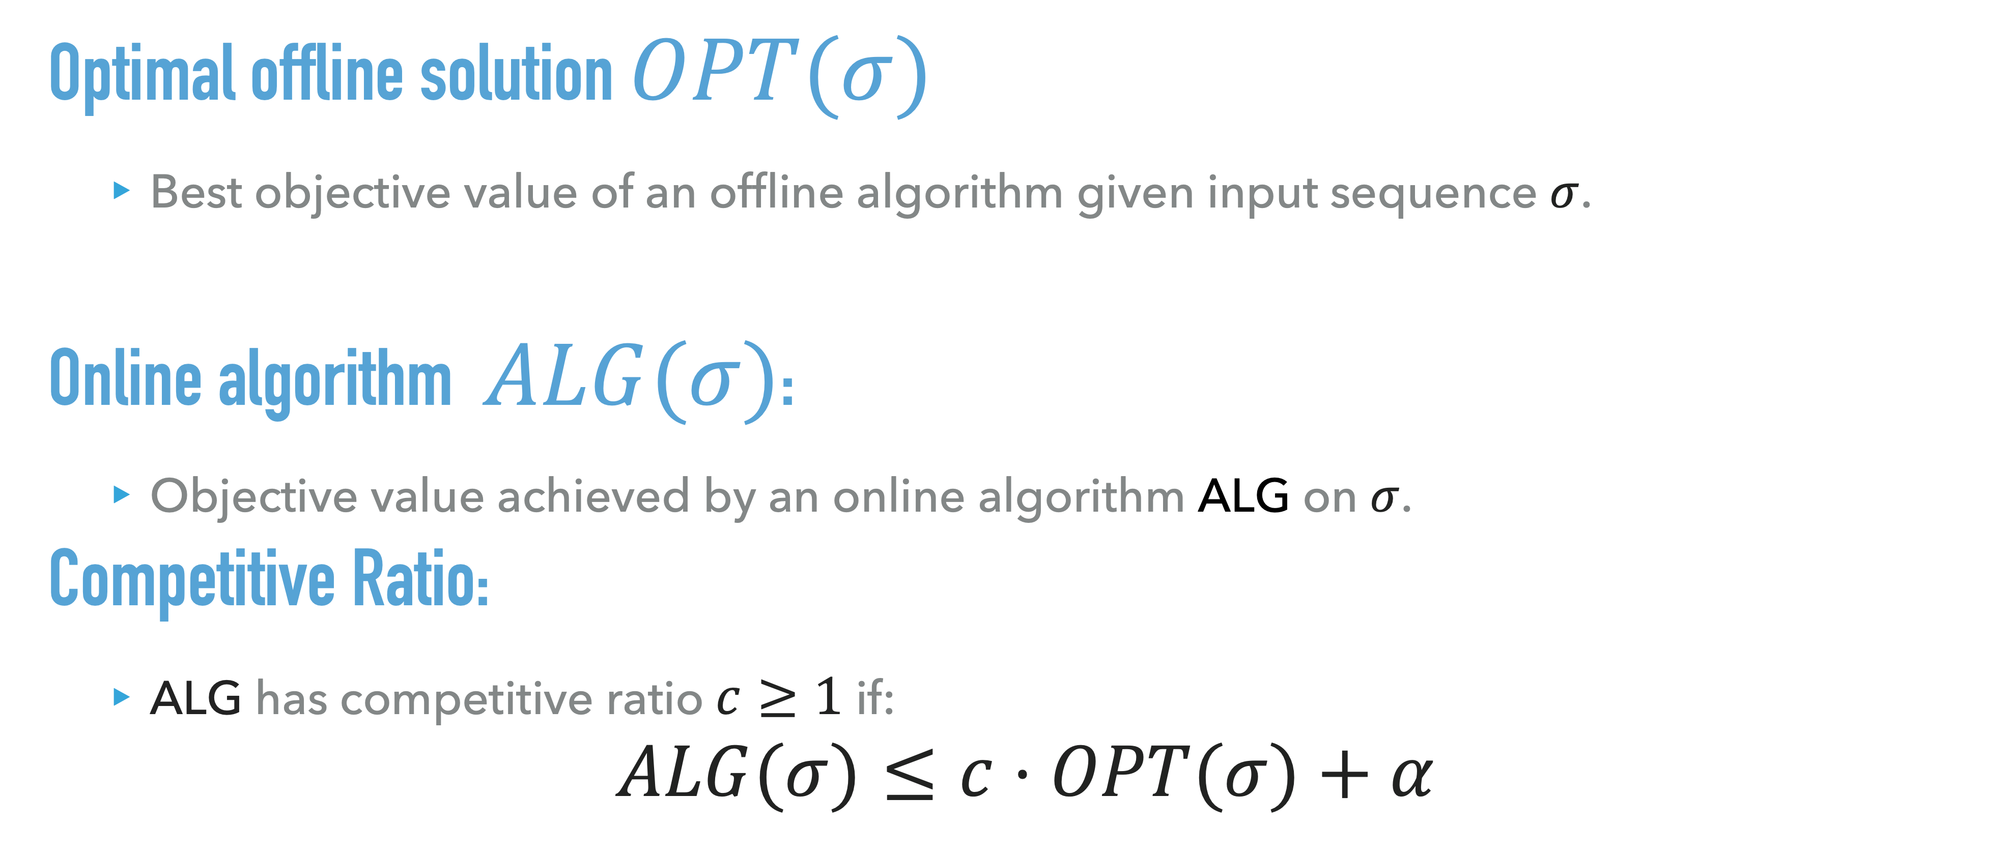
Competitive ratio
Optimal offline solution $OPT(σ)$
  Best objective value of an offline algorithm given input sequence $σ$.
Online algorithm $ALG(σ)$:
  Objective value achieved by an online algorithm ALG on $σ$.
Competitive Ratio:
  ALG has competitive ratio $c≥1$ if:
$$ALG(σ)≤c⋅OPT(σ)+α$$

Slide 4

Randomized Algorithms
Randomized Algorithm competitive Ratio:
  A randomized online algorithm ALG has competitive ratio $c≥1$ if:
$$𝔼\left[ALG(σ)\right]≤c⋅OPT(σ)+α$$

Slide 5
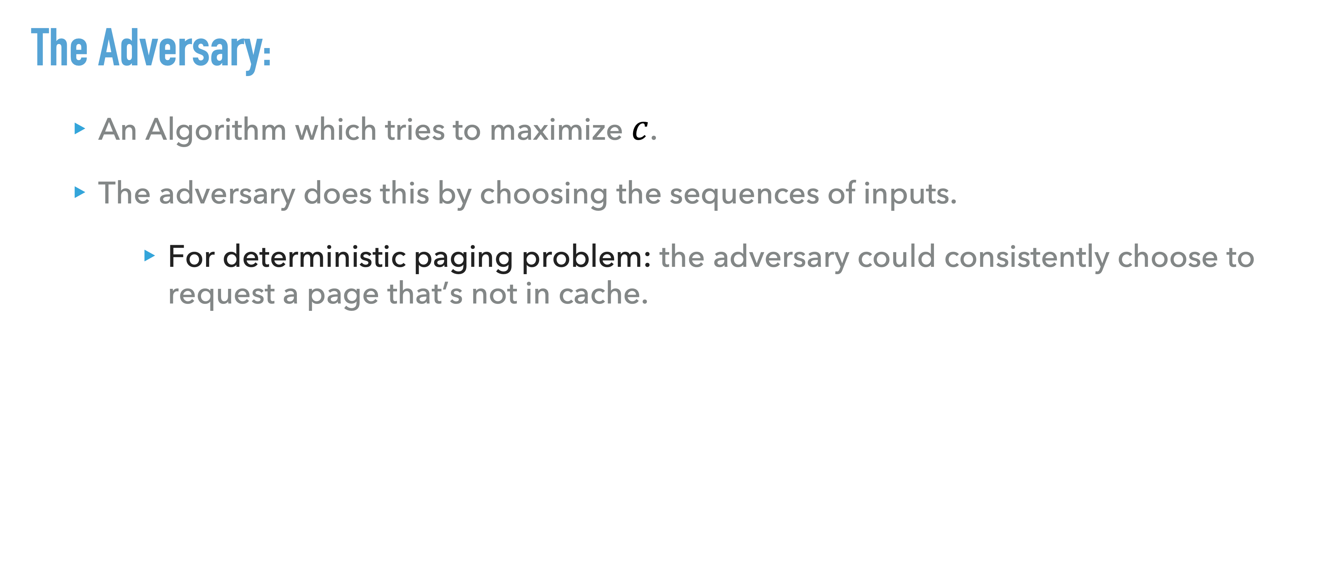
Adversaries
The Adversary:
  An Algorithm which tries to maximize $c$.
  The adversary does this by choosing the sequences of inputs.
      For deterministic paging problem: the adversary could consistently choose to request a page that’s not in cache.

Slide 6
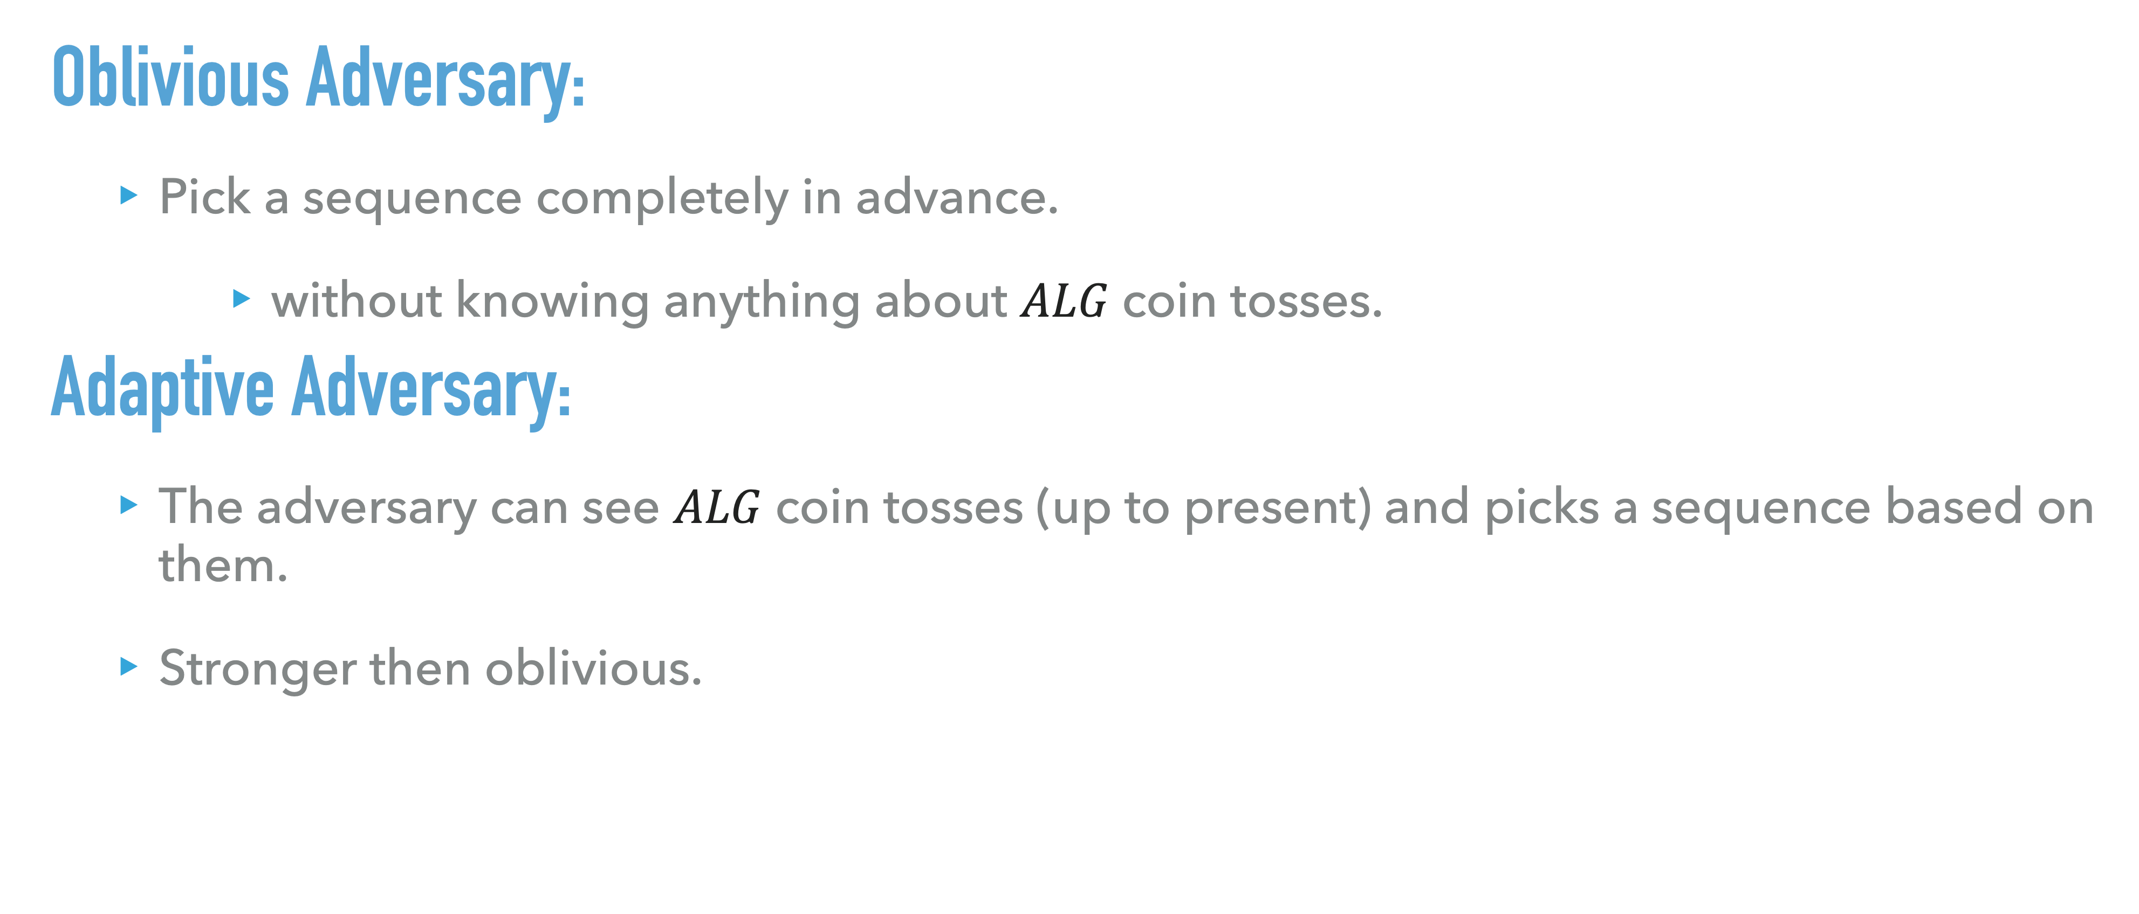
Adversaries
Oblivious Adversary:
  Pick a sequence completely in advance.
      without knowing anything about $ALG$coin tosses.
Adaptive Adversary:
  The adversary can see $ALG$coin tosses (up to present) and picks a sequence based on them.
  Stronger then oblivious.

Slide 7
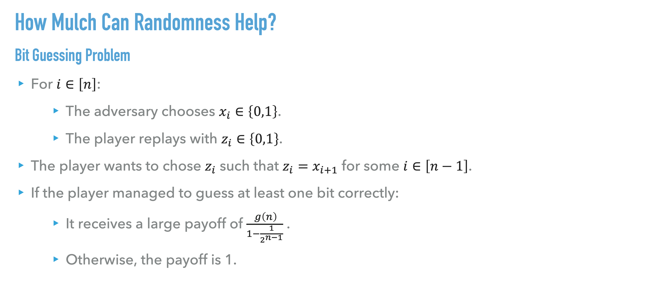
Bit Guessing Problem
How Mulch Can Randomness Help?
Bit Guessing Problem
For $i∈\left[n\right]$:
    The adversary chooses $x_{i}∈\left\{0,1\right\}$.
    The player replays with $z_{i}∈\left\{0,1\right\}$.
The player wants to chose $z_{i}$ such that $z_{i}=x_{i+1}$ for some $i∈\left[n−1\right]$.
If the player managed to guess at least one bit correctly:
    It receives a large payoff of $\frac{ g\left(n\right)}{1−\frac{1}{2^{n−1}}}$ .
    Otherwise, the payoff is 1.

Slide 8
Bit Guessing Problem
Claim: Every deterministic algorithm ALG achieves objective value 1.
Consider a Deterministic algorithm ALG , The adversary strategy is as follows:

Slide 9

Bit Guessing Problem
Claim: Every deterministic algorithm ALG achieves objective value 1.
Consider a Deterministic algorithm ALG , The adversary strategy is as follows:
    Choose $x_{1}=0$.

Slide 10

Bit Guessing Problem
Claim: Every deterministic algorithm ALG achieves objective value 1.
Consider a Deterministic algorithm ALG , The adversary strategy is as follows:
    Choose $x_{1}=0$.
    ALG plays $z_{1}$.

Slide 11

Bit Guessing Problem
Claim: Every deterministic algorithm ALG achieves objective value 1.
Consider a Deterministic algorithm ALG , The adversary strategy is as follows:
    Choose $x_{1}=0$.
    ALG plays $z_{1}$.
    Choose $x_{2}=\overline{z_{1}}.$

Slide 12

Bit Guessing Problem
Claim: Every deterministic algorithm ALG achieves objective value 1.
Consider a Deterministic algorithm ALG , The adversary strategy is as follows:
    Choose $x_{1}=0$.
    ALG plays $z_{1}$.
    Choose $x_{2}=\overline{z_{1}}.$
    ALG plays $z_{2}$.

Slide 13

Bit Guessing Problem
Claim: Every deterministic algorithm ALG achieves objective value 1.
Consider a Deterministic algorithm ALG , The adversary strategy is as follows:
    Choose $x_{1}=0$.
    ALG plays $z_{1}$.
    Choose $x_{2}=\overline{z_{1}}.$
    ALG plays $z_{2}$.
    Choose $x_{3}=\overline{z_{2}}$

Slide 14
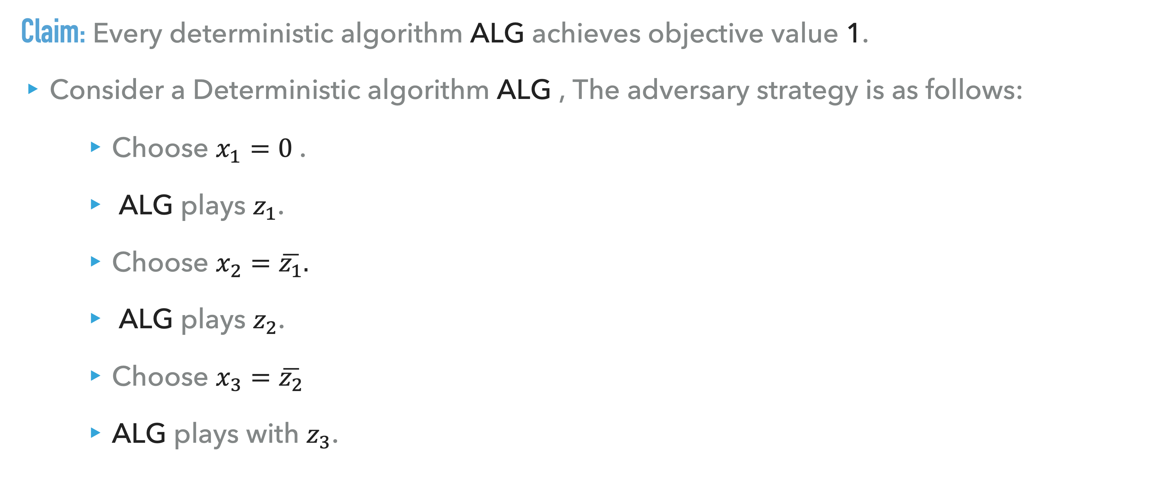
Bit Guessing Problem
Claim: Every deterministic algorithm ALG achieves objective value 1.
Consider a Deterministic algorithm ALG , The adversary strategy is as follows:
    Choose $x_{1}=0$.
    ALG plays $z_{1}$.
    Choose $x_{2}=\overline{z_{1}}.$
    ALG plays $z_{2}$.
    Choose $x_{3}=\overline{z_{2}}$
    ALG plays with $z_{3}$.

Slide 15
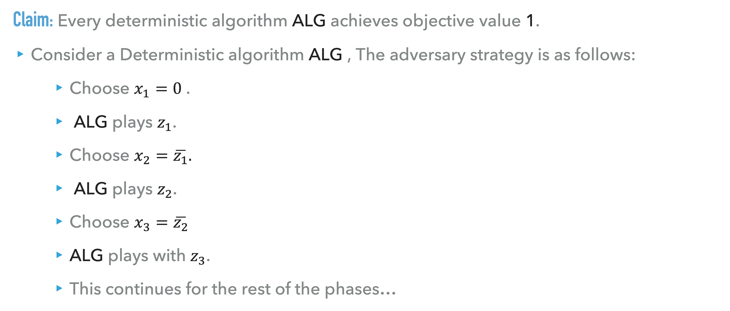
Bit Guessing Problem
Claim: Every deterministic algorithm ALG achieves objective value 1.
Consider a Deterministic algorithm ALG , The adversary strategy is as follows:
    Choose $x_{1}=0$.
    ALG plays $z_{1}$.
    Choose $x_{2}=\overline{z_{1}}.$
    ALG plays $z_{2}$.
    Choose $x_{3}=\overline{z_{2}}$
    ALG plays with $z_{3}$.
    This continues for the rest of the phases…

Slide 16
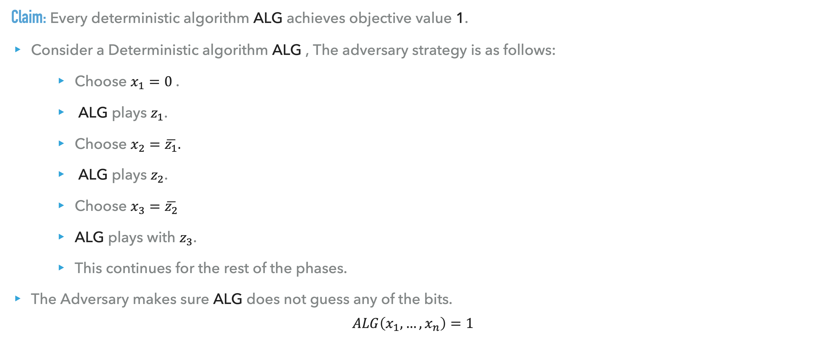
Bit Guessing Problem
Claim: Every deterministic algorithm ALG achieves objective value 1.
Consider a Deterministic algorithm ALG , The adversary strategy is as follows:
    Choose $x_{1}=0$.
    ALG plays $z_{1}$.
    Choose $x_{2}=\overline{z_{1}}.$
    ALG plays $z_{2}$.
    Choose $x_{3}=\overline{z_{2}}$
    ALG plays with $z_{3}$.
    This continues for the rest of the phases.
The Adversary makes sure ALG does not guess any of the bits.
$$ALG\left(x_{1},…,x_{n}\right)=1$$

Slide 17

Bit Guessing Problem
Claim: There is a randomized algorithm that achieves expected objective value $g\left(n\right)$ against an oblivious adversary on inputs of length $n$.
Consider a randomized algorithm that selects $z_{i}$ uniformly at random.

Slide 18

Bit Guessing Problem
Claim: There is a randomized algorithm that achieves expected objective value $g\left(n\right)$ against an oblivious adversary on inputs of length $n$.
Consider a randomized algorithm that selects $z_{i}$ uniformly at random.
The probability it picks $z_{1},…,z_{n}$different from $x_{1},…,x_{n}$ in all coordinates is $\frac{1}{2^{n−1}}\text{.}$

Slide 19
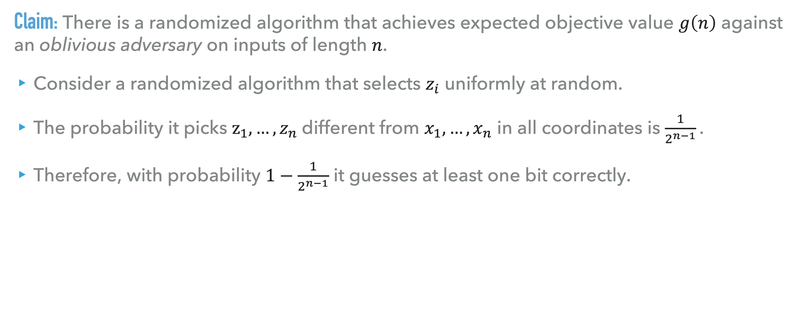
Bit Guessing Problem
Claim: There is a randomized algorithm that achieves expected objective value $g\left(n\right)$ against an oblivious adversary on inputs of length $n$.
Consider a randomized algorithm that selects $z_{i}$ uniformly at random.
The probability it picks $z_{1},…,z_{n}$different from $x_{1},…,x_{n}$ in all coordinates is $\frac{1}{2^{n−1}}\text{.}$
Therefore, with probability $1−\frac{1}{2^{n−1}}$ it guesses at least one bit correctly.

Slide 20
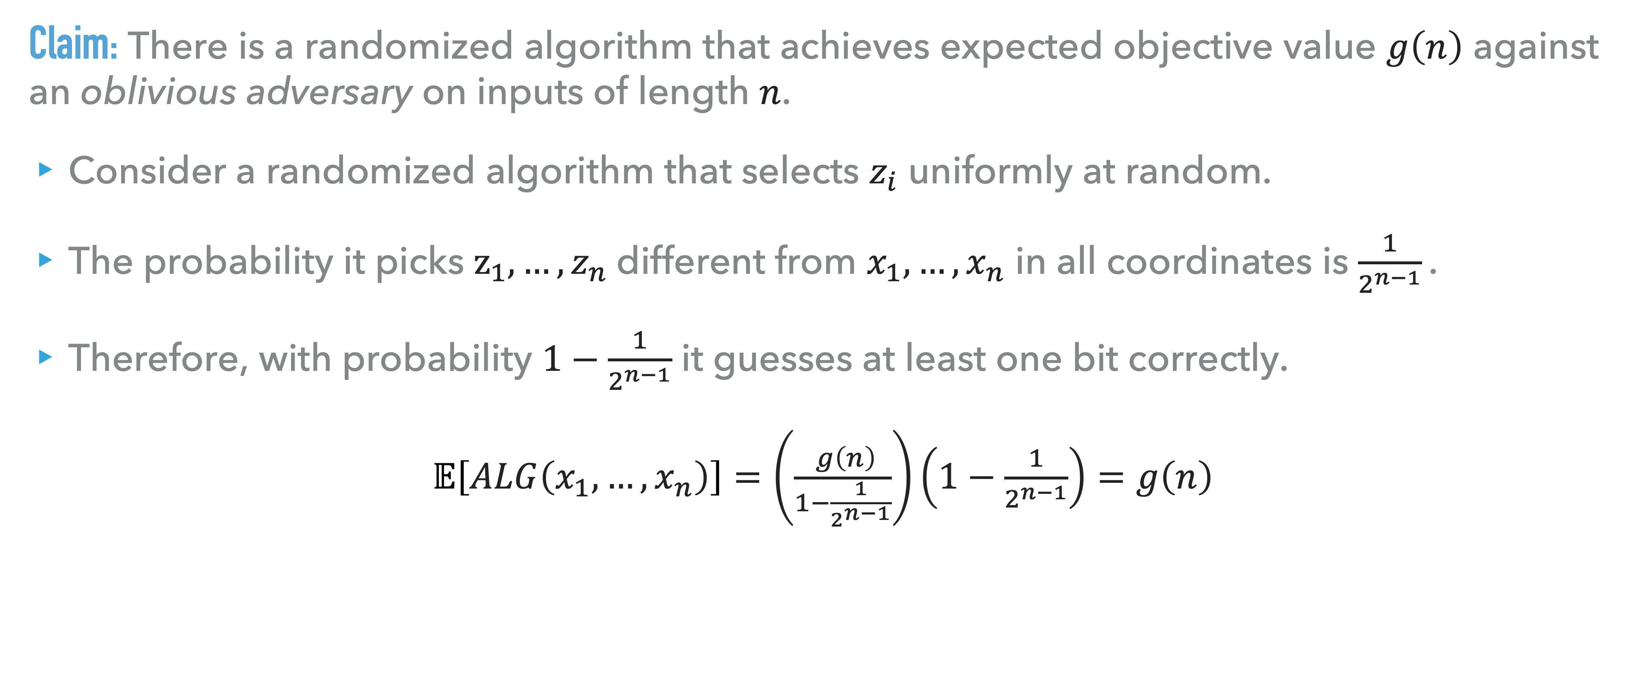
Bit Guessing Problem
Claim: There is a randomized algorithm that achieves expected objective value $g\left(n\right)$ against an oblivious adversary on inputs of length $n$.
Consider a randomized algorithm that selects $z_{i}$ uniformly at random.
The probability it picks $z_{1},…,z_{n}$different from $x_{1},…,x_{n}$ in all coordinates is $\frac{1}{2^{n−1}}\text{.}$
Therefore, with probability $1−\frac{1}{2^{n−1}}$ it guesses at least one bit correctly.
$𝔼\left[ALG\left(x_{1},…,x_{n}\right)\right]=\left(\frac{ g\left(n\right)}{1−\frac{1}{2^{n−1}}}\right)\left(1−\frac{1}{2^{n−1}}\right)=g\left(n\right)$

Slide 21
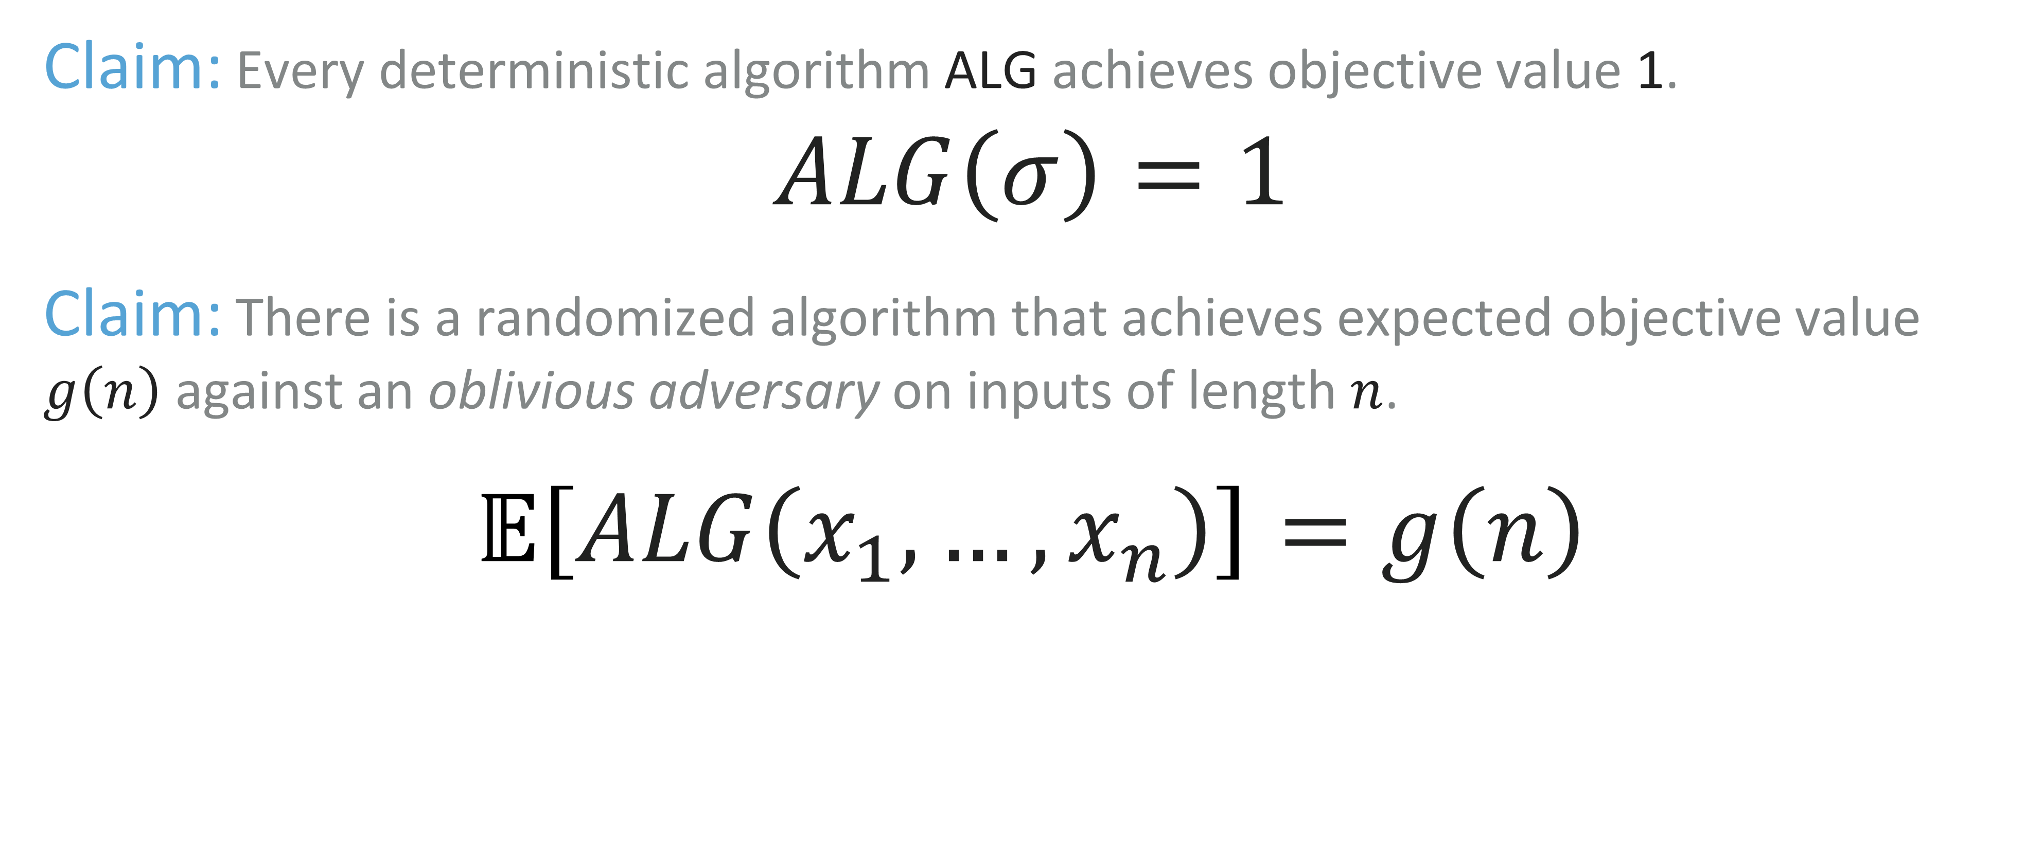
Bit Guessing Problem
Claim: Every deterministic algorithm ALG achieves objective value 1.
$$ALG\left(σ\right)=1$$
Claim: There is a randomized algorithm that achieves expected objective value $g\left(n\right)$ against an oblivious adversary on inputs of length $n$.
$𝔼\left[ALG\left(x_{1},…,x_{n}\right)\right]=g\left(n\right)$

Slide 22
Paging

Slide 23
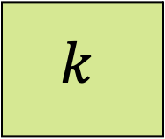
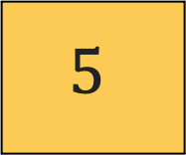
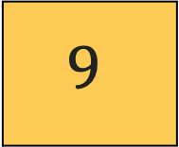
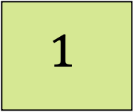
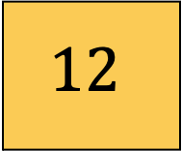
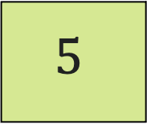
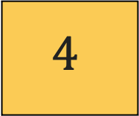
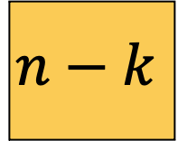
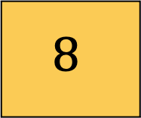
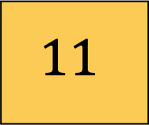
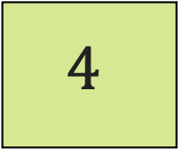
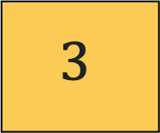
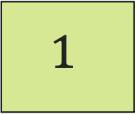
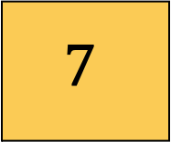

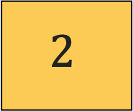
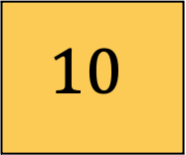
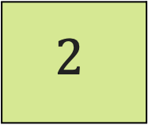
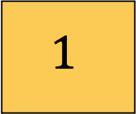
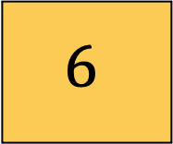

Paging Algorithm
$$1$$
$$2$$
$$1$$
$$4$$
$$5$$
$$…$$
$$k$$
Cache
$$1$$
$$2$$
$$3$$
$$4$$
$$5$$
$$6$$
$$7$$
$$8$$
$$9$$
$$10$$
$$11$$
$$12$$
$$…$$
$$n−k$$
Memory

Slide 24
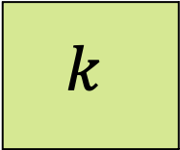
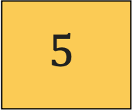
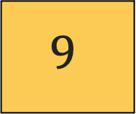
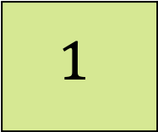
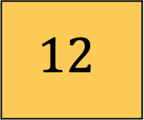
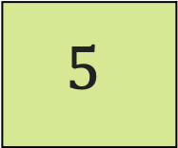
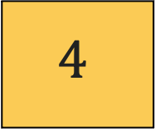
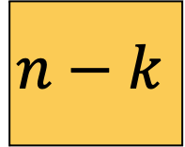
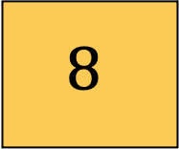
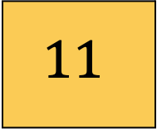
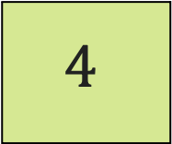
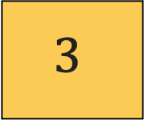
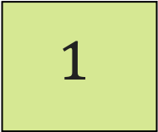






If a memory page has to be accessed:
Paging Algorithm
$$1$$
$$2$$
$$1$$
$$4$$
$$5$$
$$k$$
Cache
$$1$$
$$2$$
$$3$$
$$4$$
$$5$$
$$6$$
$$7$$
$$8$$
$$9$$
$$10$$
$$11$$
$$12$$
$$n−k$$
Memory
  Page in cache (hit):
      take page from there

Slide 25
If a memory page has to be accessed:
Paging Algorithm
$$1$$
$$2$$
$$1$$
$$4$$
$$5$$
$$k$$
Cache
$$1$$
$$2$$
$$3$$
$$4$$
$$5$$
$$6$$
$$7$$
$$8$$
$$9$$
$$10$$
$$11$$
$$12$$
$$n−k$$
Memory
  Page in cache (hit):
      take page from there
  Page not in cache (miss):
      leads to a page fault

Slide 26
If a memory page has to be accessed:
Paging Algorithm
$$1$$
$$2$$
$$1$$
$$4$$
$$5$$
$$k$$
Cache
$$1$$
$$2$$
$$3$$
$$4$$
$$5$$
$$6$$
$$7$$
$$8$$
$$9$$
$$10$$
$$11$$
$$12$$
$$n−k$$
Memory
  Page in cache (hit):
      take page from there
  Page not in cache (miss):
      leads to a page fault
  Page fault:
      Evict some page from memory and load into cache.

Slide 27

















Paging Algorithm
$$1$$
$$2$$
$$1$$
$$4$$
$$5$$
$$k$$
Cache
$$1$$
$$2$$
$$3$$
$$4$$
$$5$$
$$6$$
$$7$$
$$8$$
$$9$$
$$10$$
$$11$$
$$12$$
$$n−k$$
Memory
Paging Algorithm:
  decides which page to eject from cache.
  The cost to be minimized is the number of page faults.

Slide 28

Random Marking
Random Marking Algorithm
  $2H_{k}$-Competitive randomized algorithm for the paging problem agains an oblivious adversary.
      $H_{i}=1+\frac{1}{2}+\frac{1}{3}+…+\frac{1}{i}$

Slide 29

Random Marking
Random Marking Algorithm
  $2H_{k}$-Competitive randomized algorithm for the paging problem agains an oblivious adversary.
      $H_{i}=1+\frac{1}{2}+\frac{1}{3}+…+\frac{1}{i}$
  The algorithm works in phases.

Slide 30

Random Marking
Random Marking Algorithm
  $2H_{k}$-Competitive randomized algorithm for the paging problem agains an oblivious adversary.
      $H_{i}=1+\frac{1}{2}+\frac{1}{3}+…+\frac{1}{i}$
  The algorithm works in phases.
  Every entry in the cache has a mark bit.

Slide 31

Random Marking
Random Marking Algorithm
  Initially, all entries are unmarked.
  If a page in cache is accessed, it gets marked.
  If all $k$ pages in cache are marked, unmark all pages and start a new phase.

Slide 32

Random Marking
Random Marking Algorithm
  Initially, all entries are unmarked.
  If a page in cache is accessed, it gets marked.
  If all $k$ pages in cache are marked, unmark all pages and start a new phase.
  When a miss occurs:

Slide 33

Random Marking
Random Marking Algorithm
  Initially, all entries are unmarked.
  If a page in cache is accessed, it gets marked.
  If all $k$ pages in cache are marked, unmark all pages and start a new phase.
  When a miss occurs:
    Evict a uniformly chosen unmarked page.
    Fetch the new page into cache, then mark it.

Slide 34
Random Marking
Example:

Slide 35





Random Marking
Example:
Fast memory $\left(k=4\right)$:
$$A1$$
$$A2$$
$$A3$$
$$A4$$

Slide 36

Random Marking
Example:
Access $B1$
Fast memory $\left(k=4\right)$:
$$A1$$
$$A2$$
$$A3$$
$$A4$$

Slide 37
Random Marking
Example:
Access $B1$
Miss
Fast memory $\left(k=4\right)$:
$$A1$$
$$A2$$
$$A3$$
$$A4$$

Slide 38
Random Marking
Example:
Access $B1$
Miss
Fast memory $\left(k=4\right)$:
$$A1$$
$$A3$$
$$A4$$

Slide 39

Random Marking
Example:
Access $B1$
Fast memory $\left(k=4\right)$:
$$A1$$
$$B1$$
$$A3$$
$$A4$$

Slide 40

Random Marking
Example:
Access $B3$
Fast memory $\left(k=4\right)$:
$$A1$$
$$B1$$
$$A3$$
$$A4$$

Slide 41
Random Marking
Example:
Access $B3$
Miss
Fast memory $\left(k=4\right)$:
$$A1$$
$$B1$$
$$A3$$
$$A4$$

Slide 42
Random Marking
Example:
Access $B3$
Miss
Fast memory $\left(k=4\right)$:
$$A1$$
$$B1$$
$$A3$$

Slide 43

Random Marking
Example:
Access $B3$
Fast memory $\left(k=4\right)$:
$$A1$$
$$B1$$
$$A3$$
$$B3$$

Slide 44

Random Marking
Example:
Access $B1$
Fast memory $\left(k=4\right)$:
$$A1$$
$$B1$$
$$A3$$
$$B3$$

Slide 45
Random Marking
Example:
Access $B1$
Hit
Fast memory $\left(k=4\right)$:
$$A1$$
$$B1$$
$$A3$$
$$B3$$

Slide 46

Random Marking
Example:
Access $A4$
Fast memory $\left(k=4\right)$:
$$A1$$
$$B1$$
$$A3$$
$$B3$$

Slide 47
Random Marking
Example:
Access $A4$
Miss
Fast memory $\left(k=4\right)$:
$$A1$$
$$B1$$
$$A3$$
$$B3$$

Slide 48
Random Marking
Example:
Access $A4$
Miss
Fast memory $\left(k=4\right)$:
$$A1$$
$$B1$$
$$B3$$

Slide 49

Random Marking
Example:
Access $A4$
Fast memory $\left(k=4\right)$:
$$A1$$
$$B1$$
$$A4$$
$$B3$$

Slide 50

Random Marking
Example:
Access $A2$
Fast memory $\left(k=4\right)$:
$$A1$$
$$B1$$
$$A4$$
$$B3$$

Slide 51
Random Marking
Example:
Access $A2$
Miss
Fast memory $\left(k=4\right)$:
$$A1$$
$$B1$$
$$A4$$
$$B3$$

Slide 52
Random Marking
Example:
Access $A2$
Miss
Fast memory $\left(k=4\right)$:
$$B1$$
$$A4$$
$$B3$$

Slide 53

Random Marking
Example:
Access $A2$
Fast memory $\left(k=4\right)$:
$$A2$$
$$B1$$
$$A4$$
$$B3$$

Slide 54
Random Marking
Example:
Phase Ended
Fast memory $\left(k=4\right)$:
$$A2$$
$$B1$$
$$A4$$
$$B3$$

Slide 55




Random Marking
Example:
Fast memory $\left(k=4\right)$:
$$A2$$
$$B1$$
$$A4$$
$$B3$$

Slide 56
Random Marking
Random Marking Algorithm
  $2H_{k}$-Competitive randomized algorithm for the paging problem agains an oblivious adversary.
      $H_{i}=1+\frac{1}{2}+\frac{1}{3}+…+\frac{1}{i}$

Slide 57


Notation
  At phase $P_{i}$ we label a page:
      OLD if it was in the cache at the beginning of the phase.
      NEW if it was requested during phase $P_{i}$ phase but wasn’t old.

Slide 58


Notation
  Let $m$ be the number of phases $P_{1},P_{2},…,P_{m}$ .
  Let $n_{i}$ be the number of new pages in $P_{i}$ .

Slide 59

Competitive raito
  Claim 1:$OPT\left(σ\right)≥\frac{1}{2}\left(\sum_{i=1}^{m}{n_{i}}\right)$
  Proof:
    Let $q_{i}$ be the number of page faults to OPT during $P_{i}$ .
    Phase $P_{1}$:
        $q_{1}$ pages must be replaced: $q_{1}≥n_{1}$.
    Phase $P_{i>1}$:
        At phases $P_{i}$ and $P_{i−1}$ we have requested $k+n_{i}$ pages.
        OPT pays at least $n_{i}$ for these phases: $q_{i−1}+q_{i}≥n_{i}$ .

Slide 60

Competitive raito
  Claim 1: $OPT\left(σ\right)≥\frac{1}{2}\left(\sum_{i=1}^{m}{n_{i}}\right)$
  Proof:
    $q_{1}≥n_{1}$.
    $q_{i−1}+q_{i}≥n_{i}$ .
    $$OPT\left(σ\right)≥\frac{1}{2}q_{1 }+\frac{1}{2}\sum_{i=2}^{m}{\left(q_{i−1}+q_{i}\right)}≥\left(\underset{\begin{aligned} \\ ≥n_{1}\end{aligned}}{\underbrace{q_{1}}}+\frac{1}{2}\underset{\begin{aligned} \\ ≥n_{i}\end{aligned}}{\underbrace{\sum_{i=2}^{m}{\left(q_{i−1}+q_{i}\right)}}}\right)≥\frac{1}{2}\left(\sum_{i=1}^{m}{n_{i}}\right)$$

Slide 61

Competitive raito
  Claim 2: $𝔼\left[RMARK\left(σ\right)\right]≤H_{k}\overset{m}{\underset{i=1}{∑}}n_{i}$
  Proof:
    All NEW pages leads to a page fault.
    An OLD page leads to a page fault if it was evicted in one of the previous faults.

Slide 62


Competitive raito
  Claim 2: $𝔼\left[RMARK\left(σ\right)\right]≤H_{k}\overset{m}{\underset{i=1}{∑}}n_{i}$
  Proof:
    All NEW pages leads to a page fault.
    An OLD page leads to a page fault if it was evicted in one of the previous faults.
    Let $B_{1},B_{2},…{,B}_{k−n_{i}}$ be the OLD pages requested in $P_{i}$ .

Slide 63
Random Marking
Example:
Fast memory $\left(k=4\right)$:
$$A1$$
$$A2$$
$$A3$$
$$A4$$

Slide 64

Random Marking
Example:
Access $A1$
Fast memory $\left(k=4\right)$:
$$A1$$
$$A2$$
$$A3$$
$$A4$$

Slide 65
Random Marking
Example:
Access $A1$
OLD
Hit
Fast memory $\left(k=4\right)$:
$$A1$$
$$A2$$
$$A3$$
$$A4$$

Slide 66

Random Marking
Example:
Access $A1$
OLD
Hit
Fast memory $\left(k=4\right)$:
$$A1$$
$$A2$$
$$A3$$
$$A4$$

Slide 67

Random Marking
Example:
Access $A5$
Fast memory $\left(k=4\right)$:
$$A1$$
$$A2$$
$$A3$$
$$A4$$

Slide 68

Random Marking
Example:
Access $A5$
NEW
Miss
Fast memory $\left(k=4\right)$:
$$A1$$
$$A2$$
$$A3$$
$$A4$$

Slide 69
Random Marking
Example:
Access $A5$
NEW
Miss
Fast memory $\left(k=4\right)$:
$$A1$$
$$A2$$
$$A4$$

Slide 70

Random Marking
Example:
Access $A5$
NEW
Miss
Fast memory $\left(k=4\right)$:
$$A1$$
$$A2$$
$$A5$$
$$A4$$

Slide 71

Random Marking
Example:
Access $A3$
Fast memory $\left(k=4\right)$:
$$A1$$
$$A2$$
$$A5$$
$$A4$$

Slide 72
Random Marking
Example:
Access $A3$
OLD
Miss
Fast memory $\left(k=4\right)$:
$$A1$$
$$A2$$
$$A5$$
$$A4$$

Slide 73
Random Marking
Example:
Access $A3$
OLD
Miss
Fast memory $\left(k=4\right)$:
$$A1$$
$$A5$$
$$A4$$

Slide 74

Random Marking
Example:
Access $A3$
OLD
Miss
Fast memory $\left(k=4\right)$:
$$A1$$
$$A3$$
$$A5$$
$$A4$$

Slide 75

Competitive raito
  Consider a request for $B_{j}$(OLD pages requested in $P_{i}$ ).
    Let $\tilde{n_{j}}$ be the number of NEW pages requested prior to the first request for $B_{j}$ .
    $B_{1},B_{2},…,B_{j−1}$already marked.
    There are $k−\tilde{n_{j}}−\left(j−1\right)$ pages which are OLD and unmarked.

Slide 76

Competitive raito
    $\tilde{n_{j}}$ - the number of NEW pages requested prior to the first request for $B_{j}$ .
    The probability that $B_{j}$ is in the cache is $\frac{ k−\tilde{n_{j}}−\left(j−1\right) }{k−\left(j−1\right)}.$
    The probability of a page fault is $1−\frac{ k−\tilde{n_{j}}−\left(j−1\right) }{k−\left(j−1\right)}=\frac{ \tilde{n_{j}} }{k−\left(j−1\right)}≤\frac{ n_{i}}{k−\left(j−1\right)}$
    Worst Case: the Adversary request first the NEW pages $\tilde{n_{j}}≤n_{i}$.

Slide 77

Competitive raito
At Phase $P_{i}$:
    The probability of a page fault $≤\frac{ n_{i}}{k−\left(j−1\right)}$ .
    The expected number of page faults for $RMARK$ in that phase:
    $$𝔼\left[RMARK\left(P_{i}\right)\right]≤n_{i}+\sum_{j=1}^{k−n_{i}}{\frac{ n_{i}}{k−\left(j−1\right)}}=n_{i}\left(1+\frac{1}{k}+\frac{1}{k−1}+…+\frac{1}{k−\left(k−n_{i}−1\right)}\right)=n_{i}\left(1+\sum_{l=1}^{k}{\frac{ 1}{l}}−\sum_{t=1}^{n_{i}}{\frac{ 1}{t}}\right)=n_{i}\left(1+H_{k}−\underset{≤1}{\underbrace{H_{n_{i}}}} \right)≤n_{i}H_{k}$$
Overall: $𝔼\left[RMARK\left(σ\right)\right]≤H_{k}\overset{m}{\underset{i=1}{∑}}n_{i}$.

Slide 78

Competitive raito
  Claim 1: $OPT\left(σ\right)≥\frac{1}{2}\overset{m}{\underset{i=1}{∑}}n_{i}$.
  Claim 2: $𝔼\left[RMARK\left(σ\right)\right]≤H_{k}\overset{m}{\underset{i=1}{∑}}n_{i}$.
                $$𝔼\left[RMARK\left(σ\right)\right]≤2H_{k}OPT\left(σ\right)$$
  Therefore is $2H_{k}$-competitive.

Slide 79

Randomized Lower Bound
Randomized Lower Bound:
  The competitive ratio of any randomized algorithm for the paging problem against an oblivious adversary is at least $H_{k}$.

Slide 80
Randomized Lower Bound
Yao’s Principle:
  If for some input distribution no deterministic algorithm is c-competitive, then no randomized c-competitive algorithm exists.
Proving a lower bound using Yao’s principle:
  Design a random input distribution.
  Show that every deterministic algorithm has a bad expected competitive ratio if the input is chosen at random according to this distribution.
  Yao’s principle then implies that every randomized algorithm is at least equally bad for a fixed worst-case input.

Slide 81

Randomized Lower Bound
Setting:
  $n=k+1$.
      There are $k+1$ distinct pages.
Distribution of the sequences:
  Uniform distribution , each page has probability of $\frac{1}{k+1}$ of being chosen.

Slide 82

Randomized Lower Bound
Deterministic Online Algorithm:
  Assume that page $P$ is being accesed:
$$\underset{σ}{Pr}\left[page fault\right]=\underset{σ}{Pr}\left[request for page P\right]=\frac{1 }{k+1}$$
  Expected number of faults after $n$ request is $\frac{n}{k+1}$.

Slide 83

Randomized Lower Bound
Optimal offline Algorithm (LFD):
  After each page fault:
      OPT loads the page that will not be used for the longest possible time.
      All $k+1$ pages are requested at least once before the next page fault.
  OPT fails once in each phase.

Slide 84

Randomized Lower Bound
Claim:
  The expected length of phase $i$, $T_{i}$ is: $𝔼\left[T_{i}\right]=\left(k+1\right)H_{k+1}−1$
Proof:
$$\operatorname{Pr}\left[request the j^{′}th page after requesting \left(j−1\right) different pages\right]=\frac{k+1−\left(j−1\right)}{k+1}$$

Slide 85

Randomized Lower Bound
$$\operatorname{Pr}\left[request the j^{′}th page after requesting \left(j−1\right) different pages\right]=\frac{k+1−\left(j−1\right)}{k+1}$$
  Let $T_{i}^{j}$be the time to request the $j$’th page after $\left(j −1\right)$ different pages requested.
    $T_{i}^{j}\sim Geo\left(\frac{k+1−\left(j−1\right)}{k+1}\right), 𝔼\left[T_{i}^{j}\right]=\frac{k+1}{k+1−\left(j−1\right)}$
    The expected length of phase $i$, $T_{i}=\sum_{j=1}^{k}{T_{i}^{j}}$
$$𝔼\left[T_{i}\right]=\sum_{j=1}^{k}{𝔼\left[T_{i}^{j}\right]}=\sum_{j=1}^{k}{\left(\frac{k+1}{k+1−\left(j−1\right)}\right)}=\left(k+1\right)\left(1+\frac{1}{2}+…+\frac{1}{k+1}\right)−1=\left(k+1\right)H_{k+1}−1$$

Slide 86

Randomized Lower Bound
  The expected length of phase $i$, $T_{i}$ is: $𝔼\left[T_{i}\right]=\left(k+1\right)H_{k+1}−1$
  By renewal theorem after $n$ request:
  $$𝔼\left[m\right]≤\frac{n}{\left(k+1\right)H_{k+1}−1 }$$
  OPT fails once in each phase:
        $\text{Expected} \text{number} \text{of} \text{faults} \text{after} n \text{request} \text{is} \frac{n}{\left(k+1\right)H_{k+1}−1}\text{.}$

Slide 87

Randomized Lower Bound
  Best deterministic algorithm:
      Expected number of faults after $n$ request is $\frac{n}{k+1}$.
  Best offline algorithm
        Expected number of faults after $n$ request $\frac{n}{\left(k+1\right)H_{k+1}−1}$.
  The competitive ratio: $\frac{\frac{n}{k+1}}{\frac{n}{\left(k+1\right)H_{k+1}−1}}=\frac{\left(k+1\right)H_{k+1}−1 }{k+1}=H_{k+1}−\frac{1}{k+1}=H_{k}$.

Slide 88
Random
Random Algorithm
  When encountering a Page Fault, evict a random page.

Slide 89

Random
Random Algorithm
  When encountering a Page Fault, evict a random page.
Analysis:
  Consider the following scenario:
      $n=k+1$.
      Currently memory holds: $1,2,…,k$.
      $σ=\underset{\begin{aligned} \\ A\end{aligned}}{\underbrace{{\left(k+1, 1, 2,,…,k−1\right)}^{l}}}\underset{\begin{aligned} \\ B\end{aligned}}{\underbrace{{\left(k,1, 2,…,k−1\right)}^{l}}}\underset{\begin{aligned} \\ A\end{aligned}}{\underbrace{{\left(k+1, 1, 2,,…,k−1\right)}^{l}}}\left(B\right)\left(A\right)\left(B\right)$… .
      $l≫k$

Slide 90

Random
  $σ=\underset{\begin{aligned} \\ A\end{aligned}}{\underbrace{{\left(k+1, 1, 2,,…,k−1\right)}^{l}}}\underset{\begin{aligned} \\ B\end{aligned}}{\underbrace{{\left(k,1, 2,…,k−1\right)}^{l}}}\underset{\begin{aligned} \\ A\end{aligned}}{\underbrace{{\left(k+1, 1, 2,,…,k−1\right)}^{l}}}\left(B\right)\left(A\right)\left(B\right)$… .
  $l≫k$
  OPT (LFD) will replace $\left(k+1\right)$with $k$ when moving from $A$ to $B$and pay only one Page Fault per $k⋅l$requests.
  Algorithm RANDOM will take $k$faults on average for each block ($A$ or $B$), until it brings the correct page.
  This yield a competitive-ratio of $k$.

Slide 91
References
  Fiat, Amos, et al. ”Competitive paging algorithms.” Journal of Algorithms 12.4 (1991): 685- 699.
  Borodin, A., & El-Yaniv, R. (2005). Online computation and competitive analysis. Cambridge university press.
  Borodin, A., & Pankratov, D. (2019). Online Algorithms.

