Slide 1
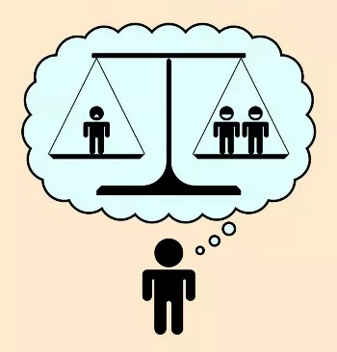
Cardinality and
Utilitarianism through
Social Interactions
Shiri Alon & Ehud Lehrer
-Part of a project investigating preferences in a social context-
(Subjective Utilitarianism, JET 2020)

Slide 2
A fundamental question in Social Choice Theory
A society is composed of individuals and a social planner
Individuals have different, possibly conflicting preferences
The social planner needs to aggregate the preferences of the individuals into a social preference
How should the social planner aggregate individual preferences into a social preference?
Notes:
A basic question in social choice
It is a normative question – you take individual preferences as given (elicited from choices) and ask how to construct a social preference based on them.

Slide 3
What do we know about the individual preferences?
In many problems the preferences of individuals are ordinal:
We only know whether one alternative is better than another, but not by how much it is better (e.g., preferences over bundles)
Difficult to perform interpersonal comparisons and weigh the advantages of one social alternative compared to another
Arrow (1950) – impossibility theorem
Notes:
The answer to the basic question differs depending on the type of individual preferences
If we can’t compare tradeoffs within the preferences of the same individual, then it is surely difficult to compare different individuals
In essence, difficult to balance wellbeing of individuals

Slide 4
What do we know about the individual preferences?
Sometimes preferences of individuals are cardinal:
We know whether one alternative is better than another, as well as by how much it is better
Easier to balance conflicting tastes of individuals
Harsanyi (1955) – possibility – if the preferences of the individuals and the social planner are cardinal, aggregation must be utilitarian
Notes:
When we can measure tradeoffs for individual preferences it’s easier to weigh the advantages and disadvantages of alternatives for individuals

Slide 5
So, what’s the problem?
We can just take cardinal preferences as primitives and we’ll have Utilitarian aggregation. Problem solved. Why not? For that we should understand -
How are cardinal preferences typically derived?
  Domain of alternatives composed of (at least) two distinct components
  (e.g., prizes and probabilities, prizes and states of nature, prizes and time)
  Appropriate assumptions depict these components as separable
  A cardinal preference is derived, tradeoffs between prizes are measured over the separate component

Slide 6
What can go wrong?
In many problems alternatives are not composed of conceptually distinct components (e.g., bundles, allocations)
Preferences may not satisfy separability assumptions over a distinct component
Even if individual preferences are cardinal, social preference may not be. Tradeoffs over probabilities, for example, may not be relevant for a social compromise

Slide 7
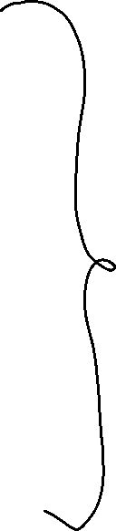
Our goal
General set of alternatives (no separable components)
Obtain a Utilitarian social preference –
without any element that is exogenous to the social problem
Extract cardinality of preferences over the general set

Slide 8
The key - cardinality through social interactions
For cardinality we need to measure tradeoffs between alternatives, hence we need some component to measure them against
We use a component intrinsic to the social decision - other individuals
The main idea: when reaching joint decisions with significant others, people compromise. That is, they make tradeoffs between their wellbeing and the wellbeing of others.

Slide 9
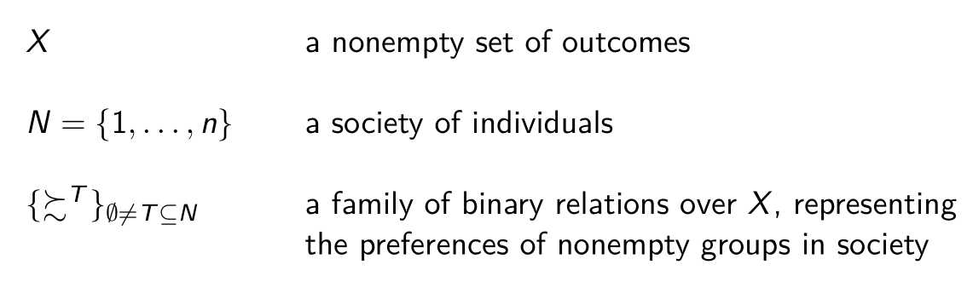
Setup
Interpretation:
Some of the groups are organic, in which individuals make joint decisions of their own accord (e.g., households). Some are non-organic.
For the former, the relation is their voluntary joint preferences, for the latter it is the social planner’s preference for the group.
Notes:
- Individual pref's in the classic model == Autonomous preferences, of single individuals and organic groups (social planner observes and elicits, passive)
- Social pref in the classic model == Pref's for non-organic groups formed by the social planner (social planner should construct, active)

Slide 10
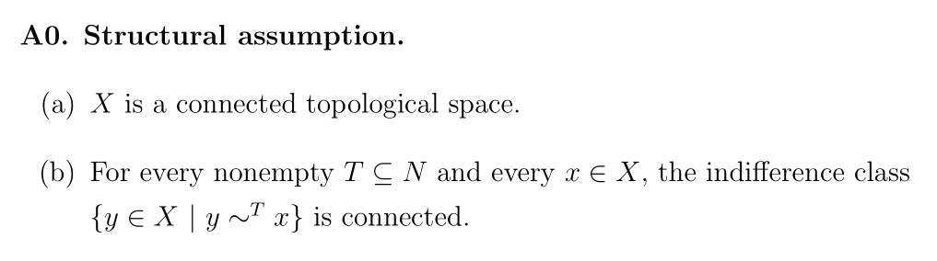
Setup
For example:
preferences over bundles, with connected indifference classes
preferences over allocations, with connected indifference classes
Can accommodate public goods, other-regarding preferences

Slide 11
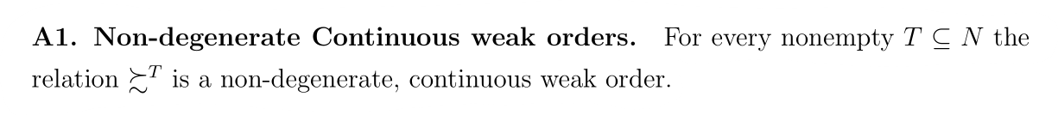
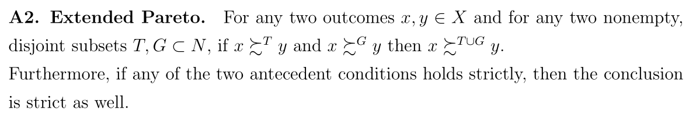


Basic assumptions

Slide 12
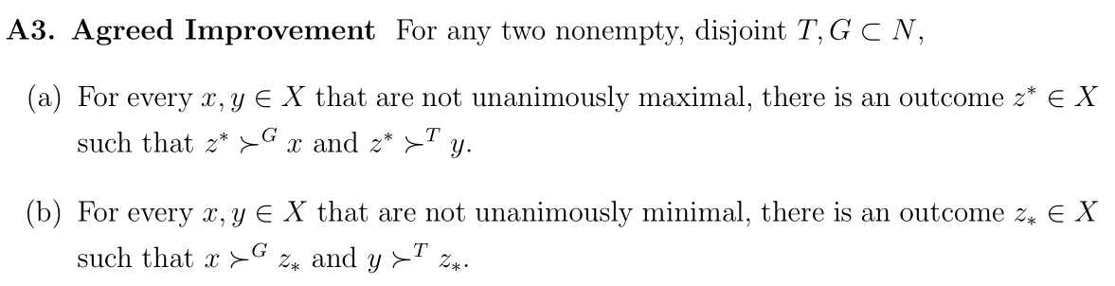
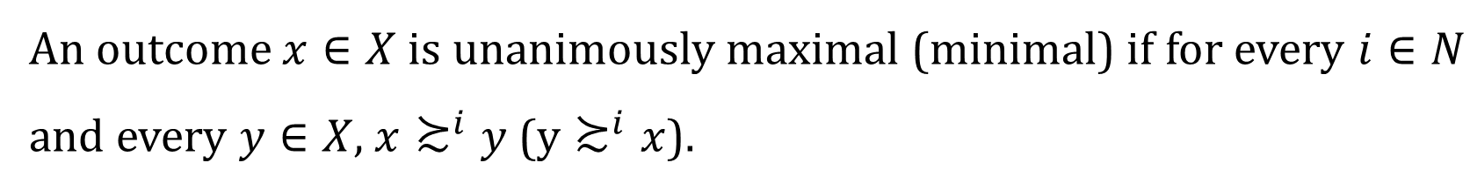

Monotonicity assumption
An outcome $x∈X$ is unanimously maximal (minimal) if for every $i∈N$ and every $y∈X$, $x≿^{i}y$ ($y≿^{i}x$).
-- A generalization of monotonicity

Slide 13
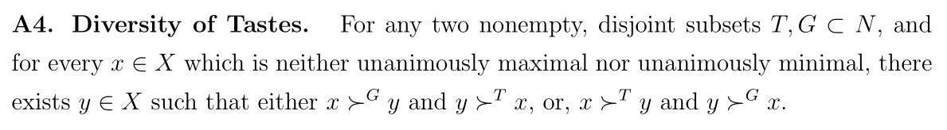
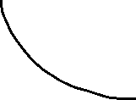


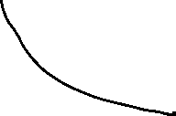
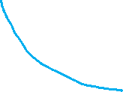

Richness assumption
For preferences over bundles, this condition will be satisfied as long as for every disjoint groups G,T, no two indifference curves, of G and of T, completely merge

Slide 14
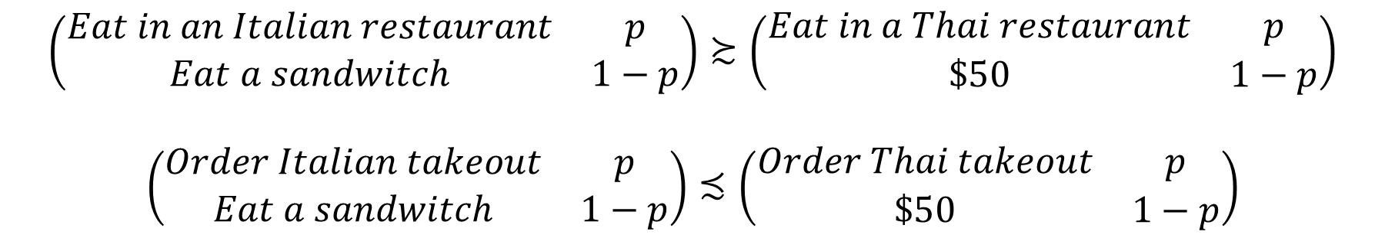
Measurement of tradeoffs – how it works with lotteries
$$\left(\begin{matrix}Eat in an Italian restaurant & p \\ Eat a sandwitch & 1−p\end{matrix}\right)≿\left(\begin{matrix}Eat in a Thai restaurant & p \\ \$50 & 1−p\end{matrix}\right)$$
$$\left(\begin{matrix}Order Italian takeout & p \\ Eat a sandwitch & 1−p\end{matrix}\right)≾\left(\begin{matrix}Order Thai takeout & p \\ \$50 & 1−p\end{matrix}\right)$$

Slide 15
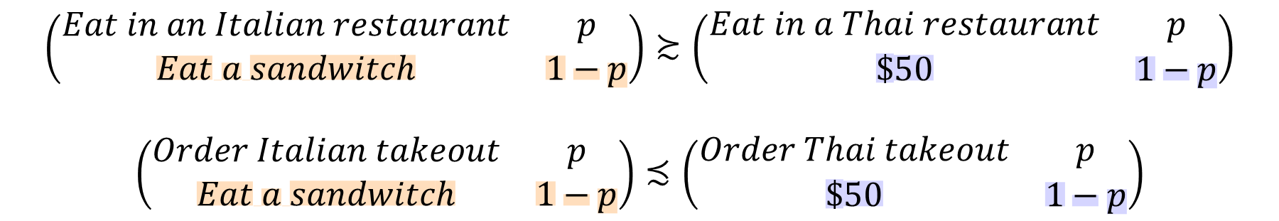
Measurement of tradeoffs – how it works with lotteries
$$\left(\begin{matrix}Eat in an Italian restaurant & p \\ Eat a sandwitch & 1−p\end{matrix}\right)≿\left(\begin{matrix}Eat in a Thai restaurant & p \\ \$50 & 1−p\end{matrix}\right)$$
$$\left(\begin{matrix}Order Italian takeout & p \\ Eat a sandwitch & 1−p\end{matrix}\right)≾\left(\begin{matrix}Order Thai takeout & p \\ \$50 & 1−p\end{matrix}\right)$$

Slide 16
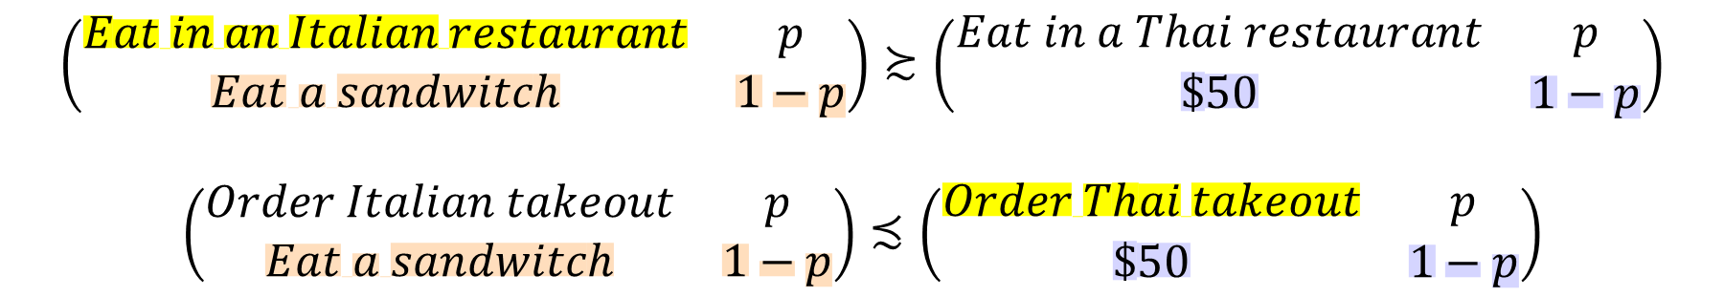
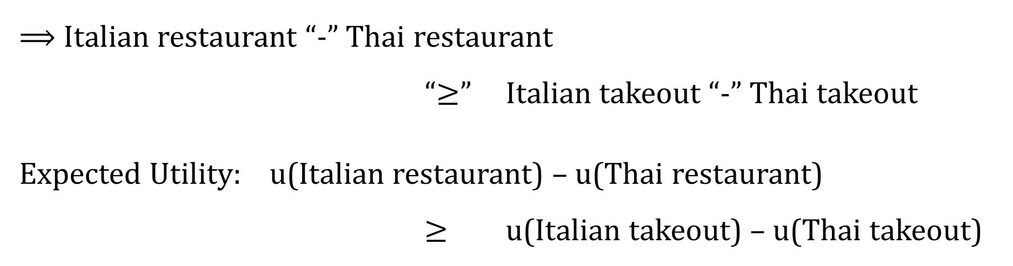
Measurement of tradeoffs – how it works with lotteries
$$\left(\begin{matrix}Eat in an Italian restaurant & p \\ Eat a sandwitch & 1−p\end{matrix}\right)≿\left(\begin{matrix}Eat in a Thai restaurant & p \\ \$50 & 1−p\end{matrix}\right)$$
$$\left(\begin{matrix}Order Italian takeout & p \\ Eat a sandwitch & 1−p\end{matrix}\right)≾\left(\begin{matrix}Order Thai takeout & p \\ \$50 & 1−p\end{matrix}\right)$$
$⟹$ Italian restaurant “-” Thai restaurant
“$≥$” Italian takeout “-” Thai takeout
Expected Utility: u(Italian restaurant) – u(Thai restaurant)
$≥$ u(Italian takeout) – u(Thai takeout)

Slide 17
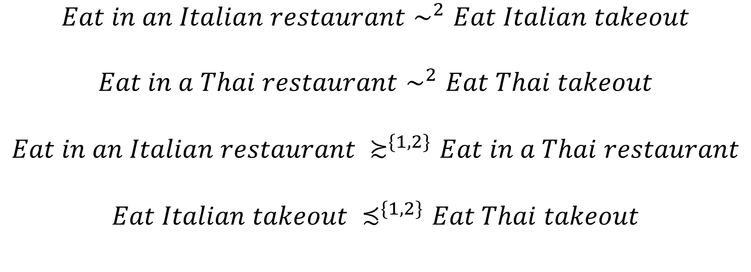
Measurement of tradeoffs – through social interaction
$$Eat in an Italian restaurant∼^{2}Eat Italian takeout$$
$$Eat in a Thai restaurant∼^{2}Eat Thai takeout$$
$$Eat in an Italian restaurant ≿^{\{1,2\}}Eat in a Thai restaurant$$
$$Eat Italian takeout ≾^{\{1,2\}}Eat Thai takeout$$
Notes:
Analogous to the measurement of tradeoffs over probabilities

Slide 18
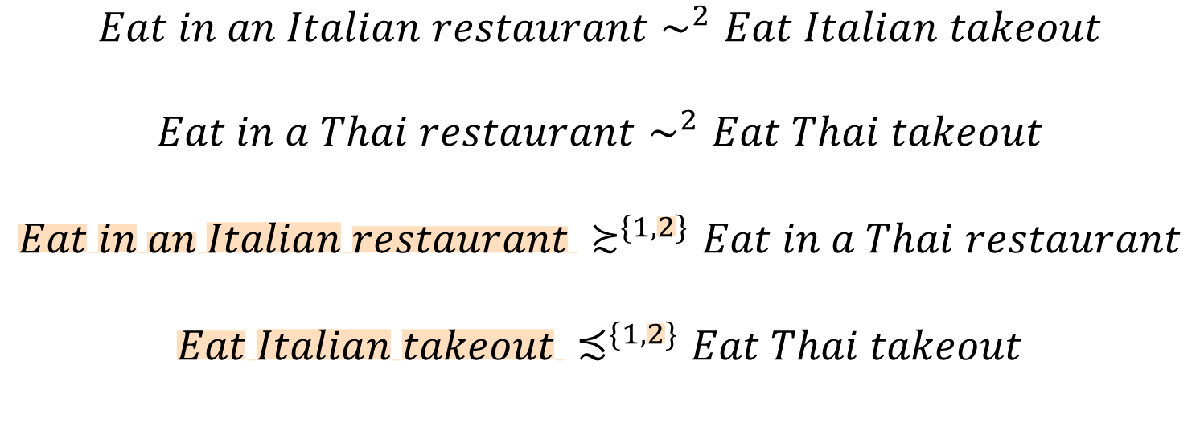
Measurement of tradeoffs – through social interaction
$$Eat in an Italian restaurant∼^{2}Eat Italian takeout$$
$$Eat in a Thai restaurant∼^{2}Eat Thai takeout$$
$$Eat in an Italian restaurant ≿^{\{1,2\}}Eat in a Thai restaurant$$
$$Eat Italian takeout ≾^{\{1,2\}}Eat Thai takeout$$

Slide 19
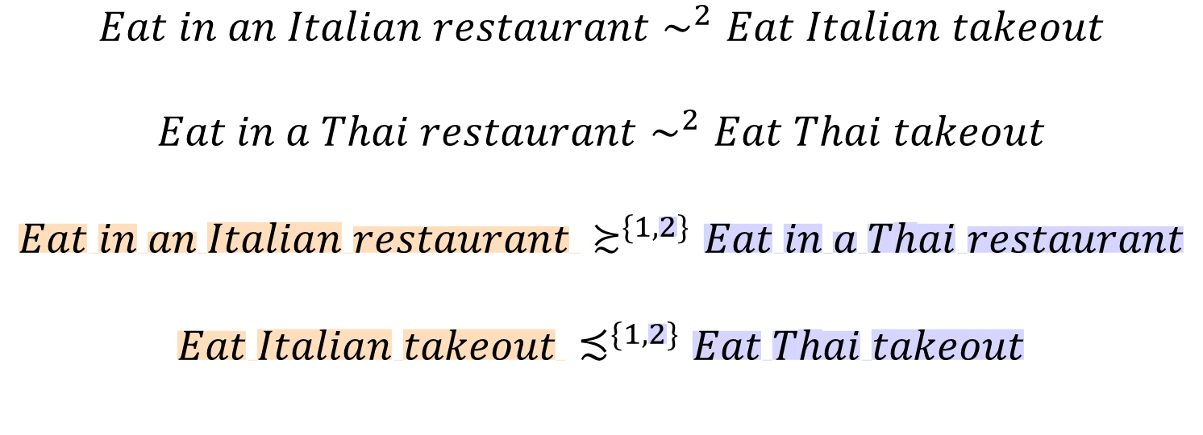
Measurement of tradeoffs – through social interaction
$$Eat in an Italian restaurant∼^{2}Eat Italian takeout$$
$$Eat in a Thai restaurant∼^{2}Eat Thai takeout$$
$$Eat in an Italian restaurant ≿^{\{1,2\}}Eat in a Thai restaurant$$
$$Eat Italian takeout ≾^{\{1,2\}}Eat Thai takeout$$

Slide 20
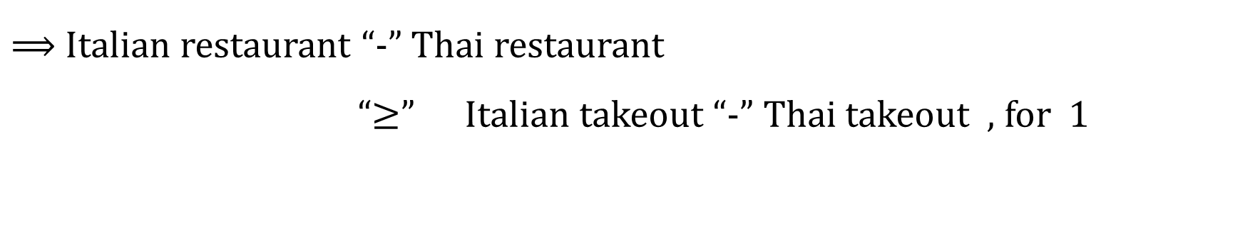
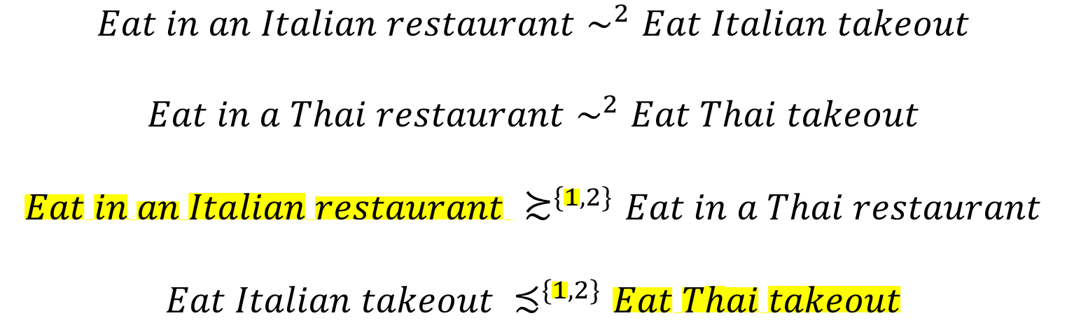
Measurement of tradeoffs – through social interaction
$$Eat in an Italian restaurant∼^{2}Eat Italian takeout$$
$$Eat in a Thai restaurant∼^{2}Eat Thai takeout$$
$$Eat in an Italian restaurant ≿^{\{1,2\}}Eat in a Thai restaurant$$
$$Eat Italian takeout ≾^{\{1,2\}}Eat Thai takeout$$
$⟹$ Italian restaurant “-” Thai restaurant
“$≥$” Italian takeout “-” Thai takeout , for 1

Slide 21
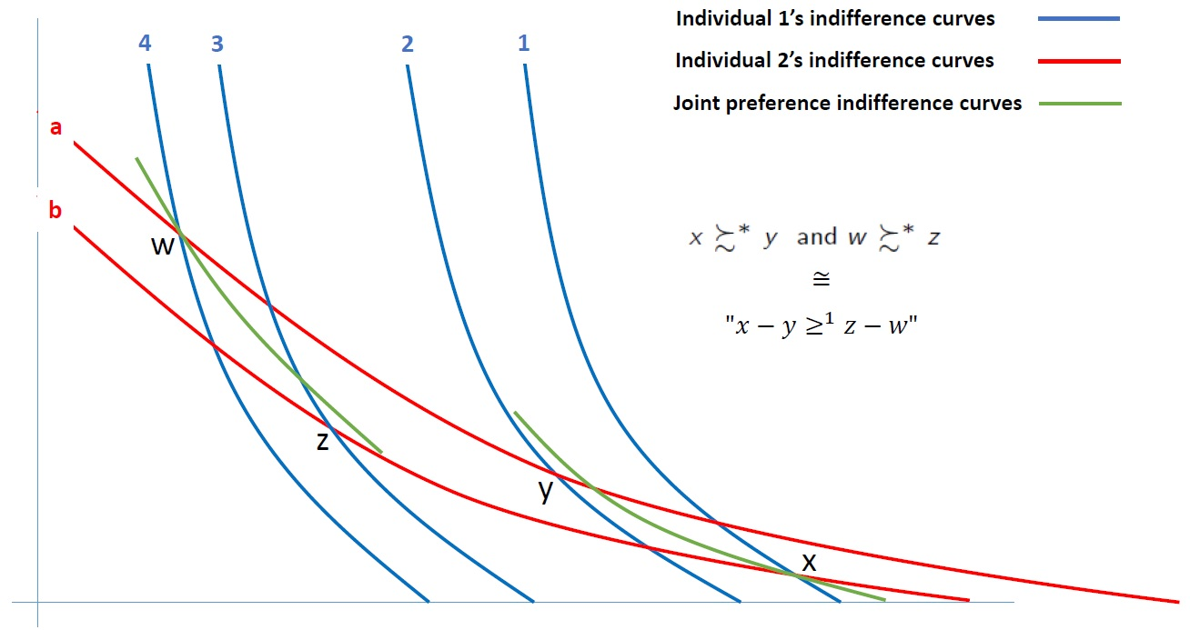
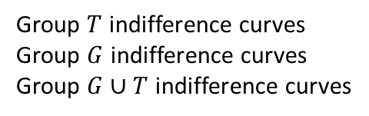
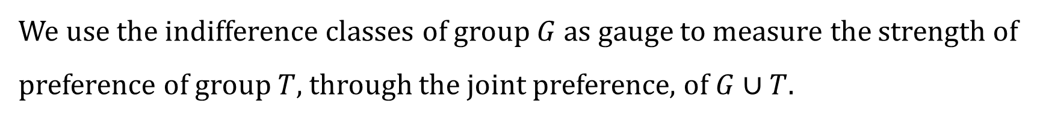
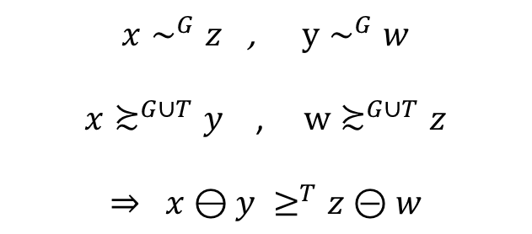
Measuring tradeoffs through social interaction
Group $T$ indifference curves
Group $G$ indifference curves
Group $G∪T$ indifference curves
$x∼^{G}z$ , $y∼^{G}w$
$x≿^{G∪T}y$ , $w≿^{G∪T}z$
$$⇒ x⊖y ≥^{T}z⊝w$$
We use the indifference classes of group $G$ as gauge to measure the strength of preference of group $T$, through the joint preference, of $G∪T$.
Notes:
We want to compare the tradeoff between indifference curves 1 and 2, to the tradeoff between curves 3 and 4
Why indifference curve and not outcomes? Tradeoff = strength of preference ➔ an attribute of preferences

Slide 22
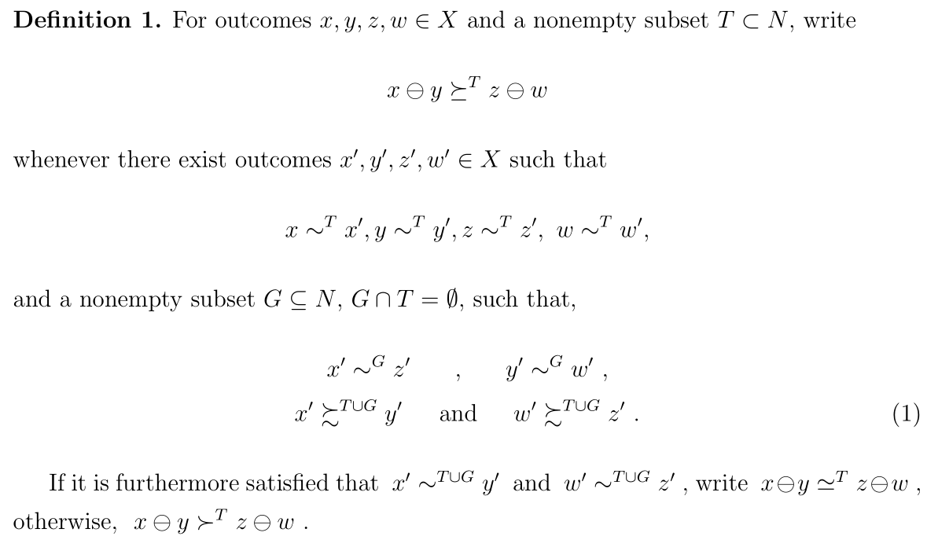
Measuring tradeoffs through social interaction
Notes:
- We have to make sure that the definition is consistent

Slide 23
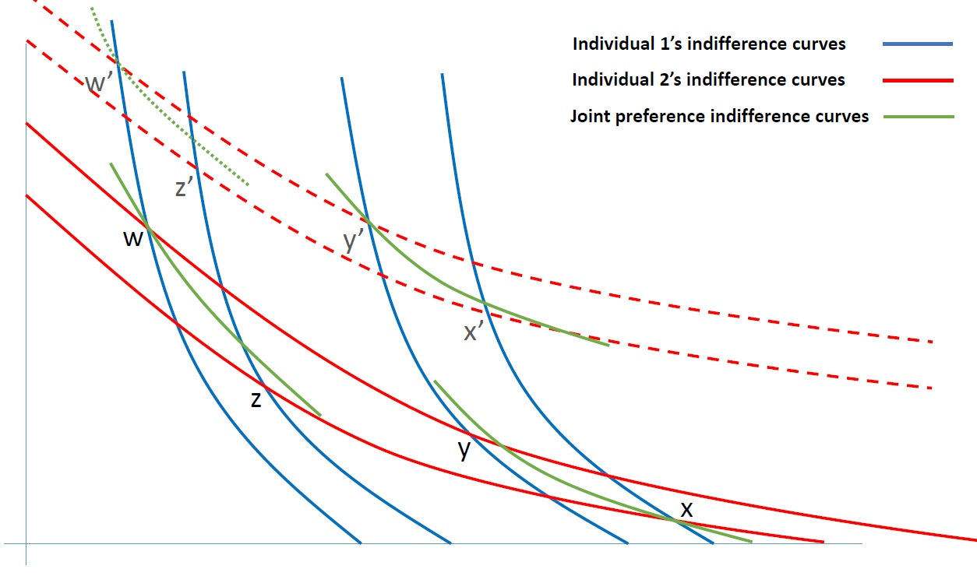
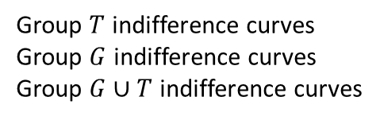
Measuring tradeoffs through social interaction
Group $T$ indifference curves
Group $G$ indifference curves
Group $G∪T$ indifference curves
We want the strength of preference to be independent of the choice of gauge – identity of the other group, and its indifference class chosen.

Slide 24
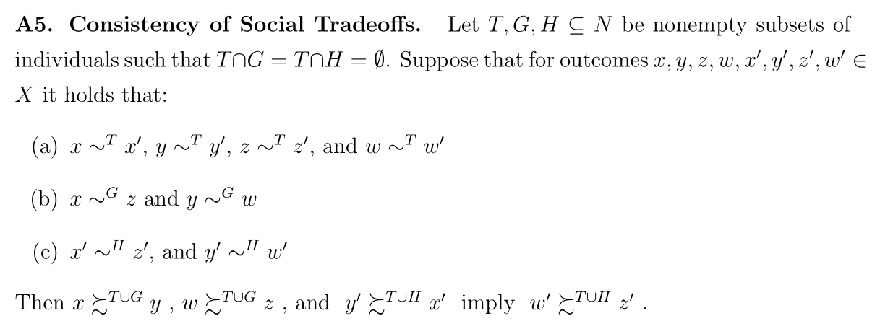
Consistency of Tradeoff measurement

Slide 25
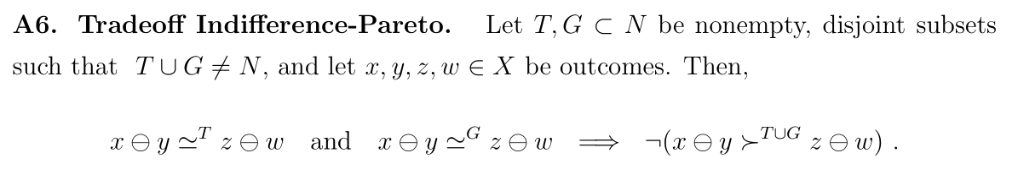
Another form of Pareto

Slide 26
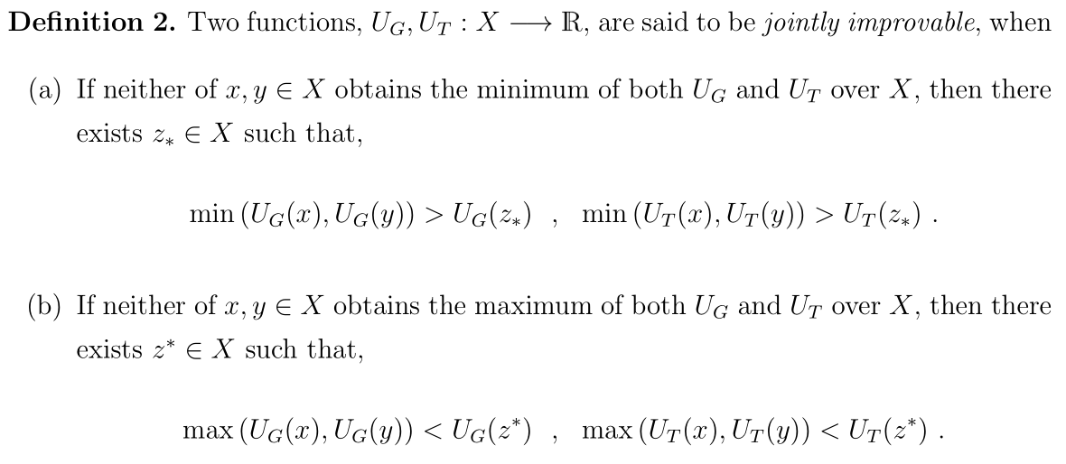
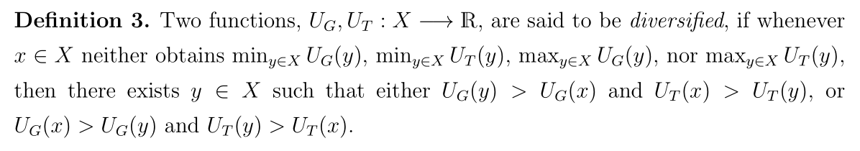





Definitions for the iff representation

Slide 27
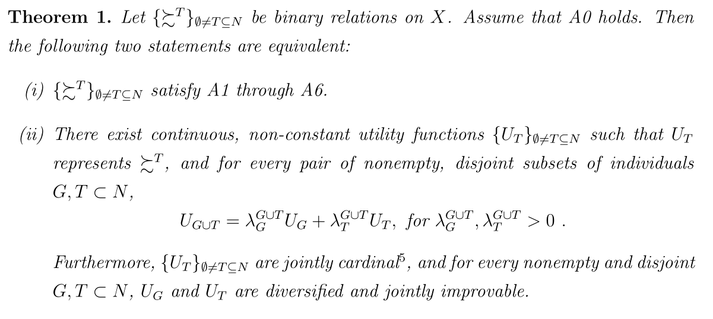
Representation theorem

Slide 28
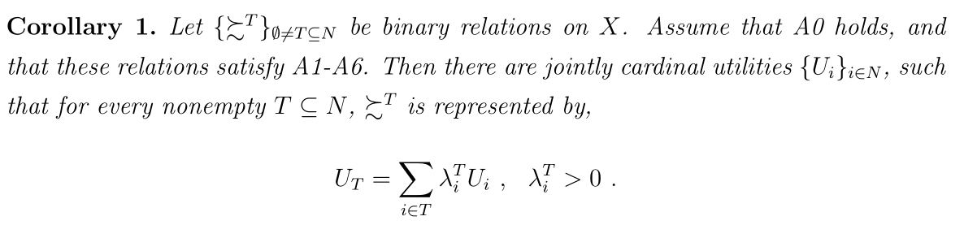
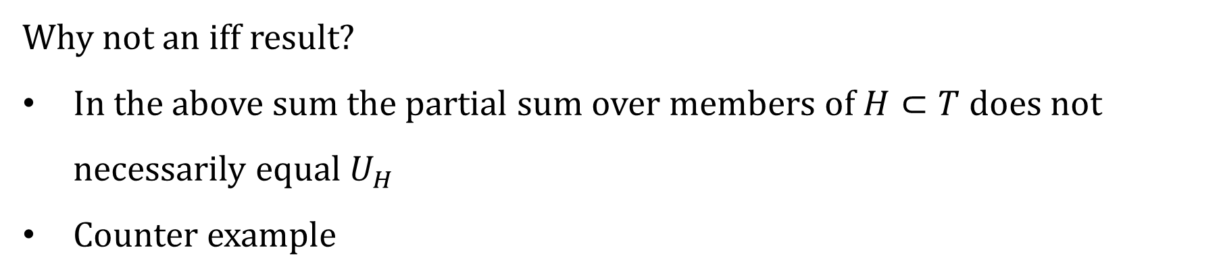
Corollary
Why not an iff result?
In the above sum the partial sum over members of $H⊂T$ does not necessarily equal $U_{H}$
Counter example

Slide 29
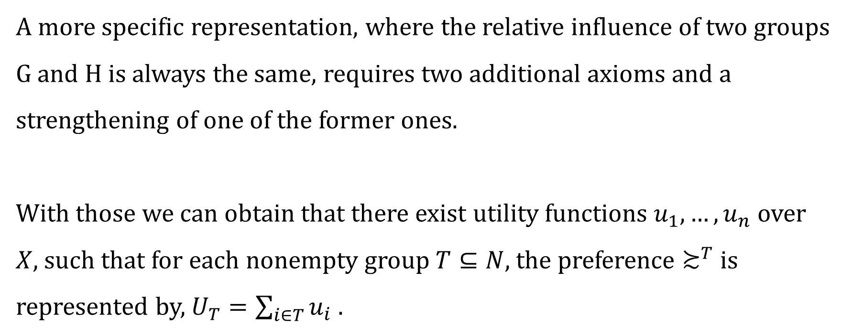
Special case
A more specific representation, where the relative influence of two groups G and H is always the same, requires two additional axioms and a strengthening of one of the former ones.
With those we can obtain that there exist utility functions $u_{1}, …, u_{n}$ over $X$, such that for each nonempty group $T⊆N$, the preference $≿^{T}$ is represented by, $U_{T}=\sum_{i∈T}{u_{i}}$ .

Slide 30
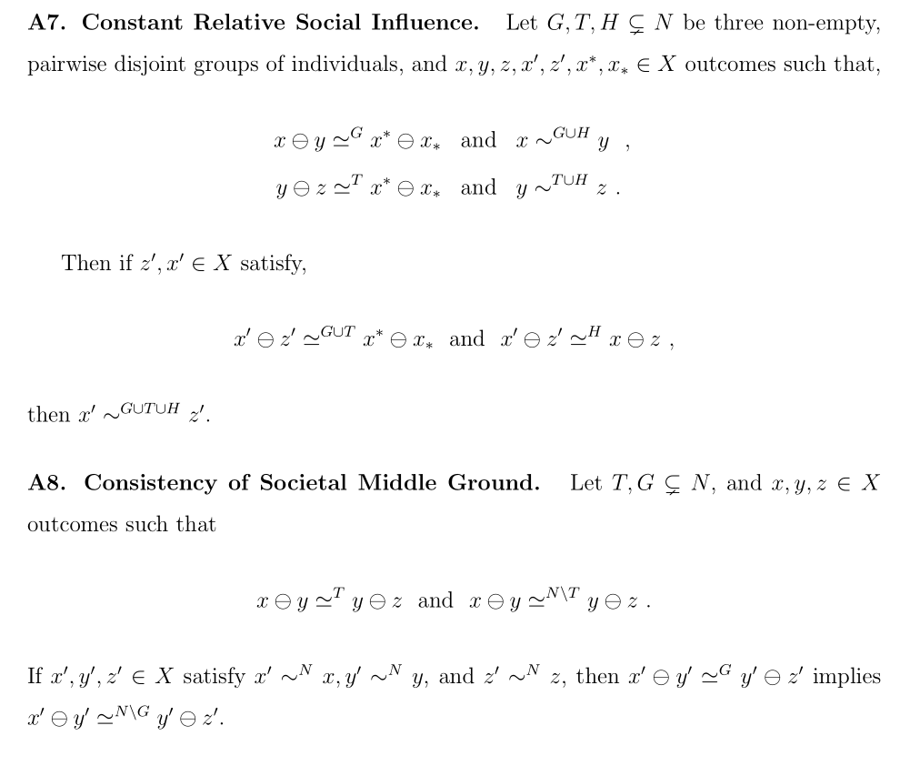
Axioms
for the
special case

Slide 31
Related literature
When alternatives are allocations of bundles and individuals care only about their personal allocated bundles, basic assumptions entail cardinal individual utilities and a utilitarian social preference. Still, these utilities do not convey any meaningful notion of strength of preference. Moreover, even when alternatives are allocations, our setup can describe individuals that care about more than their personally allocated bundles, accommodating, for example, public goods and other-regarding preferences.
Piacquadio (2017)– also starts with ordinal preferences, extracts cardinal utilities based on fairness considerations, and aggregates them into a utilitarian social preference. Differences of individual utility values in his model express the tradeoffs in individuals’ well-being levels as perceived by the social planner based on her/his concept of fairness.

Slide 32
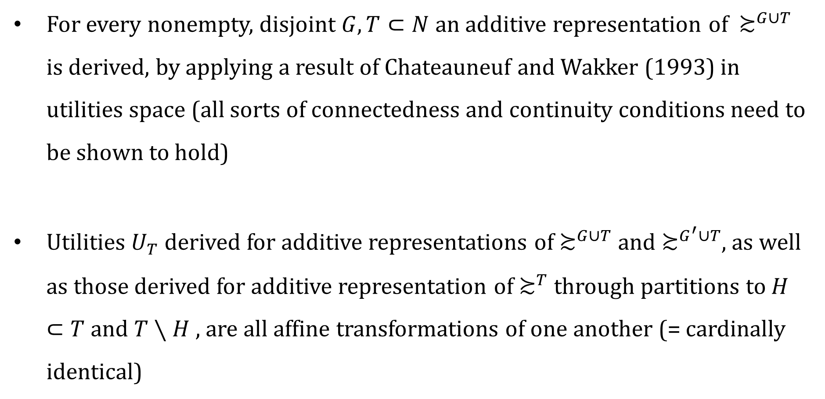
Sketch of the proof
For every nonempty, disjoint $G,T⊂N$ an additive representation of $≿^{G∪T}$ is derived, by applying a result of Chateauneuf and Wakker (1993) in utilities space (all sorts of connectedness and continuity conditions need to be shown to hold)
Utilities $U_{T}$ derived for additive representations of $≿^{G∪T}$ and $≿^{G^{′}∪T}$, as well as those derived for additive representation of $≿^{T}$ through partitions to $H⊂T$ and $T∖H$ , are all affine transformations of one another (= cardinally identical)

Slide 33
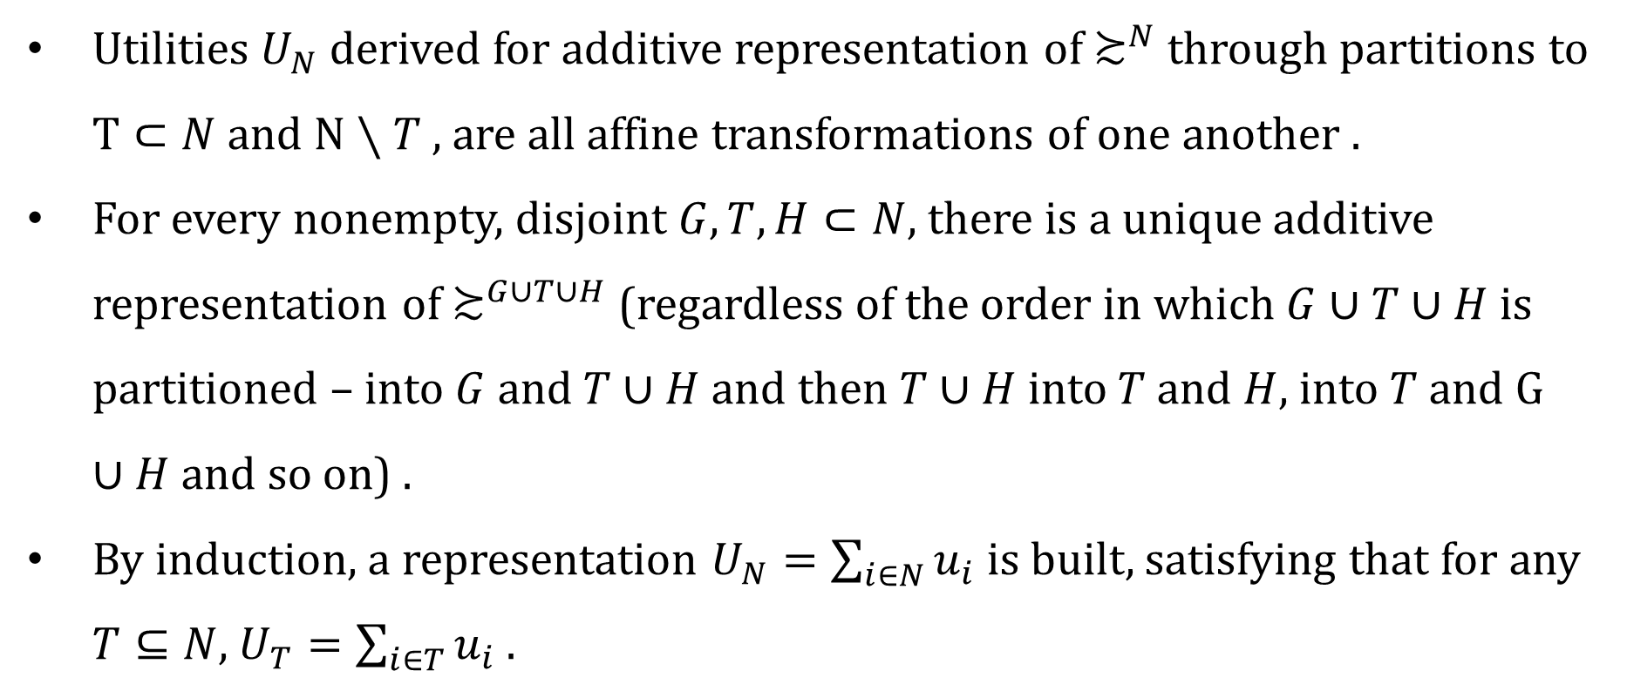
Sketch of the proof of the special case
Utilities $U_{N}$ derived for additive representation of $≿^{N}$ through partitions to $T⊂N$ and $N∖T$ , are all affine transformations of one another .
For every nonempty, disjoint $G,T,H⊂N$, there is a unique additive representation of $≿^{G∪T∪H}$ (regardless of the order in which $G∪T∪H$ is partitioned – into $G$ and $T∪H$ and then $T∪H$ into $T$ and $H$, into $T$ and $G∪H$ and so on) .
By induction, a representation $U_{N}=\sum_{i∈N}{u_{i}}$ is built, satisfying that for any $T⊆N$, $U_{T}=\sum_{i∈T}{u_{i}}$ .

