Slide 1
Decomposition-Integral: Unifying Choquet and the Concave Integrals
Yaarit Even
Tel-Aviv University
December 2011

Slide 2
Non-additive integral
Decision making under uncertainty
Game theory
Multi-criteria decision aid (MCDA)
Insurance and financial assets pricing

Slide 3
In this presentation
A new definition for integrals w.r.t. capacities.
Defining Choquet and the concave integrals by terms of the new integral.
Properties of the new integral.
Desirable properties and the conditions for which the new integral maintains them.

Slide 4
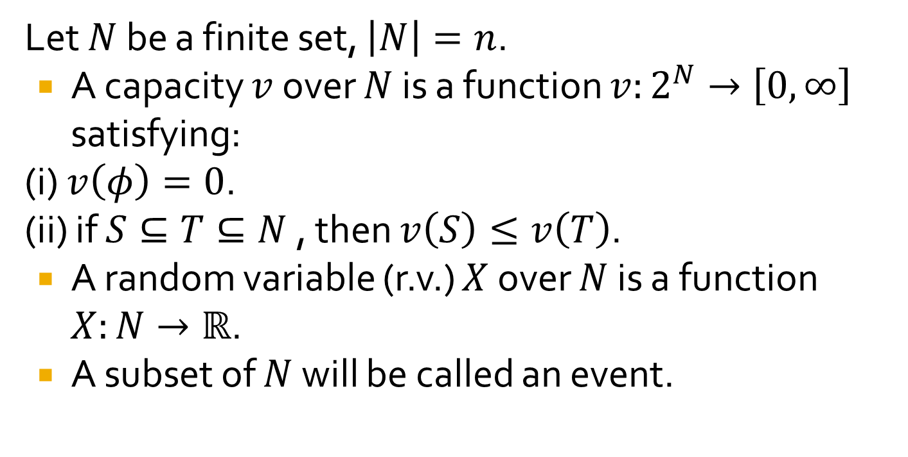
Definitions
Let $N$ be a finite set, $\left|N\right|=n$.
A capacity $v$ over $N$ is a function $v:2^{N}→\left[0,∞\right]$ satisfying:
(i) $v\left(φ\right)=0$.
(ii) if $S⊆T⊆N$, then $v\left(S\right)≤v\left(T\right)$.
A random variable (r.v.) $X$ over $N$ is a function $X:N→ℝ$.
A subset of $N$ will be called an event.

Slide 5
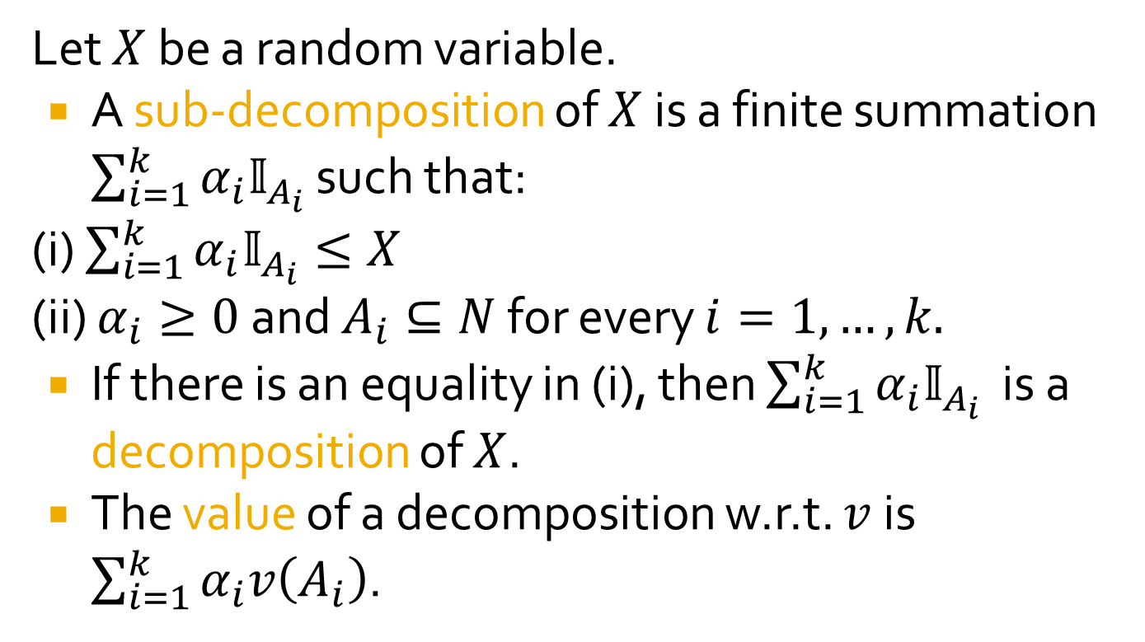
Sub-decompositions and decompositions of a random variable
Let $X$ be a random variable.
A sub-decomposition of $X$ is a finite summation $\sum_{i=1}^{k}{α_{i}𝕀_{A_{i}}}$ such that:
(i) $\sum_{i=1}^{k}{α_{i}𝕀_{A_{i}}}≤X$
(ii) $α_{i}≥0$ and $A_{i}⊆N$ for every $i=1,…,k.$
If there is an equality in (i), then $\sum_{i=1}^{k}{α_{i}𝕀_{A_{i}}}$ is a decomposition of $X$.
The value of a decomposition w.r.t. $v$ is $\sum_{i=1}^{k}{α_{i}v\left(A_{i}\right)}$.

Slide 6
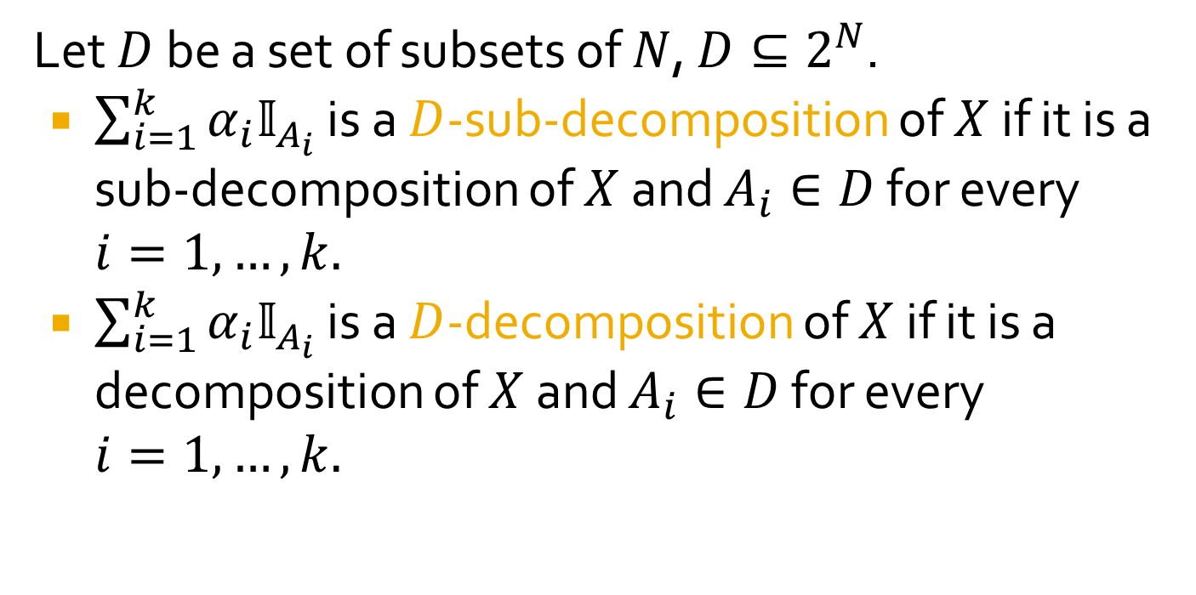
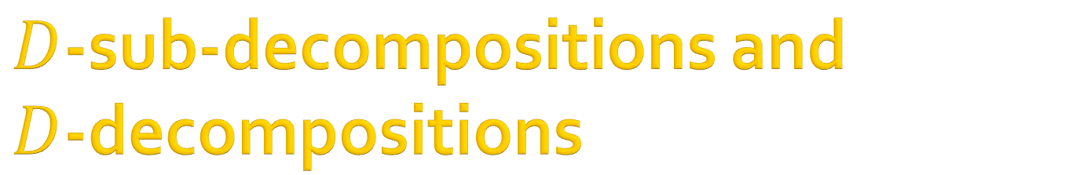
$D$-sub-decompositions and
$D$-decompositions
Let $D$ be a set of subsets of $N$, $D⊆2^{N}$.
$\sum_{i=1}^{k}{α_{i}𝕀_{A_{i}}}$ is a $D$-sub-decomposition of $X$ if it is a sub-decomposition of $X$ and $A_{i}∈D$ for every $i=1,…,k.$
$\sum_{i=1}^{k}{α_{i}𝕀_{A_{i}}}$ is a $D$-decomposition of $X$ if it is a decomposition of $X$ and $A_{i}∈D$ for every $i=1,…,k.$

Slide 7
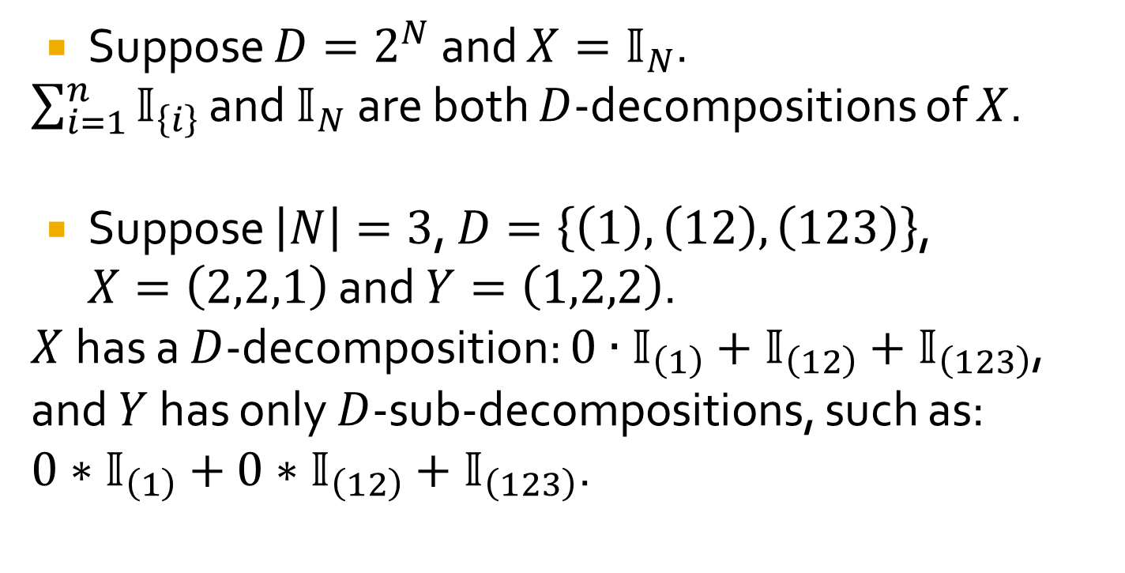
Examples
Suppose $D=2^{N}$ and $X=𝕀_{N}$.
$\sum_{i=1}^{n}{𝕀_{\left\{i\right\}}}$ and $𝕀_{N}$ are both $D$-decompositions of $X$.
Suppose $\left|N\right|=3$, $D=\left\{\left(1\right), \left(12\right), \left(123\right)\right\}$, $X=\left(2,2,1\right)$ and $Y=\left(1,2,2\right)$.
$X$has a $D$-decomposition: $0∙𝕀_{\left(1\right)}+𝕀_{\left(12\right)}+𝕀_{\left(123\right)}$, and $Y$ has only $D$-sub-decompositions, such as: ${0∗𝕀}_{\left(1\right)}+0∗𝕀_{\left(12\right)}+𝕀_{\left(123\right)}$.

Slide 8
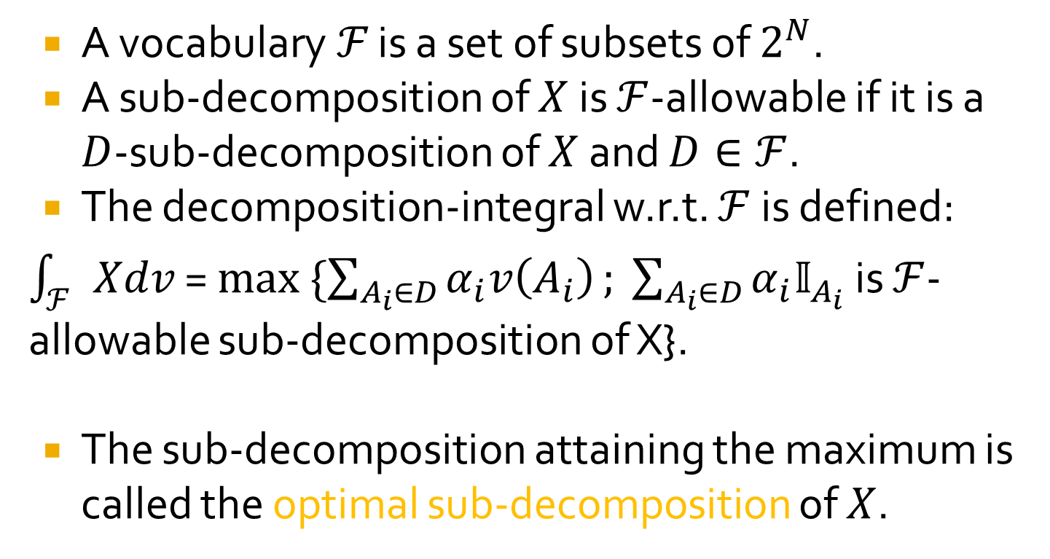
The decomposition-integral
A vocabulary$ℱ$ is a set of subsets of $2^{N}$.
A sub-decomposition of $X$ is $ℱ$-allowable if it is a $D$-sub-decomposition of $X$ and $D∈ℱ$.
The decomposition-integral w.r.t. $ℱ$ is defined:
$\int_{ℱ}{Xdv}$ = $max \{\sum_{A_{i}∈D}{α_{i}v\left(A_{i}\right)}; \sum_{A_{i}∈D}{α_{i}𝕀_{A_{i}}}$ is $ℱ$-allowable sub-decomposition of X}.
The sub-decomposition attaining the maximum is called the optimal sub-decomposition of $X$.

Slide 9
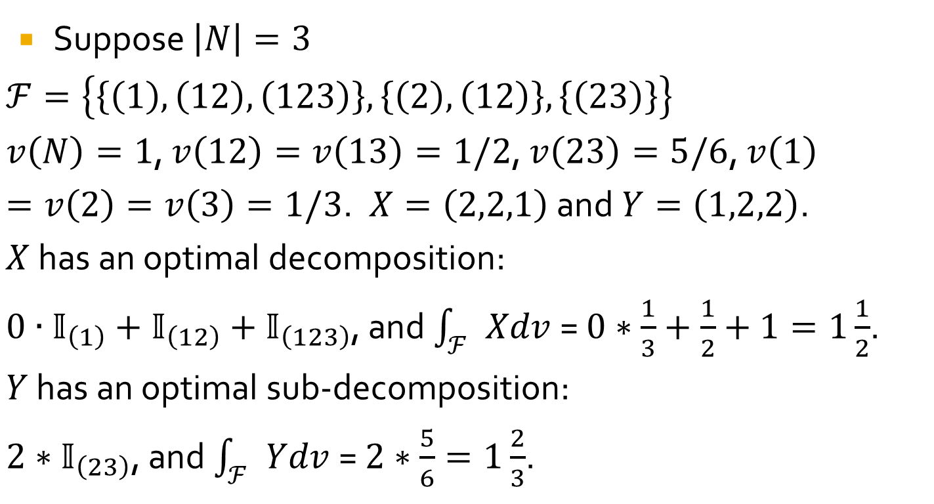
Examples
Suppose $\left|N\right|=3$
$ℱ=\left\{\left\{\left(1\right), \left(12\right), \left(123\right)\right\},\left\{\left(2\right),\left(12\right)\right\},\left\{\left(23\right)\right\}\right\}$
$v\left(N\right)=1$, $v\left(12\right)=v\left(13\right)=1/2$, $v\left(23\right)=5/6$, $v\left(1\right)=v\left(2\right)=v\left(3\right)=1/3$. $X=\left(2,2,1\right)$ and $Y=\left(1,2,2\right)$.
$X$ has an optimal decomposition:
$0∙𝕀_{\left(1\right)}+𝕀_{\left(12\right)}+𝕀_{\left(123\right)}$, and $\int_{ℱ}{Xdv }$= $0∗\frac{1}{3}+\frac{1}{2}+1=1\frac{1}{2}$.
$Y$ has an optimal sub-decomposition:
$2∗𝕀_{\left(23\right)}$, and $\int_{ℱ}{Ydv }$= $2∗\frac{5}{6}=1\frac{2}{3}$.

Slide 10
The decomposition-integral as a generalization of known integrals
Choquet integral
The concave integral
Riemann integral
Shilkret integral
And other plausible integration schemes.

Slide 11
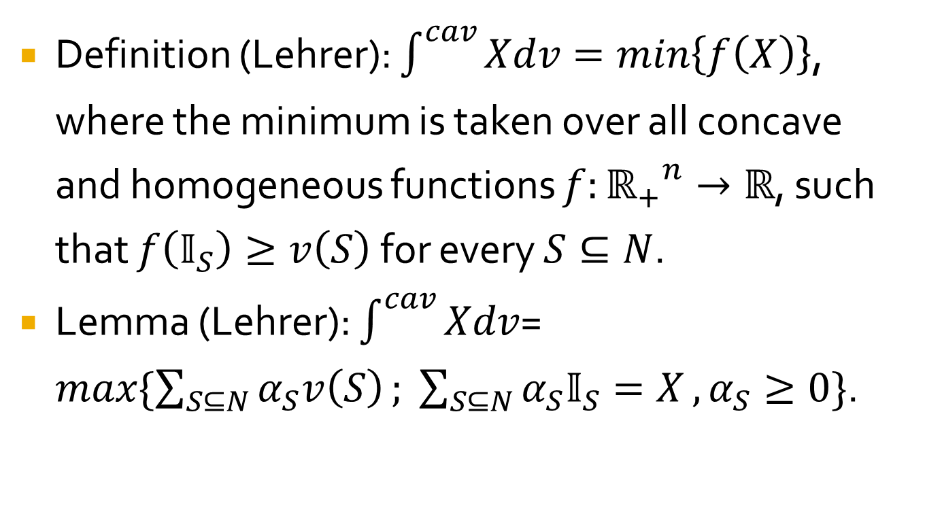
The concave integral
Definition (Lehrer): $\int^{cav}{Xdv=min\left\{f\left(X\right)\right\}}$, where the minimum is taken over all concave and homogeneous functions $f:{ℝ_{+}}_{}^{n}→ℝ$, such that $f\left(𝕀_{S}\right)≥v\left(S\right)$ for every $S⊆N$.
Lemma (Lehrer): $\int^{cav}{Xdv}$= $max\{\sum_{S⊆N}{α_{S}v\left(S\right)}; \sum_{S⊆N}{α_{S}𝕀_{S}=X}, α_{S}≥0\}$.

Slide 12
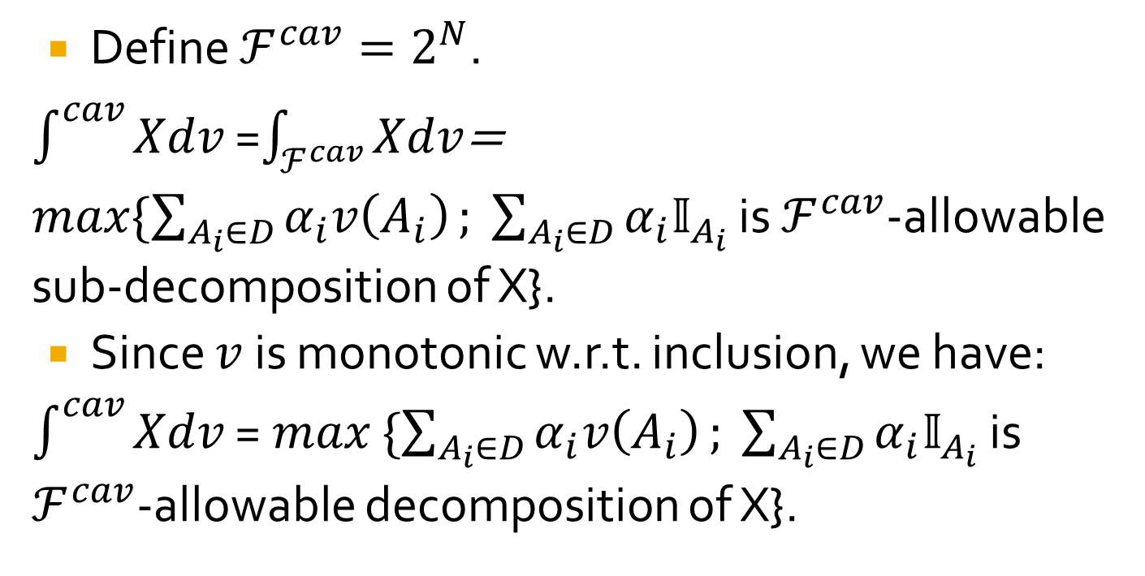
The concave integral as a decomposition-integral
Define $ℱ^{cav}=2^{N}$.
$\int^{cav}{Xdv}$ =$\int_{ℱ^{cav}}{Xdv}$= $max\{\sum_{A_{i}∈D}{α_{i}v\left(A_{i}\right)}; \sum_{A_{i}∈D}{α_{i}𝕀_{A_{i}}}$ is $ℱ^{cav}$-allowable sub-decomposition of X}.
Since $v$ is monotonic w.r.t. inclusion, we have:
$\int^{cav}{Xdv}$ = $max$ $\{\sum_{A_{i}∈D}{α_{i}v\left(A_{i}\right)}; \sum_{A_{i}∈D}{α_{i}𝕀_{A_{i}}}$ is $ℱ^{cav}$-allowable decomposition of X}.

Slide 13
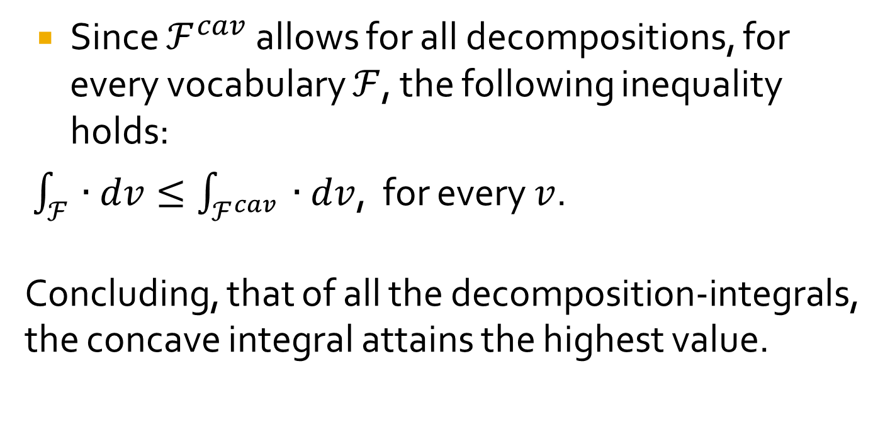
The concave integral
Since $ℱ^{cav}$ allows for all decompositions, for every vocabulary $ℱ$, the following inequality holds:
$\int_{ℱ}{∙dv}≤\int_{ℱ^{cav}}{ ∙dv}$, for every $v$.
Concluding, that of all the decomposition-integrals, the concave integral attains the highest value.

Slide 14
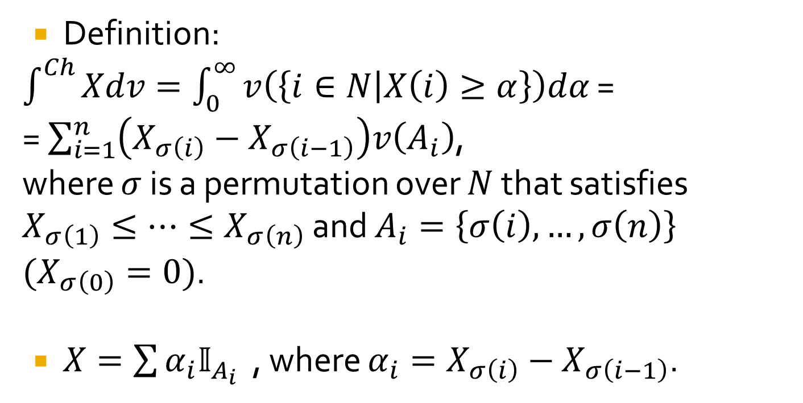
Choquet integral
Definition:
$\int^{Ch}{Xdv=\int_{0}^{∞}{v\left(\left\{i∈N | X\left(i\right)≥α\right\}\right)dα}}$ =
= $\sum_{i=1}^{n}{\left(X_{σ\left(i\right)}−X_{σ\left(i−1\right)}\right)v\left(A_{i}\right)}$,
where $σ$ is a permutation over $N$ that satisfies $X_{σ\left(1\right)}≤…≤X_{σ\left(n\right)}$ and $A_{i}=\left\{σ\left(i\right),…,σ\left(n\right)\right\}$ $(X_{σ\left(0\right)}=0)$.
$X=\sum{α_{i}𝕀_{A_{i}}}$ , where $α_{i}=X_{σ\left(i\right)}−X_{σ\left(i−1\right)}$.

Slide 15
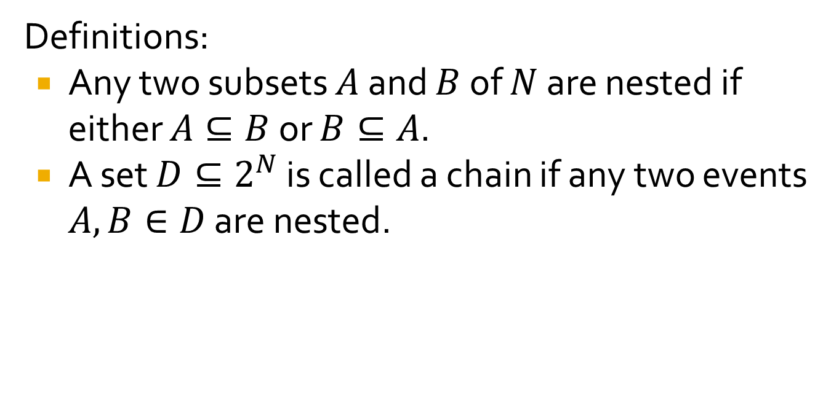
Choquet integral as a decomposition-integral
Definitions:
Any two subsets $A$ and $B$ of $N$ are nested if either $A⊆B$ or $B⊆A$.
A set $D⊆2^{N}$ is called a chain if any two events $A, B∈D$ are nested.

Slide 16
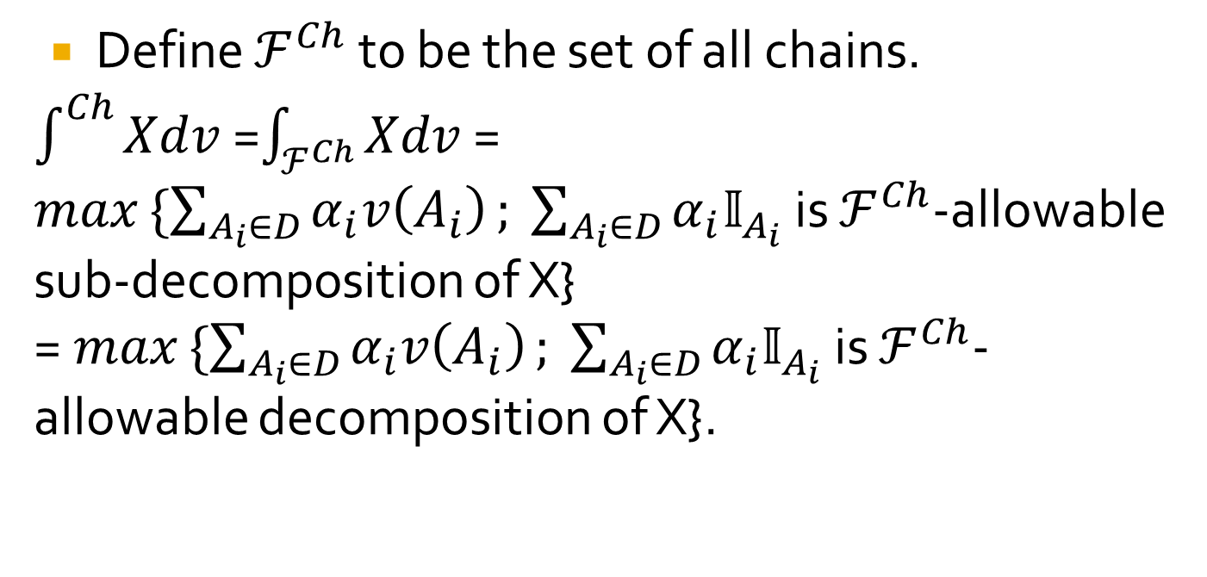
Choquet integral as a decomposition-integral
Define $ℱ^{Ch}$ to be the set of all chains.
$\int^{Ch}{Xdv }$=$\int_{ℱ^{Ch}}{Xdv}$ =
$max$ $\{\sum_{A_{i}∈D}{α_{i}v\left(A_{i}\right)}; \sum_{A_{i}∈D}{α_{i}𝕀_{A_{i}}}$ is $ℱ^{Ch}$-allowable sub-decomposition of X}
= $max$ $\{\sum_{A_{i}∈D}{α_{i}v\left(A_{i}\right)}; \sum_{A_{i}∈D}{α_{i}𝕀_{A_{i}}}$ is $ℱ^{Ch}$-allowable decomposition of X}.

Slide 17
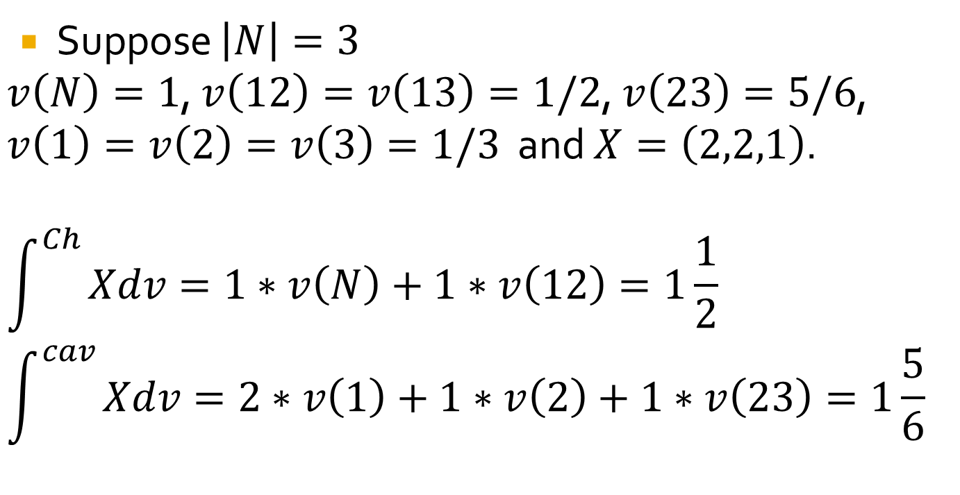
Examples
Suppose $\left|N\right|=3$
$v\left(N\right)=1$, $v\left(12\right)=v\left(13\right)=1/2$, $v\left(23\right)=5/6$, $v\left(1\right)=v\left(2\right)=v\left(3\right)=1/3$ and $X=\left(2,2,1\right)$.
$$\int^{Ch}{Xdv=1∗v\left(N\right)+1∗v\left(12\right)=1\frac{1}{2}}$$
$$\int^{cav}{Xdv=2∗v\left(1\right)+1∗v\left(2\right)+1∗v\left(23\right)=1\frac{5}{6}}$$

Slide 18
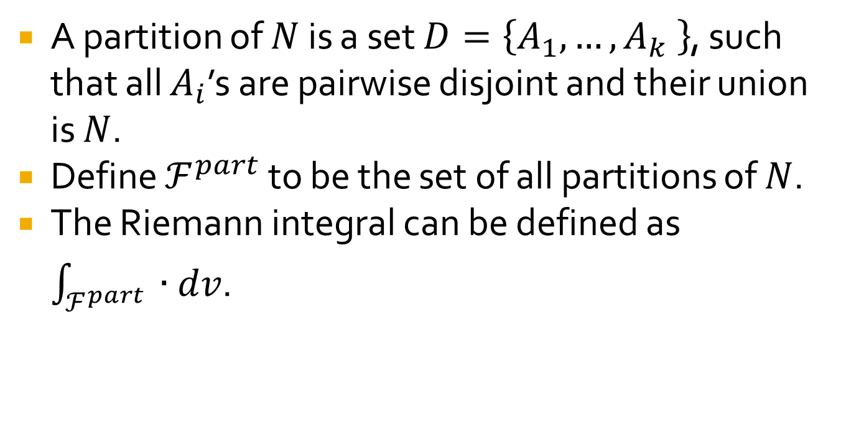
Riemann integral
A partition of $N$ is a set $D=\left\{A_{1},…,A_{k} \right\}$, such that all $A_{i}$’s are pairwise disjoint and their union is $N$.
Define $ℱ^{part}$ to be the set of all partitions of $N$.
The Riemann integral can be defined as $\int_{ℱ^{part}}{ ∙dv}$.

Slide 19
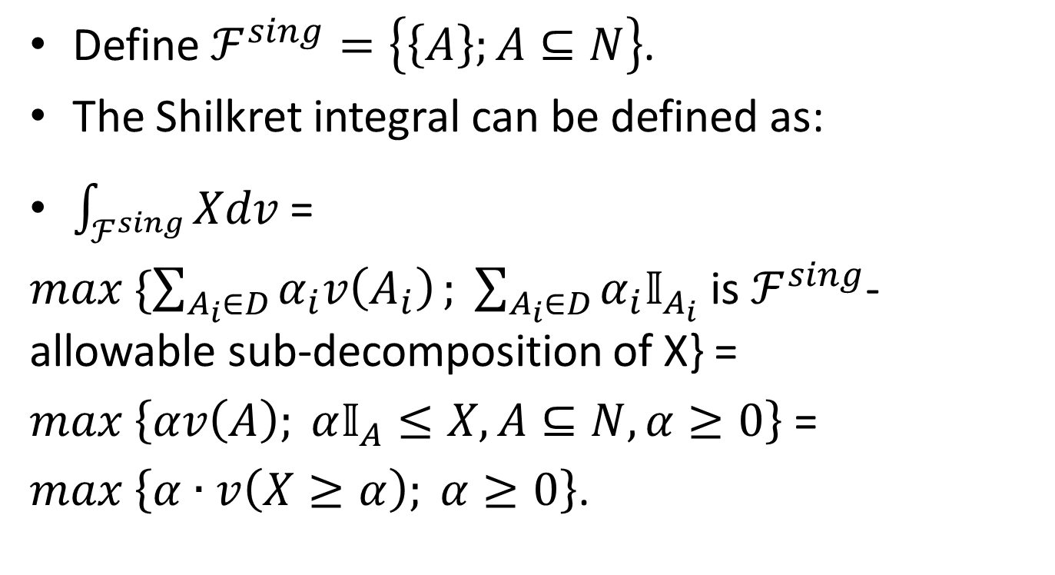
Shilkret integral
Define $ℱ^{sing}=\left\{\left\{A\right\};A⊆N\right\}$.
The Shilkret integral can be defined as:
$\int_{ℱ^{sing}}{Xdv}$ =
$max$ $\{\sum_{A_{i}∈D}{α_{i}v\left(A_{i}\right)}; \sum_{A_{i}∈D}{α_{i}𝕀_{A_{i}}}$ is $ℱ^{sing}$-allowable sub-decomposition of X} =
$max$ $\left\{αv\left(A\right); α𝕀_{A}≤X, A⊆N, α≥0\right\}$ =
$max$ $\left\{α∙v\left(X≥α\right); α≥0\right\}$.

Slide 20
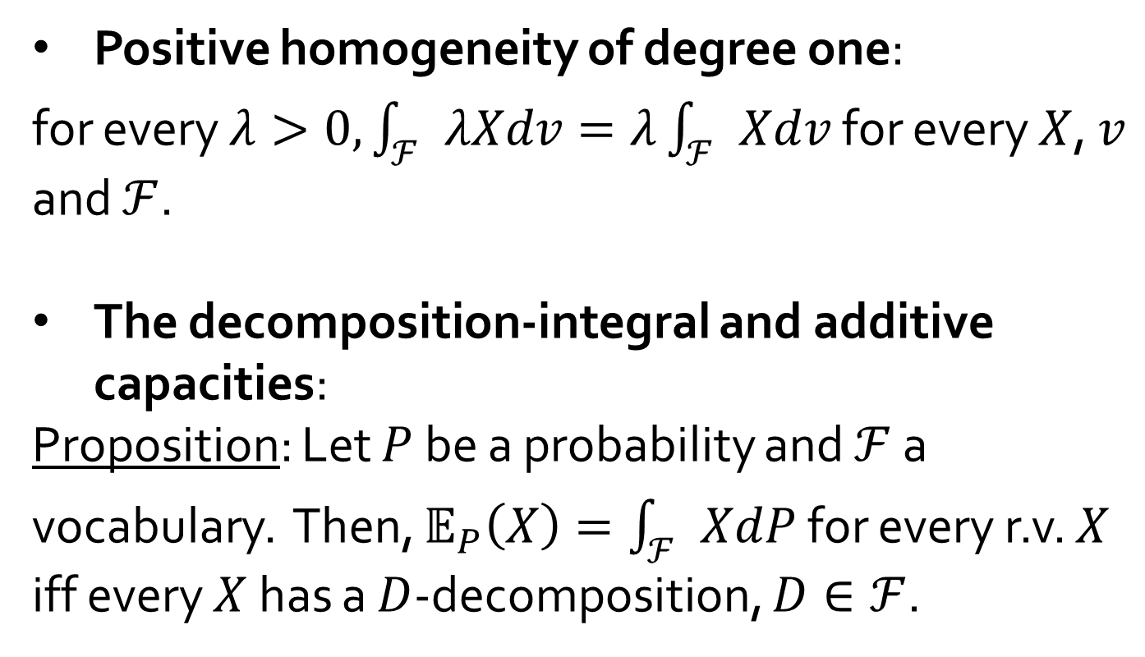
Properties of the decomposition-integral
Positive homogeneity of degree one:
for every $λ>0, \int_{ℱ}{λXdv}=λ\int_{ℱ}{Xdv}$ for every $X$, $v$ and $ℱ$.
The decomposition-integral and additive capacities:
Proposition: Let $P$ be a probability and $ℱ$ a vocabulary. Then, $𝔼_{P}\left(X\right)=\int_{ℱ}{XdP}$ for every r.v. $X$ iff every $X$ has a $D$-decomposition, $D∈ℱ$.

Slide 21
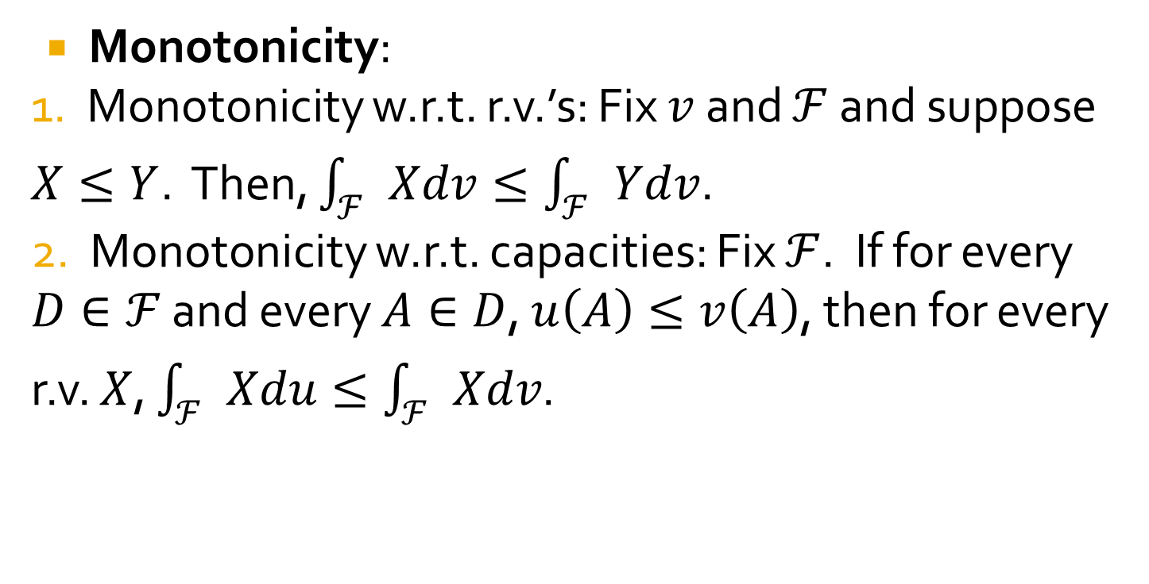
Properties of the decomposition-integral - continuation
Monotonicity:
1. Monotonicity w.r.t. r.v.’s: Fix $v$ and $ℱ$ and suppose $X≤Y$. Then, $\int_{ℱ}{Xdv}≤\int_{ℱ}{Ydv}$.
2. Monotonicity w.r.t. capacities: Fix $ℱ$. If for every $D∈ℱ$ and every $A∈D$, $u\left(A\right)≤v\left(A\right)$, then for every r.v. $X$, $\int_{ℱ}{Xdu}≤\int_{ℱ}{Xdv}$.

Slide 22
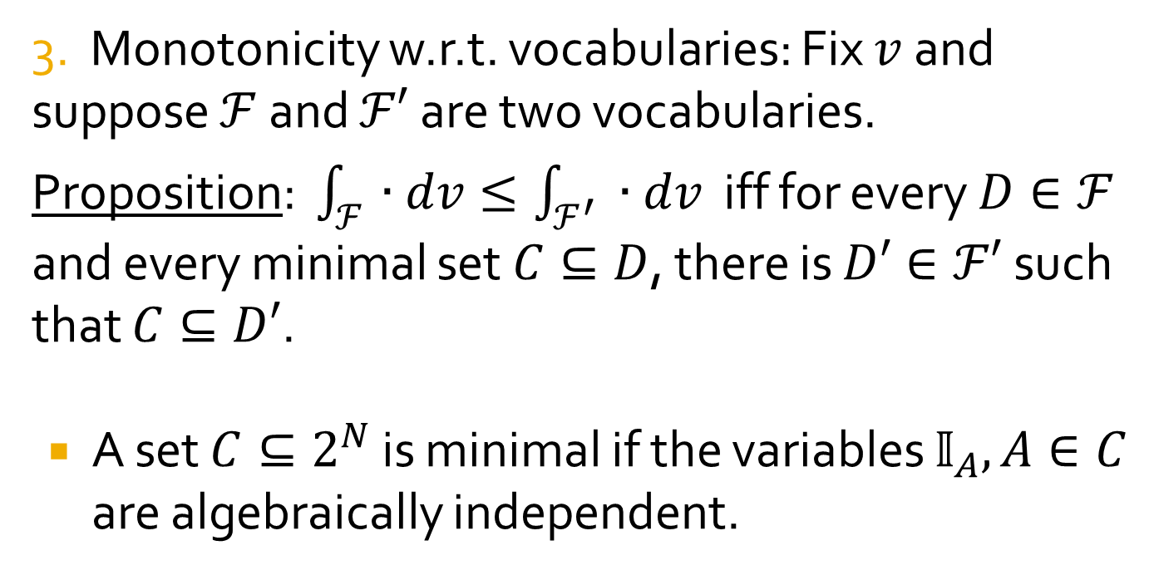
Properties of the decomposition-integral - continuation
3. Monotonicity w.r.t. vocabularies: Fix $v$ and suppose $ℱ$ and $ℱ′$ are two vocabularies.
Proposition: $\int_{ℱ}{∙dv}≤\int_{ℱ^{′}}{ ∙dv}$ iff for every $D∈ℱ$ and every minimal set $C⊆D$, there is $D′∈ℱ′$ such that $C⊆D′$.
A set $C⊆2^{N}$ is minimal if the variables $𝕀_{A}, A∈C$ are algebraically independent.

Slide 23
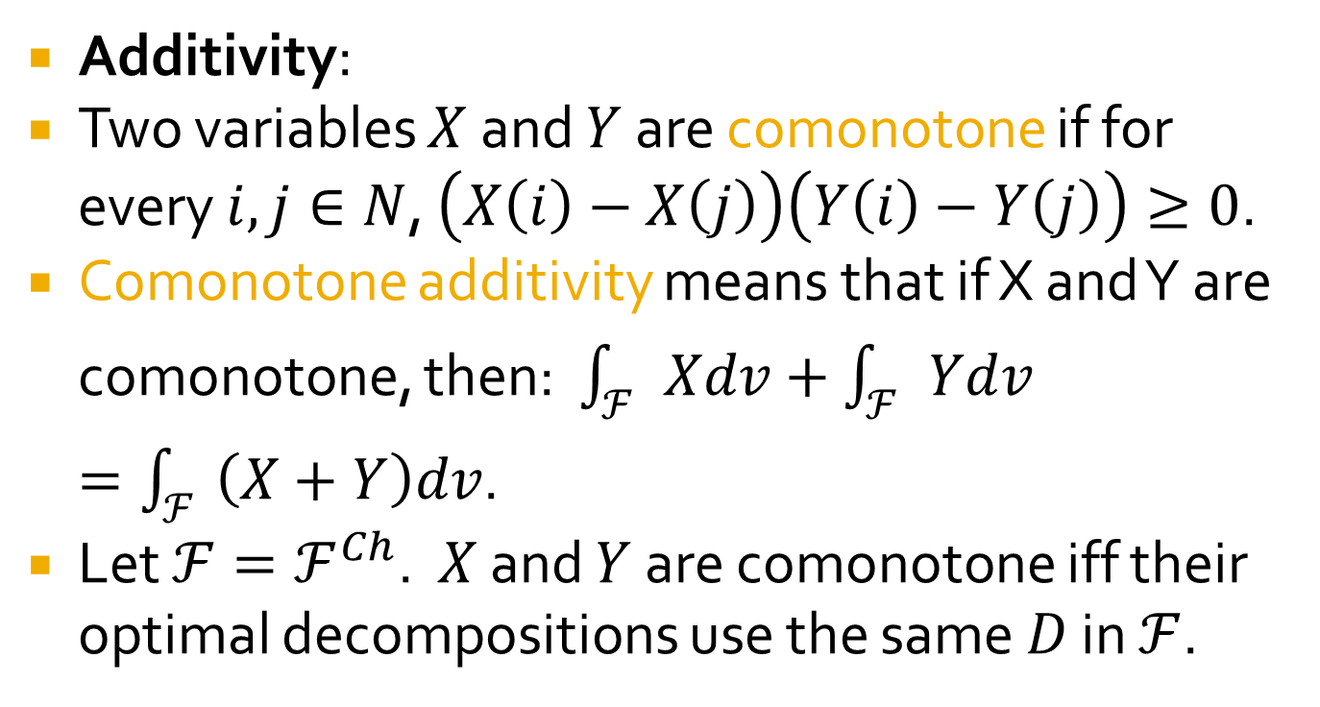
Properties of the decomposition-integral - continuation
Additivity:
Two variables $X$ and $Y$ are comonotone if for every $i, j∈N$, $\left(X\left(i\right)−X\left(j\right)\right)\left(Y\left(i\right)−Y\left(j\right)\right)≥0$.
Comonotone additivity means that if X and Y are comonotone, then: $\int_{ℱ}{Xdv}+\int_{ℱ}{Ydv}=\int_{ℱ}{\left(X+Y\right)dv}$.
Let $ℱ=ℱ^{Ch}$. $X$ and $Y$ are comonotone iff their optimal decompositions use the same $D$ in $ℱ$.

Slide 24
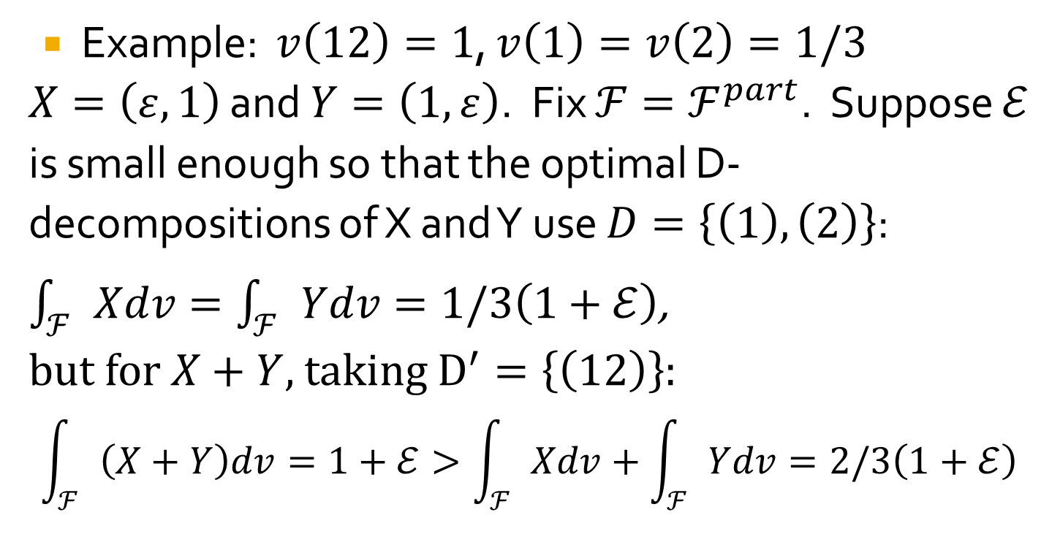
Properties of the decomposition-integral - continuation
Example: $v\left(12\right)=1$, $v\left(1\right)=v\left(2\right)=1/3$
$X=\left(ε, 1\right)$ and $Y=\left(1, ε\right)$. Fix $ℱ=ℱ^{part}$. Suppose $ℰ$ is small enough so that the optimal D-decompositions of X and Y use $D=\left\{\left(1\right), \left(2\right)\right\}$: $\int_{ℱ}{Xdv}=\int_{ℱ}{Ydv}=1/3\left(1+ℰ\right)$,
but for $X+Y$, taking $D^{′}=\left\{\left(12\right)\right\}$:
$$\int_{ℱ}{\left(X+Y\right)dv=1+ℰ}>\int_{ℱ}{Xdv}+\int_{ℱ}{Ydv=2/3\left(1+ℰ\right)}$$

Slide 25
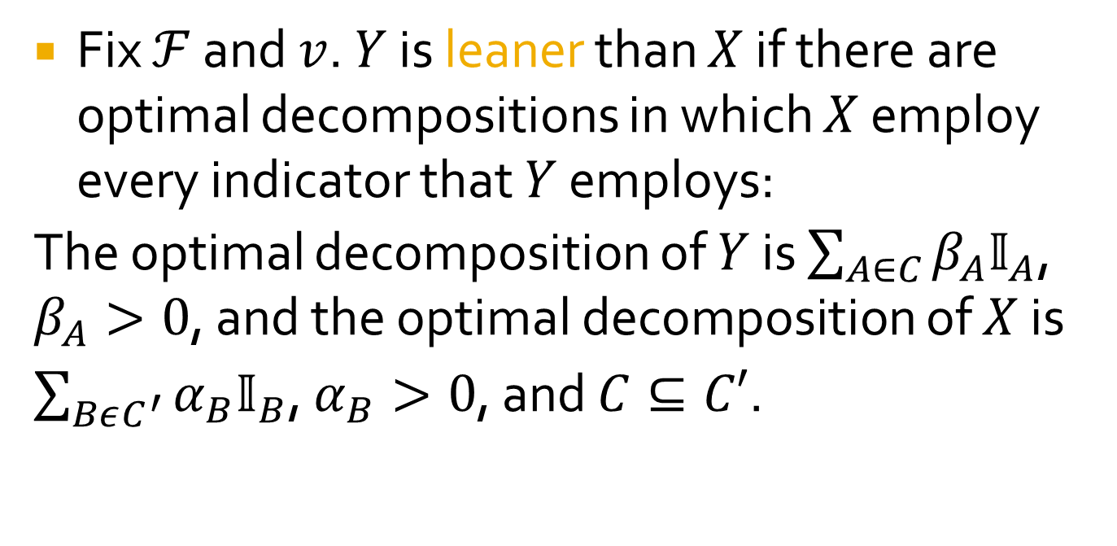
Properties of the decomposition-integral - continuation
Fix $ℱ$ and $v$. $Y$ is leaner than $X$ if there are optimal decompositions in which $X$ employ every indicator that $Y$ employs:
The optimal decomposition of $Y$ is $\sum_{A∈C}{β_{A}𝕀_{A}}$, $β_{A}>0$, and the optimal decomposition of $X$ is $\sum_{BεC^{′}}{α_{B}𝕀_{B}}$, $α_{B}>0$, and $C⊆C′$.

Slide 26
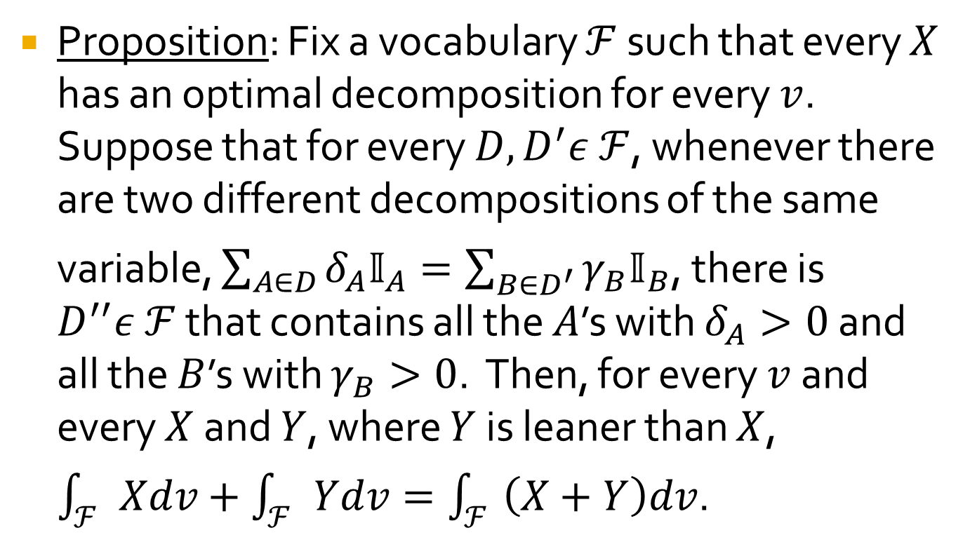
Properties of the decomposition-integral - continuation
Proposition: Fix a vocabulary $ℱ$ such that every $X$ has an optimal decomposition for every $v$. Suppose that for every $D, D^{′}ε ℱ$, whenever there are two different decompositions of the same variable, $\sum_{A∈D}{δ_{A}𝕀_{A}}=\sum_{B∈D^{′}}^{{}^{}}{γ_{B}𝕀_{B}}$, there is $D^{′′}ε ℱ$ that contains all the $A$’s with $δ_{A}>0$ and all the $B$’s with $γ_{B}>0$. Then, for every $v$ and every $X$ and $Y$, where $Y$ is leaner than $X$, $\int_{ℱ}{Xdv}+\int_{ℱ}{Ydv}=\int_{ℱ}{\left(X+Y\right)dv}$.

Slide 27
Desirable properties
Concavity
Monotonicity w.r.t. stochastic dominance
Translation-invariance

Slide 28
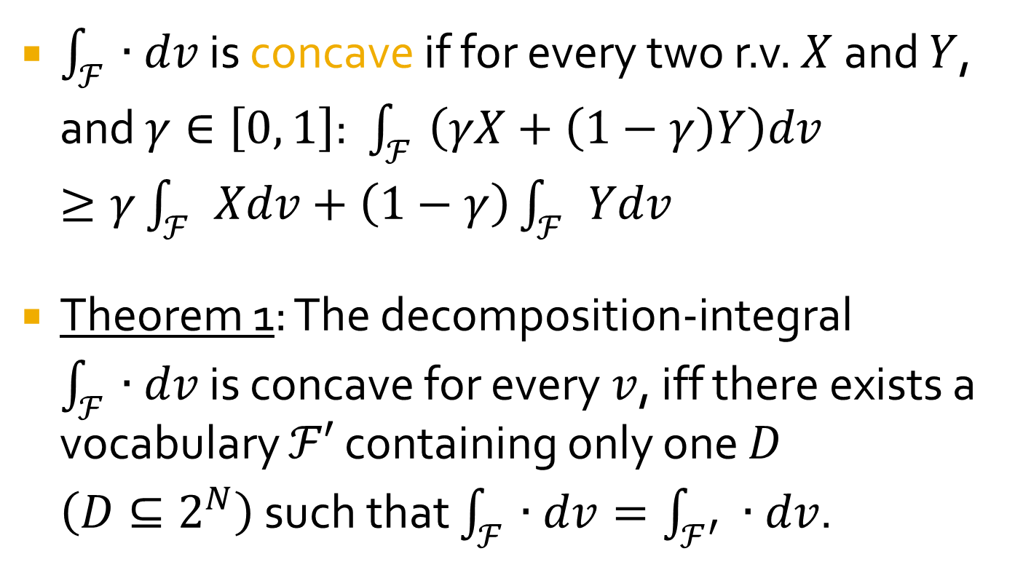
Concavity
$\int_{ℱ}{∙dv}$ is concave if for every two r.v. $X$ and $Y$, and $γ∈\left[0, 1\right]$: $\int_{ℱ}{\left(γX+\left(1−γ\right)Y\right)dv}≥γ\int_{ℱ}{Xdv}+\left(1−γ\right)\int_{ℱ}{Ydv}$
Theorem 1: The decomposition-integral $\int_{ℱ}{∙dv}$ is concave for every $v$, iff there exists a vocabulary $ℱ′$ containing only one $D$ $\left(D⊆2^{N}\right)$ such that $\int_{ℱ}{∙dv}=\int_{ℱ^{′}}{ ∙dv}$.

Slide 29
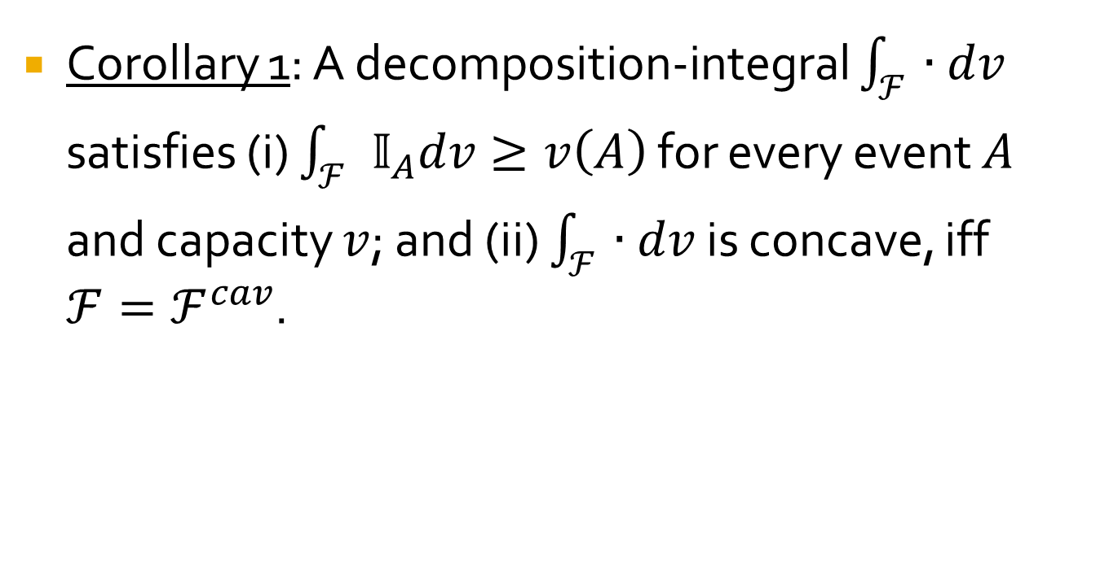
A new characterization of the concave integral
Corollary 1: A decomposition-integral $\int_{ℱ}{∙dv}$ satisfies (i) $\int_{ℱ}{𝕀_{A}dv}≥v\left(A\right)$ for every event $A$ and capacity $v$; and (ii) $\int_{ℱ}{∙dv}$ is concave, iff $ℱ=ℱ^{cav}$.

Slide 30
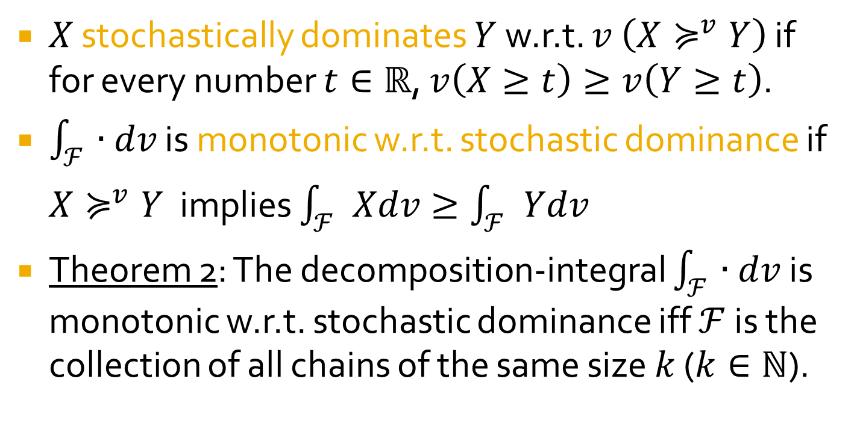
Monotonicity w.r.t. stochastic dominance
$X$ stochastically dominates $Y$ w.r.t. $v$ $\left(X≽^{v}Y\right)$ if for every number $t∈ℝ$, $v\left(X≥t\right)≥v\left(Y≥t\right)$.
$\int_{ℱ}{∙dv}$ is monotonic w.r.t. stochastic dominance if $X≽^{v}Y$ implies $\int_{ℱ}{Xdv}≥\int_{ℱ}{Ydv}$
Theorem 2: The decomposition-integral $\int_{ℱ}{∙dv}$ is monotonic w.r.t. stochastic dominance iff $ℱ$ is the collection of all chains of the same size $k$ ($k∈ℕ$).

Slide 31
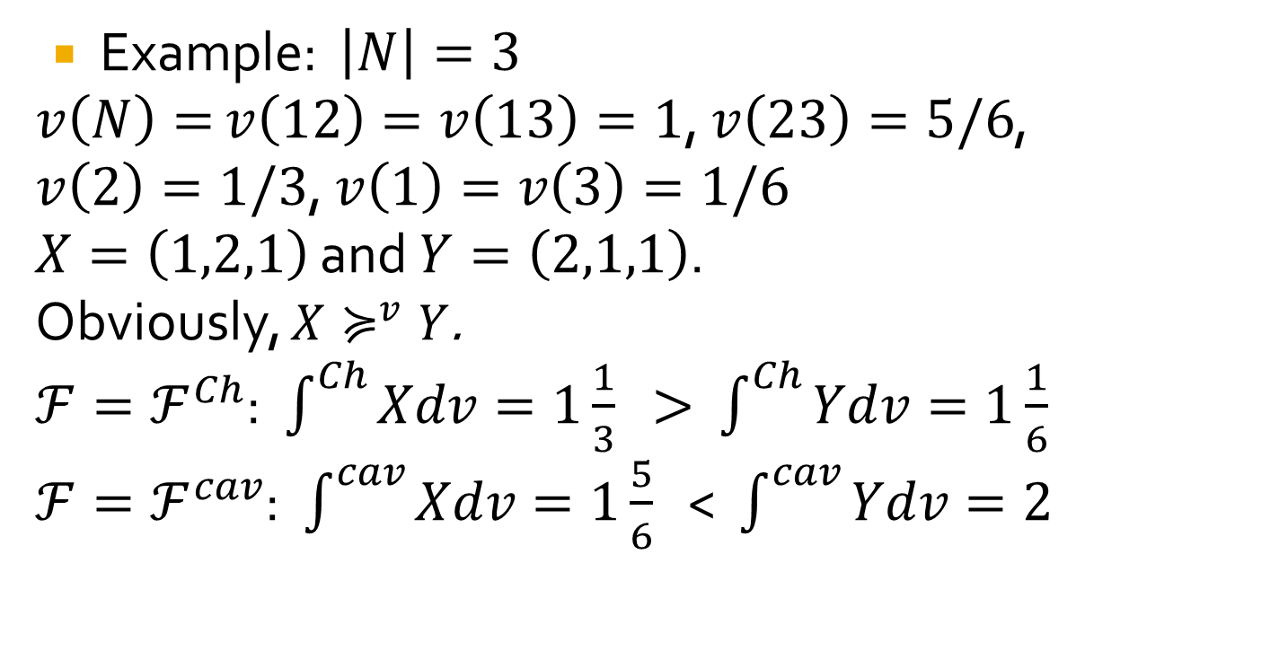
Monotonicity w.r.t. stochastic dominance
Example: $\left|N\right|=3$
$v\left(N\right)=$ $v\left(12\right)=v\left(13\right)=1$, $v\left(23\right)=5/6$, $v\left(2\right)=1/3$, $v\left(1\right)=v\left(3\right)=1/6$
$X=\left(1,2,1\right)$ and $Y=\left(2,1,1\right)$.
Obviously, $X≽^{v}Y$.
$ℱ=ℱ^{Ch}$: $\int^{Ch}{Xdv=1\frac{1}{3}}$ > $\int^{Ch}{Ydv}=1\frac{1}{6}$
$ℱ=ℱ^{cav}$: $\int^{cav}{Xdv=1\frac{5}{6}}$ < $\int^{cav}{Ydv=2}$

Slide 32
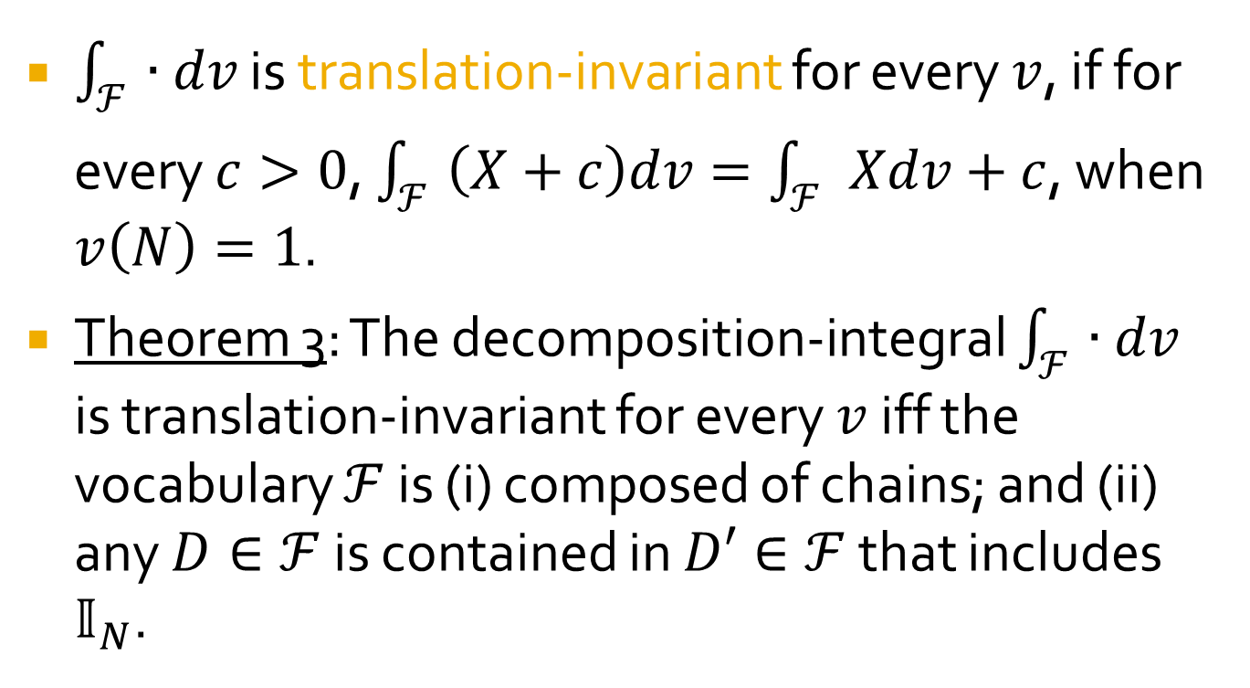
Translation-invariance
$\int_{ℱ}{∙dv}$ is translation-invariant for every $v$, if for every $c>0$, $\int_{ℱ}{\left(X+c\right)dv}=\int_{ℱ}{Xdv}+c$, when $v\left(N\right)=1$.
Theorem 3: The decomposition-integral $\int_{ℱ}{∙dv}$ is translation-invariant for every $v$ iff the vocabulary $ℱ$ is (i) composed of chains; and (ii) any $D∈ℱ$ is contained in $D′∈ℱ$ that includes $𝕀_{N}$.

Slide 33
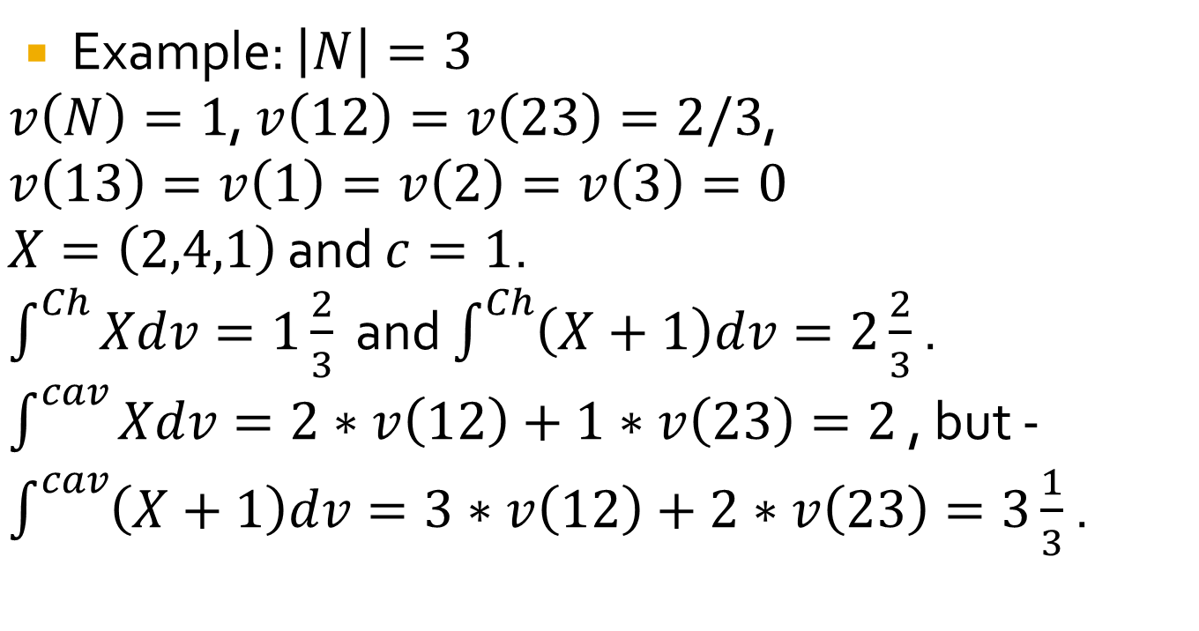
Translation-invariance
Example: $\left|N\right|=3$
$v\left(N\right)=1$, $v\left(12\right)=v\left(23\right)=2/3$,
$v\left(13\right)=v\left(1\right)=v\left(2\right)=v\left(3\right)=0$
$X=\left(2,4,1\right)$ and $c=1$.
$\int^{Ch}{Xdv=1\frac{2}{3}}$ and $\int^{Ch}{\left(X+1\right)dv=2\frac{2}{3}}$ .
$\int^{cav}{Xdv=2∗v\left(12\right)+1∗v\left(23\right)=2}$ , but -$\int^{cav}{\left(X+1\right)dv=3∗v\left(12\right)+2∗v\left(23\right)=3\frac{1}{3}}$ .

Slide 34
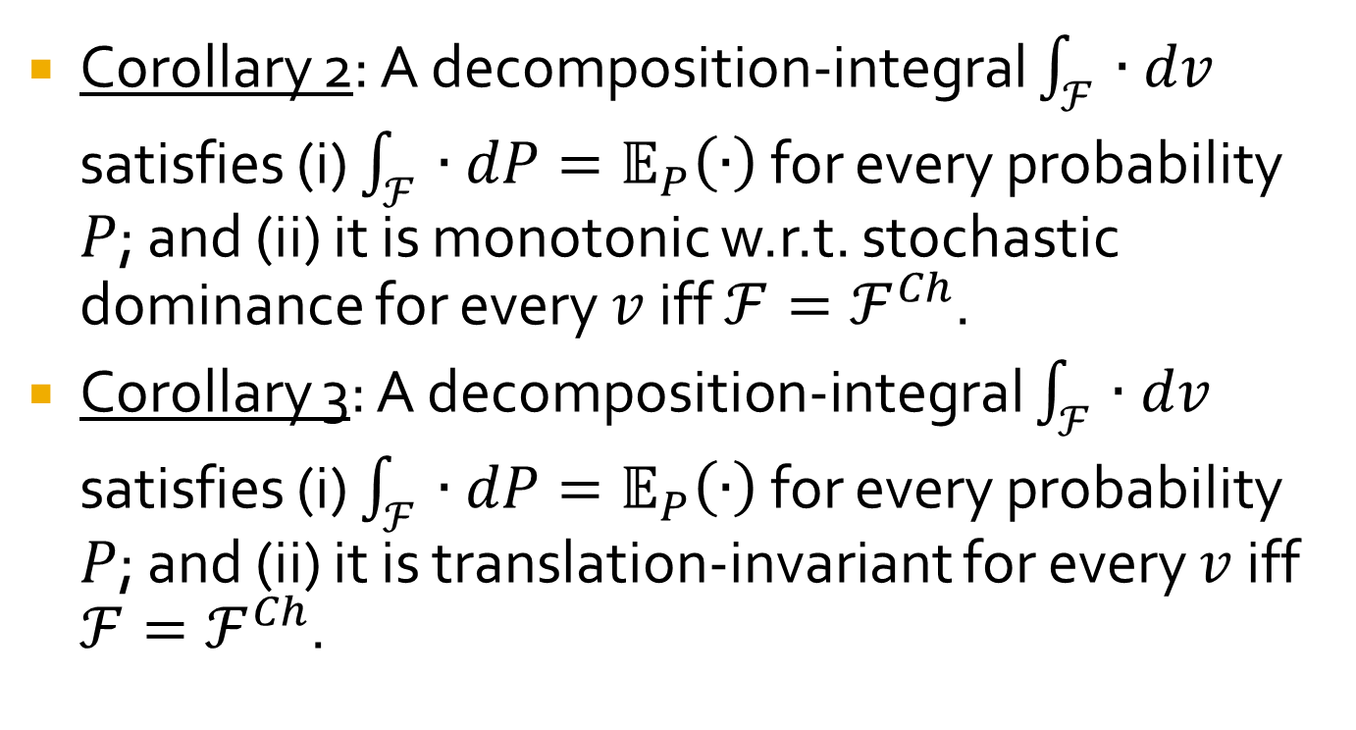
A new characterization of Choquet integral
Corollary 2: A decomposition-integral $\int_{ℱ}{∙dv}$ satisfies (i) $\int_{ℱ}{∙dP}=𝔼_{P}\left(∙\right)$ for every probability $P$; and (ii) it is monotonic w.r.t. stochastic dominance for every $v$ iff $ℱ=ℱ^{Ch}$.
Corollary 3: A decomposition-integral $\int_{ℱ}{∙dv}$ satisfies (i) $\int_{ℱ}{∙dP}=𝔼_{P}\left(∙\right)$ for every probability $P$; and (ii) it is translation-invariant for every $v$ iff $ℱ=ℱ^{Ch}$.

Slide 35
For Conclusion
A new definition for integrals w.r.t. capacities.
A new characterization of the concave integral.
Two new characterizations of integral Choquet (that do not use comonotone additivity).
Finding a trade-off between different desirable properties.

Slide 36
THE END

