Slide 1
Computational Game Theory
Lecture 1 - Introduction
Notes:
Written by Yoav Cohen

Slide 2
Agenda
Introduction to Game Theory
Basic Game Theory Examples
Strategic Games
More Game Theory Examples
Equilibrium
Mixed Strategy

Slide 3
Computational Game Theory
The study of Game Theory in the context of Computer Science, in order to reason about problems from computability and algorithm design.

Slide 4
CGT in Computer Science
Artificial Intelligence
  Single/multi agent environment
  Learning
Communications Networks
  Many players (end-users, ISVs, Infrastructure Providers)
  Players wish to maximize their own benefit and act accordingly
  The trick is to design a system where it’s beneficial for the player to follow the rules

Slide 5
CGT in Computer Science
Theory
  Algorithms design
  Complexity
  Quality of game states (Equilibrium states in particular)
Industry
  Sponsored search – design biddings to maximize bidder’s benefit while ensuring good outcome for the owners

Slide 6
Game Theory
Rational Player
  Prioritizes possible actions according to utility or cost
  Strives to maximize utility or to minimize cost
Competitive Environment
  More than one player at the same time
  Game Theory analyzes how rational players behave in competitive environments

Slide 7
Agenda
Introduction to Game Theory
Basic Game Theory examples

Slide 8
The Prisoner’s Dilema
Two criminals committed a crime and they’re held in isolation
If they both confess they get 4 years each
If neither confesses they get 2 years each
If one confesses and the other doesn’t, the one that confessed gets 1 year and the other gets 5 years.

Slide 9
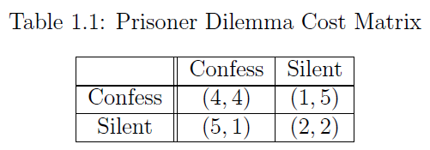
The Prisoner’s Dilema
Matrix representation of the game:

Slide 10
The Prisoner’s Dilema
Matrix representation of the game:
Row Player

Slide 11
The Prisoner’s Dilema
Matrix representation of the game:
Column Player

Slide 12
The Prisoner’s Dilema
Matrix representation of the game:
For example: Column player confesses, row player doesn’t.
Column player gets 1 year, row player gets 5 years

Slide 13
The Prisoner’s Dilema
Think about player i
  If player 1-i confesses then:
    If player i confesses he will get 4 years
    If player i doesn’t confess he will get 5 years
  If player 1-i doesn’t confess then:
    If player i confesses he will get 1 year
    If player i confesses he will get 2 years
What will player i do?

Slide 14
The Prisoner’s Dilema
Think about player i
  If player 1-i confesses then:
    If player i confesses he will get 4 years
    If player i doesn’t confess he will get 5 years
  If player 1-i doesn’t confess then:
    If player i confesses he will get 1 year
    If player i confesses he will get 2 years
Confessing is the best action for player i

Slide 15
The Prisoner’s Dilema
Game Theory predicts that both players will choose to confess
This is called an Equilibrium (to be defined later)

Slide 16
ISP Routing
Internet Service Providers (ISP) often share their physical networks for free
In some cases an ISP can either choose to route traffic in its own network or via a partner network

Slide 17
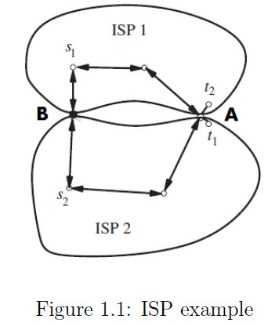
ISP Routing
ISPi needs to route traffic from si to ti
A and B are gateways between their physical networks
The cost of routing
along each edge is
1
A
B

Slide 18
ISP Routing
For example: ISP1 routes via A
  Cost for ISP1: 1
  Cost for ISP2: 3
A
B

Slide 19
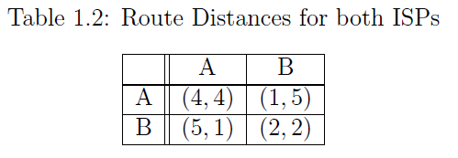
ISP Routing
Cost matrix for the game:
A
B

Slide 20
ISP Routing
Think about ISPi
  If ISP1-i routes via A
    If ISPi routes via A its cost would be 3+1=4
    If ISPi routes via B its cost would be 3+2=5
  If ISP1-i routes via B
    If ISPi routes via A its cost
    would be 1+1=2
    If ISPi routes via B its cost
    would be 1+2=3
A
B

Slide 21
ISP Routing
Think about ISPi
  If ISP1-i routes via A
    If ISPi routes via A its cost would be 3+1=4
    If ISPi routes via B its cost would be 3+2=5
  If ISP1-i routes via B
    If ISPi routes via A its cost
    would be 1+1=2
    If ISPi routes via B its cost
    would be 1+2=3
    A is the best option for ISPi
A
B

Slide 22
ISP Routing
(A,A) is an Equilibrium
A
B

Slide 23
Agenda
Introduction to Game Theory
Basic Game Theory examples

Slide 24
Strategic Games
The game consists of only one ‘turn’
All the players play simultaneously and are unaware of what the other players do
Players are selfish, wanting to maximize their own benefit

Slide 25
Strategic Games – Formal Model
N = {1,…,n} players
Player i has m possible actions Ai = {ai1,…,aim}. Action == Strategy (wording)
The space of all possible action vectors is A = A1×…×An
A joint action is the vector a∈A (the game outcome – the action of each player)
Player i has a utility function ui: A→ℛ or a cost function ci: A→ℛ

Slide 26

Strategic Games – Formal Model
A strategic game is the triplet:

Slide 27
Strategic Games – Formal Model
A strategic game is the triplet:
Players

Slide 28
Strategic Games – Formal Model
A strategic game is the triplet:
Actions of each player

Slide 29
Strategic Games – Formal Model
A strategic game is the triplet:
Utility of each player

Slide 30
Dominant Strategy
Describes the best action a player can choose
Action ai of player i is a Weak Dominant Strategy if:
Action ai of player i is a Strong Dominant Strategy if:

Slide 31
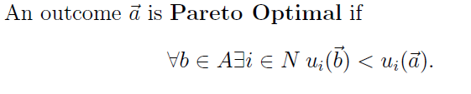
Pareto Optimality
An outcome a of a game is pareto optimal if for every other outcome b, some player will lose by changing to b

Slide 32
Agenda
Introduction to Game Theory
Basic Game Theory examples

Slide 33
Picking up after your dog
N players live in a neighborhood. Each owns a dog.
Each player has a cost function:
  The cost of picking up after your dog is 3
  The cost incurred by not picking up after a dog is 1
A single player’s point of view:
  If k players choose “Leave” and n-k-1 players choose “Pick”:
    If I choose “Leave” my cost would be k+1
    If I choose “Pick” my cost would be k+3

Slide 34
Picking up after your dog
“Leave” is a dominant action for a player
Note:
  If all players choose “Pick” the cost would be 3 for each
  The dominant action can be changed by changing the rules: assume the authorities would fine me every time I choose “Leave”

Slide 35
Tragedy of the commons
Assume there’s a shared resource (network bandwidth) and N players.
Each player requests a proportion of the resource, by choosing Xi from [0,1].
If the sum of all Xi > 1 then the resource collapses (everyone gets 0, all ui = 0)
Otherwise, each gets according to their request: uj=(1-ΣXi)Xj

Slide 36



Tragedy of the commons
A single player’s point of view:
  Define
  Player i will try to maximize f which is:
  Taking the derivative of f yields:
  In order to find the maximum of f we require:

Slide 37


Tragedy of the commons
The dominant action for player i is:
The utility for player i according to Xi is:
(see scribe notes for a complete proof)

Slide 38


Tragedy of the commons
Even though we calculated a dominant action for each player, it is not Pareto Optimal:
  If each player choose:
  We will get:

Slide 39
Agenda
Introduction to Game Theory
Basic Game Theory examples

Slide 40
Nash Equilibrium
A Nash Equilibrium is an outcome of the game in which no player can improve its utility alone:
Alternative definition: every player’s action is a best response:

Slide 41
Battle of the Sexes
2 players (of different gender) should decide on which even to attend (Sports or Opera)
The man prefers going to the Sports event
The woman prefers going to the Opera
Each player has a utility:
  If I attend my preferred event I get 2 points, 1 otherwise.
  If we both go to the same event I get 2 points, 0 otherwise.

Slide 42
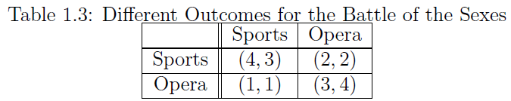
Battle of the Sexes
The payoff matrix:

Slide 43
Battle of the Sexes
The payoff matrix:
Row player has no incentive to move up

Slide 44
Battle of the Sexes
The payoff matrix:
Column player has no incentive to move left

Slide 45
Battle of the Sexes
The payoff matrix:
So this is an Equilibrium state

Slide 46
Battle of the Sexes
The payoff matrix:
Same thing here

Slide 47
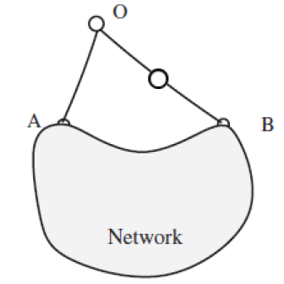
Routing Game
2 players need to send a packet from point O to the network.
They can send it via A (costs 1) or B (costs 2)

Slide 48
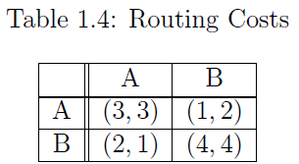
Routing Game
The cost matrix:

Slide 49
Routing Game
The cost matrix:
Equilibrium states

Slide 50
Agenda
Introduction to Game Theory
Basic Game Theory examples

Slide 51
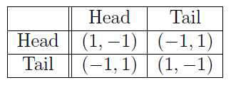
Matching Pennies
2 players, each chooses Head or Tail
Row player wins if they match the column player wins if they don’t
Utility matrix:

Slide 52
Matching Pennies
2 players, each chooses Head or Tail
Row player wins if they match the column player wins if they don’t
Utility matrix:
Row player is fine, but Column player wants to move left

Slide 53
Matching Pennies
2 players, each chooses Head or Tail
Row player wins if they match the column player wins if they don’t
Utility matrix:
Column player is fine, but Row player wants to move up

Slide 54
Matching Pennies
2 players, each chooses Head or Tail
Row player wins if they match the column player wins if they don’t
Utility matrix:
Row player is fine, but Column player wants to move right

Slide 55
Matching Pennies
2 players, each chooses Head or Tail
Row player wins if they match the column player wins if they don’t
Utility matrix:
Column player is fine, but Row player wants to move down

Slide 56
Matching Pennies
2 players, each chooses Head or Tail
Row player wins if they match the column player wins if they don’t
Utility matrix:
No equilibrium state!

Slide 57
Mixed Strategy
Players do not choose a pure strategy (one specific strategy)
Players choose a distribution over their possible pure strategies
For example: with probability p I choose Head, and with probability 1-p I choose Tail

Slide 58
Matching Pennies
Player 1 chooses Head with probability p and Tail with probability 1-p
Player 2 chooses Head with probability q and Tail with probability 1-q
Player i wants to maximize its expected utility
What’s the best response for player 1?
  If I choose Head then with probability q I get 1and with probability 1-q I get -1. u = 2q-1.
  If I choose Tail then with probability q I get -1 and with probability 1-q I get 1. u = 1-2q.

Slide 59
Matching Pennies
So player 1 will choose Head if 2q-1 > 1-2q which results in q > ½
If q < ½ player 1 will choose Tail
If q = ½, the player is indifferent
The same holds for player 2
Equilibrium is reached if both players choose the mixed strategy (½, ½)

Slide 60




Mixed Strategy
Each player selects where is the set of all possible distributions over Ai
An outcome of the game is the Joint Mixed Strategy
An outcome of the game is a Mixed Nash Equilibrium if for every player

Slide 61



Mixed Strategy
2nd definition of Mixed Nash Equilibrium:
Definition:
Definition:
3rd definition of Mixed Nash Equilibrium:

Slide 62
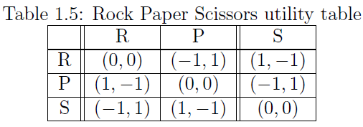
Rock Paper Scissors
No pure strategy Nash Equilibrium, only Mixed Nash Equilibrium, for mixed strategy (1/3, 1/3, 1/3) .

Slide 63

Location Game
N ice cream vendors are spread on the beach
Assume that the beach is the line [0,1]
Each vendor chooses a location Xi, which affects its utility (sales volume).
The utility for player i :
X0 = 0, Xn+1 = 1

Slide 64
Location Game
For N=2 we have a pure Nash Equilibrium:
No player wants to move since it will lose space
For N=3 no pure Nash Equilibrium:
The player in the middle always wants to move to improve its utility
0
1/2
1
0
1/2
1

Slide 65
Location Game
If instead of a line we will assume a circle, we will always have a pure Nash Equilibrium where every player is evenly distanced from each other:

Slide 66


Cournot Competition
N companies are producing the same product
Company I needs to choose its production volume, Xi>=0
The price is determined based on the overall production volume,
Each company has a production cost:
The utility of company i is:

Slide 67


Cournot Competition
Case 1: Linear price, no production cost
  Company i’s utility:
  Pure Nash Equilibrium is reached at:

Slide 68

Cournot Competition
Case 2: Harmonic price, no production cost
  Company i’s utility:
  Companies have incentive to produce as much as they can – no pure or mixed Nash Equilibrium

Slide 69
Auction
N players wants to buy a single item which is on sale
Each player has a valuation for the product, vi
Assume WLOG that v1>=v2>=…
Each player submits its bid, bi, all players submit simultaneously.

Slide 70
Auction
Case 1: First price auction
  The player with the highest bid wins
  The price equals to the bid
  1st Equilibrium is:
    The first player needs to know the valuation of the second player – not practical
  2nd Equilibrium is:

Slide 71
Auction
Case 2: Second price auction
  The player with the highest bid wins
  The price equals to the second highest bid
    No incentive to bid higher than one’s valuation - a player’s utility when it bids its valuation is at least as high than when it bids any other value
    This mechanism encourages players to bid truthfully

