Slide 1
Video game training enhances cognitive control in older adults Research directed by Dr. Adam Gazzaley
Undergraduate EEG Seminar
By Idan Misgav

Slide 2
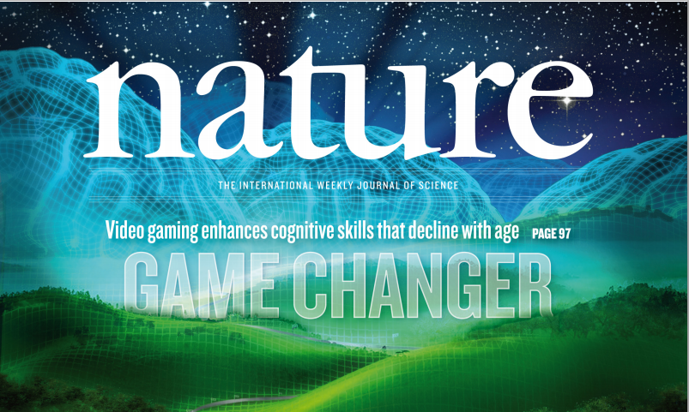

Slide 3
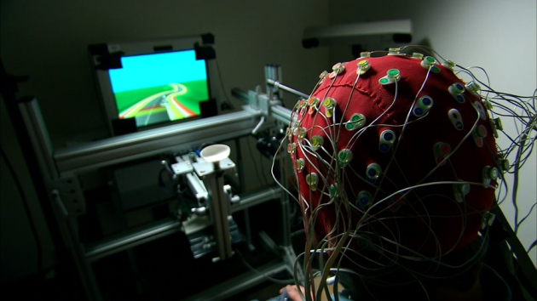
http://www.nature.com/news/gaming-improves-multitasking-skills-1.13674
Introduction
Motivating video:

Slide 4
Introduction
Multitasking behavior has become ubiquitous in today’s world
Cognitive control deficits and multitasking difficulties in ageing population
Develop platforms to enhance cognitive abilities (and make it publicly affordable)
Extend use as a therapeutic tool

Slide 5
Research overview
evaluate multitasking performance across the adult lifespan
Explore if differences in training programs make significant effects on multitask results
Compare between multitask performance of trained older adults to untrained younger adults
Benefits to untrained cognitive abilities

Slide 6
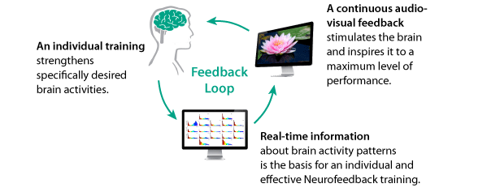
Background: neurofeedback
NeuroRacer feedback methods

Slide 7
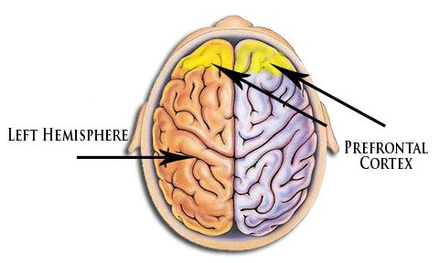
Background: prefrontal cortex
Acts as an "executive" for the decision making process
Planning a person's response to complex problems
Attention

Slide 8
Background: prefrontal cortex
Regulating behavior
Make choices and react to changing situations
Predict outcomes and plan ahead
contains the connections between the major sensory and major motor systems
The place where information converges in the brain

Slide 9
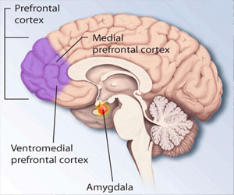
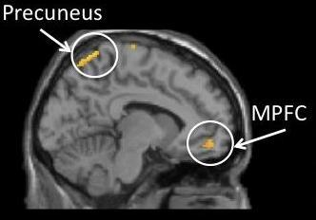
Background: medial prefrontal cortex
Acts as an "executive" for the decision making process
Planning a person's response to complex problems
Attention

Slide 10
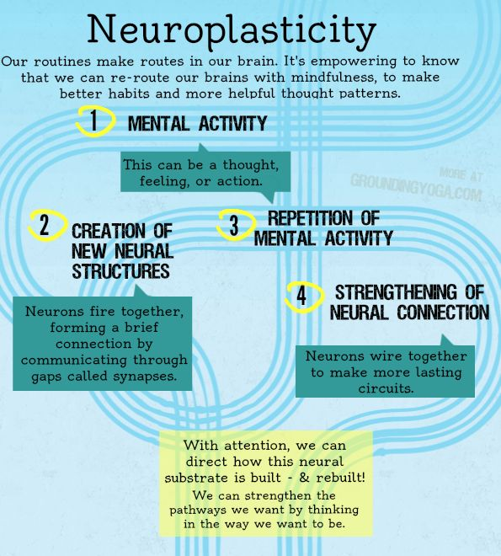
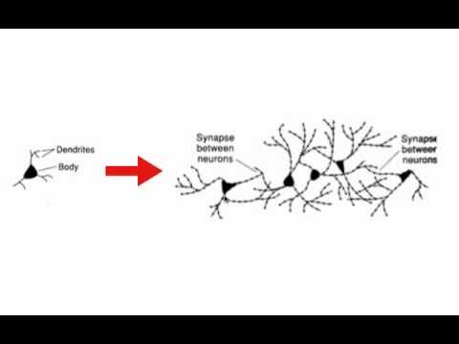
Background: neuroplasticity
Brain remodels itself based on experiences
NeuroRacer designed to maximally drive neural plasticity

Slide 11
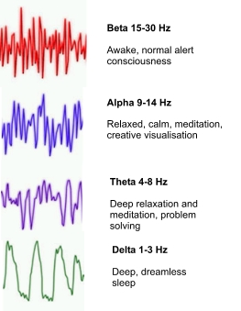
EEG
Theta waves oscillate about 3.5 – 7.5 times per second (Hz)
Each brain wave has a purpose and serves in mental functioning
Theta waves are connected to us experiencing and feeling deep and raw emotions

Slide 12
Frontal midline theta
can be observed in normal subjects, during mental task performance
reflects focused attentional processing
related to working memory (WM) processes, as it typically increases with WM load
Reflects transfer of information from\to long-term memory

Slide 13
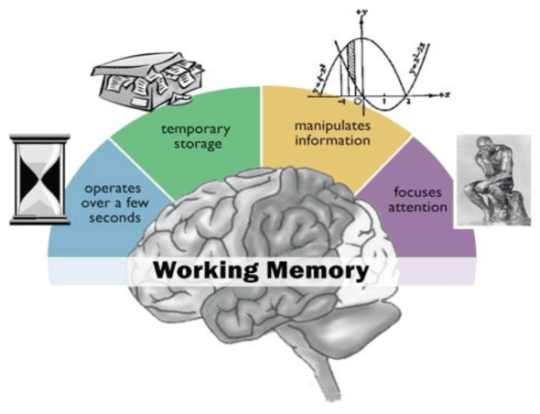
Important terms
Working memory- Refers to the capacity to keep track of and update information at the moment. “Brain’s scratch pad”
Location: prefrontal cortex

Slide 14
First experiment
Main goal: evaluate multitasking performance across the adult lifespan
174 participants spanning six decades of life
(ages 20–79; ~30 individuals per decade)
Participants performance evaluated by two tasks:
Discrimination ability (‘sign only’) – measure response time
Multitask performance (‘sign and drive) – combined score

Slide 15
Experiment procedure
Location: lab
3 runs (180 seconds each) of ‘sign only’ task
3 runs (180 seconds each) of ‘sign and drive’ task
Each run contained 72 shapes (36 green circles , 36 lures)

Slide 16
Terms and definitions for results understanding
Signal detection method of discriminability (d’):
A statistic to quantify the ability to discern between information-bearing patterns
When sampled variable is normal, d’ has an exact formula
Usually the following estimator is used:
d’ := Z(hit rate) – Z(false alarm rate)

Slide 17
Terms used for analysis
Cost := percentage change in d’ from ‘sign only’ to ‘sign and drive’
greater cost (that is, a more negative percentage cost) indicates increased interference when simultaneously engaging in the two tasks

Slide 18
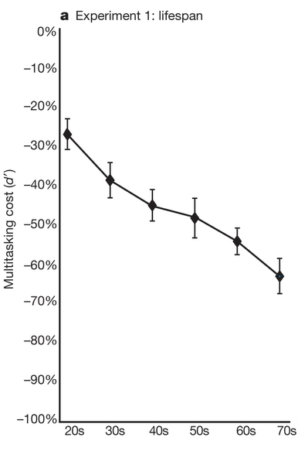
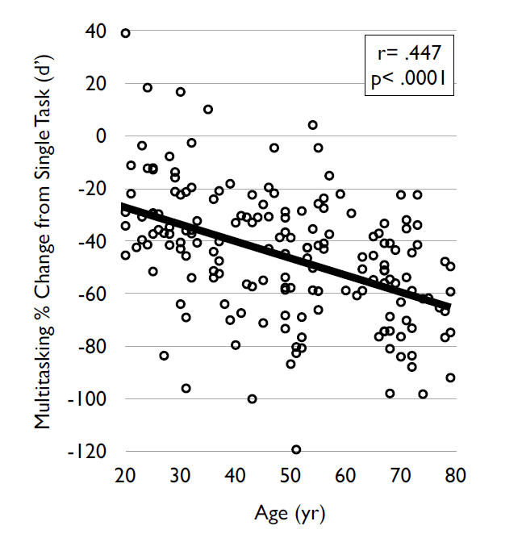
Experiment 1 results

Slide 19
Experiment conclusions
Multitasking performance diminished significantly across the adult lifespan
Linear fashion reduction
Most significant difference cost between adjacent decades from the twenties (-26.7% cost) to the thirties (-38.6% cost)
Deterioration in multitask performance is consistent with age-related cognitive abilities decline (e.g. working memory, reasoning)

Slide 20
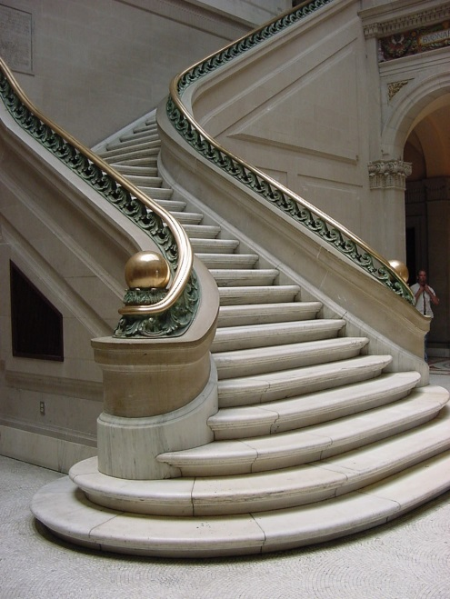
Adaptive staircase Algorithm
Participants underwent an adaptive thresholding procedure
Determine ‘sign level’ and ‘drive level’ for each participant
Converge to ~80% accuracy

Slide 21
Adaptive staircase Algorithm
Thresholding parameters chosen following extensive pilot
Regression analysis to ideally determine levels
Fairer comparison across ages and abilities
Frequently omitted phase from another studies

Slide 22
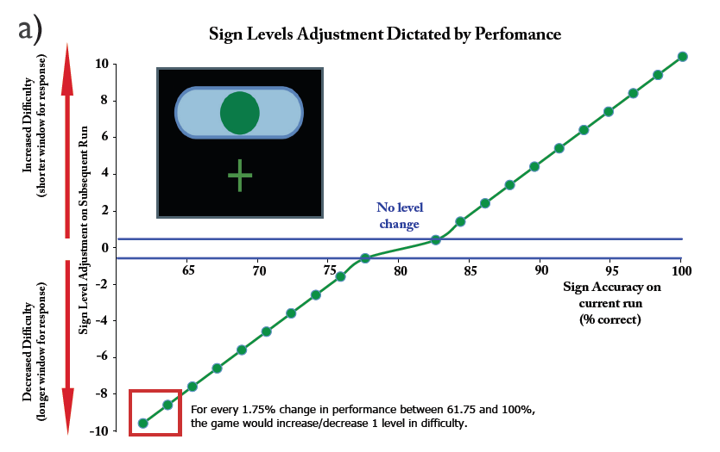
Min window: 250 msec ; Max window: 1000 msec
Level of difficulty = 10 msec

Slide 23
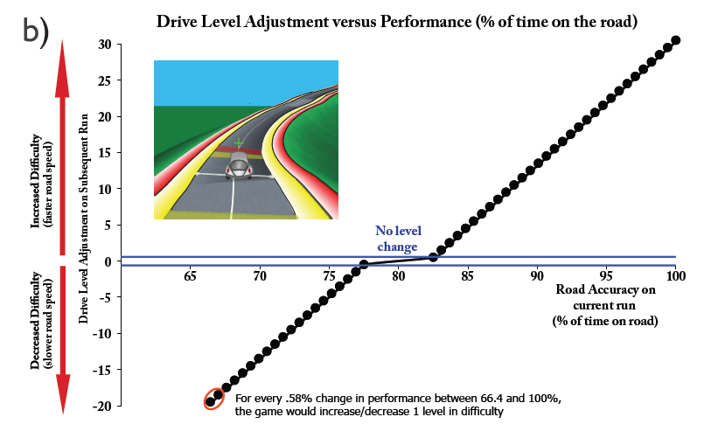
40 different levels
http://www.youtube.com/watch?v=qnW9iMTSD0E

Slide 24
Game level and single task performance

Slide 25
Another algorithm aspects
Equivalent number of randomly ordered “track pieces” for each run
Equal number of green circle and distractive shape appearances (appear on screen every 2, 2.5 or 3 sec randomly)

Slide 26
Second Experiment
main goals:
explore whether older adults who trained by playing in multitasking mode would exhibit improvements in their multitasking performance on the game
Explore whether performance gains would remain stable after a significant amount of time
Determine if the multitask training helps to improve cognitive abilities beyond the improvements achieved after component task training

Slide 27
Participants (n=46)
MTT
STT
NCC
Multitask training
Single Task Training
No Contact control
MTT group (n=16) played the ‘sign and drive’ condition exclusively during the training period
STT group (n=15) divided their time between a ‘sign only’ and a ‘drive only’ condition
(component tasks)
NCC group (n=15) have not trained at all
Older adults (60-85 years old; 67.1 (4.2 ±
Must meet certain criteria
No between-group difference observed

Slide 28
Procedures
Training involved playing NeuroRacer on a laptop at home for 1 h a day, 3 times a week for 4 weeks (12 h of training in total)
Isolate the multitask factor
All groups returning for a post-training assessment after 1 month, and a follow-up assessment after 6 months
Again, adaptive algorithm approach

Slide 29
Experiment tools
The neural basis of training effects was evaluated using EEG (neural assessment version of NeroRacer)
Long-range theta coherence as a secondary cognitive control measure
a battery of cognitive control tests used to assess the breadth of training benefits

Slide 30
Neural basis analysis
ERSP (Event Related Spectral Perturbation):
Measure of event-related brain dynamics
The ERSP measures average dynamic changes in amplitude of the broad band EEG frequency spectrum as a function of time
Identify stable features in a spontaneous EEG spectrum

Slide 31
Neural basis analysis
ERSP (Event Related Spectral Perturbation):
Isolate markers of cognitive control
Powerful and innovative
Researchers felt it was the most accurate

Slide 32
Experiment results
Only MTT group showed significant post-training multitask cost reduction (from -64.2% cost to -16.2% cost).
Equivalent improvement in component task skills was exhibited by both MTT and STT
Notably in the MTT group, the multitasking performance gains remained stable 6 months after training

Slide 33
Experiment results
MTT group’s post-training cost improved significantly beyond the cost level attained by a group of 20 year olds who played a single session
Only MTT group demonstrated a significant increase in both neural measures
Coherence results demonstrate for the first time modulation of a neural network in response to cognitive training in older adults

Slide 34
Experiment results
MTT group showed an improvement in general (untrained) cognitive control abilities
Only MTT group exhibited a strong correlation between multitasking cost reduction and improvements on an untrained cognitive control task (delayed-recognition with distractions)
Cognitive improvements were specific to working memory and sustained attention

Slide 35
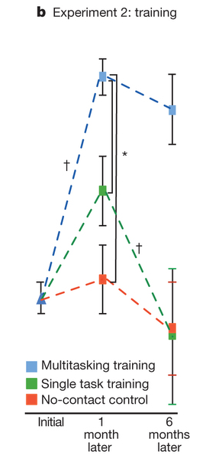
Experiment Results

Slide 36
Experiment Results

Slide 37
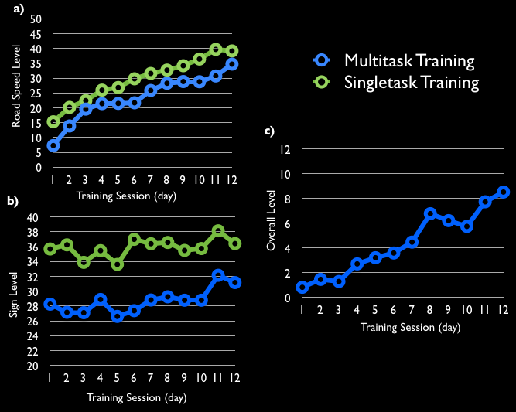
Experiment Results

Slide 38
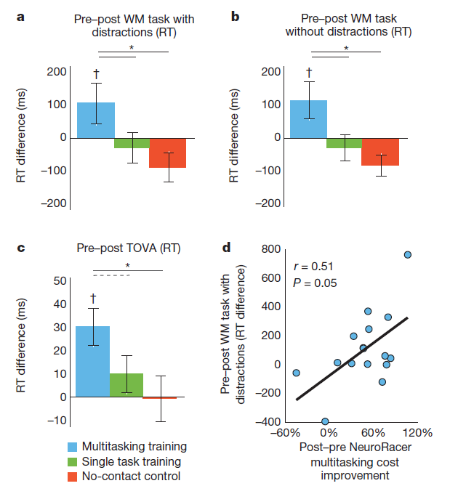
Experiment Results

Slide 39
Conclusions
Centrality of the interference factor during training
Enhanced multitasking ability was not solely the result of enhanced component skills, but a function of learning to resolve interference generated by the two tasks when performed concurrently

Slide 40
Conclusions
Performance gains preserved for a long period of time
Enhanced cognitive performance on untrained tasks
Improvements were specific to WM and sustained attention – no between group difference in processing speed tests

Slide 41
Conclusions
Underlying mechanism of cognitive control was challenged and enhanced
Training-induced Neuroplasticity is the mechanistic basis of training effects
These findings evidence a shift in the rapid engagement of prefrontal cognitive control processes (400ms from sign to motor response)

Slide 42
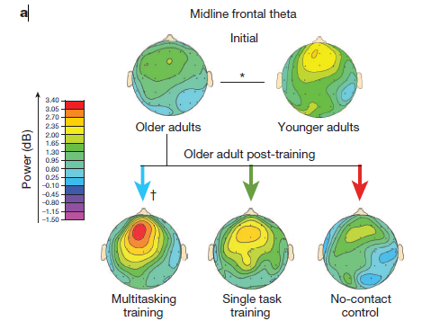
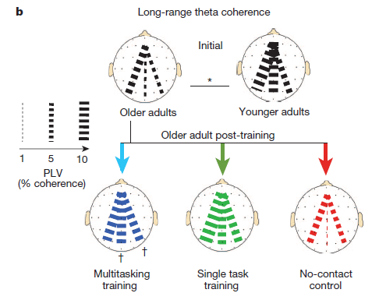
Neural basis of training effects

Slide 43
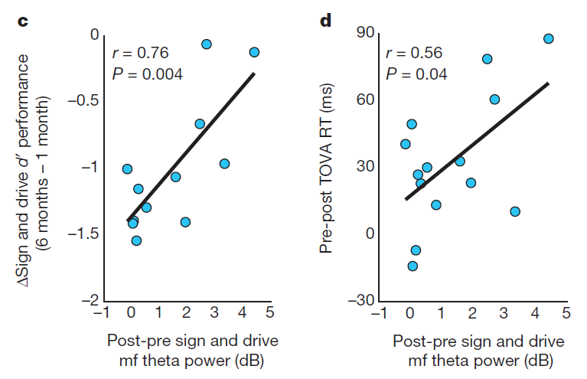
Neural basis of training effects

Slide 44
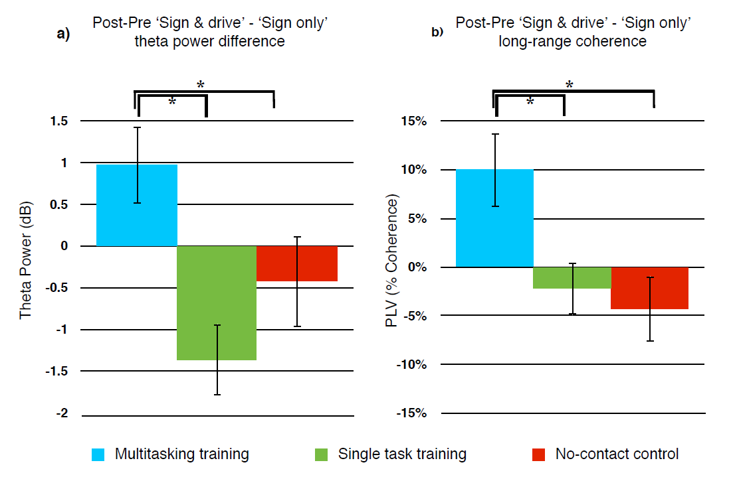
Neural basis of training effects

Slide 45
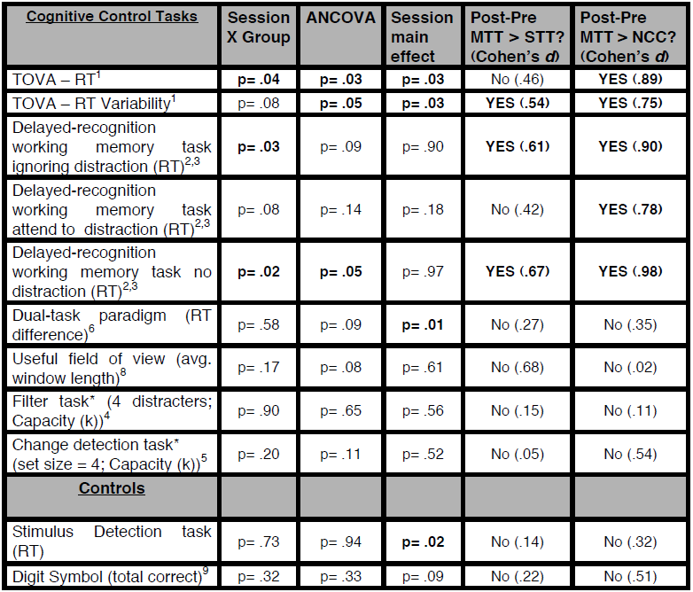
Cognitive tests

Slide 46
Third experiment
Main goal:
Compare neural measures between younger adults and older adults
Participants:
Same 47 older adults from experiment two
Untrained younger adults (n=18; 20–29 years old (24.1 ± 2.9))

Slide 47
Experiment procedure
Compare midline frontal theta power and long-range coherence between groups
Compare MTT group post-training neural measures to those of the young adults

Slide 48
Experiment results
Less theta power and coherence in older adults when processing signs in either condition
Compare MTT group post-training neural measures to those of the young adults
MTT group training led to changes in the neural processing of signs that reached level comparable to neural activity patterns of younger adults

Slide 49
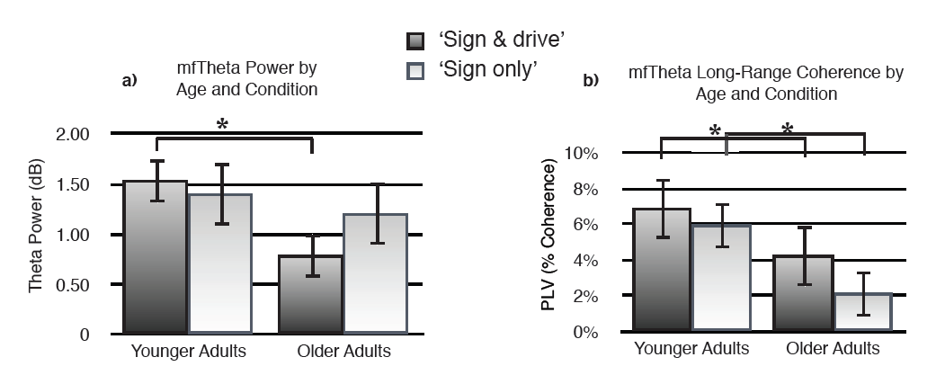
results Experiment

Slide 50
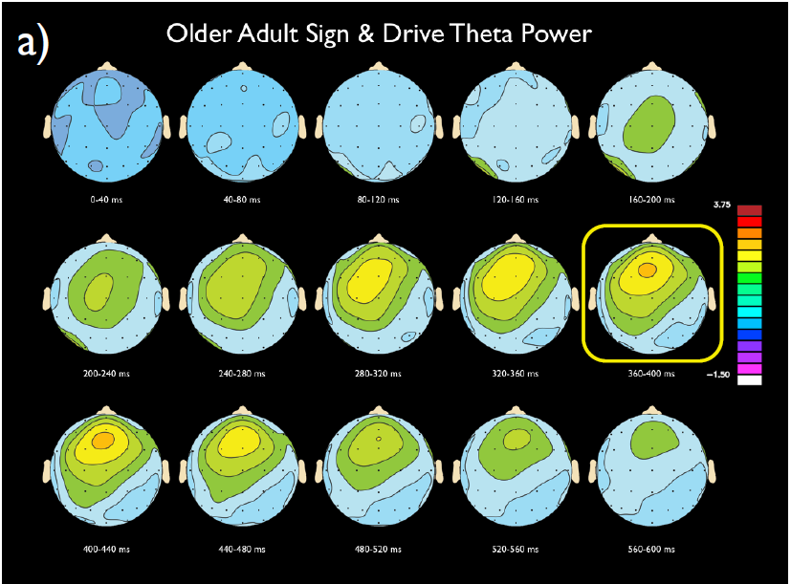
results Experiment

Slide 51
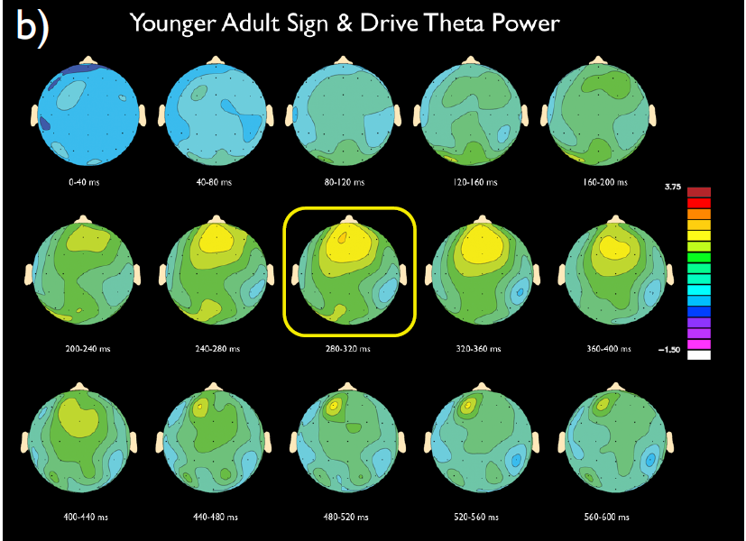
results Experiment

Slide 52
conclusions Experiment
Ageing is associated with a reduction in neural measures while discriminating visual stimuli
NeuroRacer training may benefit cognitive control abilities by improving the ability of older adults to suppress the default network during task engagement

Slide 53
Summary
Neural and behavioral evidence of positive effects from video game training on cognitive control abilities
Enhancements comparable to young and habitual video game players

Slide 54
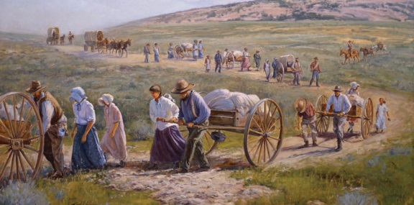
Summary
A first of it’s kind pioneering research
A custom-designed videogame can be used to assess cognitive abilities during lifespan
Can be used also to evaluate underlying neural mechanisms
Can serve as a powerful tool for cognitive enhancements
Far transfer of benefits to untrained task

Slide 55
Summary
Go ahead and buy your beloved elderly a nice video game!
Questions?

