Slide 1
Effect of Brain Stimulation on Attention
Itai Admi
Guy Rosenmann
Yair Levi

Slide 2


Introduction to ADHD & ADD
ADHD (Attention deficit hyperactivity disorder): one of the most common childhood brain disorders . Affects about 10% of school-age children.
ADD (Attention deficit disorder): Similar to ADHD, without hyperactivity. children are more socially withdrawn, and may be described as “daydreamers”.
Similar but different …

Slide 3
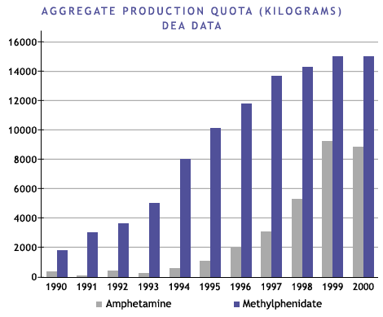
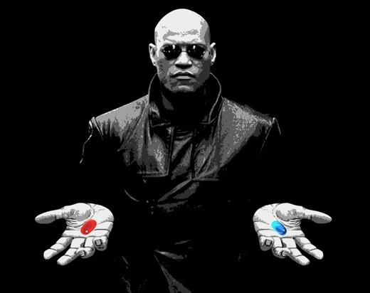
Problem Description
In modern times, the percentage of people diagnosed with ADD or ADHD is constantly increasing. As a result, the use of central nervous system stimulant (Ritalin, Concerta, etc..) is more common.
Patients have no indications for the right time to take the drug and sometimes take more than needed – causing strong side effects (anxiety, dizziness, sleep problems and many more).
There is no quick and efficient way to monitor patients.

Slide 4
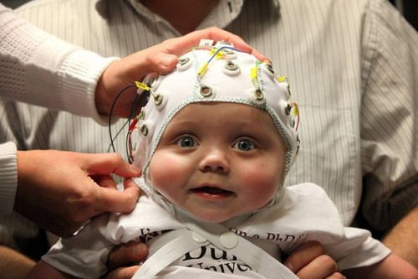
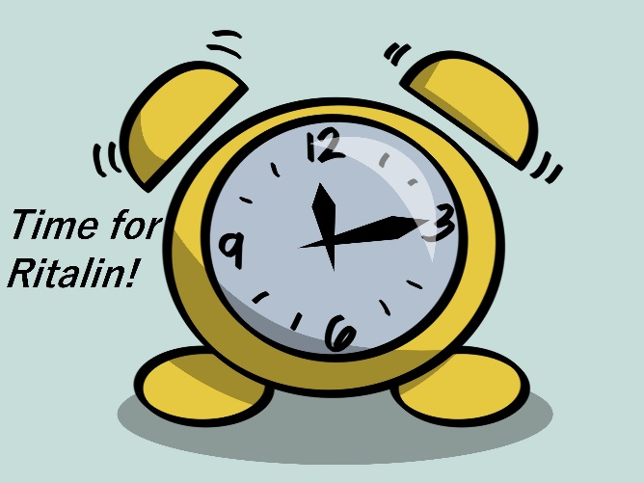
Our goals
Analyze brain activity using the EEG box in order to enable fast, easy and reliable diagnosis of ADD/ADHD. A simple and quick way to diagnose patients would help treat only the ones who need help.
Maximize the medicine effect while reducing the overall usage by indicating the right time to use the drug.

Slide 5
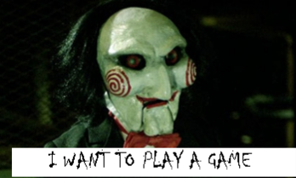
Our Solution
We will collect brain activity data from 3 groups: control group and Ritalin/Concerta divided to ADD & ADHD groups.
Each participant will play a game measuring his level of attention for several minutes, while connected to the EEG box.
After collecting data from as many users as possible, we will analyze the results from the game and the EEG box.

Slide 6
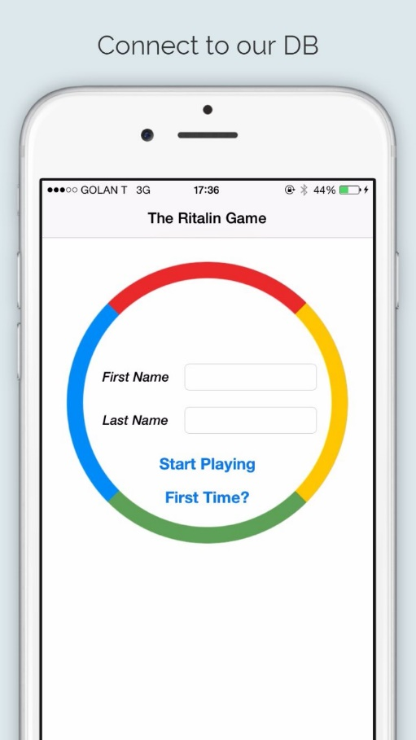
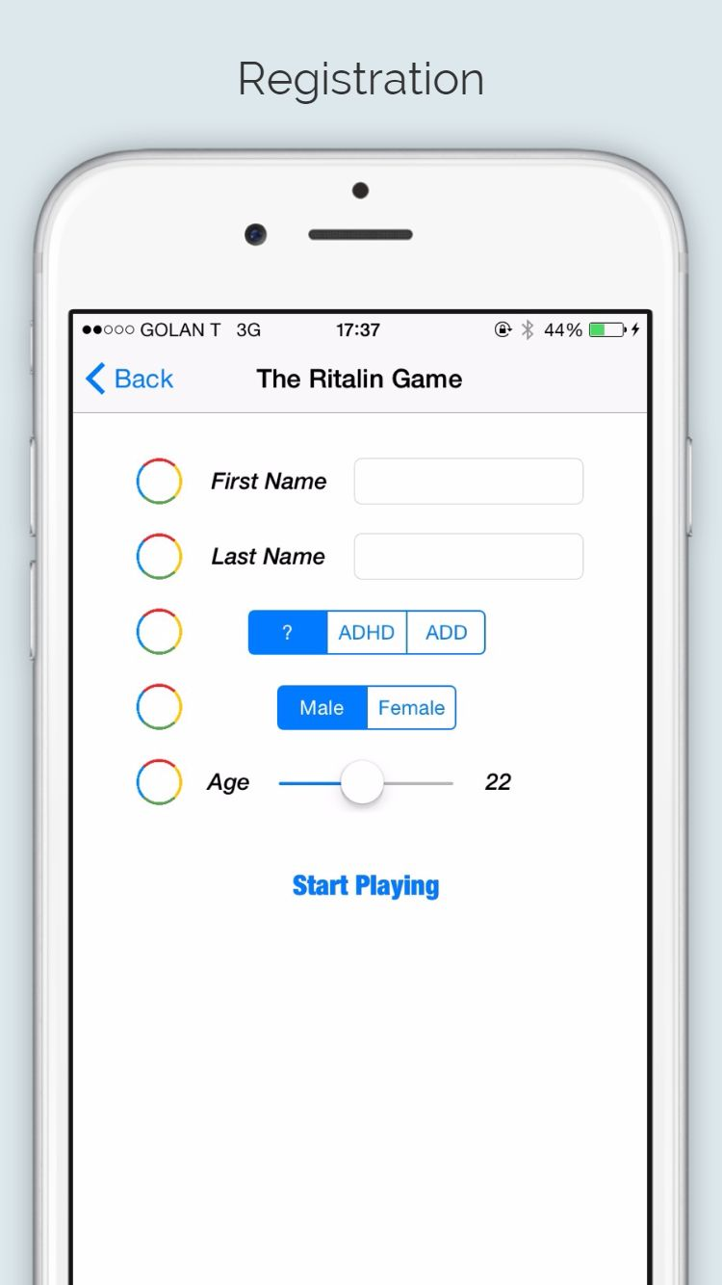
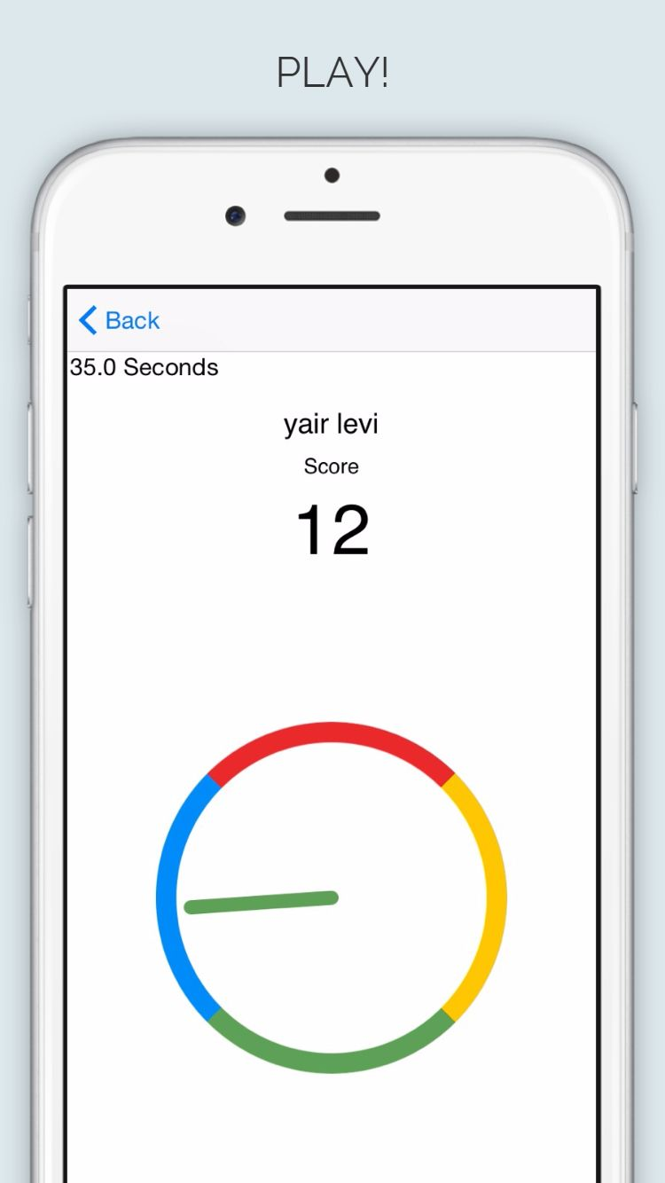
Our Solution - THE App

Slide 7
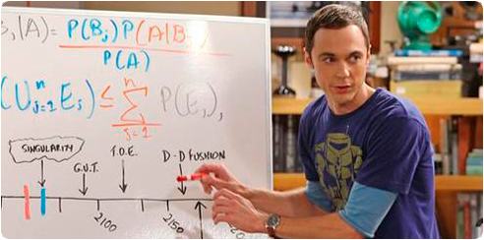
Our Solution - Analyzing Results
Use results as a POC of a new diagnostic tool for ADD/ADHD. This tool will result a much more fast and reliable diagnosis.
As the technology advances and EEG boxes will become more convenient for personal daily use, patients can use it as a monitor. The monitor will inform the best time to consume the medicine.

Slide 8
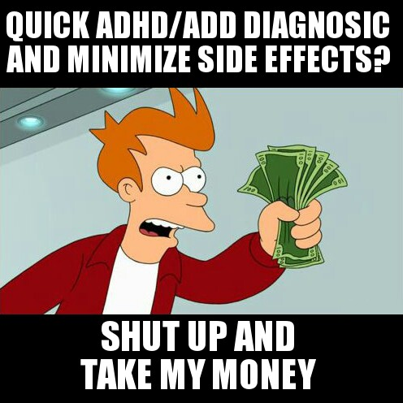
Potential Users
Licensed clinicians, such as psychologists, physicians (including psychiatrists, neurologists, pediatricians, and family practitioners), nurse clinicians, and many more – in order to diagnose patients.
Daily consumers of concentration drugs.

Slide 9

Timeline
Game Development (in final stages) – a game with adjustable difficulty, which patients will play during EEG monitoring time.
Collecting brain activity data from different participants, while they play the game (preferably ADD/ADHD diagnosed).
Analyzing collected data from the EEG box and the game. Concluding results.
1 week
3-4 weeks
1-2 weeks

