Slide 1
Physiological Monitoring for NeuroMarketing
Reut Ben Mocha, Tom Sisso, Raz Lugassi
Workshop 14/15b

Slide 2
Overview
Marketing strategy is the fundamental goal of increasing sales and achieving a sustainable competitive advantage.
Advertising is a form of marketing communication used to persuade an audience to take or continue some action, usually with respect to a commercial offering.
The marketing mix it was proposed by professor E. Jerome McCarthy in the 1960s consists of four basic elements called the "four P's“: Product Price Place Promotion
In 2014, a study conducted over 7 years found that the television commercial is still the most effective mass-market advertising format.

Slide 3
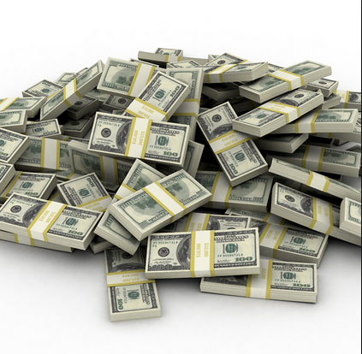
Let the numbers “talk”
In 2010, spending on advertising was estimated at $143 billion in the United States and $467 billion worldwide.
The average cost of a single thirty-second television spot during The annual Super Bowl football game reached US $4 million & a 60-second spot double that figure in 2014.
The average hour-long TV show is 36% commercials. Let's be generous and assume that you don't see half these commercials. A typical American watch around 5 hours of television a day, which adds up to 140,000 hours over a lifetime. So the number of hours you spend watching commercials is ½ × 36% × 140,000 = 25,000 hours, more or less.

Slide 4
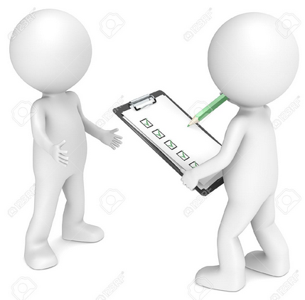
So what’s the problem?!
How does the advertiser know whether the commercial achieved it’s goal?
Today:
advertiser needs to take a
survey in retrospect, count on
subjective and unreliable answers,
collect and analyze data etc...

Slide 5
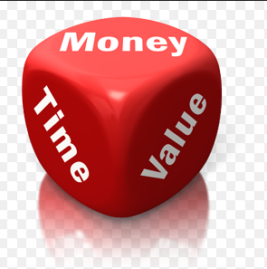
Our Solution
Save time!
Save money!
All that needs to be done is watch the commercial –
Real time samples will be gathered into a credible conclusions.

Slide 6
Our Solution
Develop an application to advertising and marketing agencies, to examine the commercials’ quality.
The application will contain information on several aspects: the level of concentration during the ad (in sections outline specific time), points of interest in model groups (age, gender) etc.
The output will be based on the analysis of information received from EEG sensor combine with Eye Follower, connected to a real-time heterogeneous viewers while watching an ad.

Slide 7
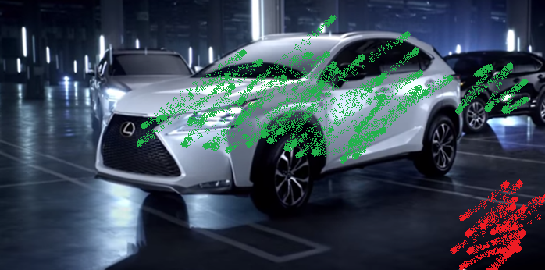
Advertiser’s Real Time View

Slide 8
How does it work?!
Cloud
Advertiser (App’s client)
viewer
viewer
viewer
viewer
viewer
viewer

Slide 9
Planned schedule
Design
Summarize general idea - done
Present project - done
Implementation
API – eye follower – 29.5.15
API – EEG sensor – 1.6.15
First sample group
Integrate apps – 18.6.15
Media player app (collect DB from single user) – 5.6.15
Test applications with sample group – 25.6.15
Analyzer app (GUI showing results) – 12.6.15
Present final results – 12.7

Slide 10
Specific Develop Tasks
Media Player App (viewer):
GUI interface development (including opening videos for playback).
Eye Follower interface – sample, send and analyzed data.
EEG interface – sample, gather data (from tau’s cloud) and analyzed it.
integrate data from two sensors and send it in real time to Analyzer App.
develop self logger.

Slide 11
Specific Develop Tasks
Analyzer Player App (viewer):
GUI interface development – real time view in a few options (on the commercial as background, graphs etc.) + option to re-view the analyses summary once the “live viewers” done.
write an algorithm to integrate and weight the data into final conclusions.
develop self logger.

