Slide 1
Enumeration of rational surfaces and moduli spaces of configurations of points in the projective plane

Slide 2
Motivation: enumeration of rational curves
The space of rational curves of degree d in a projective plane is of dimension
What is the number of rational curves of degree d through given generic points?

Slide 3
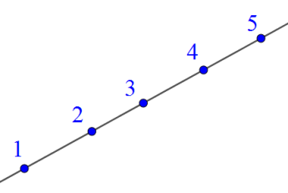
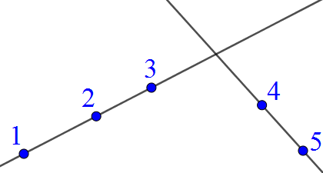
How was it done?
1. Consider a moduli space of configurations of n marked points on a projective line
2. Compactify it in a correct way to get
3. We get a compact smooth algebraic variety! .Describe its cohomology ring / intersection theory
4. Consider a moduli space of pairs: , and of given degree d. This space is a projective variety.
5. Use intersection theory on to get the formula

Slide 4
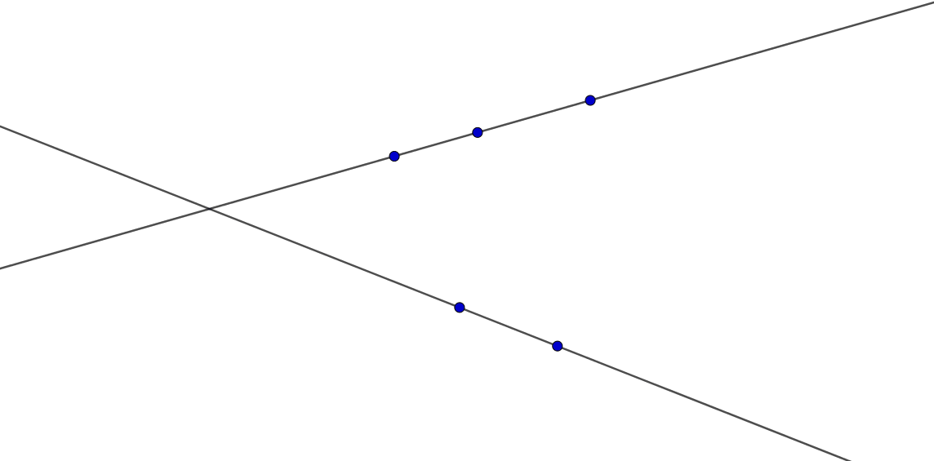
But where do nodal curves come from?

Slide 5
Similar problem for surfaces – to enumerate all kinds of rational surfaces in
.With given number/type of basepoints
First step: to find a good moduli space for configurations of points in projective plane (up to equivalence by projective transformations).

Slide 6
Wish list for the “good” moduli space:
1. Generic configurations of n marked points in projective plane, modulo equivalence by projective transformations, being a dense open subset.
2. Additional things added to account for degenerations.
3. Smooth compact projective algebraic variety (we want to do intersection theory!)
4. Extend or generalize in some natural way.

Slide 7
Kapranov’s “Chow quotients of Grassmanians”
Consider a complex projective variety X
For example, configurations of n marked points in
Algebraic group H acting on X
Projective transformations
A closure of each orbit gives an algebraic cycle.
A closure of generic orbit gives an algebraic cycle of a specific homological class.
Thm. Algebraic varieties representing a specific homology class form a projective algebraic variety - Chow variety
A closure of the set of generic orbits in the Chow variety is the Chow quotient.

Slide 8
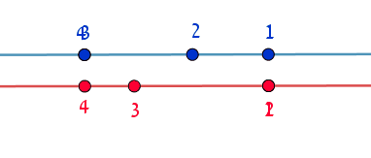
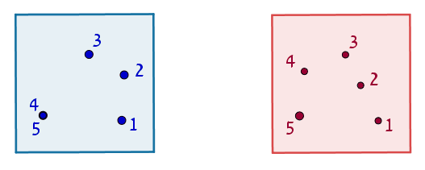

Slide 9
… even the configurations of as few as 6 points in the projective plane (we call it .Y₆) is not a smooth variety
Unlike some other well-known moduli spaces for configurations of n marked points in projective planes, Kapranov’s “Chow quotients of Grassmanians” satisfies almost all requirements from our wish list.
But

Slide 10
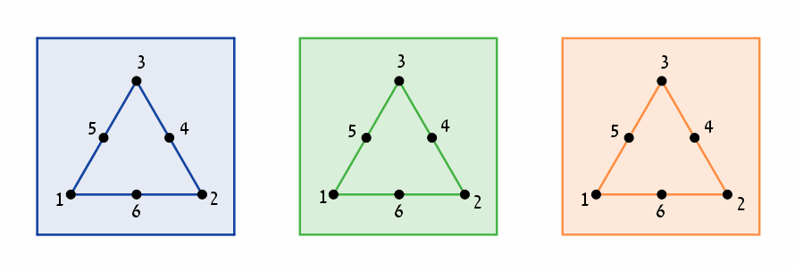
A singular point in Y₆

Slide 11
A new moduli space based on Chow quotient
Projective variety X
Configurations of n marked points in
With projective lines
Algebraic group H acting on X
Projective transformations
Chow quotient
Theorem. is smooth.
Conjecture. is smooth.
Counter-conjecture. More blow-ups are required.

Slide 12
Theorem. is smooth.
Proof. Describing local coordinates at all point.

Slide 13
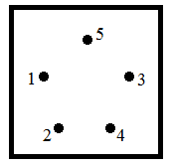
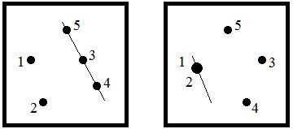
Configurations of 5 points

Slide 14
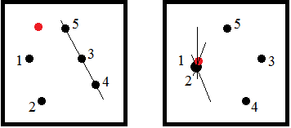
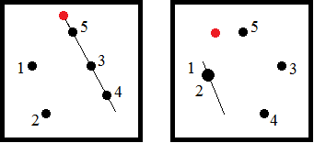
Configurations of 6 points

Slide 15
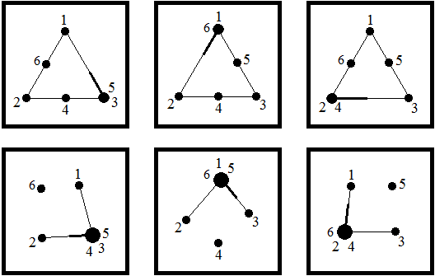
More configurations of 6 points

Slide 16
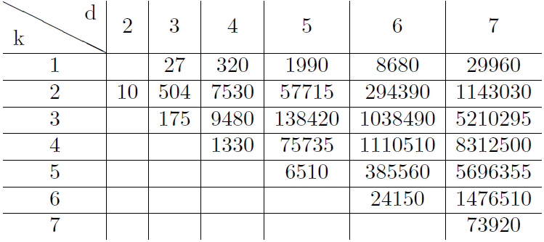
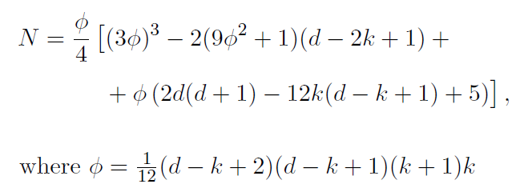
A specific enumerative question:
Surfaces of order d, vanishing to order k at some unspecified line.
The dimension of the moduli space of such surfaces
(number of degrees of freedom) is
How many such surfaces pass through
generic points?

Slide 17
Outline of the proof
1. Describe the relevant polynomials as a vector bundle over the space of lines.
2. Express that vector bundle via more standard vector bundles.
3. Computation with Chern characters to get the numbers.

Slide 18
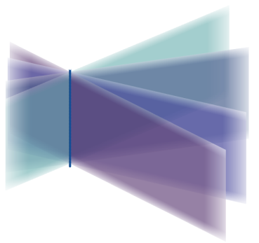
Some remarks on the answer:
Lines on cubic surface
The question we started with
Cubic scrolls
Books

