Slide 1
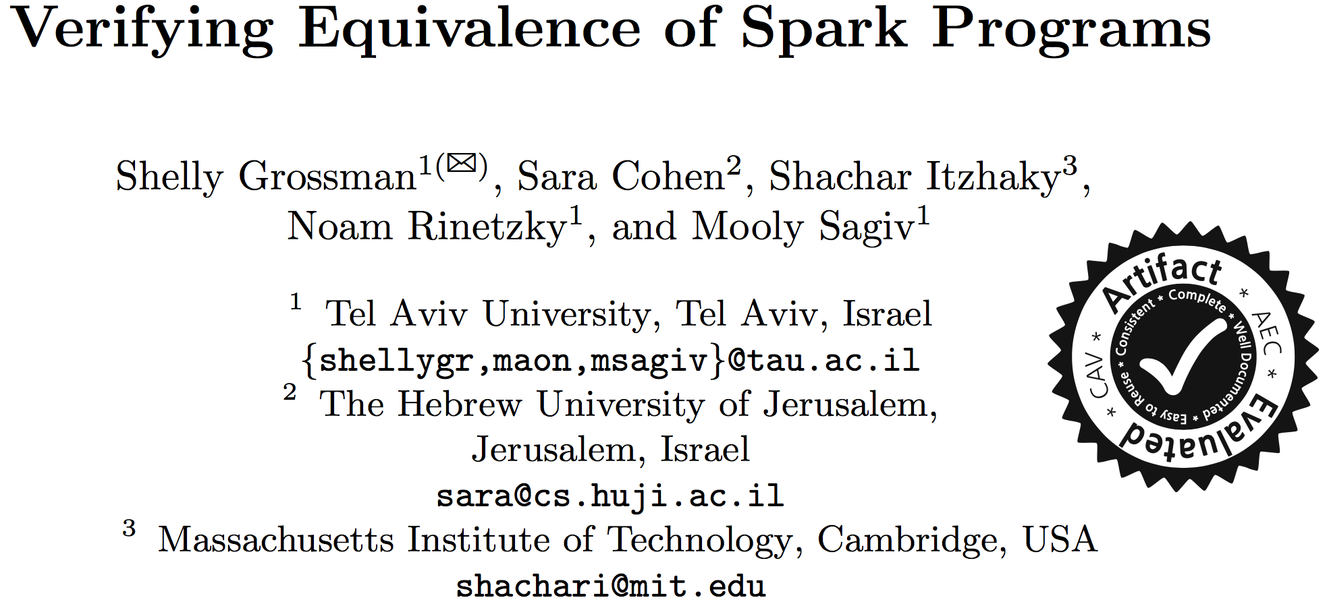

Slide 2

Verifying Equivalence of Spark Programs
Apache ™ a fast & general engine for large-scale data processing
  Accessed via programs, e.g., Scala, Python, Java
Program Equivalence P₁ ≃ P₂ ⇔∀in.P₁(in) = P₂(in)
Verification technique reduction to validity of a formula in Presburger Arithmetic using inductive reasoning
  Undecidability for general programs (even with one aggregation)
  Sound & (sometimes) complete techniques for restricted classes of SparkLite programs
  Prototype (using Z3)

Slide 3


Apache
Driver
…
Workers
…

Slide 4
Apache
Driver
…
Workers
…
Key | Data
Key | Data
Key | Data
Key | Data
Key | Data
Key | Data
RDD
…
…
…
…
…
…

Slide 5
Apache
Driver
…
Workers
…
RDD 1
Key | Data
Key | Data
Key | Data
Key | Data
Key | Data
Key | Data
Key | Data
Key | Data
Key | Data
Key | Data
Key | Data
Key | Data
RDD 2
Key | Data
Key | Data
Key | Data
Key | Data
Key | Data
Key | Data
…
…
…
…
…
RDD 3
…
…
…
…
…
…

Slide 6
Apache
Driver
…
Workers
…
Bag 1
Key | Data
Key | Data
Key | Data
Key | Data
Key | Data
Key | Data
Key | Data
Key | Data
Key | Data
Key | Data
Key | Data
Key | Data
Bag 2
Key | Data
Key | Data
Key | Data
Key | Data
Key | Data
Key | Data
…
…
…
…
…
Bag 3
…
…
…
…
…
…

Slide 7

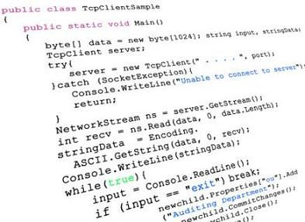

Programs

Slide 8
Programs

Slide 9
Programs
Key | Data
2 | 40
2 | 60
1 | 70
1 | 90
3 | 70
4 | 20
def dataGtThan50((k,d)): return (d>50)
def doubleData((k,d)): return (k, 2*d)
def filter1Map2(rdd):
return rdd.filter(dataGtThan50)
.map(doubleData)
Key | Data
2 | 120
1 | 140
1 | 180
3 | 140
Key | Data
2 | 60
1 | 70
1 | 90
3 | 70

Slide 10
Programs
Key | Data
2 | 40
2 | 60
1 | 70
1 | 90
3 | 70
4 | 20
def dataGtThan50((k,d)): return (d>50)
def doubleData((k,d)): return (k, 2*d)
def filter1Map2(rdd):
return rdd.filter(dataGtThan50)
.map(doubleData)
Key | Data
2 | 120
1 | 140
1 | 180
3 | 140
Key | Data
2 | 60
1 | 70
1 | 90
3 | 70

Slide 11
Programs
Key | Data
2 | 40
2 | 60
1 | 70
1 | 90
3 | 70
4 | 20
def dataGtThan50((k,d)): return (d>50)
def doubleData((k,d)): return (k, 2*d)
def filter1Map2(rdd):
return rdd.filter(dataGtThan50)
.map(doubleData)
+
Key | Data
2 | 120
1 | 140
1 | 180
3 | 140
Key | Data
2 | 60
1 | 70
1 | 90
3 | 70

Slide 12
Programs
def dataGtThan50((k,d)): return (d>50)
def doubleData((k,d)): return (k, 2*d)
def sumData(A,(k,d)): return A + d
def filter1Map2Fold3(rdd):
return rdd.filter(dataGtThan50)
.map(doubleData)
.fold(0, sumData)
Key | Data
2 | 40
2 | 60
1 | 70
1 | 90
3 | 70
4 | 20
580
Key | Data
2 | 60
1 | 70
1 | 90
3 | 70
Key | Data
2 | 120
1 | 140
1 | 180
3 | 140

Slide 13

Programs
def dataGtThan50((k,d)): return (d>50)
def doubleData((k,d)): return (k, 2*d)
def sumData(A,(k,d)): return A + d
def filter1Map2FoldByKey3 (rdd):
return rdd.filter(dataGtThan50)
.map(doubleData)
.foldByKey(0, sumData)
Key | Data
2 | 40
2 | 60
1 | 70
1 | 90
3 | 70
4 | 20
Key | Data
2 | 120
1 | 320
3 | 140
Key | Data
2 | 60
1 | 70
1 | 90
3 | 70
Key | Data
2 | 120
1 | 140
1 | 180
3 | 140

Slide 14
Equivalence of Programs
P₁ ≃ P₂ ⇔ ∀in. P₁(in) = P₂(in)
def dataGtThan50((k,d)): return (d>50)
def doubleData((k,d)): return (k, 2*d)
def filter1Map2(rdd):
return rdd.filter(dataGtThan50)
.map(doubleData)
def Map1Filter2(rdd):
return rdd.map(doubleData)
.filter(dataGtThan50)
def dataGtThan50((k,d)): return (d>50)
def doubleKey((k,d)): return (2 * k, d)
def filter1MapKey2(rdd):
return rdd.filter(dataGtThan50)
.map(doubleKey)
def MapKey1Filter2(rdd):
return rdd).map(doubleKey)
.filter(dataGtThan50)
≄
≃
⊥
= filter1Map2( )
⊥
2 | 40
= filter1Map2( )
2 | 40
2 | 80
= Map1filter2( )
⊥
2 | 40
= Map1filter2( )
2 | 40

Slide 15
Equivalence of Programs
P₁ ≃ P₂ ⇔ ∀in. P₁(in) = P₂(in)
def dataGtThan50((k,d)): return (d>50)
def doubleData((k,d)): return (k, 2*d)
def filter1Map2(rdd):
return rdd.filter(dataGtThan50)
.map(doubleData)
def Map1Filter2(rdd):
return rdd.map(doubleData)
.filter(dataGtThan50)
def dataGtThan50((k,d)): return (d>50)
def doubleKey((k,d)): return (2 * k, d)
def filter1MapKey2(rdd):
return rdd.filter(dataGtThan50)
.map(doubleKey)
def MapKey1Filter2(rdd):
return rdd).map(doubleKey)
.filter(dataGtThan50)
≄
≃
⊥
= filter1Map2( )
⊥
2 | 40
= filter1Map2( )
2 | 40
2 | 80
= Map1filter2( )
⊥
2 | 40
= Map1filter2( )
2 | 40

Slide 16
Equivalence of Programs
P₁ ≃ P₂ ⇔ ∀in. P₁(in) = P₂(in)
def dataGtThan50((k,d)): return (d>50)
def doubleData((k,d)): return (k, 2*d)
def filter1Map2(rdd):
return rdd.filter(dataGtThan50)
.map(doubleData)
def Map1Filter2(rdd):
return rdd.map(doubleData)
.filter(dataGtThan50)
def dataGtThan50((k,d)): return (d>50)
def doubleKey((k,d)): return (2 * k, d)
def filter1MapKey2(rdd):
return rdd.filter(dataGtThan50)
.map(doubleKey)
def MapKey1Filter2(rdd):
return rdd).map(doubleKey)
.filter(dataGtThan50)
≄
≃
⊥
= filter1Map2( )
⊥
2 | 40
= filter1Map2( )
2 | 40
2 | 80
= Map1filter2( )
⊥
2 | 40
= Map1filter2( )
2 | 40

Slide 17
Equivalence of Programs
P₁ ≃ P₂ ⇔ ∀in. P₁(in) = P₂(in)
def dataGtThan50((k,d)): return (d>50)
def doubleData((k,d)): return (k, 2*d)
def sumData(A,(k,d)): return A + d
def filter1Map2Fold3(rdd):
return rdd.filter(dataGtThan50)
.map(doubleData)
.fold(sumData)
def Map1Filter2Fold3(rdd):
return rdd.map(doubleData)
.filter(dataGtThan50)
.fold(sumData)
def dataGtThan50((k,d)): return (d>50)
def doubleKey((k,d)): return (2 * k, d)
def sumData(A,(k,d)): return A + d
def filter1Map2Fold3(rdd):
return rdd.filter(dataGtThan50)
.map(doubleData)
.fold(sumData)
def filter1Map2Mul3(rdd):
return 2 *
rdd.filter(dataGtThan50)
.fold(sumData)
≄
≃

Slide 18

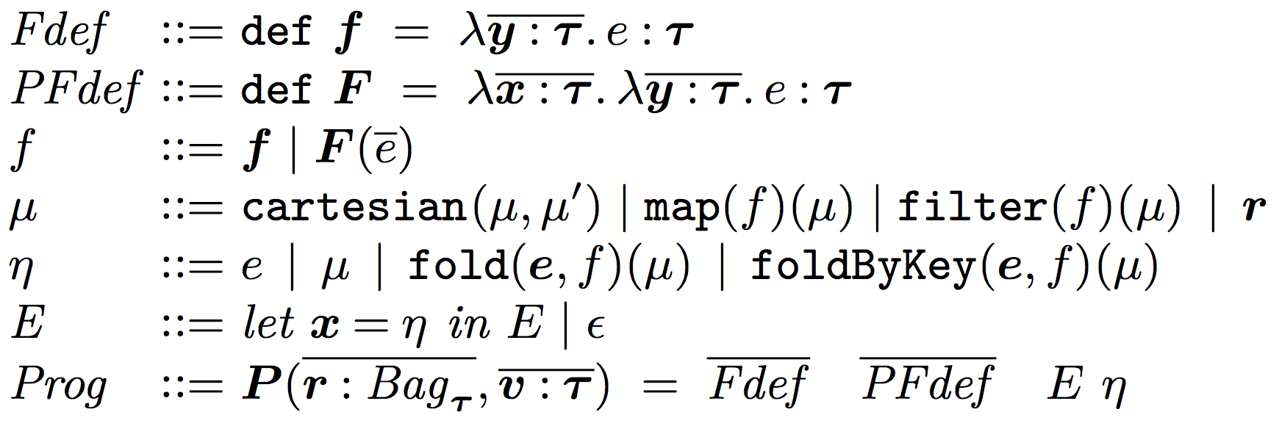
SparkLite
User Defined Functions (UDFs)
Implicit loops
Implicit nested loops
Functional language Programs are terms
  Expressions in Presburger Arithmetic
    Extended with tuples and ⊥
    Checking validity remains decidable
  fold/foldByKey operations treated as functions

Slide 19
Equivalence of
No fold/foldByKey
Theorem 1: Equivalence of NoAgg programs is
decidable
    NoAgg - programs without fold/foldByKey operations
    RDD output
Reduces to validity of quantifier-free formulae
  Intuition: Apply program term to a single record
See also Loncaric et al. PLDI’16

Slide 20
Equivalence of
Theorem 2: Equivalence of AggOne^{p} programs is
undecidable
  AggOne^{p} - programs with a single fold operation
  primitive output
Reduction to halting of 2-counter machine
  Intuition: fold operation “accumulates” the effects of the 2-counter machine
    RDD contents ignored

Slide 21
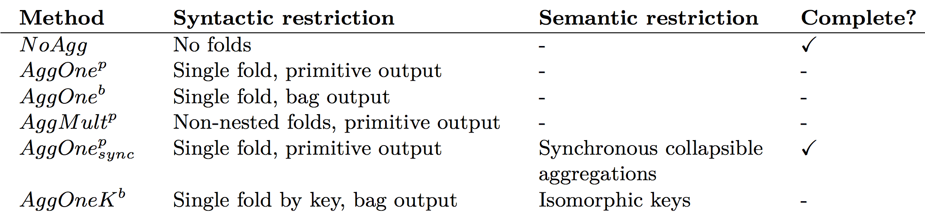
Equivalence of
Semantic
Restriction

Slide 22

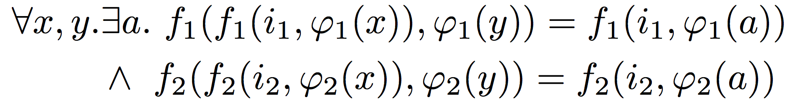
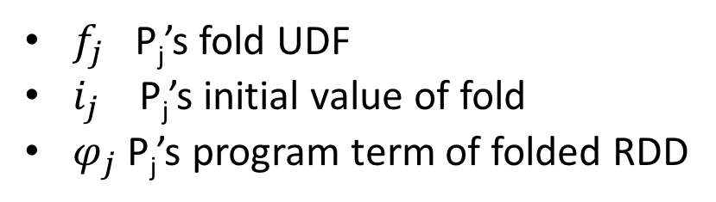
Equivalence of
Synchronous
Collapsible
Aggregations
Theorem 3: Equivalence of AggOne^{p} programs is
decidable
  AggOne^{p} - AggOne^{p} programs with
  Synchronous Collapsible Fold UDF
P₁ and P₂ collapsible synchronously if
Sync
Sync
✓
Z3
$f_{j}$ P_{j}’s fold UDF
$i_{j}$ P_{j}’s initial value of fold
$φ_{j}$ P_{j}’s program term of folded RDD

Slide 23
Limitations / Future work
Supported operators map, filter, cartesian product, fold, and foldByKey
Forbidden operators
  Self products (possible, but cumbersome)
  Union, subtraction (tricky because of bag semantics)
Implementation uses Z3
  Not Cooper’s algorithm for verifying validity of formulae in Presburger Arithmetic.

Slide 24

Read the paper
Lemma 1 Sound method for verifying equivalence of AggOne^{p} programs
  Uses inductive reasoning
Implementation
Lemma 7 Sound verification technique for AggOneK^{b} programs
  Programs with Single foldByKey, bag output
  Manipulate their keys in an ``isomorphic’’ way

Slide 25
Read the paper
Technical Report*
Nested
Lemma 1 Sound method for verifying equivalence of AggOne^{p} programs
  Uses inductive reasoning
Implementation
Lemma 7 Sound verification technique for programs with single foldByKey operation
RDD output
  Manipulate their keys in an ``isomorphic’’ way
* http://www.cs.tau.ac.il/~shellygr/pubs/sparkeq-tr.pdf

Slide 26
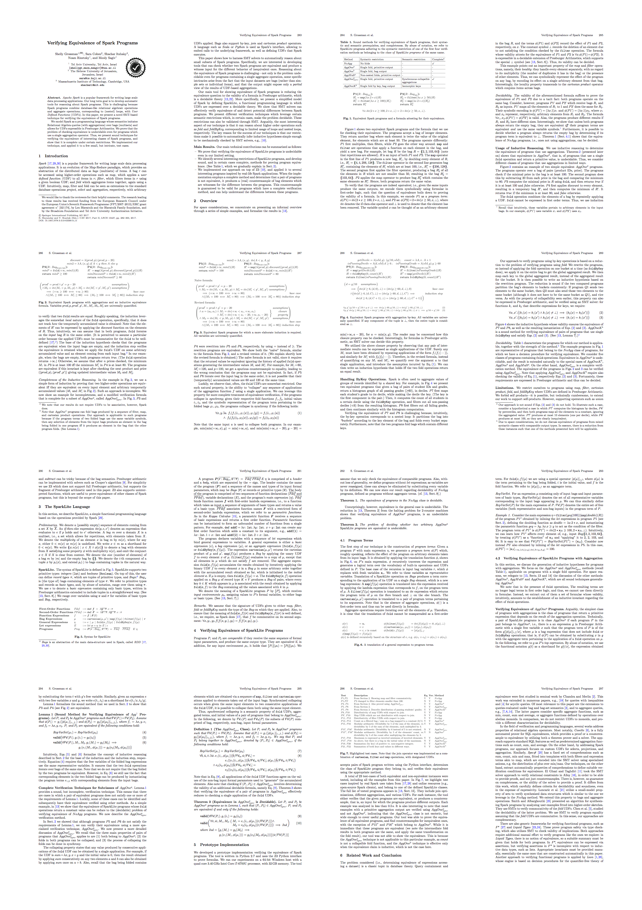


Apache Spark™ fast, general engine for large-scale data processing
SparkLite
Program Equivalence
P₁ ≃ P₂ ⇔∀in.P₁(in) = P₂(in)
Verification technique reduction of program equivalence to validity Presburger Arithmetics formulae
  The 1. Decidable for NoAgg programs
  The 2. Undecidable for general programs
  Lem 1. Sound method for AggOne^{p} programs
  The 3. Decidable for AggOne^{p} programs
Implementation
✓
Z3
≃
Lite
Lite
Sync

Slide 28
Thank You!
≃
✓
Z3
Lite
Lite
http://www.cs.tau.ac.il/~shellygr/pubs/sparkeq-tr.pdf

Slide 29
Thank You!
✓
Z3
≃
Lite
Lite
✓
≃
Z3
Lite
Lite

